Slide 1


Trinity Catholic School
Child Safety Policy 2020

Slide 2
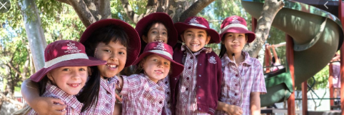
Introduction And Purpose
Our school is responsible for our care, safety and wellbeing.
We have a Child Safe Policy so that everyone is respected and feels safe.
It is important that we are listened to and have an opportunity to share our thoughts and opinions.
The purpose of this policy is to make sure that all students feel comfortable with the people around them.
Our teachers care about us and also make sure that we feel safe when we are at school, excursions, on camps and anywhere else in the community.
The teachers and staff in the school know what to do if a student says that they feel unsafe.

Slide 3
Rights And Responsibilities
EXPECTATIONS
Students have the right to be safe
Students have the right to be respected
Everyone has the right to learn
Speak Appropriately
Follow Directions
Move Safely
Listen To The Speaker
Care For All Property
Keep Hands, Feet and Other Objects To Yourself

Slide 4

Commitment To Child Safety
And Managing Risks
RISK MANAGEMENT
The school keeps us safe by-
closing the gates
teachers on yard duty who wear bright vests
‘children only’ toilets
Adults at our school must use adult toilets / visitor toilets
Before every event, excursion or camp our teachers think about how to avoid situations that might be dangerous or that may hurt us.
We should always tell someone if we see a risk
Our school is committed to keeping our students safe from unsafe behaviour and bullying
Every student has the right to feel and be safe.

Slide 5

Visitors Must Sign In To The Office
All adults in our school need to sign in to the office.
If you see an adult without a school lanyard / name badge you should let a teacher/ LSO know so they can take that person back to the office to sign in to our visitors register.
This includes:
· Parent helpers
· Visitors
· Maintenance people like electricians, plumbers and builders
· Guest speakers

Slide 6
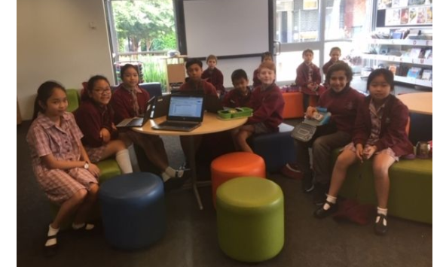
Code of Conduct
Our school makes sure there is a Code of Conduct for all teachers, helpers, office staff, Fr Huy, Emergency Teachers, parent helpers, other volunteers and workers that describes how they should behave.
Just like we have the school rules for students, the Code of Conduct is the expectation for adults and can be found on the school website and in the office.

Slide 7
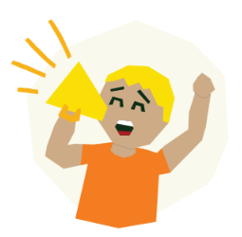
Inclusion And Empowerment
For Students
Trinity Catholic School values everyone's individuality.
We look after children with different abilities, backgrounds, beliefs and appearances.
TCS aims to make everyone feel comfortable.
Trinity Catholic School works with students to-
ensure that they are empowered to understand their rights
recognise what abuse is
encourage them to speak up when they feel uncomfortable or afraid
all students have a voice and will be listened to

Slide 8

Feeling Safe Program
At Trinity we build student capacity to:
Identify when we feel safe and unsafe, and when we are at risk
Can identify safe and unsafe touching
Promote personal safety (avoid harm where possible)
And to seek help using identified safety networks
The “Feeling Safe Program” gives students the skills, strategies and confidence to prevent abuse and keep safe

Slide 9

Responding And Reporting
Our teachers as well as other adults will listen to our problems on the yard, in the classroom and if we are having an issue at home.
If it is a big problem sometimes other people are called in to help us solve the problem
The Principal and teachers at Trinity Catholic School understand that it is important for all students to feel safe.
If you don’t feel safe at school you can….
tell your class teacher or Learning Support Officer (LSO)
tell the teacher on yard duty
tell another trusted adult at school
tell a buddy/ friend

