Slide 1
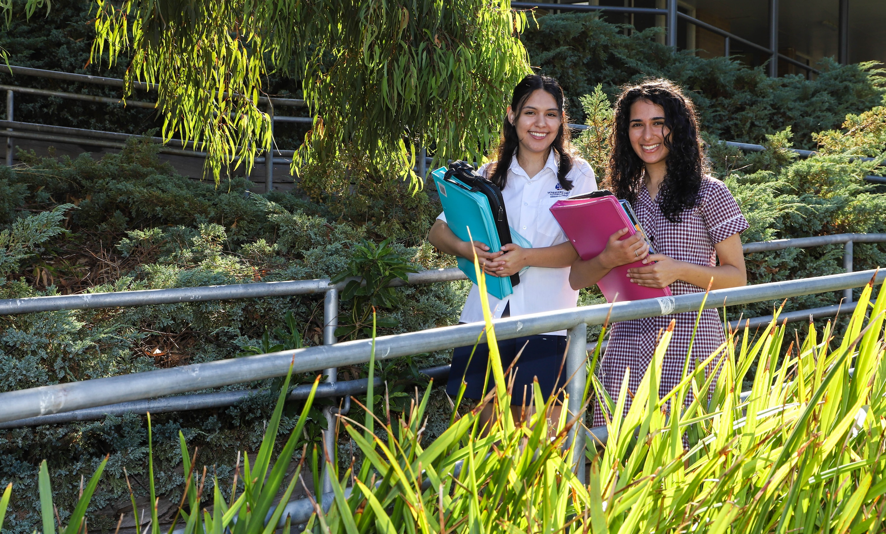


[VCE LITERATURE]
Notes:
Hello and welcome to the VCE Literature briefing. My name is Phyllis and I am currently teaching Year 11 Literature. Today I will take you through an overview of the new VCE Literature study design.

Slide 2


PRIOR KNOWLEDGE AND SKILLS
Students prepared to enjoy reading challenging texts
Competent writers and readers
Confident to present ideas and information through oral presentations and written texts
Key skills focused on peer collaboration and classroom discussion
Notes:
VCE Literature is a subject that focuses on the close study of written texts in many forms. Students should be prepared to enjoy reading challenging texts. It is recommended that prospective students are competent writers and readers, and have achieved success in their Year 10 English studies. They should also be comfortable to present their ideas through oral presentations and be able to express their ideas with insight and flair because there is a requirement for one assessment task in Units 1 and 2, and one in Units 3 and 4 to include an oral component.

Slide 3
ENTRY
Can be taken in conjunction with English or as an alternative
Selection process (e.g. teacher’s recommendation, reference to work ethics and exam results in Year 10 English, written expression of interest from students)
No VCAA prerequisites for Units 1 and 2
Students must undertake both Units 3 and 4 as a sequence.

Slide 4
SCOPE OF STUDY
VCE Literature focuses on
the meanings derived from texts
the relationships between texts
the contexts in which texts are produced and read
how readers’ experiences shape their responses to texts

Slide 5
4 key abilities
an ability to offer an interpretation of a whole text (or a collection of texts)
an ability to demonstrate a close analysis of passages or extracts from a text, in consideration of the whole text
an ability to understand and explore multiple interpretations of a text
an ability to respond creatively to a text
Notes:
In VCE Literature students develop and refine four key abilities through their engagement with texts. The key abilities are:

Slide 6
RATIONALE AND AIMS
Students who undertake the study of VCE Literature have the opportunity to:
deepen their awareness of the historical, social and cultural influences that shape texts
enjoy and appreciate texts in many forms and from many viewpoints
develop confidence to discuss, analyse and interpret texts
create their own texts and experiment with text structures, language features and vocabulary, as well as voice.
Notes:
The VCE study design focuses on the study of local, national and international literature from a broad range of time periods.
It is a study design that offers multiple and layered engagement with texts, from analysis to creative response, from comparison to deep investigation of a text.

Slide 7
STRUCTURE
Year 11 | Year 12
Unit 1 | Unit 2 | Unit 3 | Unit 4
Area of study 1 Reading practices Area of study 2 Exploration of literary movements and genres | Area of study 1 Voices of Country Area of study 2 The text in its context | Area of study 1 Adaptations and transformations Area of study 2 Developing interpretations | Area of study 1 Creative responses to texts Area of study 2 Close analysis of texts
Notes:
The study design is made up of four units across two years of study. Each unit deals with specific content in areas of study and is designed to enable students to achieve a set of outcomes for that unit.

Slide 8
TEXT SELECTION
Units 1 and 2 | Units 3 and 4
5 texts prose/collection of poems/multimedia text/play 2 Australian texts, one of which must be by an Aboriginal or Torres Straits Islander author | 6 texts prose/collection of poems/play/film Selected from the VCE Literature Text List published by VCAA
School Office
Gymnasium
Sports grounds outside Gym
Sports grounds
Notes:
The selection of texts are as follows: Units 1 and 2…Units 3 and 4
Students are encouraged to read widely to support the achievement of all outcomes.

Slide 9
FURTHER INFO
You can find more information on the study design here.
School Office
Gymnasium
Sports grounds outside Gym
Sports grounds

Slide 10
CONTACT US…
Krista Rainsford
Teacher
Email: Krista.Rainsford@education.vic.gov.au
Phone: 03 9561 5811
Phyllis Chee
Teacher
Email: Phyllis.Chee@education.vic.gov.au
Phone: 03 9561 5811

