Slide 1
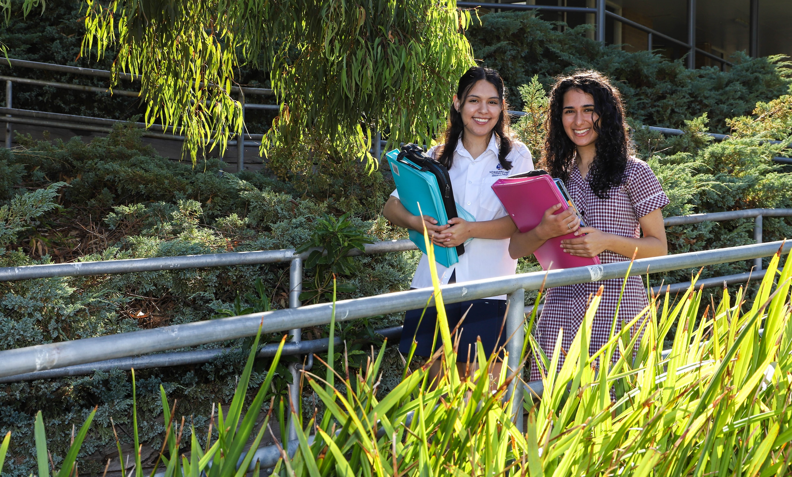


VCE – Physical Education
(2025-2029 Study Design)

Slide 2

Focus of Physical Education
Focus of Physical Education:
  To extend your knowledge of the human body and its various systems
  To increase you understanding of how to prepare thoroughly for your own sport and how to best recover.
  Links theory with practical study and incorporates science, technology & maths (why & how the human body moves)
School Office
Gymnasium
Sports grounds

Slide 3
INTRO
UNIT 1 & 2
  UNIT 1: The human body in motion
  UNIT 2: Physical activity, sport, exercise and society

Slide 4
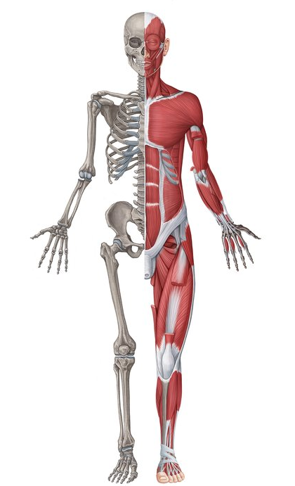
Unit 1 – The human body in motion
AREA OF STUDY 1
  How does the musculoskeletal system work to produce movement?
TOPICS
    Structure and function of the musculoskeletal system
    Preventing musculoskeletal injuries and illnesses
    Legal and illegal methods that enhance performance
School Office
Gymnasium
Sports grounds outside Gym
Sports grounds

Slide 5
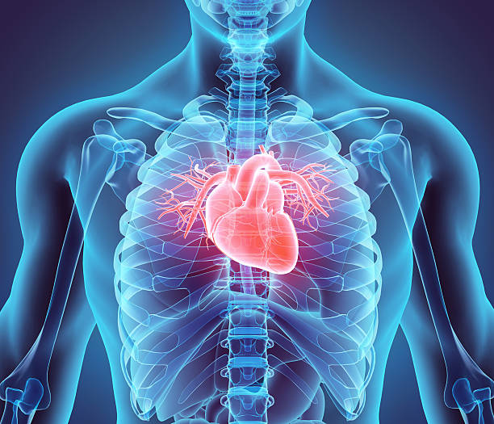
Unit 1 – The human body in motion
AREA OF STUDY 2
  What role does the cardiorespiratory system play in movement?
TOPICS
    Structure and function of the cardiorespiratory system
    Factors affecting the cardiorespiratory system
    Legal and illegal methods that enhance performance of the cardiorespiratory system
School Office
Gymnasium
Sports grounds outside Gym
Sports grounds

Slide 6

Unit 2 – Physical activity, sport, exercise and society
AREA OF STUDY 1
  How do physical activity, sport and exercise contribute to healthy lifestyles?
TOPICS
    Physical activity concepts
    Physical, social, mental and emotional benefits, and health risks of inactivity
    Assessment of physical activity and sedentary behaviours
    Sociocultural influences on participation in physical activity
    Prevalence and trends in physical activity, sport and sedentary behavior in the population
    The social-ecological model
    Promoting physical activity and reducing sedentary behaviour
School Office
Gymnasium
Sports grounds

Slide 7
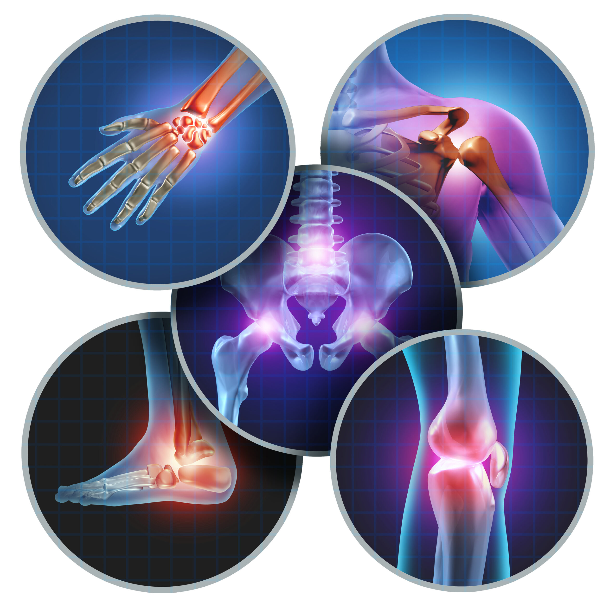
Unit 2 – Physical activity, sport, exercise and society
AREA OF STUDY 2
  What are the contemporary issues associated with physical activity and sport?
TOPICS
    Contemporary issues associated with physical activity and sport
School Office
Gymnasium
Sports grounds

Slide 8
Unit 1 & 2 Assessment
Unit 1:
Assessment Task 1 – Musculoskeletal system test
Assessment Task 2 – Laboratory report
Unit 1 Exam
Unit 2:
Assessment Task 1 – Physical activity and sedentary behavior plan
Assessment Task 2 – Test
Assessment Task 3 – Analysis of contemporary issues in sport
Unit 2 Exam
School Office
Gymnasium
Sports grounds outside Gym
Sports grounds

Slide 9
INTRO
3
UNIT 3 & 4
  UNIT 3: Movement skills and energy for physical activity, sport and exercise
  UNIT 4: Training to improve performance

Slide 10
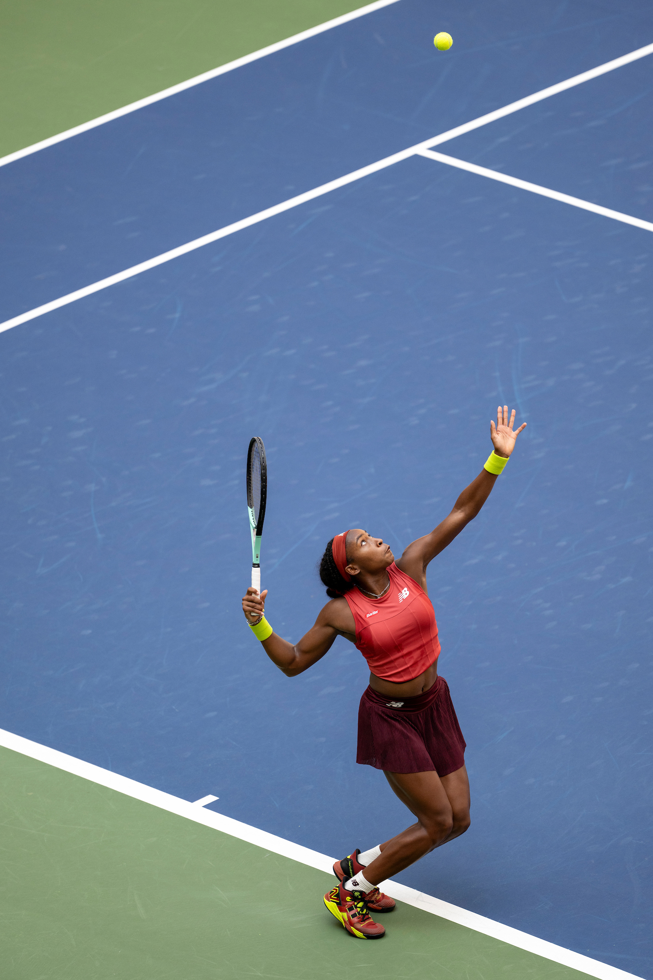
Unit 3 – Movement skills and energy for physical activity, sport and exercise
AREA OF STUDY 1
  How are movement skills improved?
TOPICS
    Characteristics of skills and stages of learning
    Improving skills and coaching considerations
    Biomechanical principles for analysis of human movement
    Qualitative movement analysis
School Office
Gymnasium
Sports grounds outside Gym
Sports grounds

Slide 11
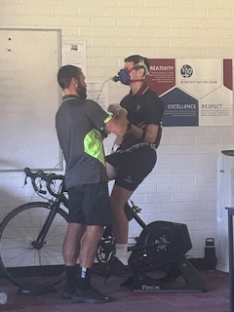
Unit 3 – Movement skills and energy for physical activity, sport and exercise
AREA OF STUDY 2
  How does the body produce energy?
TOPICS
    The three energy systems working together to produce ATP
    Acute responses to exercise
    Energy system fatigue and recovery mechanisms
School Office
Gymnasium
Sports grounds

Slide 12
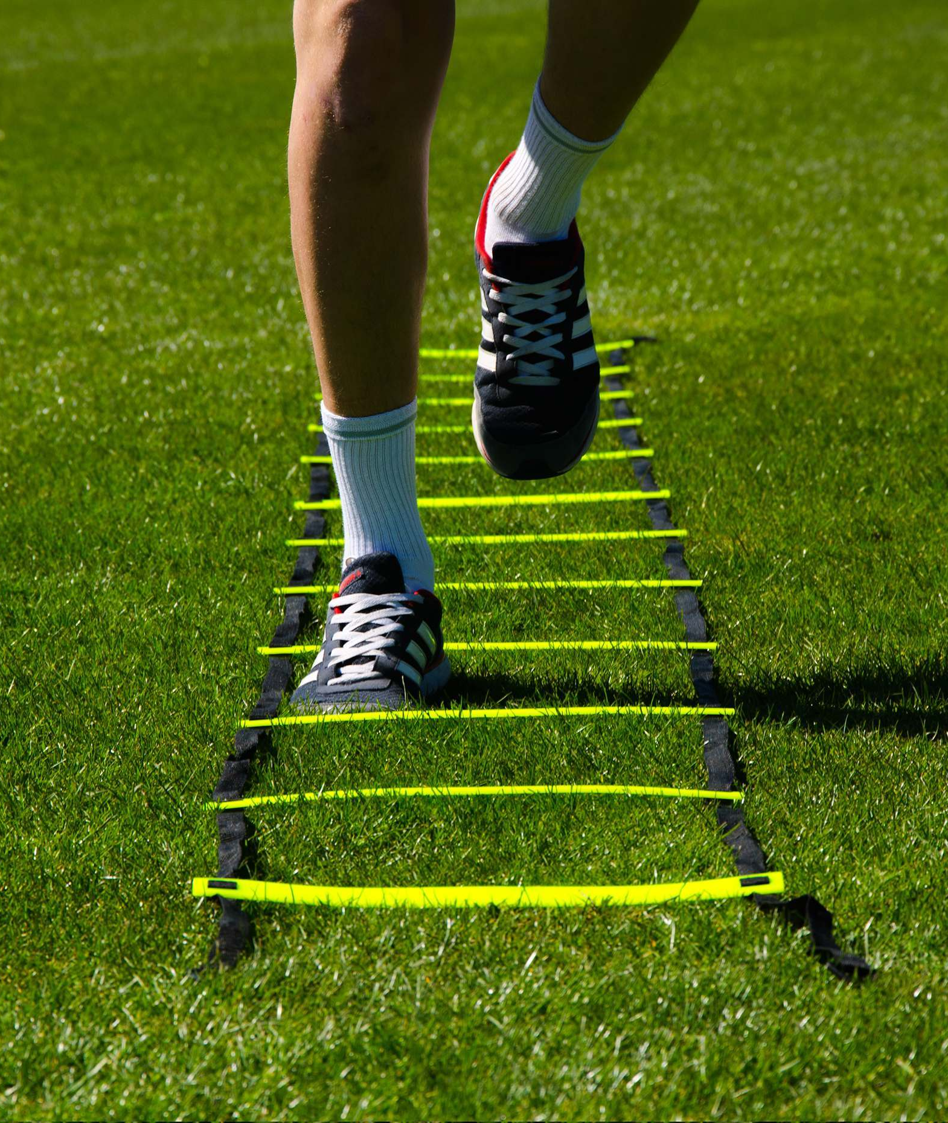
Unit 4 – Training to improve performance
AREA OF STUDY 1
  What are the foundations of an effective training program?
TOPICS
  Fitness components used in sports and activities
  Activity analysis in sports
  Assessment of fitness
School Office
Gymnasium
Sports grounds outside Gym

Slide 13
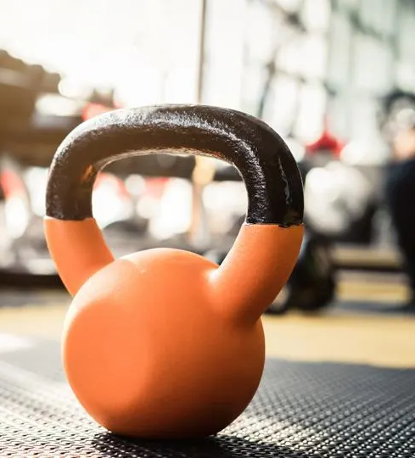
Unit 4 – Training to improve performance
AREA OF STUDY 2
  How is training implemented effectively to improve fitness?
TOPICS
  Training program principles
  Fitness training methods
  Training program design: planning, implementation and evaluation
  Chronic adaptations to training
  Psychological strategies to enhance performance and recovery
School Office
Gymnasium
Sports grounds outside Gym

Slide 14

Unit 4 – Training to improve performance
AREA OF STUDY 3
  Integrated movement experiences
TOPICS
The integration of theory and practice utilised in and through participation in practical activity
interdisciplinary learning that connects knowledge related to skill acquisition, biomechanics, energy production and training and the impacts these have on performance.
Gymnasium
Sports grounds outside Gym

Slide 15
Unit 3 & 4 Assessment
Unit 3:
Assessment Task 1 – Structured Questions
Assessment Task 2 – Laboratory Report
Unit 4:
Assessment Task 1 – Written Report
Assessment Task 2 – Case Study
Assessment Task 3 – Structured Questions
Assessment Task 4 – Extended Response
Unit 3 & 4 Exam
School Office
Gymnasium
Sports grounds outside Gym
Sports grounds

Slide 16
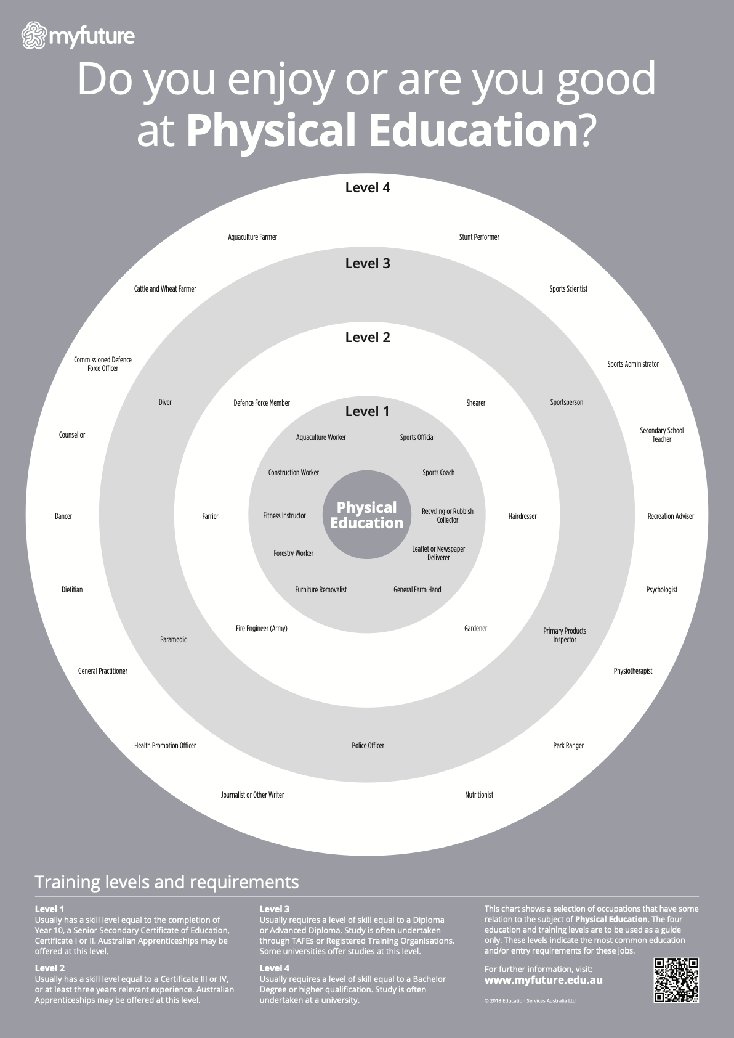
Leads to…
Physical Education teaching
Physiotherapy
Occupational therapy
Sports Science
Dietician (nutrition)
Technique analysis (biomechanic)
Sports psychology
Sports Management/Sport Development
Fitness and Personal Training courses
Exercise Physiologist
School Office
Gymnasium
Sports grounds outside Gym
Sports grounds

