Slide 1
Lake Burley Griffin
By Ellie Hoy

Slide 2
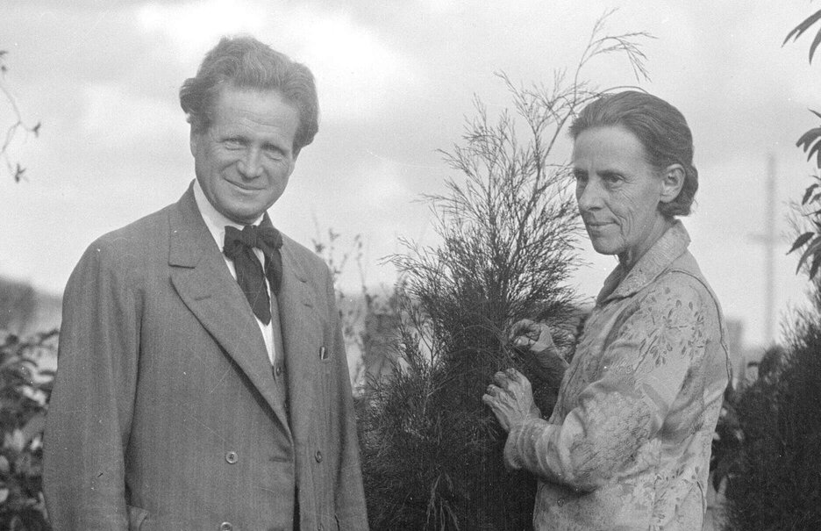
Introduction
Lake Burley Griffin is a lake in the center of Canberra(Australia’s Capital Territory) The lake was supposedly designed by Walter Burley Griffin but years later someone discovered that the lake was actually designed by Walter’s wife Marion Mahony Griffin.The reason the credit was given to Walter was because at the time women weren’t allowed to enter the competition; so Marion entered her designs under Walter’s name. Walter gave her all of the credit.Basically,everybody thought that Walter was a genius for creating Canberra when really the Canberra creator was Marion.

Slide 3
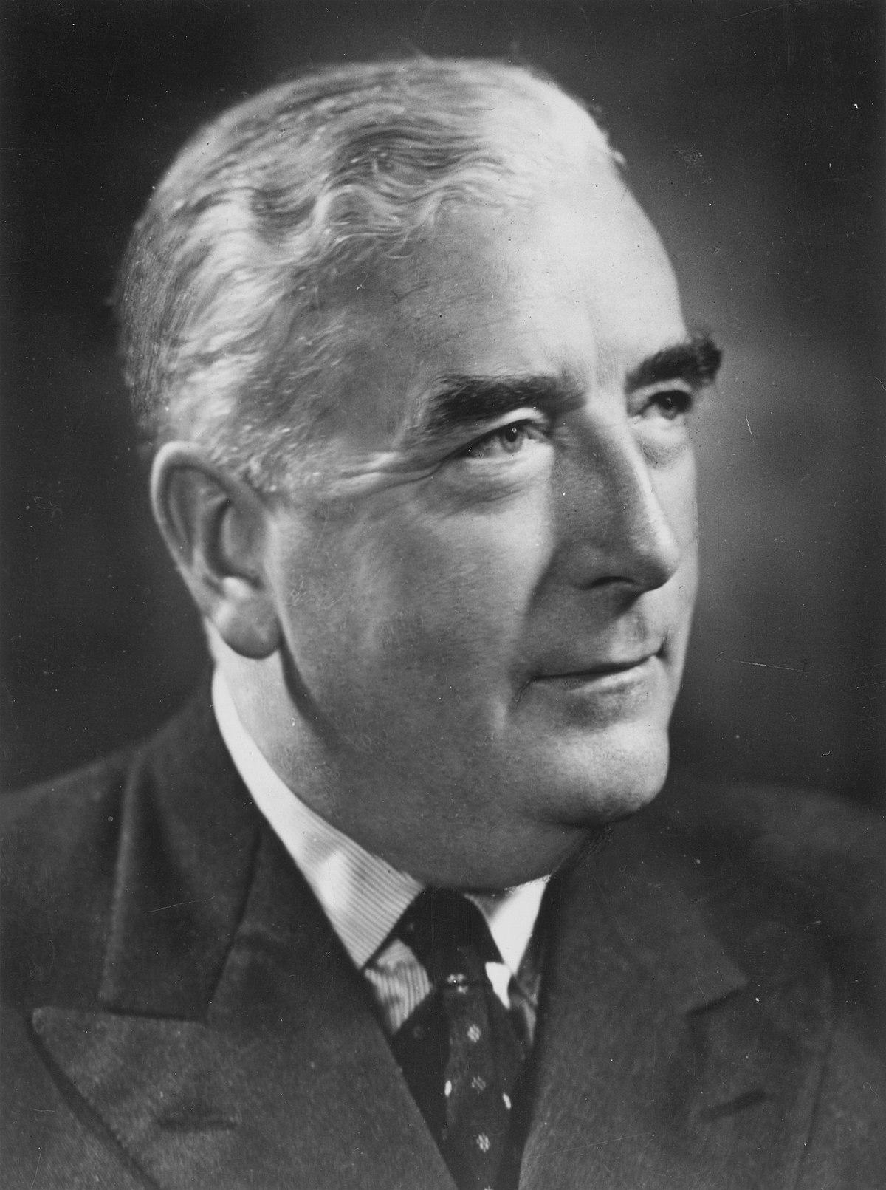
Why was Lake Burley Griffin made?
In 1909 Charles Robert Scrivener thought it would be a good idea,to use the area where Canberra is now to make the capital of Australia.He also thought he would like to use the space for a large lake(now known as Lake Burley Griffin),which is used to store water and for a decorative feature.In 1963 Marion’s plan for Lake Burley Griffin was put into action.With over 400 people working around the clock to get the lake done; in 1964 Lake Burley Griffin was finally finished.On the 17th of October 1964 the then Prime Minister - Sir Robert Menzies had the opportunity to officially open Lake Burley Griffin.

Slide 4
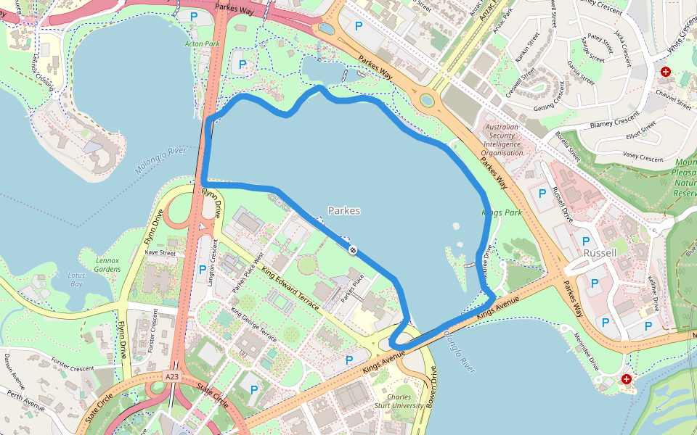
About Lake Burley Griffin
Lake Burley Griffin is 18m deep, 11km long and 1.2km at its widest part.Did you know that there are 6 island within the lake? Aspen Island(also known as Queen Elizabeth ll), Springbank Island and Spinnaker Island.The other 3 islands remain unnamed.There are lots of trees around Lake Burley Griffin such as:Eucalyptus blakeli,E.melliodora,E.bridgesianna,Pinus radiata and Salix spp. There are also 5 different types of fish swimming in the lake;large Murray Cod,Golden Perch,Redfin and Carp.
You can have a quick 19km walk around the lake which should only take 4h and 23m to complete.

Slide 5
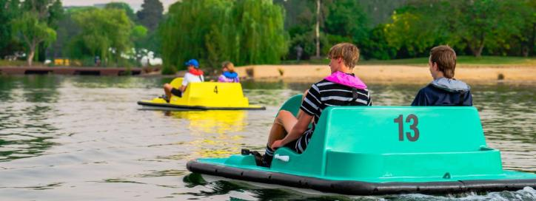
What activities can you do on Lake Burley Griffin?
Fishing,rowing,sailing,kayaking,stand-up paddle boarding,canoeing and windsurfing are all things that you can find people doing on Lake Burley Griffin.The good thing about the lake is anybody can do these things,tourists or locals.Even though the fish have a lot of fun swimming in the lake, people are not allowed to swim in there.

Slide 6
Conclusion
Lake Burley Griffin is a entertaining place to go for all ages.If you are looking for some fun or the water or just a nice spot to go and relax, Lake Burley Griffin is for you.
It has an interesting history,fun activities and is generally pretty;and that is all thanks to Marion Mahony Griffin.

