Slide 1

Parent Information Session
Year 5 /6
Notes:
Sophia

Slide 2
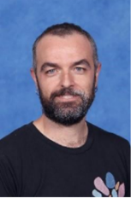
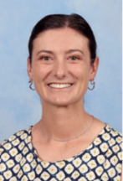
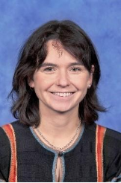
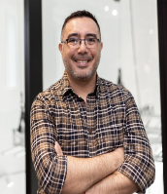
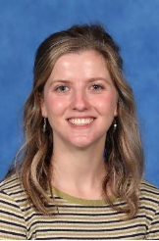
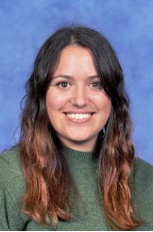
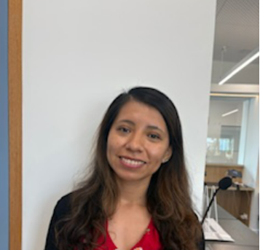
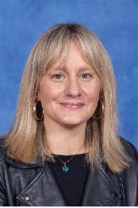
The 5 /6 Team
Jose
Emma
Israel
Courtney
Team Leader 56 AB
56AB
56CD
56CD
Kaya
Florencia
Carola
Luisa
56EF
56EF
56 Education Support
5/6 Leading Teacher
Notes:
JOse

Slide 3




The Learning Community Leader
The LCL's primary role is to Build Effective Professional Learning Teams that support and develop the teachers and students within their team.
Intervention
Planning
Wellbeing & Behaviour support
Mentoring & Coaching
Lead small group intervention sessions.
Guide and implement the NPS planning/instructional model across all subject areas.
Support students to settle positively each morning and respond early to wellbeing or behavioural needs.
Mentoring and coaching teachers to strengthen practice, confidence and collaboration across the team.
Notes:
Luisa
They’ll be in the classrooms, supporting teachers, and working side-by-side with them through mentoring, coaching, and collaborative teaching. It’s all about making sure both teachers and students thrive and grow together!

Slide 4

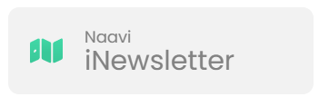


School / Parent Communication
  School Communication
  Payment and Permissions
  Absence Management
  Notifications and Notices
  Parent/Teacher Interview Booking.
  Access to School Calendar
  Semester Reports
  Published weekly (Friday)​
  Essential school-based communication​
  Upcoming events, classroom news, community news, school initiatives and ensures families stay up to date with essential and current happenings at Newlands.
Ensure urgent/timely communication goes via the office
  Payment and Permissions
  Absence Management
  Communicate medical/health care plans
  Visibility into learning experience to support and celebrate learning.
Notes:
JOse
Sentral -
School Communication: Send and receive messages from your child’s homeroom, specialist teachers, and LCL
Payment and Permissions: Provide permission and make payments for camps, excursions, and incursions.
Absence Management: Easily communicate and respond to unexplained absences, as well as submit future absence requests.
Notifications and Notices: Receive timely notifications for community events, absence alerts, and school notices sent directly to your device.
Parent/Teacher Interview Booking.
Access to School Calendar: View and sync the school calendar with your phone to keep track of important dates and events.
Semester Reports: Stay informed by viewing your child’s individual learning plans and end-of-semester reports.

Slide 5

Communication Flowchart
Teachers
The classroom teachers are the first point of contact. Contact for day to day questions, non- urgent updates or concerns.
Learning Community Leader
If you feel like there's an issue or wellbeing concern that requires further support, please reach out to Luisa.
If the issue has not been resolved at the previous levels, or if it involves a school-wide concern (e.g., bullying, major academic challenges, safety), the Principal or Assistant Principals should be contacted.
Principals
Notes:
Luisa

Slide 6

Laptops and personal items
Students are expected to charge their laptops at home.
Students will sign an ICT contract and an ICT code of conduct.
Gadgets are allowed but if they are not being used appropriately, students will be asked to put them in their bag.
We are currently using a program called Typing Club which the children are welcome to use at home.
Notes:
Luisa

Slide 7
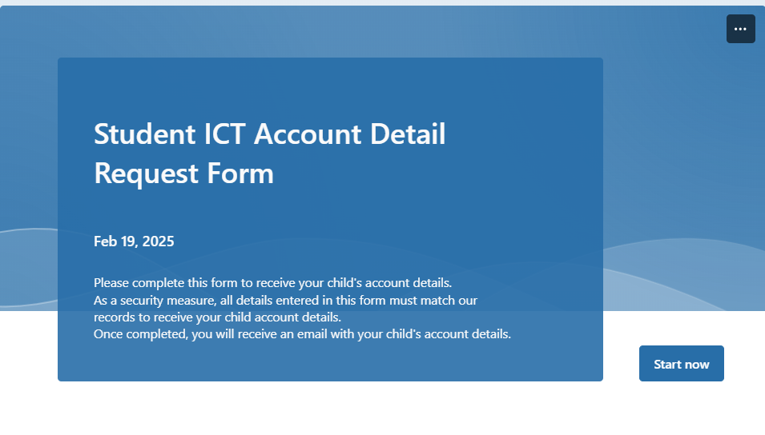
Student ICT Account Details
Student ICT account details will be email at the start of each school year.
You can also request your child’s account details by completing the Student ICT Account Details Form on the school's website.
Please contact the classroom teacher if you are having trouble signing into any platforms.
Notes:
JOse

Slide 8
Grade 5 NAPLAN
Starts week 7 (Wednesday 11th March)
Students will be with English teacher during the NAPLAN times
Students will need their laptops; they will be using these for their tests.
They will have to have a NAPLAN test program put onto their laptops (Graeme will organise this). Please keep the program on their computers.
The students will need headphones for their tests – we have a communal collection at school; however, you may like to bring your own.
Tests are around an hour long.
Notes:
Luisa

Slide 9
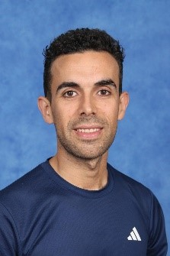
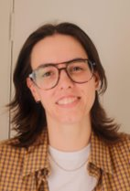
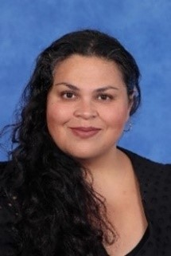
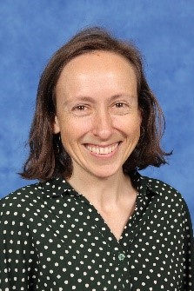
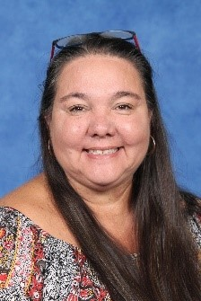
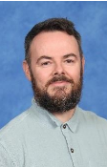






Specialist Team
Margaret
Visual Arts
Rob
Music/Performing Arts
Jess
STEAM
Nerida
Inquiry
Karren
Wellbeing
Raul
HPE
2026 Specialist days are Tuesdays and Fridays.
Specialist teachers can be messaged on Sentral.​
Whole School Events 2026 ( Whole School Production!)
Notes:
Jose

Slide 10
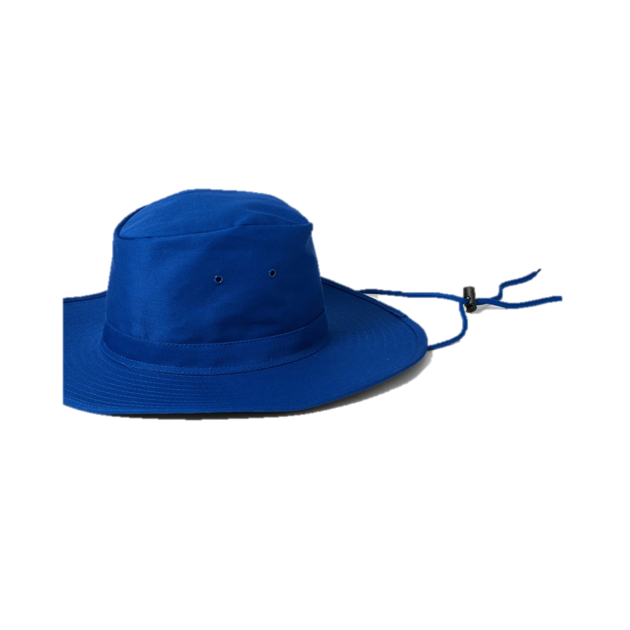
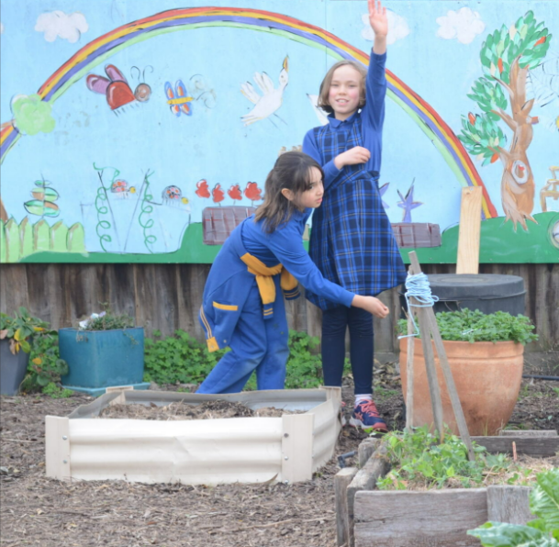
Uniform, Hats and
Lost Property
Lost Property
Small tubs are located in each of the 5/6 communal areas.
At the end of each week unclaimed items will be moved to C block outside the STEAM classroom.
Hats
Wide brim hats are compulsory to wear in Term 1 and 4.
Uniform
Ensure all uniform/ personal items are clearly labelled. We encourage runners on PE days.
Notes:
JOse

Slide 11
Attendance
Morning music will begin at 8:57am, at which time students should move to their classroom door and line up ready to enter.
Classes will commence at 9:00am. To minimise interruptions to learning, please ensure your child is ready and on time.
Student Late Arrivals
Students that arrive at school later than 9:10 am, must sign in at the office. If a student arrives between 9:00 and 9:10am are to be marked as present by the classroom teacher.
All students who are late to school or are collected early are required to sign out at the office.
If your child is leaving early, we ask that it is not between 3:00- 3:30 or during playtime.
Notes:
JOse

Slide 12
Supporting Learning at Home
(Homework)
Students will bring home a homework book with a fortnightly tasks that are designed to support and extend their learning at home. This includes activities for Spelling, Reading, Writing, Spanish and Maths.
Students are required to bring their homework book and reader bags every second Friday (assembly weeks).
Homework is designed to build on learning that has already been taught. Your support is most helpful when it focuses on encouraging positive routines and helping students feel confident as they work towards their homework goals.
Homework will start on Friday week 3.
Notes:
Luisa

Slide 13
Parent Helper Program
A link was sent out on the newsletter today.
Parent help will with reading in English and Spanish if possible. From 9:15am – 10am on Mondays, Tuesdays, Wednesdays and Fridays.
Your classroom teacher will provide you with a list of students to read with.
If for some reason you are unable to come on the day, please contact your classroom teacher.
Notes:
Luisa

Slide 14


Parent Teacher Interviews, Meet the Teacher & Reporting Periods
Term 1
Meet the teacher
Termly Parent Teacher Interviews
Alternate between Spanish and English teacher
Reports published Semester 1 and Semester 2
Term 1 Meet the Teacher (Week 2)
Term 1 PTI with both teachers​
Term 2-4 PTI with one teacher
Notes:
JOse

Slide 15
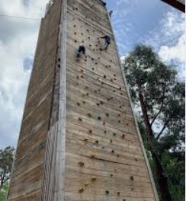

Camps, Excursions and Incursions
Each term we will have an excursion/incursion. This is an opportunity to link our learning to a fun collaborative experience whilst building background knowledge for our students.
Term 1 – Interschool sports starts Friday 13th February
Term 1 – Incursion TBC
Term 2 – Grade 5/ 3 camp 2 nights at Marysville camp – Morning (21st July to 24th July)
Notes:
Jose

Slide 16
Term 1 Community events
Meet the Teachers: Week 2 :
Welcome Picnic: Week 4- 20th February
Ride 2 School: Week 8- 20th March
Spanish Fiesta: Week 9 –27th March
Parent Teachers Interview: Week 9. (5/6's Tuesday and Friday)
School Photos: Week 10 – 30th March
Last day of school: Week 10: Thursday 2nd April
Notes:
Luisa

Slide 17
Local Excursions / Photography
A permission slip will published on Sentral to obtain consent for all local excursion and photography that may take place in 2026.​
If you do not want to give consent for local excursions, please indicate this on the Sentral Permission Slip. ​
Local excursions may include walking to local parks and community spaces. ​
Parents and caregivers will be notified of any upcoming local excursion beforehand. ​
You may withdraw consent for local excursions at any point in the year by calling the school on (03) 9354 2928, or emailing the school at newlands.ps@education.vic.gov.au.
Notes:
Luisa

Slide 18
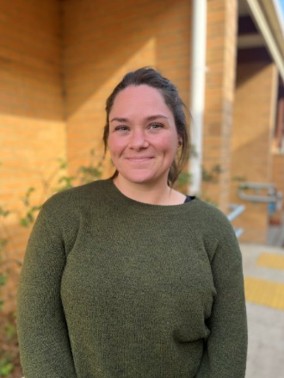
Outside of School Hours Care
Newlands Primary School offers a nationally accredited before and after school care program.
Care is provided from 7:00am until 8.55am each day, and until 6:00 pm after school from Monday to Friday.
OSHC Phone Number: 0491 273 710
You can book in advance for the whole term, or book in casually.
Registrations are be completed online. The link can be found on our website.
Most families are eligible for a fee reduction through the childcare subsidy system.
Example Activities: Arts and craft, sport, cooking, relaxation and quiet corners.
Notes:
Jose

Slide 19

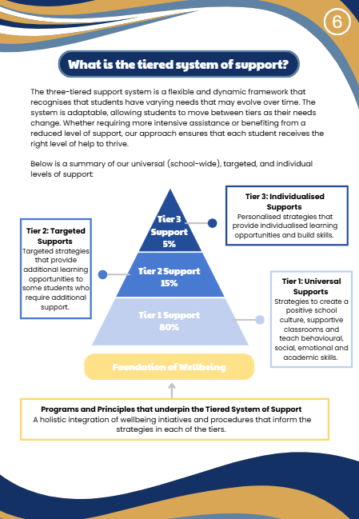
Supporting Your Childs
Wellbeing at School
Notes:
LUisa

Slide 20
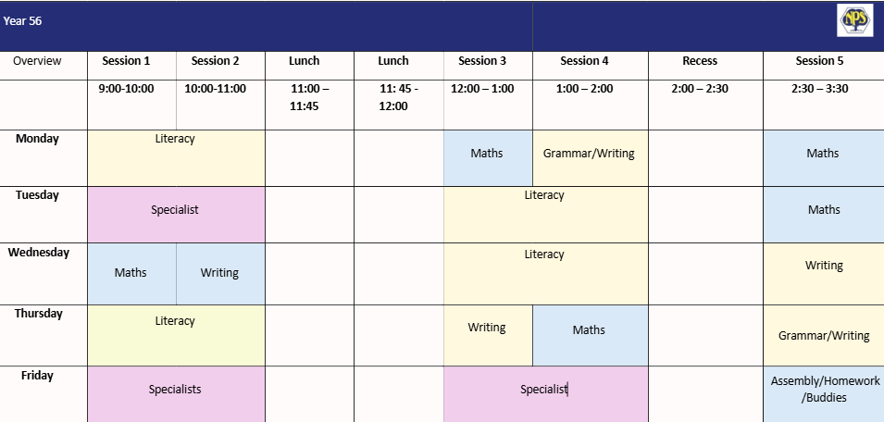
56 Term 1 Timetable
Notes:
JOse

Slide 21
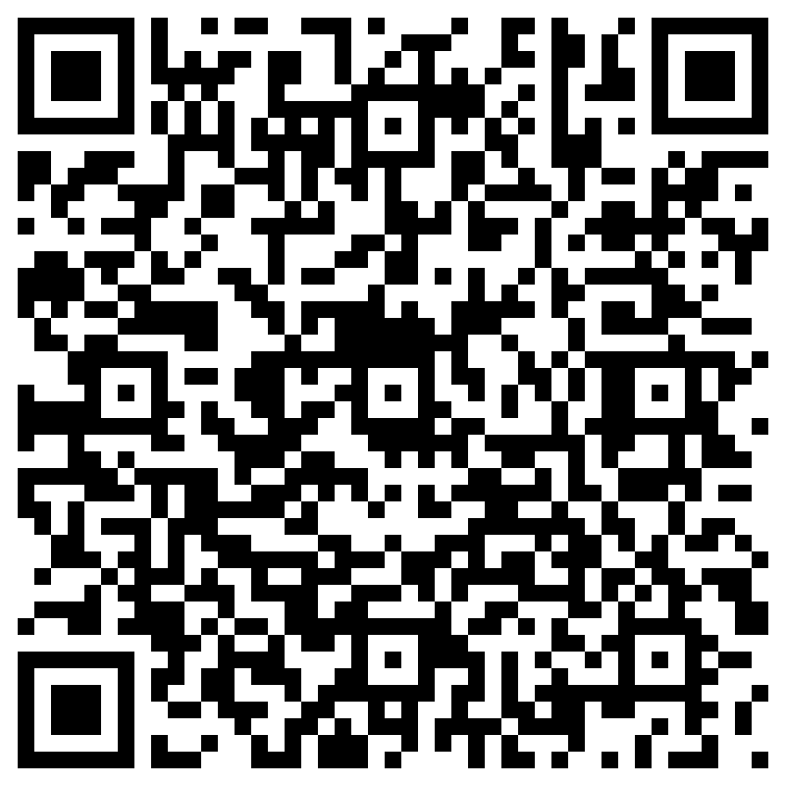
Further Questions
2026 Parent Information Session Q&A – Collaboration
If you have a question that hasn't been addressed, please ask away in the QR code.
All responses will be published in next weeks newsletter.
Notes:
Sophia

