Slide 1

Homework Program 2025
Programa de Tareas 2025
August 15th, 2.30pm
Notes:
Bilingual School

Slide 2
Rationale
Provides opportunity for parents to support their child’s learning journey
Parallels classroom learning
Evidence base:
Promotes long-term retention: Regular homework provides opportunities for students to revisit concepts over time, strengthening memory and reducing forgetting.
Encourages repetition: Reinforces key skills and knowledge through repeated exposure, which helps solidify learning.
Builds fluency: Consistent practice at home helps students become quicker and more accurate in foundational skills such as reading, writing, and mathematics.
Strengthens skill consolidation: Homework allows students to apply what they've learned independently, reinforcing classroom instruction.
Improves confidence and mastery: Familiar tasks completed at home can increase a student’s sense of competence and reduce anxiety about new material.
Builds good habits: Having a regular homework routine teaches children responsibility and helps them develop focus and independence.
Provides additional practice time: Especially important for students who need more time to grasp concepts fully outside of limited classroom hours.
Notes:
Newlands ensures that everyone feels safe, valued and can be themselves
Over the last 18 months we have refined our developmental management and wellbeing processes to ensure all students can strive to be their best.
We do this by being deliberate in making sure students have a strong sense of belonging and connectedbness
That we all live and breahe our school values
That teachers strive to understand how our students not only learn but their needs to be succesful.

Slide 3
Homework Expectations - Foundation
Opportunity for families to strengthen and extend the learning that takes place at school
Further support your child’s educational journey
Each child is unique, and levels of engagement with homework will vary depending on individual circumstances, including wellbeing
Partnership with families to ensure that homework is a positive and supportive experience for all students
Parents/carers role is to provide some support, where possible
Foundation
set weekly, collected weekly
flexibility for families to choose a time that best suits their schedules
We understand that family life can be busy, and while we encourage students to aim for up to 50 minutes of homework each week (10 minutes, 5 times per week), we also recognise that this may vary depending on individual circumstances.
Homework will consist of:
  reading texts/activities
  numeracy tasks
  spelling tasks
Homework may consist of:
  simple reinforcement tasks associated with classroom activities
  reading
Notes:
We understand that transition is for both students and families and we aim to prepare both, for a successful and positive start to school
We begin our transition process early – beginning in the middle of Term 3. Try and have familiar faces and start introducing families to a life at Newlands.
The school provides small group sessions during term 4 that provide parens and carers strategies to support their childs transition into school.

Slide 4
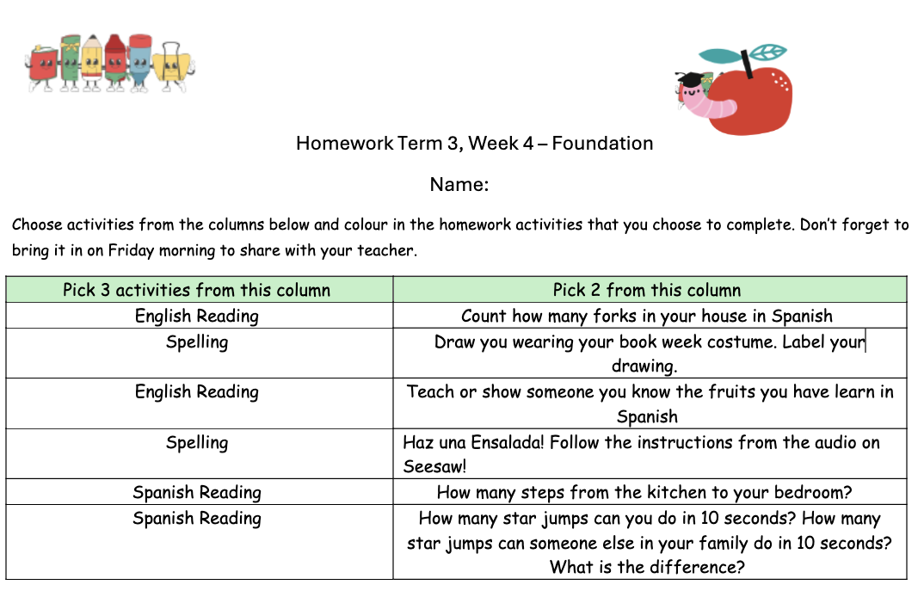
Tasks/Activities
Choose your own adventure homework
Reading
  Have your child read aloud
  If they encounter a tricky word, encourage your child to look at the letters, make the sounds and blend the sounds to read the word. After two incorrect attempts, read the word to your child.
  Ask you child the comprehension questions at the back of the book, or make up your own.
Spelling:
  Students to choose 3 words from their spelling list.
  Students will be given a new spelling list when they move up a reading. They will be given words to consolidate from their previous level. i.e. A student on Stage 3 readers, will receive a Stage 2 spelling list.
  Parent to read the word aloud and ask their child to write it down. Feel free to make it fun! Chalk, white board, fridge magnets etc..
Notes:
We understand that transition is for both students and families and we aim to prepare both, for a successful and positive start to school
We begin our transition process early – beginning in the middle of Term 3. Try and have familiar faces and start introducing families to a life at Newlands.
The school provides small group sessions during term 4 that provide parens and carers strategies to support their childs transition into school.

Slide 5
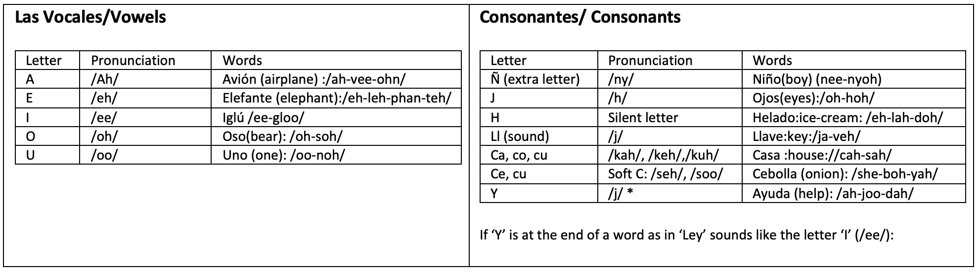
Spanish Reading
Raz Kids
Tips for Reading at home in Spanish
Use these tables of special sounds to help you become expert readers in Spanish at home with your child!
The Spanish alphabet has 27 letters; most of the consonants have the same sound as the English alphabet apart from the ones below. There are also some extra sounds, which are also included in the tables below.
Notes:
We understand that transition is for both students and families and we aim to prepare both, for a successful and positive start to school
We begin our transition process early – beginning in the middle of Term 3. Try and have familiar faces and start introducing families to a life at Newlands.
The school provides small group sessions during term 4 that provide parens and carers strategies to support their childs transition into school.

Slide 6


Digital Accounts
Nessy and Razkids are available as options for English and Spanish Literacy
Login details have been sent

Slide 7
Monitoring Homework
Whole class effort towards an end of term celebration - students to decide!
Our class goal this term is: 70 tally marks per classroom
Students will bring in their homework, showing they have made an attempt to complete their homework
Bring in on a Friday!

Slide 8
Delivery
Teachers will distribute homework on a Friday afternoon
It will be printed

Slide 9
How can parents support?
Provide a space for students to undertake homework
Provide positive reinforcement
If providing feedback, choose one aspect of the work to provide constructive feedback
Use questioning to prompt students to self-correct, i.e. Have you included all your punctuation?
Encourage a growth mindset
Encourage persistence
Build a routine
Generate positive talk

Slide 10
Thank You
Gracias
Notes:
Luke

