Slide 1
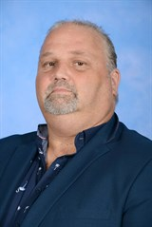
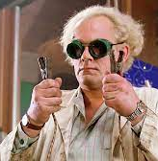
Mr. Stephen Lytton
Donations
The STEM program loves donations of cardboard boxes, straws, plastic spoons, or anything that we can make things out of… I will be asking for your recycled donations please.
I am the STEM specialist teacher in 2024.
STEM stands for
Science
Technology
Engineering
Mathematics.
I was born in England and came to Australia in 1986 and became an Australian Citizen in 1988.
My family are:-
My wife, Rowena Lytton
My daughter, Isobel (age 7)
1 dog (Lula),
3 cats (Abby, Georgie and Regi)
Important Class information:
The STEM room will be the portable - Room 2.
Each class will have a one hour STEM lesson each week.
Our major focuses will be Science, Design, Technology and Experimentation.
I encourage group work using an Inquiry model.
This is how I see myself as a STEM teacher, amateur scientist.
Quotes from the 2023 year of STEM.
Stem is the best! (Grade 2 student)
You are the best stem teacher I have ever had. (Prep student)
Will you be a real teacher next year or a STEM teacher? (Grade 5 student)
Some of my favourite things are:-
Mint choc chip ice-cream
Gummy shark lollies
Coffee
Gaming with my friends

