Slide 1
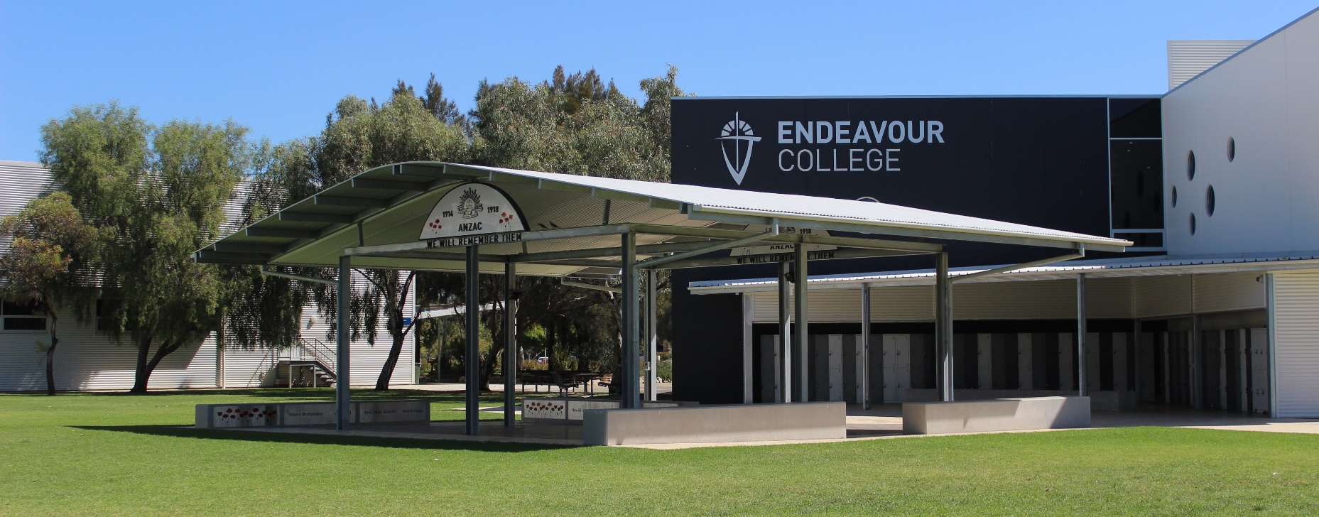
Surviving Year 10 in 2020
Darren Willsmore, Year 10 Year Level Leader
Notes:
*Give out survey at start so they can fill it in during the presentation

Slide 2
Year 10 Support Team
Darren Willsmore – Year 10 Year Level Leader
Sharon Ward - Director of Senior Years
Sandra Barry - Director of Learning
Annie Fitridge - Pathways Leader and Careers Counsellor
Marni Harding – College Counsellor
Care Group, Subject Teachers and Course Counsellor ​
Notes:
Welcome
Just like to reinforce to you our team.
We are here for your child and we have all reintroduced and indicated this team to them during their orientation and YL meetings

Slide 3
Communication via Edumate Parent Portal
Some of the features that parents/carers will have access to via the Portal will be:
Your child's Timetable and Calendar
School Calendar
Attendance records
The ability to see and update your child’s medical information
The ability to see and update your personal contact information
Upcoming assessments and results
Notes:
Edumate as most of you would know is the place to login to to be able to update or access the listed features. As we move further to a more transparent and accessible system for sharing a students progress in each class, teachers will continue to upload tasks and due dates to Edumate as they are set. Within approximately 2 weeks of a due date parents and students can expect to find the results uploaded. For at least 2 assessment items per term, there will be a comment added to allow for a fuller explanation of the mark awarded. This is also an opportunity for a comment to be written on the student’s approach to their learning in that subject. For that unit of work. Our aim is that the ongoing nature of this feedback, will assist students and parents to track their progress in a more authentic way. As a result parents will receive the same end of semester printed report noting summary grades and attitudes, but there will be no need to be sending out an interim report at the end of terms 1 and 3. As has been the custom for many years, Learning Conversations will remain and provide families the valuable opportunity to meet with class teachers face to face. We are excited to be further down the path of this journey and look forward to it providing another way of connecting home and school to support student learning.

Slide 4
SACE Overview
Annie Fitridge
Pathways Leader and Careers Counsellor

Slide 5
What is the SACE?
The South Australian Certificate of Education
Australia wide and internationally recognised
A qualification awarded to students who successfully complete their senior secondary education
Students gain credits through a range of flexible learning opportunities including
  School based subjects
  External programs such as VET
  Recognition of Community Learning
Leads to work, training and further study
https://www.sace.sa.edu.au/
Notes:
The South Australian Certificate of Education is awarded at the end of 13 years of full time education and who successfully complete 200 credits as part of their senior secondary education.
The majority of the 200 Credits required are gained from completing school based subjects, however external programs such as VET qualifications and other recognised learning opportunities such as Royal Life Saving or higher level Dance and Music Examinations provide flexible approaches to gaining credits.
There are 4 compulsory components of the SACE include the PLP, RP and Numeracy and Literacy. Students must receive a C grade of better in these subjects to achieve the SACE.
Completion of the SACE is a develops the capabilities that students need to undertake work, training and further study.

Slide 6
Commencing the SACE - Personal Learning Plan
Undertaken in Year 10 – “setting up for success”
Worth 10 credits at Stage 1 level (first stage of SACE)
Compulsory Subject - C grade or better is required
Opportunities to explore future plans including subject selection and potential career choices
Work placement component
Notes:
The Personal Learning Plan undertaken one day a week at Endeavour provides opportunity for us to support the students in “Setting up for success” into the senior years and beyond!
Looking at options for the future and thinking about how the SACE can help you achieve your goals.
Understanding of what Year 11 and Year 12 studies may look like and how to decide on subject choices.
Discuss and identify goals for career planning
The PLP is a Compulsory 10-credit Stage 1 subject, Assessed against performance standards established by SACE board
Students must need to achieve a C grade or better.
At Endeavour our PLP includes a compulsory work placement component.
.

Slide 7
Work Placement
Develop vocational skills, knowledge and attitudes in the context of real work environments
Links to College Values and Vision for Learners
Learn about what employers expect, what responsibilities workers have
May help to make decisions about future career options
Paid, Volunteer work and/or Work Experience (25+ hours)
Expectations and requirements
School and Parent support
Notes:
Aims for the program
An opportunity to develop skills and knowledge relevant to work environments –particularly self management skills such as time-management, working effectively in teams and handling challenging situations constructively
The workplace learning program reflects the Senior Years Vision for Learning in developing a level of independence and personal responsibility . We are ask the students to take calculate risk with their learning, to try something new and reflect on what the experience has taught them. We encourage them to think critical in creatively in finding a suitable placement.
It some cases it enables an opportunity to trial a potential career or test out an area of interest
Students are expected to complete and record their involvement in at least 25 hour of work placement – this can be achieved in a number of ways-
The majority of our students will undertake an unpaid work experience placement. In this instant the Learning Agreement will be signed of by the student and parents along with workplace provider and the school. The school is required to assess each individual students' suitability for the chosen placement and manage the risks involved. Students undertake over 5 hours workplace preparation lessons including looking at the student roles, responsibilities and rights within a workplace, and the procedures to follow
they experience unsafe workplaces such as bullying teasing, harassment and any other issues that makes them feel unsafe or uncomfortable. The WPLA form signed by all parties indicates that the all parties are aware to the requirements of the placement and that the student is covered by the schools personal and public liability insurance policies whilst undertaking the placement. Further details regarding the program along with a hard copy of the Learning agreement form and the WHS checklist will be provided to parent via the Students during PLP lessons week. Work Experience week is held in Week 10 of term 2 , teaching staff will be on campus at this time to support and visit the students during their placement. Other times can be negotiated with the College.
Further copies of the WPLA form are also available on the Endeavour Pathways Web Page.
Students who already have paid casual employment or are part of a regular Volunteer opportunity can use this involvement towards their Workplace Learning. As the student is an employee or volunteer a different form is completed to indicate that the insurance details are the responsibility of the workplace.
In all instance's students are required to record evidence of their involvement through the completion of the work place Journal and reflection task.
Support to finding placements is available via the PLP teachers, me, care group and subject teachers
Students are strongly encouraged to undertake the process as independently as possible however it would be helpful for parents to commence discussions about possible options, introducing the student to friends and colleagues who may be able to offer opportunities, taking them to meet owners or managers of local businesses.

Slide 8
Year Level Information
Darren Willsmore
Year 10 Year Level Leader

Slide 9
What to expect in Year 10
More work in lesson and more homework
Teachers expect to be able to teach students not spend time controlling students.
Examinations at the end of each semester
Subject selection for Stage 1 and 2 in the middle of the year
Semester 2 – Zero Letters for all work not completed by due date

Slide 10
Survival Tips: Organisation
Lockers/bags need to be tidy so you can find your books and work - tidy them every week
All work needs to be kept neatly in each subjects’ folder/book.
Put you name on all work
Keep your laptop battery charged
Keep computer files in appropriate folders

Slide 11
Survival Tips: Organisation
If you struggle with organisation use one folder for all subjects
Use a diary
Discipline – set aside time to organise yourself each week -get help at home to do this
Follow school expectations about uniform, hair, phone use, etc. No one wants to spend time dealing with these issues. There are more important things to spend time on.

Slide 12
Survival Tips:
Use lesson time properly
More work done during lesson means less that needs to be done at home
Listen to what is needed in an assignment/test.
Write due dates in diary
If you don’t understand something ask questions. Ask during the lesson or organise another time
Don’t use lesson time to socialise. When you are asked to do work, then work.

Slide 13
Survival Tips:
Time to get serious about school
Need to respect other students’ right to learn in every class and each teacher’s right to teach.
Future employees will hold you accountable for your results and behaviour at Year 10. You will need to own what you do this year, no excuses.
Some future choices depend on your results this year.

Slide 14
Survival Tips:
Time to get serious about school
Maintain a balance between school work, sport, paid work and family time
Recommend no more than 10 hours per week spent working in a part time job
Plan your weekly commitments carefully to allow time for each.

Slide 15
If things get too hard
There are plenty of people who will help you.
YLL – problems with subjects, issues with teachers, organisation problems, bullying, anything else
Marni – help with personal issues, relationship issues
The Hub – specialist support to help with work
Mrs Fitridge - Careers
Care Group Teacher/Subject Teacher
If you are struggling see someone. The sooner you do the quicker we can help

Slide 16
How can you be of support?
Relationship
Support school procedures – uniform, punctuality to school, assessment policy
Reduce child’s part-time work hours – no more than 10 hours per week
Organisation and time management
Adequate time devoted to study.
Notes:
Your relationship with your child is really important – you are their parent, not their best friend and during these senior years – they still need guidance and boundaries.

Slide 17
Questions

Slide 18
Health and Wellbeing
Senior School
Sexting Year 10
Partying and Violence (Sammy D Foundation) Year 10
SAPOL – Protective Behaviours Online Year 10
Mental Health (Headspace) Year 10, 11, 12
Safe use of Alcohol (Paul Dillion) Year 10, 11, 12
P.A.R.T.Y Impact of Risk Taking (Program ) Year 10 and 11
Road Safety (SAPOL) Year 11
Managing Examination Stress Year 10 , 11 and 12
Notes:
These are the various ‘programs’ tat we have put in place to support and educate our senior students

Slide 19
Online Reputation

Slide 20

Sexting
https://www.lawsocietysa.asn.au/LSSA/Out_of_Bounds_App.aspx

Slide 21
Cyber Bullying

Slide 22
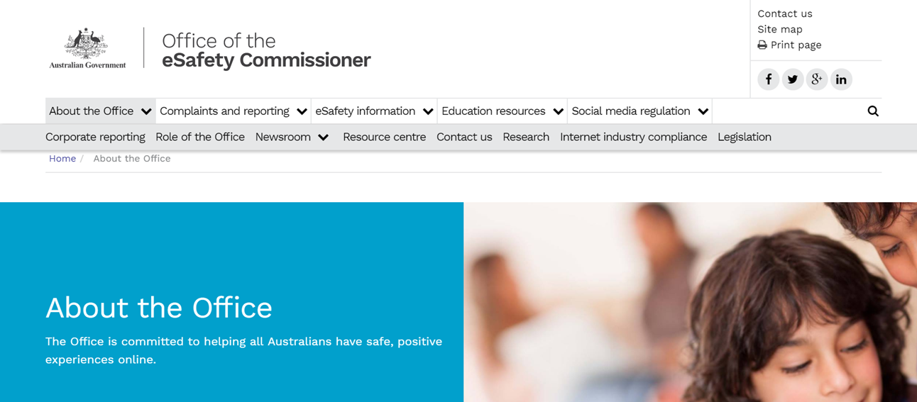
Cyber Bullying - Resources
https://www.esafety.gov.au/about-the-office

Slide 23
Guidelines for Parents
Keep personal information stays personal
Spend time online with your kids
Help your kids use the Internet as an effective research tool
Put the internet computer in a public area of the home – smart phones
Talk to your kids about their Internet experiences
Teach your kids ways of dealing with disturbing material – print offending messages
Help them find a balance between inline and other activities
Warn them that people may not be what they seem to be

Slide 24
Questions

Slide 25
Alcohol And Teens

Slide 26
Guidelines for parents for alcohol use by their children
Set high and reasonable expectations – be clear and consistent about what you expect.
Set an example – responsible use of alcohol in the home is a good predictor of responsible use by the child.
Don’t be reactive – proactive education is the key - start your alcohol and other drug education early. Prevention is better than cure!

Slide 27
How parents and their children can plan together for safe partying
Practical Support - transport arrangements.
Emergency Support - who to call for back up or rescue.
Expectations - to have a good time but be responsible for your safety.
Social Support - how to look out for your friends – don’t be afraid to call for help if needed.
Courage - to stick by what you know to be right even when others are not acting with you.

Slide 28
ASSADS 2011
Australian Secondary Students Alcohol and Drug Survey (ASSADS) 2011
Every 3 years: 1999-2011
Random sample of schools across the 3 sectors
Anonymous survey
Students aged 12-17yrs, including year 7
2011: sample of 2,875 students
Thanks to the Cancer Council and to DASSA

Slide 29
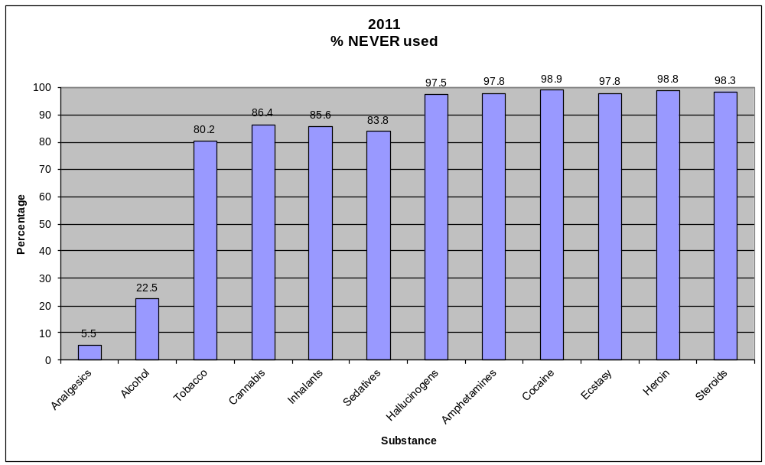
‘Flip the stats’: NEVER used: ASSADS (SA) 2011

Slide 30
Questions

Slide 31

The Year 10 Student

Slide 32
Message from teenagers
DO
Choose a calm moment to talk with us
Bring up the conversation about an issue
Ask us to predict what we might have to deal with
Tell us what you think we may have to deal with
Find out about our needs and wishes
Trust us more than once
Ask us to tell you what is hard or easy for us
Set clear expectations for us

Slide 33
Message from teenagers
DON’T
Make it a lecture (every time)
Do all your talking at the time of a request or a wrongdoing
Do all the thinking for us
Assume you know how it is for us
Assume all teenagers are the same
Assume we think you are approachable

Slide 34

LOVE
Courage
Forgiveness
HOPE
Notes:
Invite people to Year 8 Area for an opportunity to speak with key people – Annie, Jamie, Sharon etc

