Slide 1
the Y Northern Territory Youth Parliament – Info Deck 2024
PURPOSE | To empower young people across the Northern Territory with a meaningful, relevant and inspiring civics engagement opportunity to influence legislative decision-making.
OUTCOMES | Comprehensive understanding of civics, citizenship, and law-making in the Northern Territory; Develop leadership, teamwork, self-esteem, storytelling and public speaking skills with a diverse range of peers; Young people’s solutions to complex and real programs are heard by decision-makers in the Legislative Assembly, and; Young people are celebrated for their excellence and connected to a community striving to make a better world.
APPROACH | Bringing together a geographic and demographic representation of 25 young Territorians, between 15 to 25 years old, to propose ‘Bills’ (proposed pieces of legislation) at the Northern Territory Legislative Assembly over a week in the June school holidays; Train up and support a group of 8 aspiring Journalists to create media on Youth Parliament as part of our Youth Press Gallery, and; It’s a non-partisan, issues-based and youth-led program by an inspirational, diverse and renowned group of peer-leaders, in collaboration with the Department of the Legislative Assembly, Office for Youth Affairs, and other program sponsors.
“[The BEST part of Youth Parliament 2023 was] meeting so many like-minded people who were able to inspire me and show me new perspectives. And being able to practice my public speaking, further developing my debating skills and growing my confidence.”
- 2023 Youth Parliamentarian

Slide 2
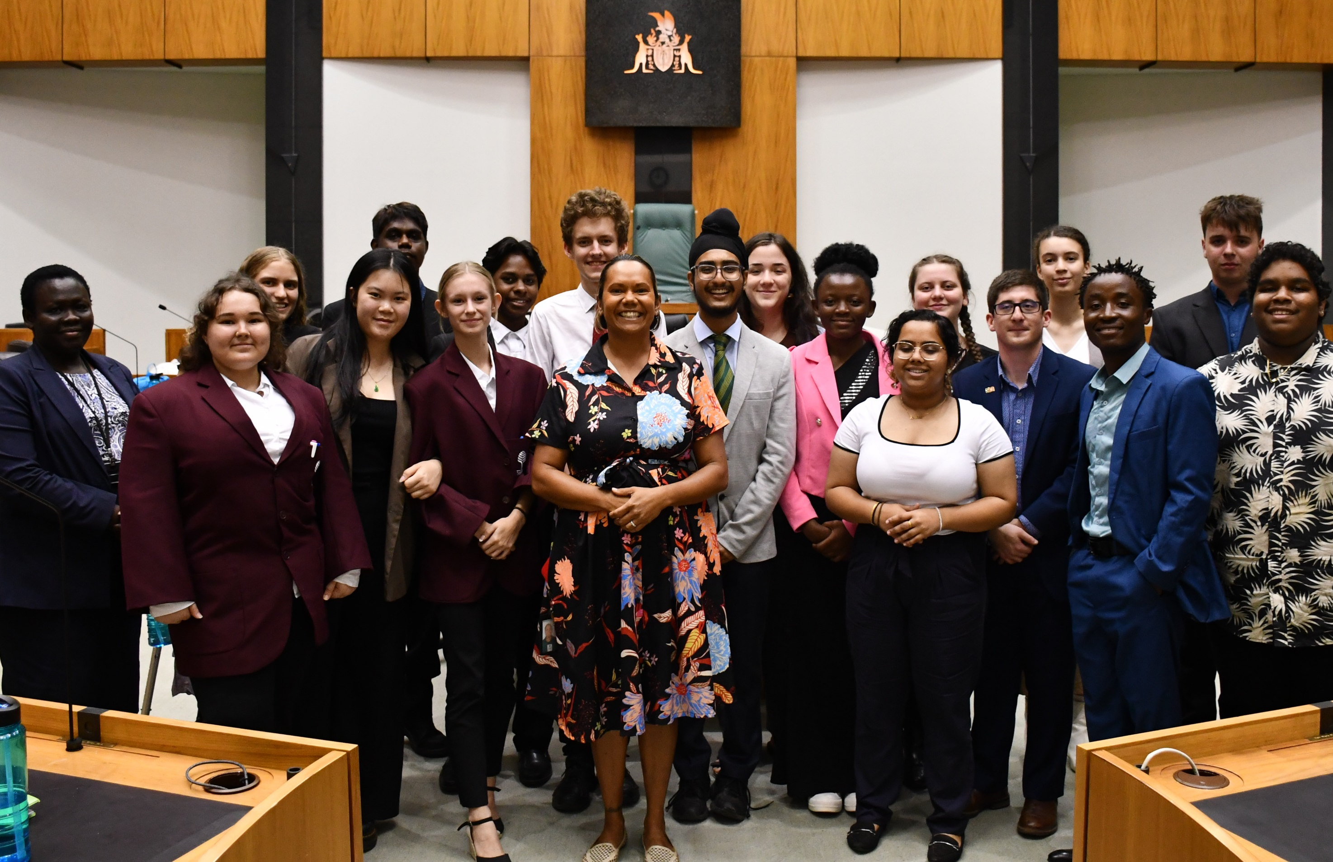
Key Details
HOW TO GET INVOLVED
Email or call/text our Program Director Tahlia Biggs at tahlia.biggs@ynt.org.au or 0438 103 484 and say hey!
FOR YOUTH PARLIAMENT:
Find 5 young people who are keen and available for the Week of Youth Parliament!
Help them fill out this form: https://forms.office.com/r/cKM0X0NArM
FOR YOUTH PRESS GALLERY: (Young people apply as individuals)
Young people will mentored to develop media about the youth parliamentarians and their bills. Write articles, conduct interviews, share on social media platforms
Express your interest via this form (if under-18, with parent permission): https://forms.office.com/r/vvNemhtm7P
DATES & TIMEFRAMES | Complete
Youth Parliament team EOI’s close | Monday 29 April 2024
Youth Press Gallery EOI’s close | TBC
Youth Parliament & Youth Press Gallery teams selected | Friday 10 May 2024
Teams draft Bills with mentors | Monday 13 May 2024 to Friday 7 June 2024
Regional & online training workshops
WEEK OF YOUTH PARLIAMENT | Sunday 23 June to Friday 29 June
“[The most significant change I experienced on the program was] my future, I want to be a part of Parliament.”
- 2023 Youth Parliamentarian
Image on the right:
Youth Parliamentarians with program alumni Selena Uibo MLA at the end of a brilliant week in the Legislative Assembly!

Slide 3
FAQ
COST
Key Contact | Tahlia Biggs, Program Director e: tahlia.biggs@ynt.org.au m: 0438 103 484
Do young people have to be good speakers? | Nope, this is a great learning experience, plus we provide workshops for those wanting to build their conference (included in the total cost)
How do young people sign up for the program? | You can express interest to participate in the program either by submitting a short form in the links below or by contacting Tahlia.
What accessibility support do you provide? | We provide support on a case-by-case basis. Our team will do our best to make sure each young person has the support they need to participate so they have the best experience possible!
I’m based in a regional/remote area, can I participate? | Of course! A key priority is engaging young people from regional and remote communities to participate. Please contact Tahlia for support in organising transport ☺
How do Youth Parliamentarians write a Bill? | Our team will provide learning workshops, resources and feedback to facilitate bill writing – basically identify an issue and come up with a solution, expressed in a parliamentary fashion!
How can I support young people to participate in Youth Parliament? | - Be a Team Coordinator: Find 5 young people to support their participation and be a line of communication - Sponsor a team by covering the participation fee - Spread the word
The program runs at a breakeven cost subsidised by sponsors. Team cost for a team of five to participate in Youth Parliament covers the below:
Accommodation | $1,150.00
Catering | $600.00
Transport to from Parliament House and campsite | $600.00
Apparel | $150.00
TOTAL | $2500 per team, + GST
YOUTH PARLIAMENT EOI HERE | https://forms.office.com/r/cKM0X0NArM
YOUTH PRESS GALLERY EOI HERE | https://forms.office.com/r/vvNemhtm7P

