Slide 1




VCE INDUSTRY AND ENTERPRISE

Slide 2

Unit 1: workplace participation

Slide 3
Area of Study 1
Outcome 1: Contributing to the workforce
On completion of this unit the student should be able to explain the importance to Australia of having a skilled
workforce, investigate career pathways and analyse current and future work options.
To achieve this outcome the student will draw on key knowledge and key skills outlined in Area of Study 1.
Key knowledge
• the importance of a skilled workforce to Australian society and to the economy
• the role of training providers, TAFE and universities in the creation of a skilled workforce
• personal, generational and community values and attitudes to work
• future industry growth areas and emerging employment trends, and the likely impact of these on individuals and
work settings
• techniques for the development of personal career goals and pathways
• statistical data and information relevant to labour market trends
• entry-level OH&S requirements
• different methods of sourcing work, such as online, networking and support agen

Slide 4
Area of Study 2
Outcome 1: developing work related skills
Outcome 2
On completion of this unit the student should be able to explain entry-level requirements for obtaining work in
two selected industries, discuss the importance of developing personal work-related skills, and conduct a selfassessment
to gauge personal work performance.
To achieve this outcome the student will draw on key knowledge and key skills outlined in Area of Study 2.
Key knowledge
• an overview of a range of different work settings, such as community and other not-for-profit organisations,
and for-profit organisations from a range of industry settings
• the way work is viewed as a productive activity
• the importance of work-related skills in a variety of work settings
• job tasks and processes for occupations in a variety of work settings
• work-related skills required for specific work tasks performed in structured work placements
• entry-level requirements for obtaining work in two selected industries: generic knowledge and skills, education
and training
• workplace self-assessment tools.

Slide 5
Area of Study 3
Outcome 3: workplace effectiveness
Outcome 3
On completion of this unit the student should be able to explain the OH&S requirements and one other workrelated
issue for a selected occupation in a specific workplace, and discuss ways in which work-related skills may
be used to deal with that issue.
To achieve this outcome the student will draw on key knowledge and key skills outlined in Area of Study 3.
Key knowledge
• an overview of workplace rights and responsibilities
• OH&S requirements for specific workplaces
• the role of equal employment opportunity and its significance for workplace participants
• the role of unions in the workplace
• strategies to work effectively with others in the workplace, such as the development of interpersonal skills and
effective communication
• ways work-related skills can be used to deal with work-related issues.

Slide 6

Unit 2: Being enterprising

Slide 7
Area of Study 1
Outcome 1: enterprising individuals & Leadership
Outcome 1
On completion of this unit the student should be able to identify and discuss enterprising behaviour in individuals
and explain the relationship between enterprising behaviour and leadership.
To achieve this outcome the student will draw on key knowledge and key skills outlined in Area of Study 1.
Key knowledge
• the characteristics of enterprising behaviour as displayed by individuals
• strategies individuals can use to develop enterprising behaviour in personal, social, community and work
settings
• enterprising behaviour exhibited by individuals in personal, social, community and work settings
• characteristics of successful leaders
• the strategies used to support the development of leadership in individuals within a workplace
• leadership behaviour demonstrated by individuals in personal, social, community and work settings, such as
mentoring and coaching
• the relationship between enterprising behaviour and leadership.

Slide 8
Area of Study 2
Outcome 1:enterprise & innovation
Outcome 2
On completion of this unit the student should be able to explain what innovation is, describe the characteristics of
a selected industry, evaluate the extent to which enterprising behaviour is applied in selected work settings within
the selected industry, and explain the role of work-related skills in supporting innovation in the selected industry.
To achieve this outcome the student will draw on key knowledge and key skills outlined in Area of Study 2.
Key knowledge
• innovation and its importance to industry competitiveness
• industry classification methods, including primary, secondary, tertiary and quaternary and the Australian Bureau
of Statistics (ANZSIC 2006) industry classification system
• major stakeholders in industries
• basic statistical profiles of major industry sectors, such as size, composition, employment levels and patterns,
and the development and decline of selected industries
• the importance of enterprising capabilities within work settings in industry
• recent people-based and technology-focused innovations in an industry or work setting
• the relationship between innovation and work-related skills in industry.

Slide 9
Area of Study 3
Outcome 1:industry issues
Outcome 3
On completion of this unit the student should be able to analyse the impact of two significant issues on an Australian
industry within the last four years and discuss how the industry has responded to the issues in an enterprising way.
To achieve this outcome the student will draw on key knowledge and key skills outlined in Area of Study 3.
Key knowledge
• characteristics of significant issues affecting Australian industry
• the impact on the industry of the significant issues
• enterprising responses to issues from industry generally and from work settings within a specific industry
• problem-solving processes used to develop an enterprising response to selected issues
• the changing role of industry stakeholders, including workers, in relation to these issues
• the importance of developing work-related skills to respond effectively to these issues.

Slide 10
Assessment
It is recommended that students complete a workplace journal or enterprise project and activity evaluation to
demonstrate the development of work-related skills in the structured work placement.
Suitable tasks for assessment in this unit may be selected from the following:
• a workplace journal or report based on participation in structured workplace learning
• an enterprise project and activity evaluation
• a career investigation and profile
• a curriculum vitae presented in a digital format
• a work-related skills portfolio including a critically reflective self-assessment
• a short written report (media analysis, research inquiry, case study analysis)
• a video or podcast
• a written blog
• an ICT-based presentation
• an essay
• structured questions.
Where teachers allow students to choose between tasks they must ensure that the tasks they set are of
comparable scope and demand.

Slide 11

Unit 3: Enterprise culture

Slide 12
Area of Study 1
Outcome 1: Enterprise culture
Outcome 1
On completion of this unit the student should be able to describe and discuss enterprise culture in a community
and/or work setting, and explain and evaluate how the development of work-related skills by individuals contributes
to an enterprise culture.
To achieve this outcome the student will draw on key knowledge and key skills outlined in Area of Study 1.
Key knowledge
• enterprise culture and its role in community and/or work settings
• the importance of enterprising behaviour of stakeholders in community and/or work settings
• the role of leadership and teamwork in developing an enterprise culture in a community and/or work setting
• enterprising approaches to safety in community and/or work settings
• the impact that the development of work-related skills in individuals has on an enterprise culture in community
and/or work settings.

Slide 13
Area of Study 2
Outcome 1: creating an Enterprise culture
Outcome 2
On completion of this unit the student should be able to discuss and evaluate the role and importance of the
management of quality, workplace flexibility, technology, and training and workplace learning in developing an
enterprise culture in work settings in one or more industries.
To achieve this outcome the student will draw on key knowledge and key skills outlined in Area of Study 2.
Key knowledge
• management of quality:
– in relation to work tasks and work processes
– quality control, quality assurance and the principles that operate within these processes
– enterprising responses in the management of quality in work settings within an industry
– the relationship between work-related skills, the development of an enterprise culture and the management
of quality processes

Slide 14
• workplace flexibility:
– features of workplace flexibility including numerical flexibility and functional flexibility
– flexible work arrangements
– enterprising flexible work arrangements in work settings within an industry
• technology:
– in relation to work tasks and work processes
– types of work-related technologies and their role in different work settings within an industry
– enterprising responses to the use of technology
– the relationship between work-related skills, the development of an enterprise culture and the use of technology
Unit 3: Enterprise culture VCE Industry and Enterprise 2019–2026 22
• training and workplace learning:
– importance in relation to lifelong learning
– types of formal and informal training and workplace learning
– the process of developing industry-specific competencies in employees
– enterprising training responses in work settings within an industry
– the relationship between work-related skills and training, the development of an enterprise culture and workplace
learning.

Slide 15
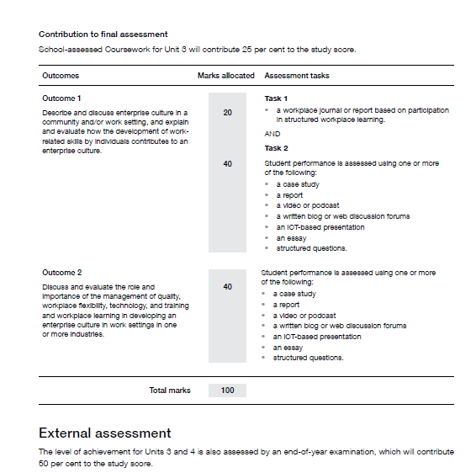
assessment

Slide 16
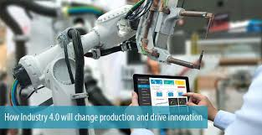
Unit 4: Industry change and innovation

Slide 17
Area of Study 1
Outcome 1:the need for change
Outcome 1
On completion of this unit the student should be able to describe and analyse pressures and opportunities creating
a need for change in Australian industry, evaluate recent responses to change in an Australian industry from the
last four years, and discuss how development of work-related skills assists the industry in responding to change.
To achieve this outcome the student will draw on key knowledge and key skills outlined in Area of Study 1.
Key knowledge
• the need for change:
– the role of government in promoting change in Australian industry including current government initiatives
– international competitiveness including Australia’s participation in global trade, the influence of the value of
the Australian dollar and changing patterns in Australian trade
– changing societal values and attitudes
– environmental sustainability within industry and the effects of changing trends in the use of natural resources
• industry responses from the last four years, to pressures and opportunities creating a need for change in an
Australian industry
• the impact on workplace stakeholders of industry responses to change
• the relationship between industry responses and the development of work-related skills within the workforce.

Slide 18
Area of Study 2
Outcome 1:innovation
Outcome 2
On completion of this unit the student should be able to discuss the extent to which innovation is occurring in a
selected Australian industry, evaluate the extent to which innovation is occurring in one or more workplaces within
that industry and discuss the relationship between innovation and an enterprise culture.
To achieve this outcome the student will draw on key knowledge and key skills outlined in Area of Study 2.
Key knowledge
• types and effect of innovation in the workplace including people-based and technology-focused innovation
• the role of research and development in creating an innovative culture
• the role of government policy including recent government initiatives in supporting innovation
• recent examples of innovation occurring in an Australian industry
• the relationships between technology, training and innovation
• the importance of work-related skills in the development of an innovative culture
• the relationship between innovation and the development of enterprise culture in a selected Australian industry.

Slide 19
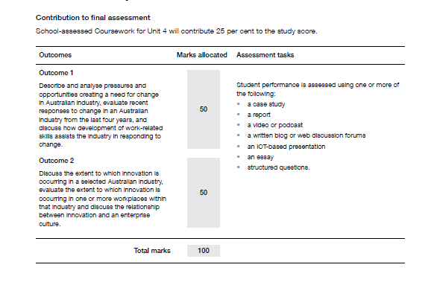
assessment

Slide 20
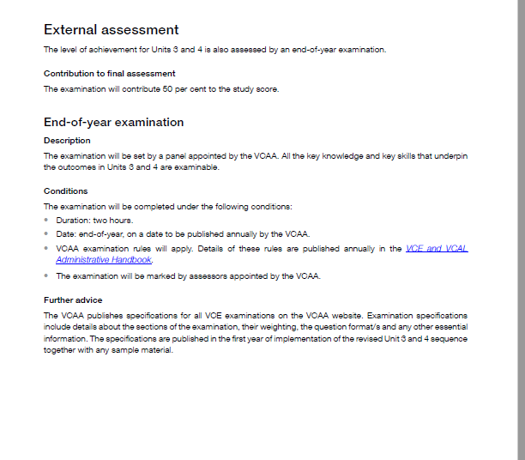

Slide 21

CONTACT
Wheelers Hill Secondary College
Phone: (03) 9561 5811
Fax: (03) 9561 8227
General Office Enquiries: wheelers.hill.sc@education.vic.gov.au

