Slide 1
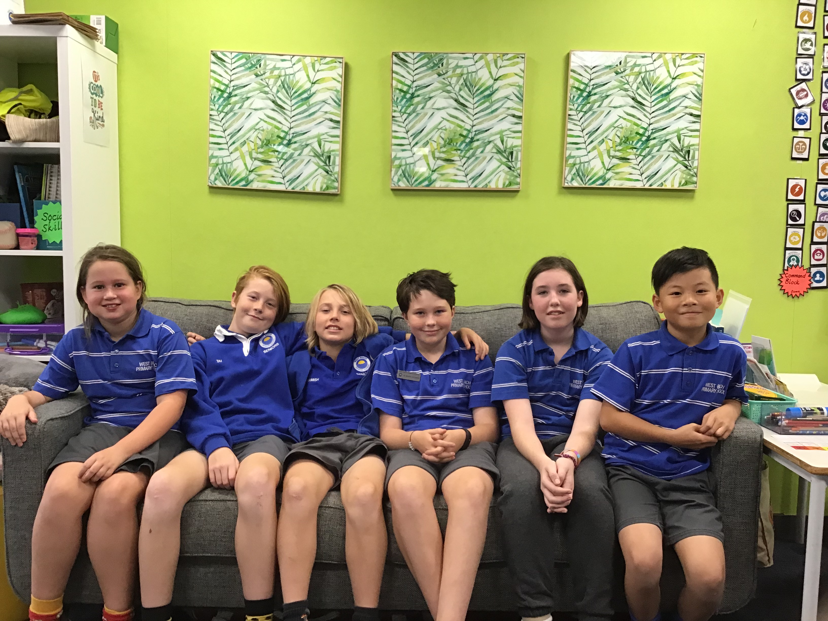
LEGO
MASTERS
IS
COMING
TO
WEST
Time: 12:55-1:15pm
When: Fridays lunch time (from Week 6 up to week 10)
Where: STEM Room
BEACH
PRIMARY
SCHOOL
AGAIN!
Kaitlin, Lilly, Tai, Hamish, Angus and Jackson will be running a Lego Masters session each week, starting in week 6.
There will be different challenges set each week and lots of prizes to be won.
KAITLIN TAI HAMISH JACKSON LILY ANGUS

