Slide 1
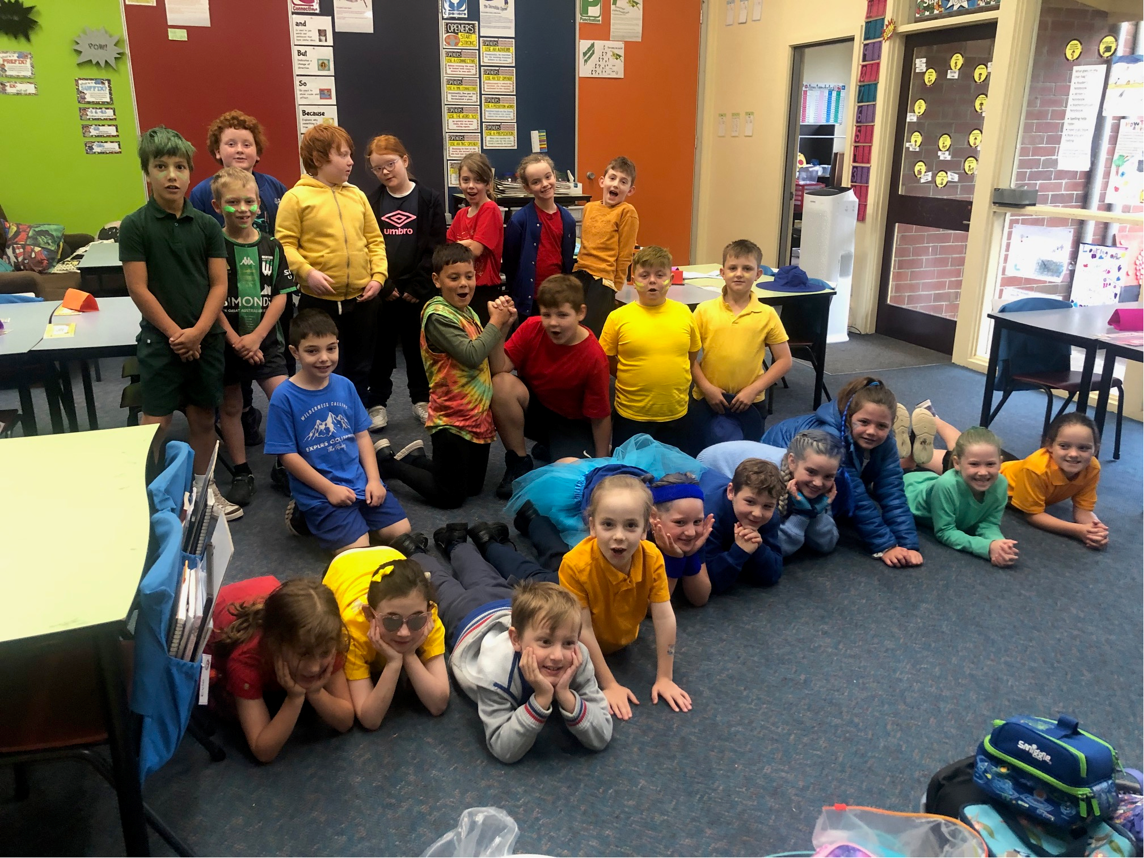
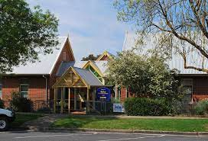
Ballan Primary School,
Ballan, Victoria, Australia
2/3A class

Slide 2

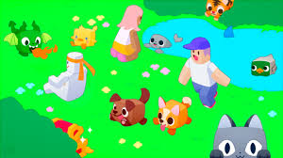
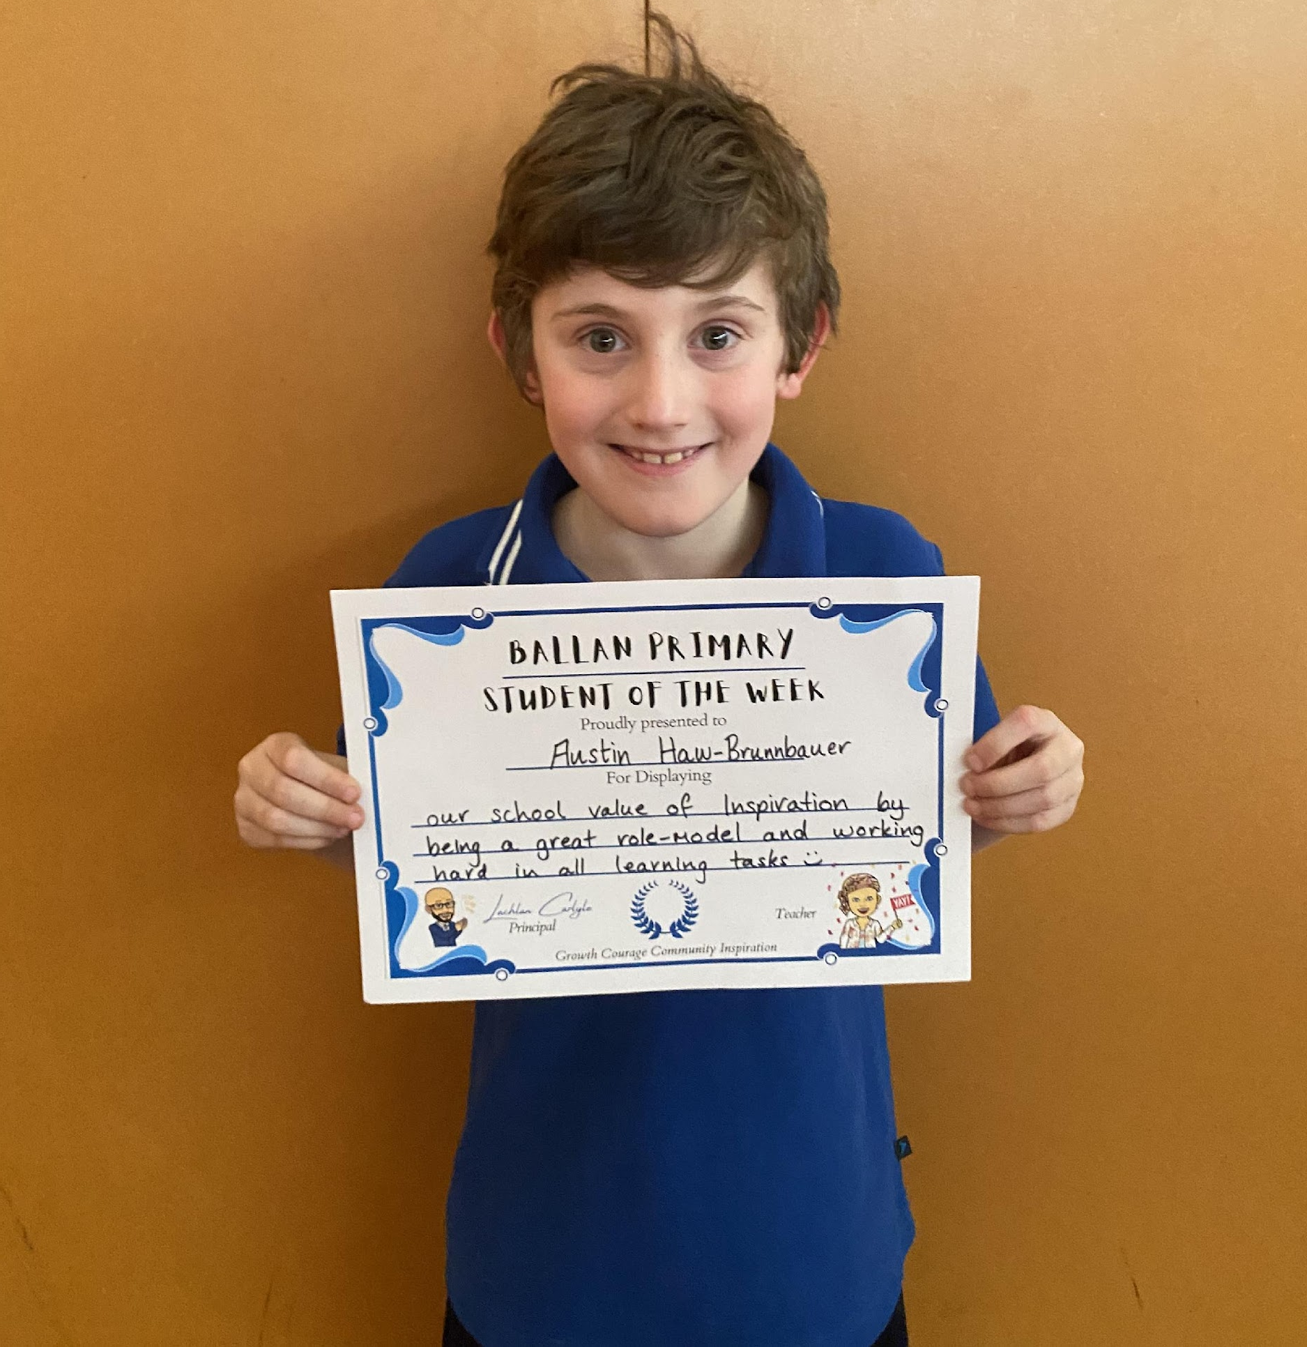
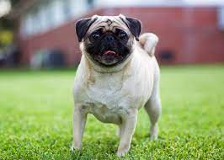
Austin
My hobby is ipad.
My favourite animals are pugs and all cute animals .
I am good at Roblox .

Slide 3
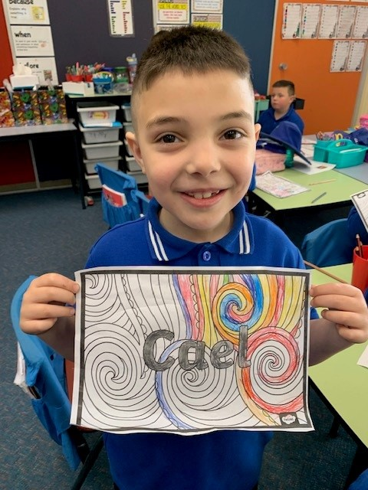
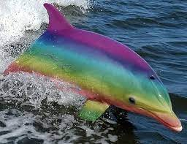
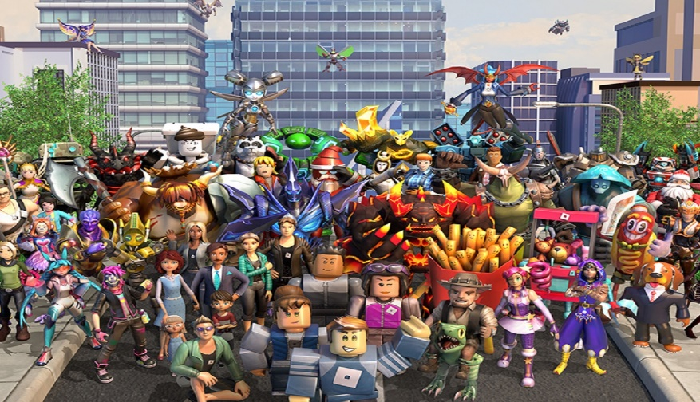
Cael
My hobby is reading.
My favourite animal is a dolphin
I am good at Roblox

Slide 4
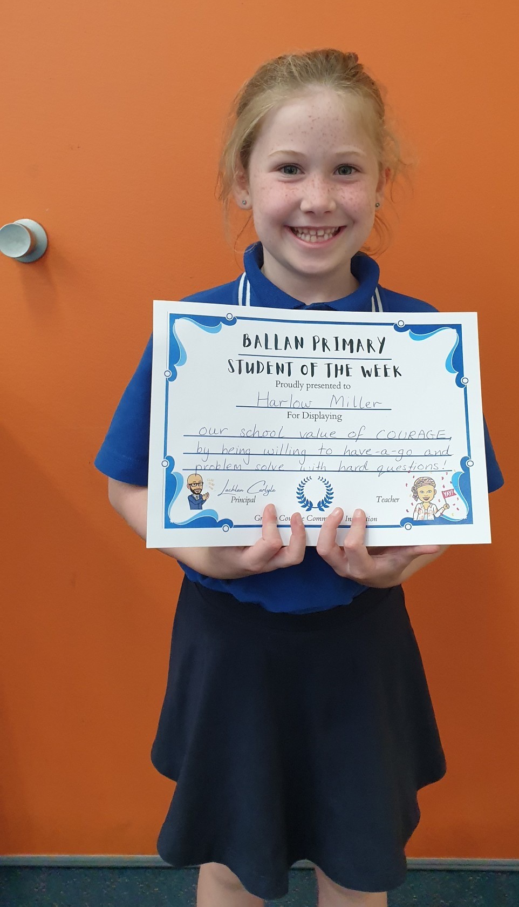
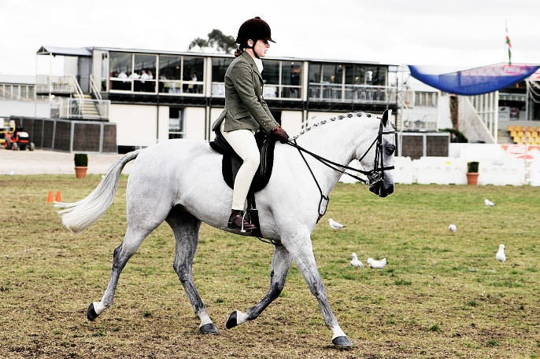
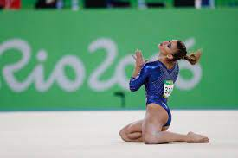
I’m Harlow
My hobbies are running and swimming.
My favourite animals are blobfish and bears.
I am good at gymnastics, and horse ridding

Slide 5
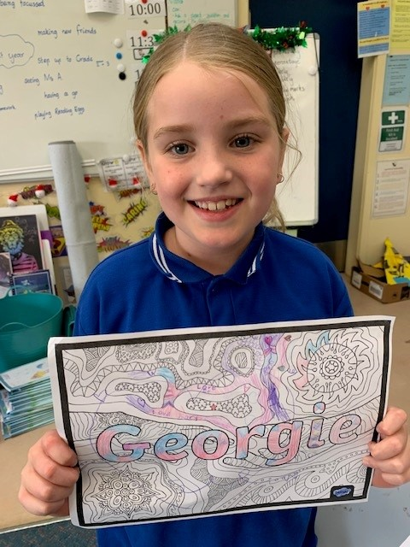
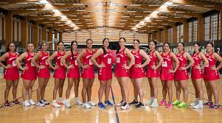
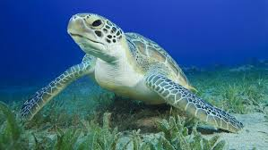
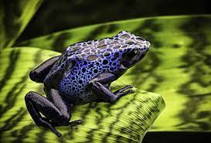
Georgie
My hobbies are netball and drawing.
My favourite animals are turtles and frogs.
I am good at being calm.

Slide 6
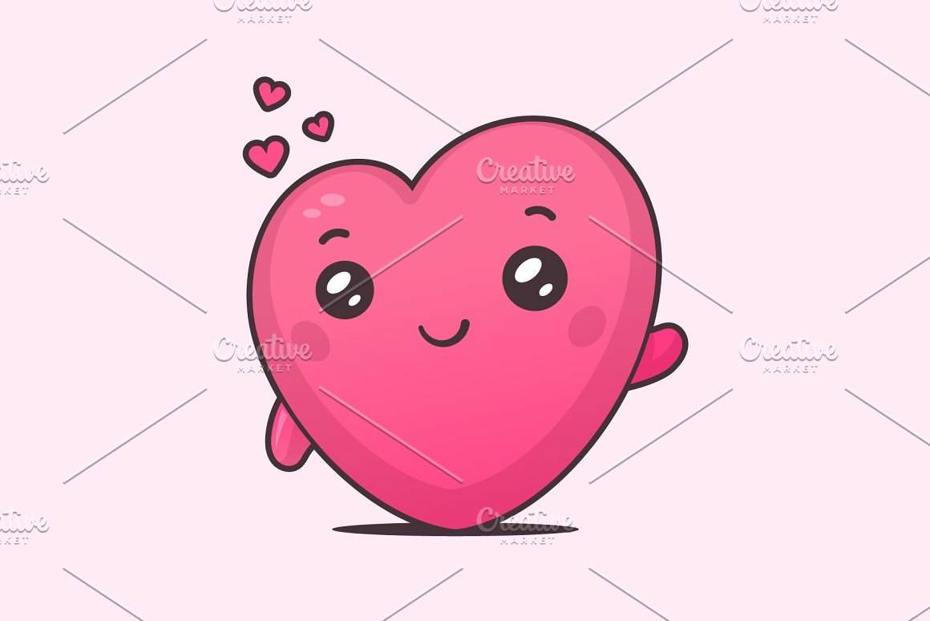
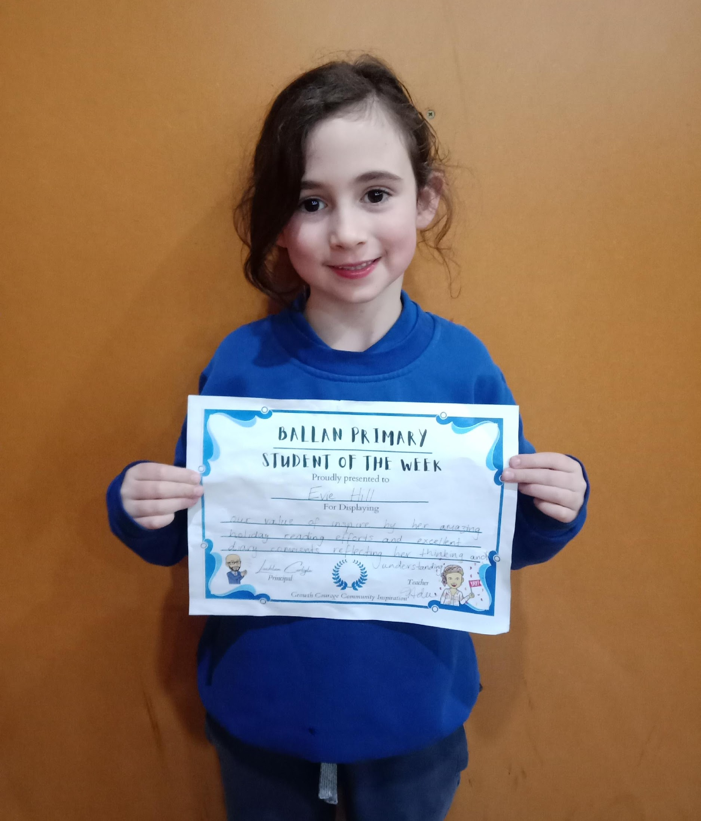
Evie
My hobbies are roller skating and the trampoline
My favourite animals are kittens, puppies and dingos
I am good at writing, reading and drawing

Slide 7
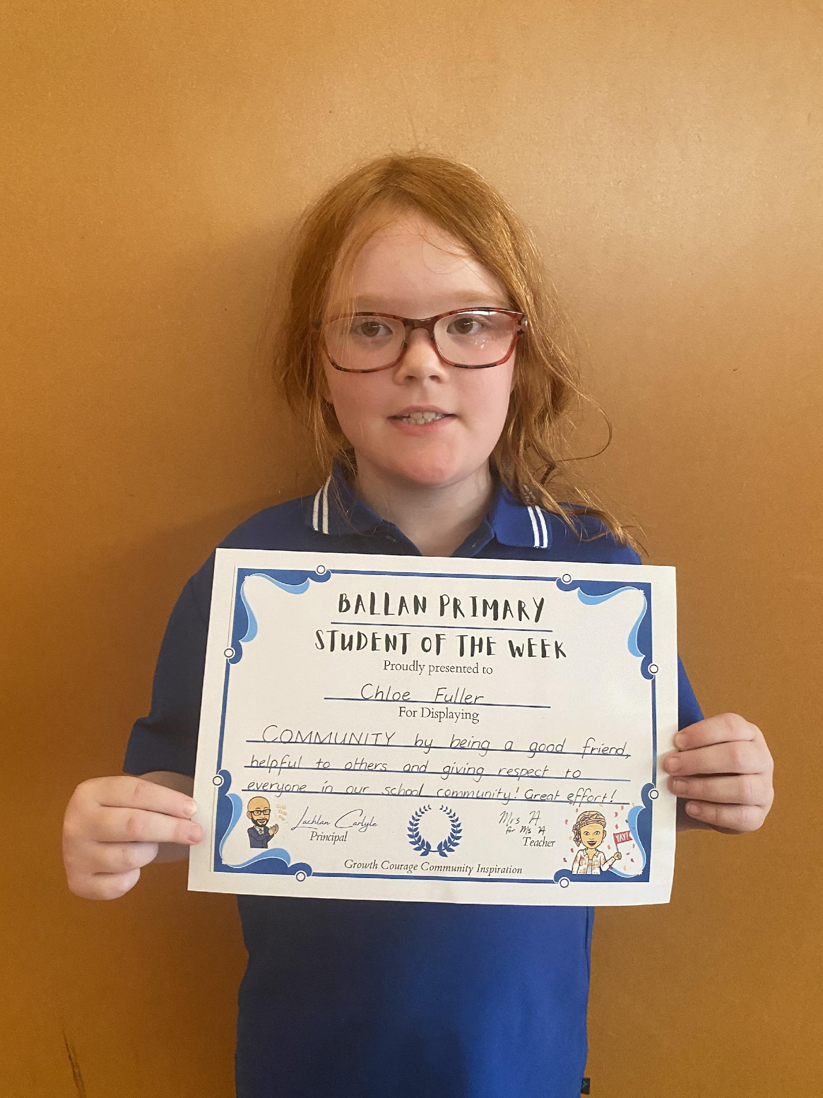
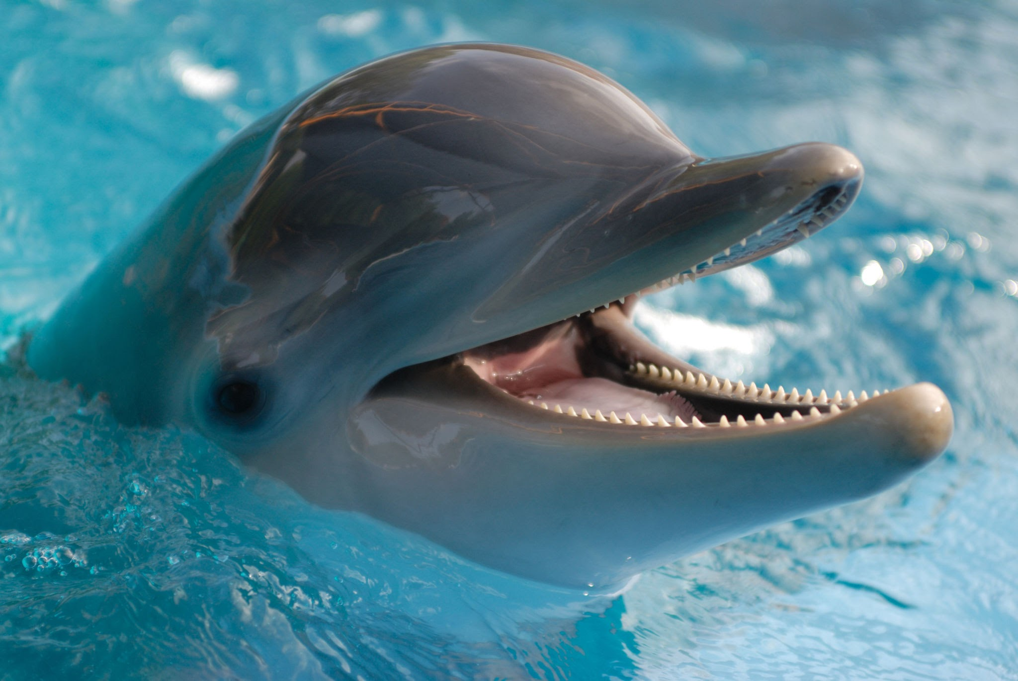
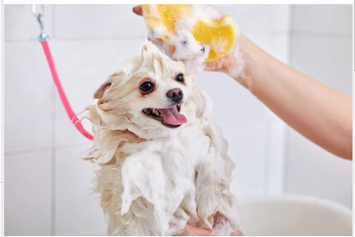
Chloe
My hobby is helping my dad.
My favourite animal is a dolphin.
I am good at taking good care of dogs.

Slide 8
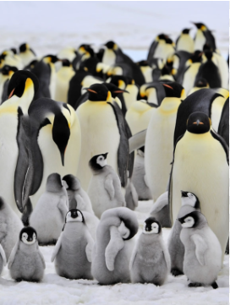
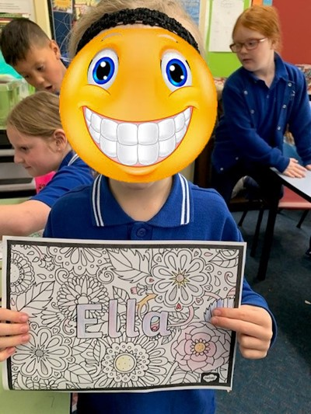
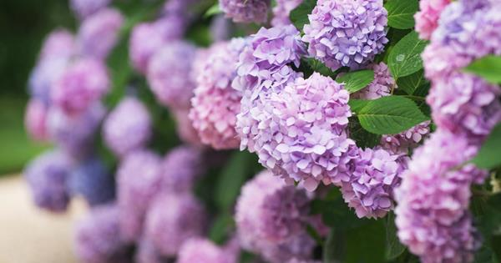
Ella.
My hobby is swimming.
My favourite animals are.
Puppies and cats (& kittens)
I am good at swimming.

Slide 9
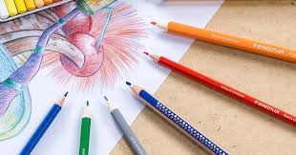
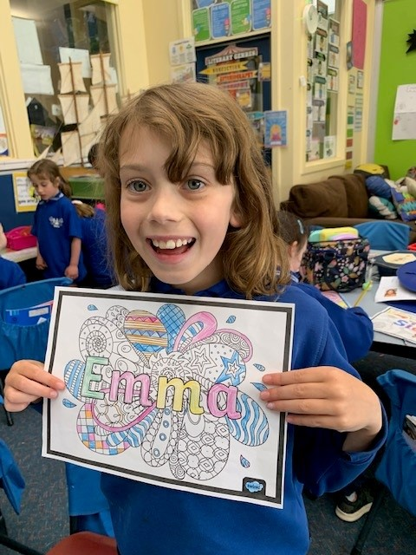
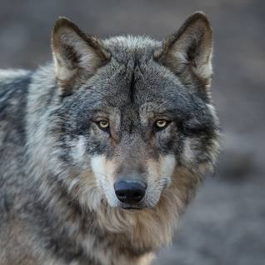
Emma
My hobby is colouring.
My favourite animal is a wolf.
I am good at drawing.

Slide 10
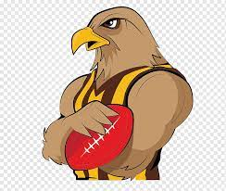
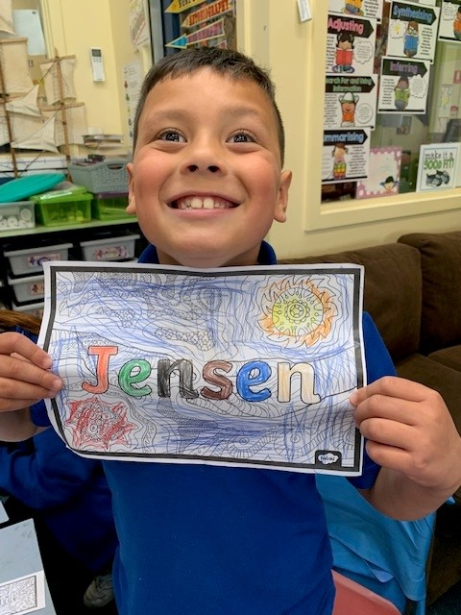

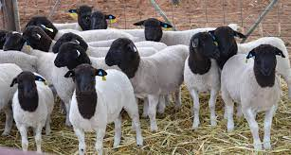
JENSEN
My hobbies are footy and gaming.
I am good at footy and Lego.
My favourite animals are sheep and dogs.

Slide 11
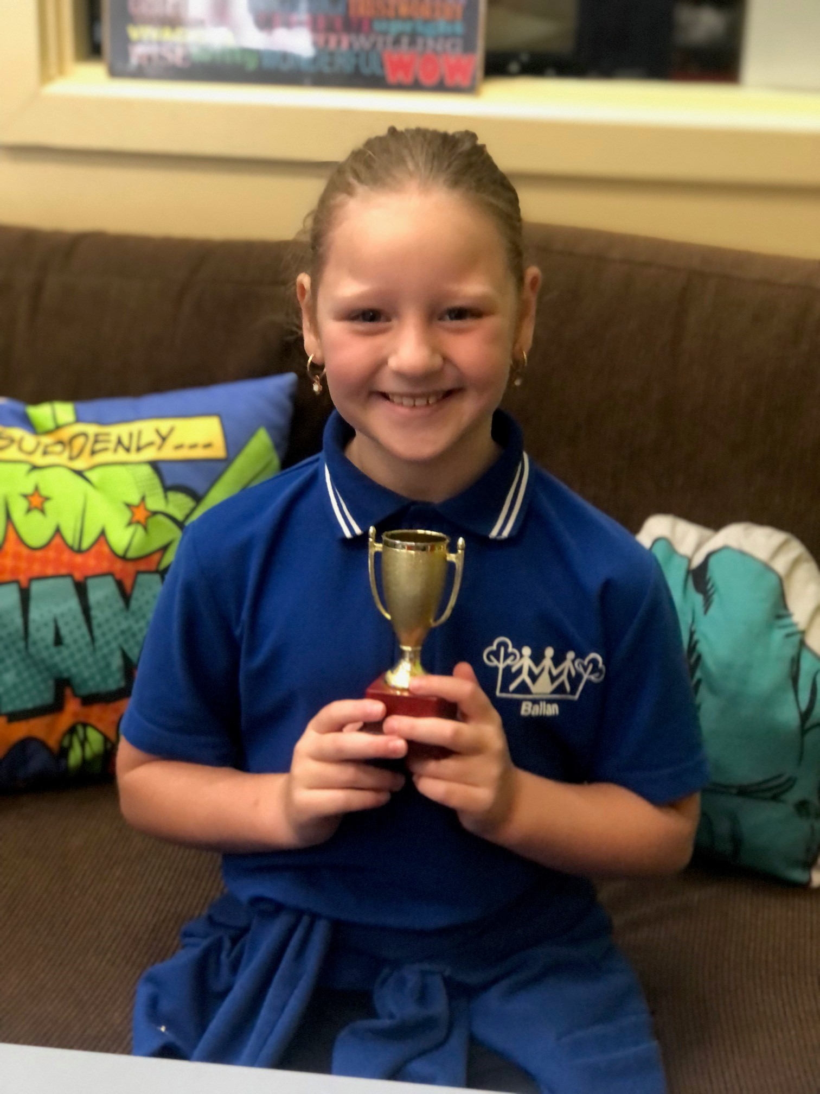
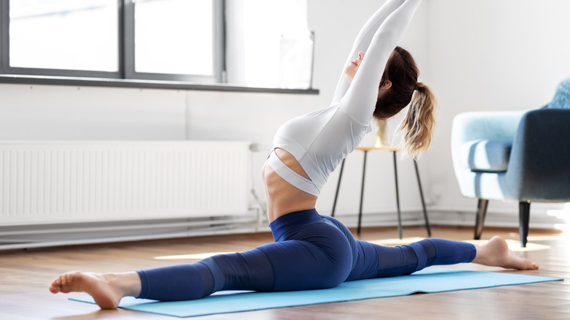
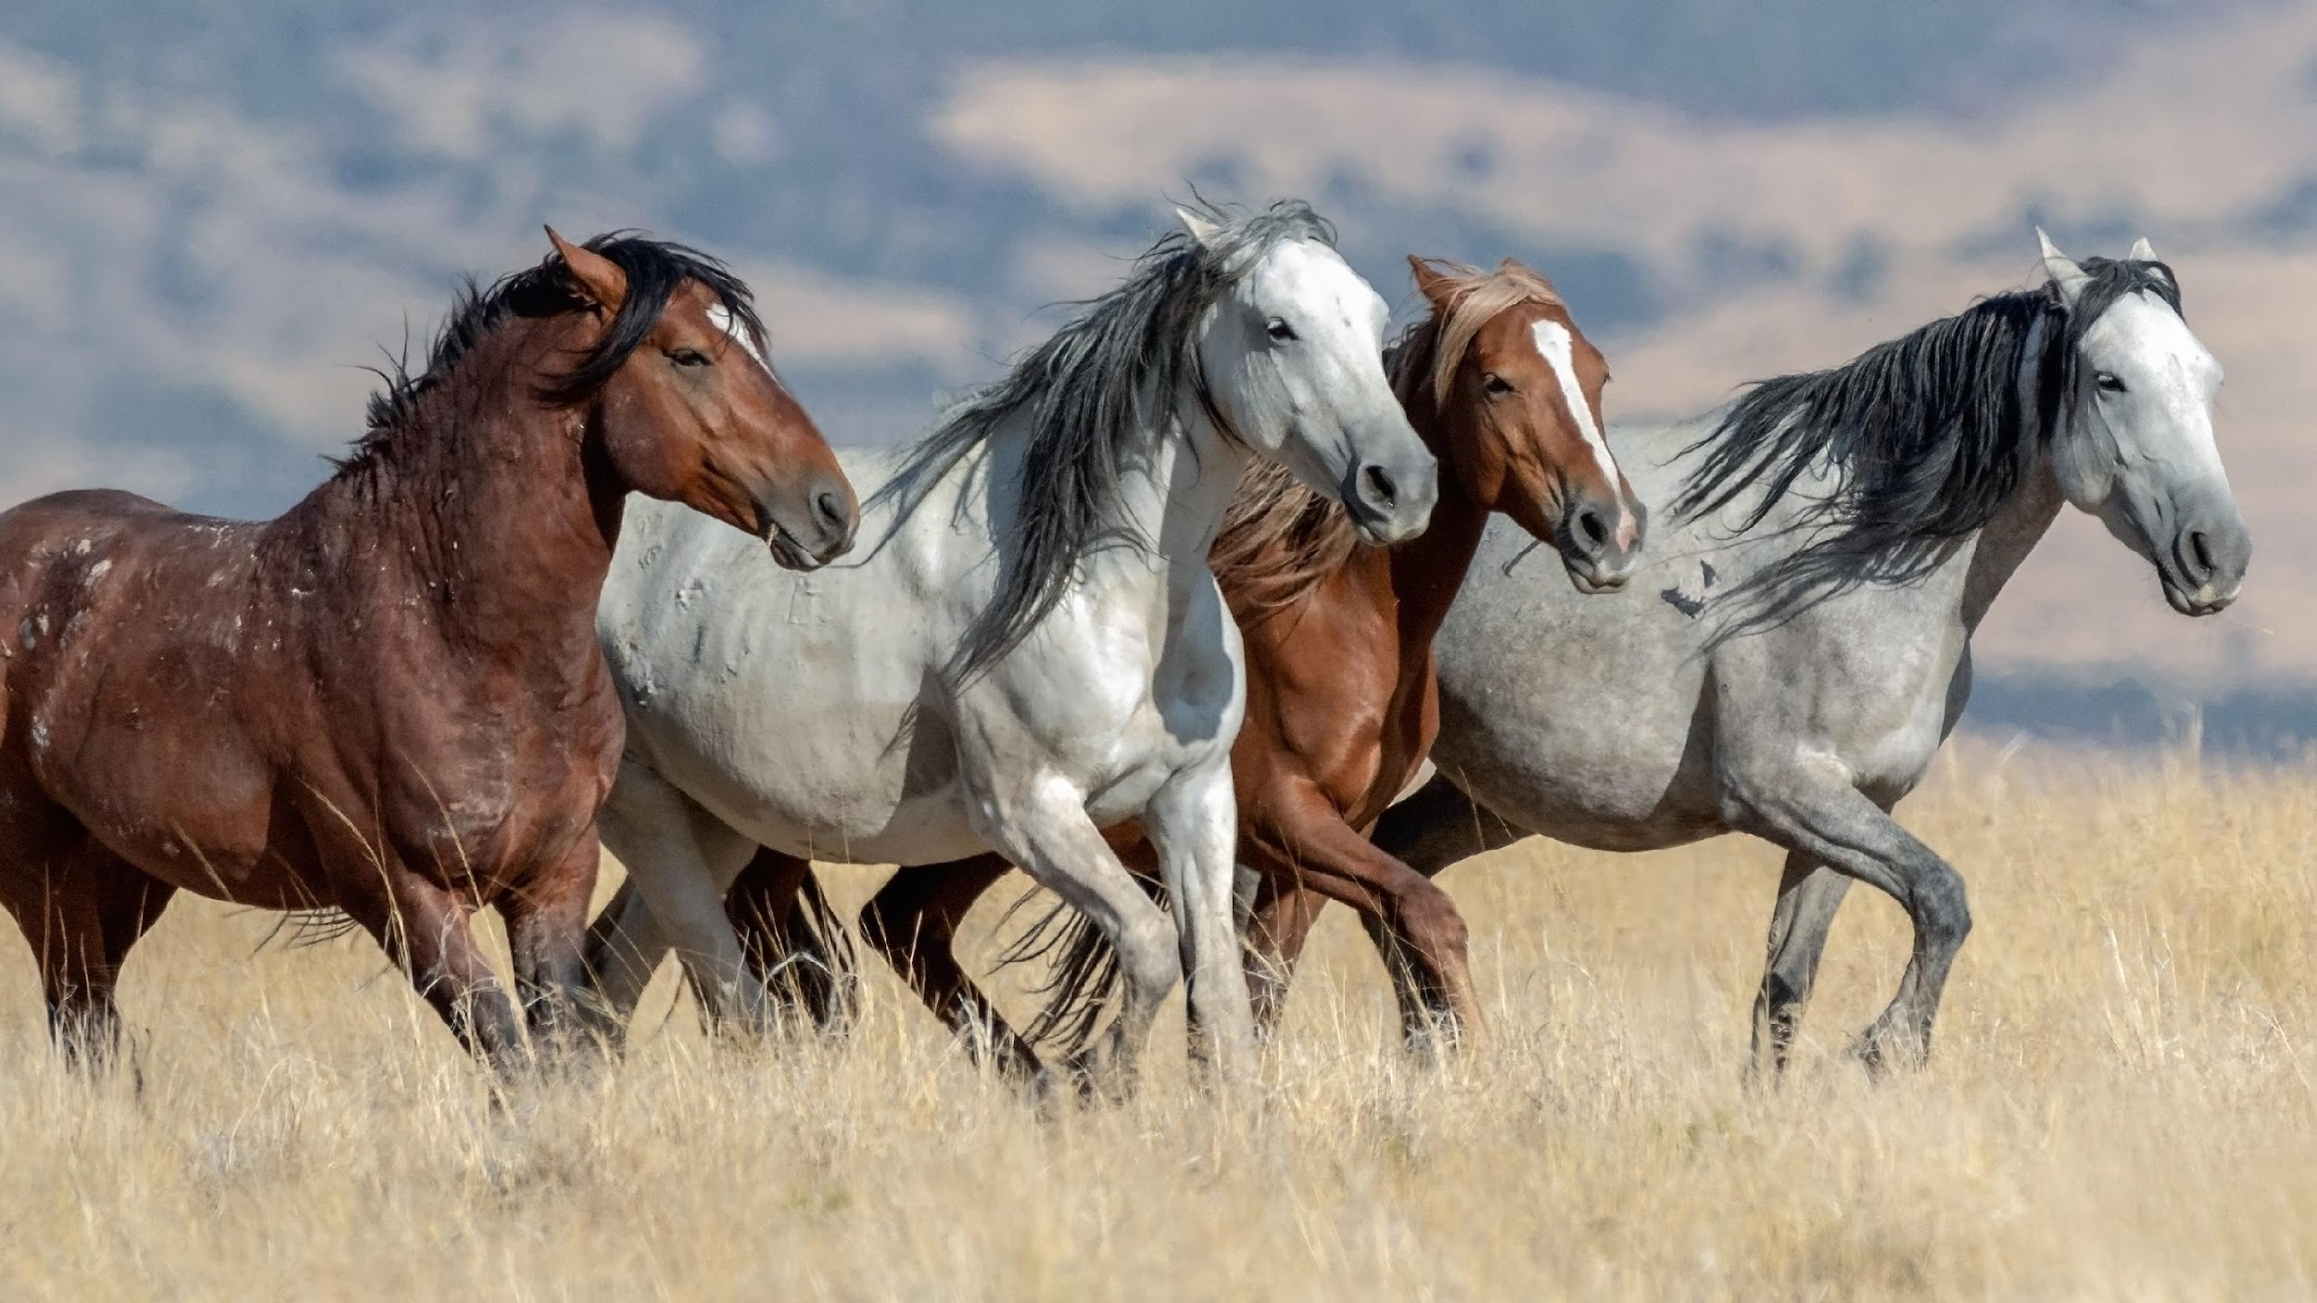
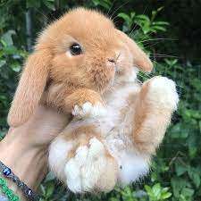
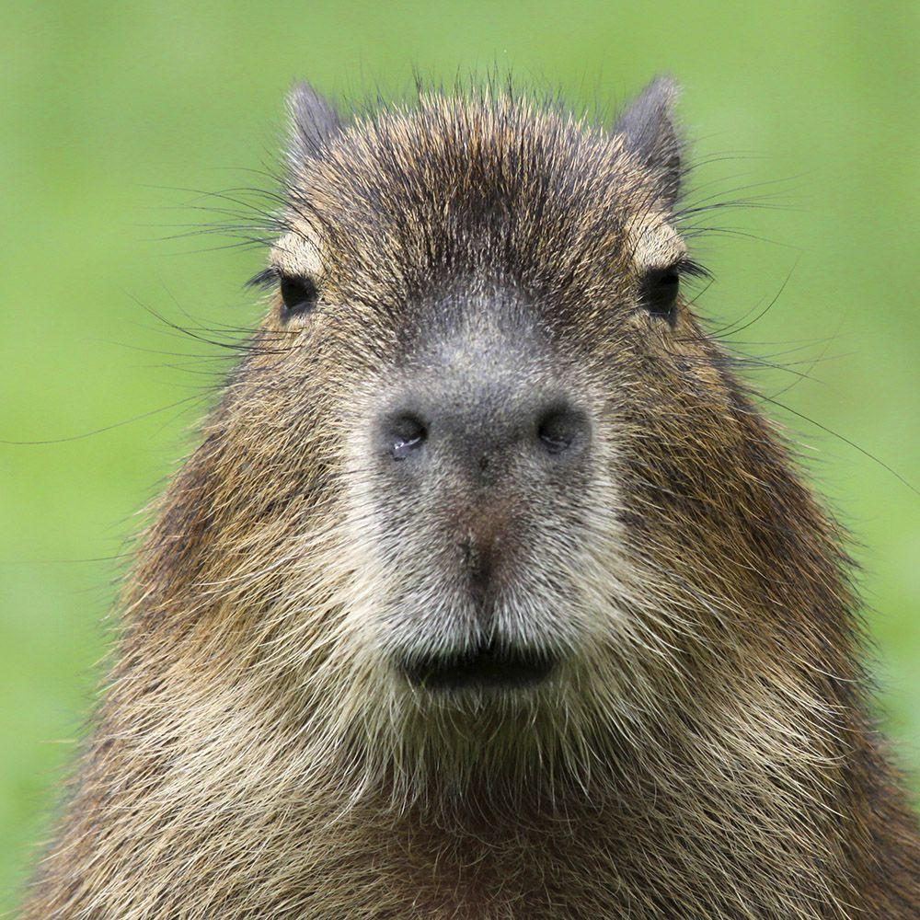
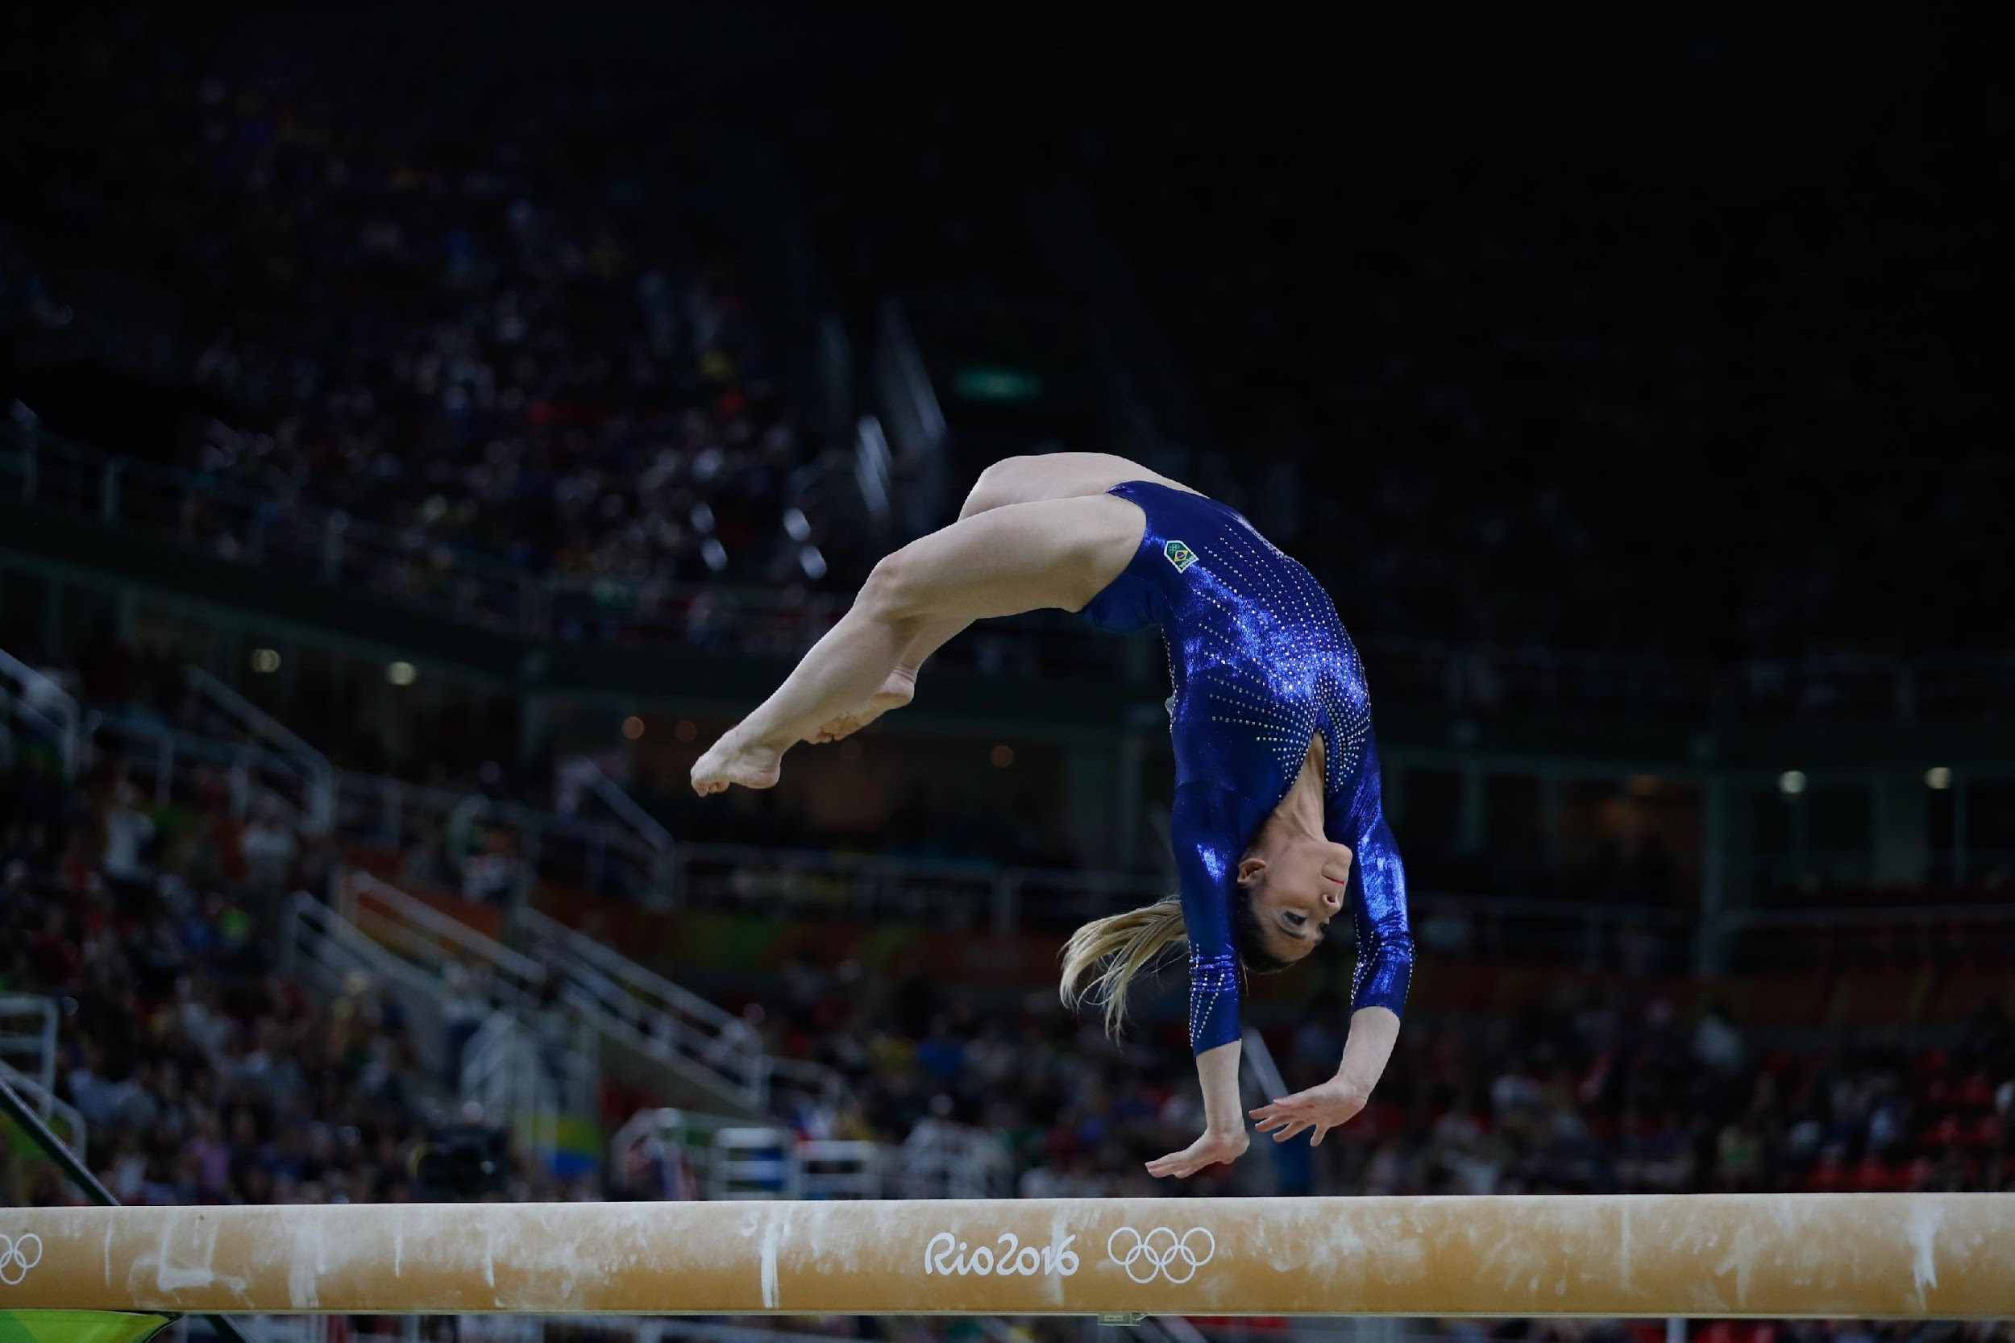
Jordyn
My hobbies are gymnastics and eating.
My favourite animals are horses, capybaras and rabbits.
I am good at doing the splits and love.

Slide 12
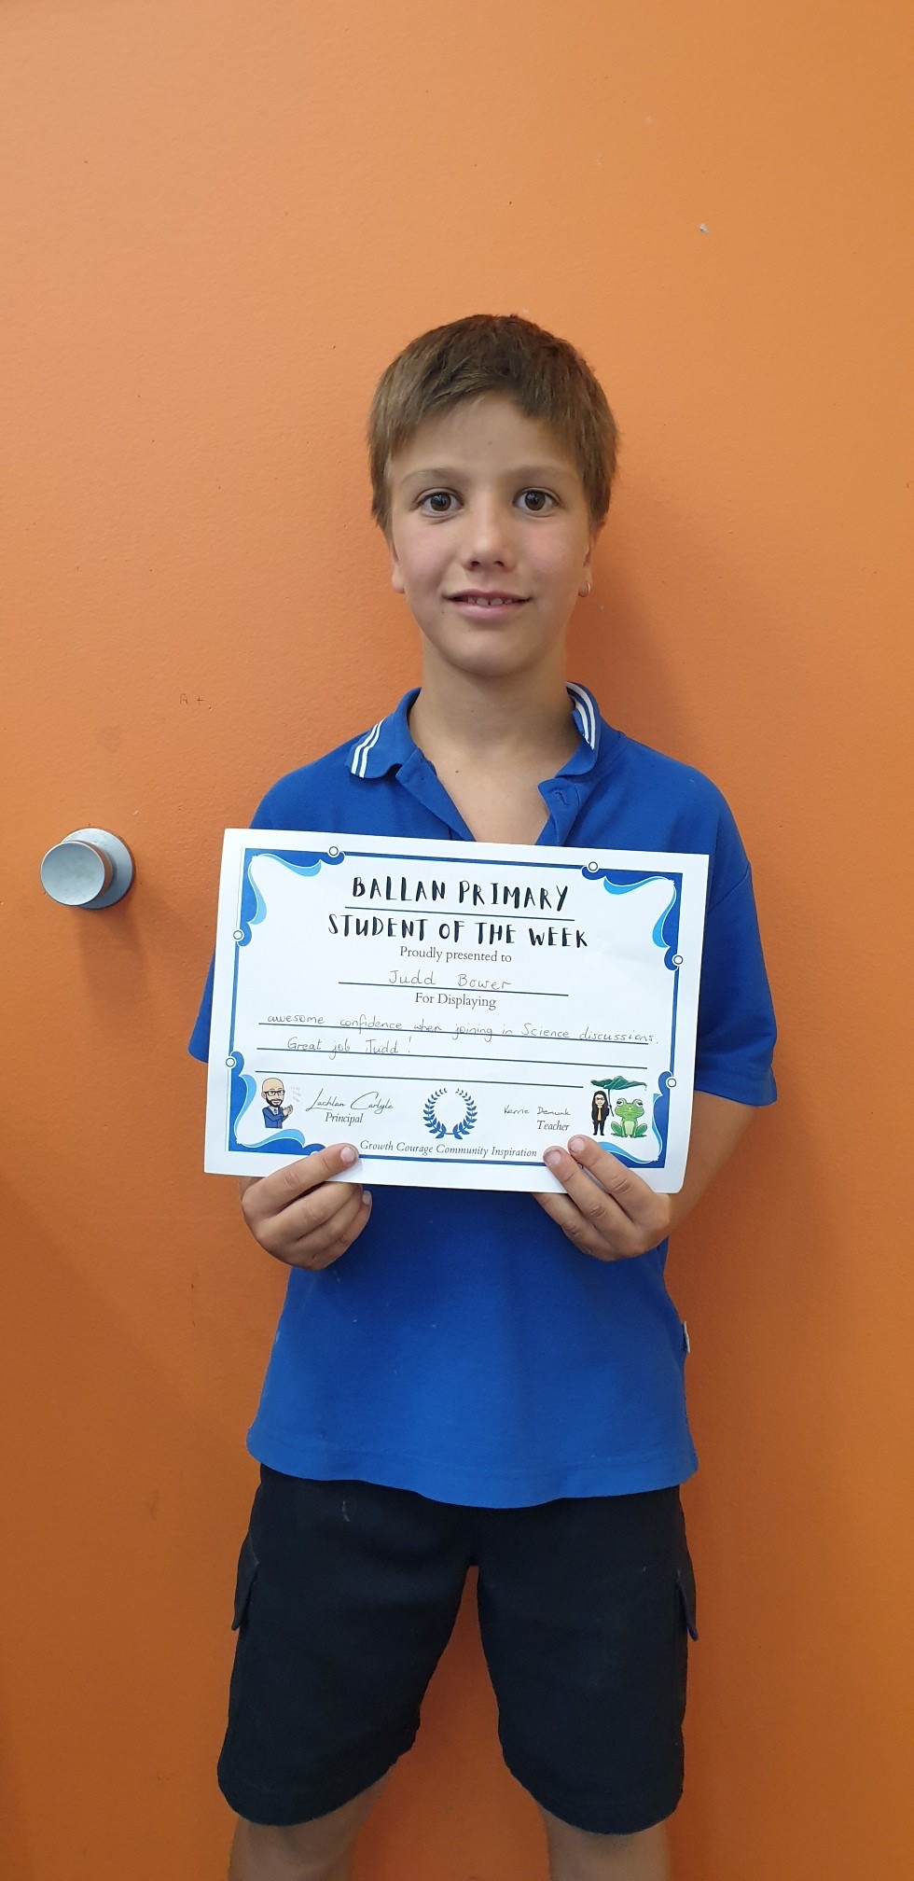
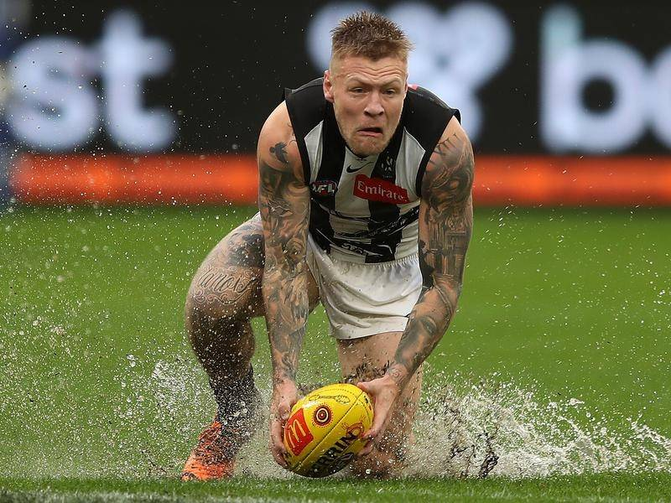
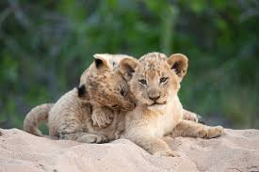
JUDD
My hobby is
playing video games.
My favourite animals are dogs.
I like football.

Slide 13
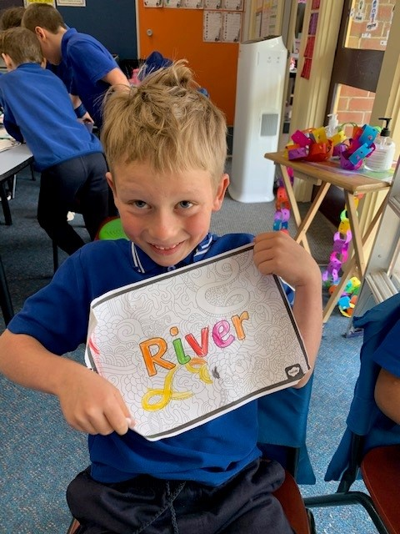
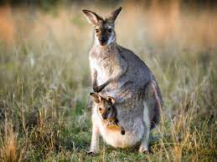
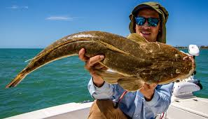
River
My hobbies are gaming, football, sports, fishing and food.
My favourite animal is a kangaroo.
I am good at sports.

Slide 14
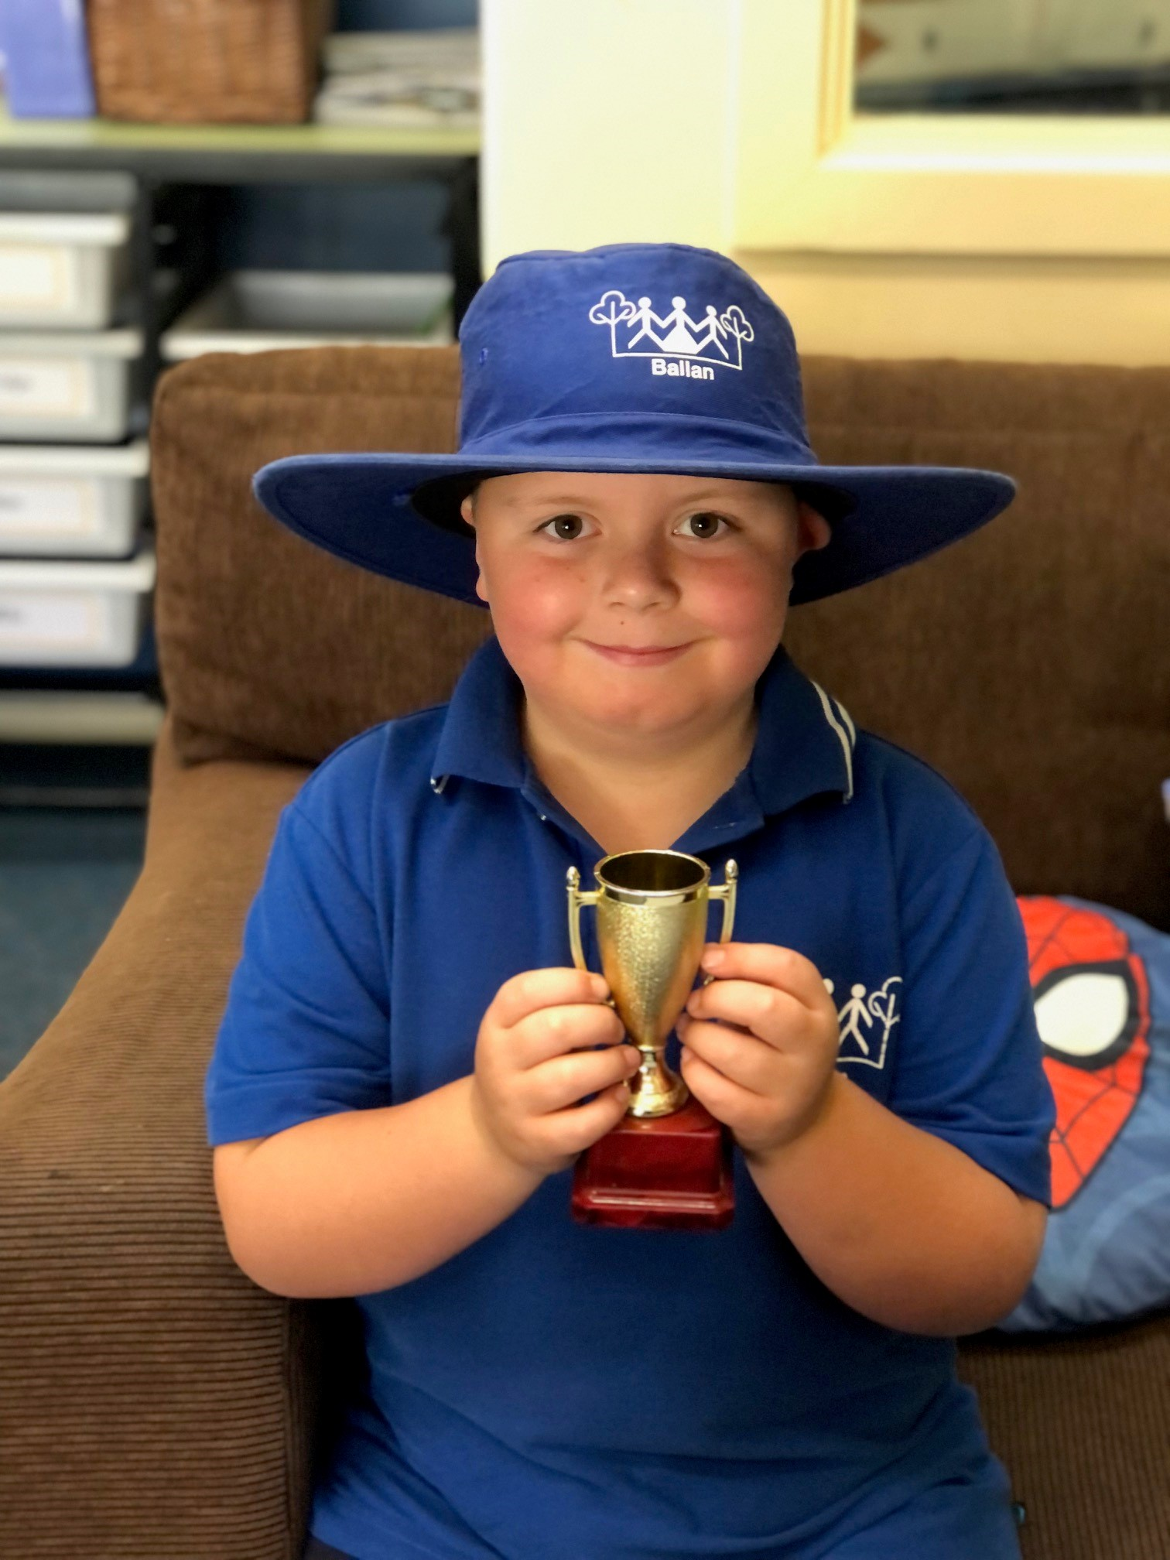
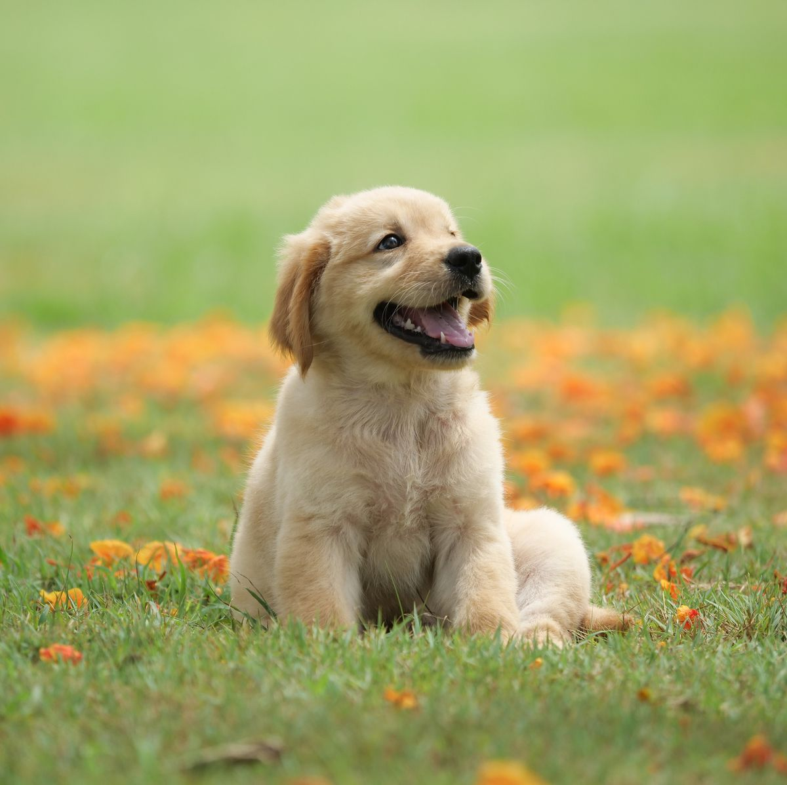
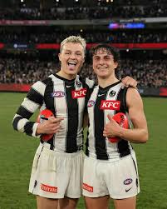
REILLY
My hobbies are football and gaming
I am good at footy
My favourite animals are dogs and sheep

Slide 15
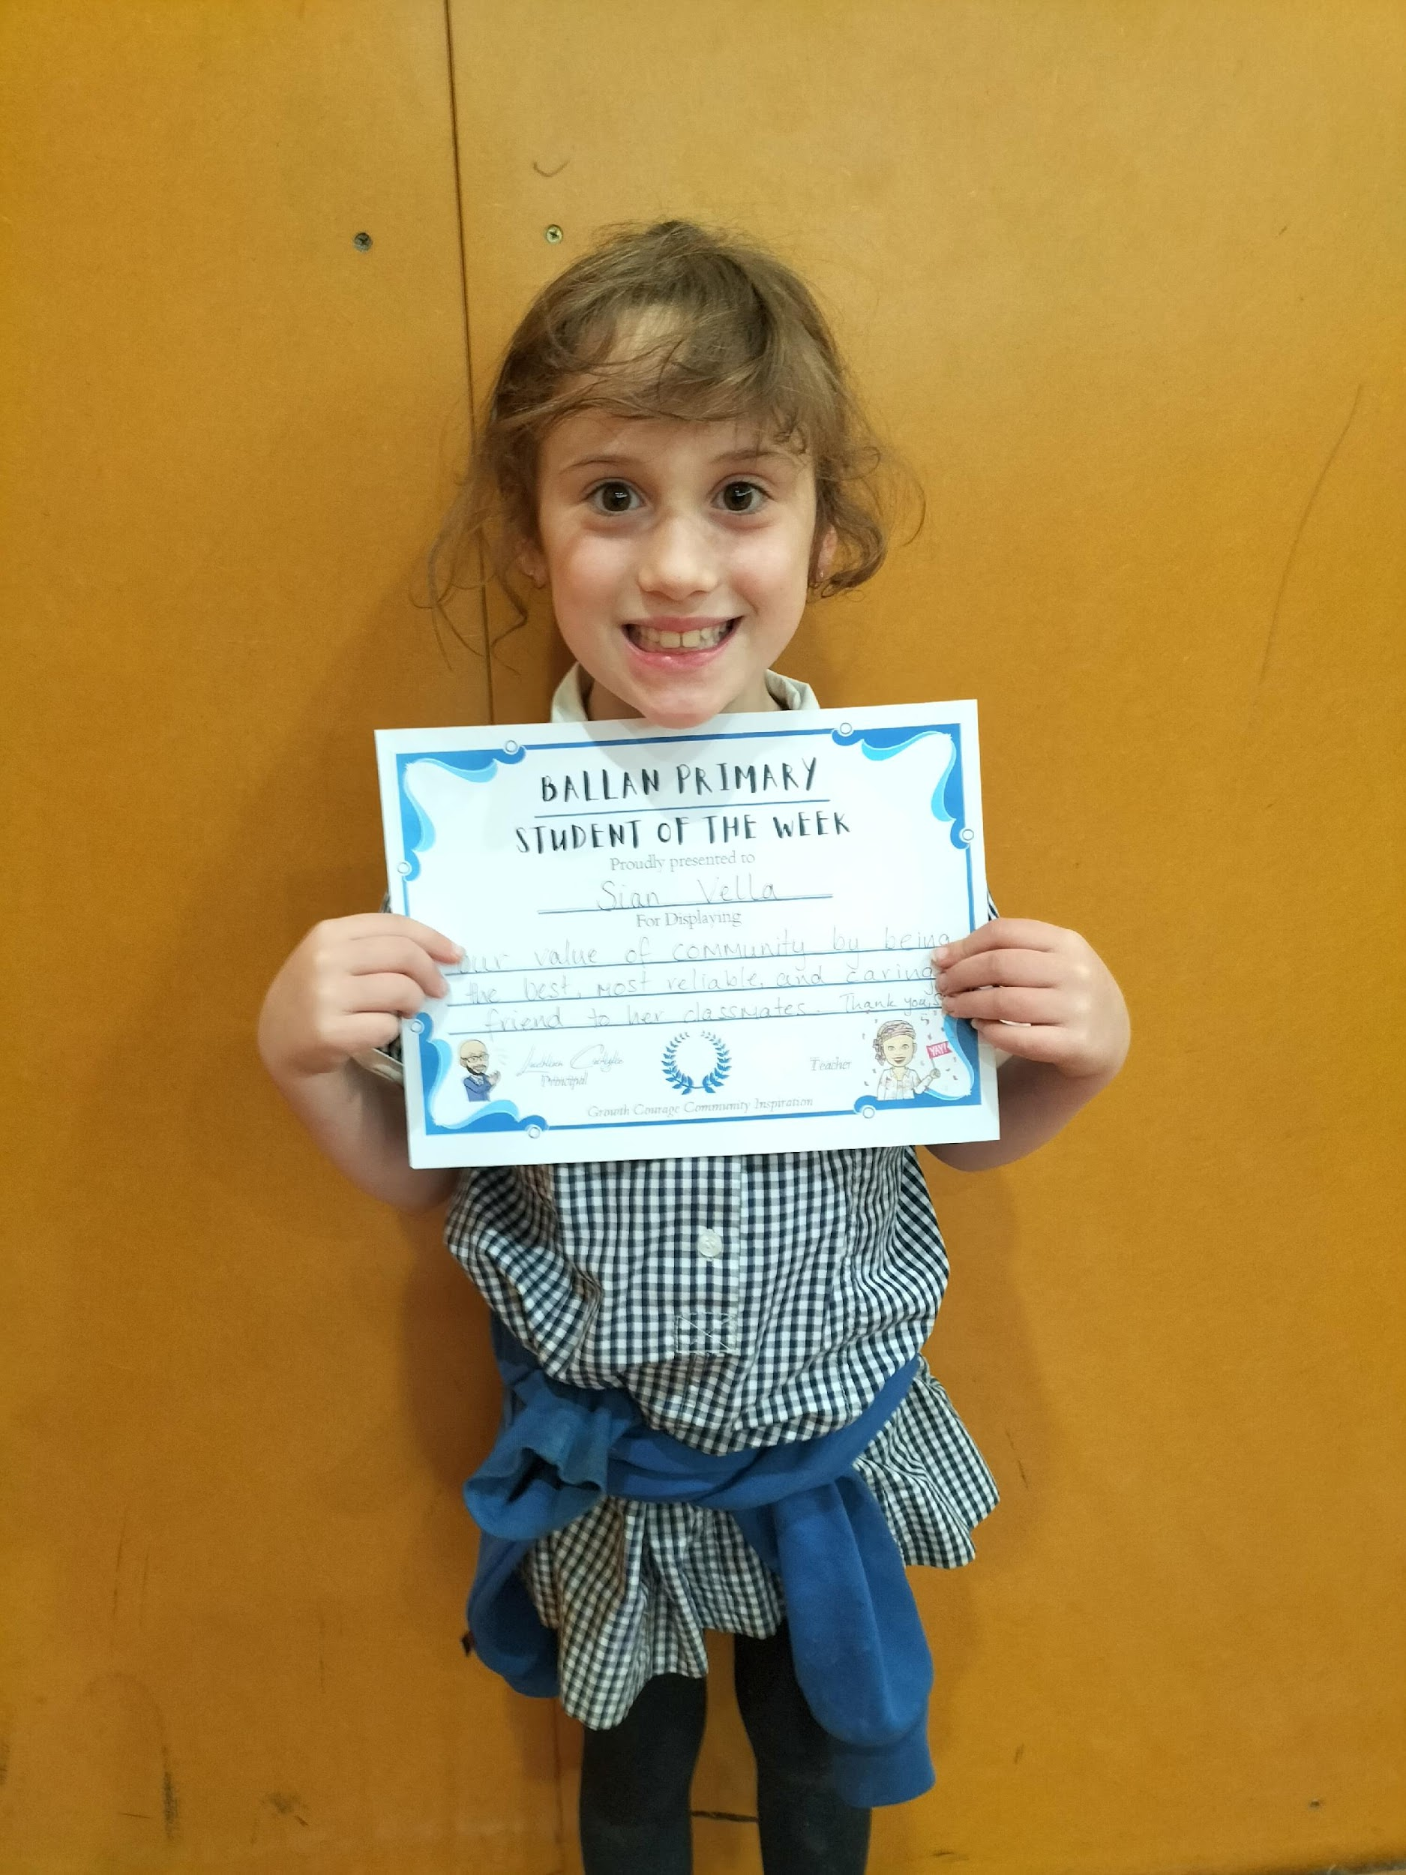
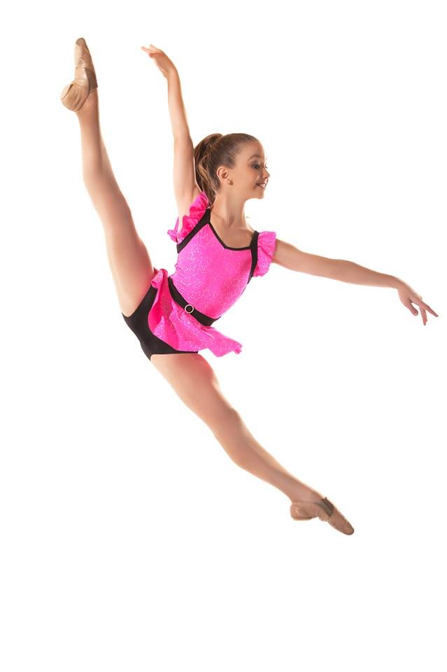
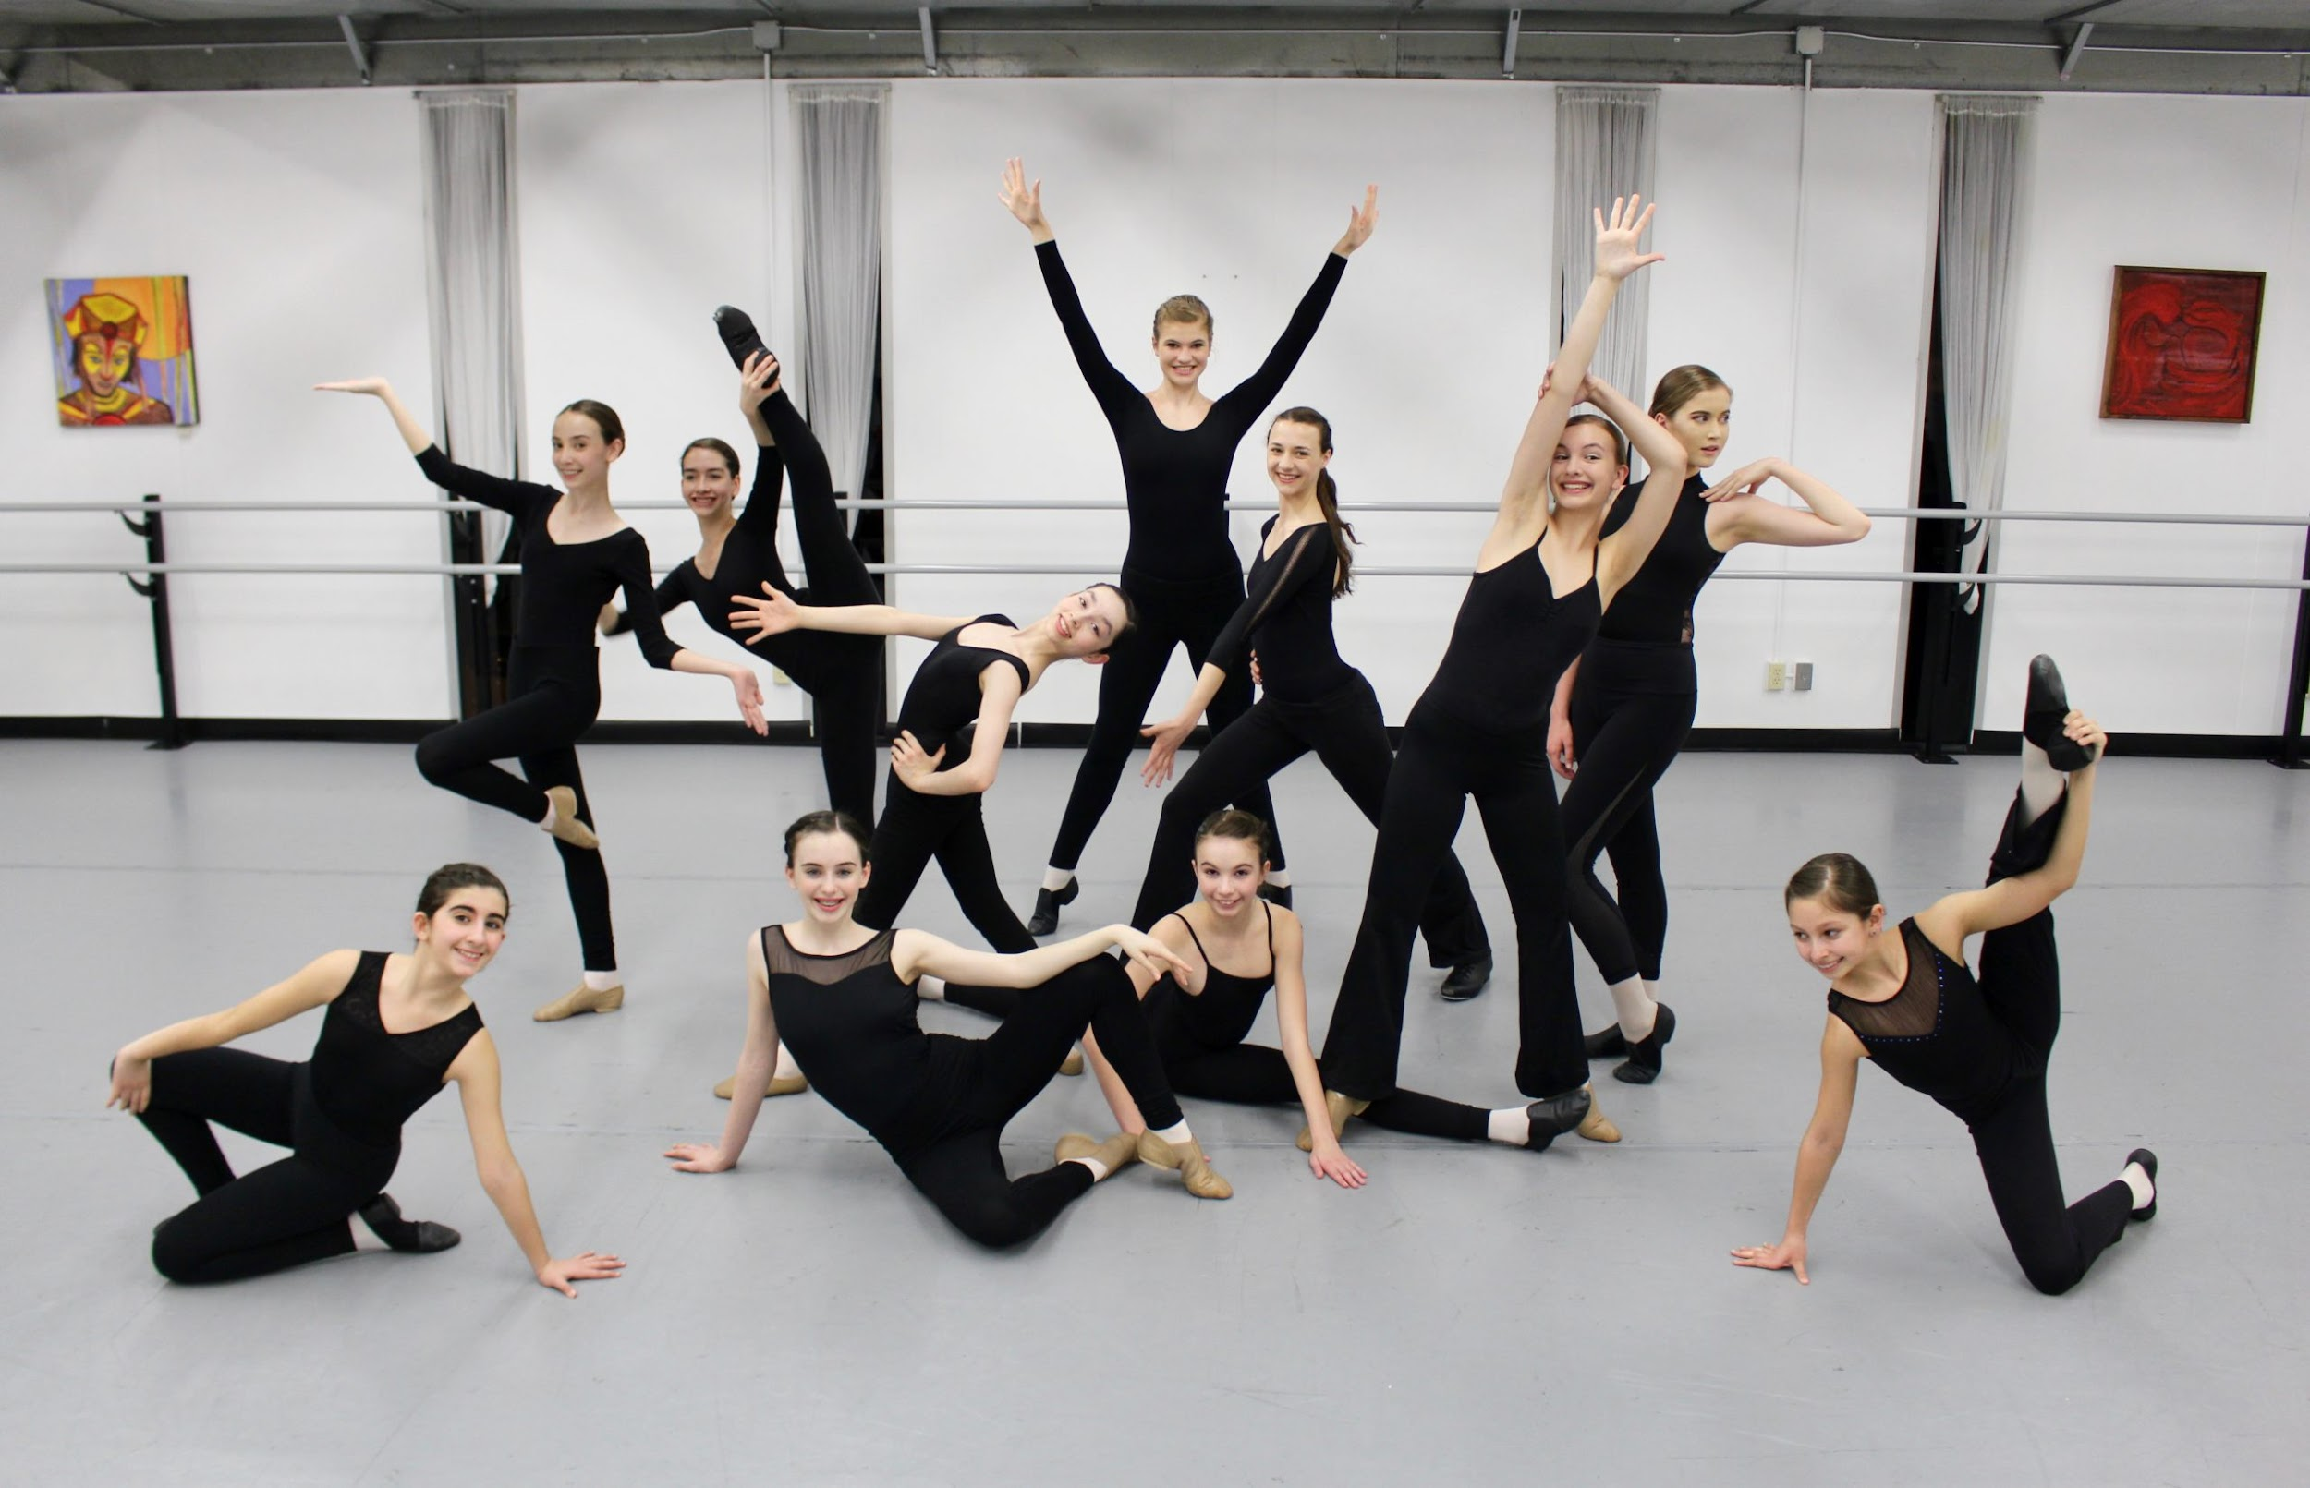
SIAN
My hobbies are roller skating
My favourite animal is a dog
I am good at dancing

Slide 16
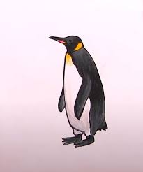
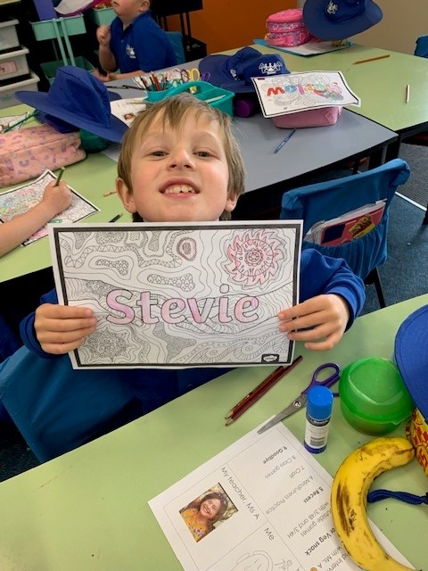

Stevie
My hobbies are Youtube and drawing.
My favourite animals are penguins and kittens
I am good at basketball and soccer.

Slide 17
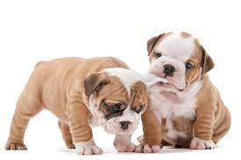



Thomas
My hobby is footy.
My favourite
animal is a dog (especially Kelpies)
I’m good at footy

Slide 18



Tyler
My hobby is gaming.
My favourite animal is a snake.
I am good at riding and also good at gaming.

Slide 19



Ms. Adcock
My hobbies are studying, visiting gardens and researching local history.
My favourite animal is the wedge tailed eagle.
I am good at writing and being creative.

Slide 20


Hi, we are the Junior School Council representatives for 2/3A.
We have answered your questions and will share our answers with you.
I’m Tyler
I’m Georgie

Slide 21







Question 1: food we like
lamb chops/lamb cutlets
veggies
chicken parmigiana
bacon
cheeseburger McDonalds
cheese and bacon burger McDonalds
steak

Slide 22








Question 1: food we like
pizza (3 students)
dim sims
sushi
pasta
chicken wrap McDonalds
fish and chips
tacos
chocolate chip muffins

Slide 23






Question 2: snacks we like
noodle snack
veggie straws
pringles (3 students)
cheetos (2 students)
spicy potato chips
oreos (4 students)

Slide 24






Question 2: snacks we like
mars bar
fruit bar
cheese and biscuits
sushi
mango (2 students)
cookies

Slide 25








Question 3: games we like
Gardens games
Evermerge
Monopoly (2 students)
Minecraft (3 students)
Roblox (7 students)
AFL 23 (online)
Racemaster 3D
Art (Nintendo)
Any game with my friend

Slide 26






Question 4: landmarks we want to introduce
Werribee River (3 students)
Ballan Primary School (2 students)
Murray River (2 students)
MCG (football ground Melbourne)
Melbourne Aquarium
Mars Oval (2 students)

Slide 27






Question 4: landmarks we want to introduce
Great Barrier Reef
Sydney Opera House
Yarra River
ANZ Bank in Melbourne
K Mart (Melbourne)
Creative Cakes

Slide 28








Question 5: characters we like
Naruto (2 students)
Brodie Mychair (AFL 23)
Lightning McLean (Cars 2)
Sponge Bob Square Pants (2 students)
Korobi
Princess Peach
Luigi
Gogo Ping

Slide 29







Question 5: characters we like
Evie (Descendants)
Little Mermaid (Evermerge)
Coco (Family reunion)
Alex & Steve (Minecraft) (3 students)
Paperrazz (YouTuber)
Salish (YouTuber)
Mario (2 students)

Slide 30






Last question: singers or songs we like
Ed Sheeran
Taylor Swift
Harry Styles (3 students)
Shaun Mendez
Meghan Trainor (2 students)
Guns and Roses

Slide 31







Last question: singers or songs we like
Shotgun (2 students)
The Blues Song
Over the Rainbow
10 35
Believer
Rise
Pink fluffy unicorns dancing on
rainbows

