Slide 1
Many talents. One VCE
Many talents. One VCE
Many talents. One VCE
Study options for Years 11 and 12 ​ 2023 / 2024​

Slide 2
VCE is changing from 2023
Senior secondary education in Victoria is changing
Victorian Certificate of Education as you know it remains the same
VCE Vocational Major (VM) is a new program within the VCE – it replaces Intermediate and Senior VCAL
Victorian Pathways Certificate (VPC) replaces Foundation VCAL

Slide 3
VCE is changing from 2023
The changes deliver a higher-quality curriculum and better workplace experiences – leading to further study, training at TAFE, or work.

Slide 4
Why change?
Review of vocational and applied learning pathways in 2019 found:​
vocational and applied learning leads to strong future outcomes ​
outstanding delivery in many schools, however,
inconsistently delivered across all schools​
not consistently held in high regard
Notes:
In 2019 The Government commissioned a review of the Victorian Certificate of Applied Learning. The certificate had been running in Victoria for 20 years, and has provided very positive outcomes for a large number of students.
The review found:
In many education providers / schools the VCAL program was delivered in a quality manner and students achieved great outcomes
In some schools it wasn’t offered at all, or didn’t meet the same high standard as the best programs
Some parents didn’t want their children to choose this pathway because it wasn’t held in high regard, as the VCE is
All 38 recommendations of the report were accepted by the government. The key ones for schools at this time are
To increase the quality of the vocational and applied learning pathway, and actually incorporate it into the VCE
Create a brand new certificate – the Victorian Pathways Certificate for Year 11 and 12 for students not yet ready to undertake the VCE or the VCE VM

Slide 5
Response to Review
The Victorian Government committed to:
lifting the quality and perception of vocational education
helping more students access high-quality applied learning programs
providing vocational pathways that give students the skills they need to move successfully into further training and jobs post-school

Slide 6
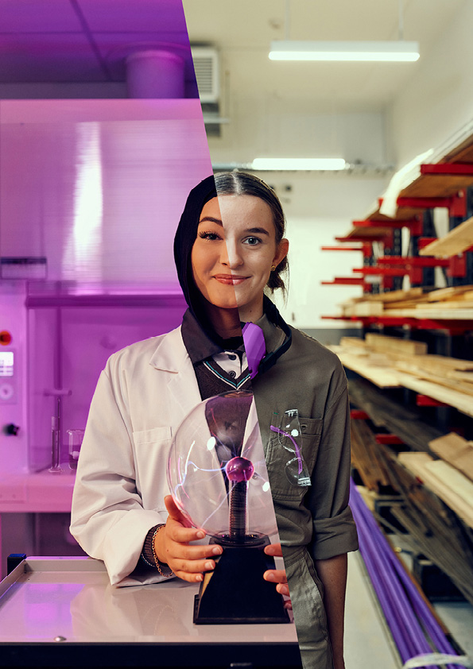
Why finish school?
Completing Year 12 studies sets up you up for lifelong learning
It means you will be ready to keep learning as you navigate your career and the opportunities of career changes throughout your life
Higher levels of education lead to higher paying jobs
Higher levels of education lead to better health over a lifetime
Notes:
In taking up a pathway to complete Year 12 studies, our young people are setting themselves up for a strong future.
Higher levels of education lead to higher paying jobs
Higher levels of education lead to better health over a lifetime, and even to lower likelihood of engagement in crime.
Completing Year 12 sets up a pattern of accepting lifelong learning as a concept, which means they will be ready to accept opportunities for career changes through their lives
As a contribution to our Victorian community, young people completing Year 12 has a very positive outcome.

Slide 7
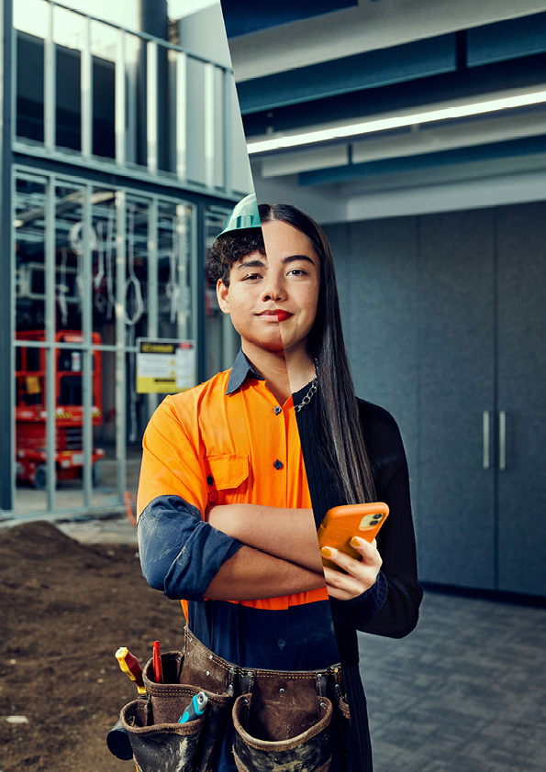
Education for future success
Nearly 80% of students leaving Year 12 go on to further study at TAFE or university immediately from school
More will enrol to study in subsequent years
It’s projected that more than 9 in 10 new jobs will require post-school qualifications – that’s university or TAFE
Notes:
You might be interested in the general trend of what young people take on after Year 12.
Statistics from the On Track survey from 2021 show some general trends
Young people who complete Year 12 are significantly more likely to go on to further education and training
This is especially important, as the Australian National Skills Commission tells us that nine in ten new jobs are thought to require a post school qualification. Education and skills development after school will be critical to securing sound and fulfilling future employment (Australian National Skills Commission)​
We all know that jobs that provide a strong future are requiring stronger skills, knowledge and capabilities. We only have to look at how the role of an auto mechanic has changed over the last 20 years with computers essential to the working of cars.

Slide 8
Your pathway options in 2023
Pathway options for 2023 video.

Slide 9
Certificate options
Victorian Certificate of Education (VCE)
Victorian Pathways Certificate (VPC)
VCE Vocational Major (VM)
Apprenticeships, traineeships, VET, university (ATAR) or work
Apprenticeships, traineeships, VET, university (through alternative entry programs) or work
Senior secondary, entry level VET or work

Slide 10
Victorian Certificate of Education
Two-year senior secondary certificate​
20 to 24 units – one unit is one semester
More than 90 subjects (called studies) to choose from​, plus Vocational Education and Training subjects (VET)​
A study has Units 1 and 2 (Year 11) and Units 3 and 4 (Year 12)​
An English study is compulsory
School assessments and final exams lead to study scores
Study scores lead to an ATAR

Slide 11
VCE Vocational Major – a program within the VCE
Two-year senior secondary certificate​
16 to 20 units
Four compulsory subjects VCE VM: Literacy, Numeracy, Personal Development Skills, Work Related Skills​
Compulsory VET subject
Gain credit from time in workplace
Assessment based on learning activities
No study scores and no ATAR

Slide 12
Each pathway builds on the learning strengths and aspirations of the student
VCE student
Classroom focus where you: build deep knowledge of a subject area apply theoretical skills and knowledge through experiments, practical activities​. Add a vocational focus through a VET subject​.
VCE Vocational Major student
Applied learning focus where you: concentrate on your future​ through real world learning contexts learn in a classroom, the workplace, and community You’ll develop project management skills and an understanding of others.​
Notes:
Note to schools
It is very important here to use language that doesn’t make one group sound less than the other
Eg Academic and non-academic
Each pathway develops its own range of skills which are equally valued in the Victorian community

Slide 13
Victorian Pathways Certificate (VPC)
For students not able or ready to complete the VCE or VCE Vocational Major
Program is tailored to meet the needs of the student
Study over 12 months, or more if needed
12 Units across VPC Literacy, VPC Numeracy, VPC Work Related Skills and VPC Personal Development Skills.
Leads into the VCE or VCE VM, entry-level VET or straight into employment
Notes:
The Victorian Pathways Certificate (VPC) is an inclusive Year 11 and 12 standards-based certificate that meets the needs of a smaller number of students who are not able or ready to complete the VCE (including the VCE Vocational Major). It is not a senior secondary certificate.
It provides an enriched curriculum and excellent support for students to develop the skills, capabilities and qualities for success in personal and civic life.
The VPC is an accredited foundation secondary qualification under the Education and Training Reform Act 2006. It aligns to Level 1 in the Australian Qualifications Framework. While the VPC is not a senior secondary qualification, it can be a pathway to the VCE.
The VPC is designed to develop and extend pathways for young people, while providing flexibility for different cohorts. The VPC is suitable for students whose previous schooling experience may have been disrupted for a variety of reasons, including students with additional needs, students who have missed significant periods of learning and vulnerable students at risk of disengaging from their education. Students will gain the skills, knowledge, values and capabilities to make informed choices about pathways into a senior secondary qualification, entry level vocational education and training (VET) course or employment.
The curriculum accommodates student aspirations and future employment goals. VPC learning programs connect students to industry experiences and active participation in the community. Through participation in the VPC students will gain necessary foundation skills to allow them to make a post-schooling transition.
May be taught in the same classroom as the VCE Vocational Major​
This certificate is really useful for a range of students who may not yet be ready to undertake the VCE. One example is students who have not attended school for a long period through illness, mental illness or other reasons.
This certificate is designed to take the student from their current skill level and develop those skills to the point where they are ready for the next stage of their future pathway – this might be an entry level VET at a TAFE, or they may wish to transfer into the VM. Alternatively, they may go straight into employment on completion.

Slide 14
Pathways after Year 12
Senior secondary education | Further study options | Employment options
VCE | Tertiary study options requiring an ATAR (e.g. for university and TAFE​) | Apprenticeship or employment​
VCE VM | Tertiary study options that don't require an ATAR (e.g. for apprenticeships, traineeships, further education and training, alternate university entry and workforce entry)​ | Apprenticeship or employment​
VPC | VCE VM or Certificate II level VET​ (e.g. entry-level Vocational Education and Training, or straight into a job)​ | Community participation, apprenticeship or employment​

Slide 15
Vocational Education and Training (VET)
Nationally recognised training
Develop industry specific knowledge and practical skills
More than 40 certificate qualifications across 27 VCE VET programs
Different schools offer different VET courses
Often undertaken at local TAFE or in-school options

Slide 16
Getting into university or TAFE
Direct entry ​with an Australian Tertiary Admission Rank (ATAR)
An alternate entry​ for courses with non-ATAR entry requirements using: folios, work experience or relevant pre-requisites for the alternative pathways to further study​
TAFE entry​ contact the preferred TAFE for their entry requirements​.
Notes:
Students can go on to university through either:

Slide 17
Choosing the right pathway
What do you want to do after finishing secondary school?
Further study / work?​
Don’t know yet? That’s ok.
Think about your interests and strengths.
Read the information provided
talk to careers staff / teachers / parents​.
Notes:
Each student, in partnership with their family and with the school, will need to choose the right pathway to meet their future aspirations.
In our school, they will draw on a range of activities that have occurred
Insert
Insert
Insert
What we know about the VCE, is that the students who do well choose subjects based on their interests and strengths
Knowing what they want to do after leaving school is really helpful, as they can choose subjects that build the right skills and knowledge and that meet the perquisites for university entry

Slide 18
Next steps for students
Attend school events to find out your options as well as
University and TAFE Open Days to think about your future.​
1
Think about the subjects you are passionate about.​
2
Reflect on the careers advice you’ve had to date.​
3
Use a career assessment tool (like Morrisby Test) to help match your interests with a career path.​
4
Speak to your careers practitioner with specific questions.​
5
Read the 'Where to Now?' guide.​
6
Visit vic.gov.au/oneVCE​
7
Notes:
NOTE: DELETE TILE 4 IF YOUR SCHOOL DOES NOT USE A CAREER ASSESSMENT TOOL

Slide 19
Next steps for parents and carers
Have conversations at home to support decision-making​
Begin to understand the language and structure of the VCE and the VCE VM
Ask questions at school​
Encourage your child to attend university and TAFE open days in Year 10, Year 11 and Year 12​

Slide 20
Many talents. One VCE
Many talents. One VCE
vic.gov.au/oneVCE

