Slide 1

Be
RESPECTFUL, RESPONSIBLE AND SAFE
Signal, Pause, Insist

Slide 2
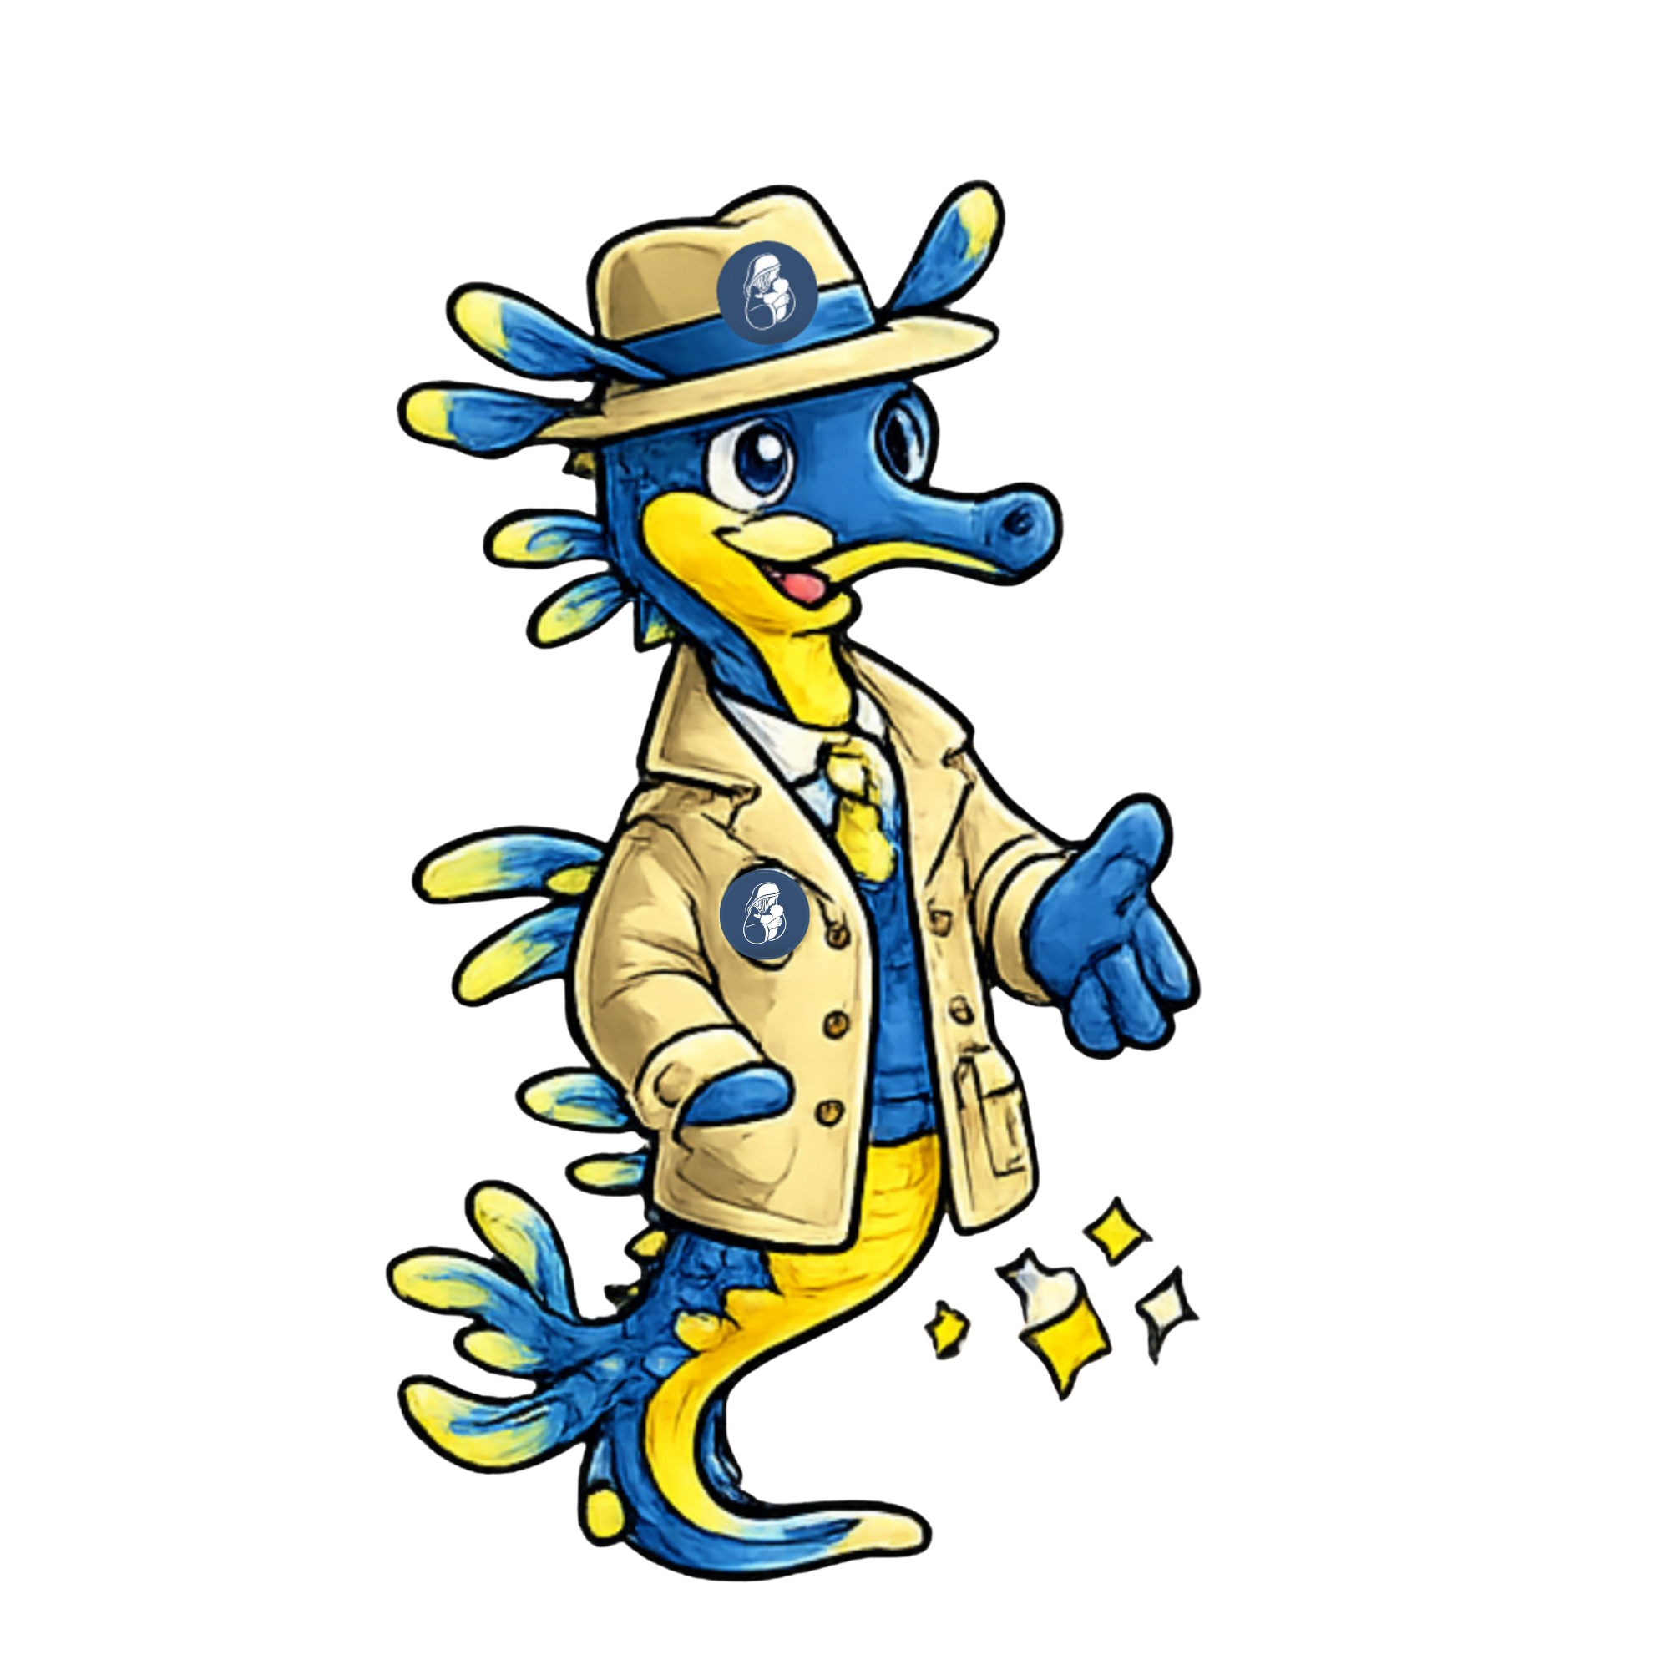
SIGNAL, PAUSE, INSIST
Everyone has the right to feel respected. When someone is speaking, we are responsible for listening respectfully.
Everyone’s safety is important at St Mary’s. When we gather together, we need to:
watch for the signal to pay attention
follow the signal by putting our hand in the air
show our respect by not talking and turn our bodies to face the speaker.

Slide 3
Learning Objective:We are learning that at St Mary’s, we always show respect by listening to the person speaking.

Slide 4


At St Mary’s, we follow the Signal, Pause, Insist routine by:
We look for the signal and we pause what we are doing and stop talking. We display the signal by raising our hand.
We watch the speaker who is insisting that everyone will pause and stop talking.
Then we listen respectfully to the speaker and follow their directions.

Slide 5
At St Mary’s, we are NOT following the Signal, Pause, Insist routine when we are:
Not facing the speaker
Talking over or interrupting the speaker
Continuing with what we are doing
Moving around and distracting others

Slide 6
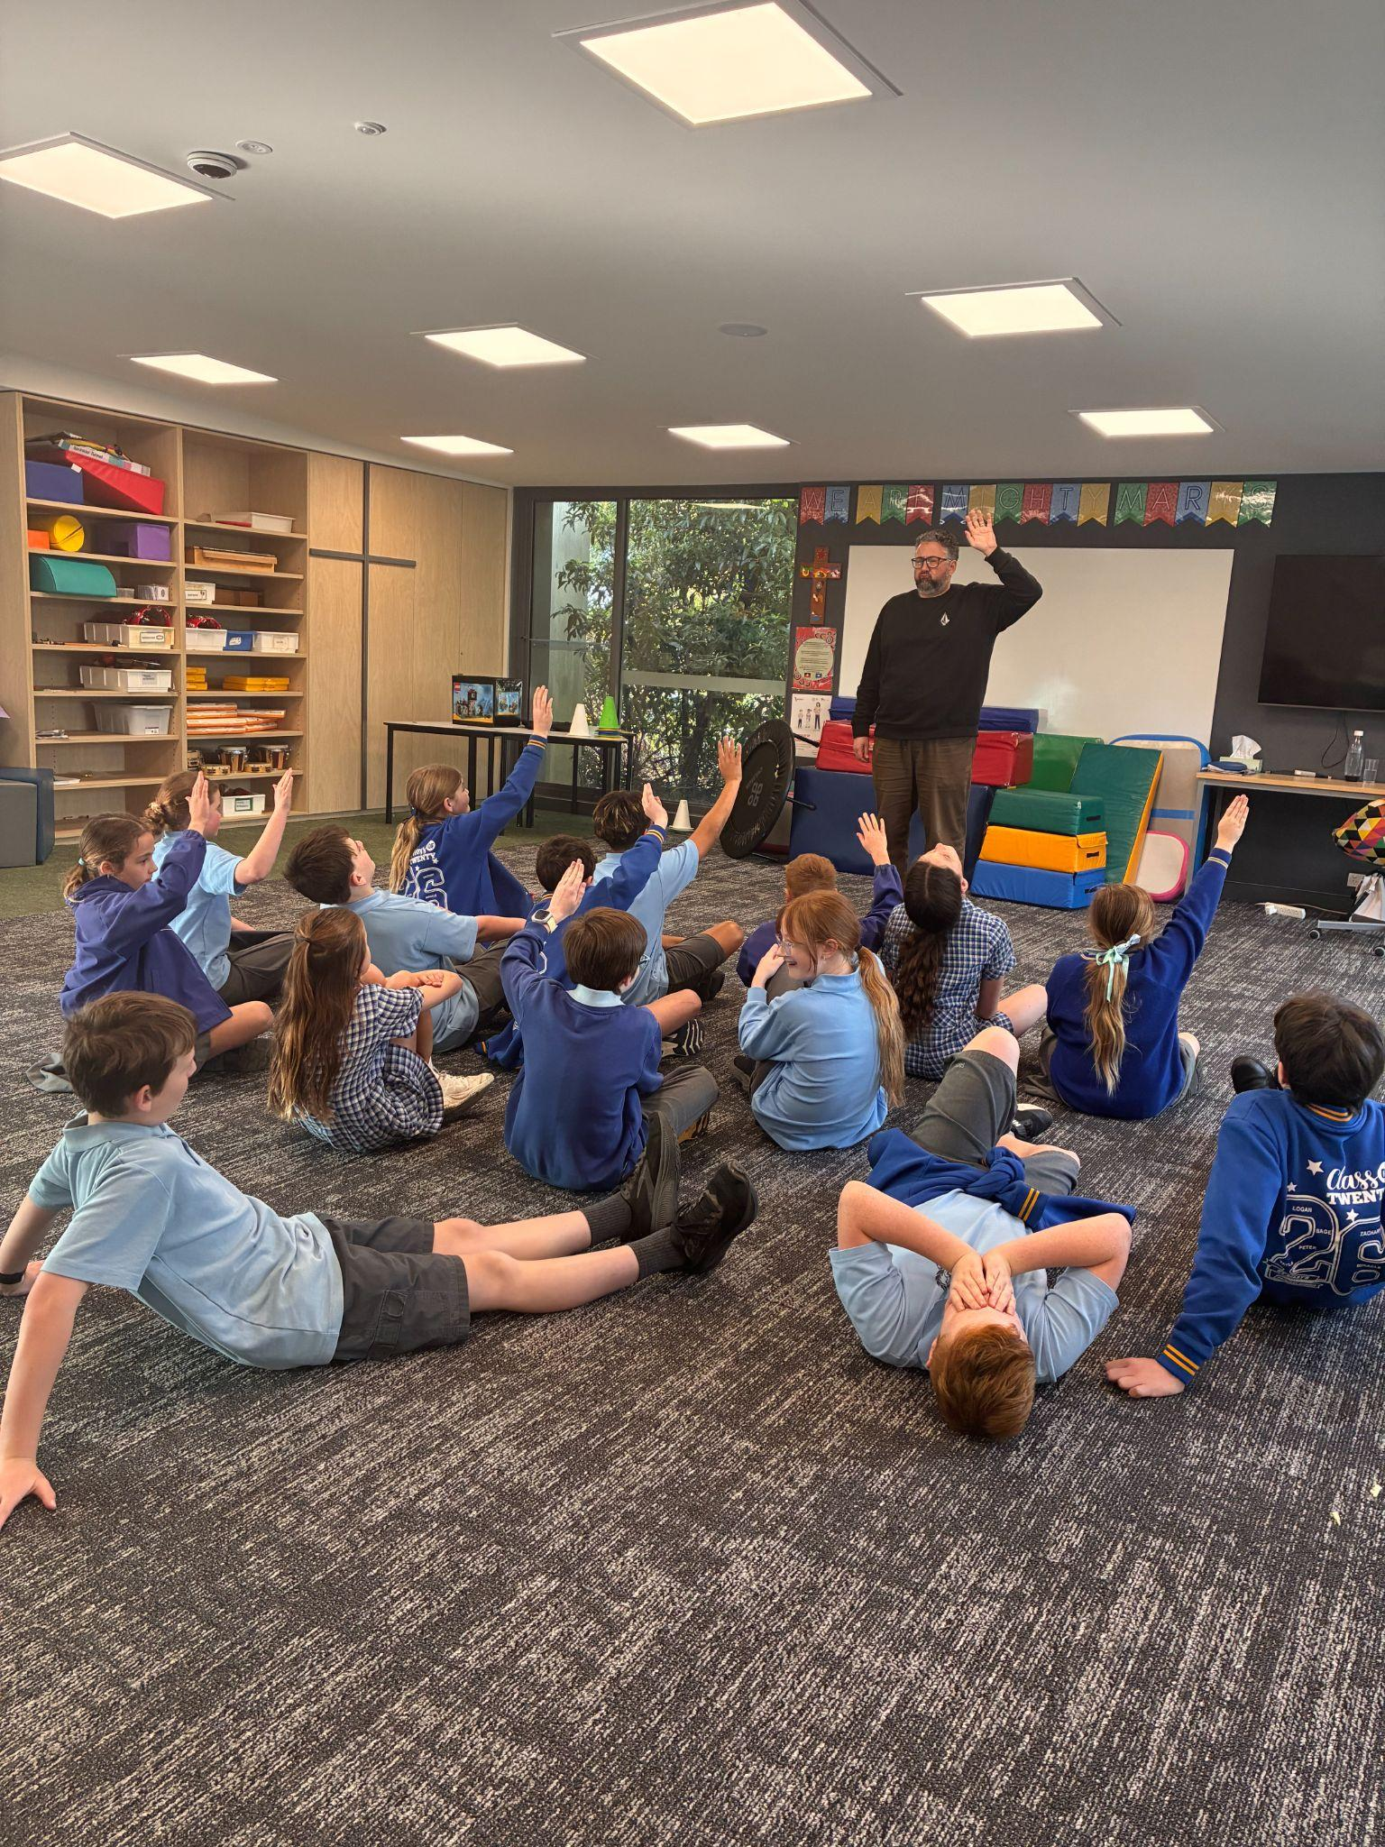
APPROPRIATE OR NOT?

Slide 7
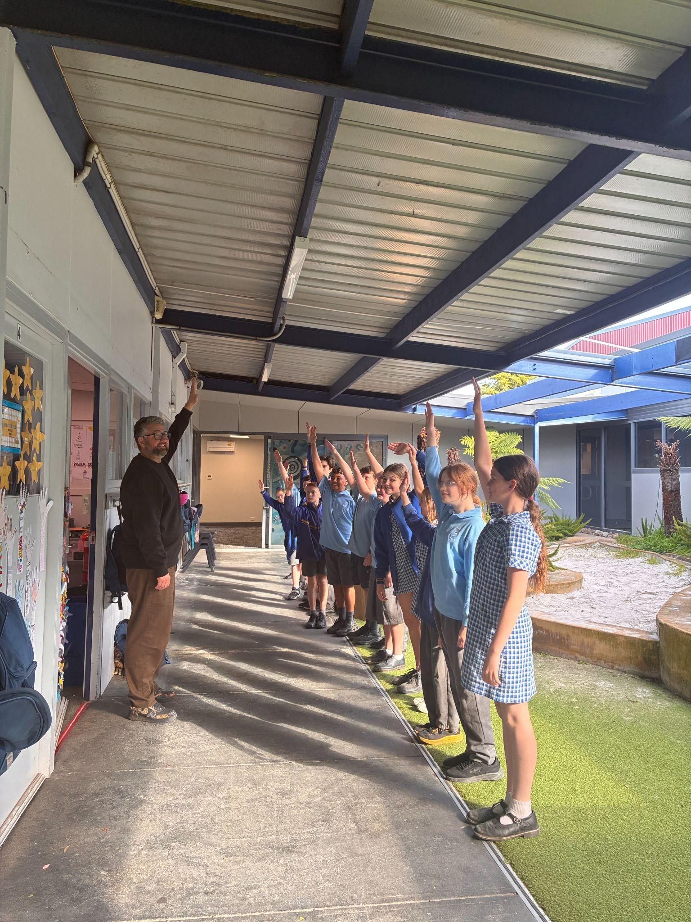
APPROPRIATE OR NOT?

Slide 8
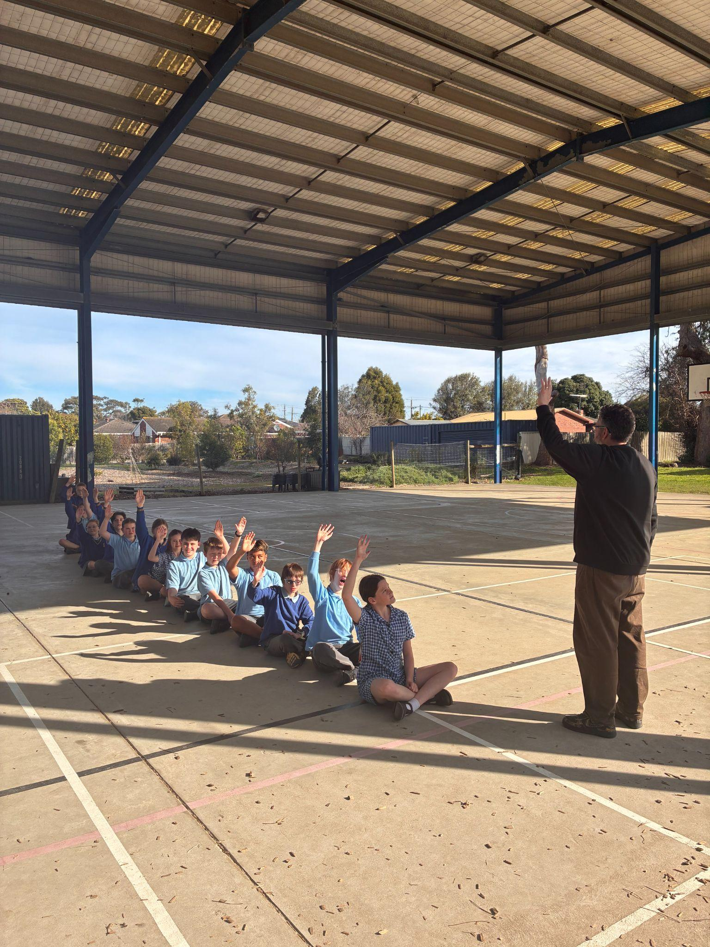
APPROPRIATE OR NOT?

Slide 9
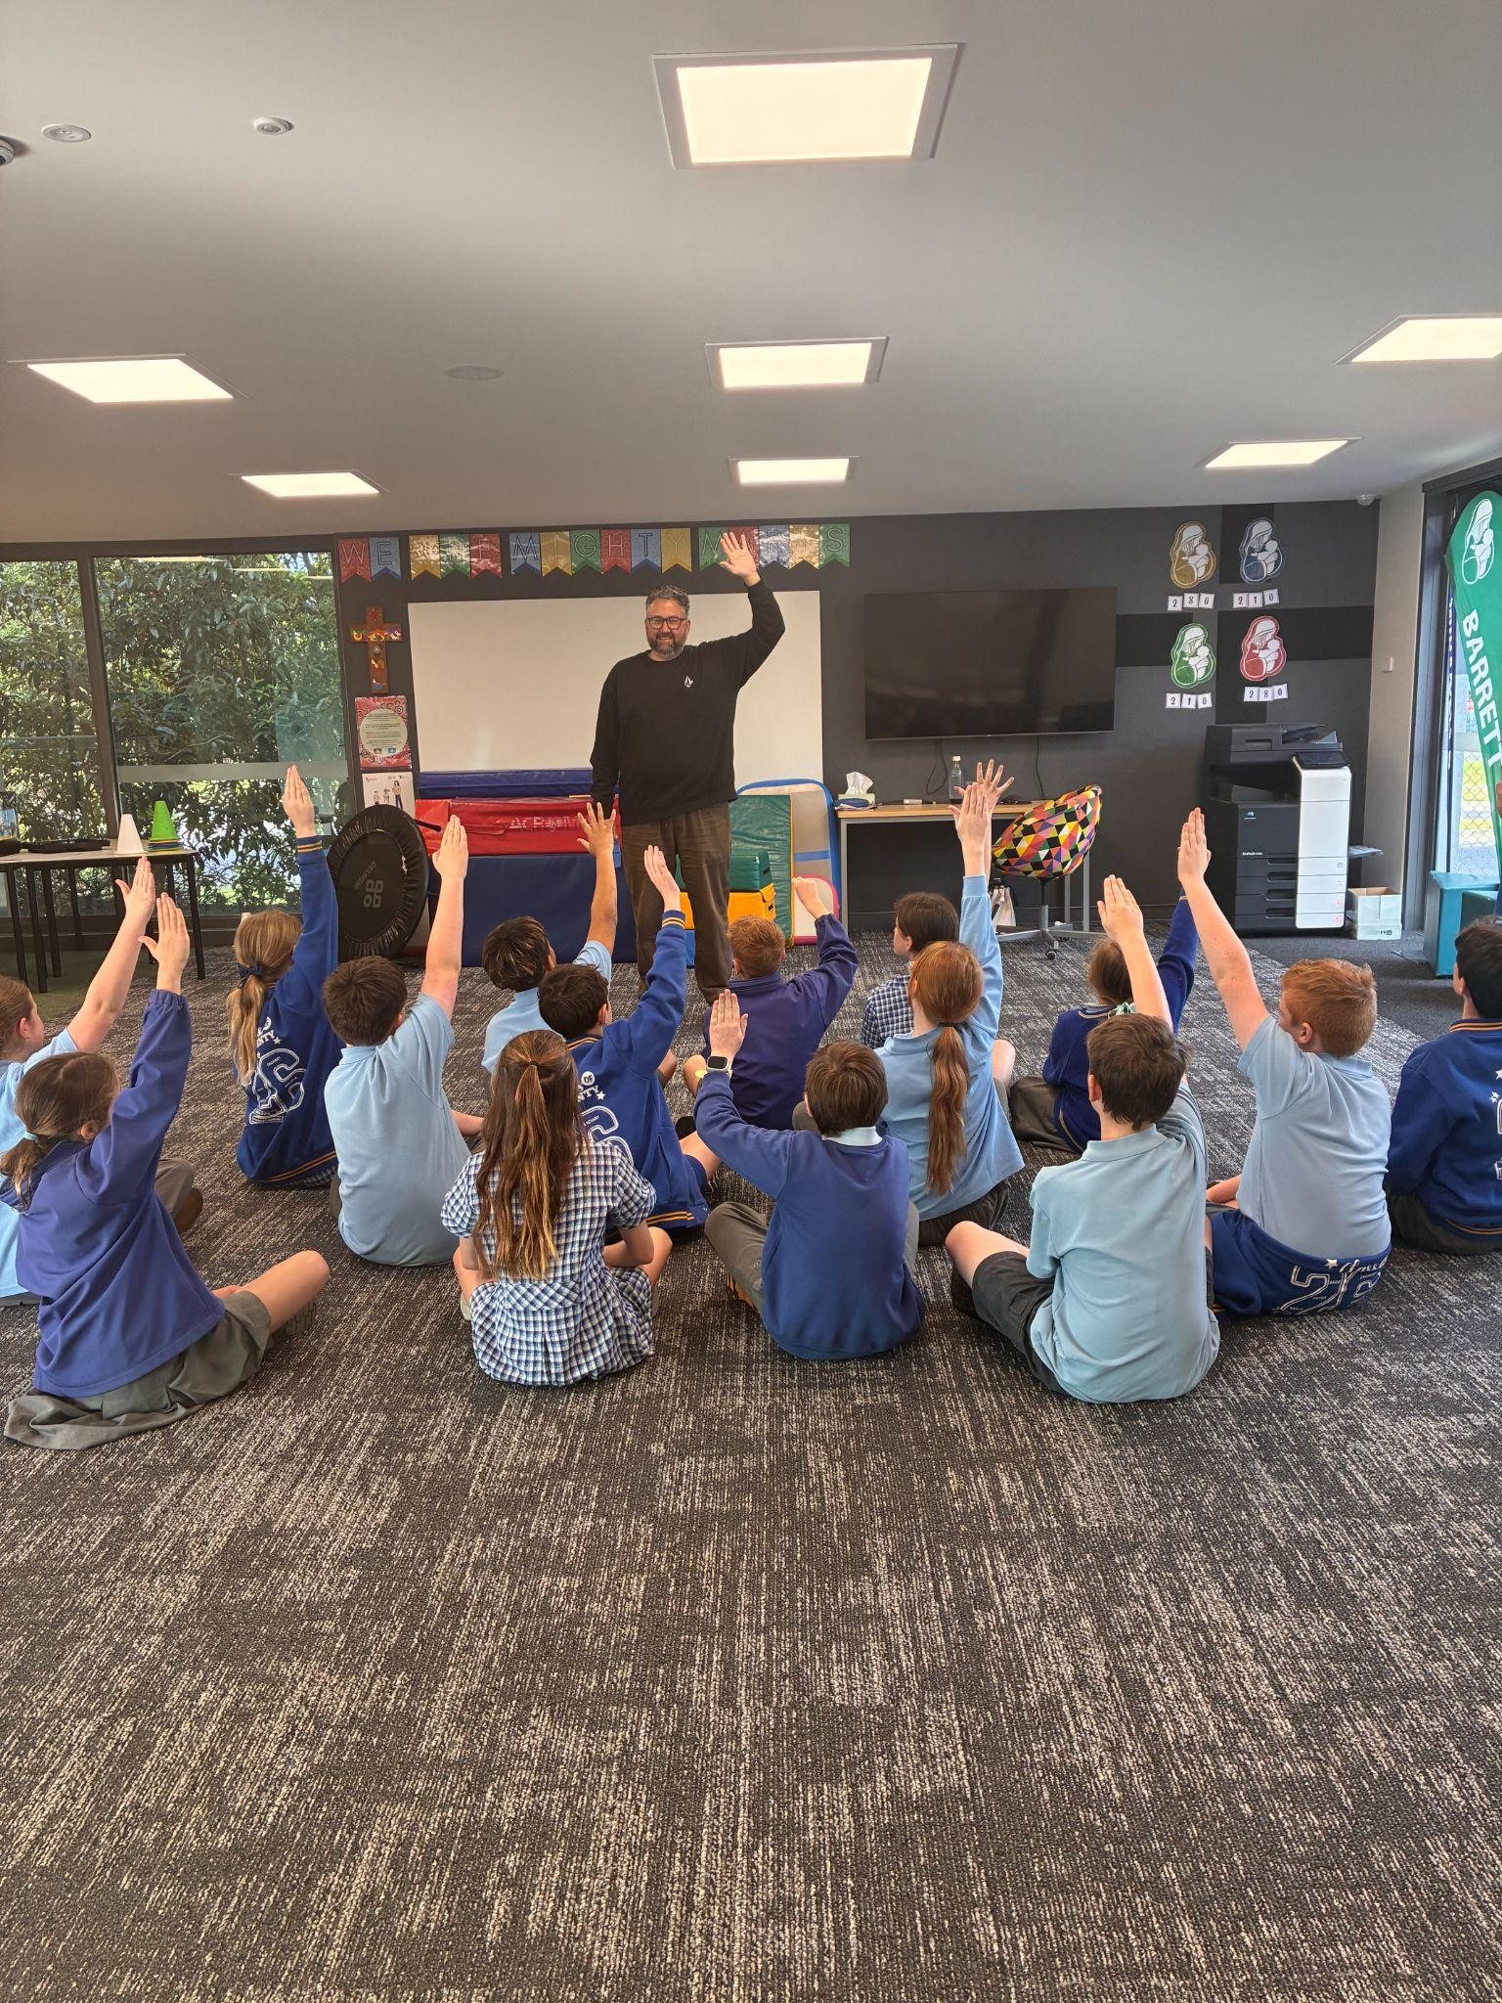
APPROPRIATE OR NOT?

Slide 10
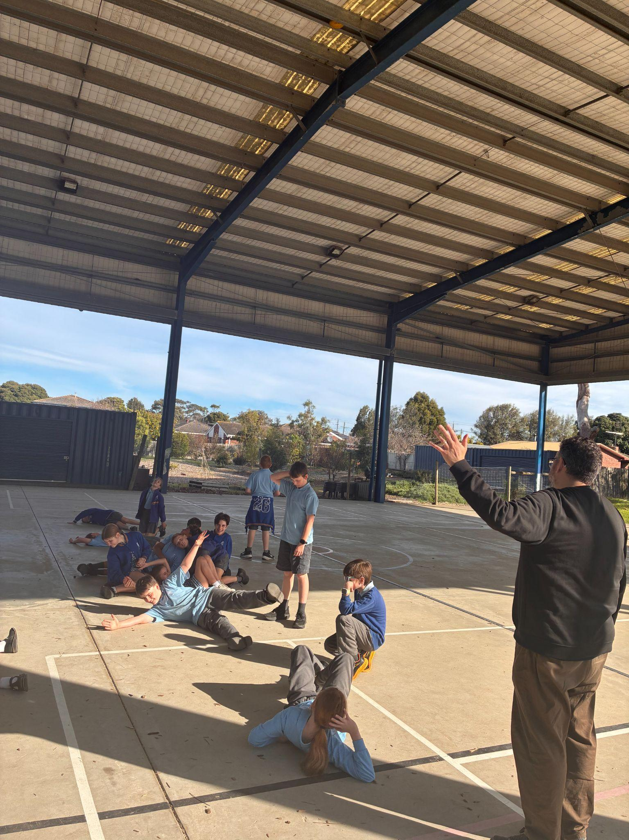
APPROPRIATE OR NOT?

Slide 11
TODAY, WE ARE GOING TO PRACTICE HOW TO FOLLOW THE SIGNAL, PAUSE, INSIST ROUTINE
Over the next two weeks:
We are going to work hard to master this skill
We will do our best to follow the signal at all times
We may be noticed by any teacher for doing a really good job
Remember: Everyone at St Mary’s has the right to feel respected and safe.

