Slide 1
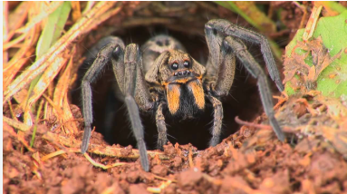
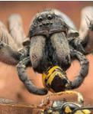
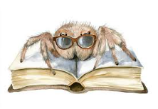
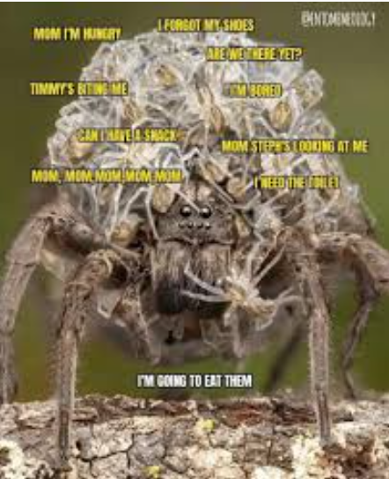
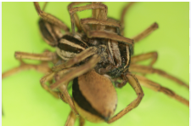
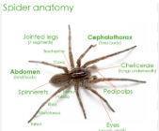

Slide 2
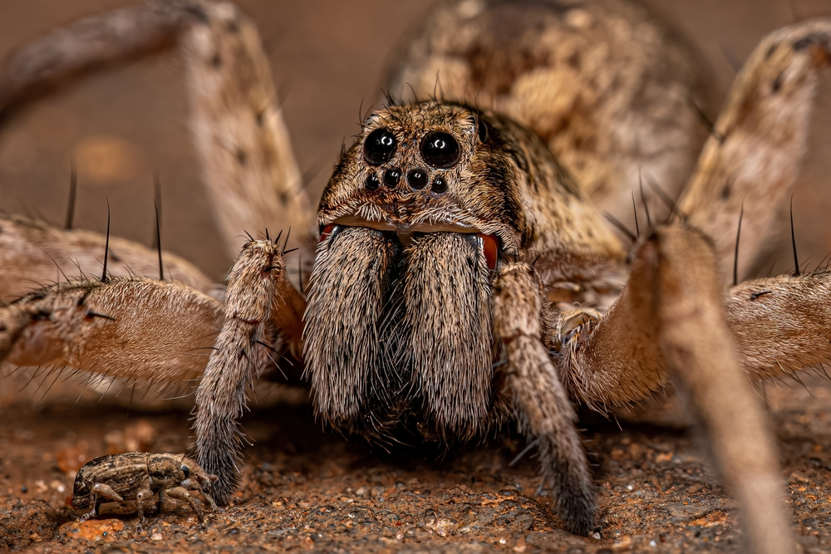
☺ wolf spiders ☺
By Alex hicks

Slide 3
Continents
habitat
Diet
Body
Life cycle
Adaptation
credits
The end

Slide 4
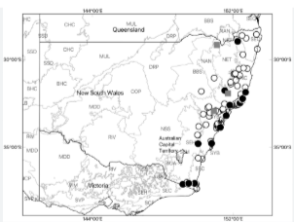

Habitat
They manly live in Australia the Tasmanicosa godeffroyi is the most common back yard wolf spider . They don’t make webs instead they live in Burrous underground .

Slide 5
diet
Mmmmm yummy
they eat crickets ,other spiders, ants and grasshoppers
They actually hunt there prey like wolfs and don’t spin
webs like spiders .

Slide 6
body
The wolf spider has two parts called the cephalothorax and the abdomen

Slide 7
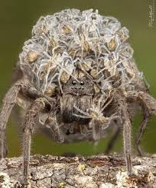
life cycle
Then when there old enough they start to breed
Then it starts again

Slide 8
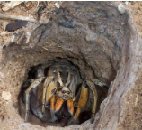

Adaptation
The aired zone build a type of tower so water wont git in

Slide 9

Credits to wolf spiders-Australian museum

Slide 10
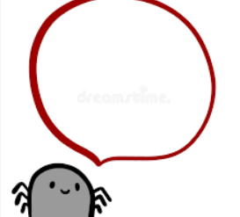

Did you find the hi in all 9 slides?

