Slide 1

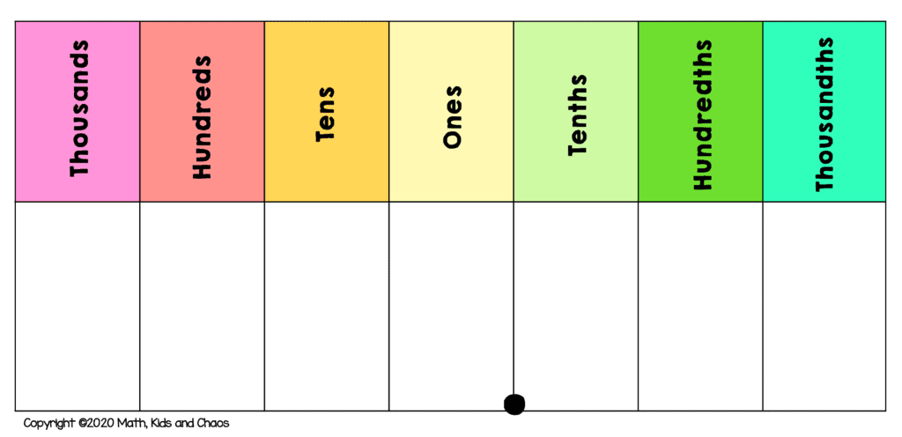
What is the value in the hundredths place of this number:
0. 3 5 8

Slide 2
Which number is divisible by 3?
512
445
366

Slide 3
Calculate 30% of 30
I
30
3
3
3
3
3
3
3
3
3
3
Answer: 9

Slide 4
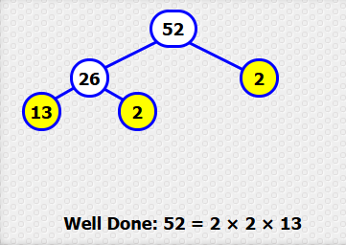
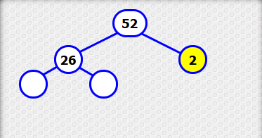
Complete this factor tree:

Slide 5
Which number is divisible by 5?
512
445
366

Slide 6
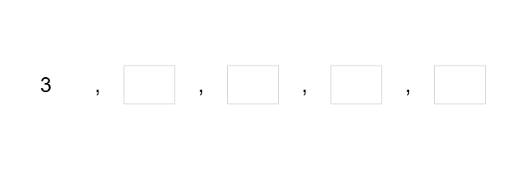
List the next four multiples of 3:

Slide 7

Which lists all factors of 12?
A
B
1, 2, 3, 4, 6, 12
1, 2, 5, 6, 10, 12

Slide 8
What is the answer?
(4 + 6) x (1 + 5 x 2) =

Slide 9
