Slide 1
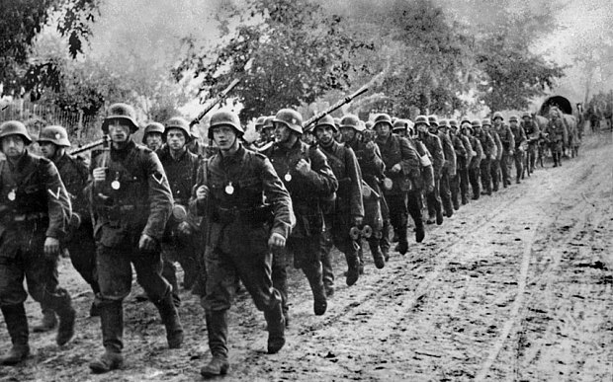
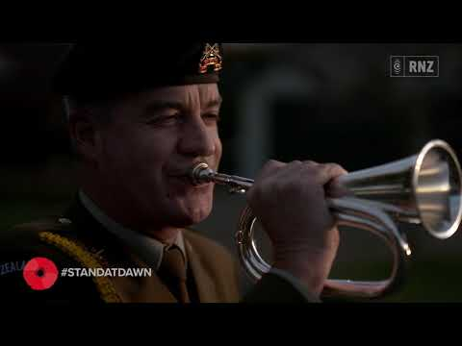
My Great Great Grandfathers Experience and Other Information
By Jahluka Flint,listen to this before watching

Slide 2
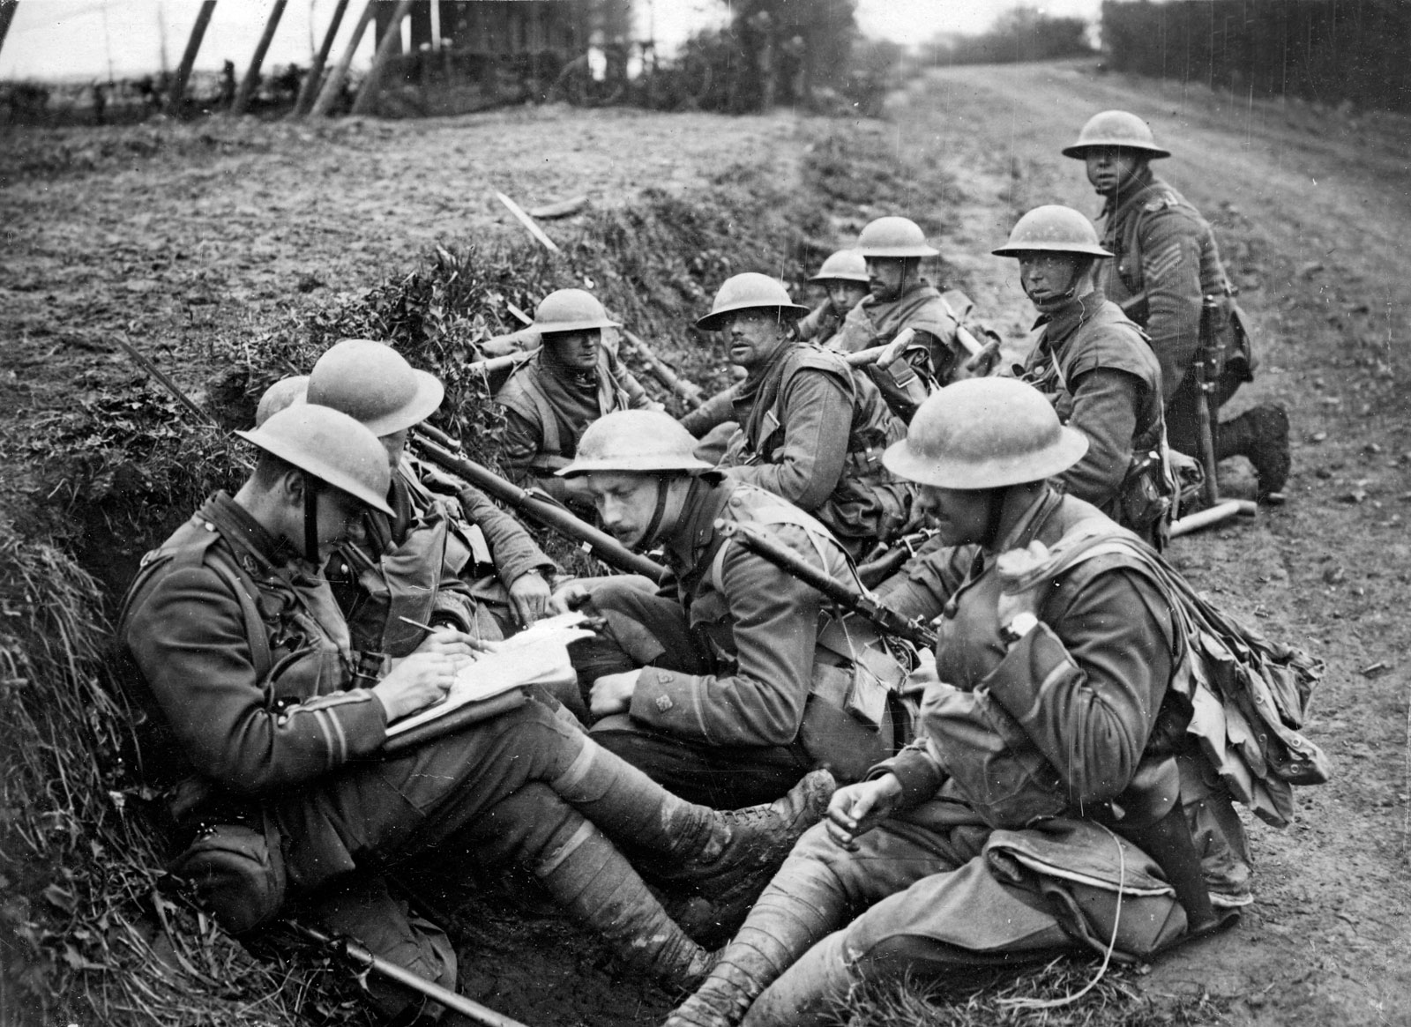
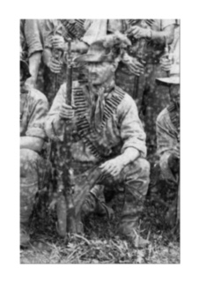
Maurice Mitchell
Maurice Mitchell my great great Grandfather fought in the Boer War this is a picture of him to the right.

Slide 3
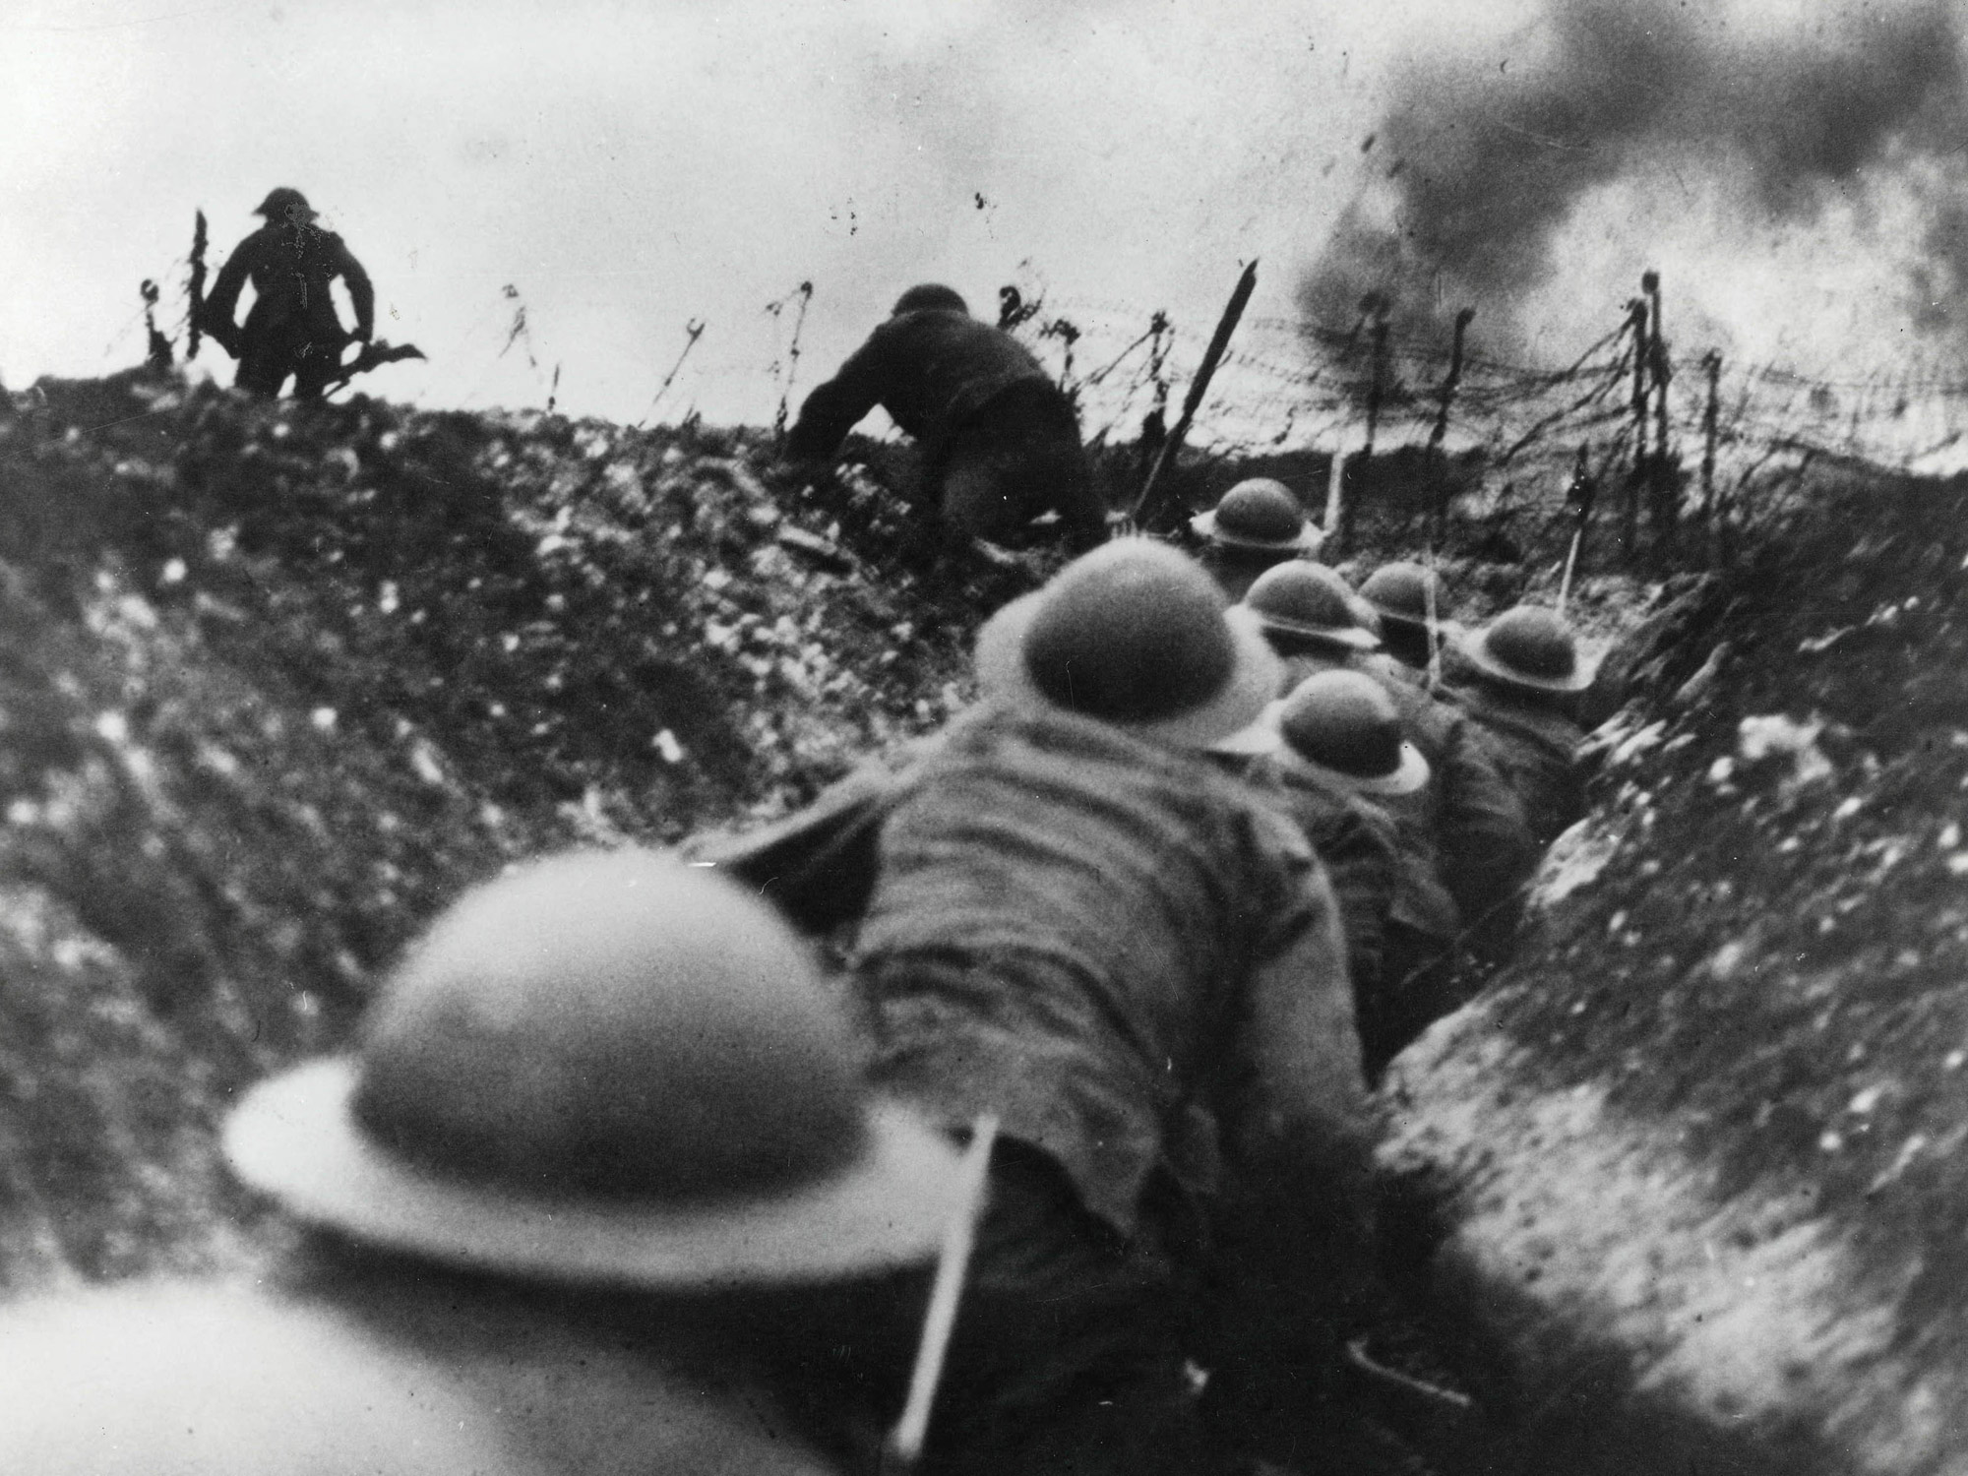
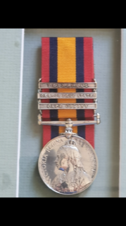
Maurice mitchell
My great great grandfather Maurice Mitchell got awarded a medal of bravery, This is his actual medal.

Slide 4
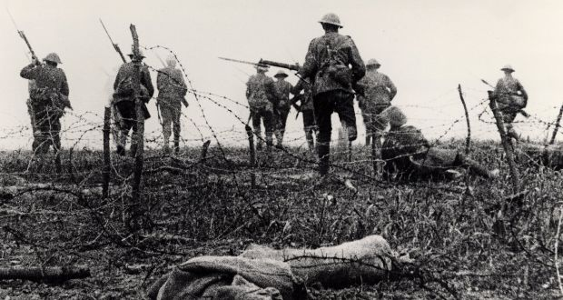
Maurice mitchell
Facts about my great great grandfather
Service number: 297
Rank: Private
Unit: QLD Imperial Bushman
Conflict/Operation: South Africa 1899-1902 (Boer War)

Slide 5
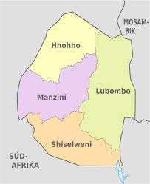
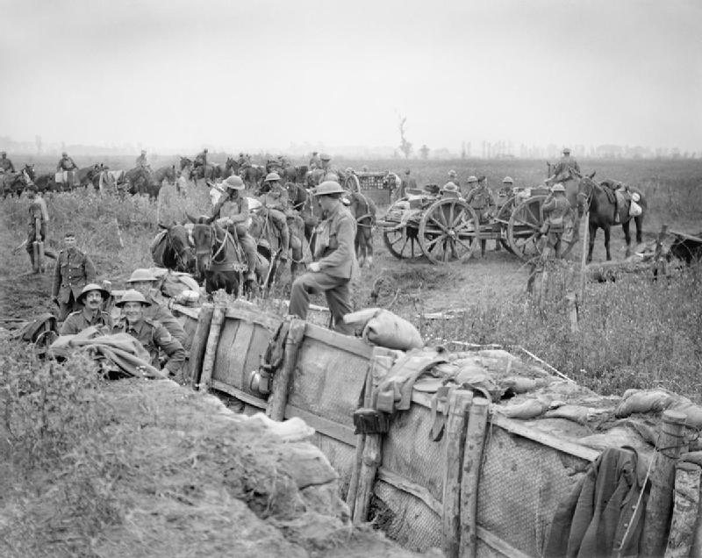
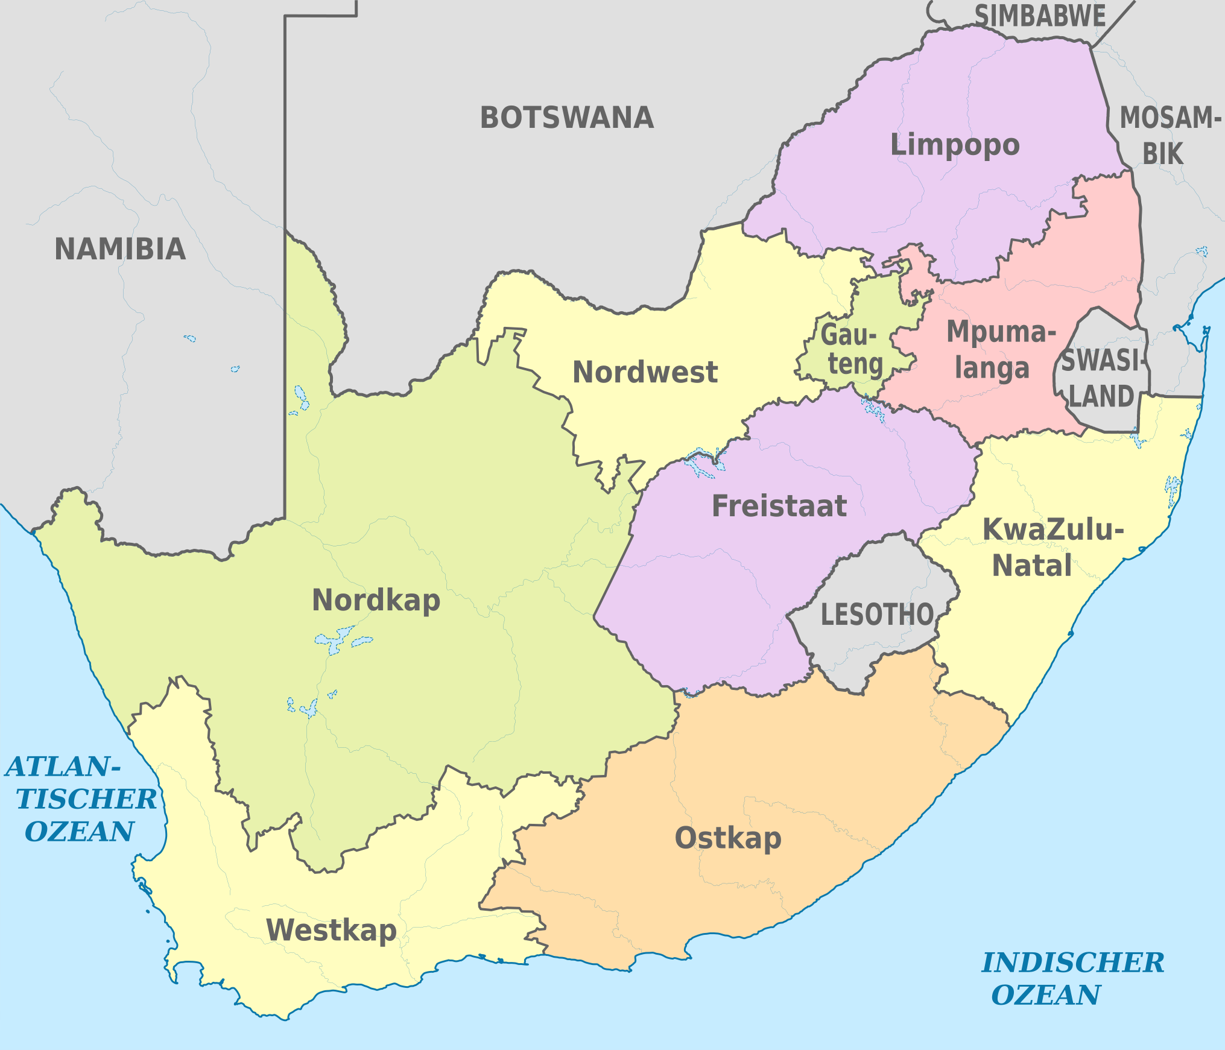
Maurice mitchell
A map Where Maurice Mitchell fought during the Boer War

Slide 6
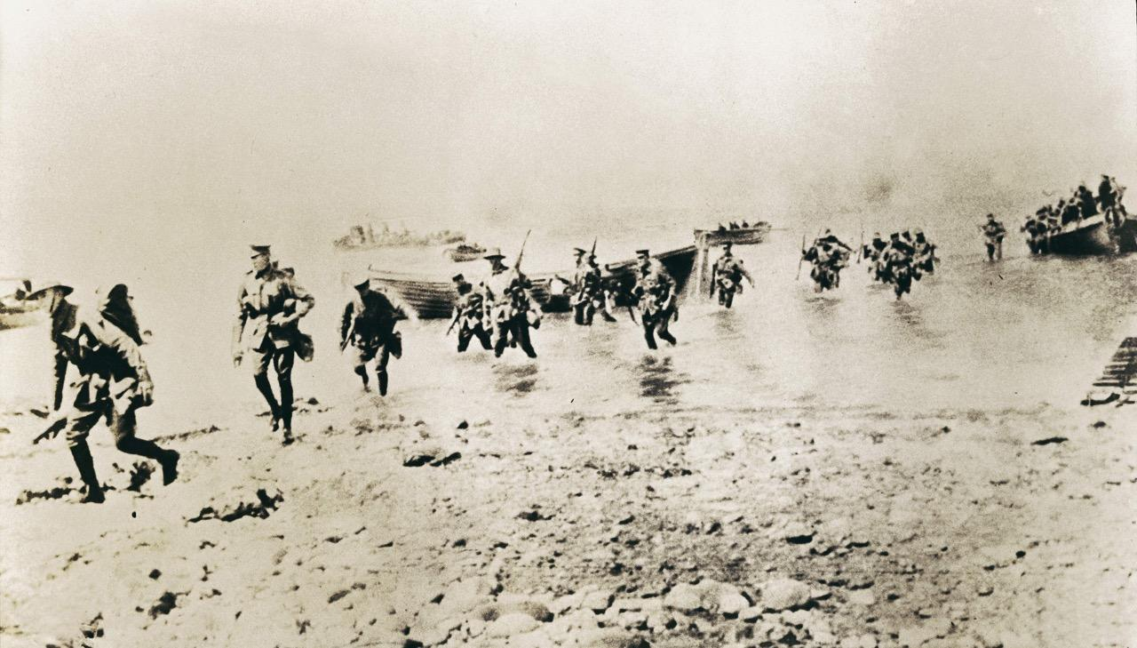
Frederick schofield
Frederick Schofield my great great grandfather fought at Gallipoli.

Slide 7
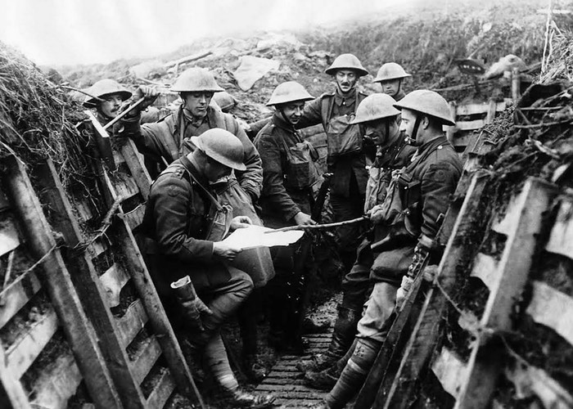
Frederick schofield
Service Number: 461 Age he left: 23 years and 10 months
Birthplace: Northcote VIC Rank: Private
Place of enlistment: Sydney NSW
When was he enlisted: 27th of August 1914
Service: 1914-1918 Gallipoli

Slide 8
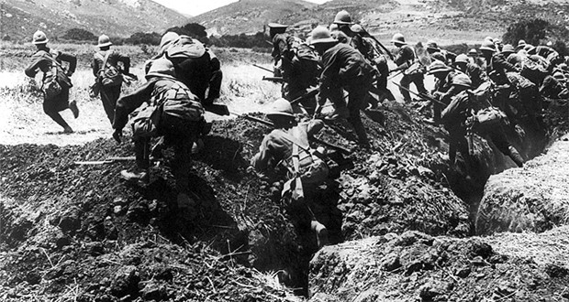
Frederick schofield
My great great grandfather Frederick Schofield was running and a bomb blew up and the inside of the bomb (Shrapnel) flew into his eye causing him to always wear a eye patch

Slide 9
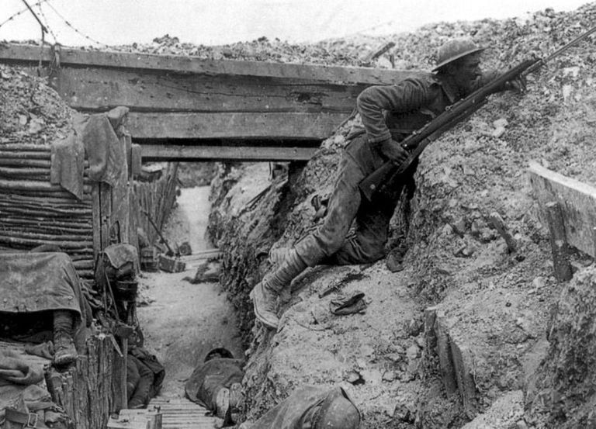
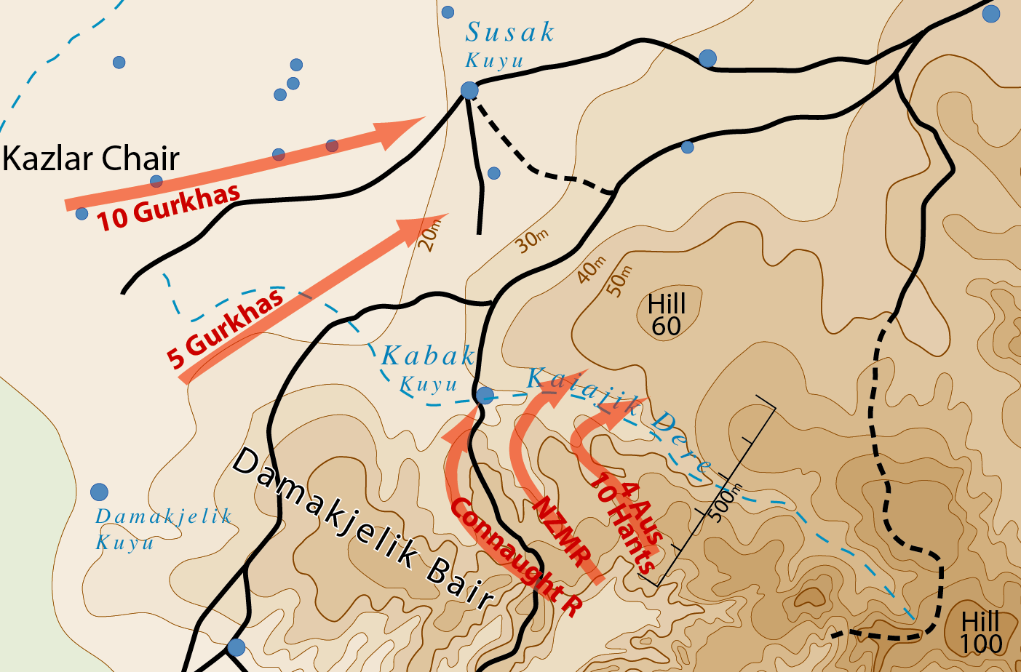
Frederick schofield
This is a map of where my great great grandfather Frederick Schofield fought

Slide 10
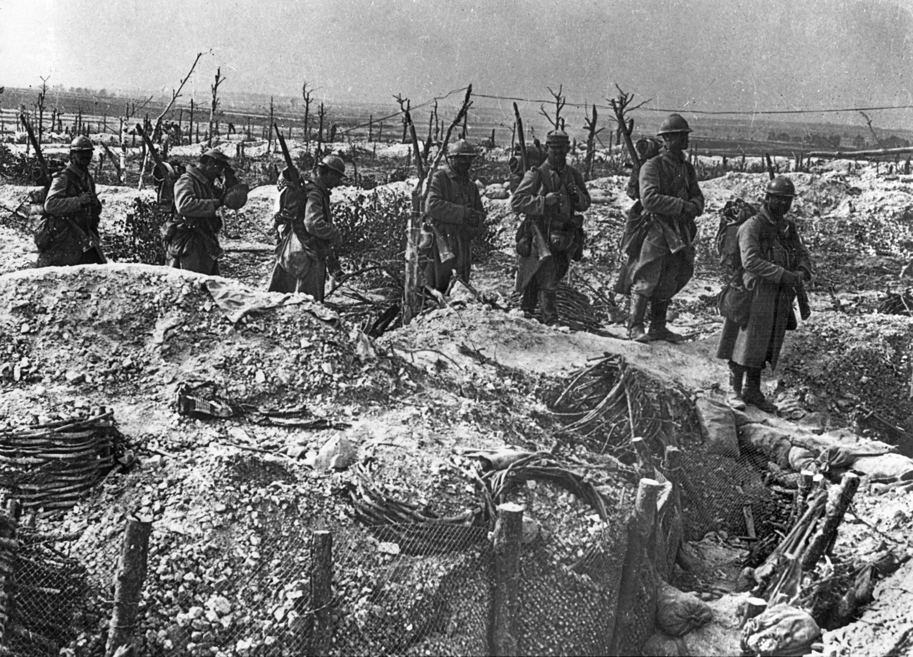
Great great grandfather feelings
These are my feelings about my great great grandfather, click in the bottom left to hear the audio

Slide 11
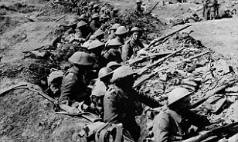
The beach they called gallipoli
A skit from the beach they called Gallipoli

Slide 12
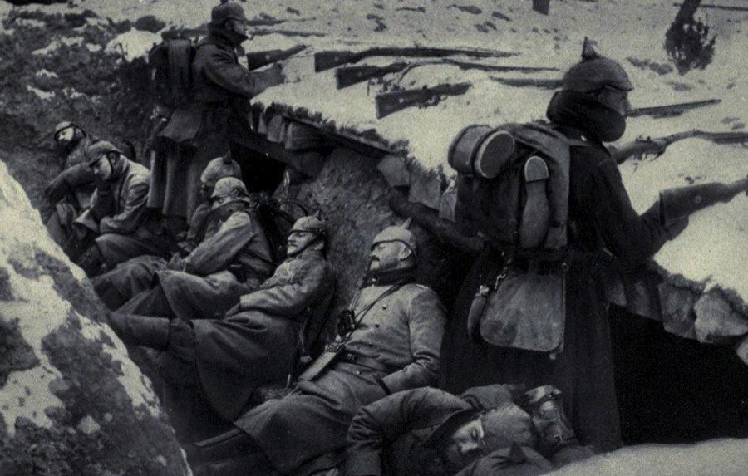
Gallipoli war
The war was horrible more than 8,000 people died and we should always commemorate them

