Slide 1


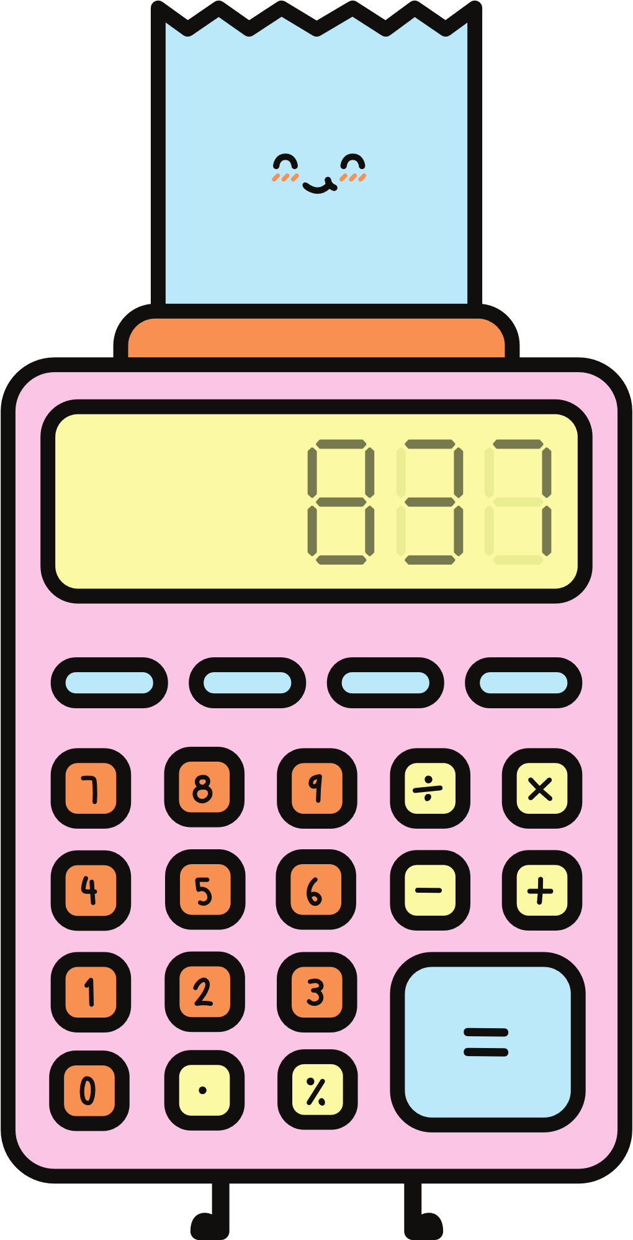
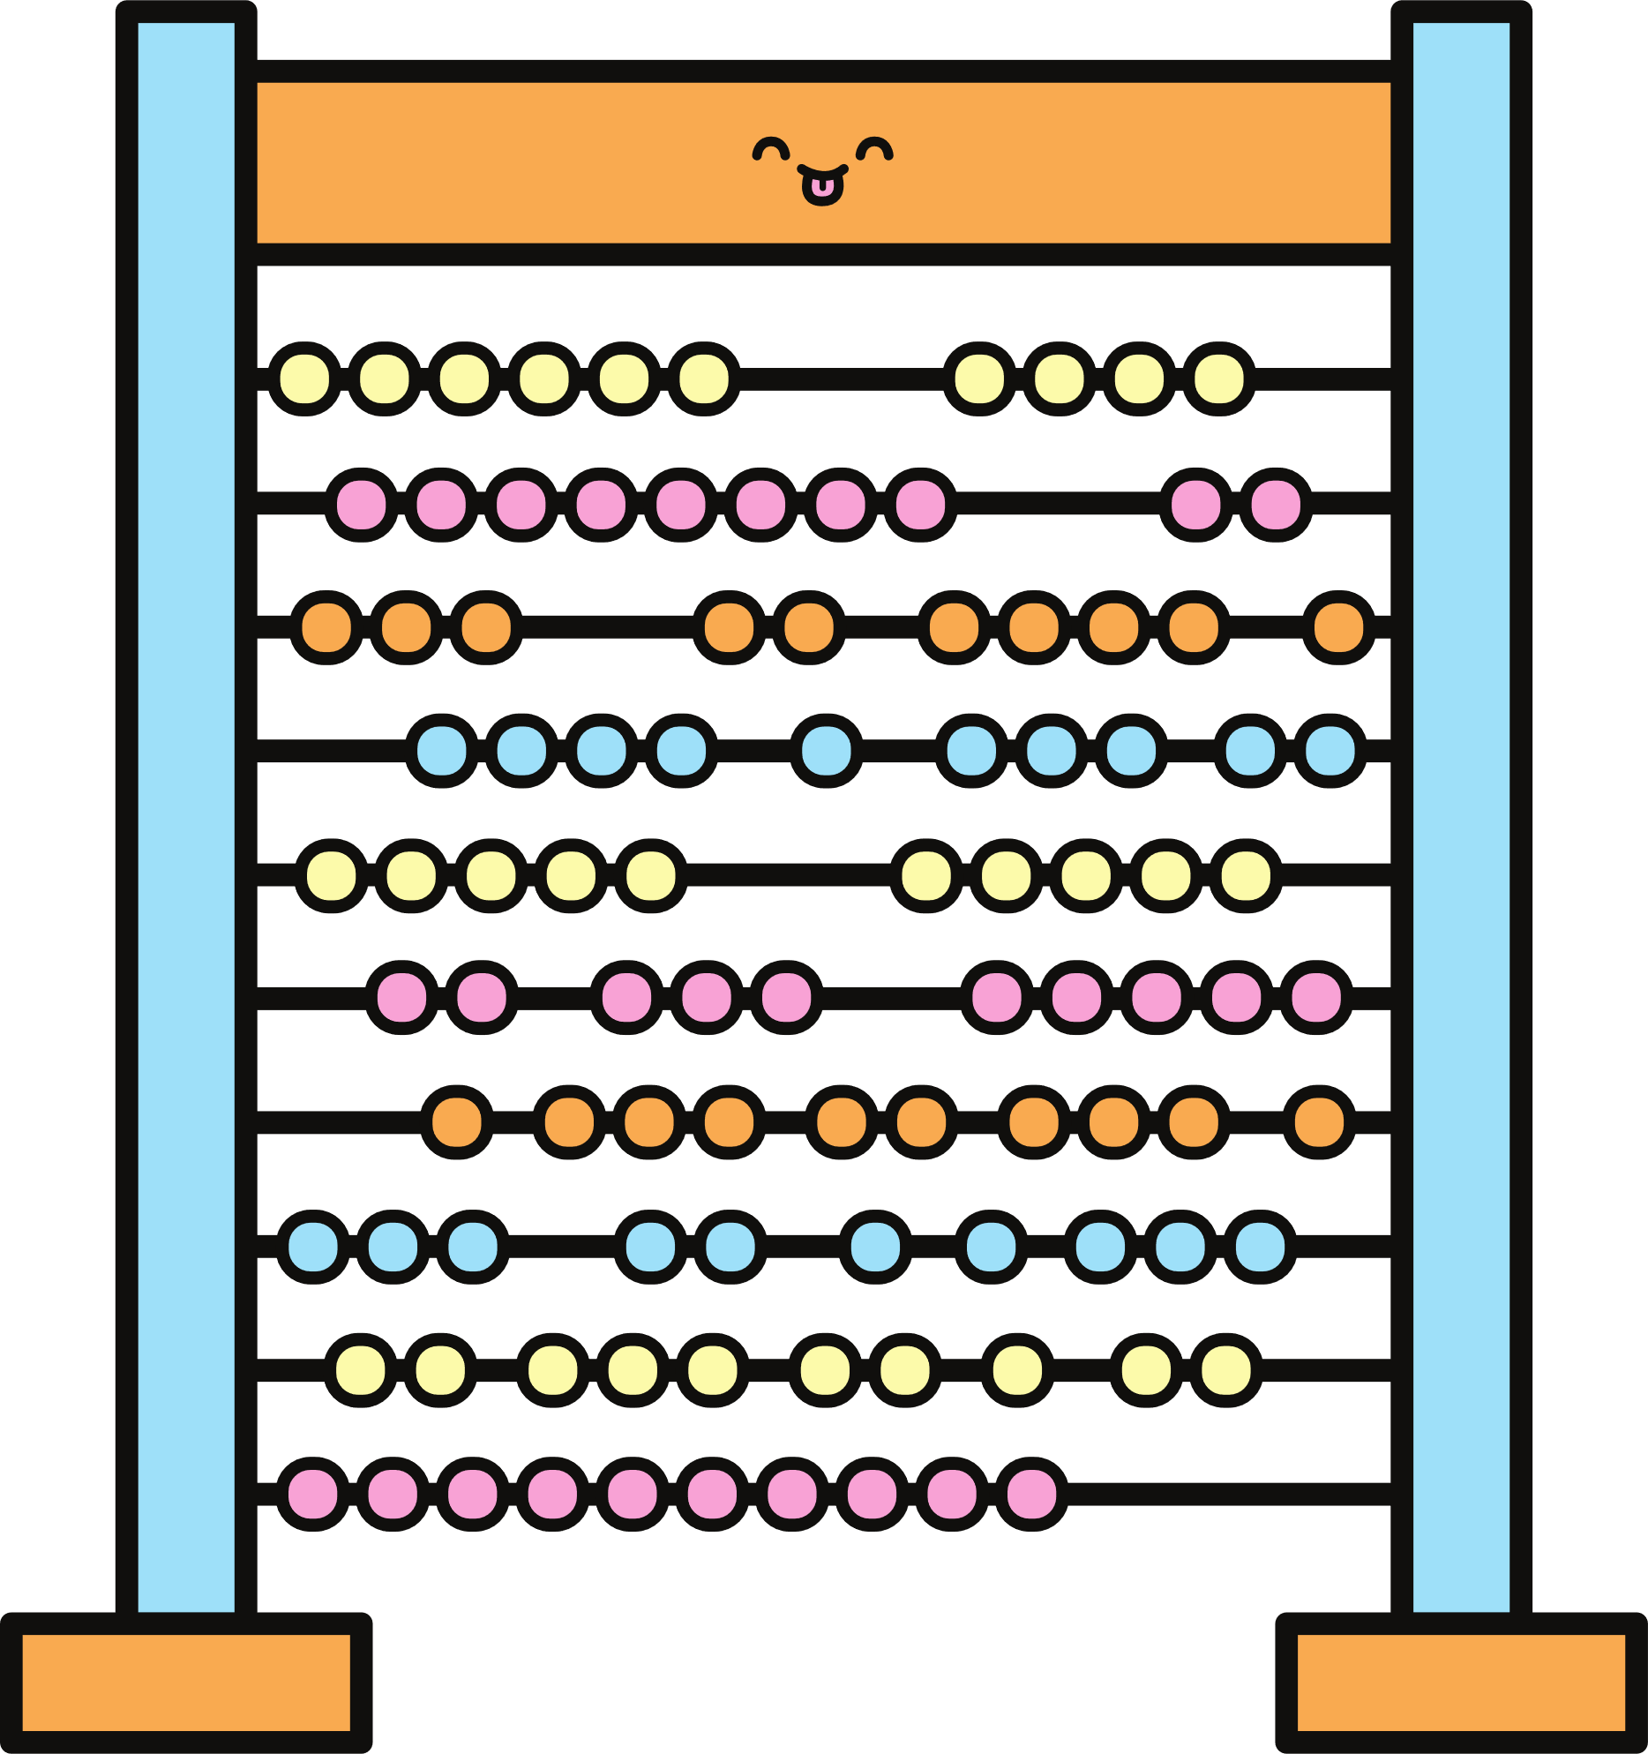
4
6
5
2
0
Maths Parent Information Session
1
3
Tuesday 27th May
2:45 to 3:10pm
8
7
9
Notes:
Things to organise
raffle tickets
maths prize pack (more than one???)
reminder to teams to get activities sorted (perhaps provide instruction template???)

Slide 2
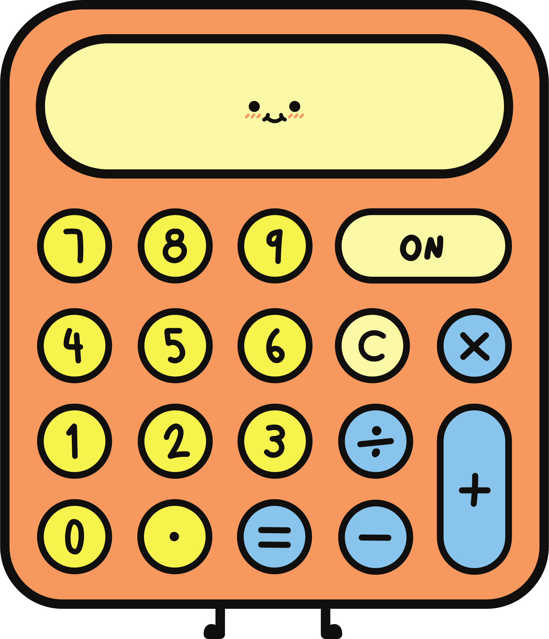
Welcome
  Cognitive Science
  Our Maths Curriculum
  Our Instructional Model
  This afternoon explained

Slide 3
Cognitive Science
Cognitive science is the study of how we think, learn, and remember. One of the most important ideas from this field—especially for helping children learn—is understanding the difference between working memory and long-term memory.

Slide 4
Cognitive Science
What is Working Memory?
Think of working memory like a mental “notepad” your child uses to hold and work with information for a short time. It helps them:
Follow instructions with multiple steps
Solve a maths problem in their head
Remember the start of a sentence while reading to make sense of the end
But this mental notepad is very small. If too much is on it at once, it can easily get overloaded, and your child might forget what they were doing.

Slide 5
Cognitive Science
What is Long-Term Memory?
Long-term memory is more like a giant library. Once something is stored there, your child can access it again and again. It holds knowledge like:
Times tables
Spelling rules
How to ride a bike
The name of their teacher or their home address
When information is stored in long-term memory, it frees up working memory—meaning your child can think more clearly and learn more easily

Slide 6
Cognitive Science
Why It Matters
Children struggle not because they’re not smart, but often because their working memory is overloaded. This happens when they’re trying to hold on to too many new ideas at once.
The goal in teaching is to move important knowledge from working memory into long-term memory, through practice, repetition, and connection to what they already know. Once it’s in long-term memory, it takes the pressure off working memory, allowing children to learn more complex things with greater ease.

Slide 7
Game Time

Slide 8
Cognitive Science - Game
NYUKOJA
USAF
LNRLGP
TBWS

Slide 9
Cognitive Science - Game

Slide 10
Cognitive Science - Game
NY UK OJ
AUS AFL
NRL GPT
BWS

Slide 11
Cognitive Science - Game

Slide 12
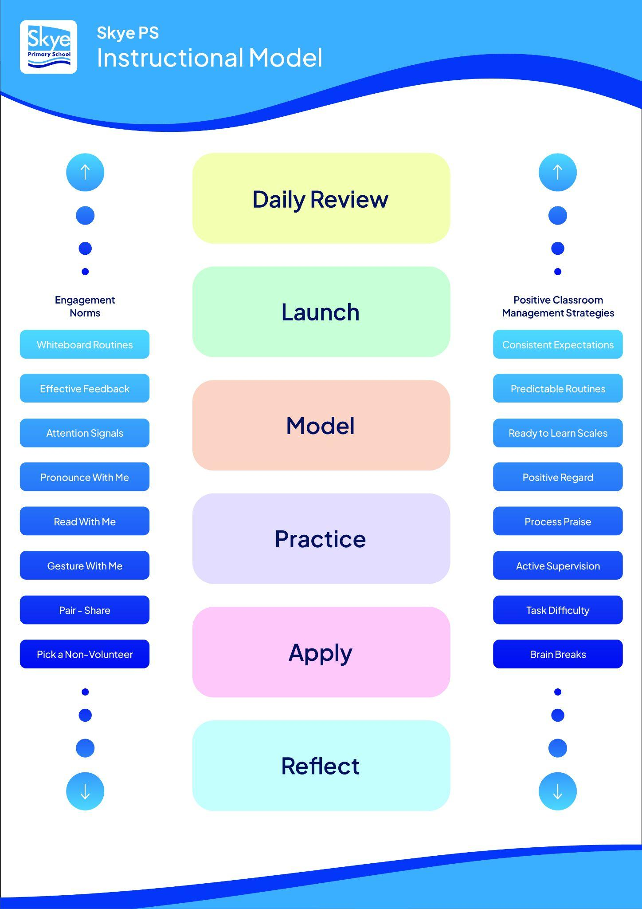
Our Instructional Model
Research: AERO - Australian Education Research Organisation
VTLM 2.0
‘How students learn best’.

Slide 13
Understanding our Maths Curriculum
With the updated Victorian Curriculum, assessment and reporting will now reflect a single progression point per learning area, rather than multiple points. This change simplifies reporting, providing a clearer and more consistent picture of student achievement and growth. It supports teachers to focus on where each student is at in their learning journey, and enables more targeted planning and communication with families.
NUMBER
MEASUREMENT
NUMERACY PROGRESSION POINT
STATISTICS
PROBABILITY
ALGEBRA
SPACE

Slide 14
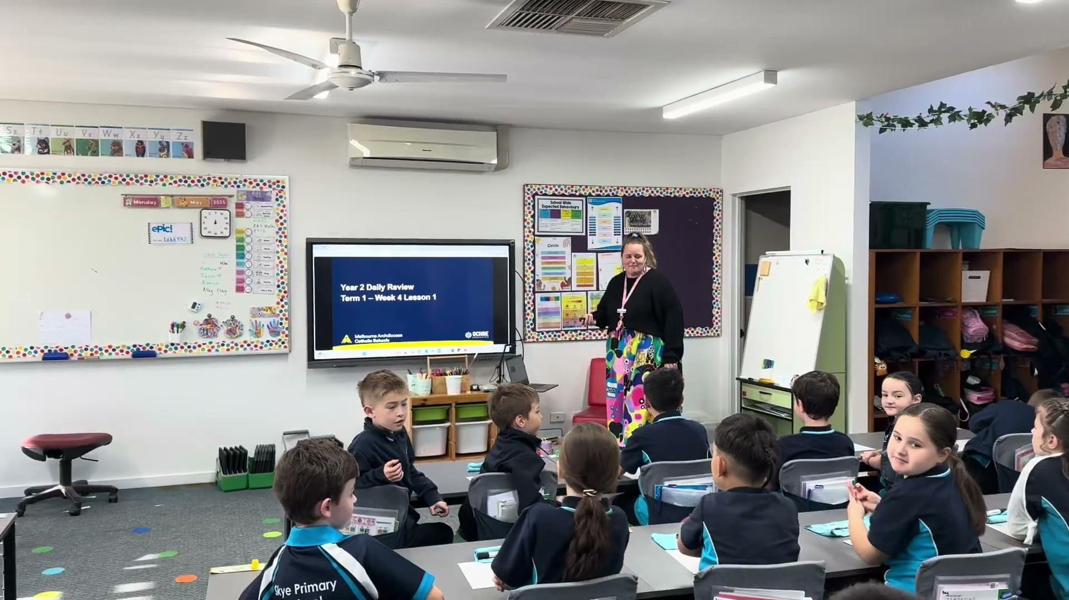
Daily Review
A short, fast paced session (10 minutes) recalling previously taught content.
This allows for regular practise and rehearsal of taught concepts.

Slide 15
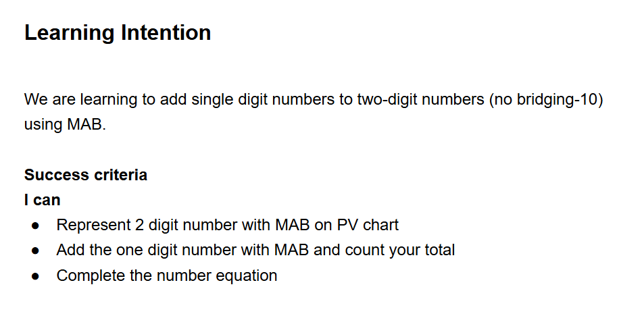
Launch
Learning Intention & Success Criteria

Slide 16
Launch
Activate Prior Knowledge
Specific knowledge linked to lesson

Slide 17



Representing numbers using base ten blocks
What number is being shown?
8
2
3
5

Slide 18
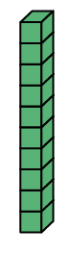

Representing numbers using base ten blocks
10 ones
1 ten
Let’s stack them
Notes:
Refer to the ‘reteach-retrieve-apply’ cycle slides, if relevant.

Slide 19
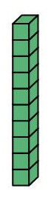
Representing numbers using base ten blocks
100
10
20
30
40
50
60
70
80
90

Slide 20
What number is shown?
30
60
20

Slide 21

Representing numbers using base ten blocks and place value chart
Tens
Ones
Tens 10s | Ones 1s
5
7

Slide 22
Representing numbers using base ten blocks
3 tens
2 ones
32
Notes:
Refer to the ‘reteach-retrieve-apply’ cycle slides, if relevant.

Slide 23

Representing numbers using base ten blocks and place value chart
Tens 10s | Ones 1s
23
2
3
Notes:
Refer to the ‘reteach-retrieve-apply’ cycle slides, if relevant.

Slide 24
Representing numbers using base ten blocks and place value chart
Tens 10s | Ones 1s
72
Notes:
Students may use concrete materials or might draw on a mini whiteboard

Slide 25
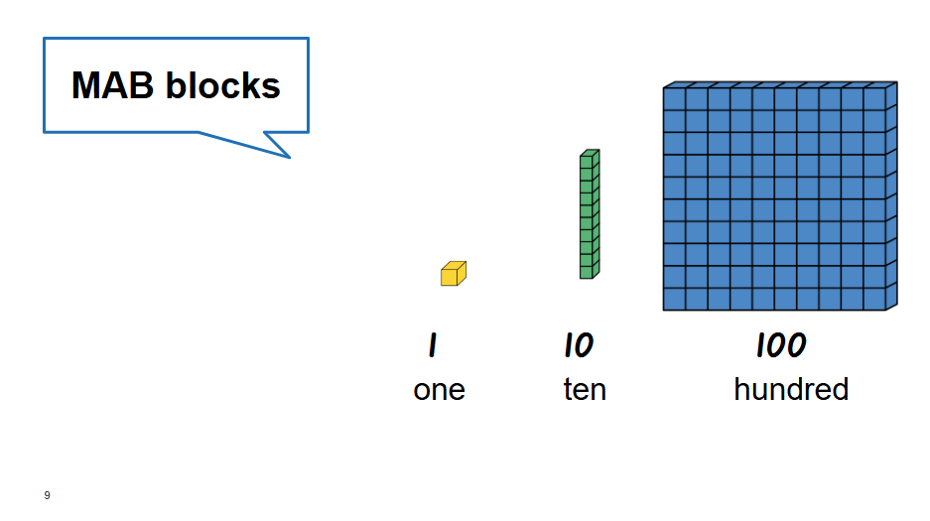
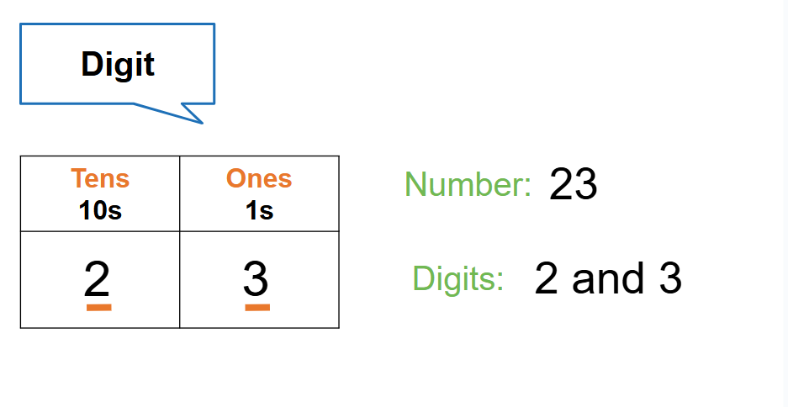
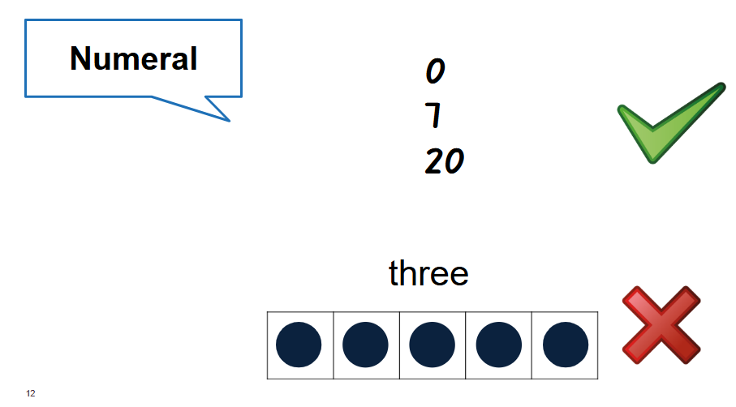
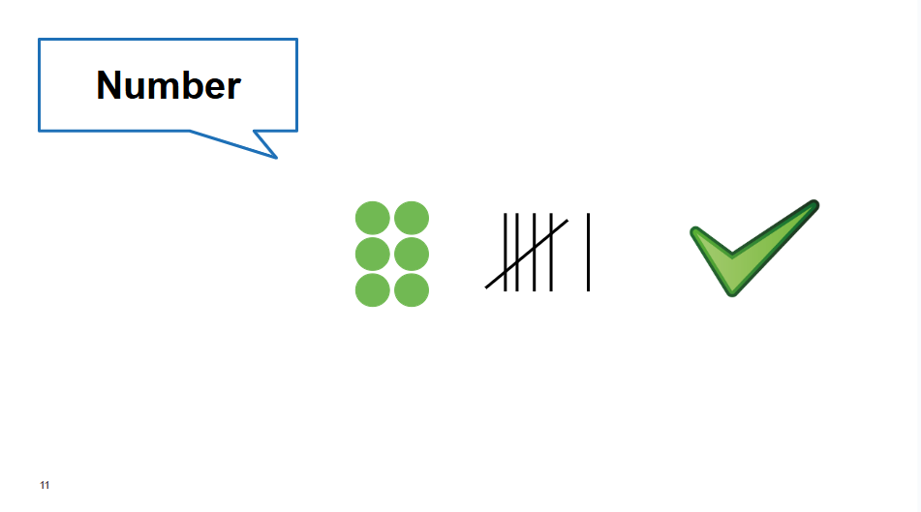
Launch
Activate Vocabulary

Slide 26
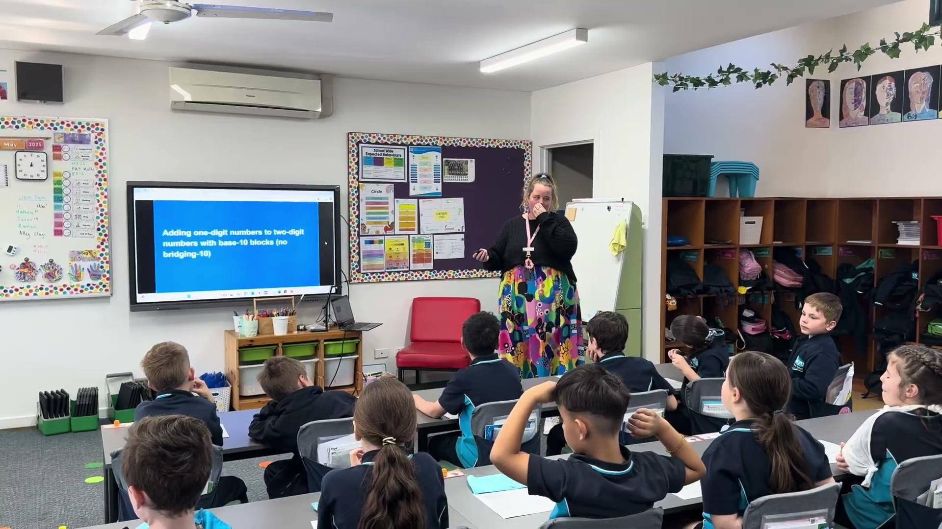
Model
Teacher models explicitly (typically three times)
Worked examples to remain available to students throughout lesson

Slide 27
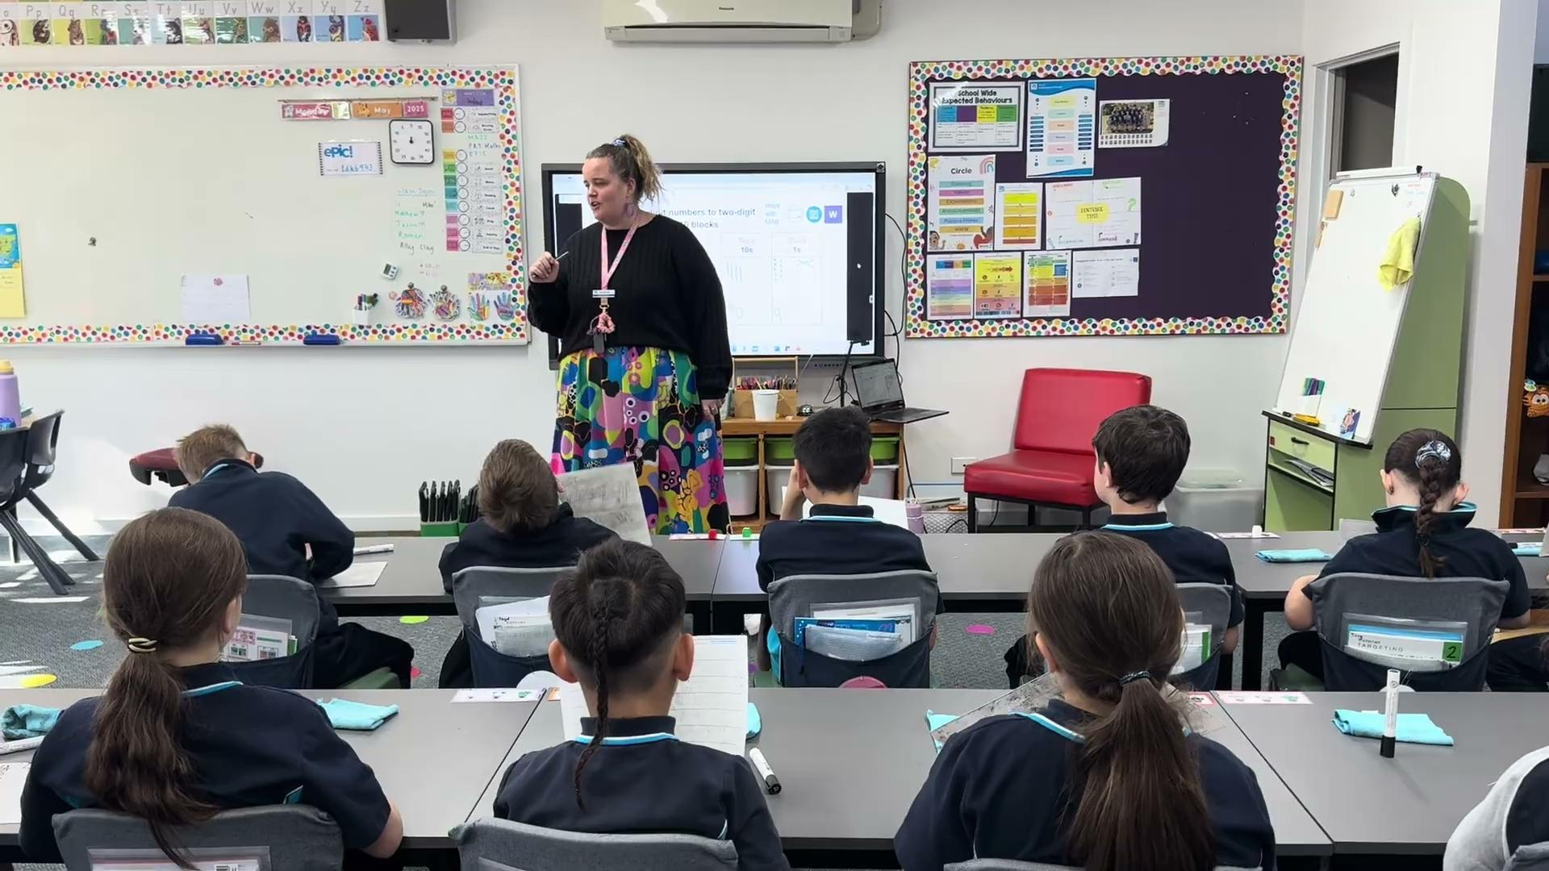
Practice
Teacher leads opportunities for students to practise the new learning (scaffolds still in place)
Students demonstrating what they have understood
Teacher checking for understanding, provisioning feedback, determining if reteach is necessary

Slide 28
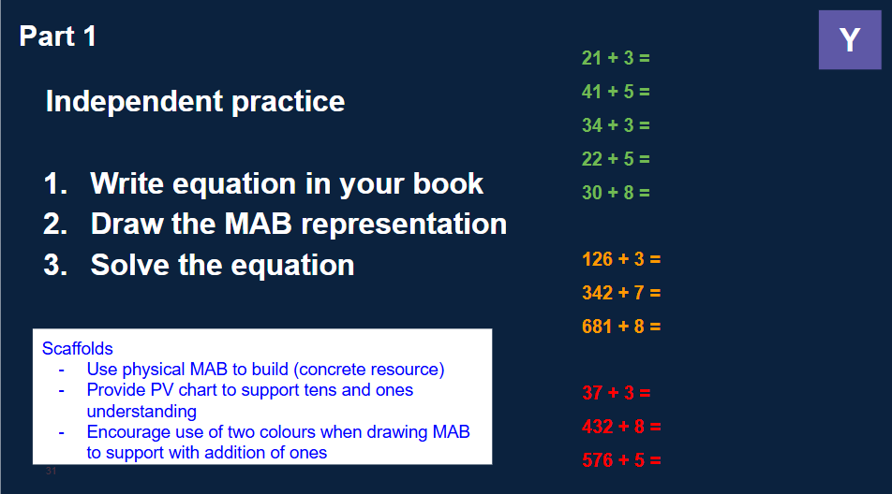
Apply
Independent opportunity to apply new learning
Teacher to check for understanding, give corrective feedback, support/extend students

Slide 29
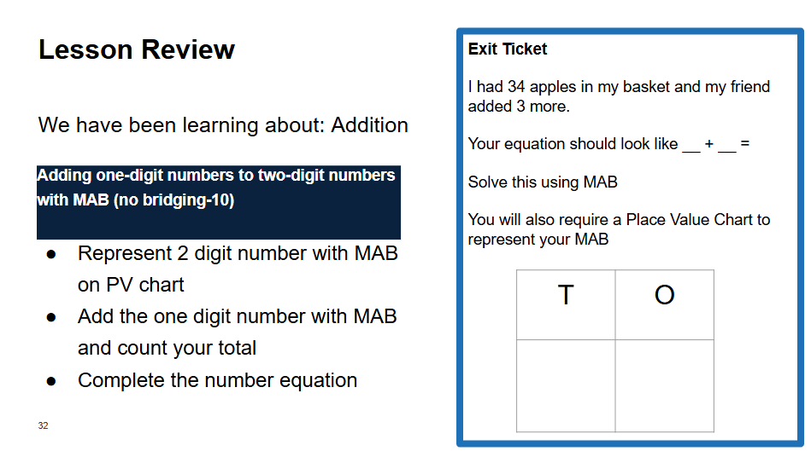
Reflect
Teacher encourages and facilitates the review of learning
Students engage in peer feedback at times
Might use an ‘exit ticket’ here

Slide 30
This afternoon explained…
🎯 3:30 – 4:30pm
Explore different "Maths Lands" around the school
🔹 Fun, hands-on activities for students from Prep–Year 6
🔹 Complete a 10-minute activity at each land
🔹 Every completed activity = a raffle entry per family
🎁 Win a Maths Prize Pack!
👨‍🏫 Activities led by teachers across all year levels
👣 Come and discover how we make maths meaningful and engaging every day!

Slide 31
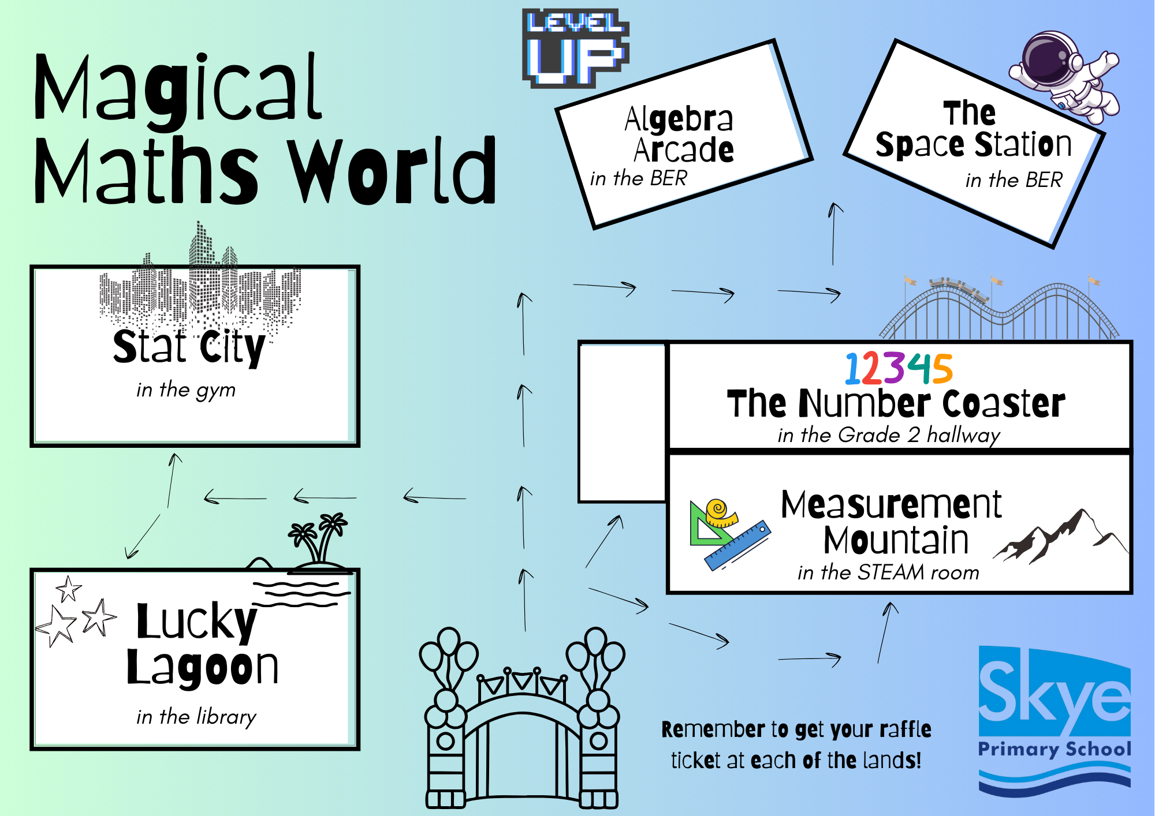
This afternoon explained…
Your child will have a map with them when they leave the classroom
Make sure you get your family raffle entry at each land you visit (there are 3 Maths prize packs up for grabs)

