Slide 1
Curriculum Day 4
2022

Slide 2


Acknowledgement of Country
Jackson School is a child safe community.
We acknowledge the traditional owners of the land on which our school is situated, the Wurundjeri (Woi Wurrung) peoples of the Kulin Nation, and pay our respects to Elders past, present and emerging.
Wominjeka!
Notes:
Before we begin can I acknowledge the transitional owners on the land we meet today, the Wathaurong peoples of the Kulin nation, and pay my respect to any indigenous peoples past, present and emerging.

Slide 3
School Staff Survey
SSS factors:
Academic emphasis - 71% positive compared to 59% for similar schools, a drop from 79% last year due to neutral (neither agree/nor disagree) responses for mainstream factors e.g. homework.
Collective efficacy - 74% positive compared to 63% for similar schools, a drop from 80% last year due to neutral (neither agree/nor disagree) responses for mainstream factors e.g. ready to learn.
Understanding curriculum - 93% positive compared to 79% for similar schools, an improvement from 86% from last year.
In modules of the School Staff Survey, many factors were 100% with the vast majority of measures being in the fourth quartile.
Teaching & Learning Modules 94% (evaluation), 93% (implementation), 95% (planning), 93% (practice)
School Leadership 87% compared to 76% at similar special schools
Professional Learning 86% compared to 75% at similar special schools
Staff Safety and Wellbeing 80% compared to 72% at similar special schools
School Climate 79% compared to 69% at similar special schools

Slide 4
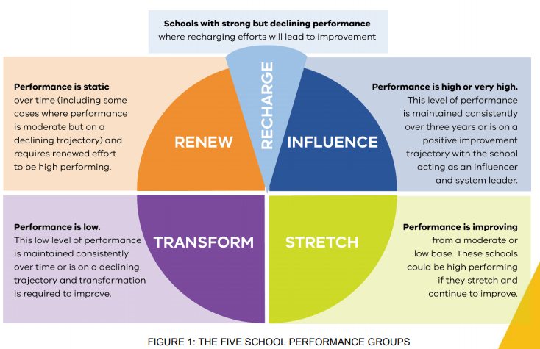

Slide 5
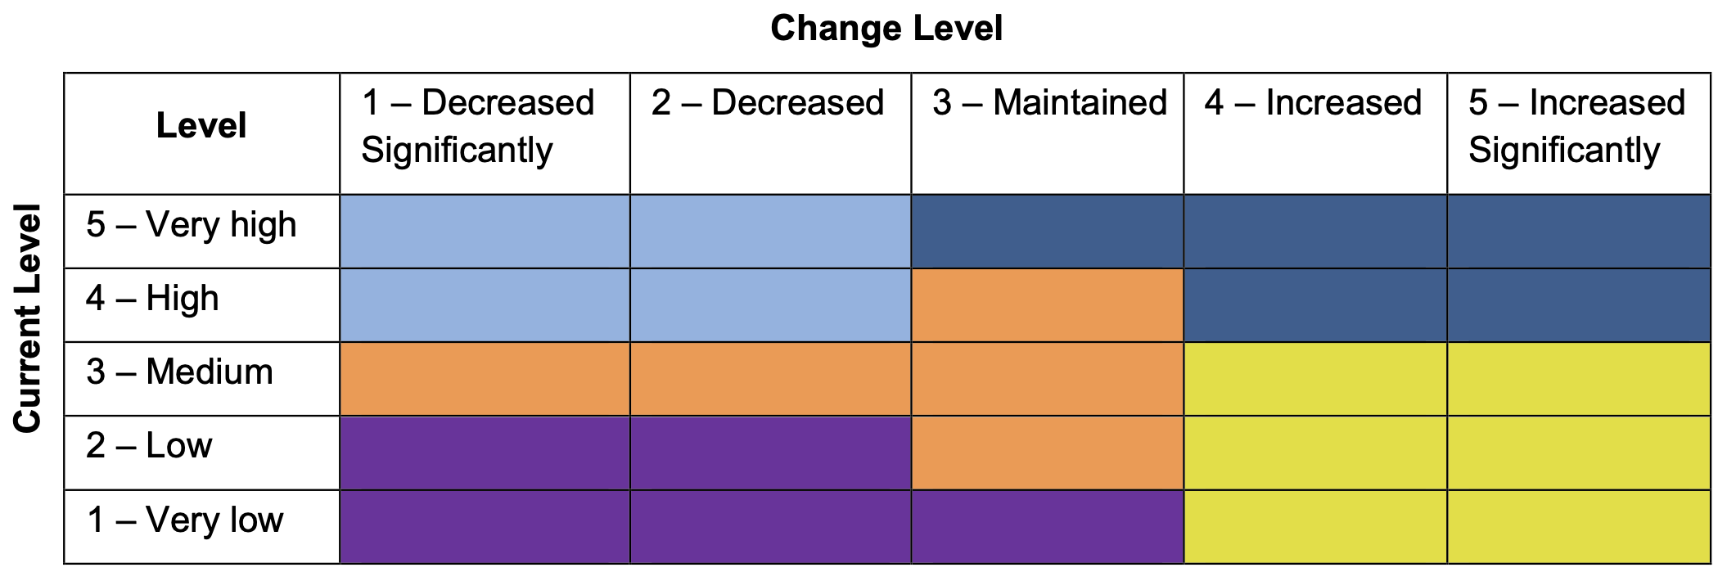
5x5 Matrix
2019
2021
2022
2018
2017

Slide 6
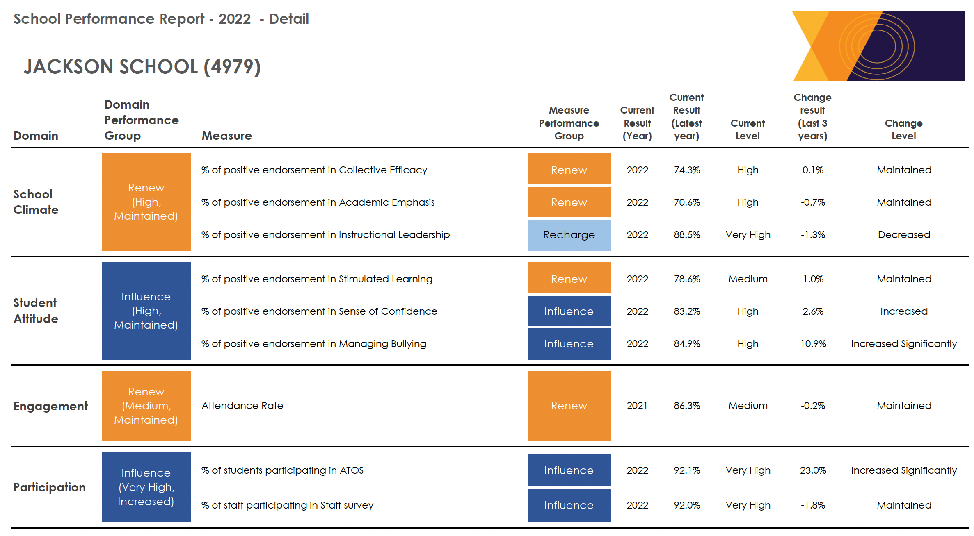
School Performance Report 2022

Slide 7
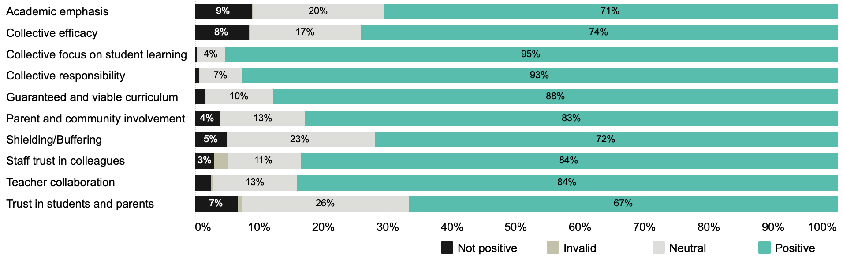
School Staff Survey 2022
SOMEWHAT AGREE/DISAGREE

Slide 8
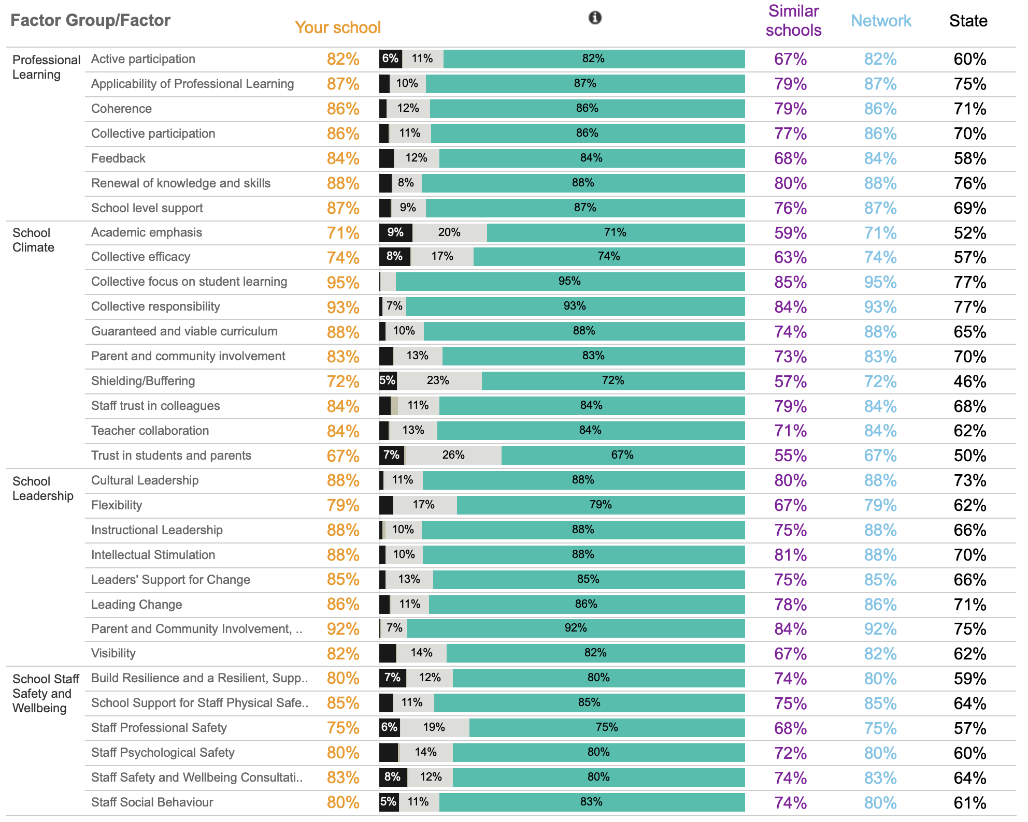
School Staff Survey

Slide 9
School Staff Survey
SSS factors:
Academic emphasis - 71% positive compared to 59% for similar schools, a drop from 79% last year due to neutral (neither agree/nor disagree) responses for mainstream factors e.g. homework.
Collective efficacy - 74% positive compared to 63% for similar schools, a drop from 80% last year due to neutral (neither agree/nor disagree) responses for mainstream factors e.g. ready to learn.
Understanding curriculum - 93% positive compared to 79% for similar schools, an improvement from 86% from last year.
In modules of the School Staff Survey, many factors were 100% with the vast majority of measures being in the fourth quartile.
Teaching & Learning Modules 94% (evaluation), 93% (implementation), 95% (planning), 93% (practice)
School Leadership 87% compared to 76% at similar special schools
Professional Learning 86% compared to 75% at similar special schools
Staff Safety and Wellbeing 80% compared to 72% at similar special schools
School Climate 79% compared to 69% at similar special schools

Slide 10
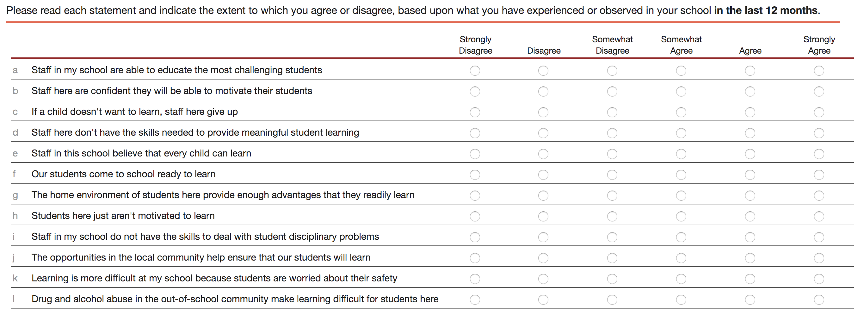
Collective Efficacy (in the last 12 months)
76%
84%
92%
88%
88%
53%
29%
76%
84%
75%
75%
65%
ALL STAFF TO COMPLETE

Slide 11
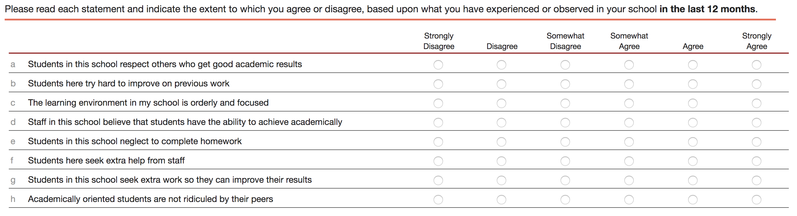
Academic Emphasis (in the last 12 months)
66%
77%
81%
86%
70%
82%
30%
72%
ONLY STAFF WHO SPEND THE MAJORITY OF THEIR TIME IN A CLASSROOM

Slide 12
