Slide 1


VCE PSYCHOLOGY
2025
Miss Mandarino, Mr Shepherd, Mrs Simpson

Slide 2
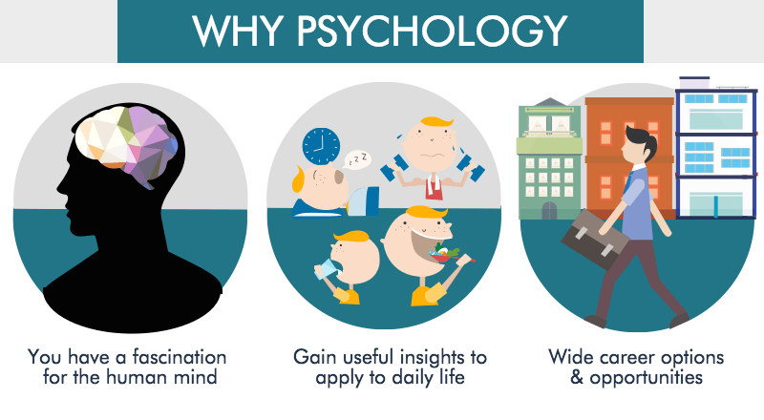
What is Psychology?
Psychology is the scientific study of mind and behaviour.

Slide 3
Focus of VCE Psychology
To explore and seek to better understand how individuals, groups, communities and societies think, feel and act.
Students study contemporary research, models and theories to understand how knowledge in psychology has developed and how this knowledge continues to change in response to new evidence and discoveries in an effort to solve day-to-day problems and improve psychological wellbeing.

Slide 4

Unit 1: Psychology
Unit 1: How are behaviour and mental processes shaped?
AOS 1: What influences psychological development?
AOS 2: How are mental processes and behaviour influenced by the brain?

Slide 5

Unit 2: Psychology
Unit 2: How do internal and external factors influence behaviour and mental processes?
AOS 1: How are people influenced to behave in particular ways?
AOS 2: What influences a person’s perception of the world?

Slide 6
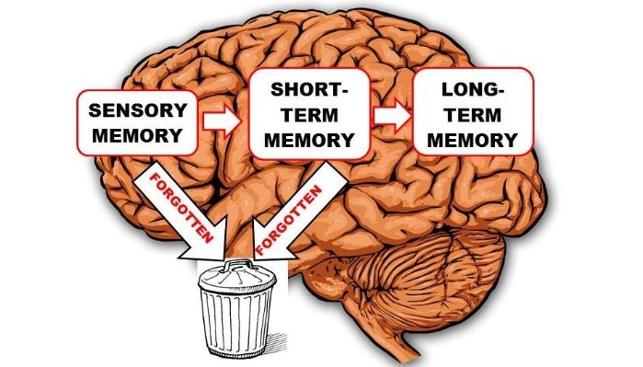
Unit 3: Psychology
Unit 3: How does experience affect behaviour and mental processes?
AOS 1: How does the nervous system enable psychological functioning?
AOS 2: How do people learn and remember?

Slide 7
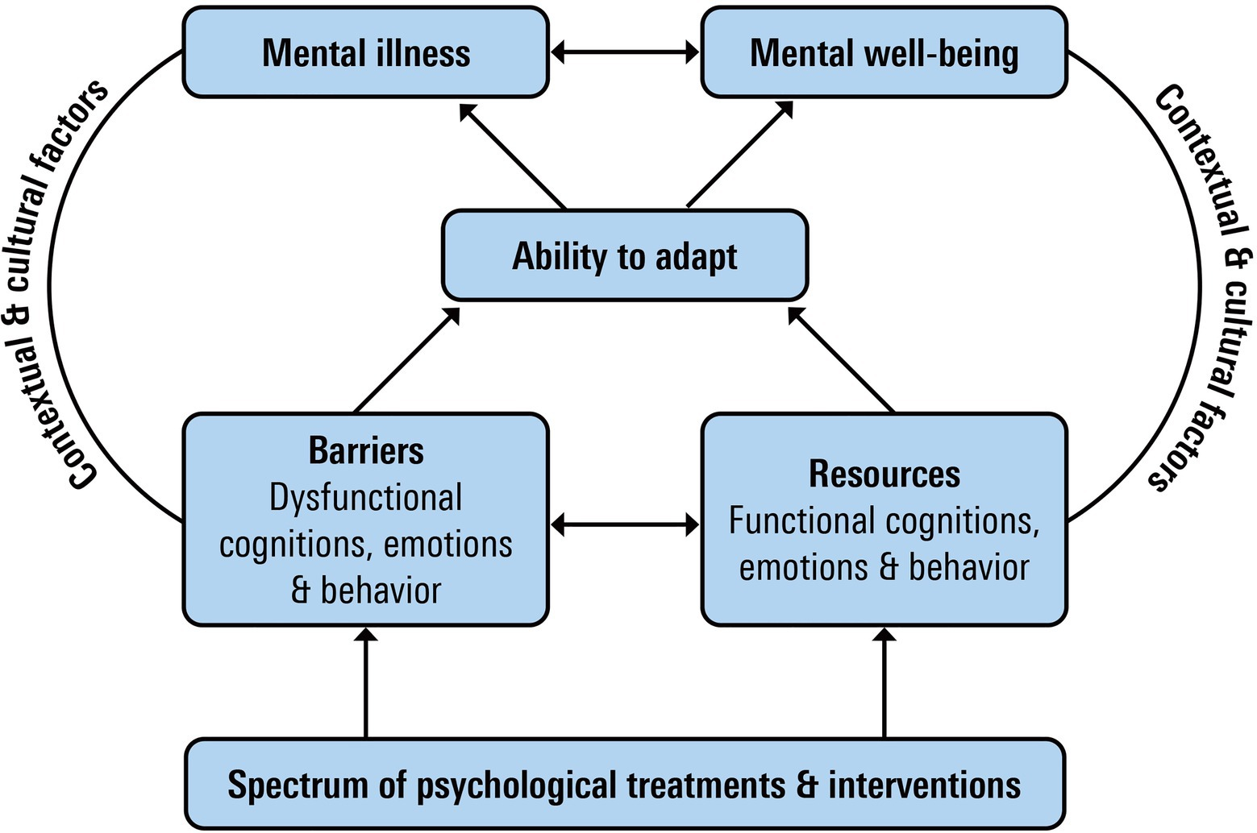
Unit 4: Psychology
Unit 4: How is mental wellbeing supported and maintained?
AOS 1: How does sleep affect mental processes and behaviour?
AOS 2: What influences mental wellbeing?

Slide 8
Unit 1 & 2 Assessment
Unit 1: How are behaviour and mental processes shaped?
Unit 2: How do internal and external factors influence behaviour and mental processes?
Assessment Tasks can include:
analysis of an experiment or case study
a data analysis of generated primary and/or collated secondary data
media analysis of one or more contemporary media texts

Slide 9
Unit 3 & 4 Assessment
Unit 3: How does experience affect behaviour and mental processes?
Unit 4: How is mental wellbeing supported and maintained?
Assessment Tasks can include:
  analysis and evaluation of at least one psychological case study, experiment, model or simulation
  analysis and evaluation of generated primary and/or collated secondary data
  comparison and evaluation of psychological concepts, methodologies and methods, and findings from three student practical activities
  analysis and comparison of two or more contemporary media texts.

Slide 10
PRIOR KNOWLEDGE AND SKILLS
Yr 10 Biology/Psychology

Slide 11

LEADS TO…….
Further study options related to this subject are:

Slide 12
Career Prospects
Career pathways associated with this subject are:
  Sport psychologists: Help athletes to achieve peak performance​
  Counselling psychologists: help people deal with personal & relationship problems​
  Clinical neuropsychologist: assesses & diagnoses brain impairment & develops programs to assist brain damaged people​
  Organisational psychologist: undertakes research on behalf of organisations​
  Research psychologist: conducts research & usually supervises psychology students in tertiary institutes

Slide 13
THANKYOU!

