Slide 1
Habits of Mind Icons
By Nicholas.s 6W

Slide 2
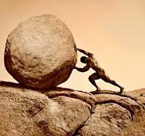
Persisting
original
Mine

Slide 3
Striving For Accuracy
original
Mine

Slide 4
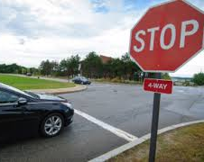
Managing Impulsivity
original
Mine

Slide 5
Thinking Flexibly
original
Mine

Slide 6
Thinking Interdependently
original
Mine

Slide 7
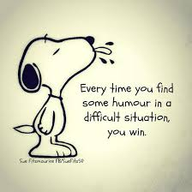
Finding Humour
original
Mine

Slide 8
Taking Responsible Risks
original
Mine

Slide 9
Questioning And Posing Problems
original
Mine

Slide 10
Remaining Open To Continuous Learning
original
Mine

Slide 11
Gathering Data Through All Senses
original
Mine

Slide 12
Creating Imagining And Innovating
original
Mine

Slide 13
Applying Past Knowledge To New Situations
original
Mine

Slide 14
Thinking And Communicating with Clarity And Precision
Mine
original

Slide 15
Thinking About Your Thinking Metacognition
original
Mine

Slide 16
Responding With Wonderment And Awe
original
Mine

Slide 17
Listening With Understanding And Empathy
original
Mine

