Slide 1
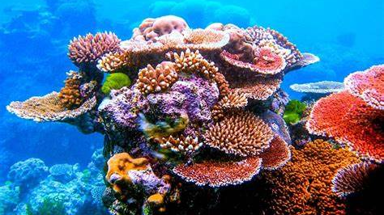
The Australian Harlequin Fish By Phoebe Castillo

Slide 2
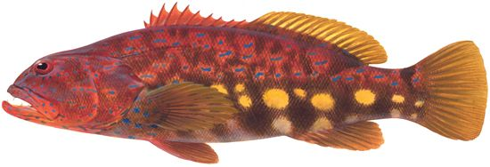
Introduction
Dorsal fin
Eye
Tail fin
The Australian harlequin fish is a rare fish and one of the largest serranids (a fish of the sea bass family) in the Western and Southern Australian water. Harlequins vary greatly in size but reach a maximum length of 76cm – 86cm and weight of 6kg. It has a diverse colour pattern that varies from fish to fish.
Pectoral fin
Canine teeth
Anal fin
Pectoral fin
Pelvic fin

Slide 3
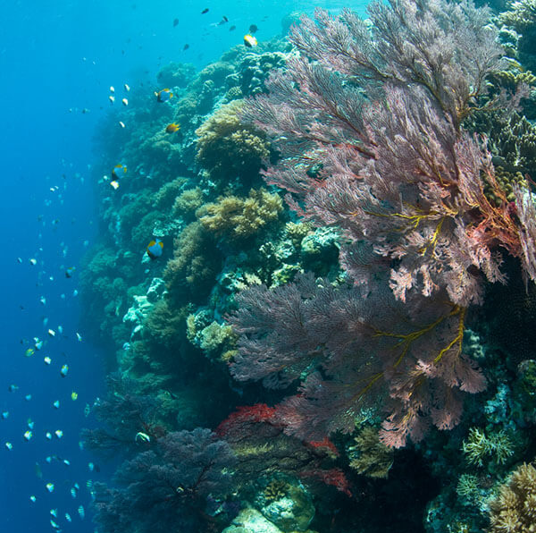
Habitat
The Harlequin is a reef fish, this means that it is native to the temperate waters, found over shallow rocky reefs and in caves located in the cool coast of Southern Australian. Rocky reefs are home to a lot of different marine creatures. The rocky reefs provide a haven and feeding opportunities for a wide variety of fish. Smaller fish can escape bigger fish/predators between caves and cervices, and the coral and rocks can serve as camouflage. The Harlequin fish prefers reefs – drops, cervices and caves in clear costal waters. Most Harlequins live in Marine parks. Marine parks is a protected sea (or lake) that conserves marine habitats and the marine species that live within and rely on theses habitats. Biologist undertook a fish tracking study to monitor the movement of Harlequin fish. They found that the Harlequin fish were strongly connected with the costal reef habitat and rarely venture from their home base.

Slide 4
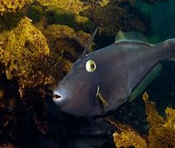
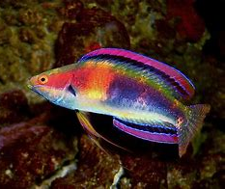
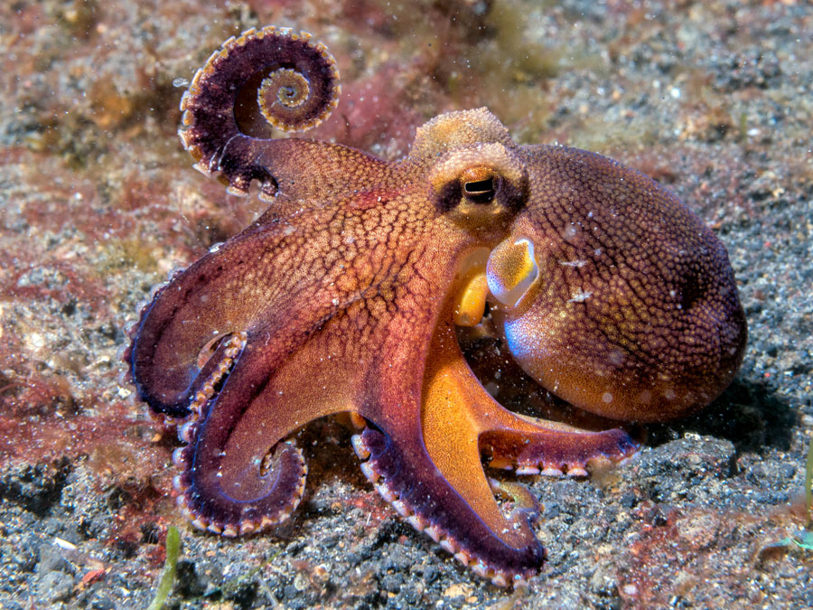
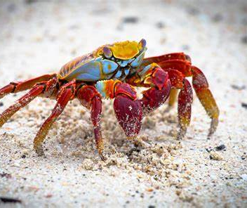
Food/Lifestyle
The Harlequin fish are carnivores and feed during daylight, it is an ambush predator. Small wrasses and leatherjackets are components of its diet, crustaceans and cephalopods. The Harlequin fish sets up a hunting spot and waits, very still, until a leatherjacket or small wrasses swims past as an easy target. When feeding on fish, they choose their prey by size rather than species. They will quickly grab the small fish with they’re razor-sharp canine teeth and bring the small fish back to its cave to enjoy the meal.

Slide 5
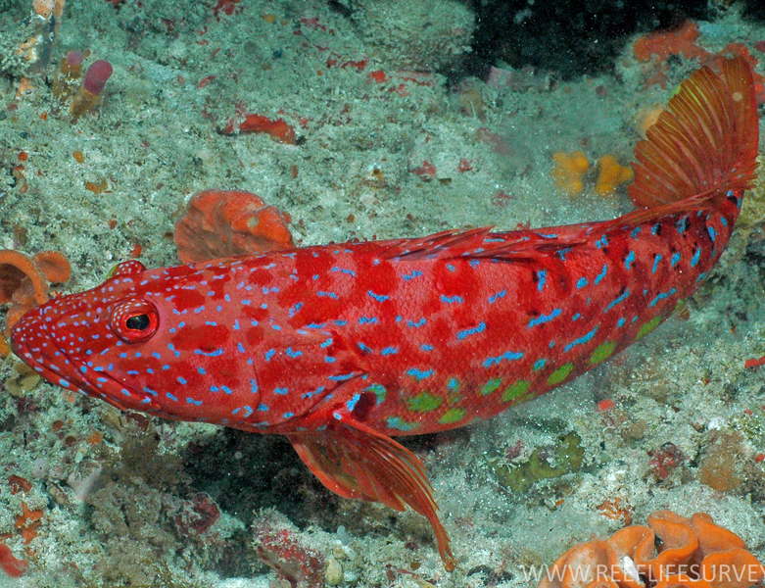
Adaptions
Harlequin fish vary greatly in color, ranging from orange, to pinkish, reddish, green or brown, with large yellow, greenish, or brilliant blue spots and dashes. The Harlequin has bright colors to blend in with the surrounding reef and coral, these colors gives them camouflage. They also have enormous canine teeth at the front of the jaws and specialized eyes for ambush predating. The Harlequin fish has a bottom dwelling habitat whereby it regularly rest on seabed, in-between short bursts of swimming.

Slide 6
Interesting facts
Harlequin fish can live for more that 40 years
The fish tracking study to monitor the movement of the Harlequin fish took place off the coast of Kangaroo island for 16 months.
The Harlequin fish helped South Australia develop marine sanctuary zones.
The Harlequin can change gender. When the dominant male dies of a group, the largest female of the group will change gender and take the role of dominant male.
When males reach the mating stage, the colors on a male intensifies, playing a role in courtship.

Slide 7
Bibliography
https://www.environment.sa.gov.au
https://en.wikipedia.org
Harlequin Fish | Great Southern Reef
Bryars 2012_ProtectingHarlequinFish.pdf (environment.sa.gov.au)

