Slide 1
St John Vianney’s Primary School
Ash McKinnon: Transitions Manager
info@theircare.com.au

Slide 2
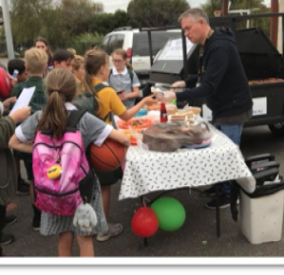
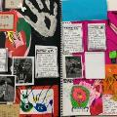
Why TheirCare?
Why TheirCare?
Australian Owned and Operated
Dedicated to providing fun and engaging program for all children
Community Focused
For Children
Food that is fresh and tasty with lots of variety
Tailored, spontaneous and planned programming
Engaging and empowered play
Because we care
“
“
For Families
Flexible booking policy and a simple fee structure
Australian based customer service who understand and respond
Safety comes first
For Schools
A consistent responsive relationship with senior management
Contribute to and become part of your community

Slide 3
Programs Designed for Engagement
Programs developed around the needs of your child!

Slide 4
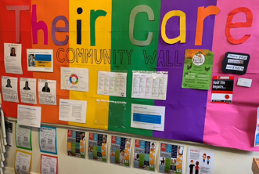
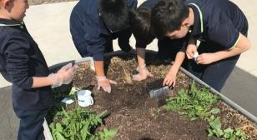
Care Types
BSC
7:00am to 8:40am
$25.00 Average $6.97 out of pocket
ASC
3:30pm to 6:00pm
$35.00 Average $7.96 out of pocket
PFD
7:00am to 6:00pm
$75.00 Average $7.50 out of pocket

Slide 5
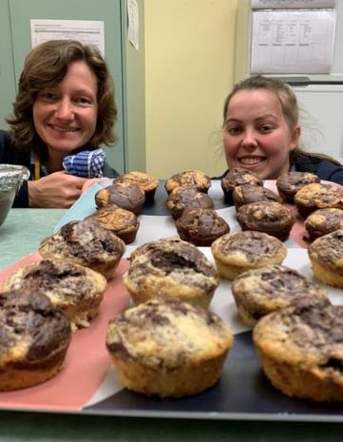
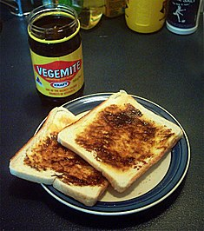
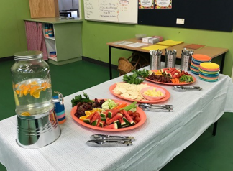
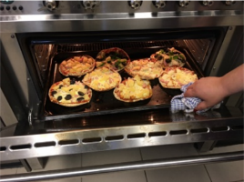
Amazing Food

Slide 6
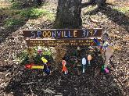
Staff Engagement
Selection
Ratio
Support & supervision
Feedback
Reward
Preparation
Engaged in play
Continuity of care

Slide 7
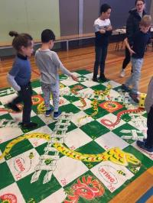
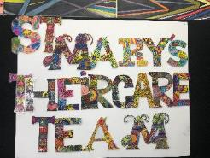
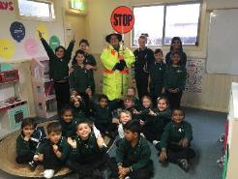
Quality of Program
Area Managers have a maximum of 12 services in their region to ensure highest quality of our program and practices.
Area Managers and Mentor Coordinators support and guide Coordinators in areas such as programming and planning to child’s interests, engagement, community building and more.

Slide 8
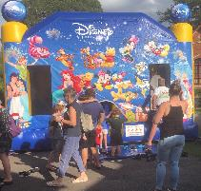
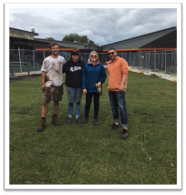
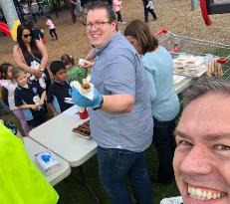
Your Community is Our Community
Reader Programs
Parent Information Days
School Welcome
Sports Days
Hardship Programs
Art Exhibitions
Lunch Support
School Upgrades
Fetes
Trivia Nights
Working Bees

Slide 9
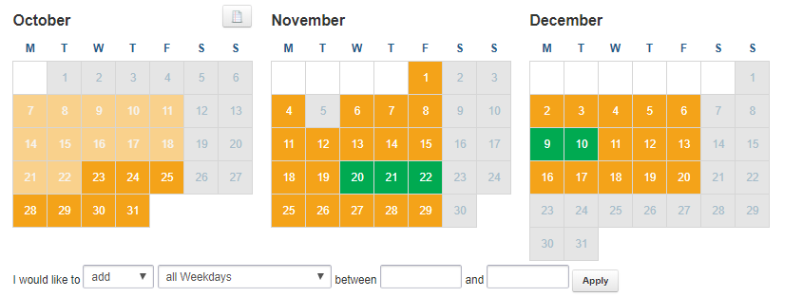
Registration and booking
Registration and bookings are completed online at TheirCare.com.au and usually takes approx. 15 to 20 minutes to complete.
When completing your child’s registration there will be some information and documents that you will need on hand to complete the registration process.
This includes…
Child & Guardian Centrelink CRN’s
Emergency contact details
Nominees for child drop off & collection
Banking / credit card details for billing
Medical & Health Details along with documentation

Slide 10
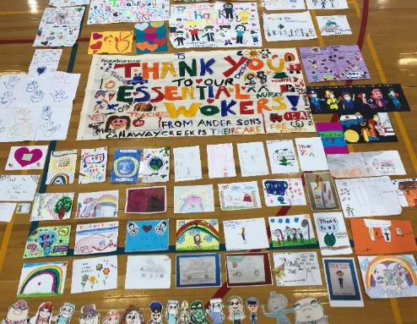
Thank you
Your community means something to us!
We are ready to make a difference!
Our invitation to you – if there is something you want, please let us know!
Proud supporters of:

