Slide 1

Parent Information Session
Foundation
Notes:
Jose

Slide 2
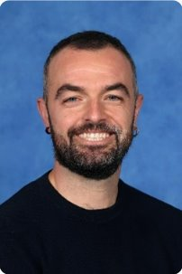
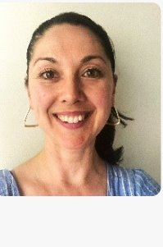
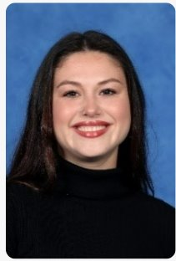
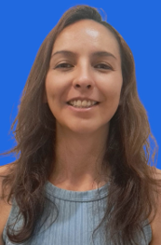
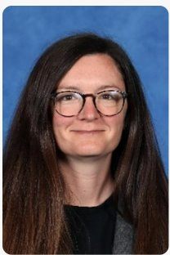
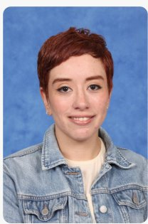
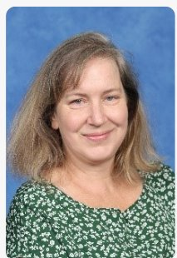
Foundation Team
Jose
Colleen
Sole
Sandra
Katherine
Paula
Lizzie
Notes:
Jose

Slide 3

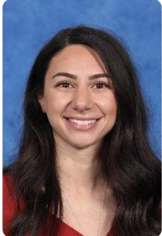





The Learning Community Leader
Learning Community Leaders primary role is to Build Effective Professional Learning Teams that support and develop the teachers and students within their team.
Running morning
Writing/ Maths programs (with teachers)
Term 2 & Term 3
Leading Newlands Planning Model in all subject areas
Visibility in cohort classrooms and supporting teachers with individual students when needed
Mentoring and coaching classroom teachers
Before & After school yard duty ensuring visibility to Parent Cohort Community
Notes:
Luke
This year, we’re excited to introduce Learning Community Leaders who are now assigned to each cohort, making things even more connected and collaborative! In the past, we had subject-based leaders like the Literacy Leader or Numeracy Leader, but these roles sometimes felt a little disconnected from the classroom. With our new approach, the focus is all about building stronger relationships and creating a more hands-on impact in coaching, mentoring, and supporting both teachers and students. It’s all about teamwork and making learning even more exciting!
In 2025, our goal is all about tapping into the strengths of each team and individual teachers, facilitating planning sessions for greater impact, and really focusing on the unique needs of each cohort. Our Learning Community Leaders are at the heart of this mission, building strong teams, running our before school writing and math programs (along with other passionate teachers), and leading the Newlands Planning Model across all subjects.
They’ll be in the classrooms, supporting teachers, and working side-by-side with them through mentoring, coaching, and collaborative teaching. It’s all about making sure both teachers and students thrive and grow together!

Slide 4

Communication Flowchart
Teachers
The teachers are the first point of contact. Contact for day to day questions, updates or concerns.
Learning Community Leader
Contact LCL when requiring further support. This may include, setting up formal meetings, wellbeing, targeted support.
If the issue has not been resolved at the previous levels, or if it involves a school-wide concern (e.g., bullying, major academic challenges, safety), the Principal or Assistant Principal should be contacted.
Principal
Notes:
Luke

Slide 5
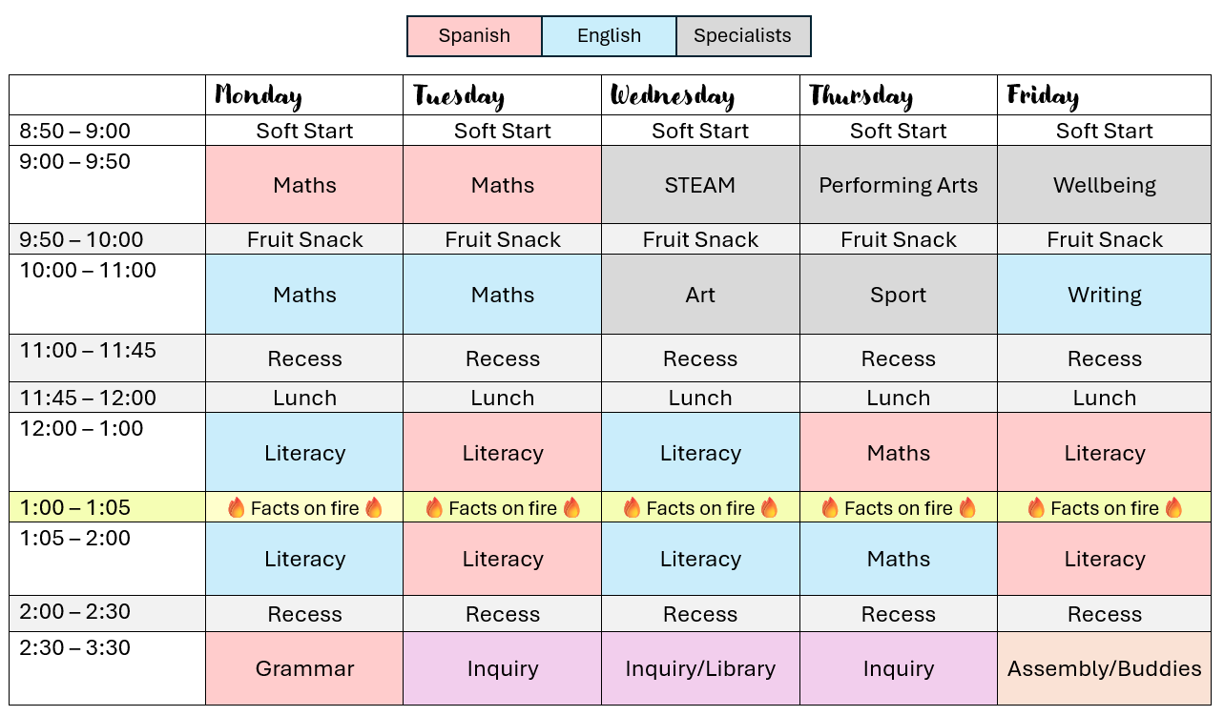
Weekly Timetable
Find your classroom timetable link in the newsletter.
Notes:
Katherine

Slide 6
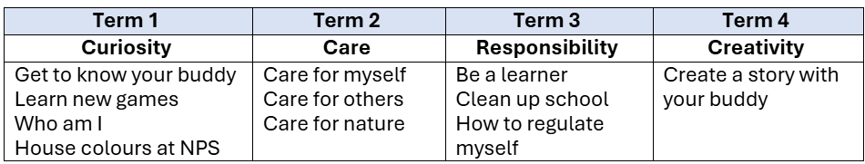
Cohort Specific Information
Buddies – Foundation and Year 6
Every two Fridays our Foundation students will spend some time with the students from Grades 5 and 6. The Buddy Program helps students to develop positive social skills. The activities focus on our school values.
Lunch boxes – Fruit snack at 10am.
Lunch orders can be done on our website. (Classroom Cuisine).
Toys/Personal Items. Do not bring valuable items to school.
Notes:
Katherine

Slide 7
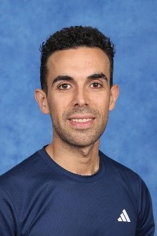
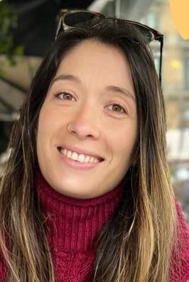
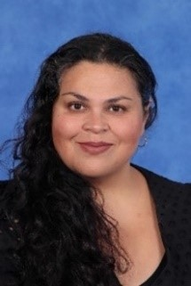
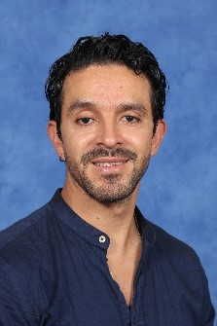
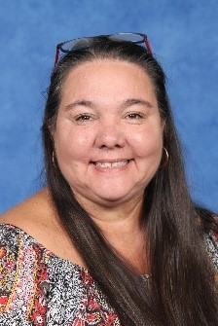
Specialist Team
Raul-HPE
Paula-STEAM
Margaret-Art
Felipe-PA/Music
Karren-Wellbeing

Slide 8






Specialist
Specialist teachers can be messaged on Sentral
Specialist Program: STEAM, Art, HPE, PA/Music and Wellbeing
Whole School Events
 | Tuesday |  | Wednesday |  | Thursday |  | Friday
 | 9am | 10am | 9am | 10am | 9am | 10am | 9am | 10am
Katherine - FA |  |  | Art | STEAM | PE | Music |  | WB
Paula - FB |  |  | STEAM | Art | Music | PE | WB
Colleen - FC |  | WB | PE | Music | Art | STEAM
Jose - FD | WB |  | Music | PE | STEAM | Art
Notes:
STEAM: The science and digital and design technologies curriculums are covered.
Students:
engage in experiments
code using robots and online sites.
create solutions related to their learning
Art is weaved throughout all of this.
Art
The Art Program focuses on develop students' abilities as an artist:
- Exposed to a range of Arts mediums; clay, drawing, collage, painting, sculpture and textiles.
Art elements, movements and artists.
Students artwork displayed throughout the school and there will be Biannual Art Show during October.
Health and PE
The HPE program helps children stay active, learn about their bodies, and develop lifelong movement skills. Through fun games and sports, we promote teamwork, well-being, and healthy habits for a strong and active future.
Music
Music and dance as subjects
focuses on developing foundational music skills
They will learn about the qualities of the sound. Dynamics and contrasts (*loud/soft*, *high/low*).
Through explicit teaching, hands-on instrument practice, group collaboration, and reflective activities.
Incorporation of cultural exploration and creative expression to enhance musical understanding and appreciation.
Wellbeing
This year, we’re diving into positive self-talk, resilience, and coping strategies to help us navigate challenges with confidence! 💪✨ Most of what we do is based on the Resilience Program, Berry Street, and Safe Schools, as well as what you need. Through fun activities, teamwork, and reflection, we’ll build skills to stay strong, support each other, and thrive. Get ready for an exciting journey of growth, kindness, and self-discovery! 🚀😊
EVENTS
Ride2School Day, Specialist Day Celebration. Term 2: Colour Run. Term 3: Athletics Carnival. Term 4: Art Show, swimming program (explain this year the swimming program is only for year 6s). In Term 4, Preps will participate in Bike Education for 2 weeks during PE too

Slide 9

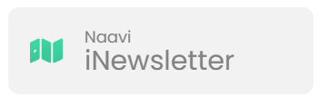


School / Parent Communication
  School Communication
  Payment and Permissions
  Absence Management
  Notifications and Notices
  Parent/Teacher Interview Booking.
  Access to School Calendar
  Semester Reports
  Published weekly (Friday)​
  Essential school-based communication​
  Upcoming events, classroom news, community news, school initiatives and ensures families stay up to date with essential and current happenings at Newlands.
Ensure urgent/timely communication via the office
  Payment and Permissions
  Absence Management
  Communicate medical/health care plans
  Visibility into learning experience to support and celebrate learning.
  Assessment posts/recording.
Notes:
Luke
Sentral -
School Communication: Send and receive messages from your child’s homeroom, specialist teachers, and LCL
Payment and Permissions: Provide permission and make payments for camps, excursions, and incursions.
Absence Management: Easily communicate and respond to unexplained absences, as well as submit future absence requests.
Notifications and Notices: Receive timely notifications for community events, absence alerts, and school notices sent directly to your device.
Parent/Teacher Interview Booking.
Access to School Calendar: View and sync the school calendar with your phone to keep track of important dates and events.
Semester Reports: Stay informed by viewing your child’s individual learning plans and end-of-semester reports.

Slide 10

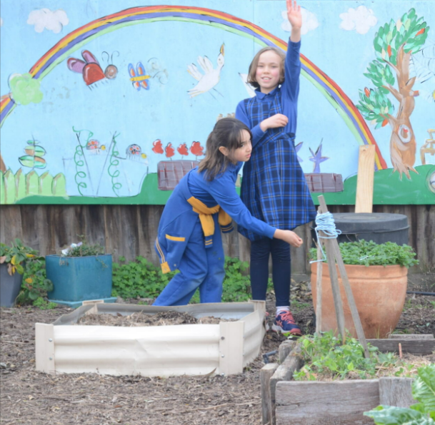
Uniform, Hats and
Lost Property
Lost Property
Located in Specialist Hub outside the STEAM classroom. We have got one on top of our lockers too if the items are found in the classroom.
Hats
Hats are compulsory to wear in term 1 and 4. We are setting up a Wellbeing hub where students can go if they don't have a hat.
Uniform
Ensure all uniform/ personal items are clearly labelled
Notes:
Katherine

Slide 11
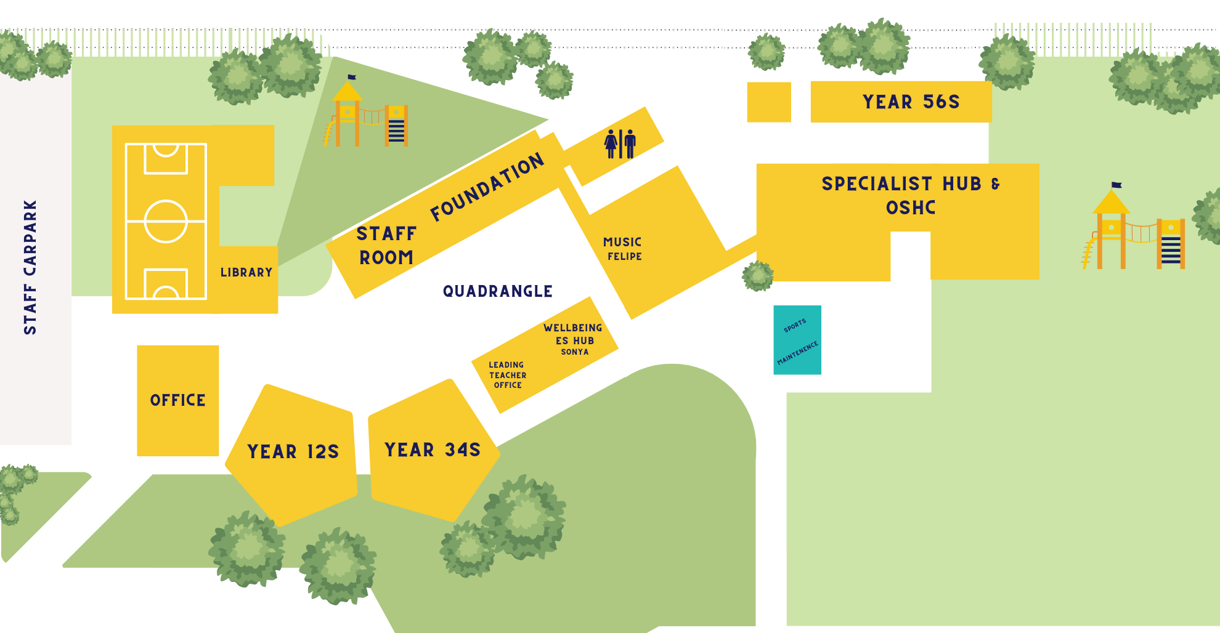
Play Areas
Out of Bounds
Notes:
Katherine

Slide 12
Attendance
Student Late Arrivals
Students that arrive at school later than 9:15 am, must sign in at the office. If a student arrives between 9:00 and 9:15am are to be marked as present by the classroom teacher.
All students who are late to school or are collected early are required to sign out at the office.
If your child is leaving early, we ask that it is not between 3:00- 3:30 or during playtime.
Notes:
Jose

Slide 13
Soft Start
8.50 – 9am students enter the learning space. It is a good opportunity to chat with teachers informally.
We ask families to say farewell to their child after swapping the reader.
Notes:
Jose

Slide 14
Home Learning
Take Home Literacy Program
Bring your child’s reader every Monday and help them change their books.
Students will take home English readers and Spanish readers (Spanish readers from Term 2)
5 minutes daily is much better than 20 minutes on one day!
Students can also practice reading using Nessy (English) and Razkids (Spanish)
Notes:
Katherine

Slide 15
Parent Helper Program
Begins in Week 6.
Times available at the beginning and end of the school day.
Teachers will provide parents with literacy activities and books to read with students.
Parent help is a valuable support for our students.
Notes:
Katherine
Expectation
Logistics
Routine

Slide 16


Reporting / Parent Teacher Interviews
Termly Parent Teacher Interviews
Reports published Semester 1 and Semester 2
Alternate between Spanish and English teacher
Term 1 with both teachers​
Term 2-4 with one teacher
Notes:
Luke

Slide 17
Camps, Excursions and Incursions
What is coming up this year? Our Excursions/Incursions are linked with Cultural Studies. Keep an eye on Sentral communication. It is essential that you process payment and authorization through Sentral.
Expectations each term – there is one related to specialist or classroom Cultural Studies program.
Term 1 | Term 2 | Term 3 | Term 4
Personal and social wellbeing | Indigenous perspectives | Ethical Capability | Geography
Notes:
Jose

Slide 18
Local Excursions / Photography
A Permission Slip has been published on Sentral to obtain consent for all local excursion and photography that may take place in 2025.​
If you do not want to give consent for local excursions, please indicate this on the Sentral Permission Slip. ​
Local excursions may include walking local kindergartens, parks and community spaces. ​
Parents and Caregivers will be notified of any upcoming local excursion beforehand. ​
You may withdraw consent for local excursions at point in the year by calling the school on (03) 9354 2928 or emailing the school at newlands.ps@education.vic.gov.au.
Notes:
Jose

Slide 19
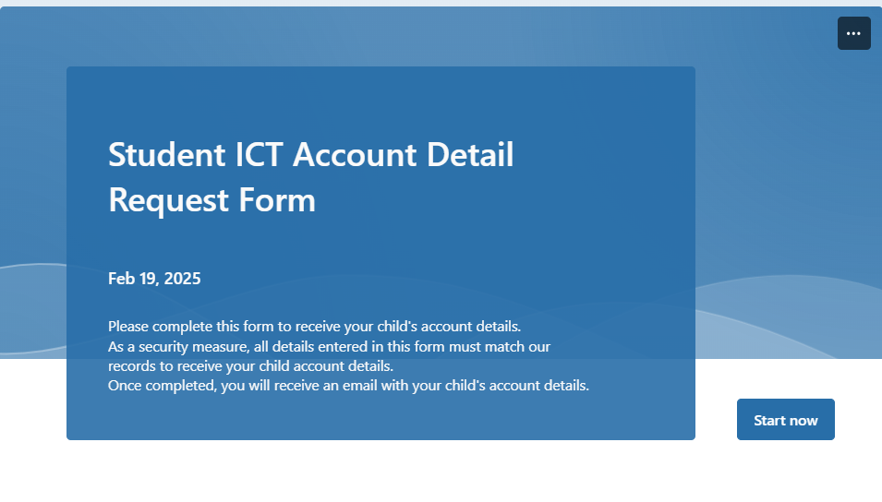
Student ICT Account Details
Student ICT account details are emailed at the start of each school year.
You can also request your child’s account details by completing the Student ICT Account Details Form on the school's website.
Please contact the classroom teacher if you are having trouble signing in to any platforms.
Notes:
Jose

Slide 20



Spanish for families
Join the classroom Duolingo group to enhance your Spanish experience at Newlands. This group is for Foundation families and careers, a little bit of competition is a great way to keep motivated in acquiring a second language.
We are all learners!

Slide 21

Term 1 Community Events
Parent teachers interview Friday 28th March
School photos March 31st
Cultural week assembly 4th April 1:30 –2:30pm
Last day of the term 4th April School finishes at 2:30pm
Bilingual Fiesta 4th April 3pm-6pm
Notes:
Jose

Slide 22
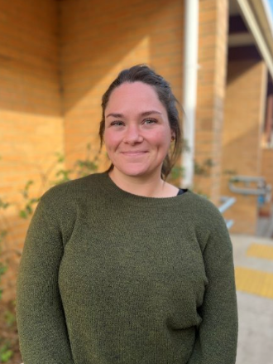
Outside of School Hours Care
Newlands Primary School offers a nationally accredited before and after school care program.
Care is provided from 7:00am until 8.50am each day, and until 6:00 pm after school from Monday to Friday.
OSHC Phone Number: 0491 273 710
You are able to book in advance for the whole term, or book in casually.
Registrations are be completed online. The link can be found on our website.
Most families are eligible for a fee reduction through the child care subsidy system.
Example Activities: Arts and craft, sport, cooking, relaxation and quiet corners.
Notes:
Luke

Slide 23

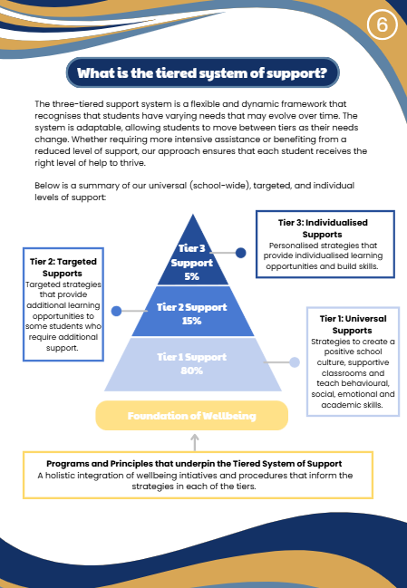
Supporting Your Child’s
Wellbeing at School
Notes:
Katherine

Slide 24
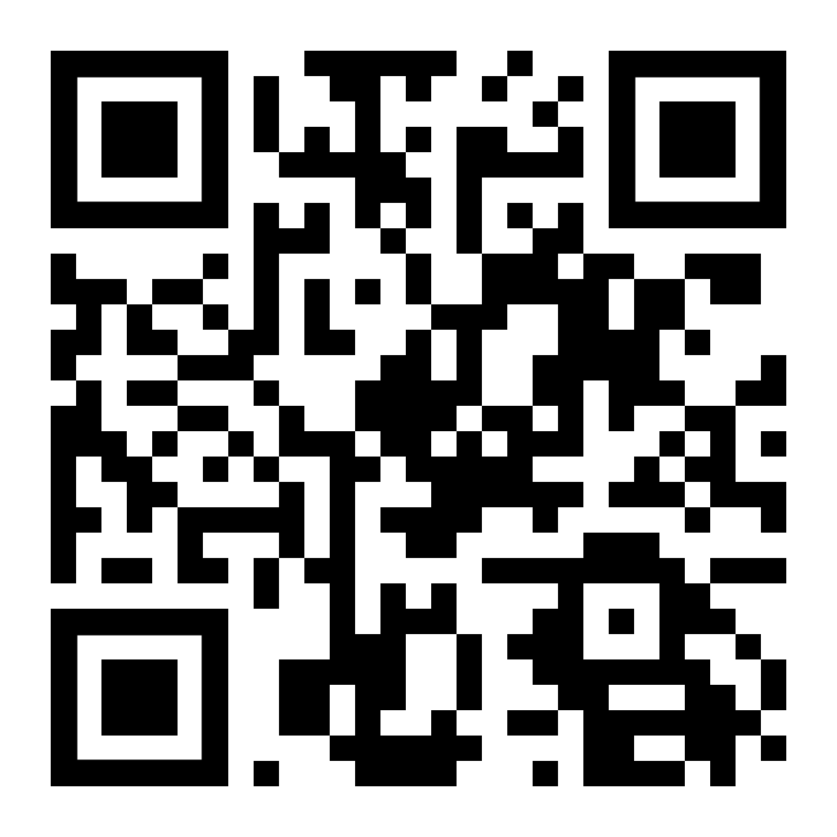
Parent Involvement
Sub-Committees
Parent & Friends Association - Community Events & Fundraising
Education Sub-Committee
Buildings and Grounds Sub-Committee
Finance Sub-Committee (School Council Members Only)
OSHC Sub-Committee
Reconciliation Action Plan Group (RAP)
Spanish Sub Committee
School Council
Notes:
Luke

Slide 25

2026 Sibling Enrolments
If your child is currently in kindergarten and will be joining us next year, please complete the enrolment form on our school website, and send it to the school via email or directly to the office.
Notes:
Luke

Slide 26
Want to Know more about Learning at NPS?
Who: Parents and families interested in knowing more about teaching and learning at Newlands are invited to a presentation.
What: A presentation from our Learning Community Leaders regarding:
Instructional Model
Assessments / Rubrics
Tiered Learning Model
When: Thursday, 20th of March
Where: Staffroom
Notes:
Luke

Slide 27
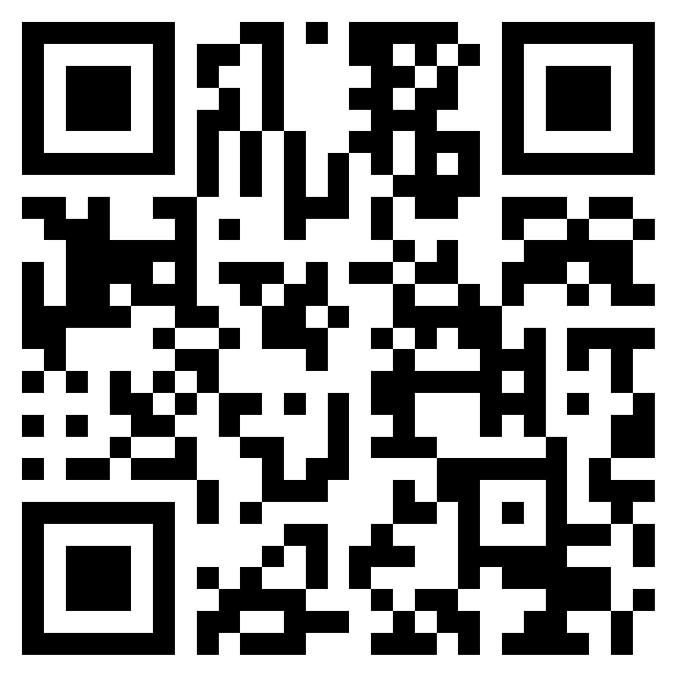
Further Questions
If you have a question that hasn't been addressed, please ask away in the QR code.
All responses will be published in next weeks newsletter.
Notes:
Luke

