Slide 1
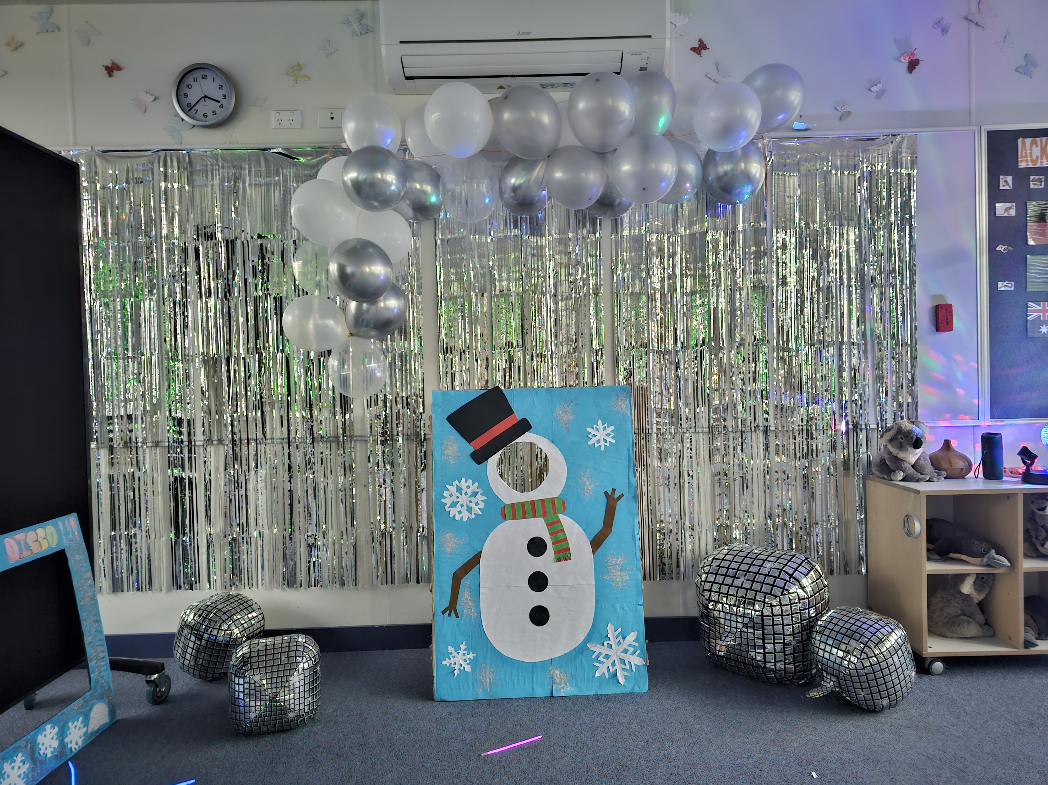
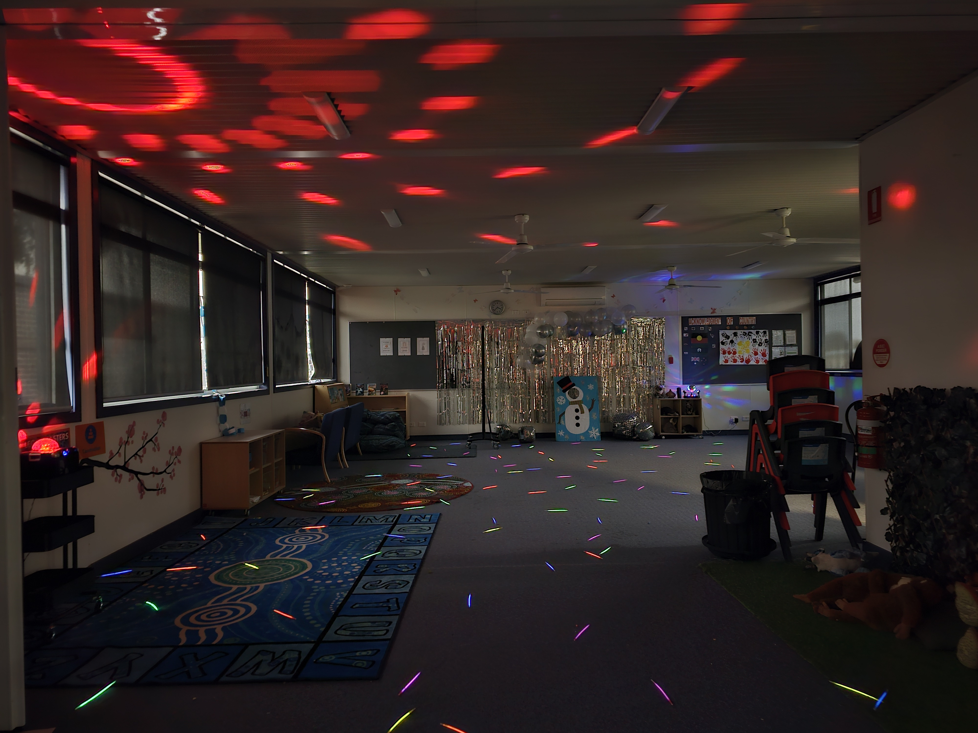
Wyndham Vale TEAMKIDS
We're thrilled to share some wonderful updates from Teamkids Wyndham Vale. On Thursday 13th of June, we had the winter disco, the afternoon kicked off with an energetic guessing game “Guess how many snowballs in the jar” that had everyone’s minds buzzing with excitement. The children also competed in a dancing competition and their enthusiasm and energy lit up the room.
Over the past few weeks, the children participated in a variety of group games such as Red-light Green-light, Gaga, and Build a Snowman. They also engaged in art and craft activities that showcased their artistic talents. The penguin craft activity allowed them to explore their imagination as they crafted adorable penguins. They also used pastel crayons to create their own artworks which allowed them to express themselves in unique ways.
For cooking club, the children engaged in a delightful biscuit decorating activity that encouraged the children to express themselves artistically while collaborating with peers. They designed adorable biscuits using colourful icing and toppings.
Stay turned for updates on upcoming events!
Week 9, 10 & 11
ART ATTACK
COOKING CLUB
^{Monday 01st July 2024}
Vacation Care Begins!
^{Monday 08th- 12th July 2024}
NAIDOC Week
0478 752 381
wyndhamvalePSjunior@teamkids.com.au
1300 035 000
info@teamkids.com.au

