Slide 1
The velvet ant
By Harrison

Slide 2
Contents
1.What is a velvet ant
2.Apperrance
3.Habitat
4.dite
5.Behavoir
6.Reprodution
7.Status and threats

Slide 3
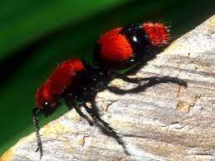
What is a velvet ant
Also know as the cow killer the velvet ant is the 4th most painful sting on the pain scale now don’ t mistake this as an ant though as this is actually a wasp and its sting is apparently so painful it can kill a cow.

Slide 4
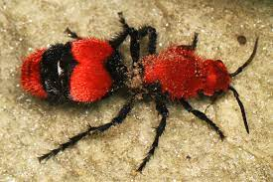
Appearance
The velvet ant looks like a queen ant with fur stuff on its back they come in many shades of red and orange the ones with wings are the males and the ones without are females but females are the ones with stingers that carry the 4th most painful sting in the world.

Slide 5
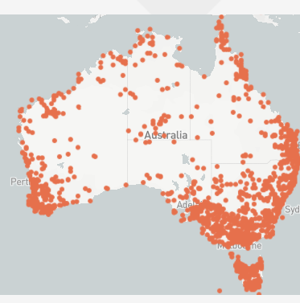
Habitat
As you can see above the velvet ant lives where the red spots are where it lives it is mainly found in Australia they live in deserted areas.

Slide 6
Diet
They feed on nectar and water but some species feed on flies and beetles (the larva will feed on ground bee or wasp larva).

Slide 7
Behaviour
The velvet ant is a nocturnal creature though females are active during the day they are mostly active during temperatures that occur after sunset.

Slide 8
Reproduction
Male velvet ants fly above plants looking for a mate once it has found a mate the female will borrow into a nest of a ground bee or wasp and then lay a egg in there once they do this a grub will hatch then it will start eating the bee or wasp’s larva.

Slide 9
Status and threats
There status is not listed however there threats inclued toads, lizards, birds, shrews and moles.

Slide 10
Bibliography
I used these sites
Google
https://australian.museum/learn/animals/insects/velvet-ants/

