Slide 1
Mirror Storyboard
By Michelle

Slide 2
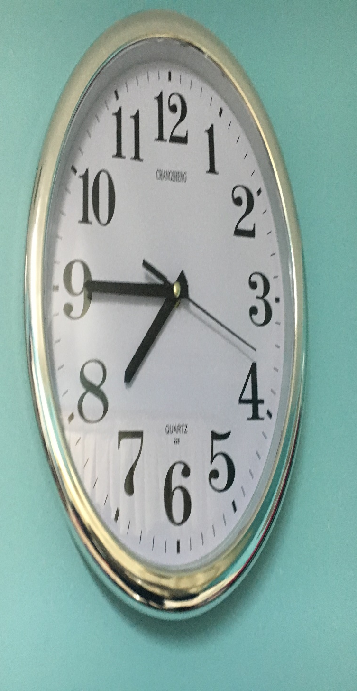
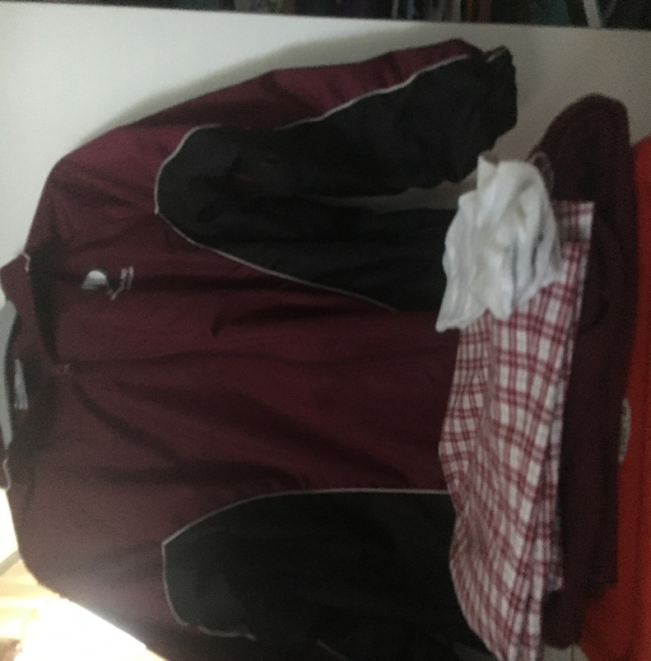
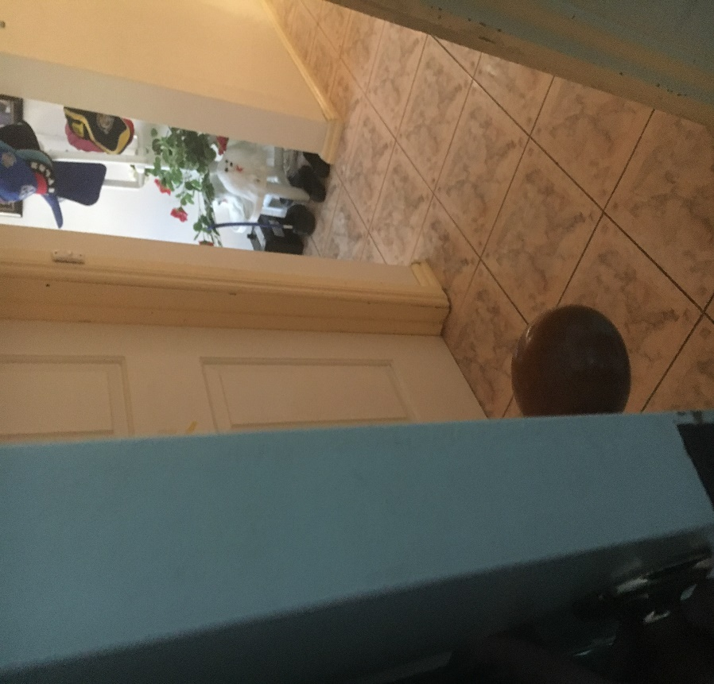
My Morning Routine
Everyday my mum, who is my alarm clock, wakes me up at 7:40am. Because I am not a morning person and I hate waking up early, I sleep in an extra (well-deserved) 5 minutes. (Why do schools have to start so early?)At 7:45pm, I change into my school uniform which has been prepared for me last night. I try to change as quickly as I can before my brother finishes and race him to the toilet and bathroom because he takes a really long time in there and I do not want to be late for school. It is very difficult for me to change quickly as I am only half awake.
(Outside my room)

Slide 3
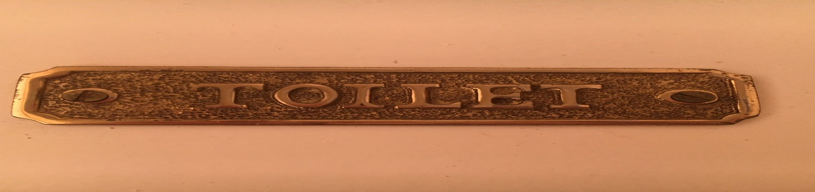
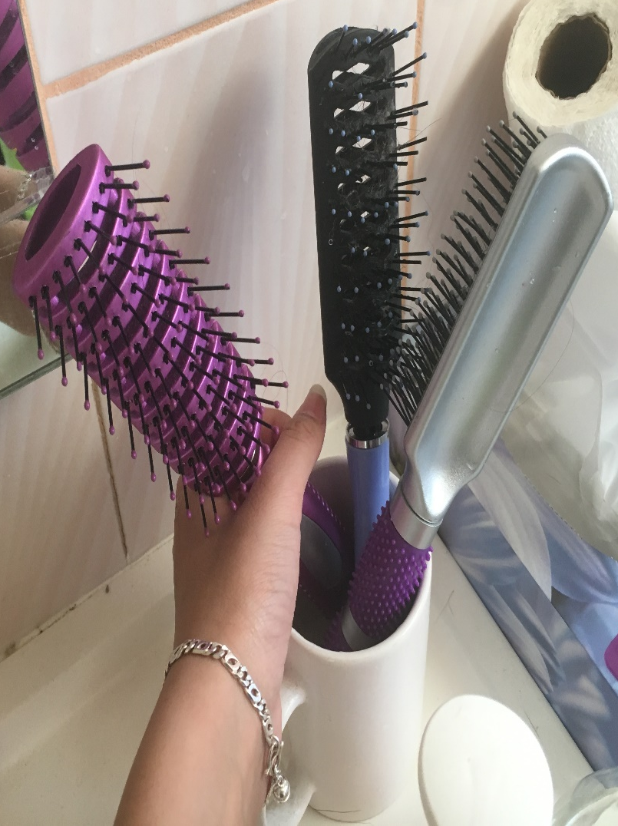
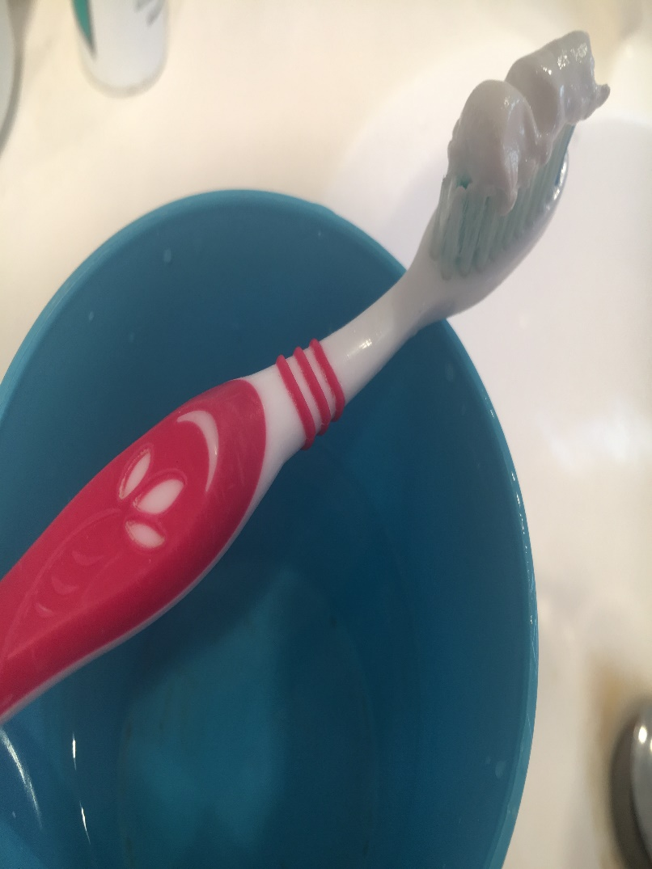
Unfortunately, my brother usually makes it before me (he is a morning person, opposite to me), but it always gives me motivation to wake up and boosts my energy so I can do my morning routine. Brushing my hair is very exhausting as my hair is extremely long and full of knots because I just woke up. When I tie my hair up into a ponytail, I have to pull my long strands of hair through my hair tie three times so it is secure and does not undo during the day. This moment makes my arms hurt as my arms have to stay up in the air for a long time. (I hope I do not miss out any hair so I do not have to start this process again.) My mum already has the toothpaste on the toothbrush ready for me (which is very kind of her to do and dearly appreciated), so I do not have to do much and procrastinate.

Slide 4
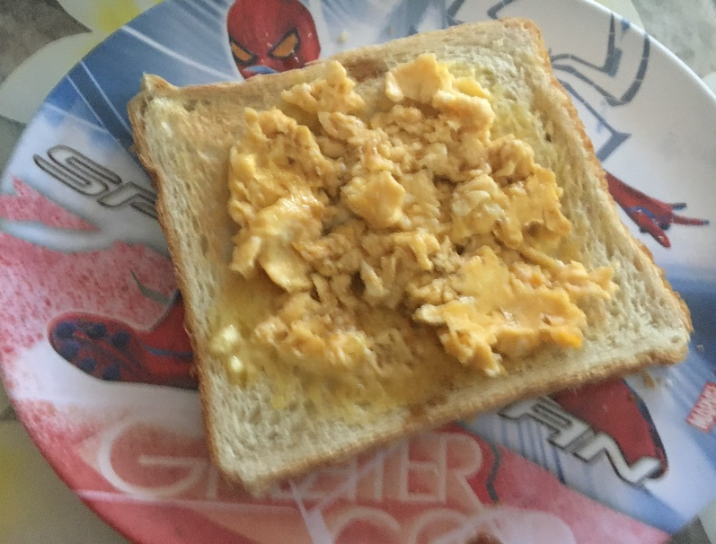
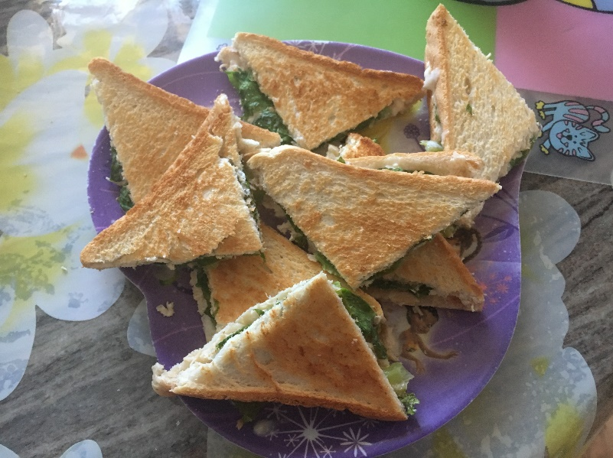
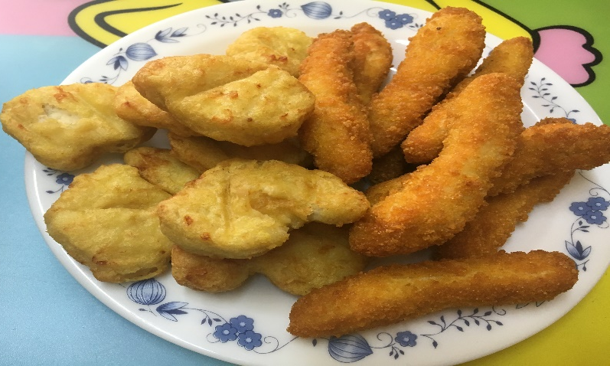
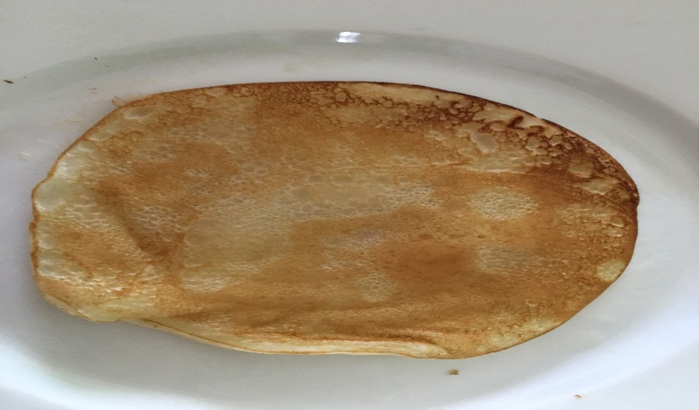
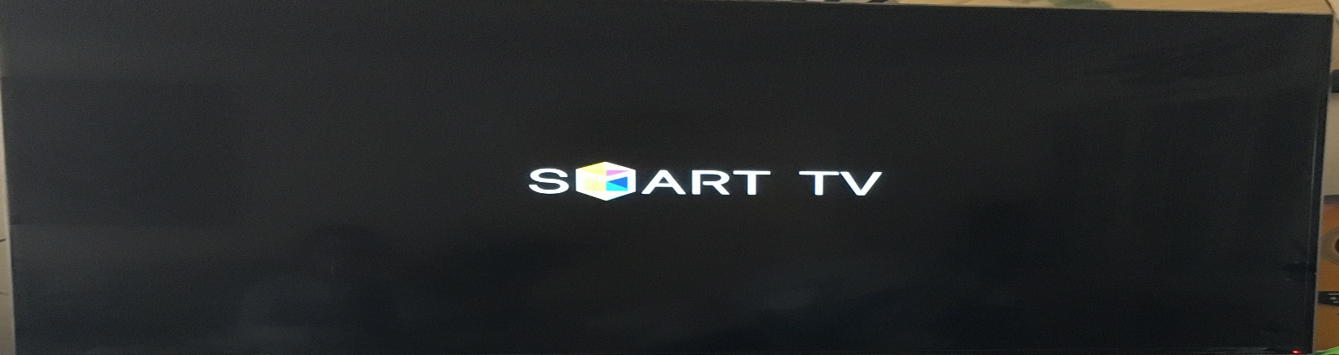
Breakfast
Most of the time I have something different for breakfast each day. On Mondays, I usually have my favourite cereal, Froot Loops, with milk or scrambled eggs. I have sandwiches with chicken, lettuce and mayo on Tuesdays and Thursdays. On Wednesdays I have the best breakfast, chicken nuggets. On Fridays I have whatever my mum decides, so I had pancakes on one of the Fridays. (Yum!) While I eat, I watch the television, channel 23 or 99, with my mum and brother. After I eat, I pack my laptop, pencil case, and any books I took home into my bag for school.

Slide 5
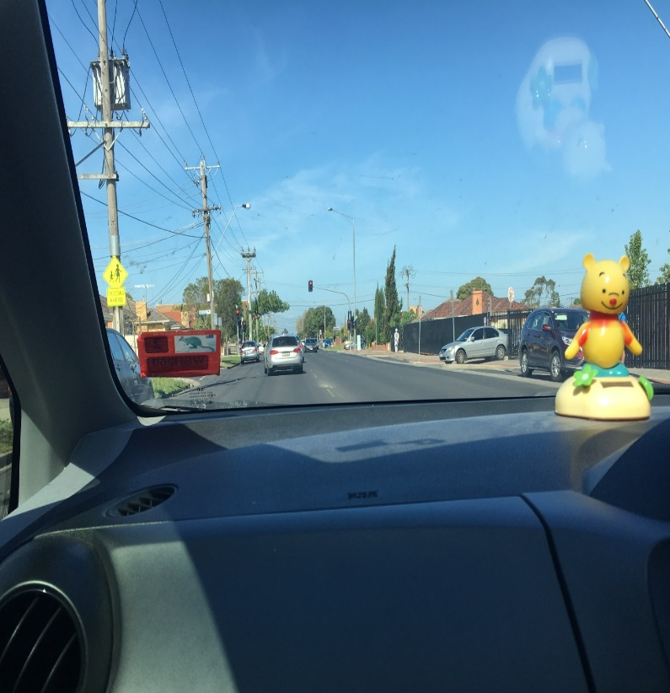
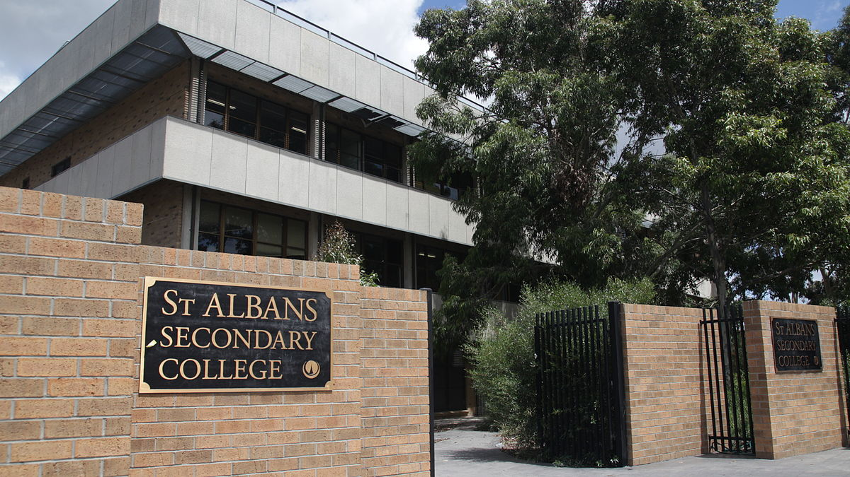
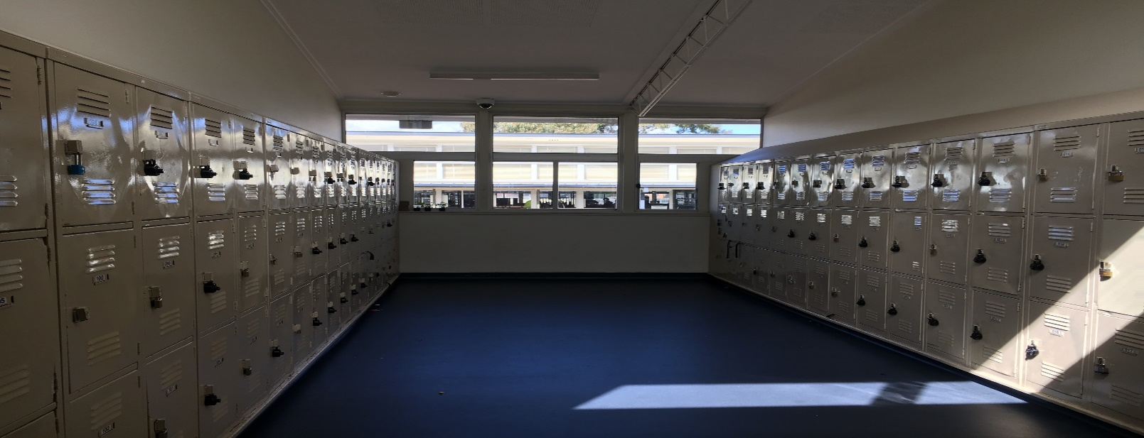
School
I leave my house and get into the car.(I wish I could listen to the radio for music but it rarely happens, as the radio hosts always talks during the time I turn the radio on. This gets on my nerves.) On Mondays, Tuesdays and sometimes Thursdays, my mum has to drop off my brother first at his school. However, on Wednesdays and Fridays, my mum takes me to school while my dad takes my brother to school. In the city there is a lot of traffic, so I like to get to school early when the traffic is not as bad. When I arrive at school early, I like to clean my locker. My locker is a top locker and sometimes I can not reach my books but when I do, my other books fall off the shelf, causing my locker to look messy and disorganised which I absolutely hate.

Slide 6
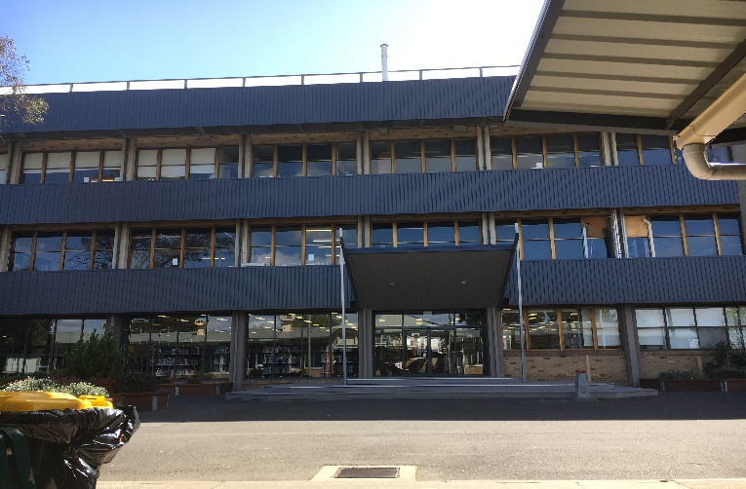
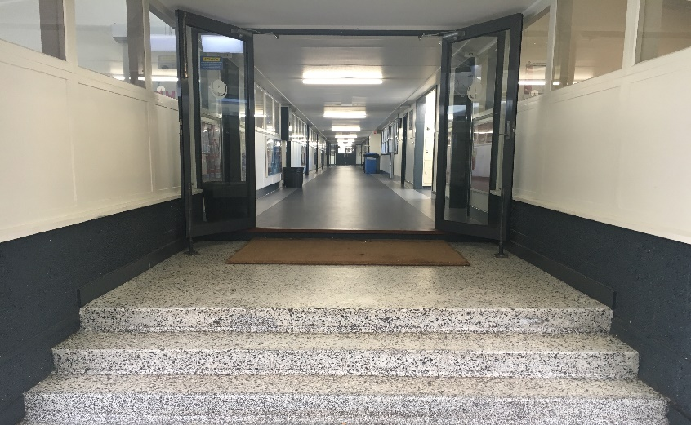
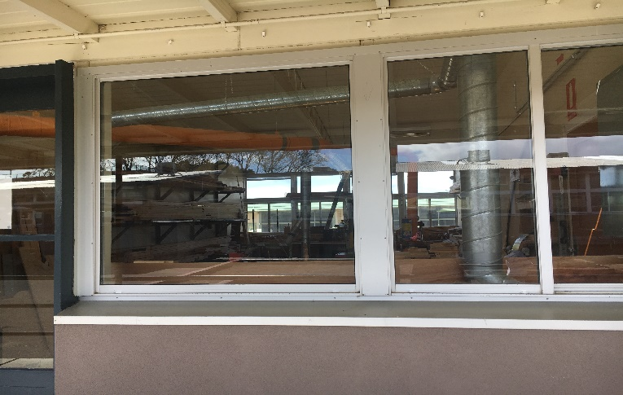
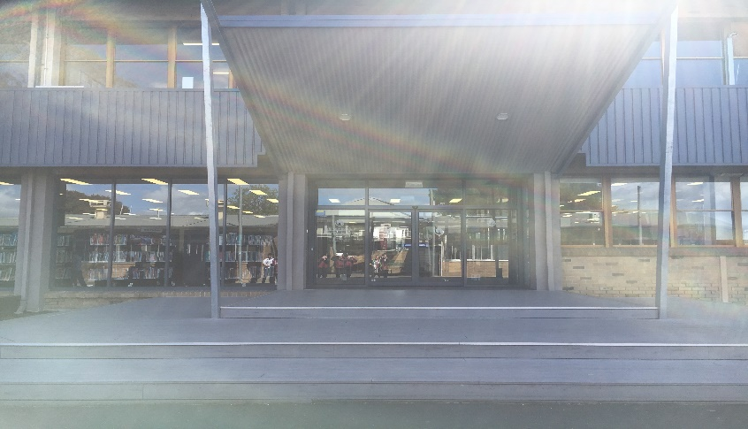
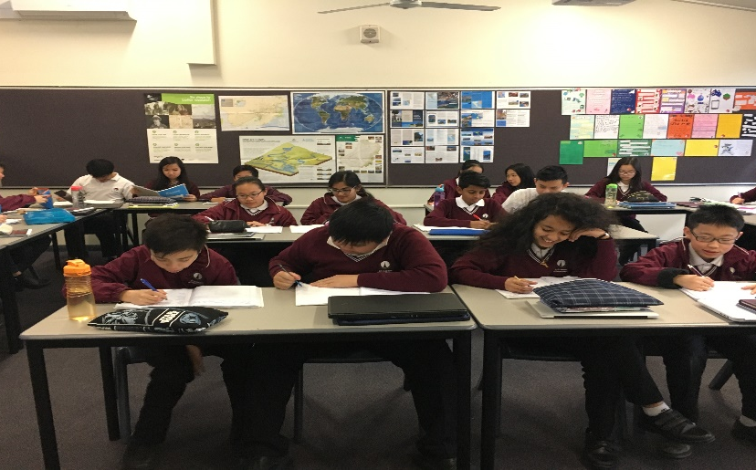
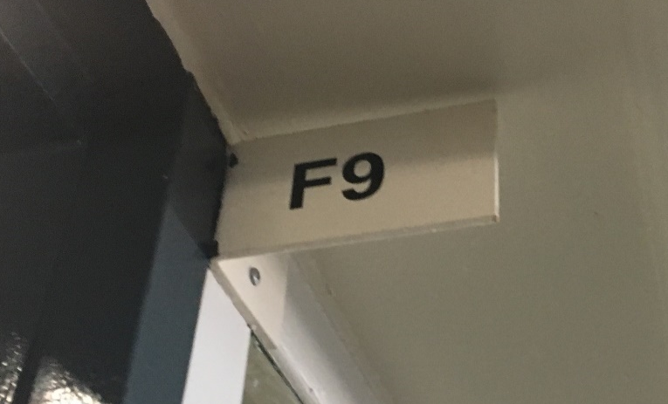
This is my timetable for Thursday. I have maths first thing in the morning, I love maths but I have to climb stairs (very annoying and tiring!) because my maths class is at the top floor of a building so it makes me not like math, but only for a few minutes. Next I have Comprehension where I get to relax and read. After snack I have Woodwork which in my opinion, has been the most fun elective I have had so far. In period 4, I have a library lesson which I enjoy because I get to read stories written by my favourite author, Roald Dahl. Lastly, I have a double lesson of geography where I get to learn about water in the world.

Slide 7
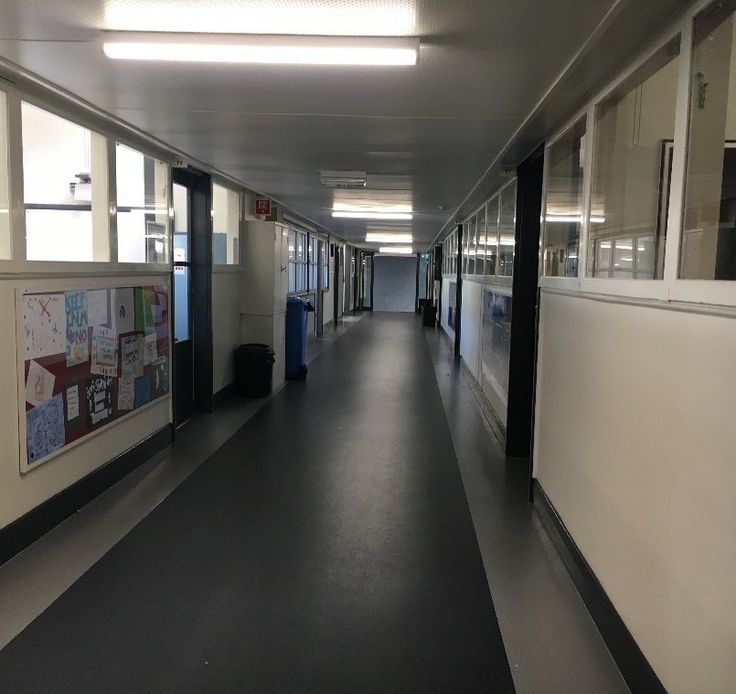
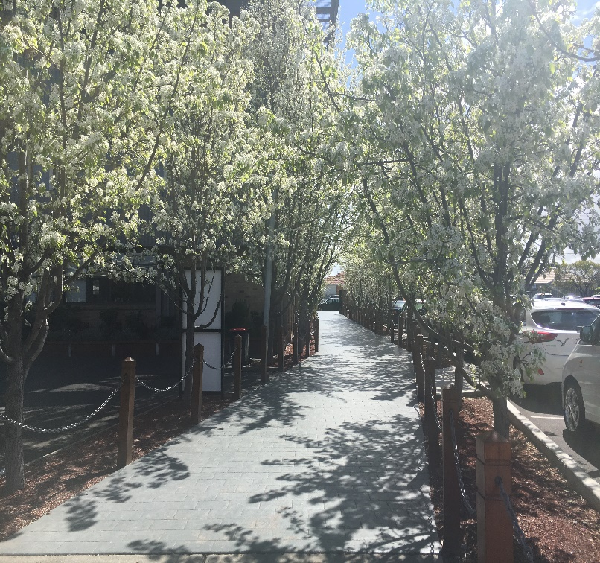
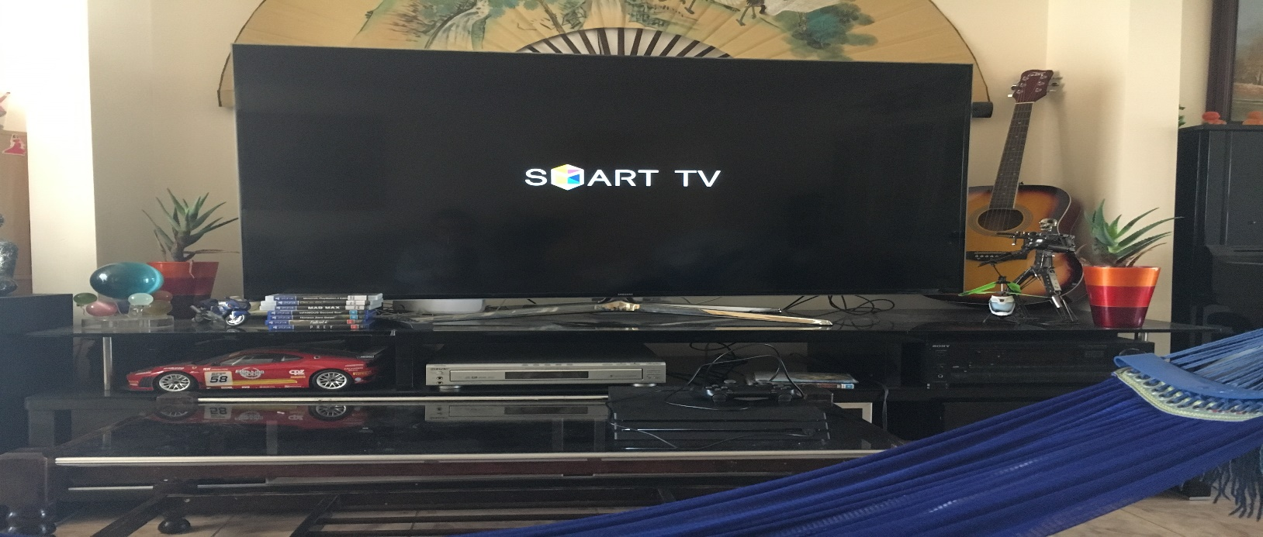
After School
When school finishes it makes the roads very busy, so I get home at around 3:30pm. When I first step foot into my house, I walk straight to the kitchen to get a little snack because I am very hungry (I deserve food after a long day of hard work!). I relax on my hammock and watch the television until 4:30pm. Everyday I do my homework from 4:30pm to 6:00pm, except on Thursdays because I have piano lessons. Sometimes I visit my grandparents with my cousins.
(one of the school’s exits)

Slide 8
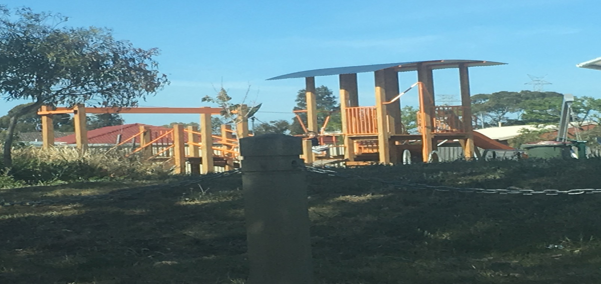
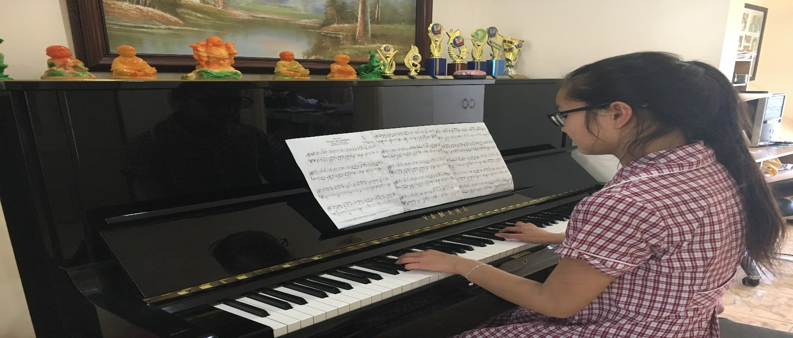
Extracurricular Activity
My piano lessons are at 6:00pm, at my piano teacher’s house. Since there is a park near my piano teacher’s house, my mum sometimes allows me to leave the house earlier than usual so I can play at the park. At the park I get physical exercise as I run around and play. My piano lessons go for half an hour but ‘time flies when you’re having fun’ so it only feels like a few minutes.
(This is my house)

Slide 9
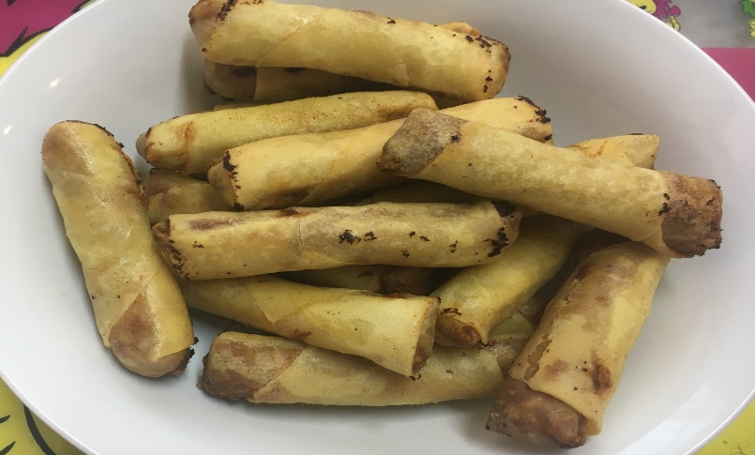
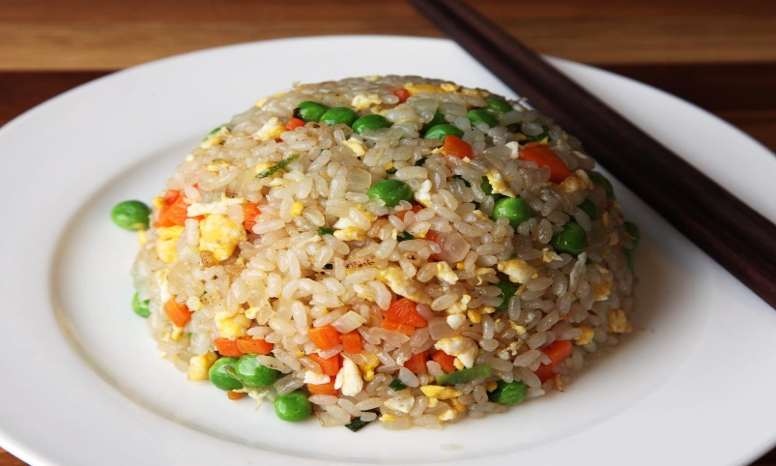
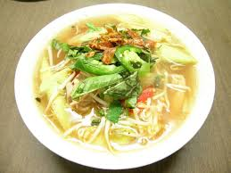
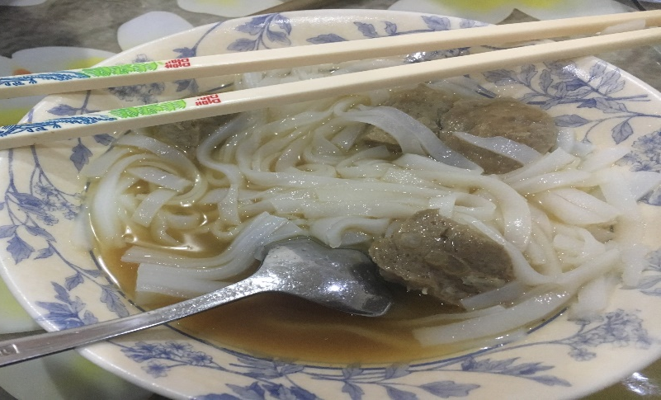
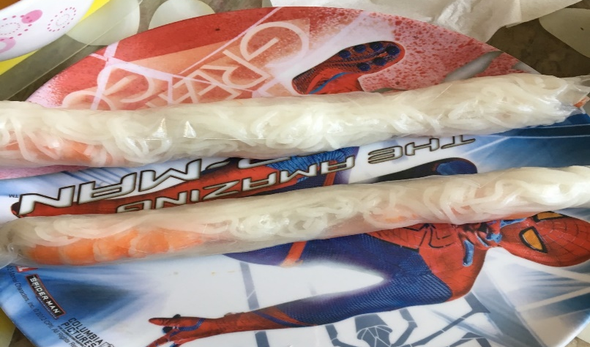
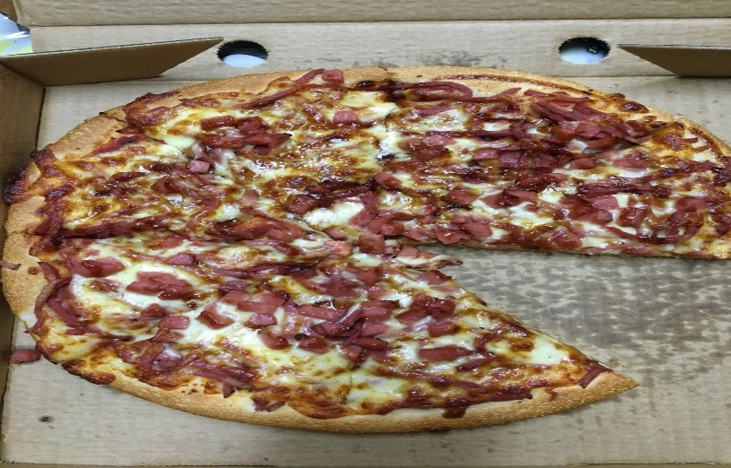

Dinner
I arrive home at around 6:45. My favourite meal of the day is dinner because it is the biggest meal. When I am not eating my cultural food such as spring rolls, rice, sour soup, pho and rice paper rolls, I eat my favourite food, Meat Lovers pizza. My family and I prefer to eat together in the kitchen while we watch a Vietnamese or Chinese movie.(I wish we could watch something else, as I only understand a little bit of what is going on.)
This picture belongs to Google. My rice looked similar to this.
This picture belongs to Google. My soup looked similar to this.

Slide 10
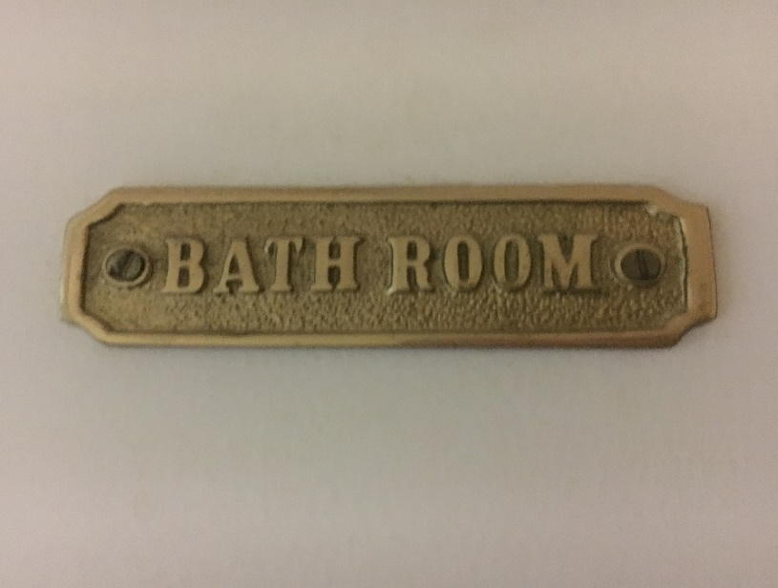

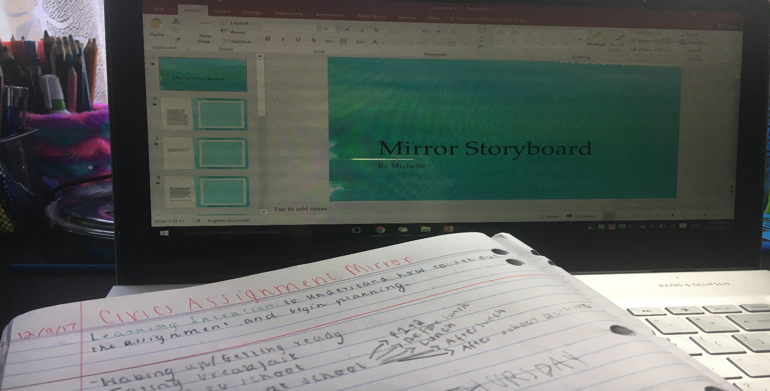
Before Bed
After a delicious dinner, I shower and brush my teeth, which altogether takes approximately 25 minutes.(Sorry mum for the water bills!) When I am all cleaned, I do my homework (again) from either my school or tutor at around 7:45pm. Depending on the subject of my homework, I listen to music whist I am working so I can have fun during learning. If my homework does not take long and it is something I can continue tomorrow as well, I do my homework until 9:00pm. 9:00pm is my free time so I can do whatever I want.

Slide 11
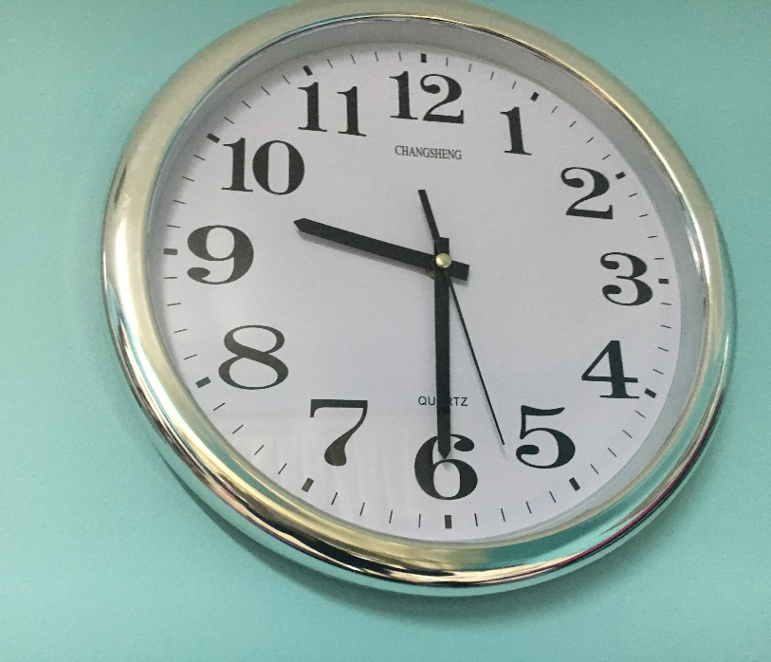
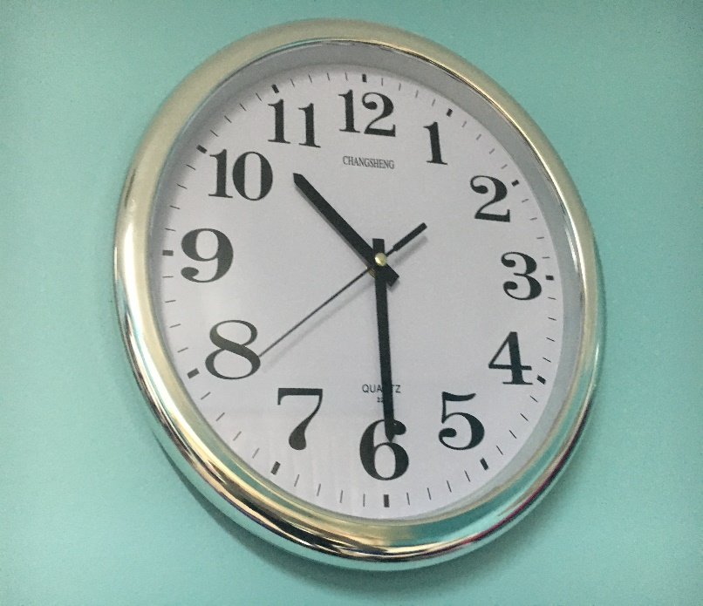
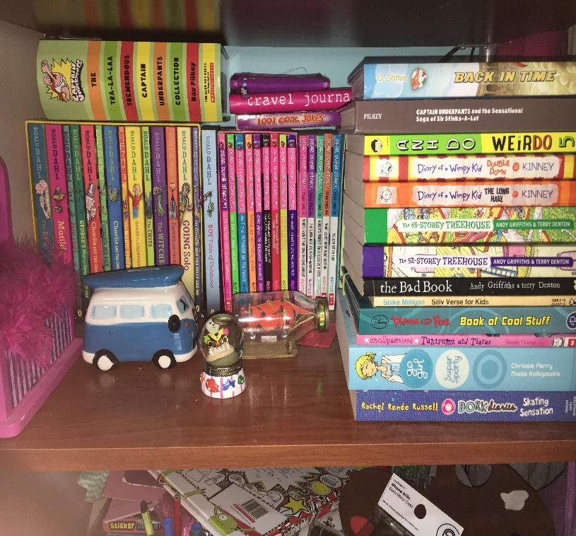
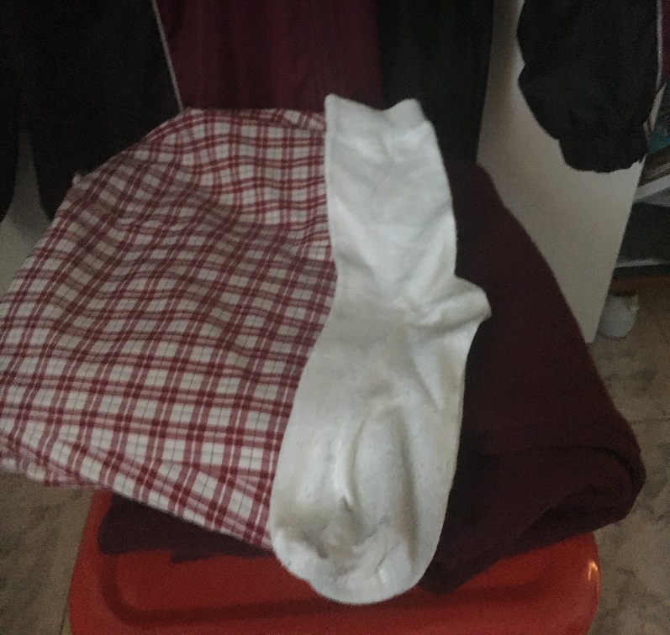
Bed Time
My free time lasts until 9:30pm, where I read a book. I usually read more than one book at a time and I have a wide variety of books to choose from my shelf. I love reading books because I get to expand my vocabulary and depending on how the author wrote the book, sometimes I feel as though I’m in the story. I read for an hour before I go to sleep. At 10:30pm, I prepare my uniform for tomorrow, then I turn on my night lamp (Yes, I still sleep with a night lamp, it makes me feel comfortable and safe) and turn off the lights, ready for another day of school, learning and fun.

