Slide 1
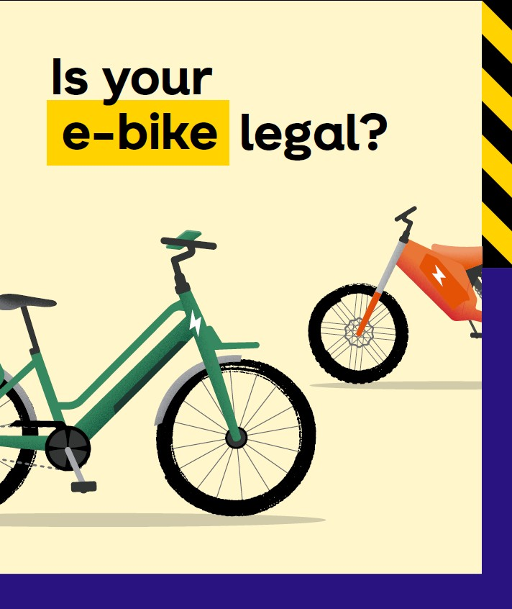
E-rideables
Rules, safe behaviour and purchasing
  STAKEHOLDER PACK
  JUNE 2026

Slide 2
Introduction
The Department of Transport and Planning has partnered with the Transport Accident Commission (TAC) and Victoria Police (VicPol) to launch a social media campaign focused on e-rideable rules, safe behaviour and purchasing.
Please share
We need your help to share this message with your community and networks.
How to use this pack:
We invite you to share campaign materials via social media, newsletters and any other channels you use to communicate with your community – please remember to tag us on:
Instagram: @Transport.Victoria
Facebook: @Transportvictoriagov
Thank you.

Slide 3
Key messaging
Always wear a fitted helmet, no exceptions - it’s a simple way to reduce serious injury.​
Stick to speed limits and ride to the conditions.​
Stay alert: avoid hand-held phones, over-ear headphones, or distractions while riding.​
Check where you can ride: bike lanes, shared paths, and some roads - but not footpaths.​
Unsafe riding puts you and others at risk.​
Respect shared spaces: slow down around pedestrians and give way.​
If you’re unsure, don’t assume - check the rules before riding.​
Only compliant e-scooters and e-bikes can be used on public roads and paths.​
Know the rules before you let a child ride.​
Set clear expectations: where they can ride, how fast, and what’s safe.​
Not all e-rideables sold are legal to use in public - check before you buy.​
Choose devices that meet Victorian safety and speed limits.​
Don’t buy high-powered or modified devices.​
Rules apply to everyone, whether you own the device or are borrowing it.​
A safer purchase means a safer rider.​
3

Slide 4
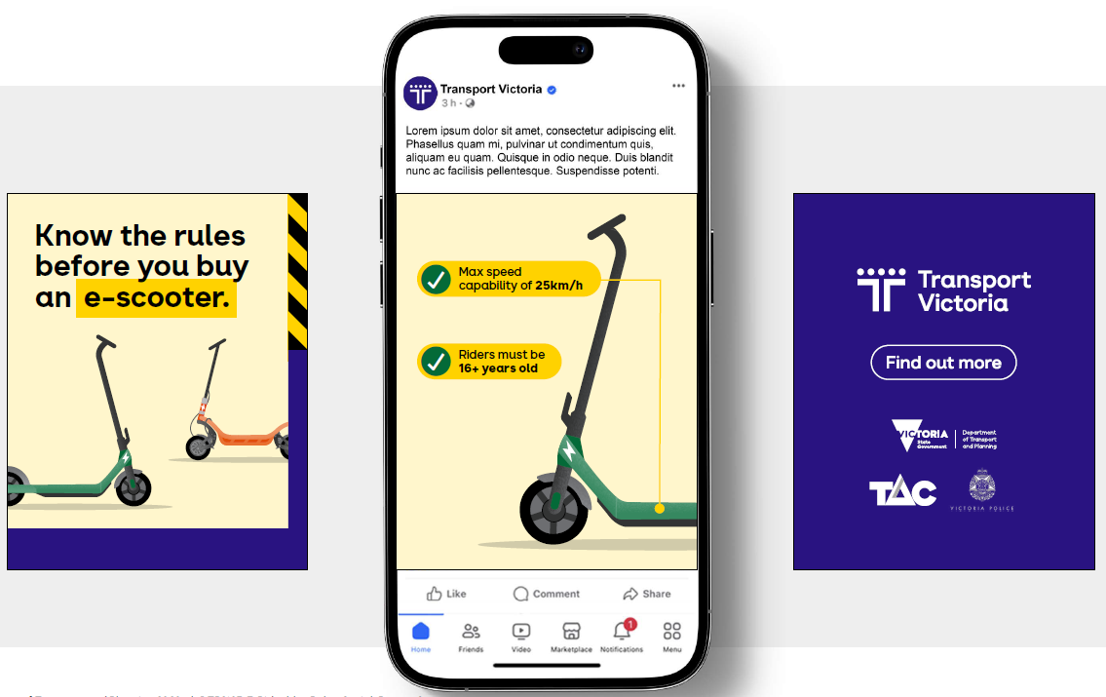
Social Media Creative – e-scooter carousel
Suggested copy:
Thinking of buying an e-scooter? 🛴
Not all e-scooters are legal.
A legal e-scooter must 👇:
Have a max speed capability of 25 km/h
Only be ridden by 16+ years and wear a helmet
Only be ridden at a max speed of 20km/hr
Have two wheels, a handlebar and a footboard
Weigh under 45 kg.
Check the rules before you buy. E-scooter road rules in Victoria - Transport Victoria
Riders
Download artwork here

Slide 5
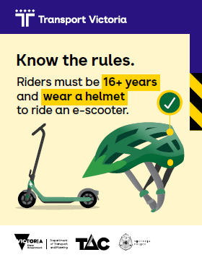
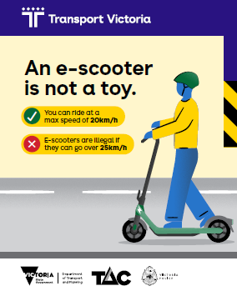
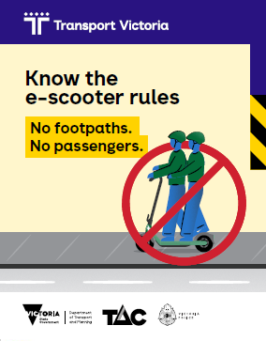
Social Media Creative – e-scooter static tiles
Download artwork here
Download artwork here
Download artwork here
Suggested copy:
Zoom smart, not reckless! 🛴💨
✔ E-scooters can be ridden to a max speed of 20km/h
✔ E-scooters can be ridden on shared paths and bike paths
✖ E-scooters cannot be ridden on roads with >60 km/h speed limit
✖ E-scooters are illegal if they go over 25km/h
✖ E-scooters can’t be ridden on footpaths
Respect the rules. Protect everyone.
Visit E-scooter road rules in Victoria - Transport Victoria
Suggested copy:
Respect the rules.
E-scooters are for riders 16+. 🛴
Ride the right way:
✔ Max riding speed of 20km/h
✔ Helmet
✔ Shared paths and bike paths
✔ One rider
✖ Not on roads with >60 km/h speed limit
✖ No passengers
✖ No phones
✖ No alcohol or drugs
✖ No footpaths
Protect everyone, visit E-scooter road rules in Victoria - Transport Victoria
Suggested copy:
No footpaths. No passengers.
Tell your mates🛴
Ride e-scooters on:
✔ Bike paths
✔ Shared paths
✔ Roads ≤60 km/h speed limit
✔ One e-scooter = One rider.
✔ Riders must be 16yrs+.
Fines apply if you break the rules.
Visit E-scooter road rules in Victoria - Transport Victoria

Slide 6
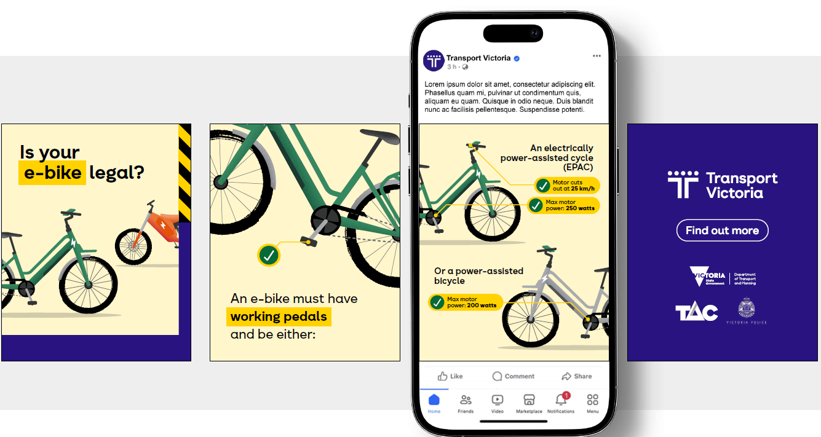
Social Media Creative – e-bike carousel
Suggested copy:
Thinking of buying an e-bike?
Not all e-bikes are legal. 🚲
A legal e-bike must 👇:
Have working pedals
Be max 250W and cut out at 25 km/h (EPAC)
Not have a throttle that powers over 6km/h (EPAC)
OR
• Be max 200W (power-assisted bicycle)
If it doesn’t meet these rules, it’s not road-legal
Check before you ride: https://transport.vic.gov.au/road-and-active-transport/active-transport/bicycles/electric-bikes
Download artwork here

Slide 7
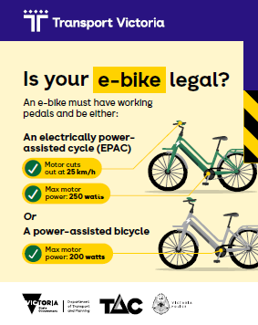
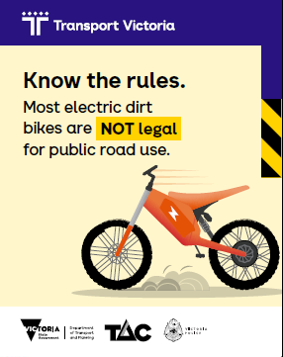
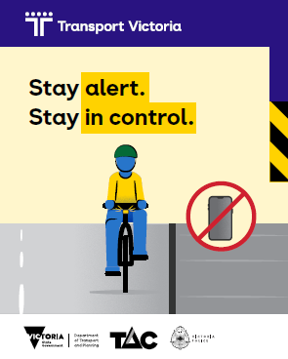
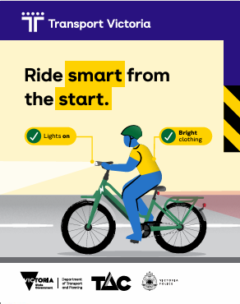
Social Media Creative – e-bike static tiles
Download artwork here
Download artwork here
Download artwork here
Download artwork here
Suggested copy:
E-bike power matters 🚲⚡
To be legal, your e-bike must meet strict power limits:
• Max 250W and cut out at 25 km/h (EPAC)
Not have a throttle that powers over 6km/h (EPAC)
OR
• Max 200W (power-assisted bicycle)
And it must have working pedals.
Travelling at a safe speed starts with a legal e-bike, visit : https://transport.vic.gov.au/road-and-active-transport/active-transport/bicycles/electric-bikes
Suggested copy:
Electric dirt bike? Read this first.⚡🏍️
High power. High speed = not an e-bike.
If it does not have pedals or exceeds e-bike limits, it is classified as a motorcycle.
Motorcycles require:
Registration
Motorcycle learners permit / Licence to ride
Must be 18+ years
Know the rules before you buy: https://transport.vic.gov.au/road-and-active-transport/active-transport/bicycles/electric-bikes
Suggested copy:
E-bikes move fast — your attention matters.
You must:
✔ Wear a properly fitted helmet
✔ Follow speed limits
✔ Respect pedestrians
✖ Not use a hand-held phone
Keep your eyes up and avoid over-ear headphones.
Shared spaces need shared awareness. Bicycle road rules | Lights, helmets and hook turns - Transport Victoria
Suggested copy:
Be seen. Be safe - visibility matters every ride.
✔ Bright clothing
✔ Lights on (day & night)
✔ Reflective gear
If they can see you, they can avoid you.
Learn more about safe riding rules: Bicycle road rules | Lights, helmets and hook turns - Transport Victoria

Slide 8
Newsletter/ e-news - suggested copy
Know the rules before you buy an e-scooter or e-bike
The Department of Transport and Planning, Transport Accident Commission (TAC) and Victoria Police (VicPol) are committed to raising awareness on the rules, safe behaviours and purchasing of e-bikes and e-scooters in Victoria.
Unsafe riding puts you and others at risk. Rules apply to everyone, whether you own the device or are borrowing it.
These are some of the key rules and safety practices for riding an e-scooter or e-bike:
Choose devices that meet Victorian safety and speed limits
Only compliant e-scooters and e-bikes can be used on public roads and paths
Always wear a fitted helmet
Stick to speed limits and ride according to the conditions
Stay alert - avoid hand-held phones, over-ear headphones, or distractions while riding
Don’t buy or use high-powered or modified devices.
A safer purchase means a safer rider. Not all e-rideables sold in stores or online are legal to use in public – check before you buy.
For more information on rules and how to stay safe, visit the Transport Victoria e-bike or e-scooter webpages.
8

Slide 9
FAQs: e-bikes
What is a legal e-bike? | There are two types of legal e-bikes in Victoria. A power-assisted bicycle with a combined maximum power output not exceeding 200 watts, or An electrically power-assisted cycle (EPAC) that requires the rider to pedal to access the power, with a limit of 250 watts. Power assistance progressively reduces as the speed increases and cuts off once a top speed of 25km/h is reached.
Do I need a driver's licence or need to register an e-bike? | No, you don't. Legal e-bikes are treated the same as normal bicycles.
How old do you have to be to ride an e-bike? | There is no set age requirement to ride an e-bike, however when buying an e-bike parents and caregivers should choose equipment that matches the person’s skill level, experience, maturity, and where it will be used.
What safety rules must I follow? | All bicycle rules apply to e-bikes. These include: Always wear a helmet Do not scroll on phones or other devices that may distract you while riding Use lights at night Follow all road rules (e.g., stopping at traffic lights)
Can I carry passengers? | You must not carry more passengers than the bike is designed to carry. Children must be seated on appropriate child bike seats, which should follow the age and weight restrictions set by the seat manufacturer.
Where can I ride an e-bike? | In Victoria, only e-bikes that meet strict requirements can be ridden in public. Footpath riding is illegal unless you are 12 years and under, supervising a person who is 12 years or younger or carrying a medical certificate exempting you from road-based riding. An adult can also ride on a footpath with a child in a bicycle baby seat or with a child pedalling on a bike attachment connected to the adult bike.
What should I check before buying an e-bike? | Check that the device is legally allowed to be used on public roads and paths in Victoria and meets the legal requirements. Assess if the e-bike is appropriate for a child’s age and ability. It is important to note that not all devices sold in shops are legal to ride on public roads and shared paths. See the Transport Victoria website for more information on the legal requirements of e-bikes.
9

Slide 10
FAQs: e-scooters
What is a legal e-scooter? | A legal e-scooter must have: Max speed capability of 25 km/h Two wheels, handlebar, footboard Weight under 45 kg
Is licensing or registration required? | No, you don't need a licence or to register an e-scooter.
Is there a minimum age required to ride an e-scooter? | You must be 16 or older to ride an e-scooter.
How fast can I go? | You should ride at a speed not more than 20km/h. However, you must ensure that your e-scooter is not able to travel beyond 25km/h.
Where can I ride an e-scooter? | In Victoria, only e-scooters that meet strict requirements can be ridden in public. Legal e-scooters can be ridden up to 20km/h on bike paths, shared paths and roads up to 60km/h. You cannot ride on footpaths.
What safety rules must I follow? | You cannot: ride on footpaths or roads with a speed limit above 60km/h ride under the influence of drugs or alcohol use a mobile phone while riding carry passengers or animals ride next to another rider (side by side)
What should I check before buying an e-scooter? | Check that the device is legally allowed to be used on public roads and paths in Victoria and meets the legal requirements (e.g., 25km/h speed limitation). Assess if the e-scooter is appropriate for a child’s age and ability – the minimum riding age is 16 years. It is important to note that not all devices sold in shops are legal to ride on public roads and shared paths. See the Transport Victoria website for more information on the legal requirements of e-scooters.
10

Slide 11
Thank you
For more information, please contact
Road Safety Victoria:
roadsafetyvictoria@transport.vic.gov.au

