Slide 1
My Career Insights Morrisby Profiling 2024
My Career Insights

Slide 2
Overview
Learning Intention:
To introduce students to the Morrisby Careers profiling and the benefits of this program. Success Criteria:
I am aware of the structure and benefits of the Morrisby Careers profiling program.

Slide 3
What is the Morrisby Career Profiling?
The Morrisby Career Profiling is a tool used to inspire you and give you some guidance as to
Your strengths and interests
How to find a career
Study options
The Morrisby Career Profiling is made up of 2 parts:
Assessment- This is a series of short questions.
Interview with a careers consultant

Slide 4
What is the Morrisby Profiling ?

Slide 5
Part One: Assessment
It will take approximately 2 hours to complete the assessment.
This is made up of a series of short questions
Questions are timed
Completed online
What to expect:
There are 8 timed aptitude modules and 2 multiple choice questionnaires (interest and personality)
Measures:
Verbal, numerical, abstract and spatial aptitudes.
Talents, motivations and personality.
Work preferences.
Notes:
One of the first things you will see in your report is a graph of your aptitudes.
The important thing to focus on is the shape of the graph rather than the length of the bars. This will be explained to you in more detail during your follow-up discussion.

Slide 6
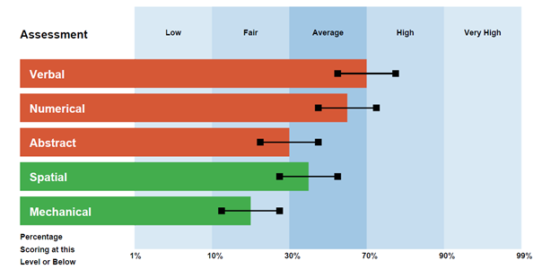
The 5 Aptitudes
VERBAL – Your ability to use words and indicates potential in dealing with written and spoken information.
NUMERICAL – Your comfort or intuitive insight when using numbers.
ABSTRACT – Your ability to deal with complex problems. This indicates a preference for dealing with real thing and visual information; charts diagrams and pictures.
MECHANICAL – Your ability to appreciate and solve mechanical problems.
SPATIAL – Your spatial ability by assessing how well you can visualize 3-dimensional objects from 2-dimensional plans.
Notes:
There are five elements that we describe as your aptitudes:
Your ability to use and understand words - verbal;
Your ability to use and interpret numbers - numerical;
Your ability to deal with charts, diagrams and pictures - abstract;
Your ability to imagine a 3D shape from a 2D image - spatial; and
Finally, your ability to solve mechanical problems – mechanical.

Slide 7
Part One: Assessment
Assessments will take place on:
Tuesday 5 March, Period 3 & 4
You MUST have a charged laptop with access to the college internet.
You must know your @schools email address
Will be required to create a password you will remember.
Notes:
Another feature of your profile is a list of subject suggestions.
The longer the ratings bar is, the more suited you are to the subject.
This can form the basis of further conversations with school staff in regard to subject selections a little later on.

Slide 8
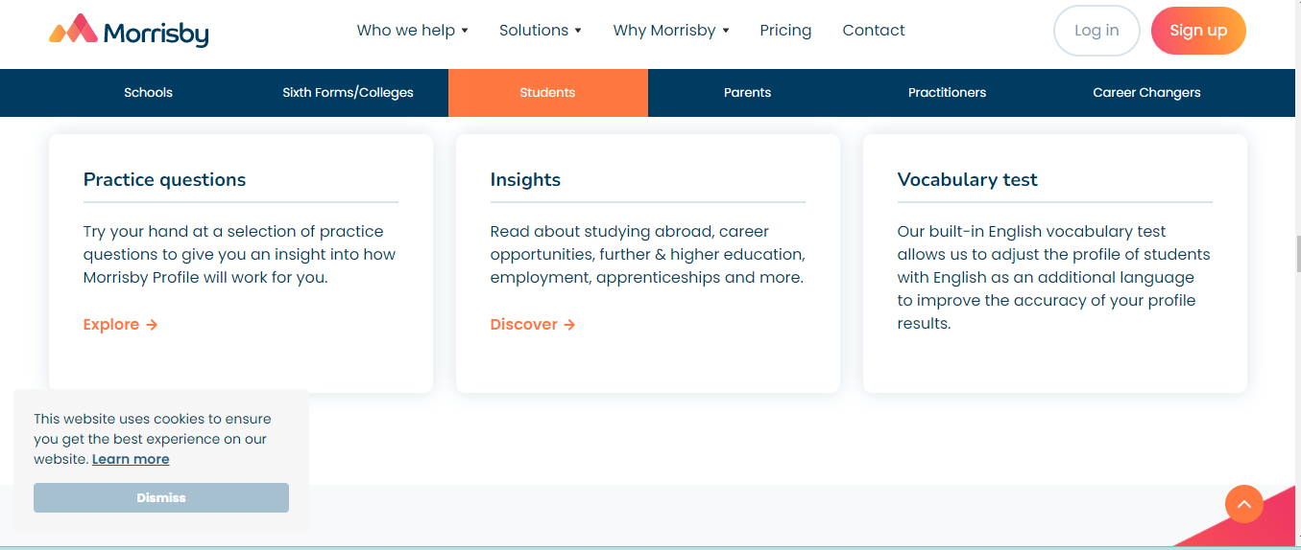
Part One: Assessment
Practice questions:
Go to www.morrisby.com
Select the “Who we help” tab
Select the student option
Scroll down to the practice questions.
Notes:
Your interests, alongside your aptitudes, provide insight in to work situations and structures that may suit you.
In this case, the person is interested in caring for people, advising people, written and spoken communication, interpreting numbers and figures.
What types of careers might suit someone with these interests?

Slide 9
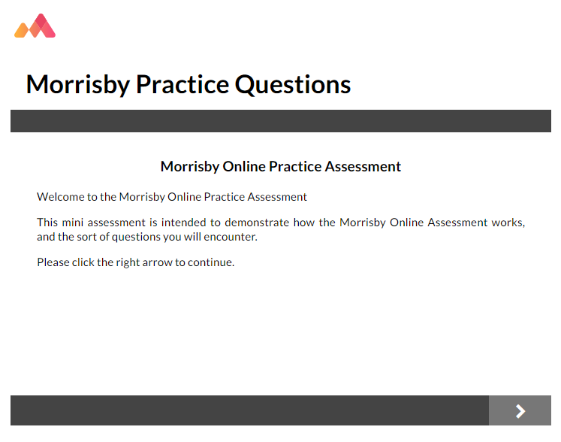
Part One: Assessment
These practice aptitude questions are designed to familarise you
with the style of questions you will be answering in your profiling session
https://app.morrisby.com/practice-questions
Notes:
While this short practice doesn't cover every question type, it will give you a good idea of how the profiling works.

Slide 10
Part One: Assessment
Sample Questions
Notes:
There are five elements that we describe as your aptitudes:
Your ability to use and understand words - verbal;
Your ability to use and interpret numbers - numerical;
Your ability to deal with charts, diagrams and pictures - abstract;
Your ability to imagine a 3D shape from a 2D image - spatial; and
Finally, your ability to solve mechanical problems – mechanical.

Slide 11
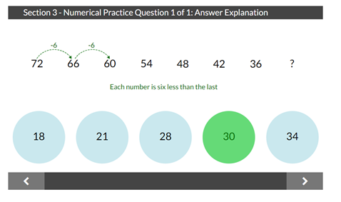
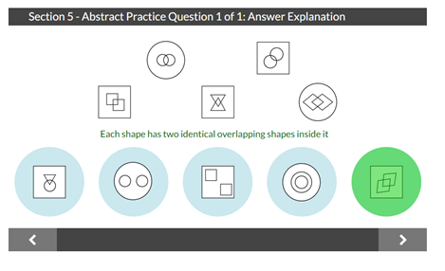
Some examples…
Notes:
The examples here, show questions taken from the Verbal, Numerical and Abstract assessments.

Slide 12
Your Morrisby Profile
Once you have completed the assessment you will receive:
A digital report
Life-long access
Notes:
Alongside the online version of your personal profile, you will receive a hard copy of your report during your follow-up discussion.
This discussion is with a Morrisby-trained Careers Consultant and they will explain your results to you.

Slide 13
Part Two- Unpack Interviews
Each of you will have a 30-minute interview with a careers consultant who will help you understand your results.
Interviews will take place between Monday 18 March & Tuesday 19 March (Week 8).

Slide 15
Important to remember:
Your Morrisby Profile is all about YOU!
It is important that we have true and accurate results so that when you have your one-on-one unpacking session, they will be able to advise you based on your authentic Morrisby profile.
It is important that all answers are your own to make sure the results reflect your true strengths and preferences.
It is NOT an exam- There is no pass or fail.
Notes:
Your interests, alongside your aptitudes, provide insight in to work situations and structures that may suit you.
In this case, the person is interested in caring for people, advising people, written and spoken communication, interpreting numbers and figures.
What types of careers might suit someone with these interests?

Slide 16
What students have to say about the Morrisby Career Profiling
https://www.tiktok.com/@fgatesecondary/video/7225459150250134786
Notes:
Your interests, alongside your aptitudes, provide insight in to work situations and structures that may suit you.
In this case, the person is interested in caring for people, advising people, written and spoken communication, interpreting numbers and figures.
What types of careers might suit someone with these interests?

