Slide 1
Gallipoli
A LEGO story

Slide 2
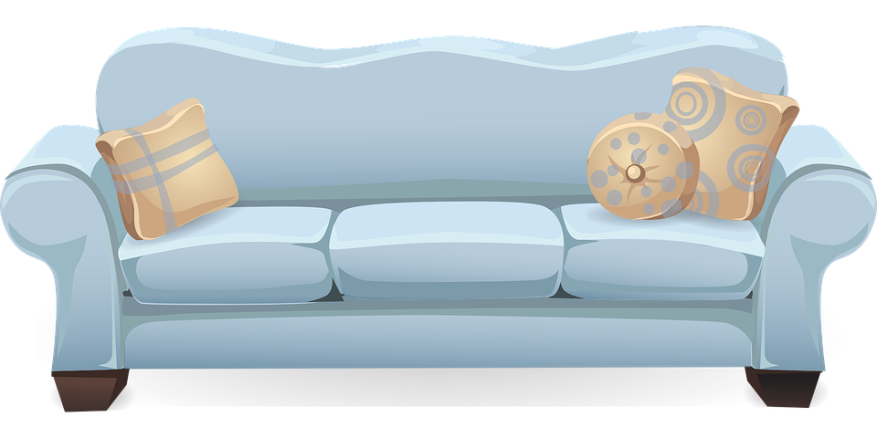
At home.
The soldiers are still at home. They have not left to fight.

Slide 3
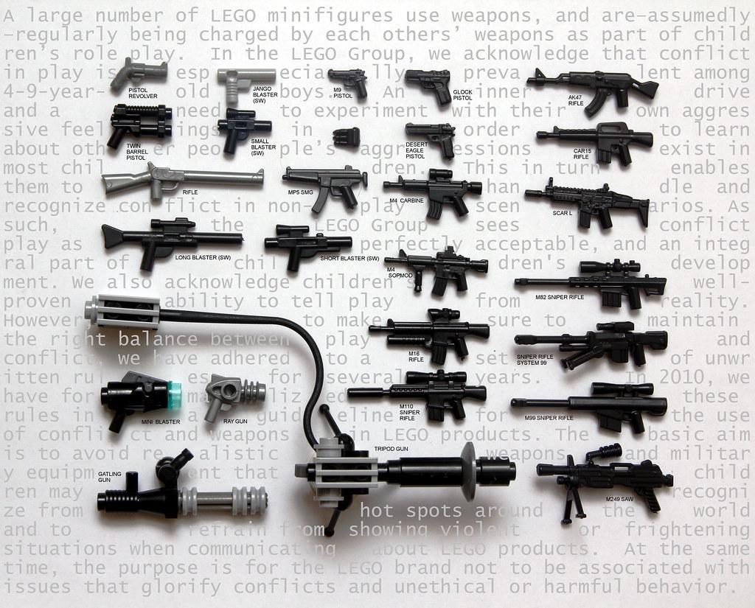
Going to war.
The soldiers have been called to fight at Gallipoli.

Slide 4
Crossing the sea.
They have left their
country and are on their
way to Gallipoli.

Slide 5
War.
They are at war
and fighting
for their lives
and country.

Slide 6
Still going.
The war has been
going for 3
months.

Slide 7
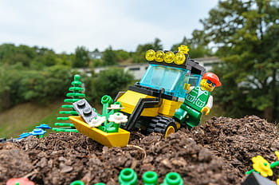
Many graves.
Graves of diggers and the enemy dead
surround the soldiers.

Slide 8
Back at home.
At home many
people are worried,
They send their love
to the soldiers.

Slide 9
On the battlefield.
Many months in and thousands
of men have died.

Slide 10
Soldiers.
The soldiers are
worn out but keep
fighting until the end.

Slide 11
One of the guns.

Slide 12
Wild life.
Animals dead or
alive are there
and have to
live through
the devastation
of the Gallipoli
war.

Slide 13
homes.
Diggers dig trenches
to protect soldiers.

Slide 14
Many more.
Many more
graves are made in
remembrance of the dear
soldiers.

Slide 15
camp

Slide 16
home
People at
home are
more worried
than ever.

Slide 17
finally.
Finally the
war has
come to
an end
142,000
people have
died and the soldiers are very sad that they have lost their friends.

Slide 18
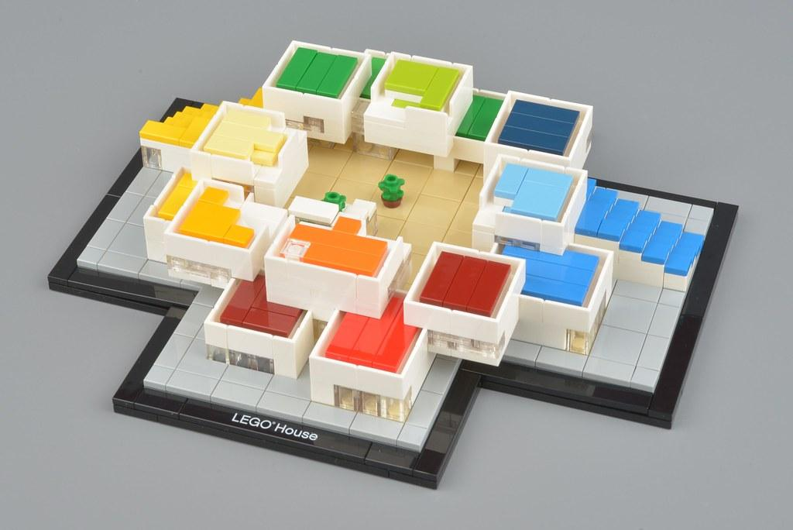
Back to home.
The soldiers now have
to cross the sea again
to get back home.

Slide 19
Some of my thoughts about this subject.
I think this project was really fun and educational at the same time.
I liked this project because i got to do fun creating tasks.
I hope that in future we get to do stuff like this.
Also i think that for the soldiers fighting there, getting a batch of biscuits would mean the world to them. .

Slide 20
Thank you!!!

