Slide 1
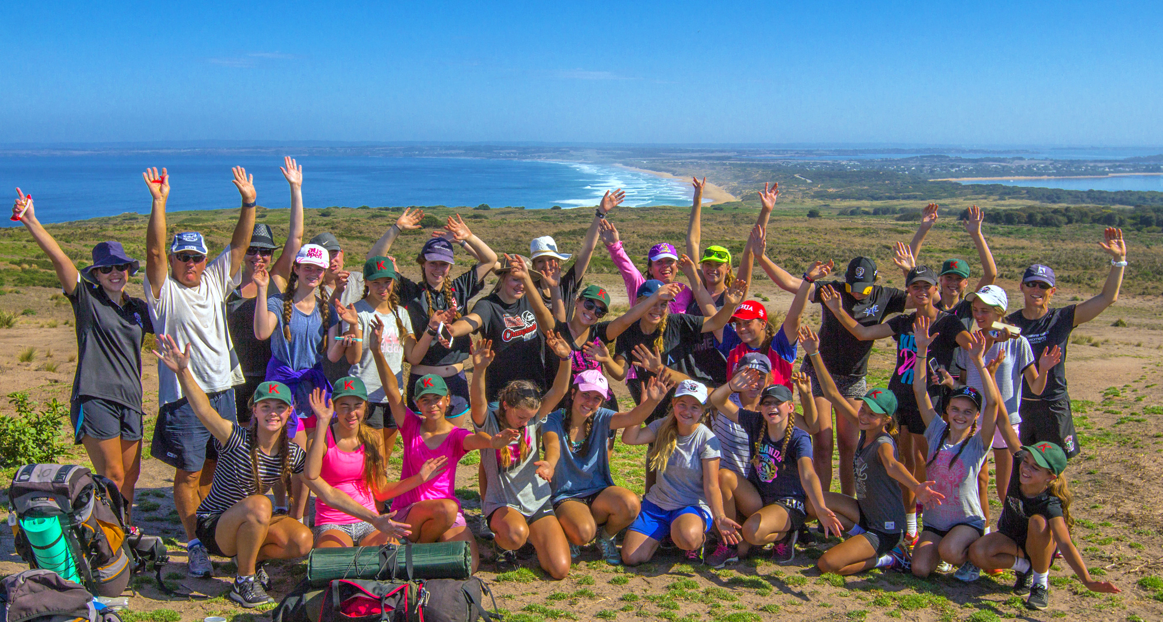
Duke of Edinburgh 2021
Mrs Jo Wood & Mrs Maree Clark
Award Coordinators

Slide 2
What is the Duke of Edinburgh award?
An award recognised world-wide
Bronze, Silver and Gold levels
Only Bronze level offered at Kilbreda

Slide 3
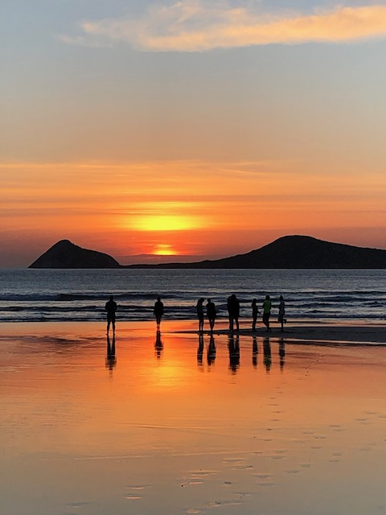
AWARD COMPONENTS
SKILL
PHYSICAL RECREATION
SERVICE
ADVENTUROUS JOURNEY

Slide 4
Requirements
Must complete 3 months each of the skill, recreation and service sections. This must be a minimum of 1 hour per week and signed off by an assessor
One of these sections must be completed for a minimum of 6 months.
An assessor is anyone with relevant experience in your chosen field (not a parent).
Attend lunchtime and afterschool sessions in preparation for the Practice and Qualifying Journeys.

Slide 5
Skill
This section should stimulate new interests or improve existing ones.
Typically non-physically demanding, maybe a hobby or life skill
Examples Music – singing, learning to play an instrument
Sports related – sports officiating, umpiring/refereeing
Arts and crafts – embroidery, jewellery making, drawing, painting, sculpture, photography, cooking
Nature and the environment – agriculture, astronomy, bee keeping, conservation, fishing, forestry, gardening
Communication – film and video, languages, reading, writing, public speaking, journalism, website development

Slide 6
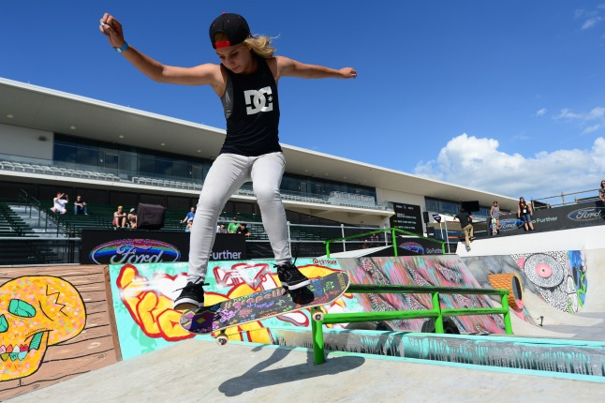
Physical Recreation
This can involve becoming a part of a sporting team or undertake a physical activity as an individual or as part of a group
You should choose a physical activity that interests you. This can be something completely new or an activity that you already have knowledge or involvement
Examples - Martial arts - Swimming - Skateboarding - Dancing - Netball

Slide 7
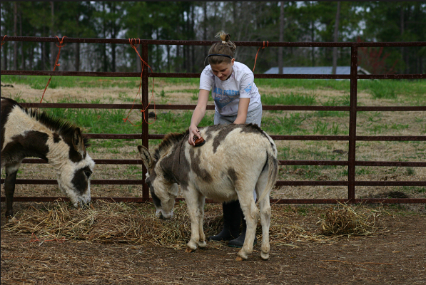
Service
This section is based on the belief that members of the community should care for each other and contribute to their community
Examples - Care for animals - First aid / surf life saving - Aged care - Coaching junior teams - Kindergarten/childcare helper - Primary school help

Slide 8
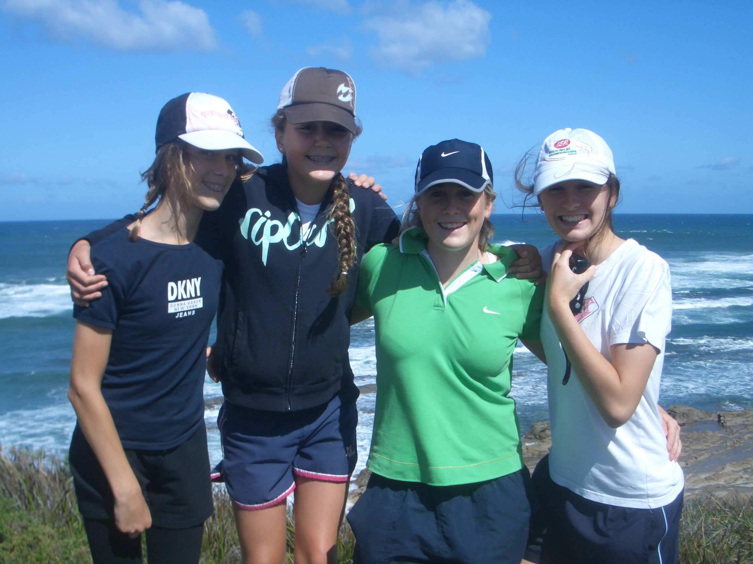
Adventurous journey
The bronze award involves an expedition that incudes hiking and camping.
Practice Hike – Term 1 Week 10 (Combined with Bridges camp)
Qualifying Journey – Middle of Term 4 (2 nights)
What is provided? - tents - cooking equipment - backpacks - japaras

Slide 9
Yes I’m keen, what do I do now?
1. Take application sheet home today and talk to your parents ($350 cost – covers Duke of Ed fee and camps).
2. Complete application sheet and return by Wednesday 2nd December 2020 (no late entries accepted)
3. Start to think about skill, physical recreation and service ideas and assessors.

Slide 10
