Slide 1
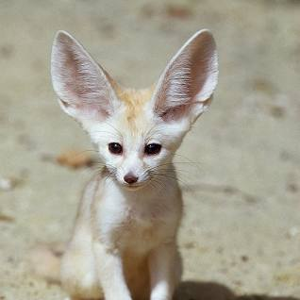
Fennec Foxes
By Amelia

Slide 2
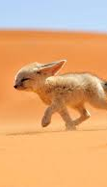
Introduction
Fennec Foxes are a very small animal and they are also very talented. Fennec Foxes are the smallest fox in the world. The average Fennec Fox is only about 8 inches tall and weighs nearly 2 – 3 pounds.

Slide 3
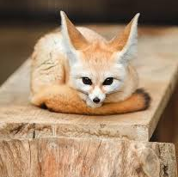
Physical Appearance
Fennec Foxes have a long, soft coat and a big range of colour from reddish cream to a light fawn to almost white. Their undersides are pure white, and their tails are bushy with black tips. Fennec Foxes are adapted to their life in the Dessert.

Slide 4
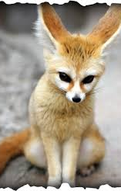
Habitat
Fennec Foxes live in North Africa, throughout the Sahara Desert and East to Sinai and Arabia. They prefer sandy deserts and arid regions with desert grasses or scrub vegetation.

Slide 5
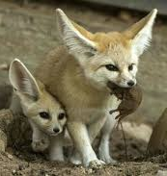
Diet
In the wild, Fennec Foxes eat insects – particularly grasshoppers and locusts – as well as small rodents such as lizards, birds and their eggs. They will also consume roots, fruit, and leaves which helps them hydrate.

Slide 6
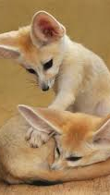
Behaviour
Fennec Foxes spend most of their day in their underground burrow that helps them to avoid the desert heat. They emerge from their dens at dusk to begin the search for food. Fennec Foxes are omnivores, feasting on a variety of prey as nigh time hunters. They enjoy snails, lizards, plants, fruits, roots, and eggs.

Slide 7
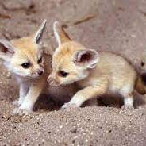
Reproduction
Fennec Foxes give birth to one litter of pups each year with between two and five young in a litter. During the four to six weeks of rutting season, males can be extremely aggressive and will mark their territory with urine.

Slide 8
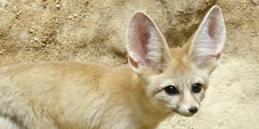
Status & Threats
Picture
The threat to Fennec Foxes if human interference. Fennec Foxes are commonly trapped for exhibition or sold to tourists. There have been limited instances of human settlements encroaching on Fennec Foxes population. Populations in the Sahara region hunt Fennec Foxes.

Slide 9
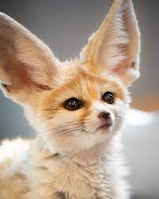
Thank you for listening

