Slide 1




VCE BUSINESS MANAGEMENT
https://www.vcaa.vic.edu.au/curriculum/vce/vce-study-designs/business-management/Pages/Index.aspx

Slide 2
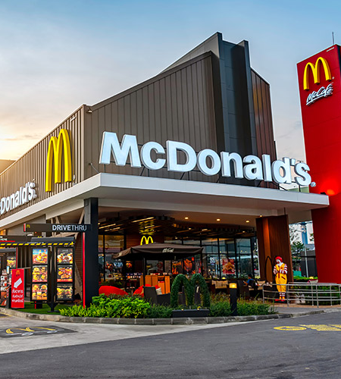
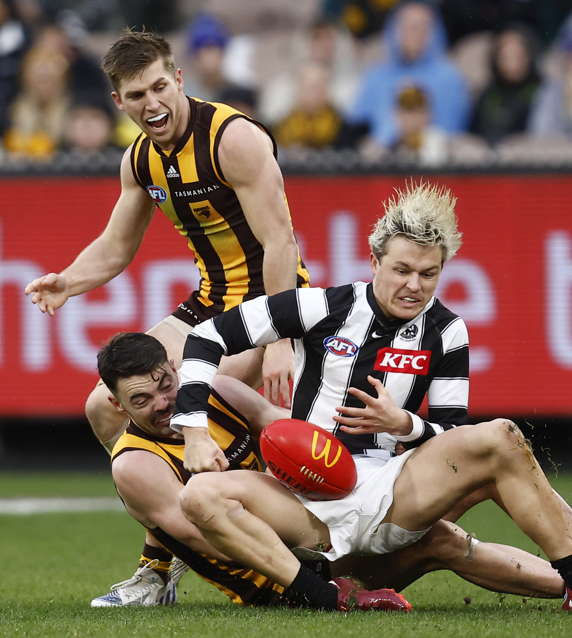
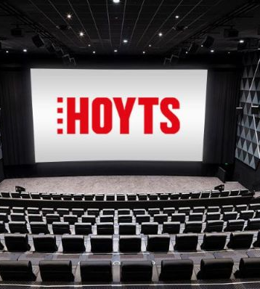
VCE BUSINESS MANAGEMENT

Slide 3
CAREERS Options
Will you be working for a large organisation in the future?
As an employee or perhaps as a manager?
Do you want to run a small business?
Maybe you are interested in the following careers:
- Operations Manager, Human Resource Manager, Marketing, Accounting, Events management ete.

Slide 4


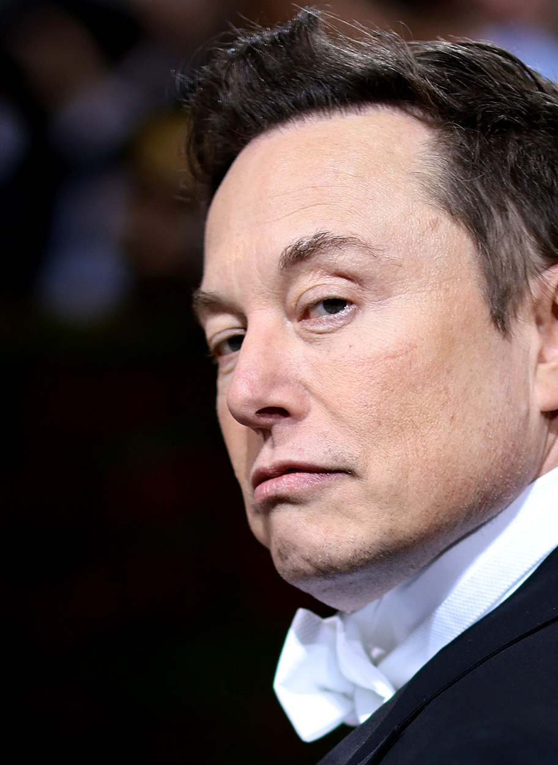

UNIT 1: Planning a business
Outcome1:
Identify business opportunities (e.g Gaps in the market)
Innovation and Entrepreneurship
Motivations behind starting a business
Market Research and Feasibility studies
Research and Development
Goal setting

Slide 5
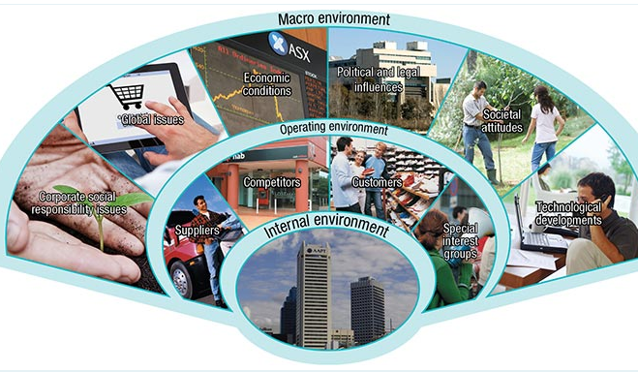
UNIT 1: Planning a business
Outcome 2&3: Business Environments
Internal, Operating and Macro Environments
The factors that impact on business operations. E.g customers, suppliers, government, employees etc.

Slide 6

UNIT 2: Establishing a Business
Outcome 1: Legal Requirements & financial considerations for businesses

Slide 7
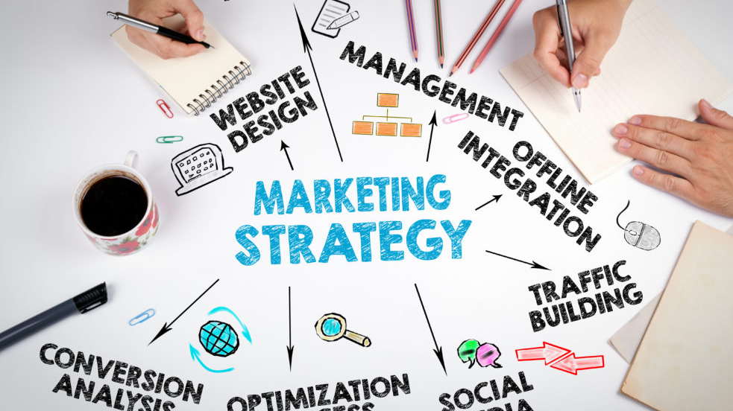
Unit2: Establishing a business – Outcome 2 Marketing

Slide 8

Unit2: establishing a business: outcome 3 staffing a business
Job analysis
Recruitment methods
Selection Methods
Pay and working conditions
Employee Expectations
Employer Expectations
Legal requirements
Corporate Social Responsibility

Slide 9
ASSESSMENT
INCLUDE
1. Assignments / Projects ( Excursions involved):
Designing an innovative product
Planning and running a small business.
2. Case Studies (Current issues ) with structured questions under test conditions.
3. Exams

Slide 10


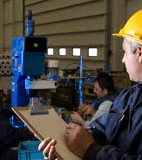
UNIT 3: Managing a business

Slide 11
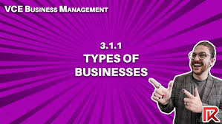
Unit 3: Managing a Business – Outcome one Business foundations
Types of businesses and their business objectives
Management styles and skills
Different types of Stakeholders
Corporate Culture

Slide 12

Unit3: managing a business – outcome 2: Human resource management
Motivation Strategies
On the job and off the job training
Performance Management Strategies
Termination Management
Role of workplace participants
Methods of determining wages and working conditions
Dispute resolution

Slide 13
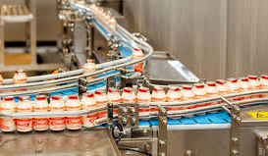
Unit 3 managing a business – outcome 3: operations management
How is Yakult manufactured?
Elements of an operations system
Characteristics of a service vs a manufacturing business
Strategies to improve efficiency and effectiveness
Global considerations in Operations
Corporate Social Responsibility considerations.

Slide 14
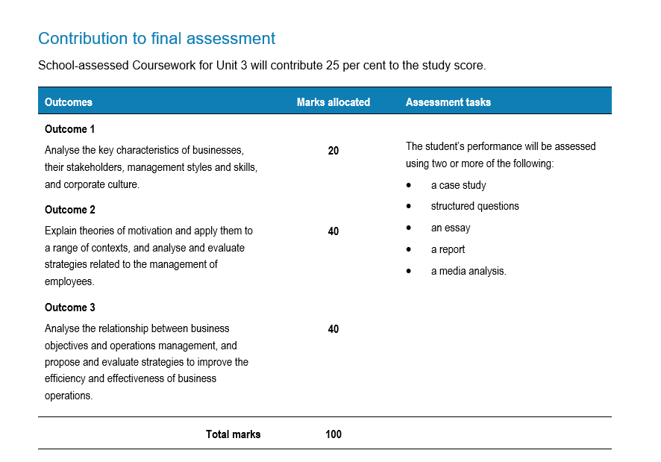
Assessment: unit 3

Slide 15

UNIT 4: Transforming a Business

Slide 16
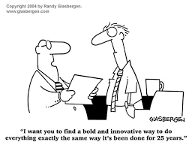
Unit 4 transforming a business: outcome 1 – REVIEWING PERFORMANCE
The need for change
Key Performance Indicators
Driving forces for change
Restraining forces for change
Different theories relating to change.

Slide 17

Unit4: transforming a business- outcome 2: implementing change
Leading change
Implementing strategies for change
Theories of change
The effect of change on stakeholders
Corporate Social Responsibility during change.

Slide 18
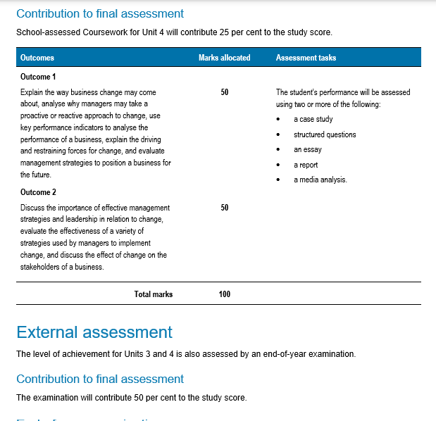
Assessment https://www.vcaa.vic.edu.au/assessment/vce-assessment/past-examinations/pages/business-management.aspx

Slide 19
KEY SKILLS REQUIRED…
Define Key terminology. 100’s of terms to remember.
Apply knowledge to Case Studies
Analyse Case Studies
Provide extended responses
Refer to Data in your responses.
Be able to compare and contrast different businesses/ organisations.

Slide 20
High ORDER THINKING QUESTIONS and command terms
Describe
Analyse
Distinguish
Compare
Discuss
Evaluate
Propose
Justify

Slide 21
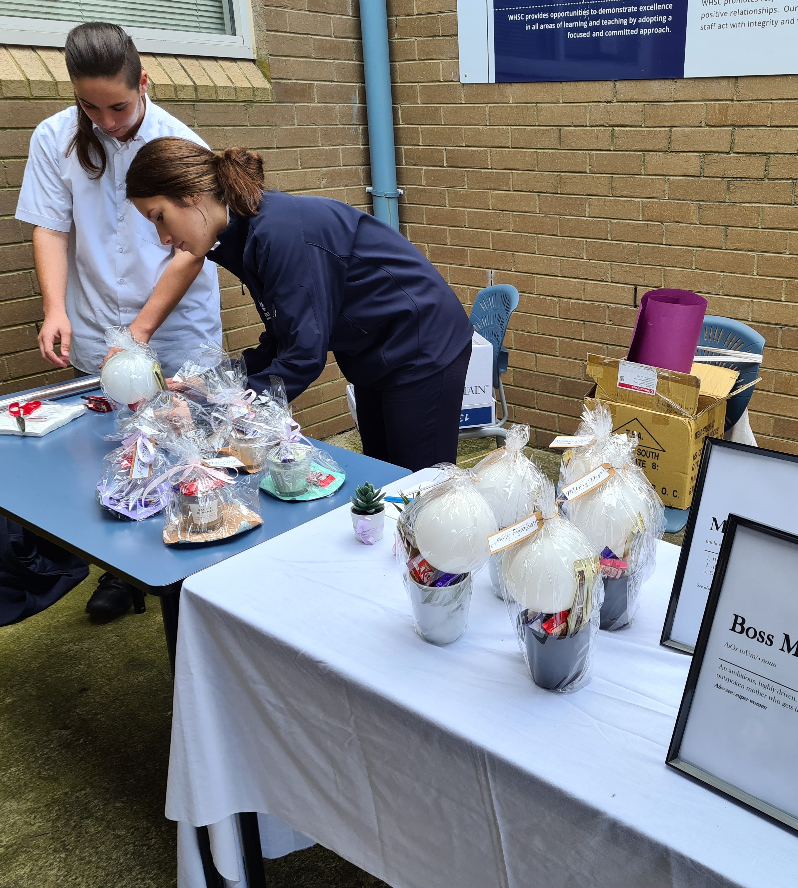
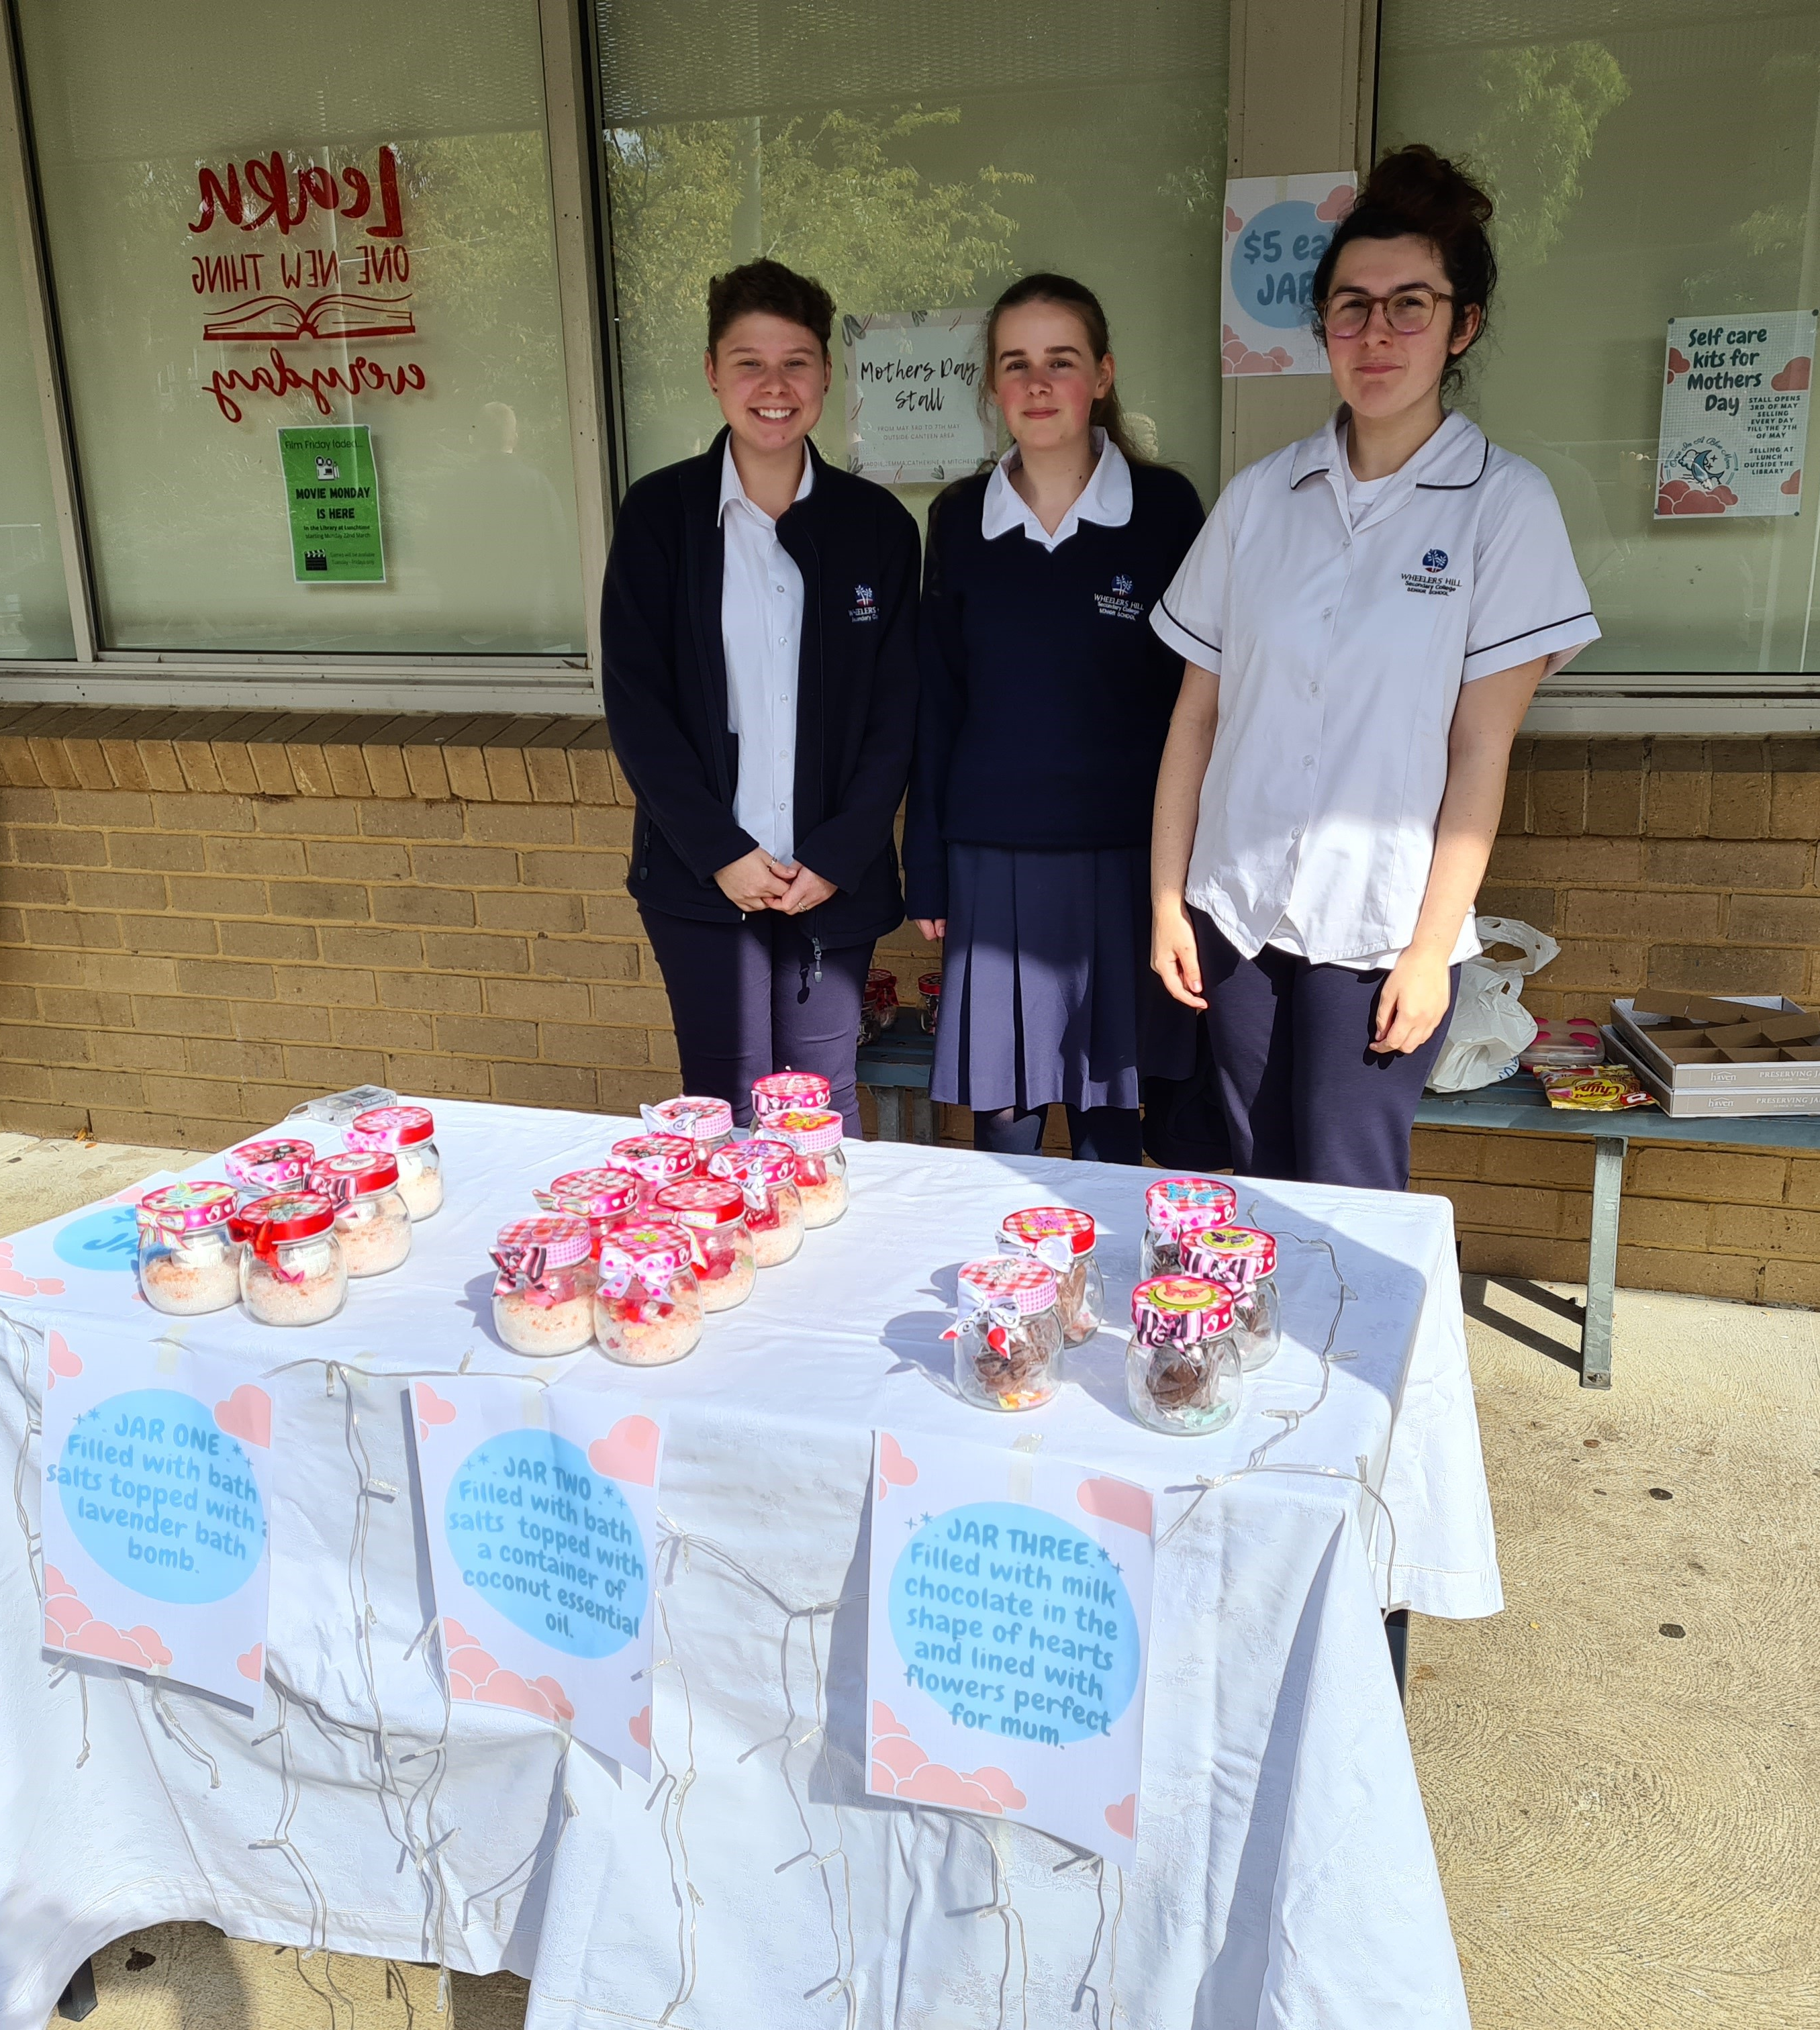
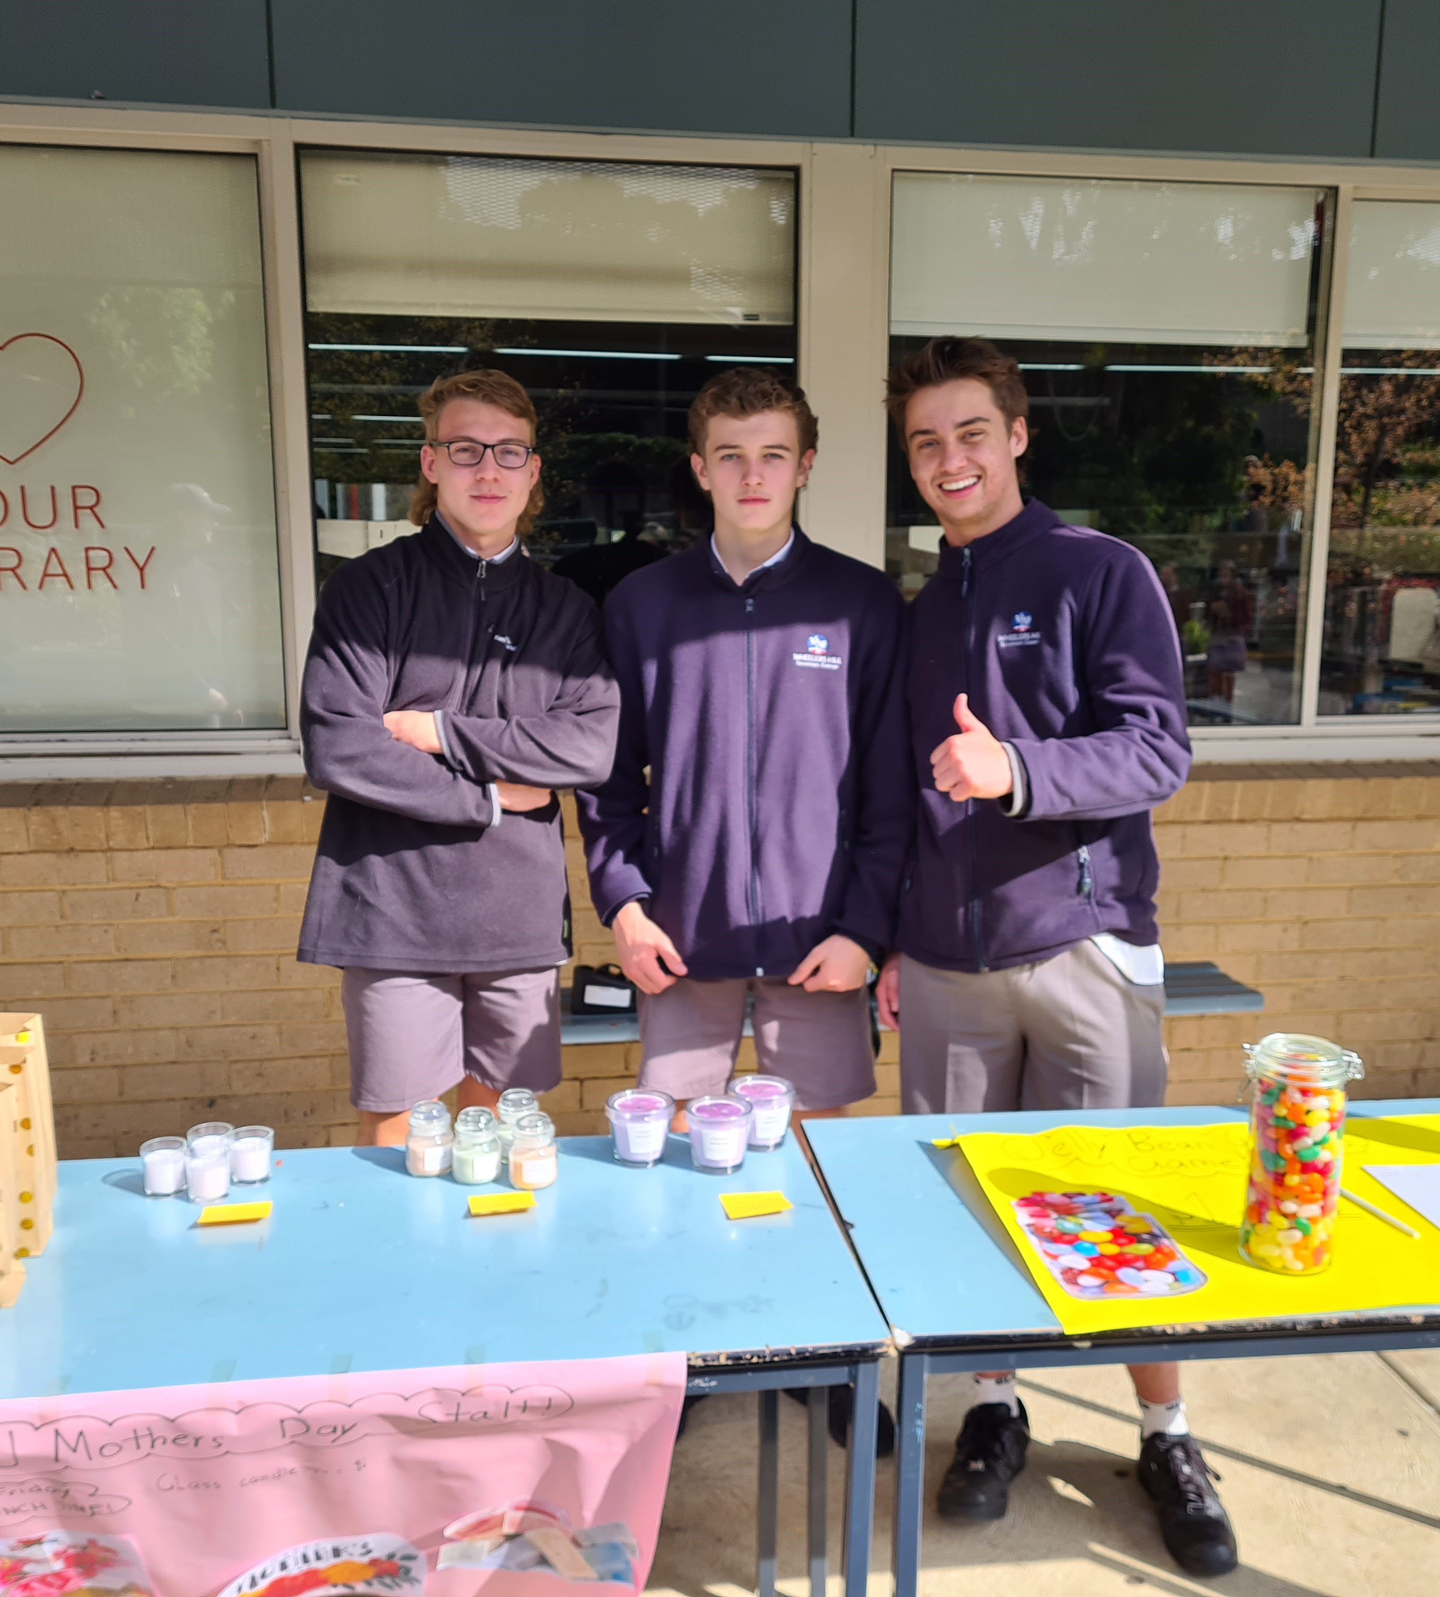
Mother’s Day stalls Unit 1 BM
You do not need any pre-requisite subjects to undertake History units 1 – 4. However, Units 1 and 2 are highly recommended.

Slide 22

CONTACT
Wheelers Hill Secondary College
Phone: (03) 9561 5811
Fax: (03) 9561 8227
General Office Enquiries: wheelers.hill.sc@education.vic.gov.au

