Slide 1


A Tribute to Pope Francis

Slide 2
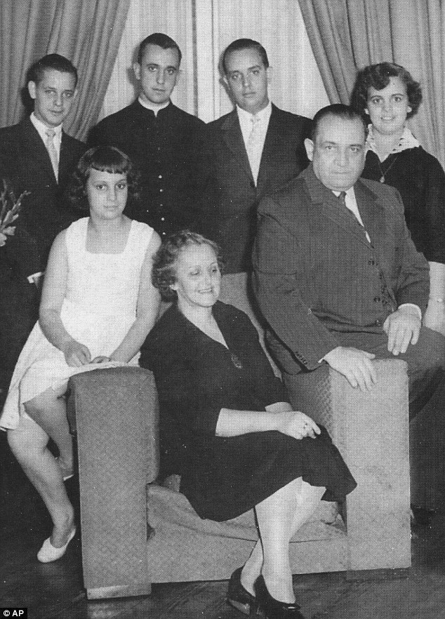
Early life and family
Pope Francis, born Jorge Mario Bergoglio. Was born on December 17, 1936, in Buenos Aires, Argentina. The son of italian immigrants, Regina Maria Sivori, a committed wife and mother of five and Mario Jose Bergoglio an accountant. Jorge was raised in a modest hardworking family, the eldest of the five children. His upbringing in a modest, working-class neighborhood fostered his sense of empathy and concern for the poor and marginalized. His upbringing inspired his choosing of the name Francis was seen as a symbol of poverty, peace, and humility, aligning with Saint Francis of Assisi's life and teachings.

Slide 3
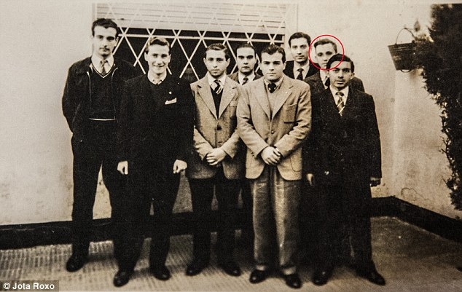
Education and First Career
Jorge attended the technical secondary school Escuela Técnica Industrial Hipólito Yrigoyen and graduated with a chemical technician's diploma before becoming a priest. Jorge always valued hard work and dedication and worked various jobs whilst receiving his education, he worked briefly in the food industry, as a janitor and a bouncer and then spent several years working in the food section of Hickethier-Bachmann Laboratory.

Slide 4
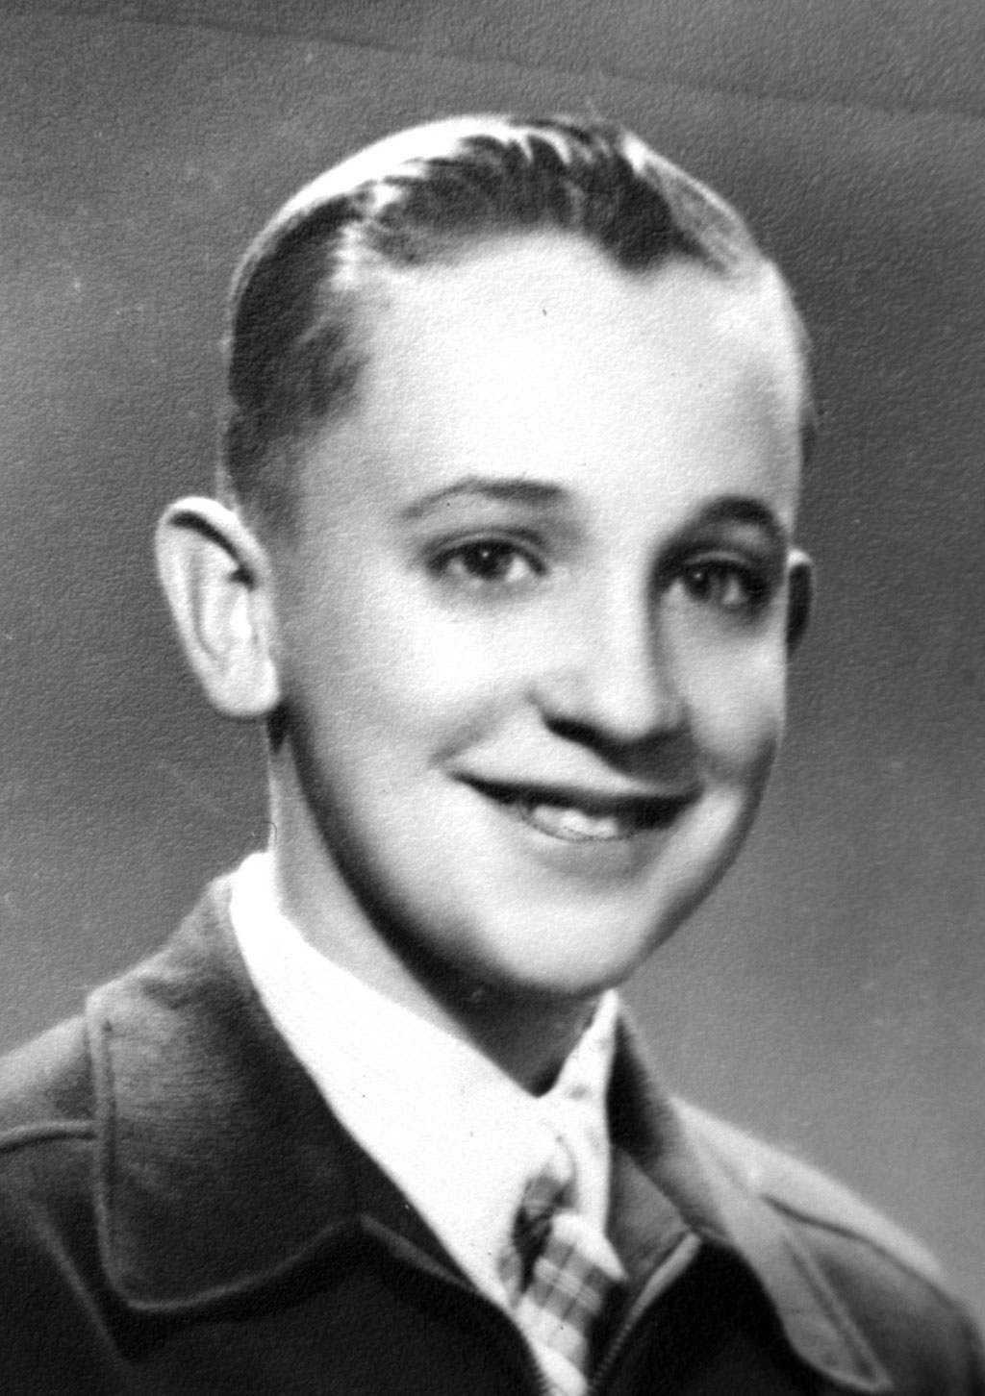
A Life-Changing Illness
At the age of 21, Jorge contracted pneumonia, a respiratory infection that affects the lungs. Jorge’s case of pneumonia was so server, a portion of his right lung had to be removed and he had believed he was going to die. Whilst on his deathbed, Jorge had a revelation and decided to serve God by becoming a priest. He then entered the Jesuit novitiate in 1958 and turned to academics, studying humanities in Santiago, Chile, and earning a master’s degree in philosophy.

Slide 5
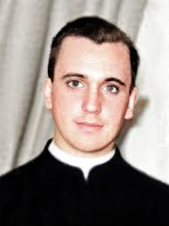
Answering the Call
On 13th December 1969 in Buenos Aires, Argentina, Bergoglio was ordained a priest by Archbishop Ramón José Castellano. In April 1973, he took his final vows in the Jesuit order, officially becoming a Jesuit priest. After Pope Benedict XVI's resignation in February 2013. A papal conclave, was convened in March 2013 to elect a new pope. On the fifth ballot, Cardinal Jorge Mario Bergoglio, the Archbishop of Buenos Aires, was chosen and he took the name Francis.

Slide 6
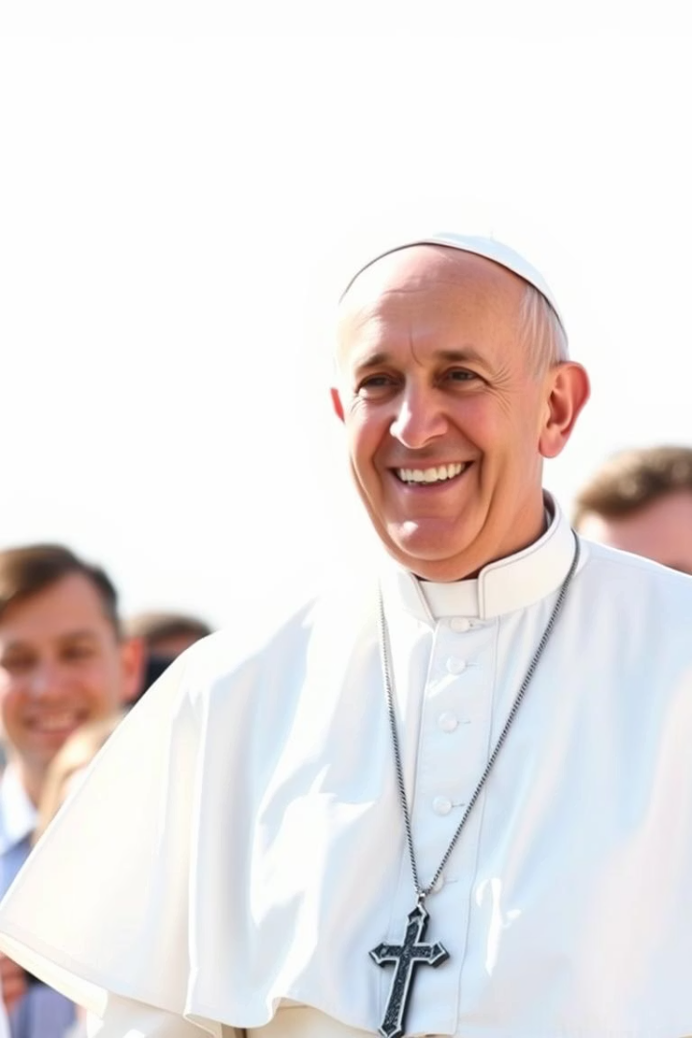
Breaking New Ground
First Jesuit Pope
Church Reform
He is the very first Jesuit and native Latin American ever chosen to lead the Catholic Church, marking a historic moment.
He pushed for greater financial transparency and took a strong stand against corruption within the Vatican Bank.
Synodality
He has championed a culture of listening, encouraging active dialogue among bishops and laypeople alike for shared leadership.

Slide 7
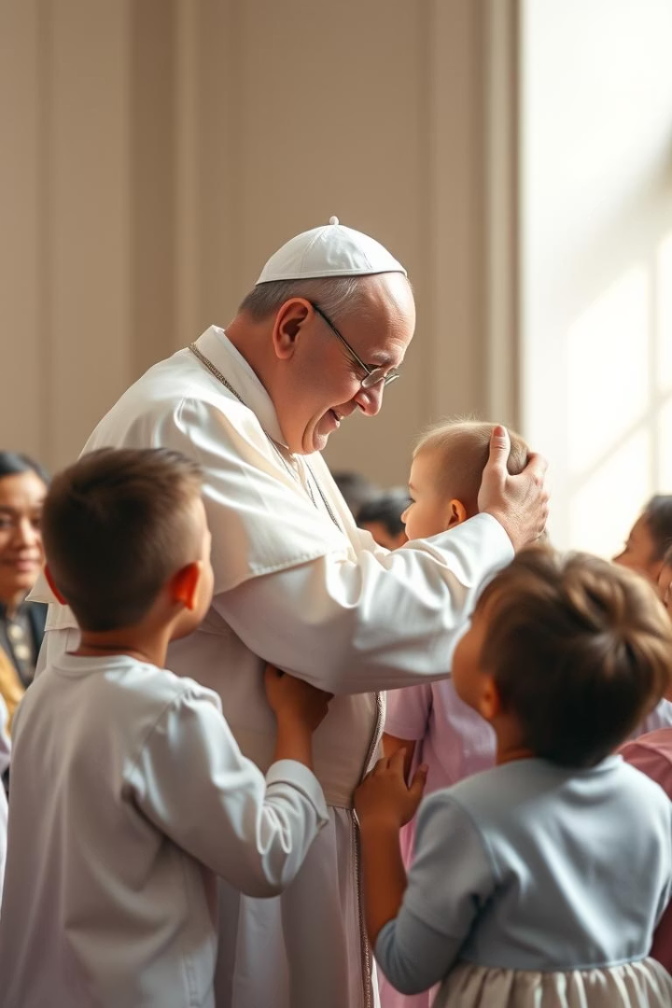
Compassion and Inclusion
Laudato Si
Amoris Laetitia
Call to action around climate change. Urgent call to society and world leaders to halt emissions.
Allowed more flexibility for divorced and remarried Catholics to participate.
Apologized to Many
Expressed sincere apologies for the Church’s past wrongs toward indigenous peoples and victims of abuse.

Slide 8
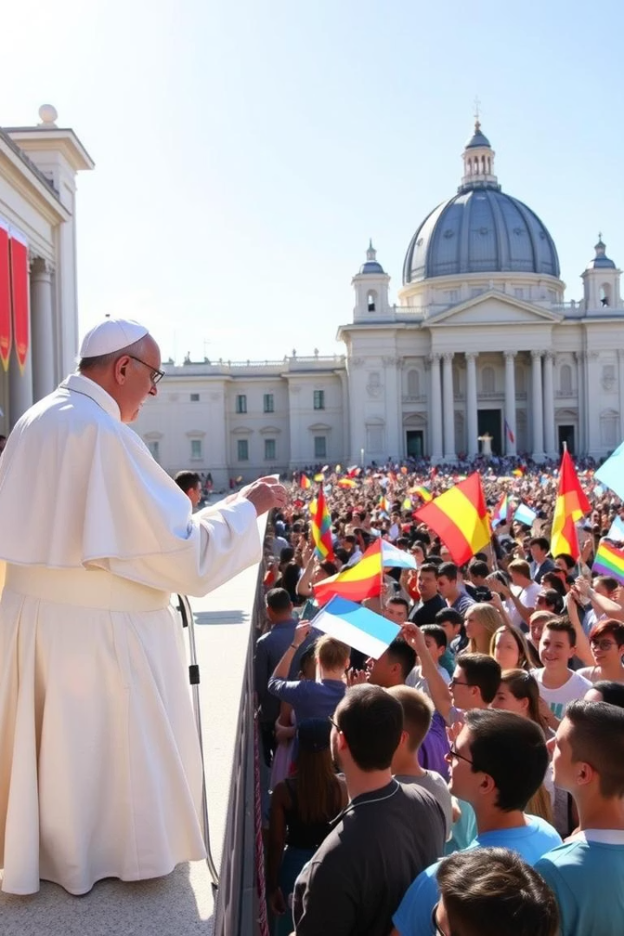
Legacy of Hope and Outreach
Global Outreach
Strengthened dialogue with Muslims and Jews to foster mutual respect.
Youth Engagement
Revitalized World Youth Days, inspiring new generations.
Compassion
His legacy centers on mercy, inclusion, and peace-building worldwide.

Slide 9
Pope Francis’s Journey through the catholic church
1958
Pope francis was inspired to join the Jesuits after recovering from a severe illness
1967-1970
He studied theology and obtained a degree from the colegio of San José
1970-1971
Trained at the university of Alcalá de Henares, Spain.
1979
Finished his role as a provincial superior in argentina
1992
Pope John paul 2nd appointed him titular bishop of Auca and Auxiliary of buenos Aires
1997
He was raised to the dignity of Coadjutor Archbishop of Buenos Aires
1969
Ordained as a priest by Archbishop Ramón José Castellano
1973
Became the Jesuit provincial superior in Argentina.
On 22nd of April, he made his final profession with the Jesuits
1986
Went to Germany to finish his doctoral. He was then sent to Colegio del salvador in buenos Aries as a spiritual director and confessor
1993
He gave his first interview as bishop to a Parish newsletter. He was immediately appointed Episcopal Vicar of Flores district and was also entrusted with the officer of Vicar general of Archdiocese
1998
The death of Cardinal Quarracino succeeded him as archbishop, Primate of Argentina and ordinary for eastern-rite faithful in Argentina.
1963
He completed his studies of the humanities in Chile and Argentina to graduate with a degree of Philosophy

Slide 10
2002
Pope francis declined to be appointed as President of Argentine bishops conference in the spirit of poverty
2001
John Paul 2nd created him Cardinal, assigning him the title of San Roberto Bellarmino
2008
He was reconfirmed for a further three-year mandate
2005
He took part in the conclave in which pope Benedict was elected.
He was also elected for the Argentine Bishops conference
2013
Pope francis was elected as the Pope or the supreme Pontiff on march 13th after pope Benedict resigned
2001
In october 2001, he was appointed general relator to the 10th ordinary general assembly of the synod of the bishops on the episcopal ministry

Slide 11
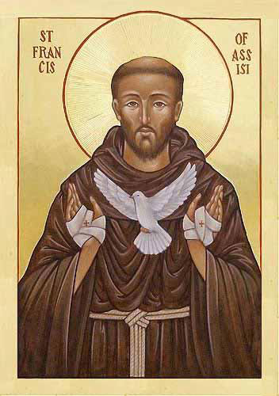
When he became Pope why did he choose the name Francis
-Following the resignation of Pope Benedict Jorge Mario Bergoglio became Pope Francis on 13 march 2013. Pope Francis chose the name Francis in honour of Saint Francis of Assisi. Saint Francis of Assisi was dedicated to caring for the poor which aligns with Pope Francis Values.

Slide 12
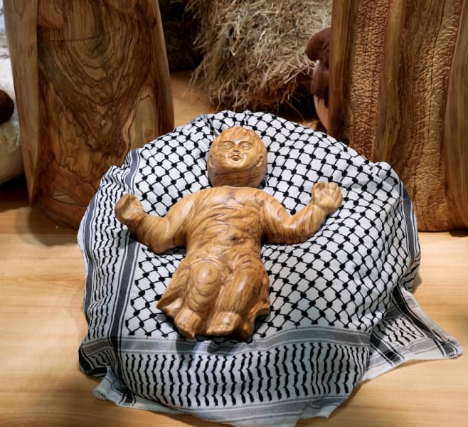
Work in Israel and Ukraine
Pope Francis advocated for Ukraine to negotiate an end to the war with Russia.
He declared “I appeal for the Ukrainians not to be left to freeze to death; stop the air strikes against the civilian population, always the most affected. Stop the killing of innocent people!”
Continued calling for peace in Ukraine, Gaza, and other conflict zones, even from his hospital bed and wheelchair.
Pope Francis has taken several important steps regarding Palestine during his papacy.
Pope Francis made sure to call Gaza's only Catholic Church every evening, and granted audiences to Israeli hostage families and freed hostages

Slide 13
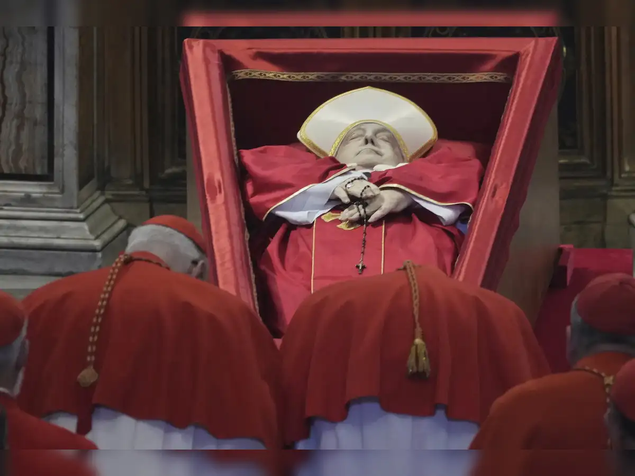
His ill health and work at the end.
Supported LGBTQIA+
Expanded diversity
Focused his last public addresses on peace, human dignity, forgiveness, and service to the poor.
Issued messages urging world leaders to negotiate and seek nonviolent solutions to conflicts.
Gave the Easter "Urbi et Orbi" blessing to over 35,000 people in St. Peter’s Square just one day before his death.
Celebrated Holy Thursday Mass and washed the feet of inmates, showing solidarity with marginalized groups.

