Slide 1
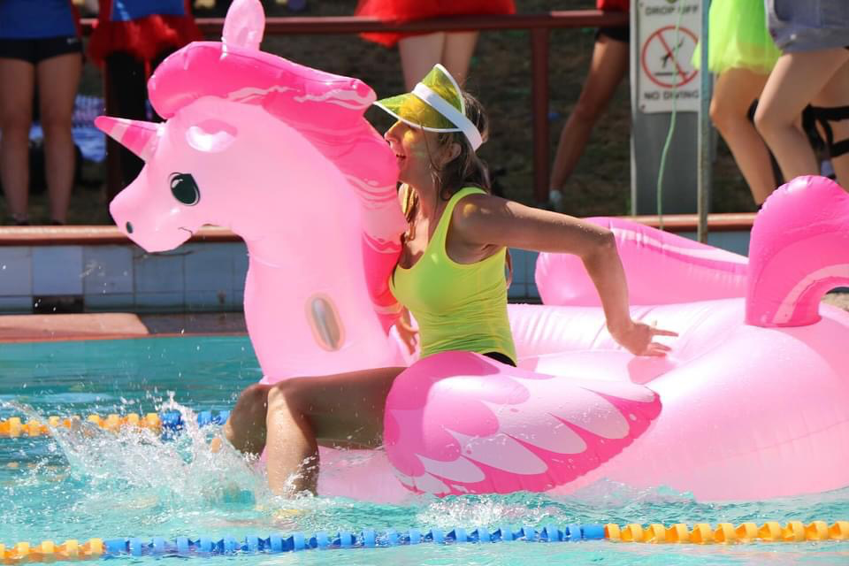
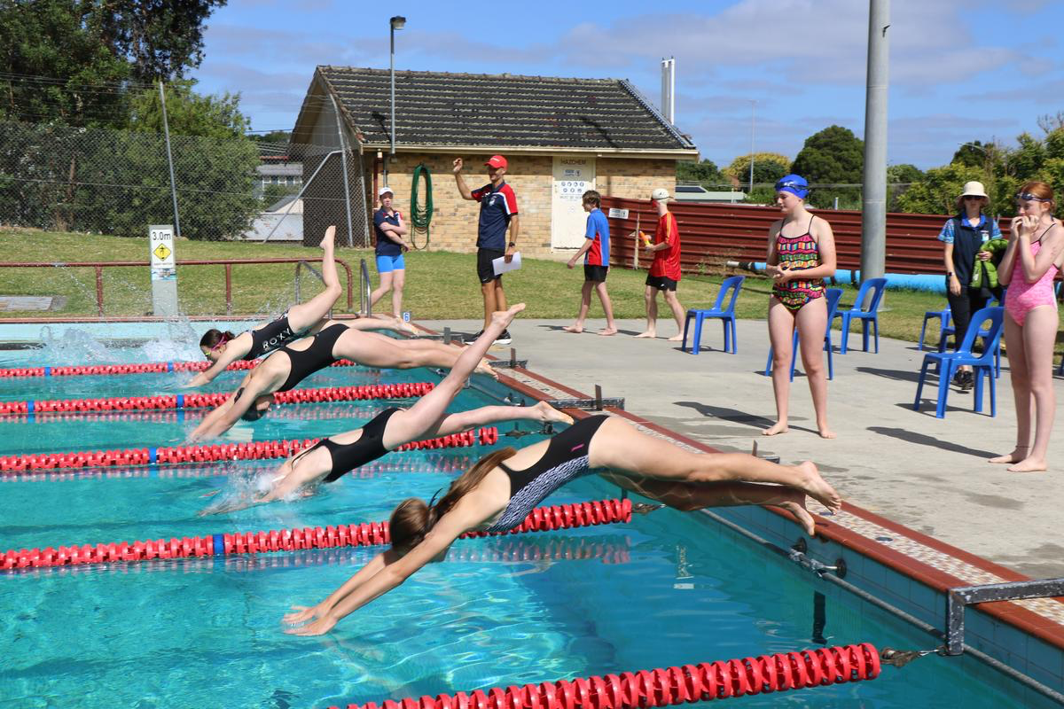
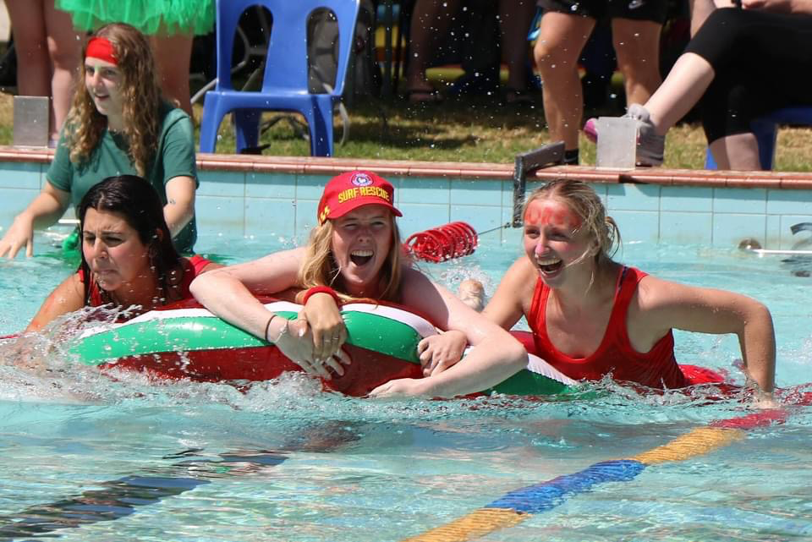
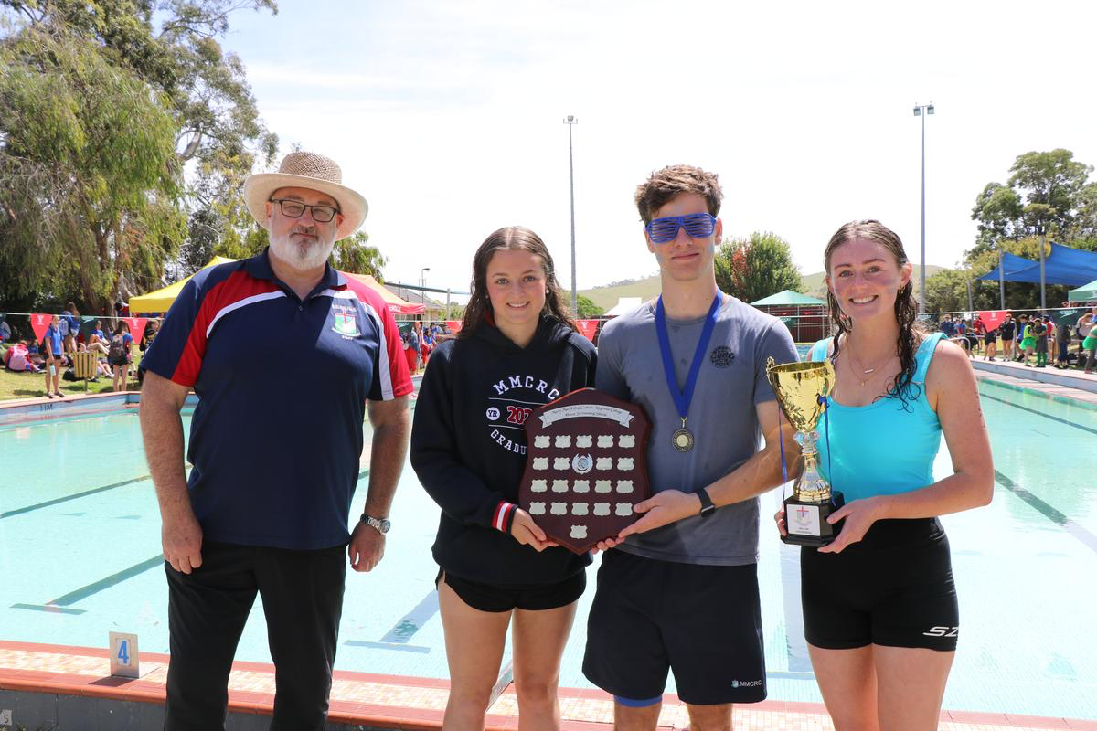
MMCRC
Swimming Carnival
2025

Slide 2
Event Details
Details of the Excursion are as follows:
Date: Monday Thursday 13th February 2025
Time: Depart 9:05am and returning by 3:00pm
Venue: Korumburra Outdoor Pool
Dress: Appropriate and Sunsmart house colours including a
t-shirt and hat (or complete College sports uniform)
Other: Bring lunch, snack, drink, and sunscreen. There will be a
fundraising sausage sizzle and limited canteen.
Attendance: All students must attend morning homeroom and then
board the delegated bus.
What to bring:
Sunscreen, hat, towel, goggles, bathers (wear), bag, food and drink.
The Korumburra pool is a great outdoor facility, so come prepared for all weather.

Slide 3
Event Details
***These times may vary on the day***
8:55am – 9:05am | Homeroom
9:15am | Depart school
9:45am | Briefing at venue
10:00am – 10:40am | Backstroke 50m
10:40am – 11:10am | Butterfly 50m
11:10am – 11:30am | Novelty Kickboard Relay (mixed levels) 25m
11:30am – 12:10pm | Freestyle 50m
12:10pm – 12:40pm | Breaststroke 50m
12:40pm – 1:20pm | Novelty Noodle Relay (mixed levels) 25m
1:20pm – 1:40pm | Year 12 Floating Race / Lunch
1:40pm – 2:00pm | House Relays – Freestyle 25m (all ages)
2:00pm – 2:15pm | Event concludes. Depart.

Slide 4
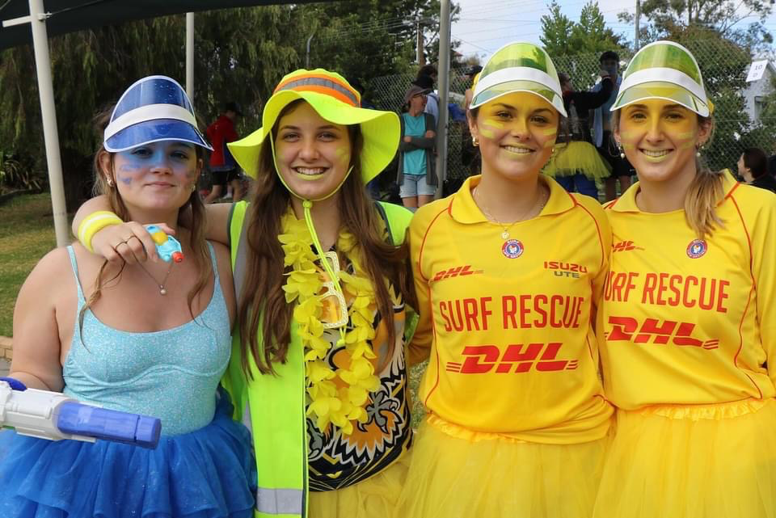
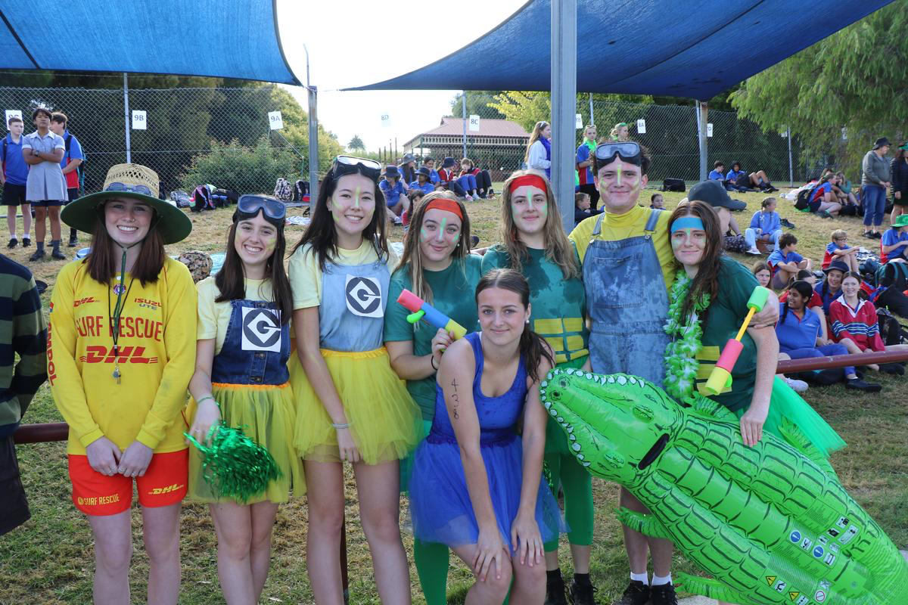
Student Expectations
Students are expected to wear appropriate swimwear for competition.
Students must adhere to the Sunsmart policy of the school which includes applying sunscreen, wearing a hat and t-shirt in between events.
All students are encouraged to participate in an event (swim race or novelty event).
Please demonstrate House spirit and respect for all participants.

Slide 5
Event Options
Swimming Races
Breaststroke, Butterfly, Freestyle and Backstroke (50m and 100m)
Novelty events
Kickboard Race
Noodle Race
Year 12 Float Race
House Relays (25m)
SIGN UP ON THE DAY!
Food/ Canteen
- Bring some of your own food and drink for the day.
- There will a sausages sizzle for $2 and fruit cups for $3.
- Limited canteen will be open.

