Slide 1
HOLY WEEK

Slide 2
We gather …
In the name of the Father
and of the Son
and of the Holy Spirit
Amen

Slide 3
We gather …
Leader:
We gather to remember the events of Holy Week. It begins with Jesus being welcomed as a king by the people of Jerusalem and ends with him dying on the cross and being placed in the tomb.

Slide 4
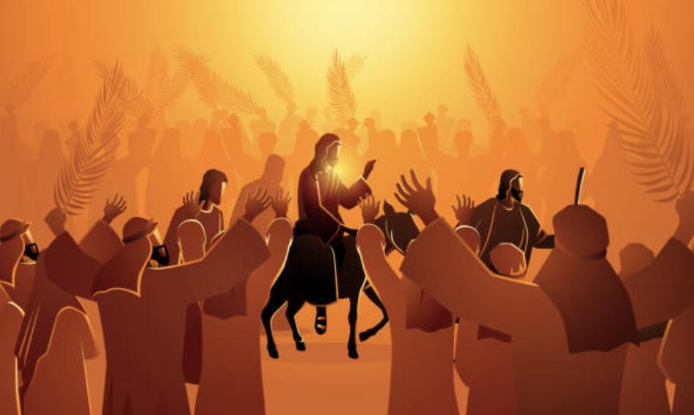
We listen …
.
Reader:
On Palm Sunday, Jesus rode into Jerusalem on a donkey.
The people waved palms and laid their cloaks on the ground for the donkey to walk on.
They shouted “Hosanna”, and welcomed him into the city.

Slide 5
We reflect …
.
Leader:
What would it be like to be in the crowd that welcomed Jesus into Jerusalem?
How can I welcome Jesus today?

Slide 6
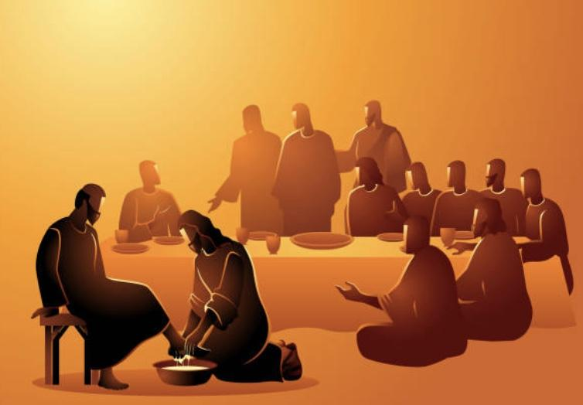
We listen …
.
Reader:
On Holy Thursday, before they ate the Passover meal, Jesus wahed the feet of his disciples.
They were confused because this welcoming sign was usually carried out by a servant.

Slide 7
We reflect …
.
Leader:
How would I feel if a person as important as Jesus washed my feet?
How can I serve people humbly, just as Jesus did for the disciples?

Slide 8
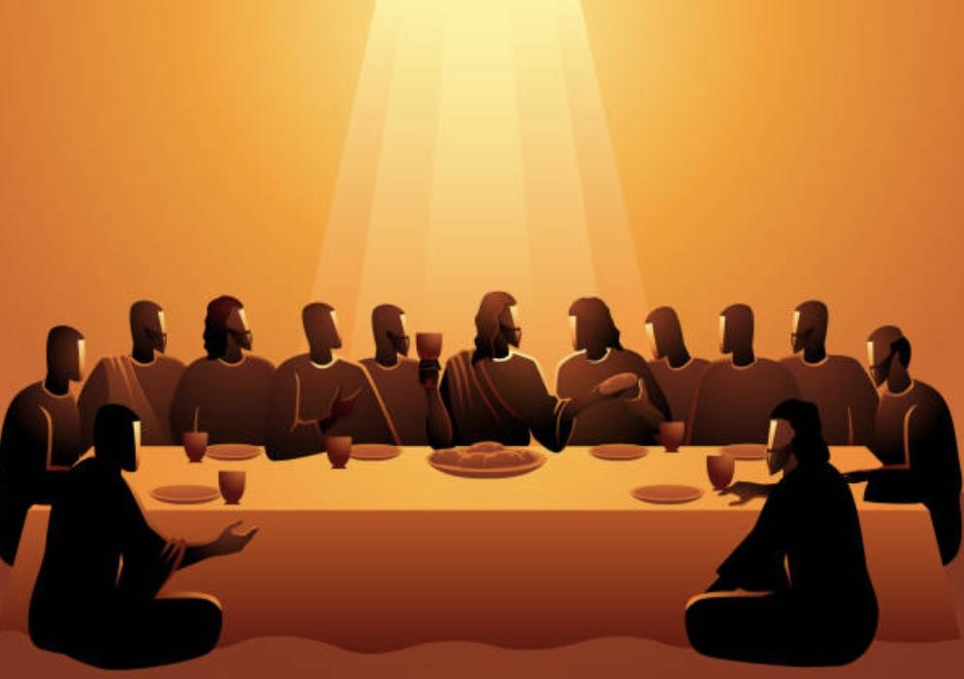
We listen …
.
Reader:
After washing their feet, Jesus blessed the bread and wine, saying , “This is my body and blood. Eat and drink this in memory of me.”
They shared the meal and talked about their good times together.

Slide 9
We reflect …
.
Leader:
How can I be thankful for the good times I have with my friends?
How can I be thankful for everything Jesus has done?

Slide 10
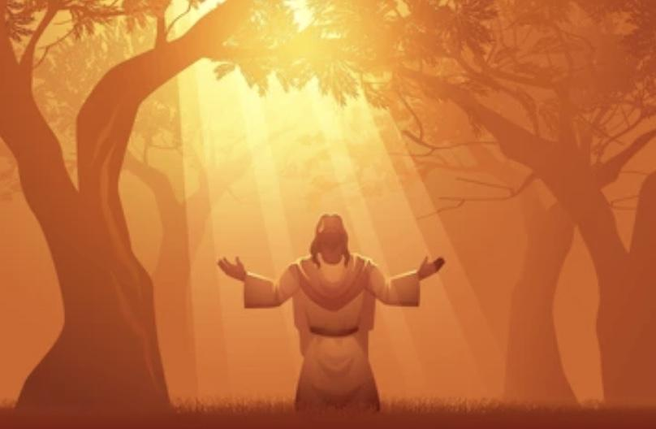
We listen …
.
Reader:
After sharing the Last Supper, Jesus went with some of the disciples into the garden to pray.
Jesus knew he would soon be suffering, he was afraid and asked God, his Father, to be with him.

Slide 11
We reflect …
.
Leader:
When I am afraid, who do I ask for support?
How can I ask Jesus to be with me?
How can I show Jesus that I am always with him?

Slide 12
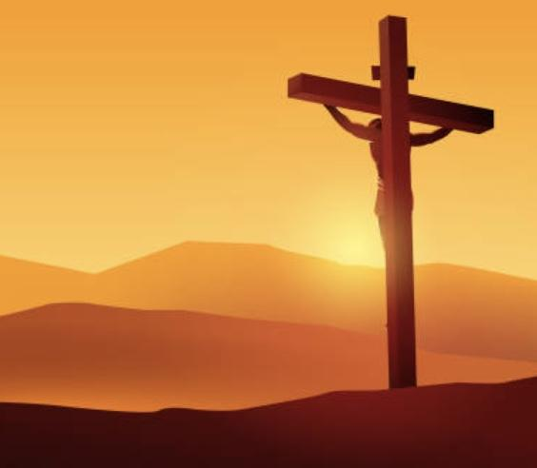
We listen …
.
Reader:
On Good Friday, Jesus suffered and was placed on the cross.
Jesus said to God and those nearby, “Father, forgive them.”
After he died, the body of Jesus was taken off the cross and placed in a tomb.

Slide 13
We reflect …
.
Leader:
How does it feel to know that Jesus is always loving and forgiving?
How can I be a forgiving person?

Slide 14
We pray …
Leader:
Let us pray this prayer together
All:
Dear God, thank you for your Son, Jesus.
Help us to remember his love and kindness during Holy Week.
We pray we grow closer to Jesus every day.
Amen.

Slide 15
We share the
love of Jesus with others …
In the name of the Father
and of the Son
and of the Holy Spirit
Amen

Slide 16
HOLY WEEK

