Slide 1

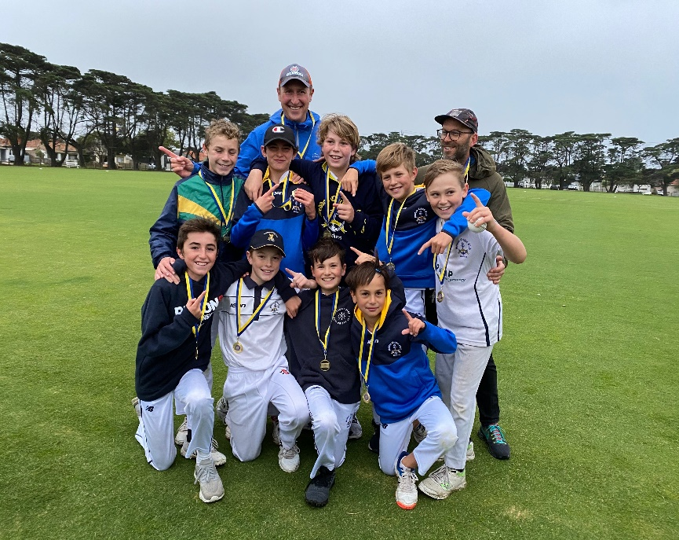
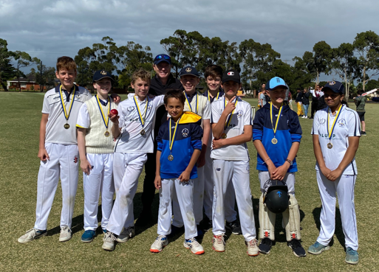
SEDDON CRICKET CLUB
Be part of a friendly club environment in the inner west
TEAMS
Under 15, Under 13’s, Under 11’s & Under 11 CUBS
PLUS
WOOLWORTHS JUNIOR BLASTERS & MASTER BLASTERS (Friday Night)
GIRLS, BOYS & PARENTS WELCOME
GET IN TOUCH…
Brian Rooney (0434 220 590)
Find out more at seddoncricketclub.com/juniors
Or register now at :
playcricket.com.au and search for “Seddon cricket Club”

