Slide 1
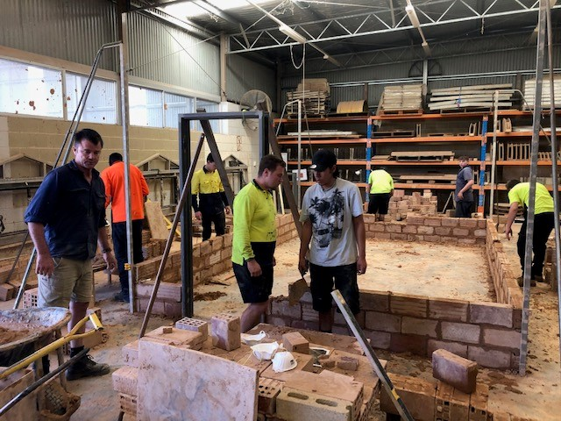
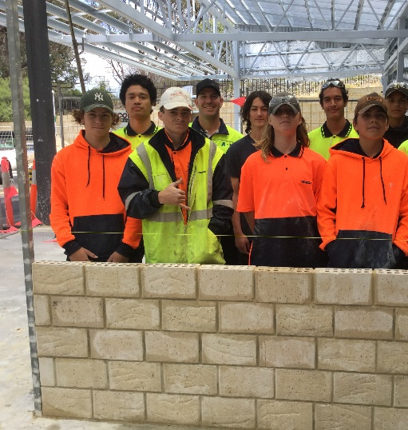
Bricklaying Apprenticeship Engagement Pathway
The current demand for Bricklayers and Bricklaying Apprentices in WA is very high.
Are you interested in becoming a bricklayer apprentice but don’t have prior knowledge or experience?
Pre -Apprenticeship or a Pre -Vocational Program will help you gain the necessary skills to transition into an actual Bricklaying Apprenticeship.
These courses are being run by registered training providers in many locations all supported by the ABBTF.
The WA Government has reduced the cost of training significantly and in some cases are cost free (Skill Sets).
To get started please contact any of the following registered training providers (listed on the back page) and enroll today.
The ABBTF and the training provider will support you in this process by providing you with information, skills and an opportunity to engage on site in either a work trial or work experience.
For more information please contact Dean Pearson on 0418 200 401 or email dean.pearson@abbtf.com.au.

Slide 2
Bricklaying Apprenticeship Engagement Pathway
Registered Training Providers:
Northern Metro
CLARKSON North Metropolitan TAFE: Primary contact Liam Cochrane 0410 218 175 Head of Programs 31 Harmony Drive, 1300 300 822, E: enquiry@nmtafe.wa.edu.au, W: www.northmetrotafe.wa.edu.au
JOONDALUP Skill Hire: Primary contact Mykala Win Admin Manager 0408 094 191 U6/45 Winton Rd, 9376 2800, E: perthoffice@skillhire.com.au, W: www.skillhire.com.au
Central Metro North
BALGA North Metropolitan TAFE: Primary contact Enzo Multari 0412 366 471 Head of Programs 18 Loxwood Rd, 1300 300 822, E: enquiry@nmtafe.wa.edu.au, W: www.northmetrotafe.wa.edu.au
BAYSWATER Trade Academy WA: Primary contact James McGuire MD 0403 336 086 Managing Director U1/13 King St, 6225 2502, E: info@tradeacademywa.com.au, W: www.tradeacademywa.com.au
East Metro Area
FORRESTFIELD Skill Hire: Primary contact Mykala Win Admin Manager 0408 094 191 U3/271 Berkshire Rd, 9376 2800, E: perthoffice@skillhire.com.au, W: www.skillhire.com.au
Central Metro South
THORNLIE South Metropolitan TAFE: Primary contact Glen Hickey 0431 890 254 Head of Programs Burslem Dr, 1800 001 001, E: info@smtafe.wa.edu.au, W: www.southmetrotafe.wa.edu.au
Southern Metro
ROCKINGHAM South Metropolitan TAFE: Primary contact David Robinson 0439 960 943 Head of Programs Simpson Rd, 1800 001 001, E: info@smtafe.wa.edu.au, W: www.southmetrotafe.wa.edu.au
Peel
GREENFIELDS South Metropolitan TAFE: Primary contact David Robinson 0439 960 943 Head of Programs 2 Education Dr, 1800 001 001, E: info@smtafe.wa.edu.au, W: www.southmetrotafe.wa.edu.au
South west
Bunbury South Regional TAFE: Primary contact Senior Lecturer Mark Baker 0422 434 987 Robertson Dr, 6371 3000, E: CourseInfo@srtafe.wa.edu.au, W: www.southregionaltafe.wa.edu.au
Bunbury Trade Academy WA: Primary contact James McGuire MD 0403 336 086 Managing Director 6225 2502 E: info@tradeacademywa.com.au, W: www.tradeacademywa.com.au
For more information please contact Dean Pearson on 0418 200 401 or email dean.pearson@abbtf.com.au.

