Slide 1
Christianity
By: Nick and Daniel

Slide 2
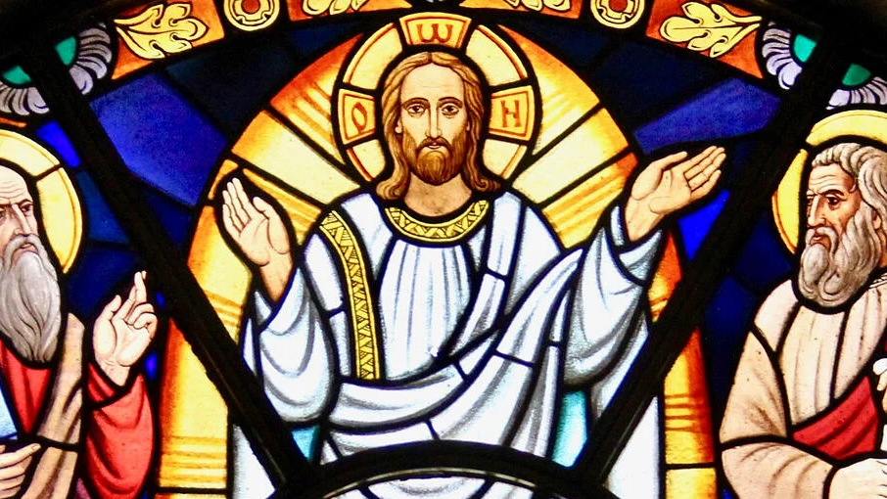
Fundamental Beliefs
Nick
Love God.
Love your Neighbor as yourself.
Forgive others who have wronged you.
Love your enemies.
Ask God for forgiveness of your sins.
Jesus is the Messiah and was given the authority to forgive others.
Repentance of sins is essential.
Don’t be hypocritical.
Don’t judge others.
The Kingdom of God is near. It’s not the rich and powerful—but the weak and poor—who will inherit this kingdom.

Slide 3
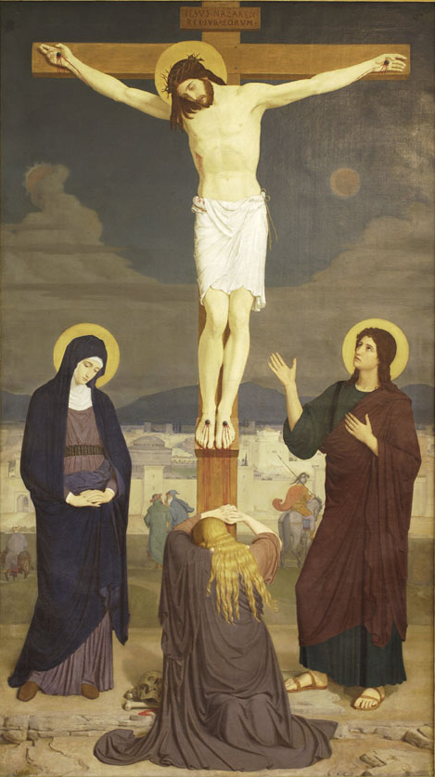
Major Events
Nick
Christmas –
The 25th of December is the time when Western Christians celebrate the birth of Jesus who Christians believe to be both the Messiah and son of God. Eastern Orthodox Christians celebrate the birth on the 7th January.
Jesus' birth or 'nativity' is described in the Bible, in the New Testament Gospels of Matthew and Luke. There is disagreement among Christians about the status of the accounts, some regarding them as describing theological truths but not historical ones.
Good Friday -
Good Friday, the Friday before Easter, the day on which Christians annually observe the commemoration of the Crucifixion of Jesus Christ. From the early days of Christianity, Good Friday was observed as a day of sorrow, penance, and fasting. Good Friday is celebrated on Friday, April 2, 2021.
It’s also followed by Easter, the day when Jesus was raised from the dead.

Slide 4
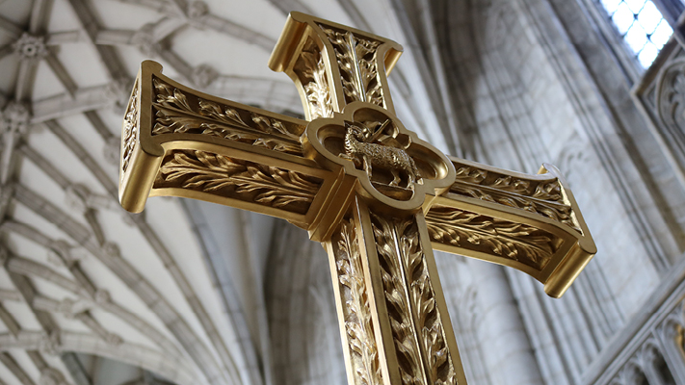
Reasons for Events
Nick
Christmas –
Christmas is celebrated to remember the birth of Jesus Christ, who Christians believe is the Son of God. The name 'Christmas' comes from the Mass of Christ (or Jesus). A Mass service (which is sometimes called Communion or Eucharist) is where Christians remember that Jesus died for us and then came back to life.
Good Friday -
Despite its name, Good Friday is a day for somber reflection. Each Friday before Easter, Christians solemnly honor the way Jesus suffered and died for their sins. They might attend a service that recounts Jesus’s painful crucifixion, and some even refrain from eating to show their sorrow.

Slide 5
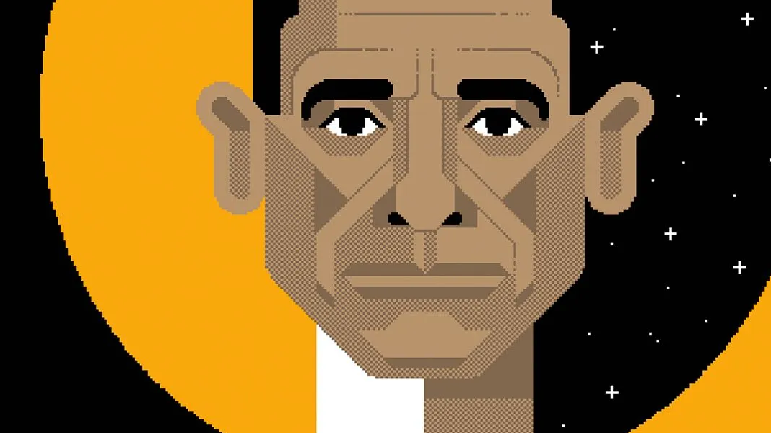
Why & How Christianity was Formed
Nick
Christianity began in the 1st century AD after Jesus died and was claimed to be resurrected, as a small group of Jewish people in Judea, but quickly spread throughout the Roman empire. Despite early persecution of Christians, it later became the state religion.
Christianity kept many practices from Jewish tradition. Christianity thought the Jewish scriptures to be sacred and used mostly the Septuagint translation of the Torah (the first five books of the Old Testament), the Hebrew Prophets and Writings (the rest of the Old Testament books) and added other texts as the New Testament. Christians professed Jesus to be the God of Israel, having taken human form, and considered Jesus to be the Messiah (Christ) who had been prophesied about in the Old Testament and so was expected by the people of Israel.

Slide 6
Unusual facts
Daniel
There are more than 2.4 billion Christians worldwide, which makes Christianity the largest religion in the world.
Christianity uses Sunday as their holy day for other religions such as Muslims who's holy day is Friday.
Since the first printed Bible, the Holy book of Christianity has spread worldwide, and it consistently ranks as the most popular book in many countries around the world. An estimated 100 million Bibles are sold each year.
Christianity has the same god as Judaism and Islam. They all stem from the same origins of Abraham, and it’s known as one of the Abrahamic religions.
Every Christian should be baptized to cleanse your soul and become free of your original sin. Since the sin of Adam and Eve, the first people who ate from the tree of knowledge in the Garden of Eden, every human has inherited their sin.
More than 70 million people have been killed for their Christian faith
The Church murdered and persecuted godless and non-Christian people during the holy inquisition

Slide 7
Christianity’s founders
Daniel
The founder of Christianity is very uncertain some will say that it was Jesus while others will say Paul, it’s very undecided overall as it’s hard to say if what Jesus was preaching is really Christianity and not Judaism. Nowhere in the New Testament does Jesus or Paul say state that they are rejecting Judaism and what they preach could be seen as Judaism, Christianity or something else entirely so who are the founders of Christianity? Really it’s subjective and there isn’t a definitive answer according to most.

Slide 8
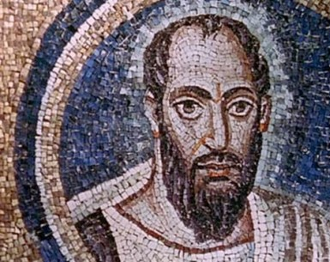
Significant dates
Daniel
Christmas: Christmas is of course the day Jesus our saviour was born this is a very significant date fir Christian’s it’s very highly celebrated within most of not all Christian households.
All saints day: All Saints' Day, also called All Hallows' Day,w21` Hallowmas, or Feast of All Saints, in the Christian church, a day commemorating all the saints of the church, both known and unknown, who have attained heaven
Ascension day: ascension day is the Thursday forty days after Easter, where Christian’s celebrate the ascension of Christ into heaven.

Slide 9
Bibliography

Slide 10
Nick’s Bibliography
Fundamental Beliefs –
https://www.life-church.com.au/about/core-beliefs/
Major Events - https://www.bbc.co.uk/religion/religions/christianity/holydays/calendar.shtml
Christmas –
https://liesyoungwomenbelieve.com/15-reasons-we-celebrate-christmas/
Good Friday –
https://slate.com/culture/2017/04/why-is-good-friday-called-good-friday-the-etymology-and-origins-of-the-holidays-name.html
Why & How Christianity was Formed –
https://www.britannica.com/topic/Christianity/The-history-of-Christianity

Slide 11
Daniel’s Bibliography
Unusual Facts -
https://www.swedishnomad.com/facts-about-christianity/
Christianity Founders -
https://www.religion-online.org/book/the-founder-of-christianity/
https://www.huffpost.com/entry/who-founded-christianity_b_13821370
Significant Dates -
https://www.bolton.ac.uk/Chaplaincy/Worldviews/Festivals/ChristianFestivals.aspx
https://www.christianity.com/church/church-history/timeline-important-dates-in-ad-christian-history-11542876.html
https://www.christianitytoday.com/history/issues/issue-28/important-events-in-church-history-christian-history.html

