Slide 1
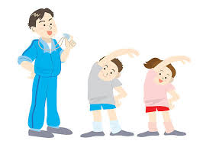
PHYSICAL EDUCATION
Years 3/4
WHAT TO DO AT HOME?

Slide 2
Did you know? children who are 5-13 years of age should participate in 60 minutes of physical activity a day.
The more you huff & puff the better.
Play outside. (30 minutes per day at least)
Look through all of the games and activities provided.
Choose an activity or activities to do each day.(30 minutes per day)
If you have great ideas for physical exercise, please play these games.
There are some great dance routines you can perform that are available from different websites, or you could create your own dance routine. Make sure you have your parents’ approval.
Try Zumba Kids on YouTube.
Go Noodle
Record what you do each day on the recording sheet provided. You could take photos or make videos of your efforts. Teach others your new dance routines when you get back to school.

Slide 3
Suggested Timetable
DAY | ACTIVITY
MONDAY | Games & Activities (link) Catching/Throwing Activities
TUESDAY | Games & Activities (link) Bouncing/Kicking Activities
WEDNESDAY | Skills Circuit
THURSDAY | Challenge Stations
FRIDAY | Games & Activities (link Hitting/Jumping/Leaping Activities

Slide 4
Record Your Fitness
Daily Record Keeping
DATE | ACTIVITY | TIME SPENT

Slide 5
Ball Skills Circuit
What to Do
Complete each activity from the next page for 1 minute.
How many did you score?
Do the circuit again.
See if you can beat your last score.

Slide 6
Ball Skills Circuit continued
Circuit
Exercises | Score | Exercises | Score
Wall Rebound Catch (Tennis Ball) |  | Wall Rebound Catch (Tennis Ball)
Wall Hit (hand, bat, racquet) |  | Wall Hit (hand, bat, racquet)
Bucket Bounce (bucket & tennis ball) |  | Bucket Bounce (bucket & tennis ball)
Dribbling (Basketball) |  | Dribbling (Basketball)
Clap & Catch (Tennis Ball) |  | Clap & Catch (Tennis Ball)
Underarm Throw in Hoop/bucket/circle (socks/ball/hoop) |  | Underarm Throw in Hoop/bucket/circle (socks/ball/hoop)

Slide 7
PE Challenge Stations 3-6
Balloon Tap Station
You need:
a balloon (a scrunched-up newspaper ball or tennis will work too),
a bat (otherwise use your hand)
I can strike a balloon with my hand 20 times in a row without the balloon hitting the ground
I can strike a balloon with my hand 20 times whilst sitting
I can strike a balloon with a bat (stick)20 times without the balloon hitting the ground
I can strike a ball with a bat 20 times without the ball hitting the ground

Slide 8
PE Challenge Stations 3-6 cont…..
Target Station
You need:
A ball (could use an option for targets)
Objects to make targets
Set up one target and stand 5 steps away – can you underarm roll/throw and hit the target?
Have 20 shots. How many times did you hit the target?
Set up one target and stand 10 steps away – can you underarm roll/throw and hit the target?
Have 20 shots. How many times did you hit the target?
Build a target with three or more objects and throw from 10 steps away. Count how many throws it takes to knock them all down
Build a target with three or more objects and throw from 20 steps away. Count how many throws it takes to knock them all down

Slide 9
PE Challenge Stations 3-6 cont...
Leap, hop, jump Station
You need:
2 markers (cones, boxes, bottles etc) spaced 20 steps apart
How many leaps (big steps) does it take you to get from one marker to the other?
How many hops does it take you to get from one marker to the other on your left leg? Try on your right too!
How many jumps does it take you to get form one marker to the other?

Slide 10
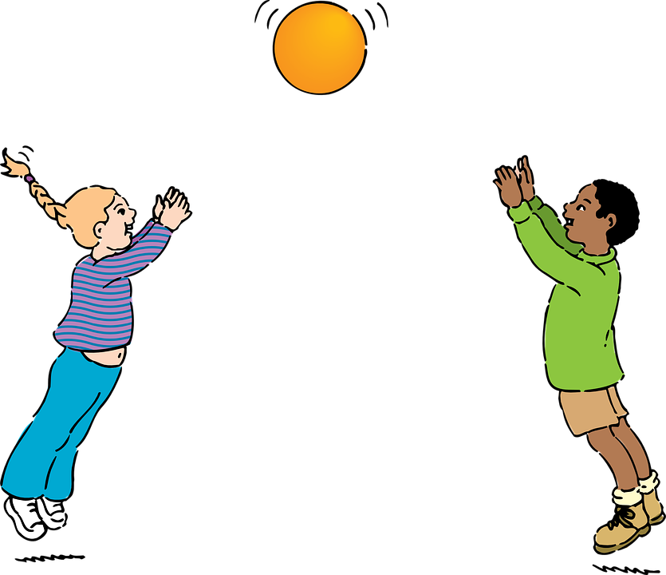

Games and Activities to Choose
Click on the icon to discover all the games and activities you can play

