Slide 1
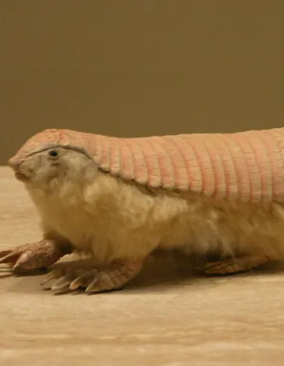
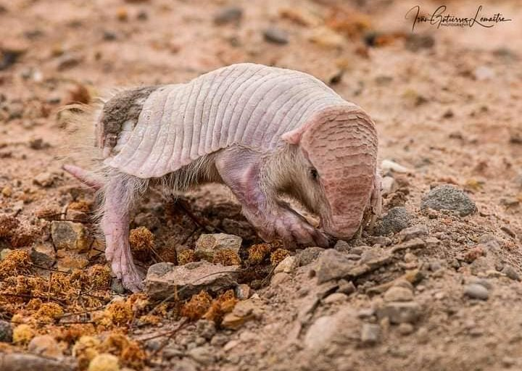
Pink Fairy Armadillo
Hadley Green​

Slide 2

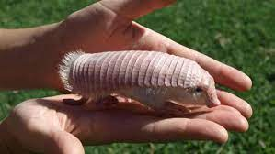
Introduction
The pink fairy armadillo, also known as the Chlamyphorus truncatus, is apart of the Chlamyphoridae and Dasypodidae family, A.K.A, the hard shell family. It is the least known armadillo, and the smallest.

Slide 3
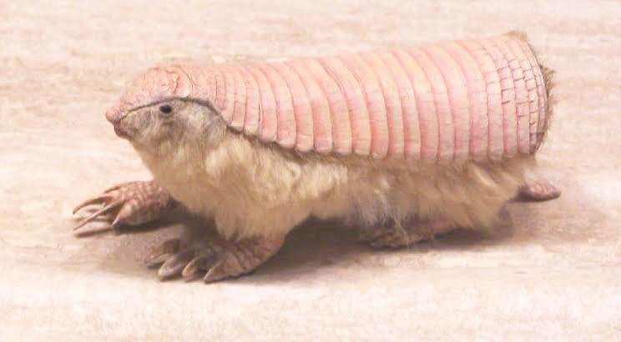
Appearance
Pink Fairy Armadillos have tiny eyes and soft yellow fur, covered by its pink shell that is attached to its body solely by a membrane. They also have a wide spatula tail and small claws.
Fun fact there are only 100 pink fairy armadillos in the wild!

Slide 4

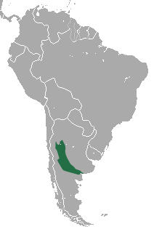

Habitat
The pink creatures dominate the sandy plains, grasslands and sand dunes of central Argentina, well, not so much dominate, as they’re so small. But the live there just the same.
Learning to adapt to the 26.c, they live in their underground dens that they build right next to ant colonies for a source of food. They come out at night to hunt.

Slide 5
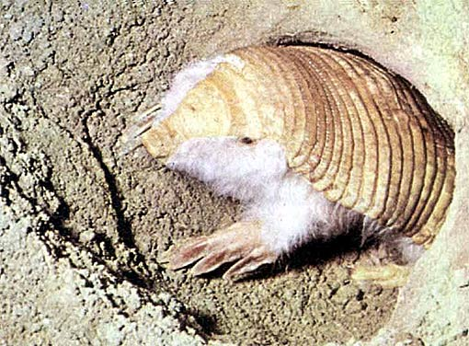
Diet
Pink fairy armadillos favorite food is beetles.
And don’t forget the roots and other plant parts.
…..to forage under and in tree roots or dig up nests, it is nocturnal.
But they also eat ants, worms and snails.
To find food, the pink fairy armadillo uses its digging skills…..

Slide 6
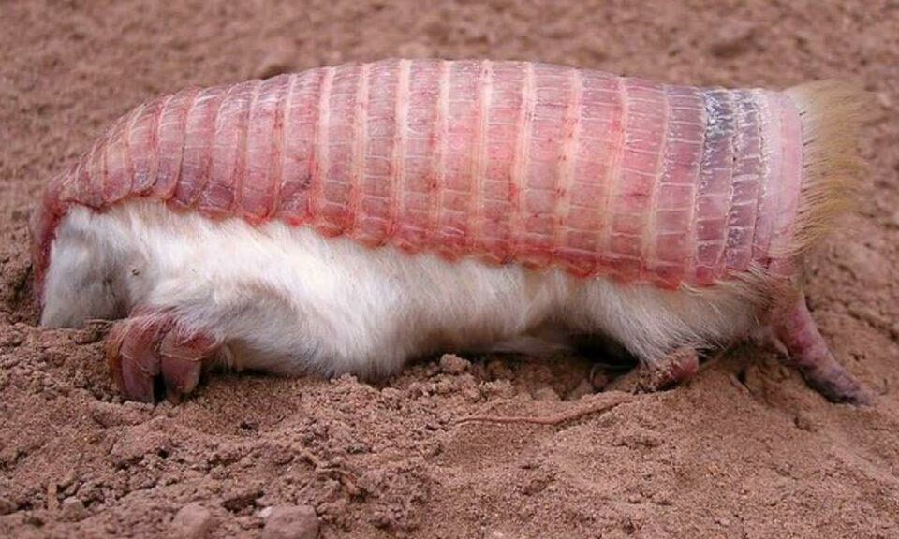
Status
Because Pink fairy armadillos haven’t been seen in such a long time, scientists have put their status as ‘data deficient’. According to different resources, there are 100 left in the wild.

