Slide 1


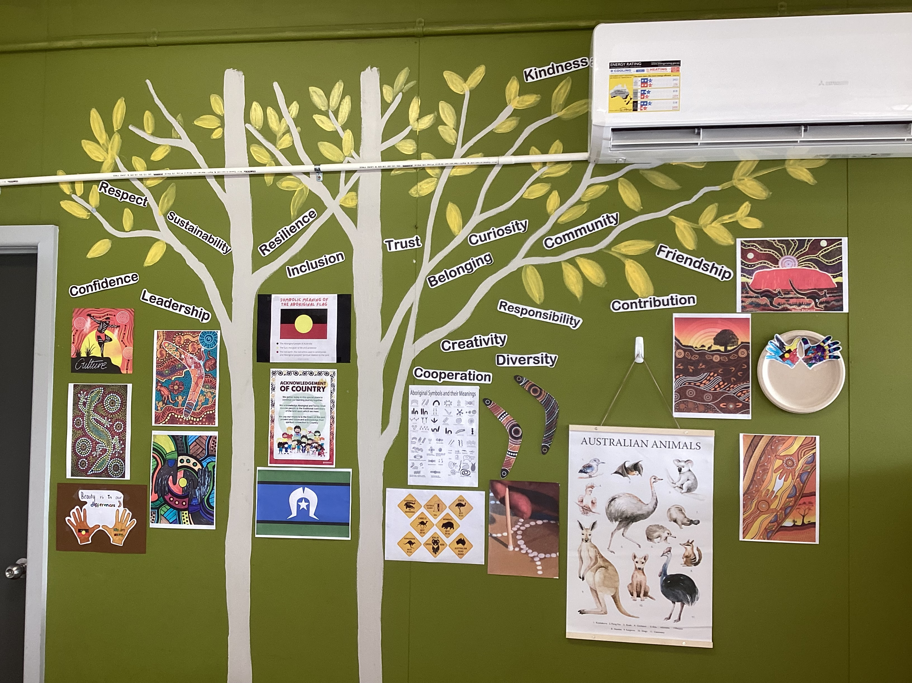
Cheltenham East Team Kids
Dear Parents and Guardians,
We hope this newsletter finds you well as we reach the halfway point of the term. We have some exciting updates and highlights to share with you about the wonderful experiences our children have had at our Before and After School Care program.
Pancakes Morning and Popcorn Night: Last Thursday was an absolute treat for our little ones! They indulged in a delightful pancake morning and enjoyed a scrumptious popcorn afternoon. The children were overjoyed with these special treats, and many of them have expressed their love for pancakes and popcorn. In fact, they enjoyed it so much that they requested to make it a weekly tradition! Therefore, starting next week, we will be serving pancakes in the morning and popcorn in the afternoon every Thursday. We are thrilled to see our children developing their decision-making skills and taking an active role in shaping their experiences.
Reflection on National Sorry Day: Last Friday, we commemorated National Sorry Day with our children. We engaged them in various activities to foster an understanding of Aboriginal culture and history. The children participated in Aboriginal art symbol coloring, allowing them to appreciate the beauty and significance of these artworks. We also held a yarning circle, where our children had the opportunity to engage in meaningful conversations and learn about the importance of reconciliation and respect. It was heartwarming to witness their curiosity and empathy as they absorbed this important part of our nation's heritage.
Winter School Holiday Program: As we approach the winter school holidays, we understand that many of you may be seeking information about our holiday program. For more details on the exciting activities planned during this break, please contact our dedicated Team Kids customer service. They will be more than happy to provide you with all the necessary information and assist you in securing a spot for your child.
Open-Mindedness and Feedback: At our Before and After School Care program, we value open-mindedness and actively encourage feedback from both children and parents. We believe that involving our community in decision-making processes enhances the overall experience for everyone. If you have any suggestions, ideas, or concerns, please don't hesitate to reach out to us. We appreciate your input and are committed to continually improving our program to meet the needs of our children and families.
Thank you for your continued support and trust in our program. We look forward to the remainder of the term, filled with more engaging activities, fun experiences, and memorable moments.
Warm regards,
Eric - Before and After School Care Program Director
6
Reading Club
Musical Theatre Club
Super Sports Club
Reading Club
Super Sports Club
Pancakes Morning and Popcorn Night
01/06/2023
Say Something Nice Day
01/06/2023
World Environment Day
05/06/2023
0432 299 468
CheltenhamEastPS@teamholiday.com.au
1300 035 000
info@teamkids.com.au

