Slide 1
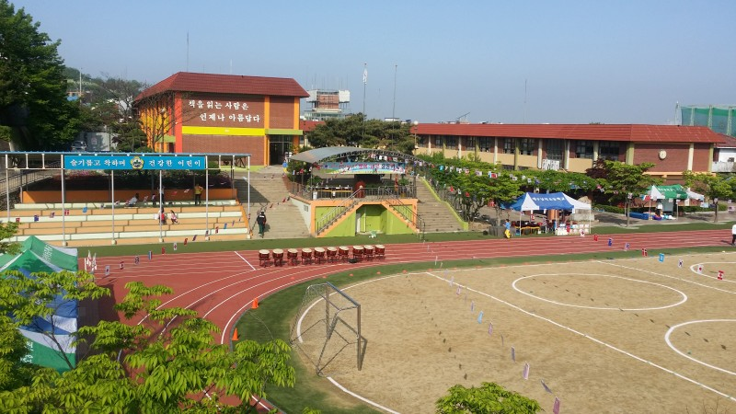
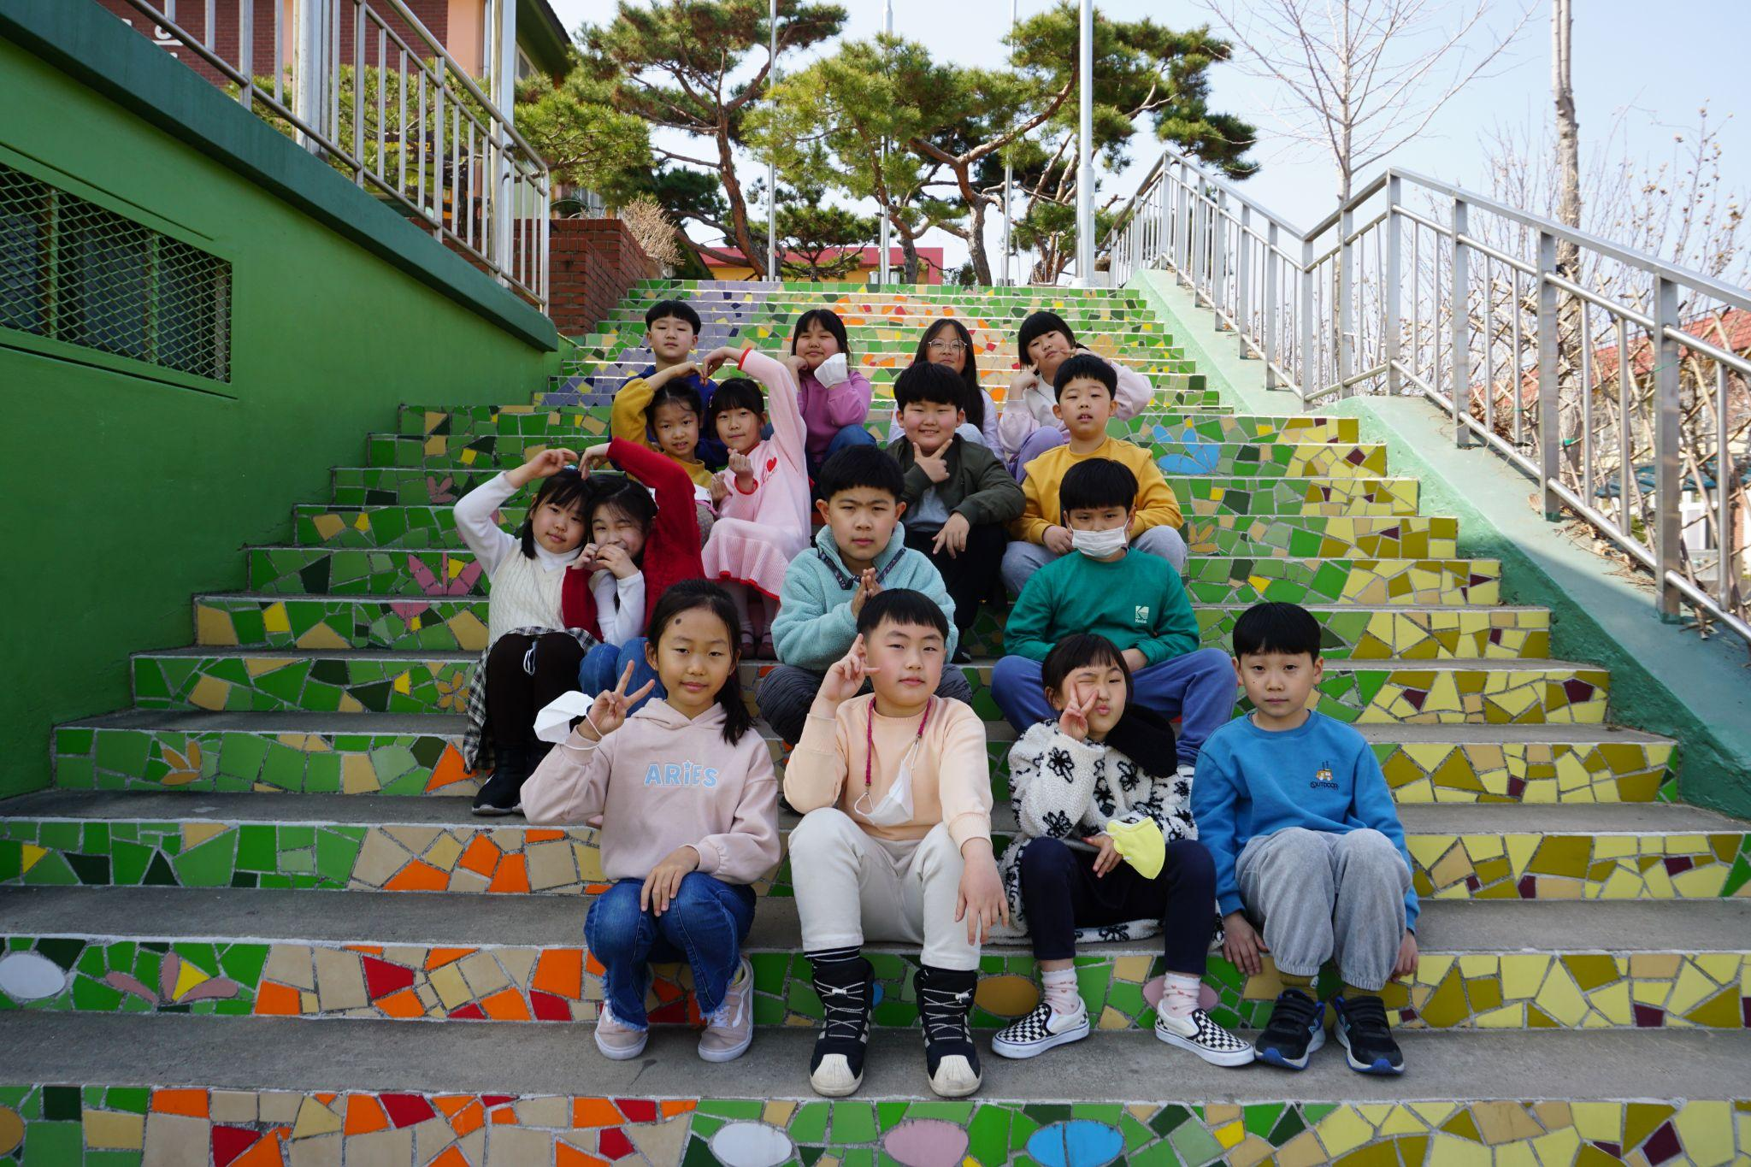
Namdeok Elementary School, Daegu, South Korea
3-2 class

Slide 2
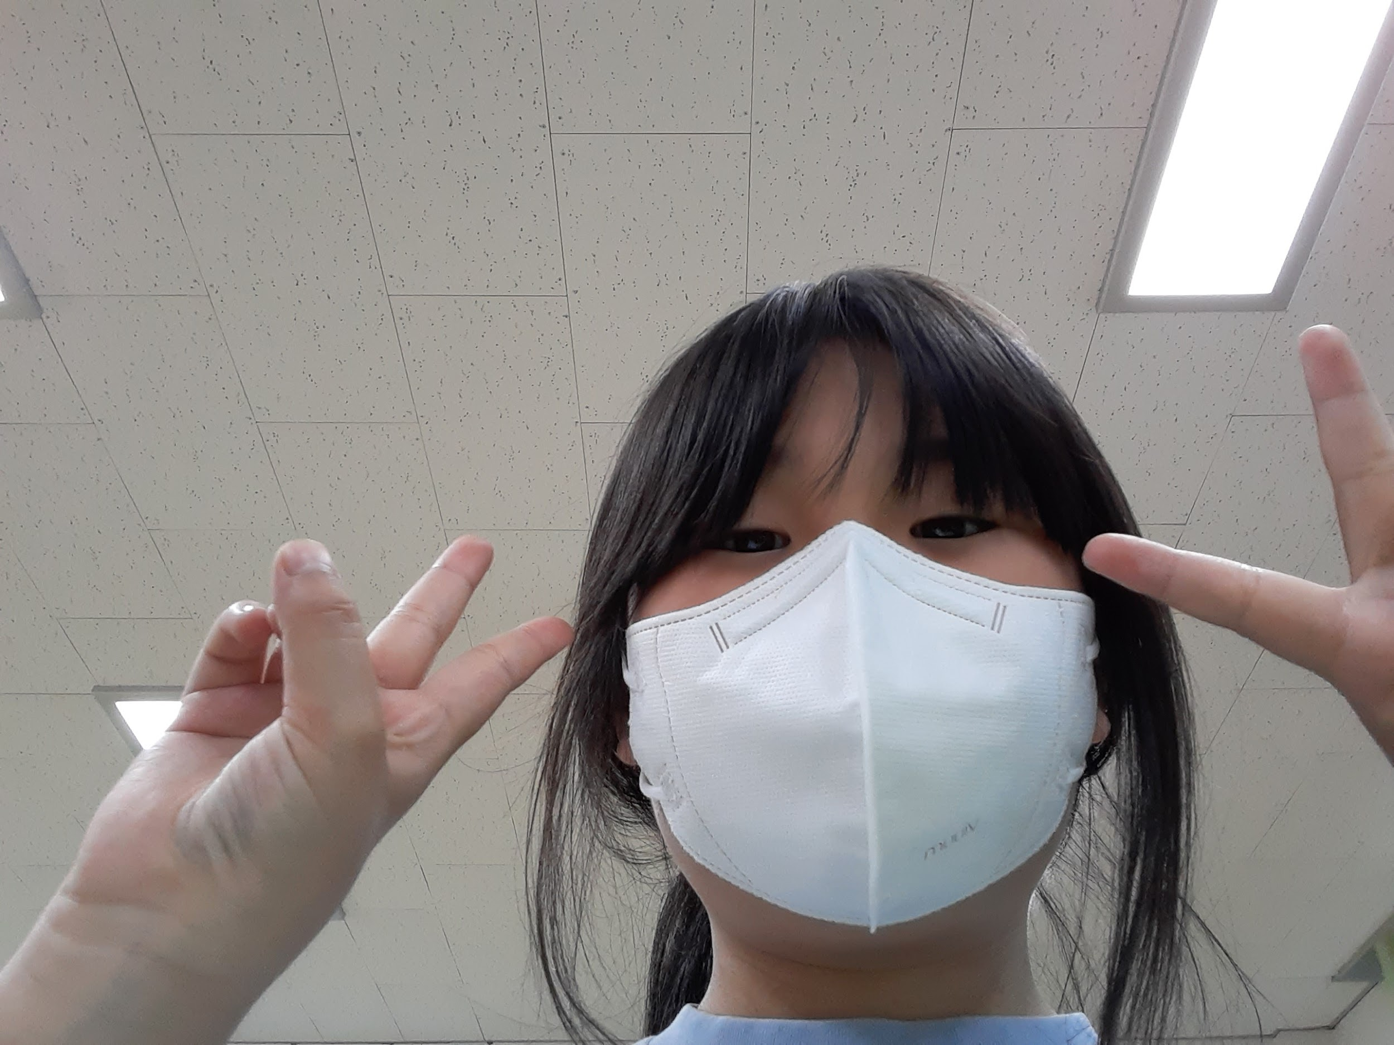
Gim Ga Won
(Picture here)
Hobby
Touching Puppy
Favorite animal
Puppy
Good at
Japanese

Slide 3
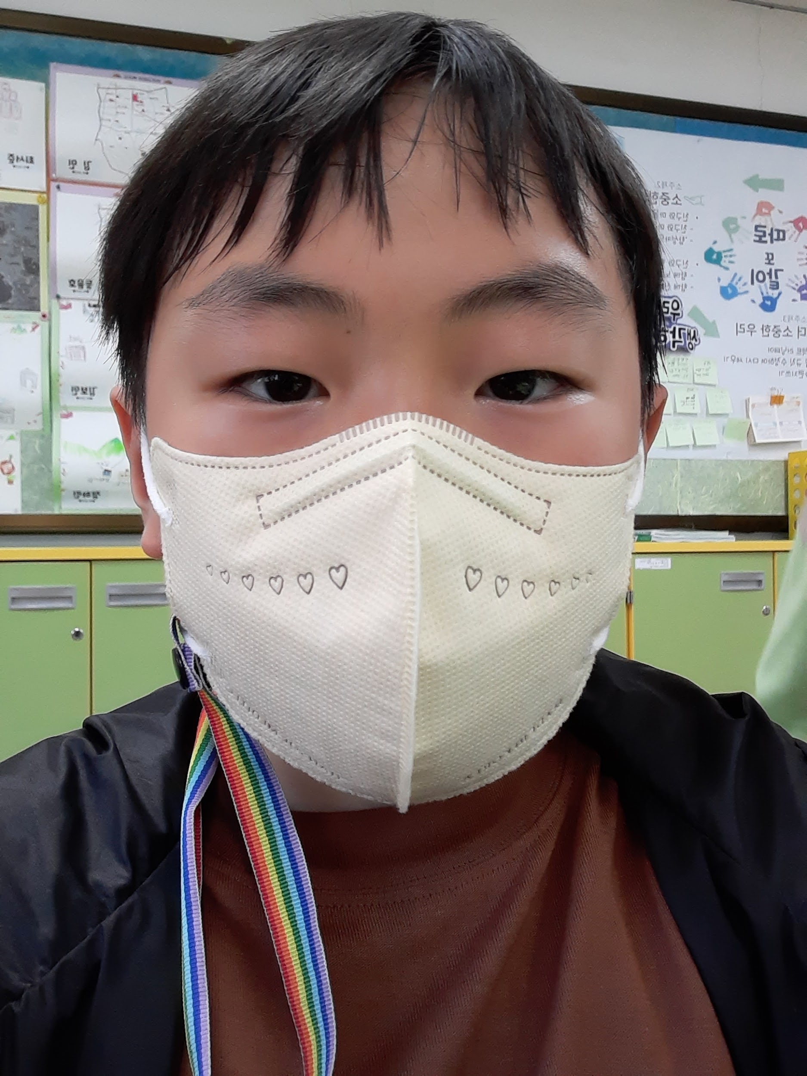
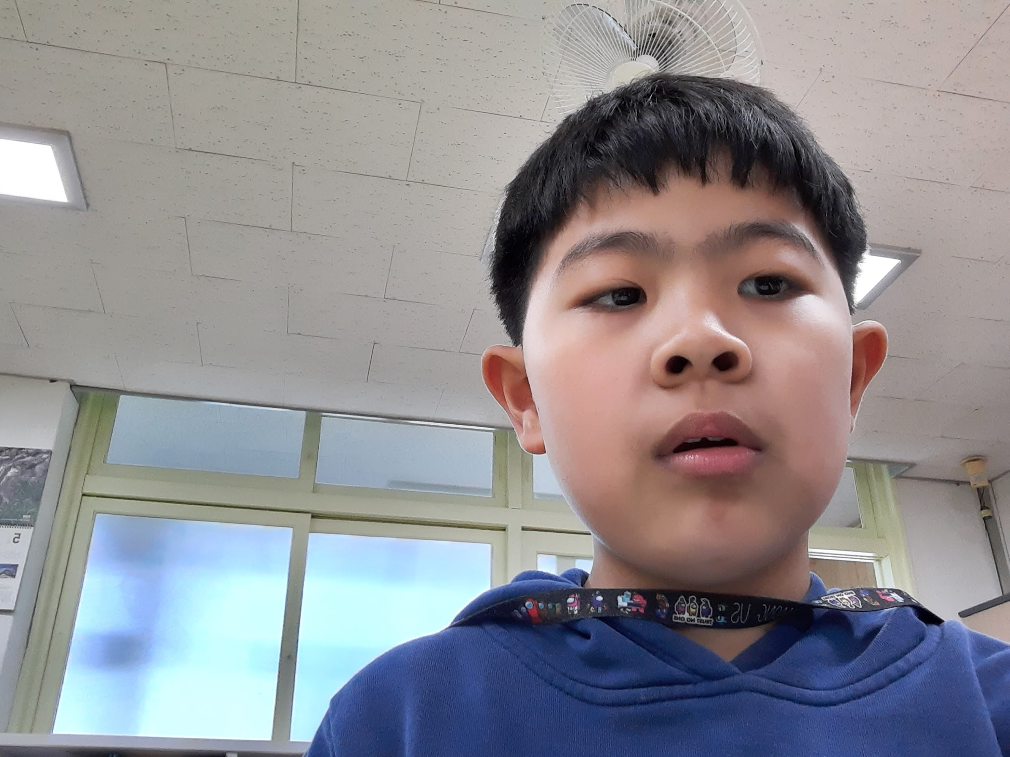
02. Gim Min
(Picture here)
Hobby
Favorite animal
Good at
Origami
Puppy
Throwing rubber bands

Slide 4
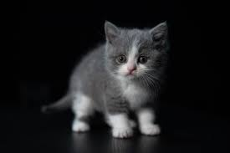
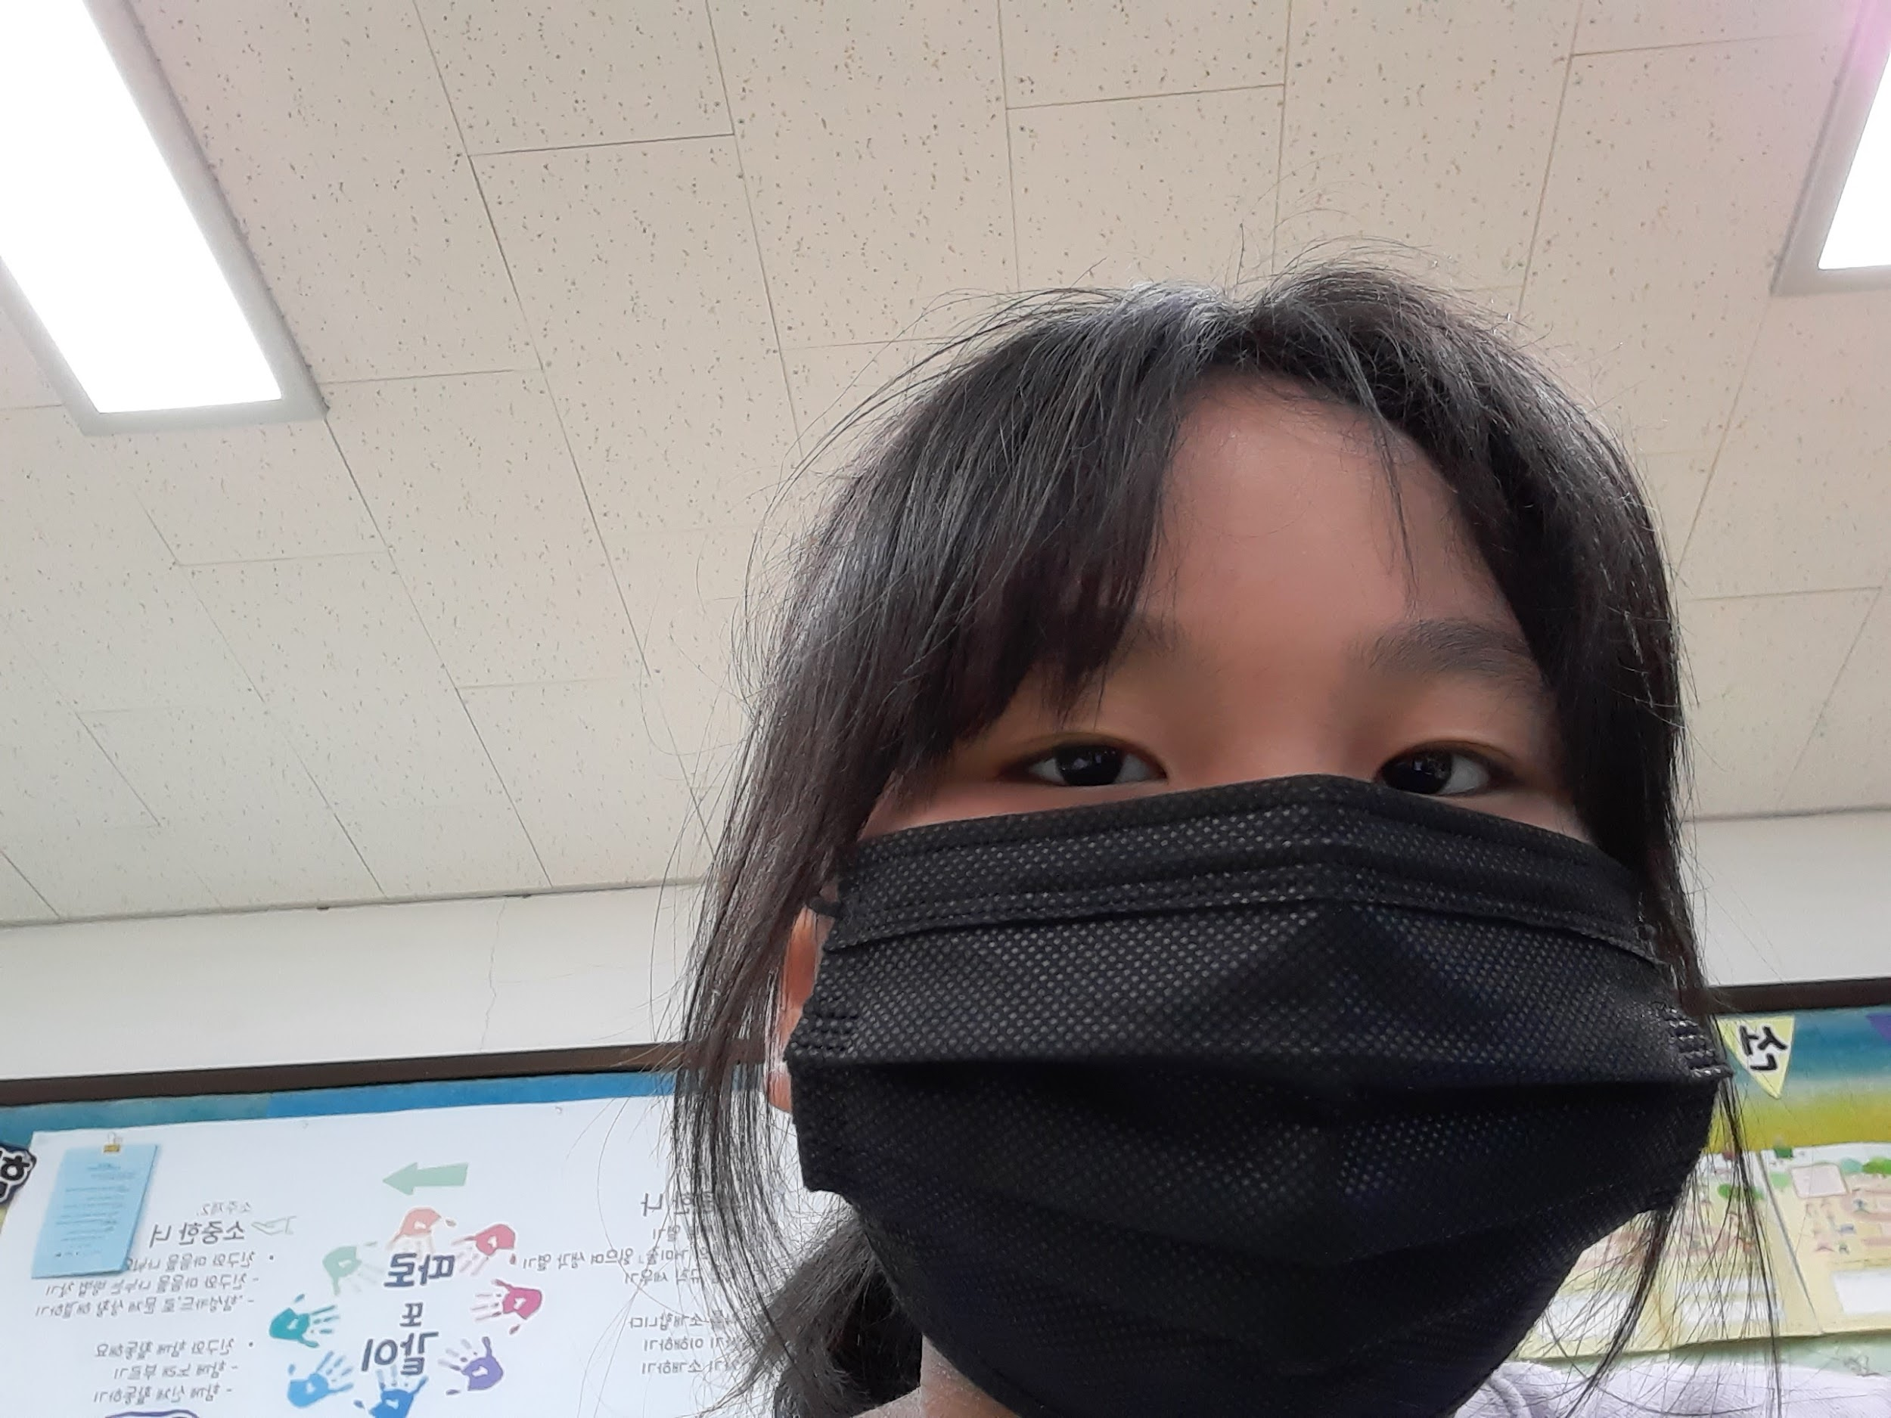
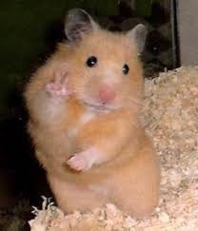
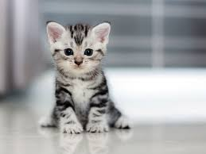
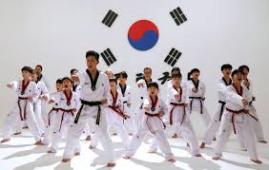
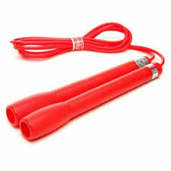
03. Gim Bo Min
(Picture here)
Hobby
Favorite animal
Good at
(Picture here)
Touching Cats
Cat, Hamster
Taegwondo, Jump rope

Slide 5


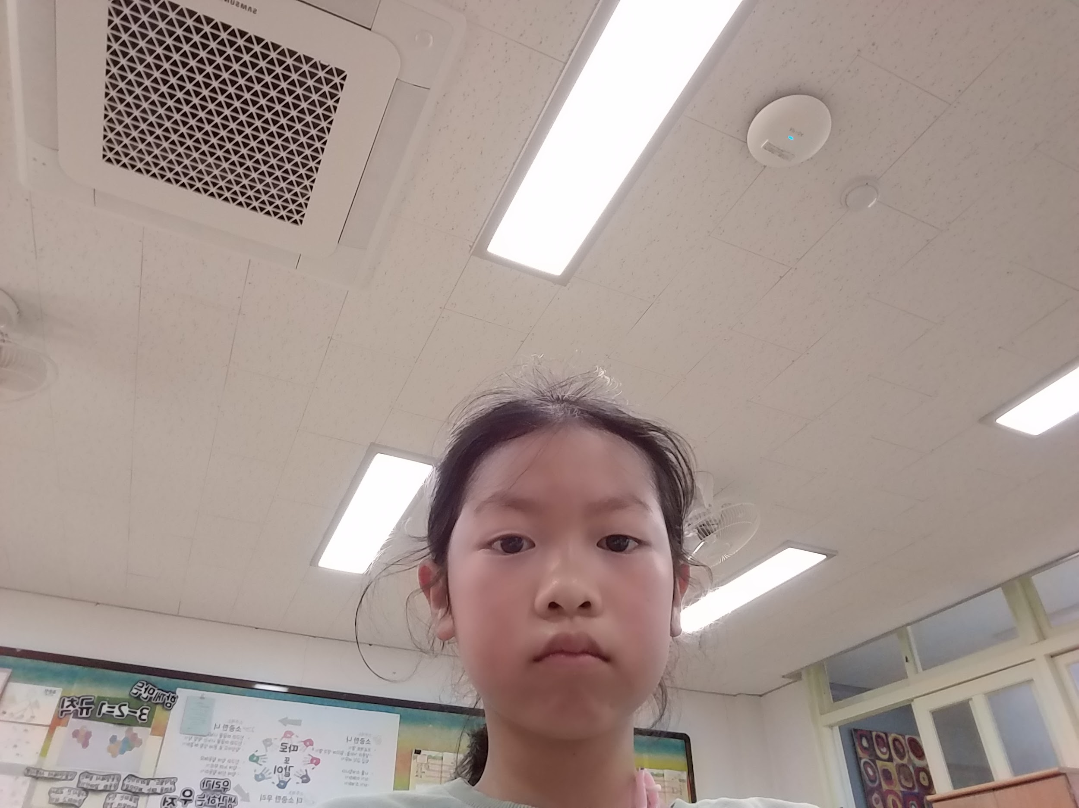



04. Gim Ye Seong
(Picture here)
Hobby
Drawing
Favorite animals
Cat, Rabbit
Good at
Drawing, Playing Games

Slide 6
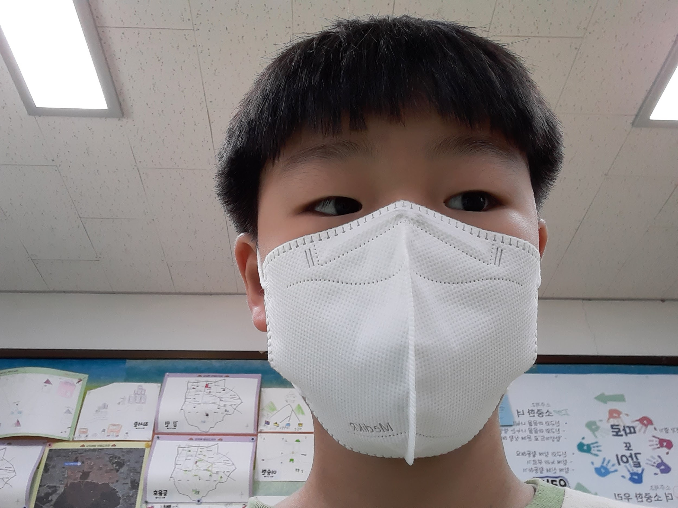

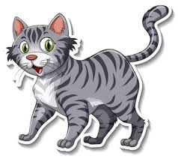

05. Deung Yun Ho
(Picture here)
Hobby
Origami
Favorite animal
cat
Good at
flying airplane

Slide 7
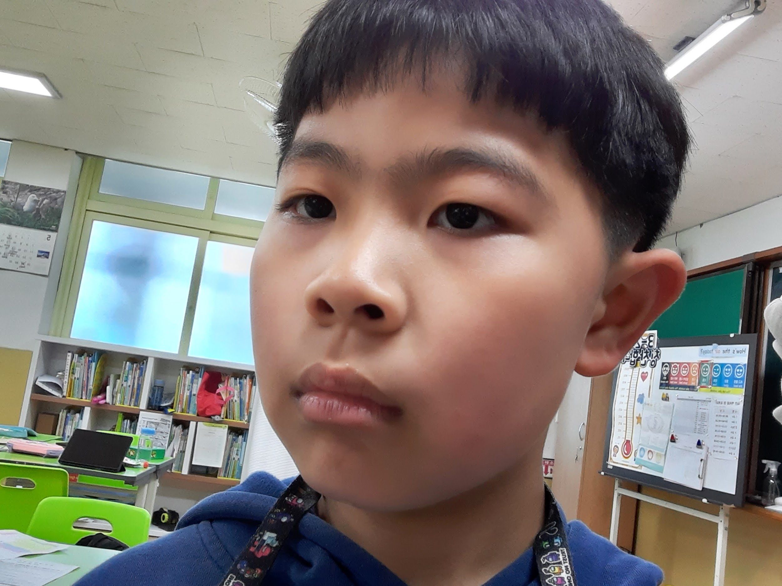
06. Bak Seong Jun
^{Hobby. art}
^{Favorite animal. dog}
^{Good at. Science}
(Picture here)
(Picture here)
(Picture here)
(Picture here)

Slide 8
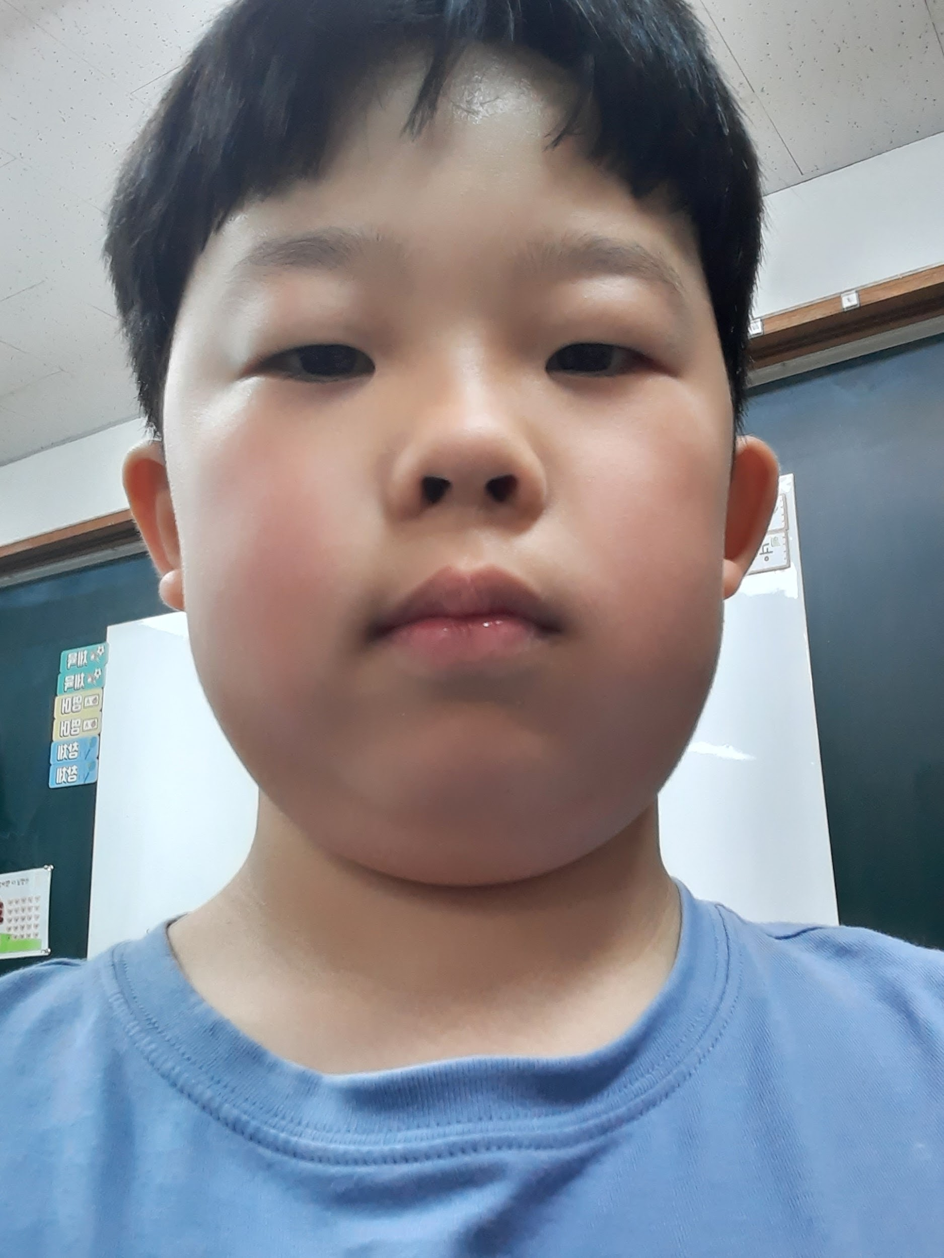
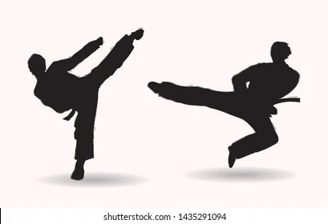
07. Bak Se On
(Picture here)
Hobby
Playing games 🎮
Favorite animal
Tiger 🐅
Good at
Taegwondo

Slide 9
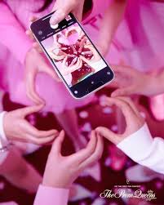
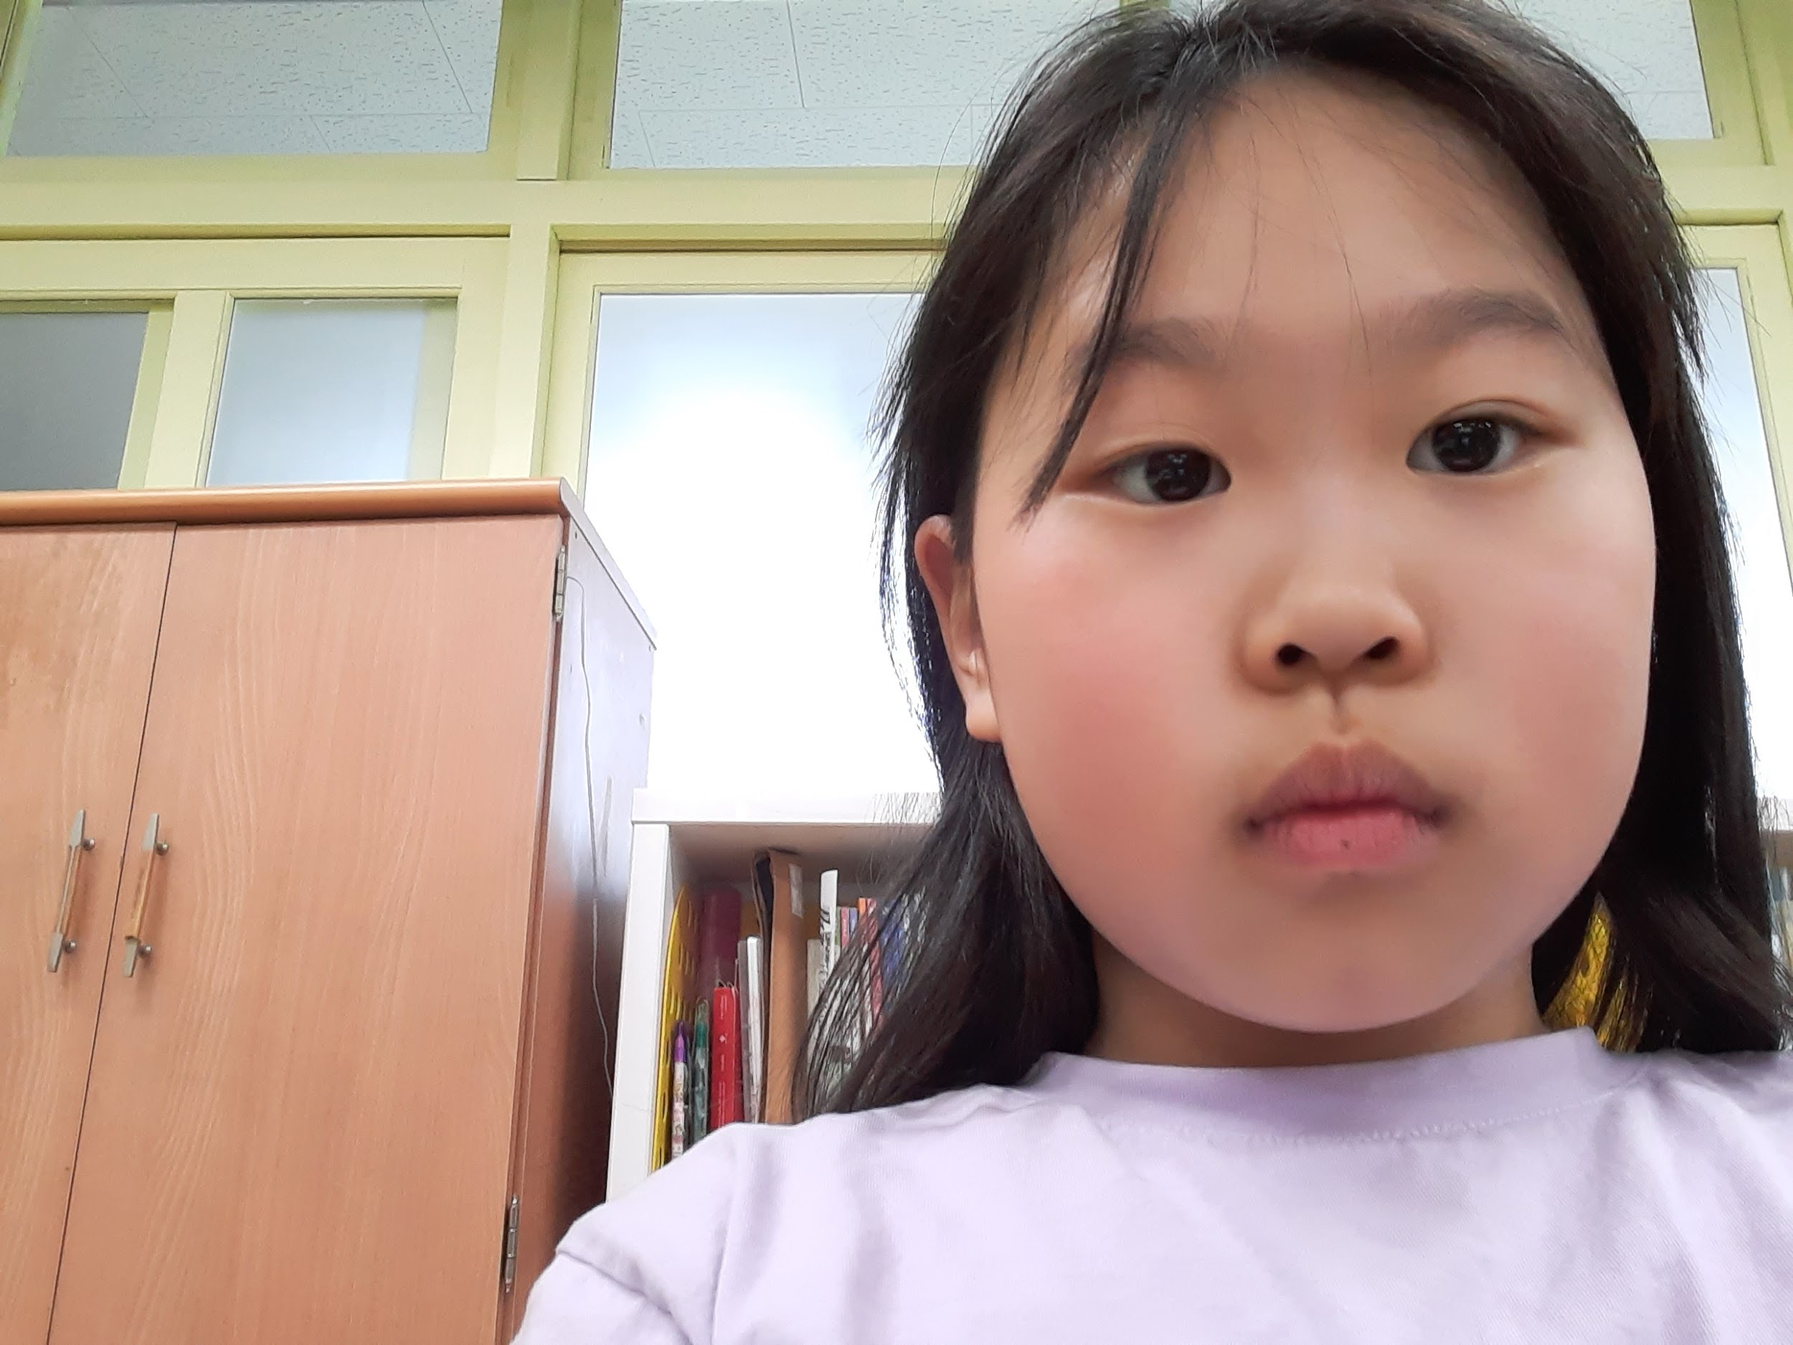
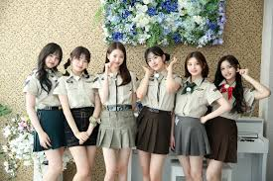
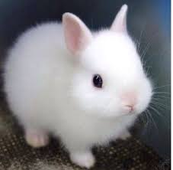

08. Eom Se Jin
Hobby
Dancing, Making craft, Singing
Favorite animal
Cat, Rabbit, Puppy
Good at.
Dancing, Making craft, Singing
(Picture here)

Slide 10
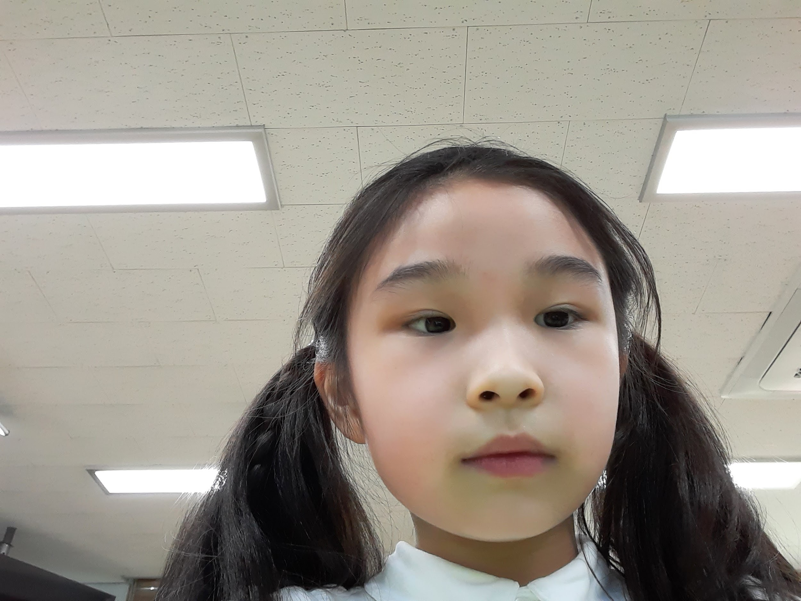
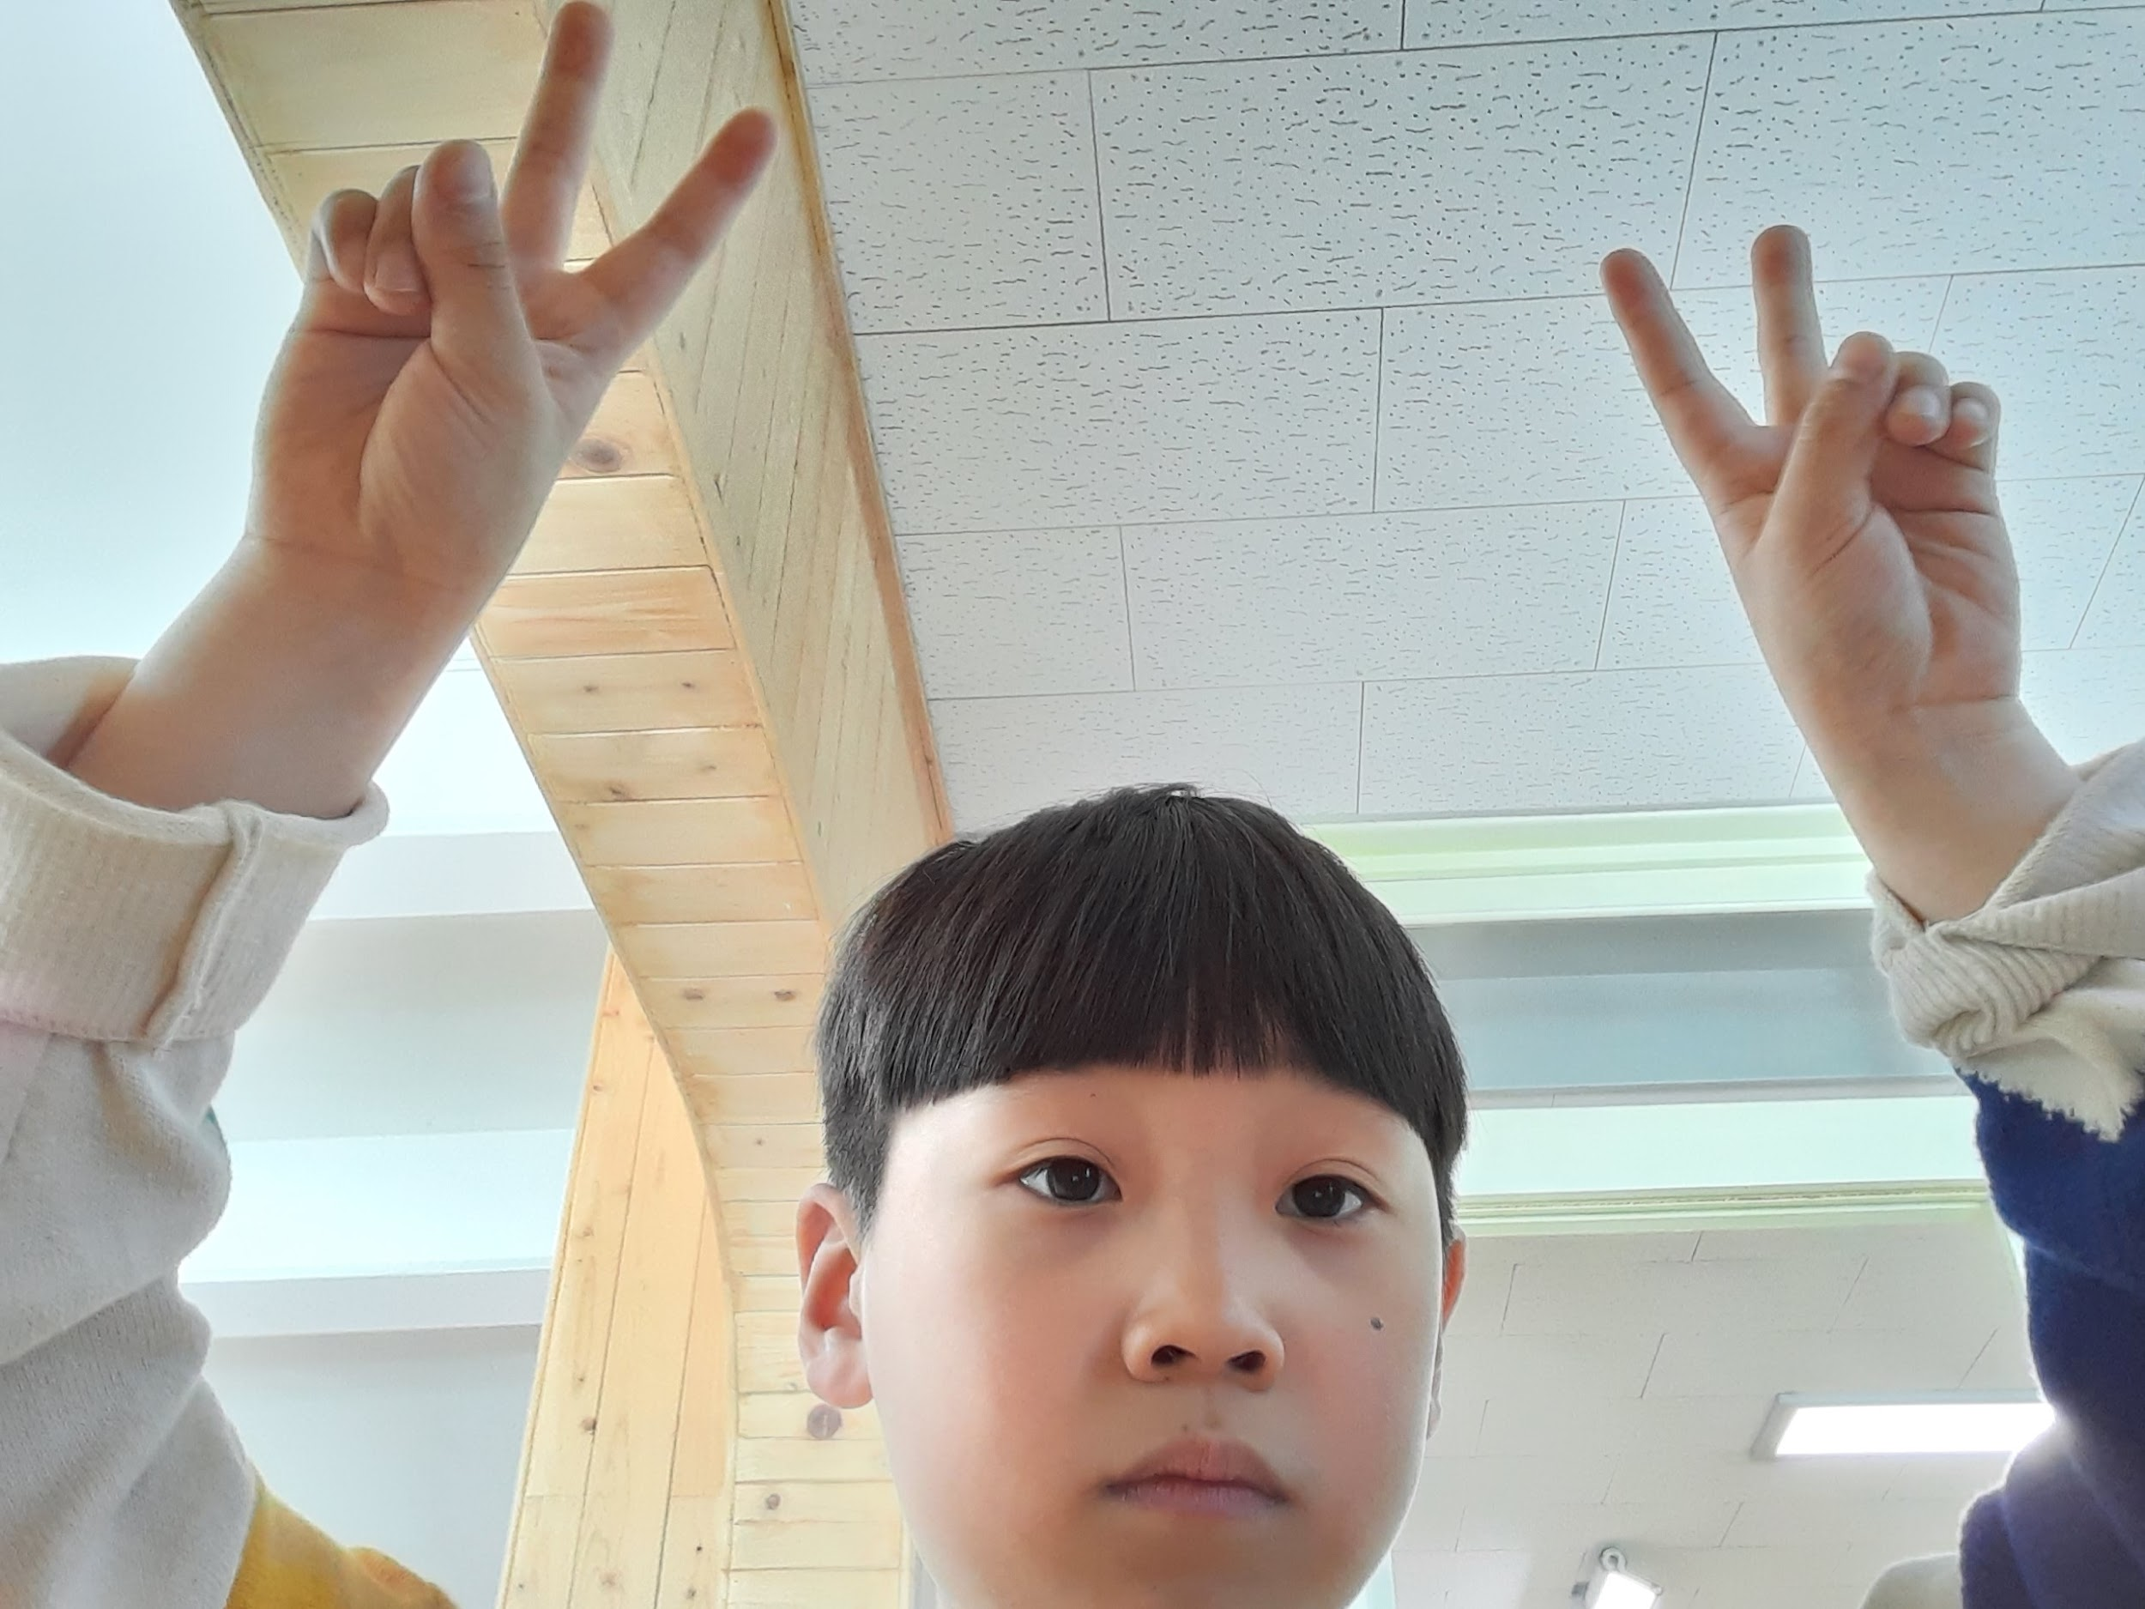



09. I Seung Hyeon
Hobby
Favorite animal
Good at
6
Play jump rope
Turtle
Make LEGO

Slide 11
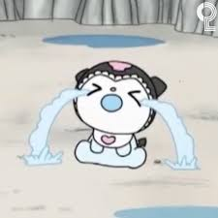
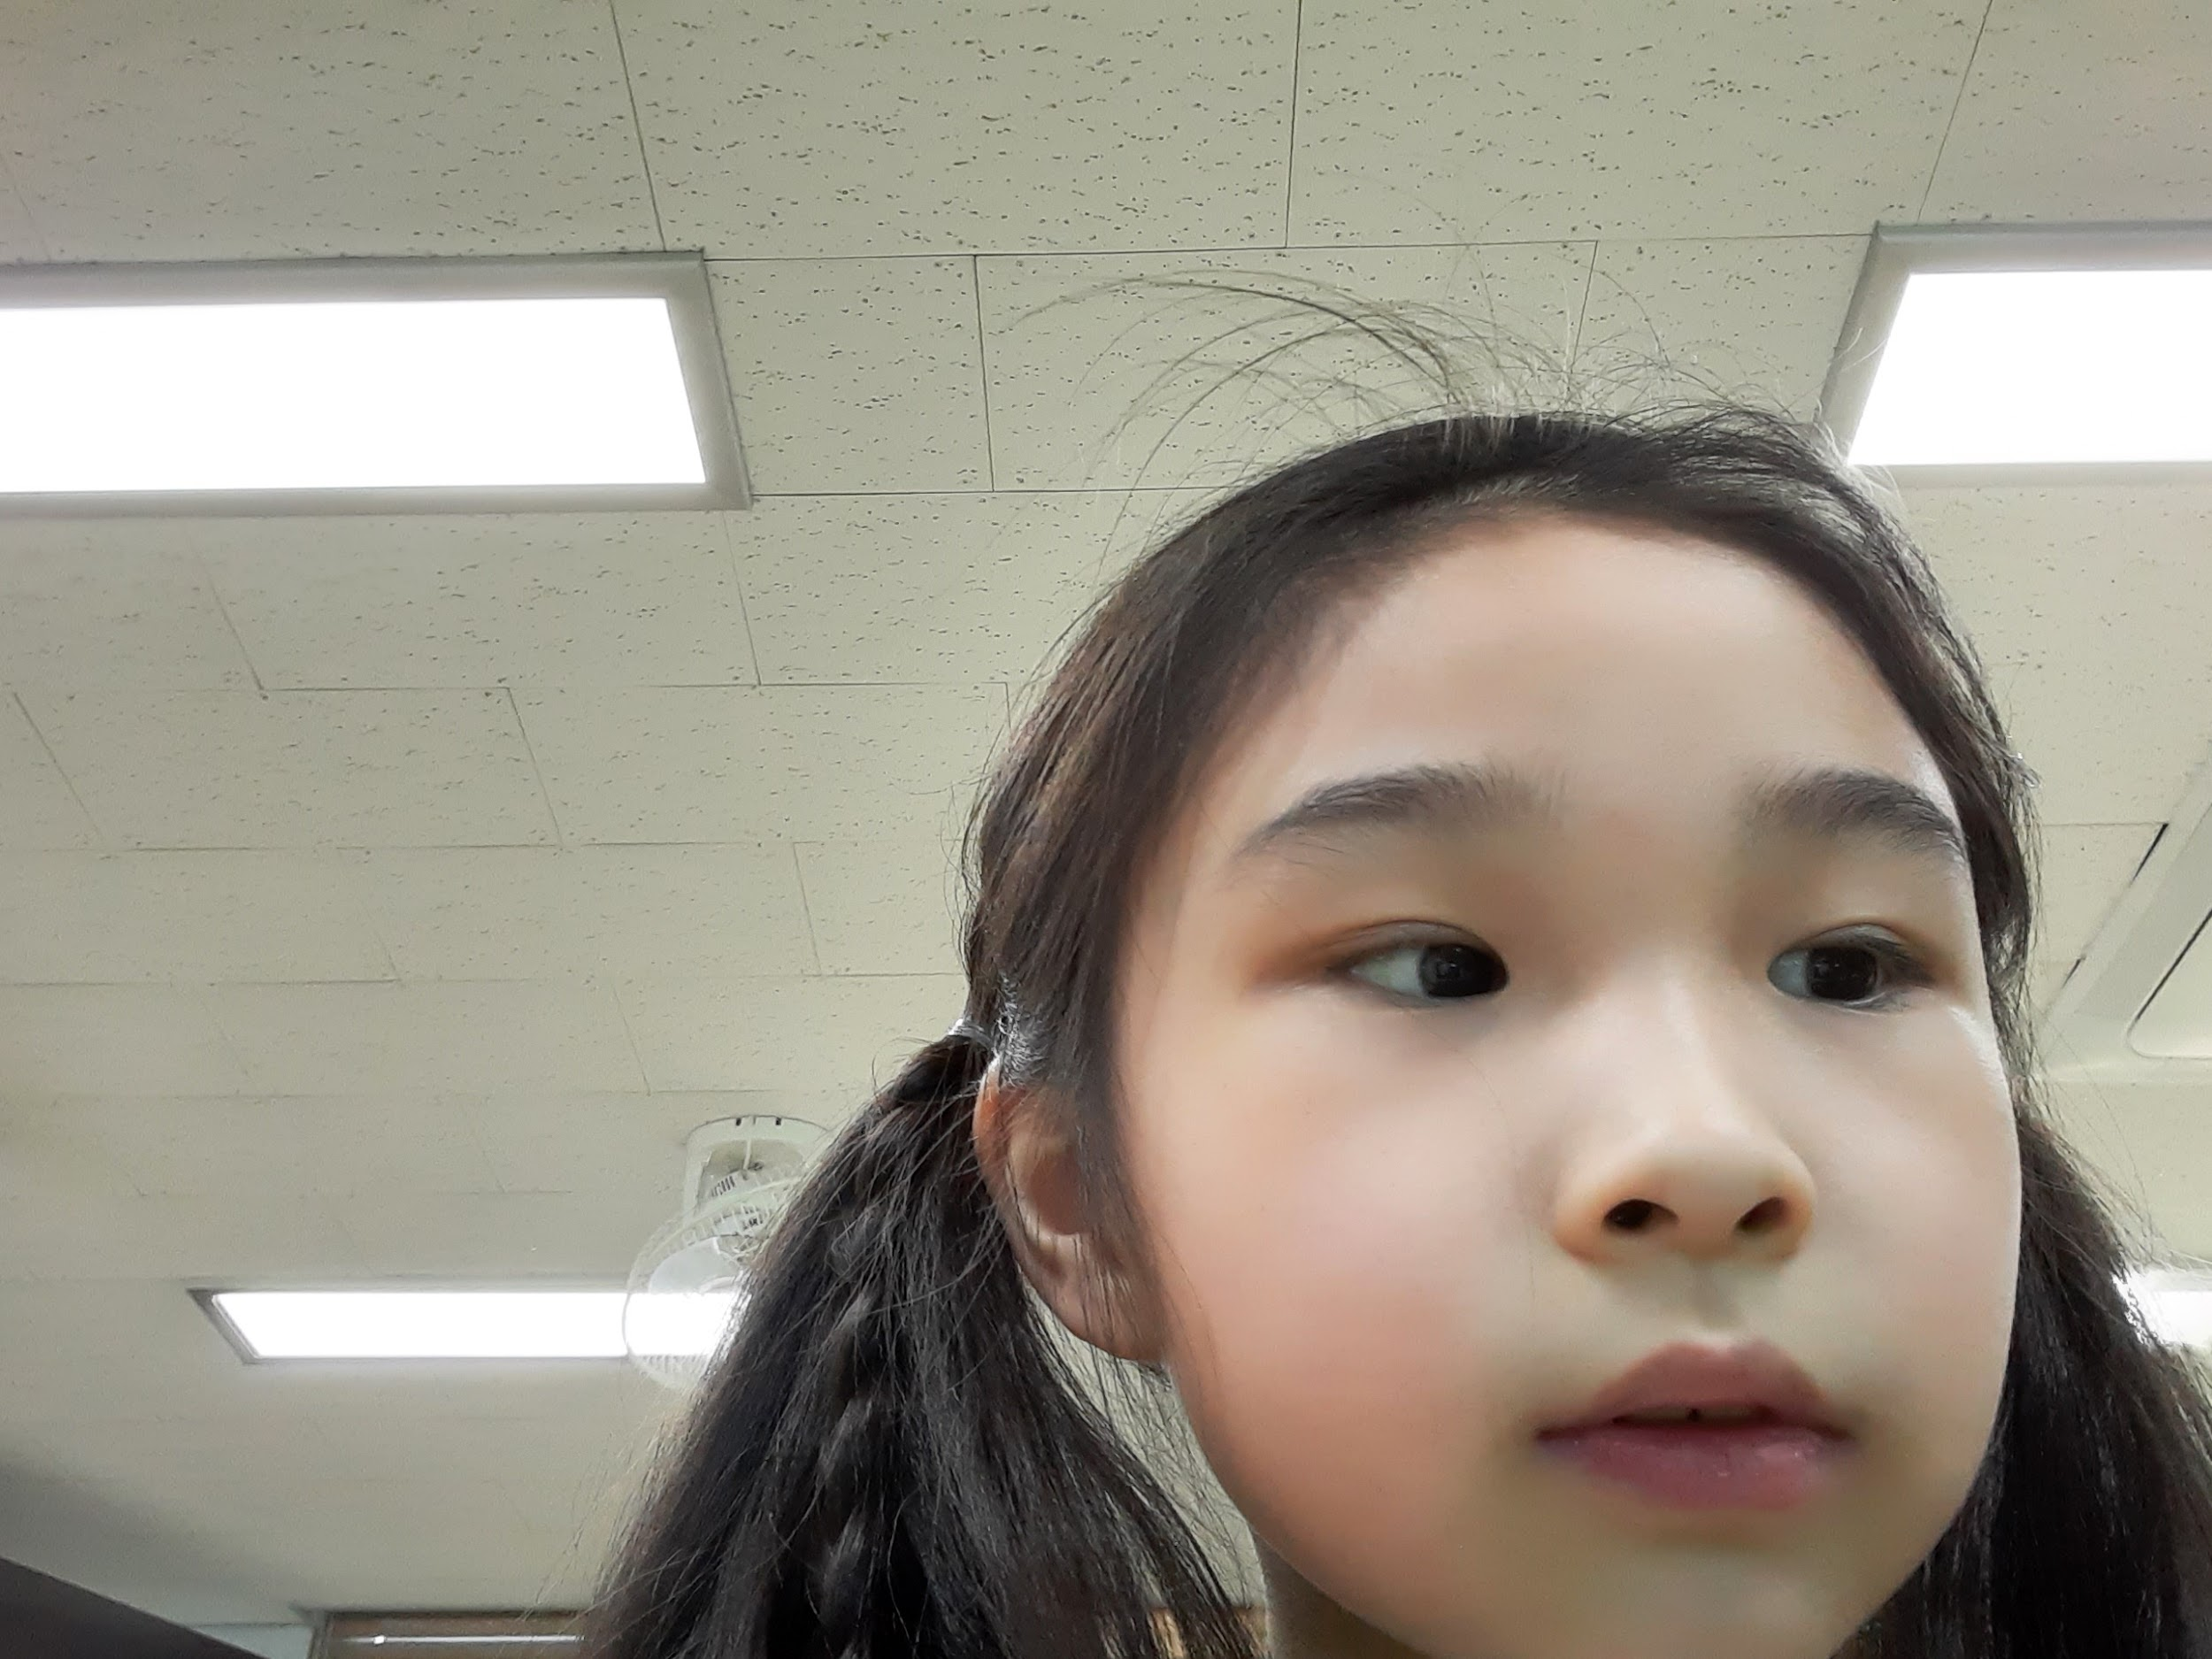

10. I Yun Seul
Hobby
Touching puppy
Favorite character
Kuromi
03. Good at
Playing the piano
(Picture here)

Slide 12
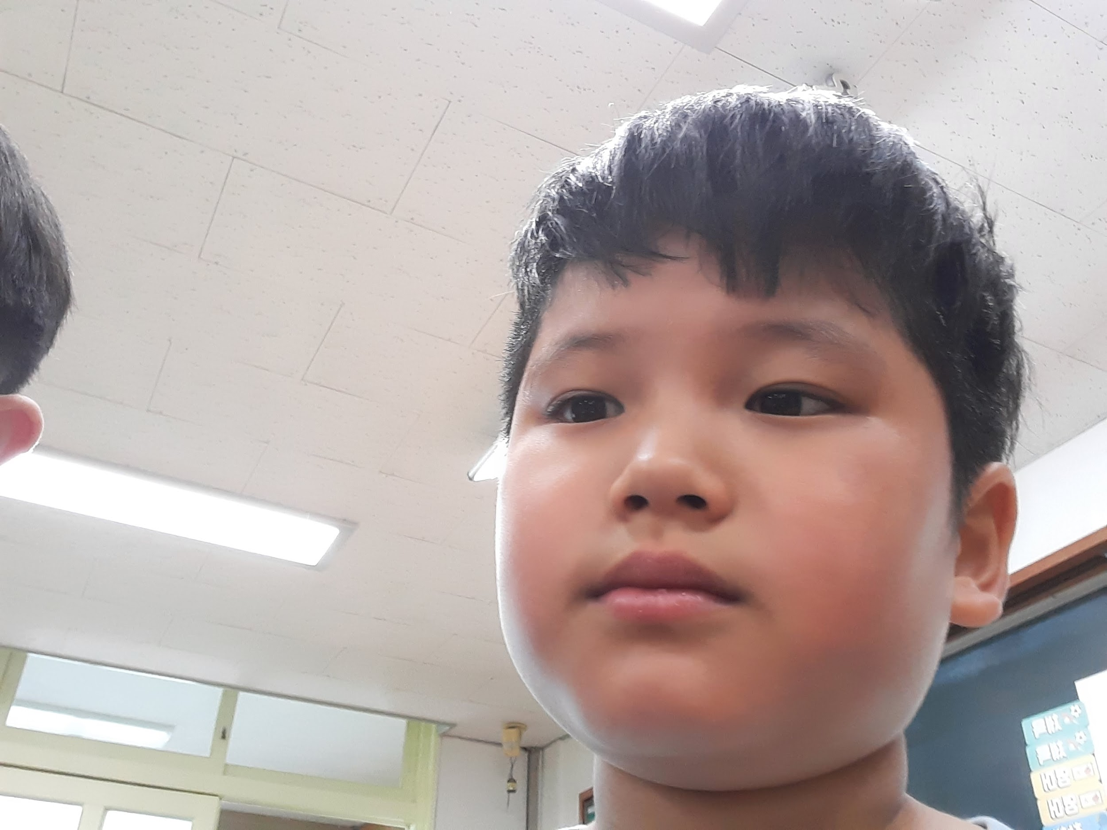
11. Im Jun Wu
Hobby
Running, Swimming
Favorite animal
Puppy, Hamster, Cat
Good at
Soccer, Swimming
(Picture here)

Slide 13

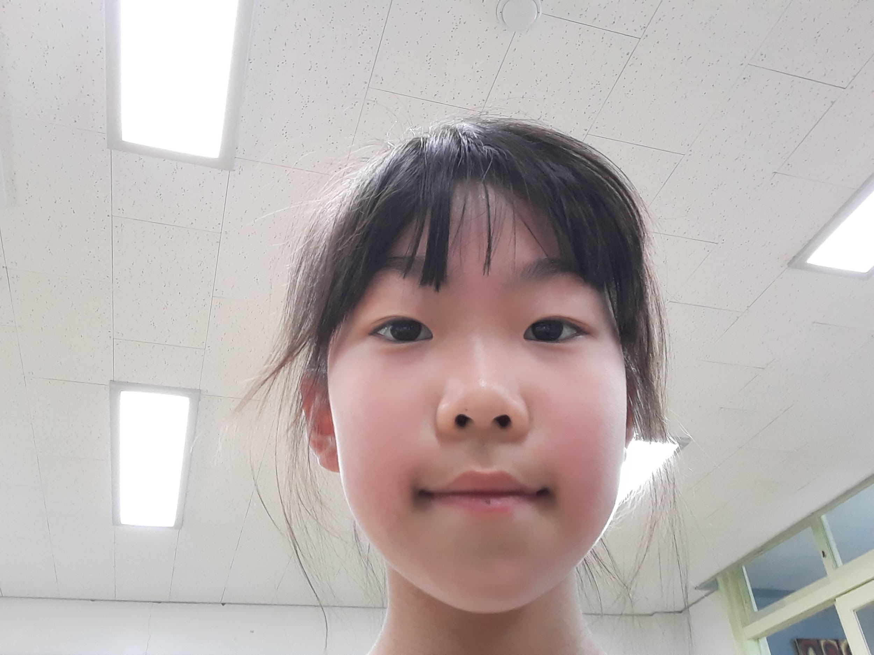
12. Jeong Ye Eun
(Picture here)
Hobby
Reading books
Favorite animal
Cat
Good at
Playing the piano

Slide 14

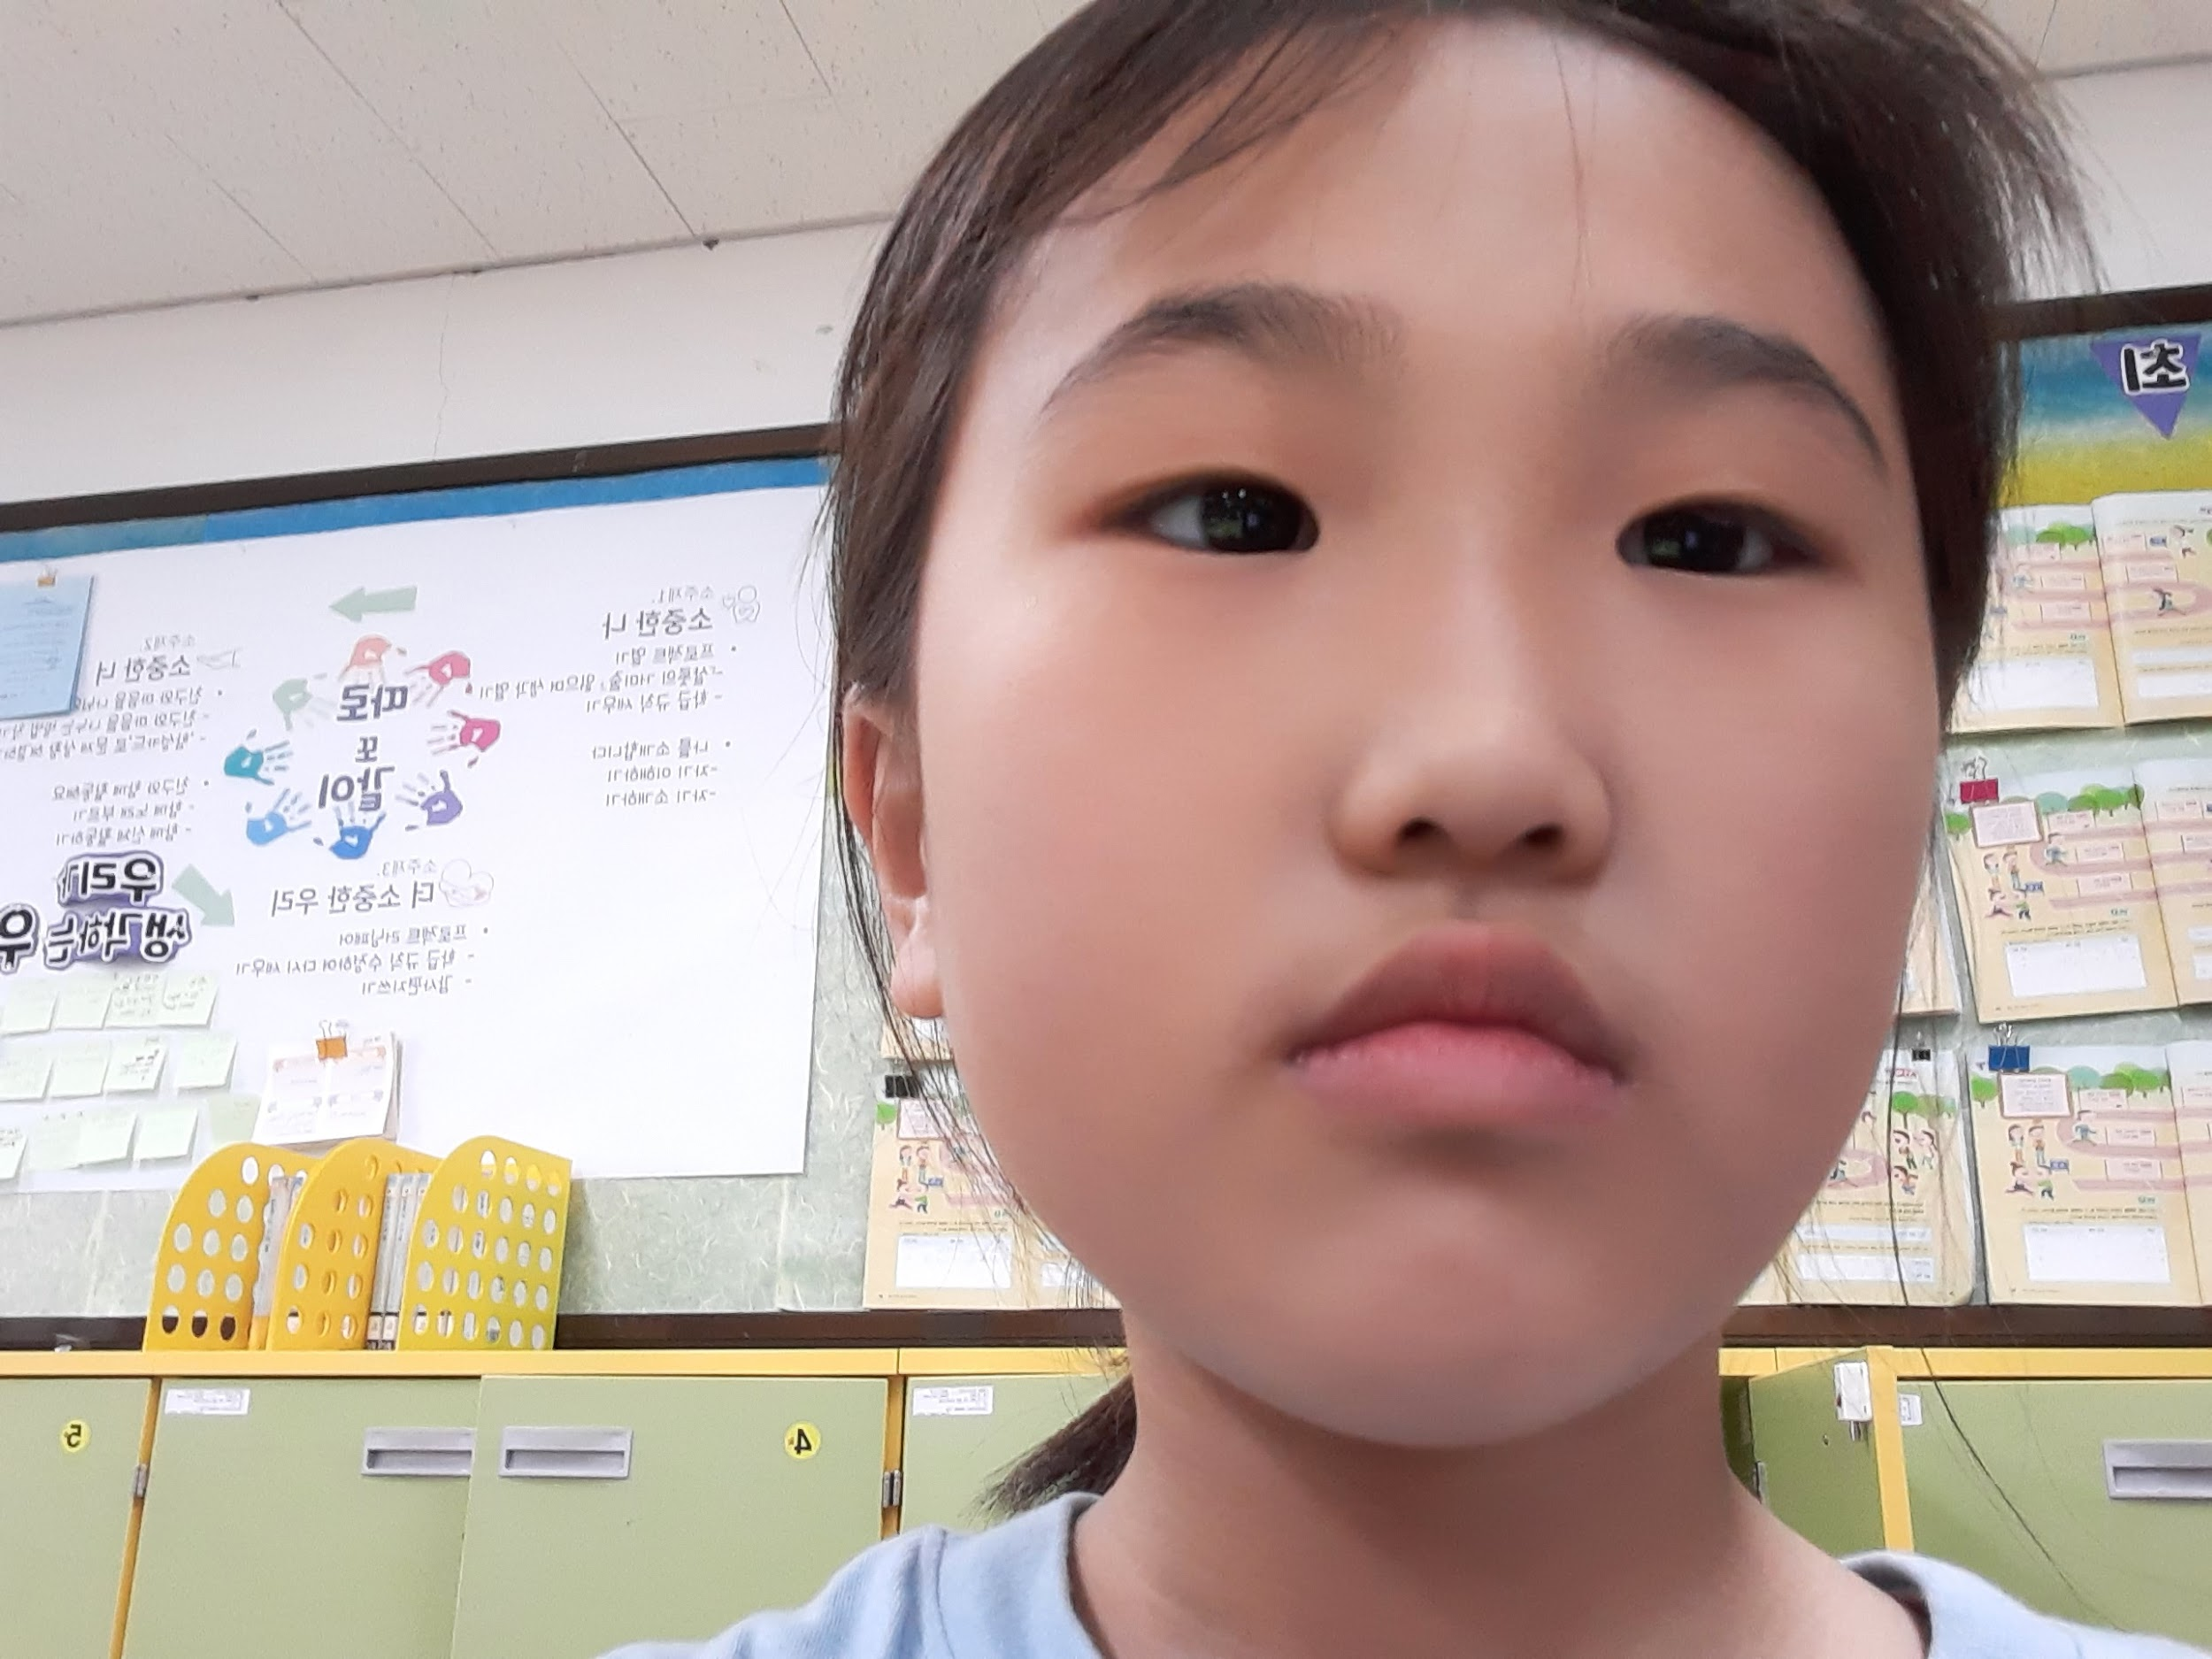
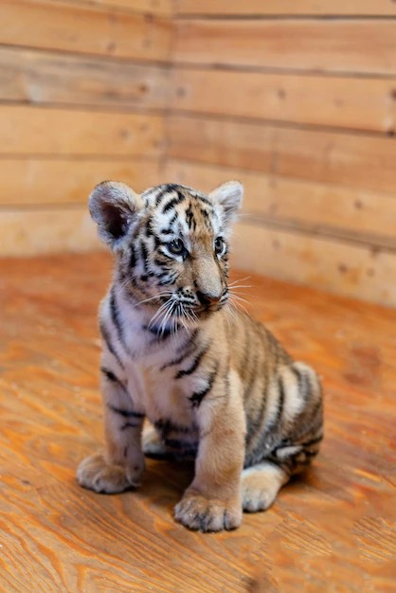
13. Jeong Ha Rin
(Picture here)
Hobby
Favorite animal
Good at
Drow picture
Tiger
Drow picture

Slide 15
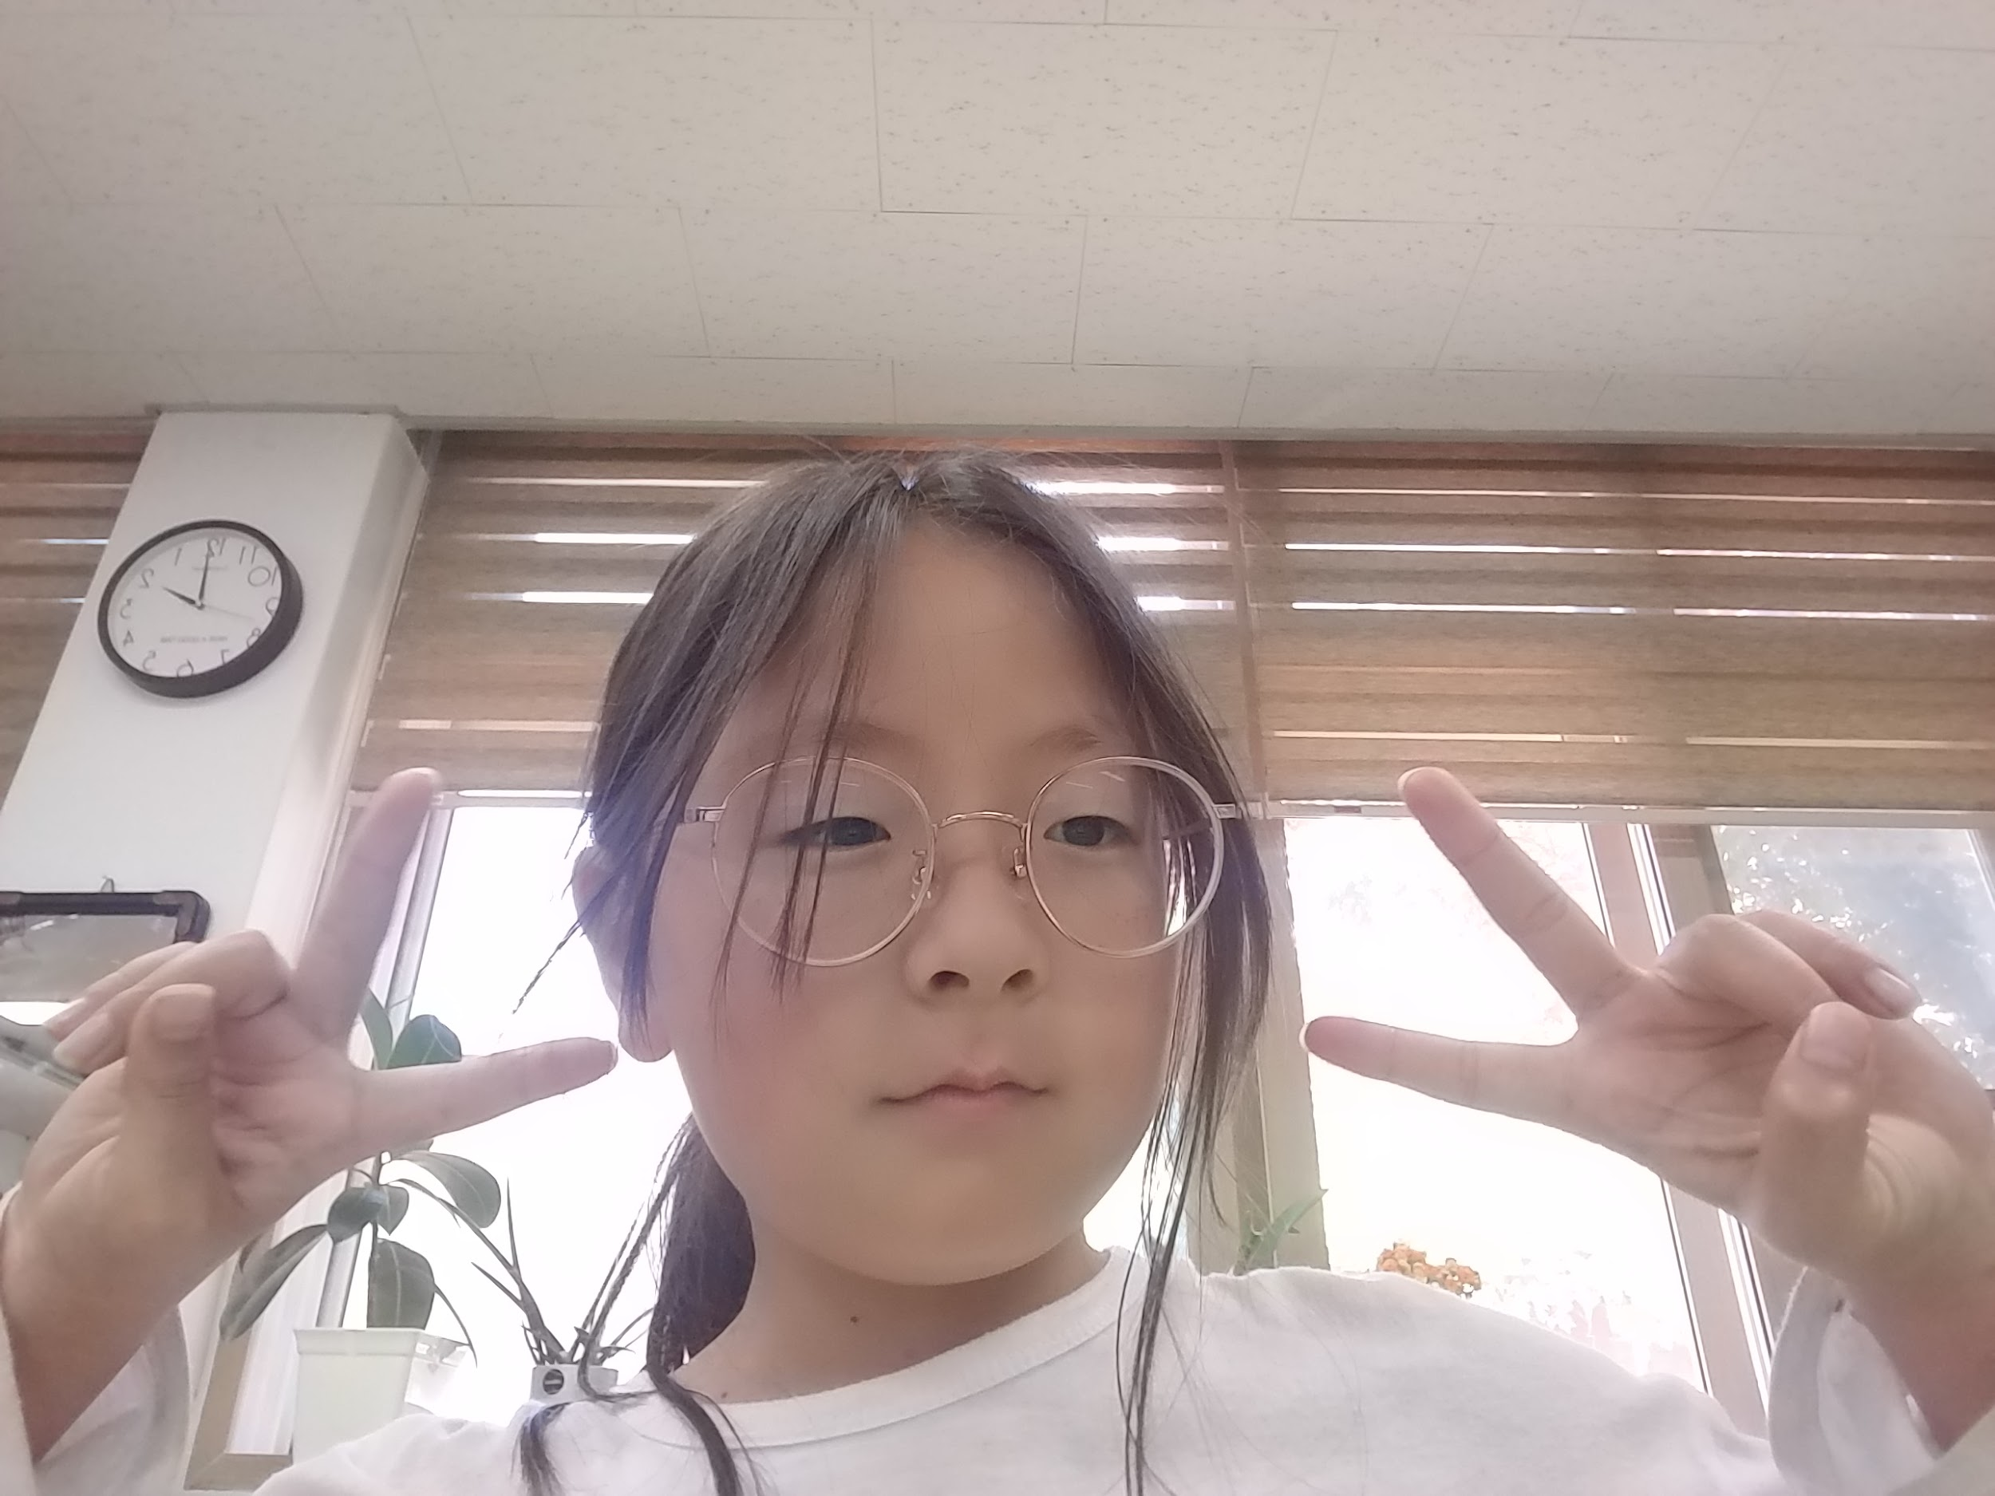
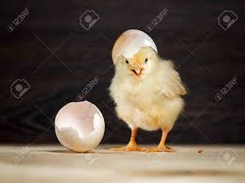
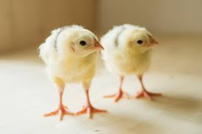
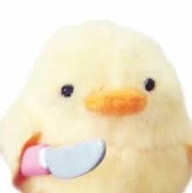

14. Jo Eun Jin
Feeding animals
Chick
art
(Picture here)
Hobby
Favorite animal
Good at

Slide 16
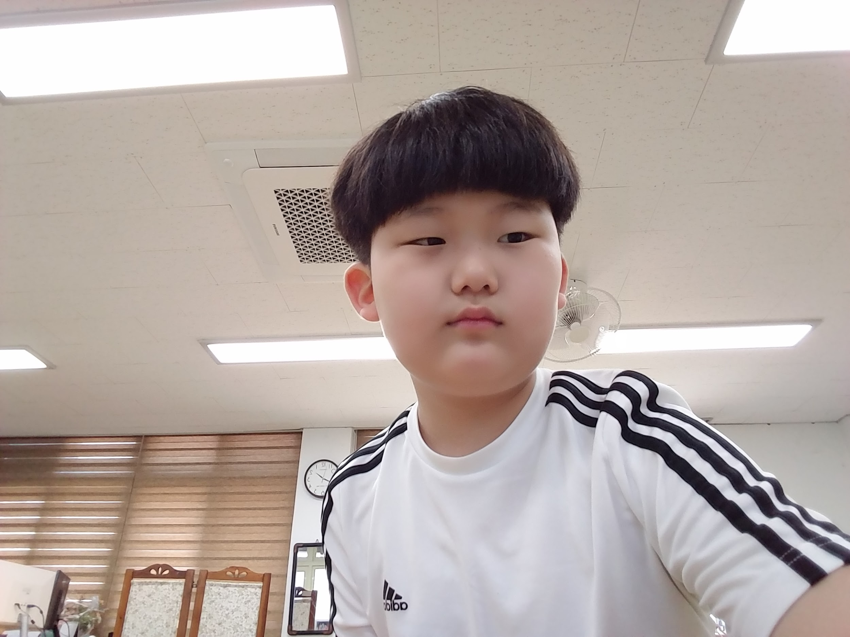
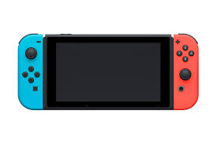
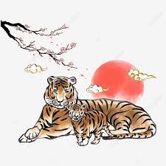

15. Choe Seo Jun
(Picture here)
(Picture here)
Hobby
Favorite animal
Good at
Play game
tiger
Pokemon Game

Slide 17
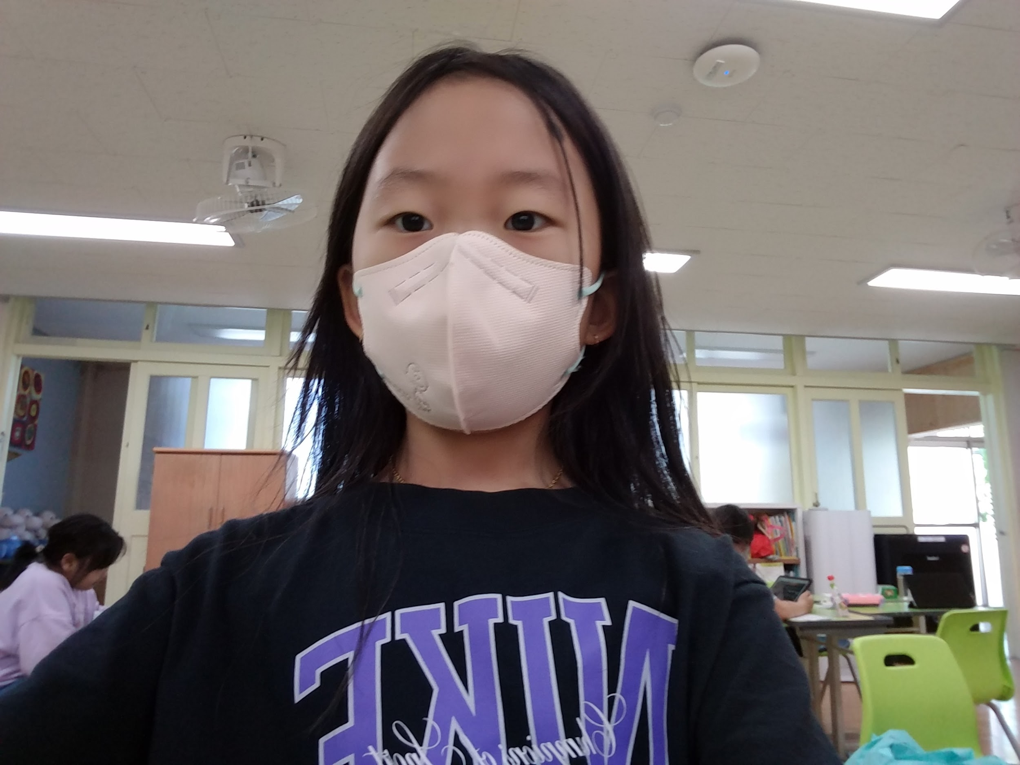

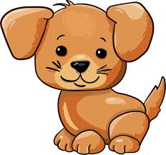
16. Choe Ha Eun
Hobby
Drawing
Favorite animal
Puppy
Good at
Drawing
(Picture here)

Slide 18
Q & A time!

Slide 19
Hi, I’m vice president of this class, 이승현.
We have some questions for you
and we also answered about us, too!
Let me start!

Slide 20
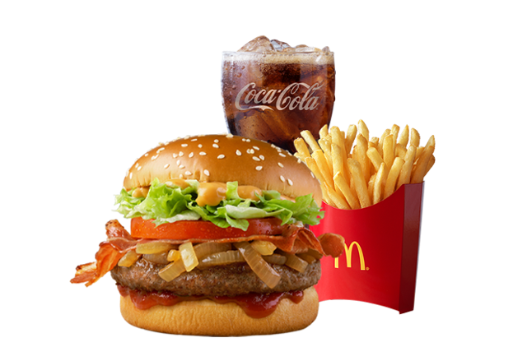
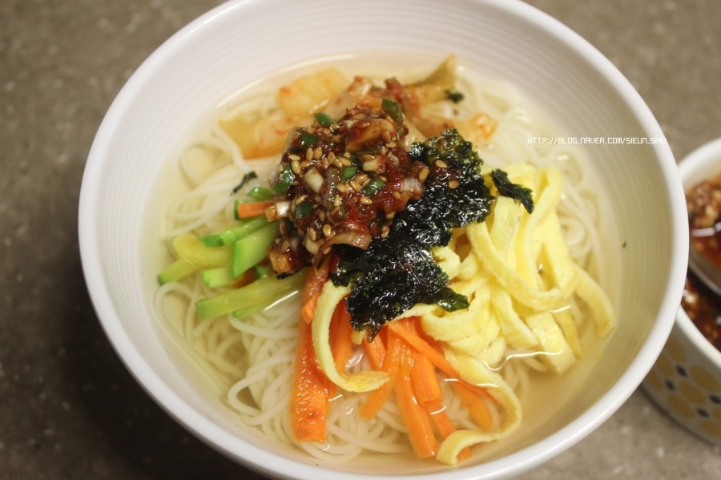
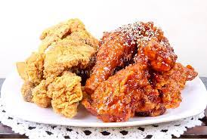
First question, what foods do you like?
For us… 2 students like

Slide 21
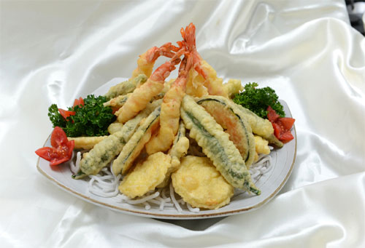
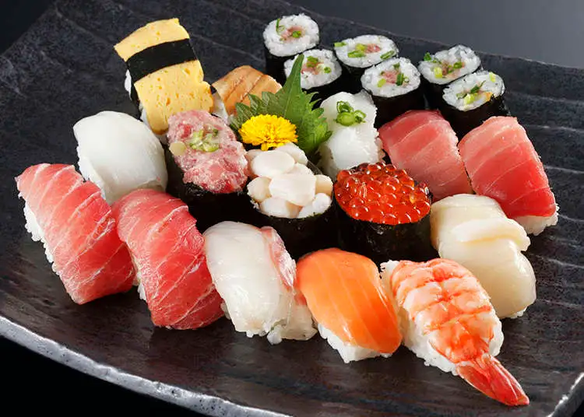
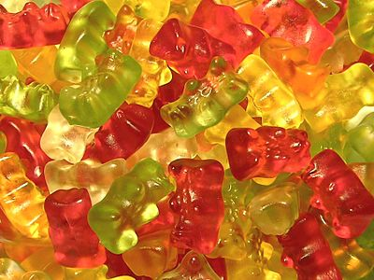
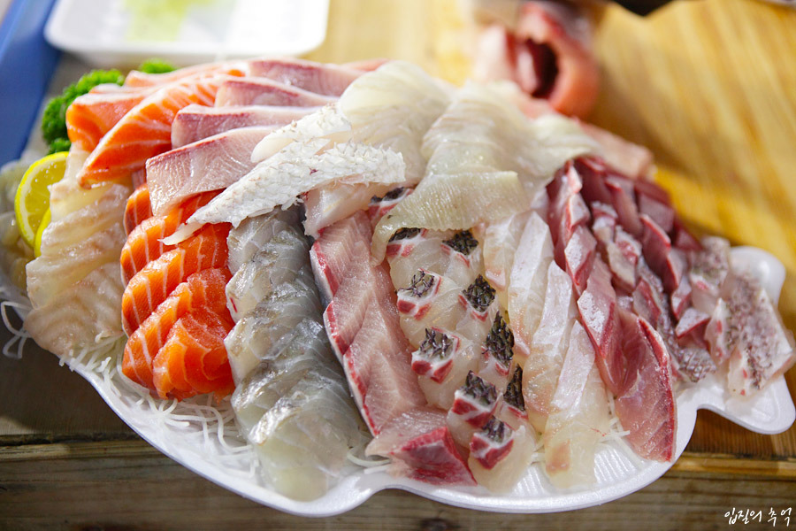
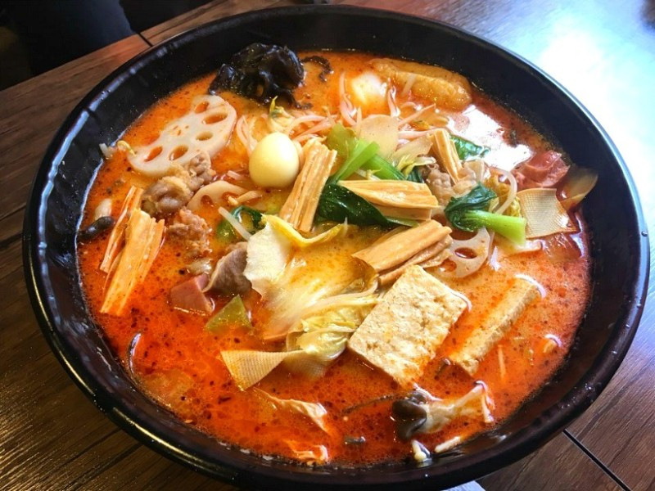
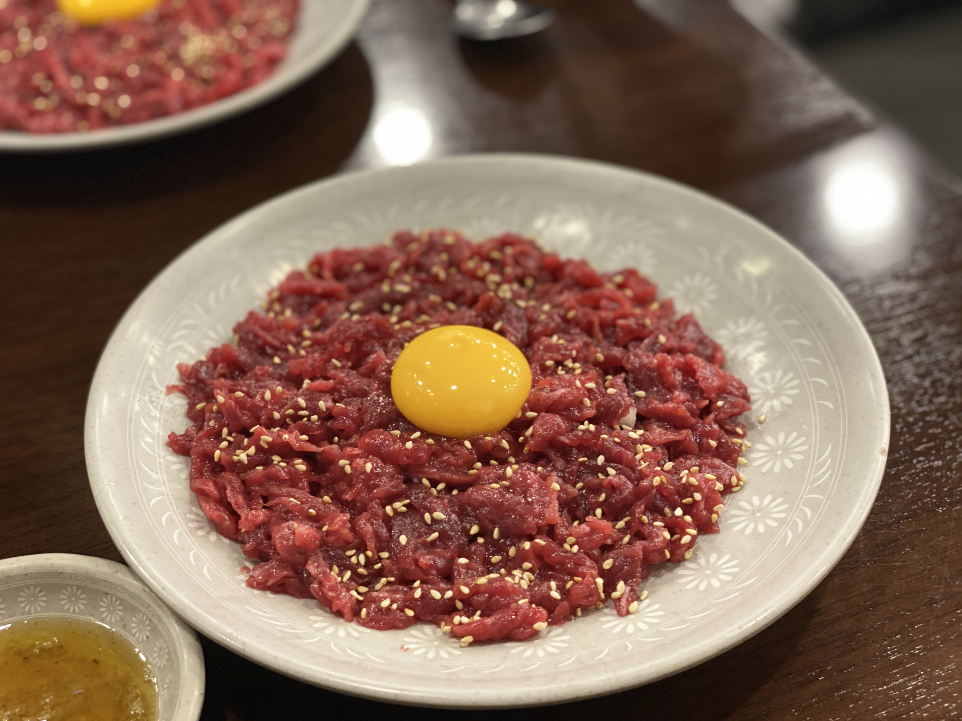
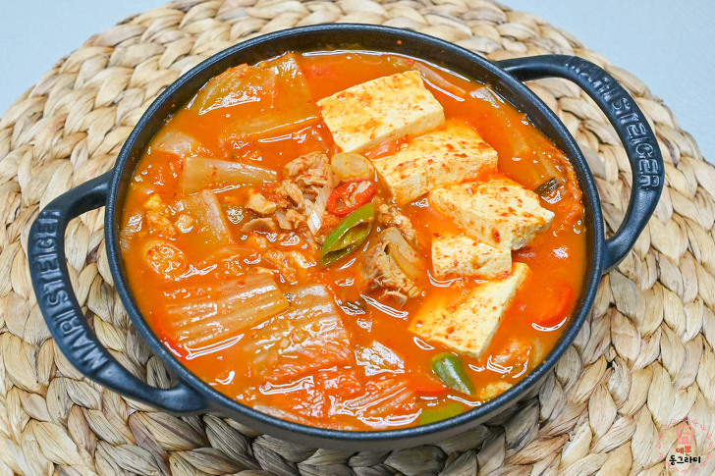
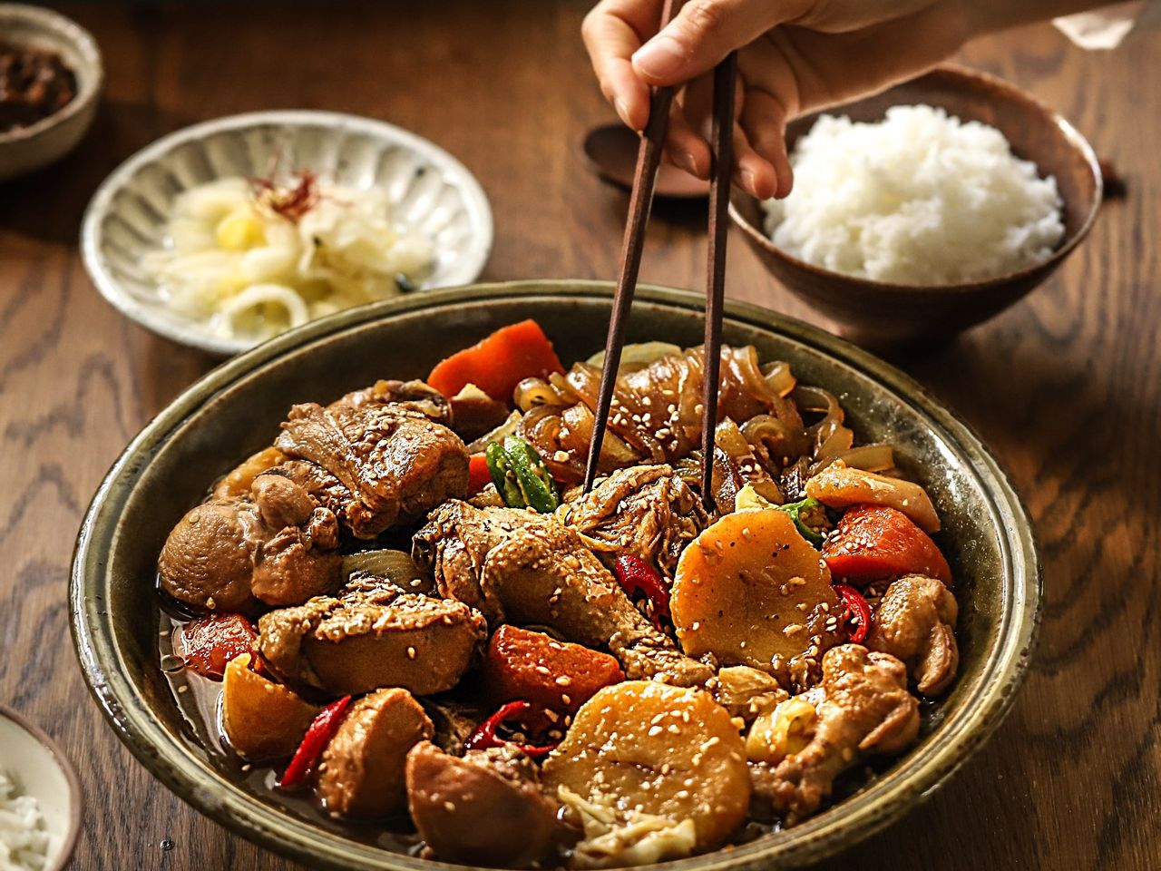
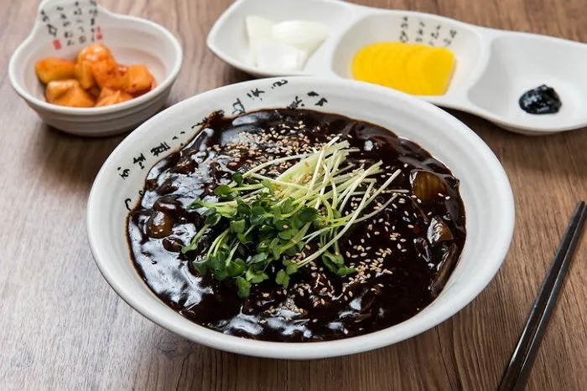

and others like fries, sushi, jelly, low fish, 마라탕, low meat, 김치찌개, 찜닭, 짜장면 and spaghetti.

Slide 22

Second question, what snacks do you like?
For us, 5 students like

Slide 23


4 students like

Slide 24



and others like…

Slide 25

Third question, what games do you like?
for us, 7 students like

Slide 26

2 students like

Slide 27





and others like

Slide 28

Fourth question, what landmarks do you want to introduce?
For us 6 students picked

Slide 29



3 students picked E-world and …

Slide 30

2 students picked

Slide 31


and others picked Lotte World and Suwon Ha seong

Slide 32

Fifth question, what characters do you like?
For us, 4 students likes

Slide 33



2 students like

Slide 34


and others like

Slide 35

The last question, what singers or songs do you like?
For us, 6 students like ive

Slide 36




and others like

Slide 37




and others like these songs, like…

Slide 38


