Slide 1

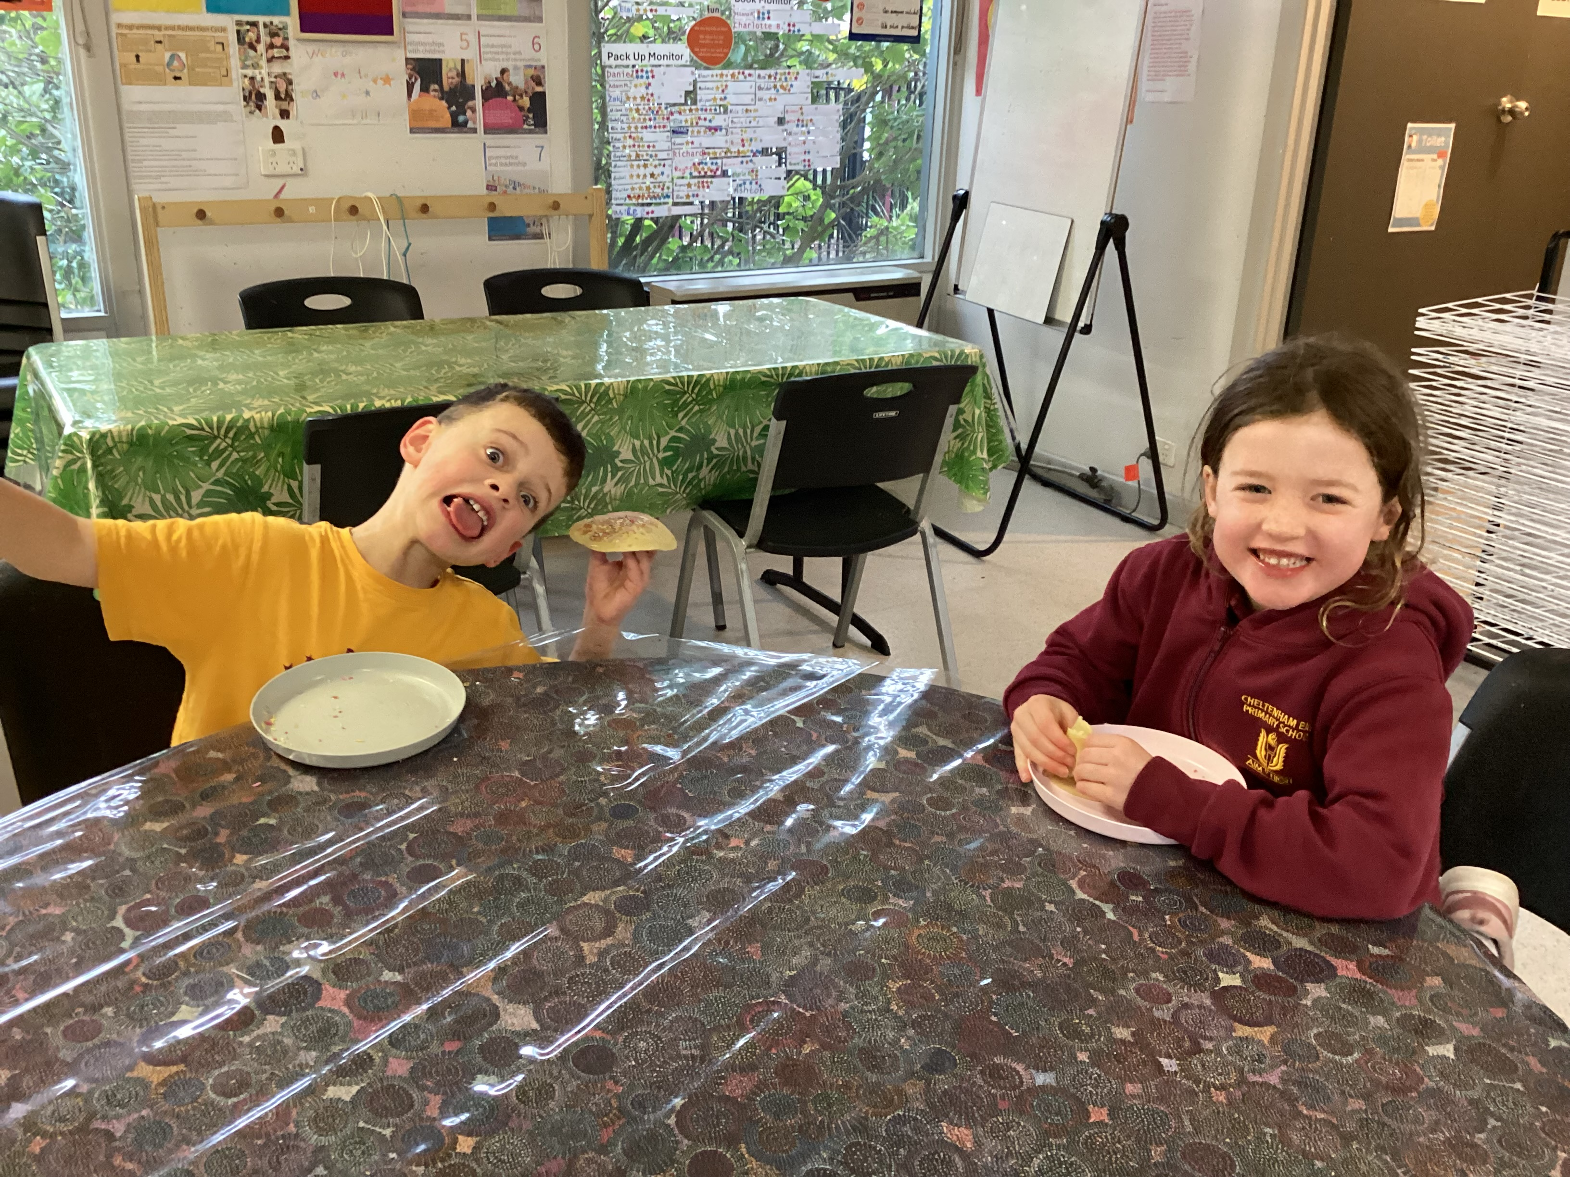

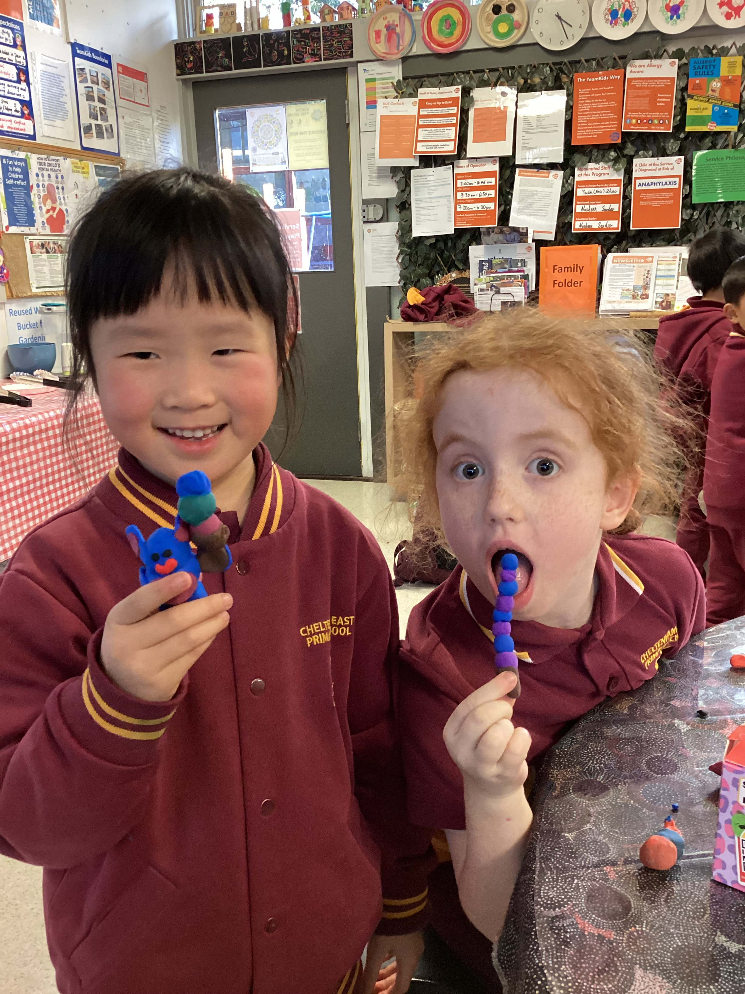
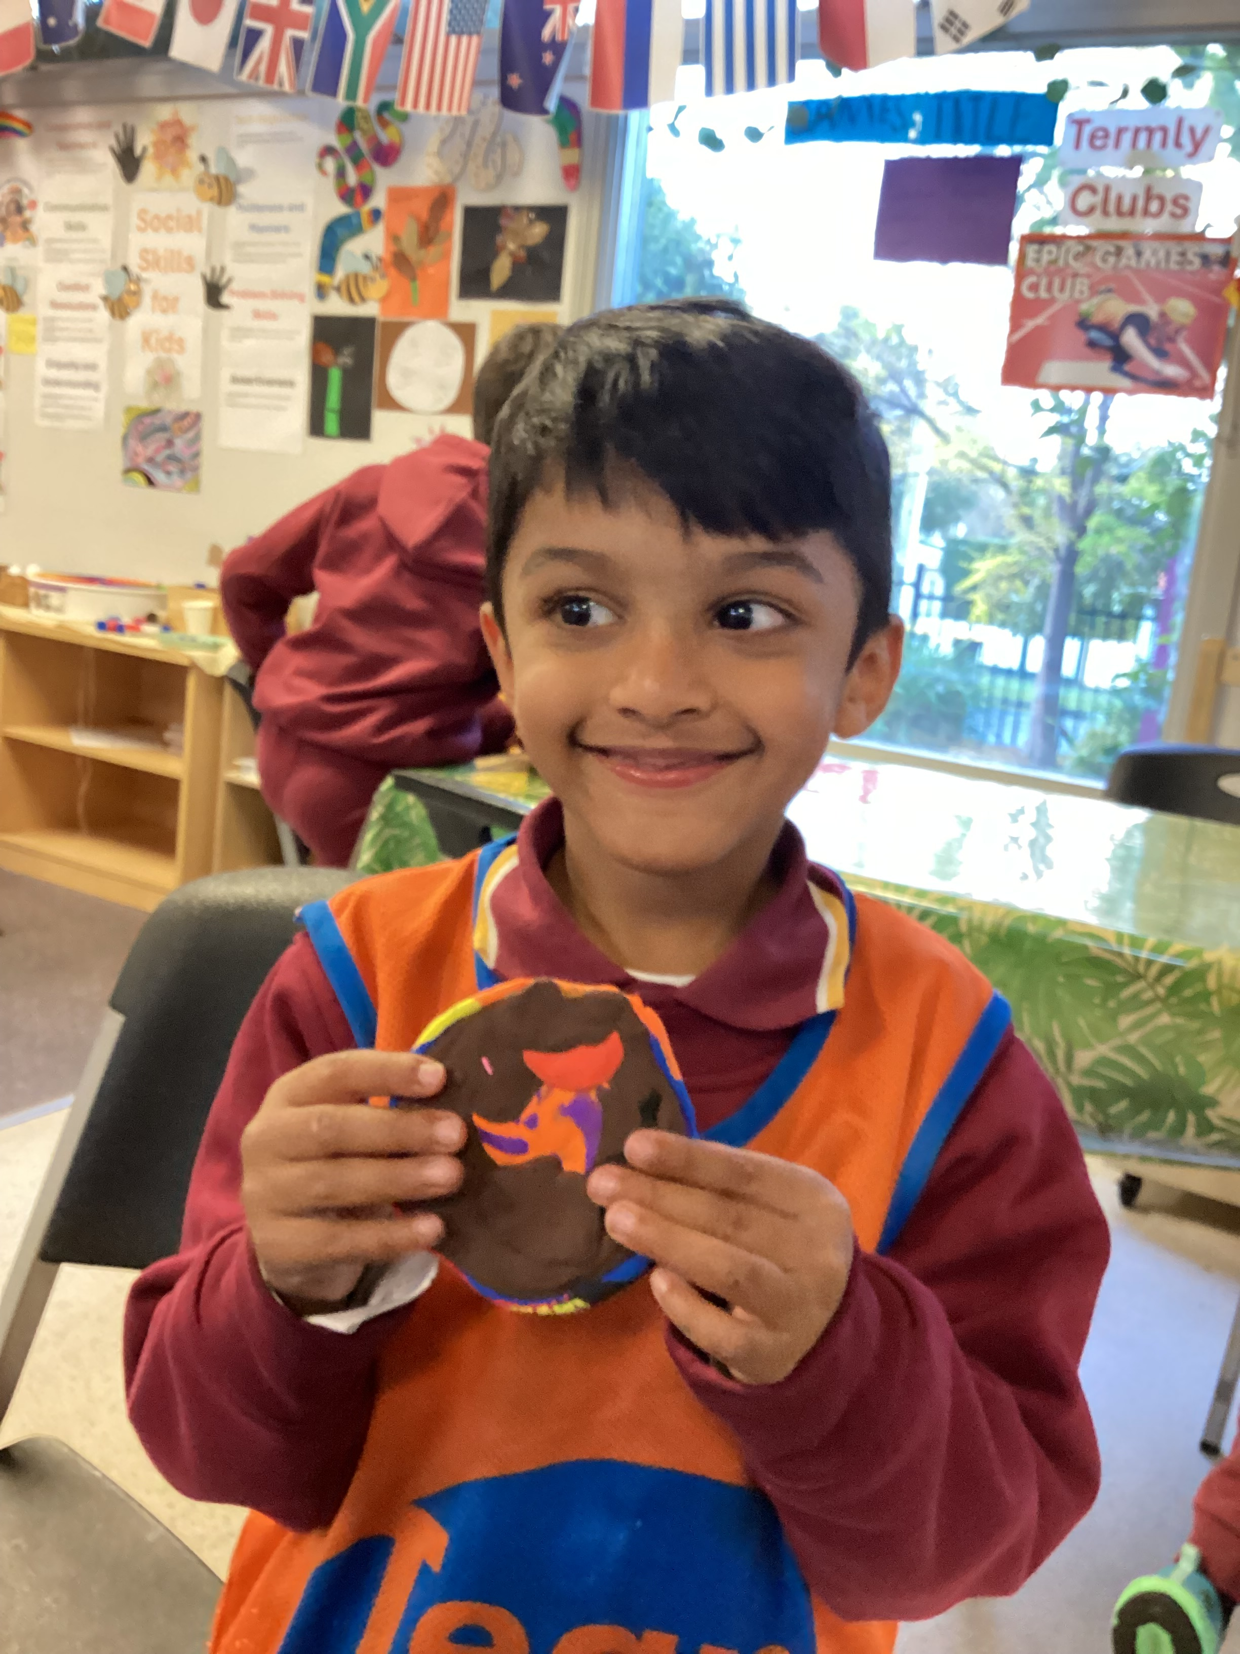
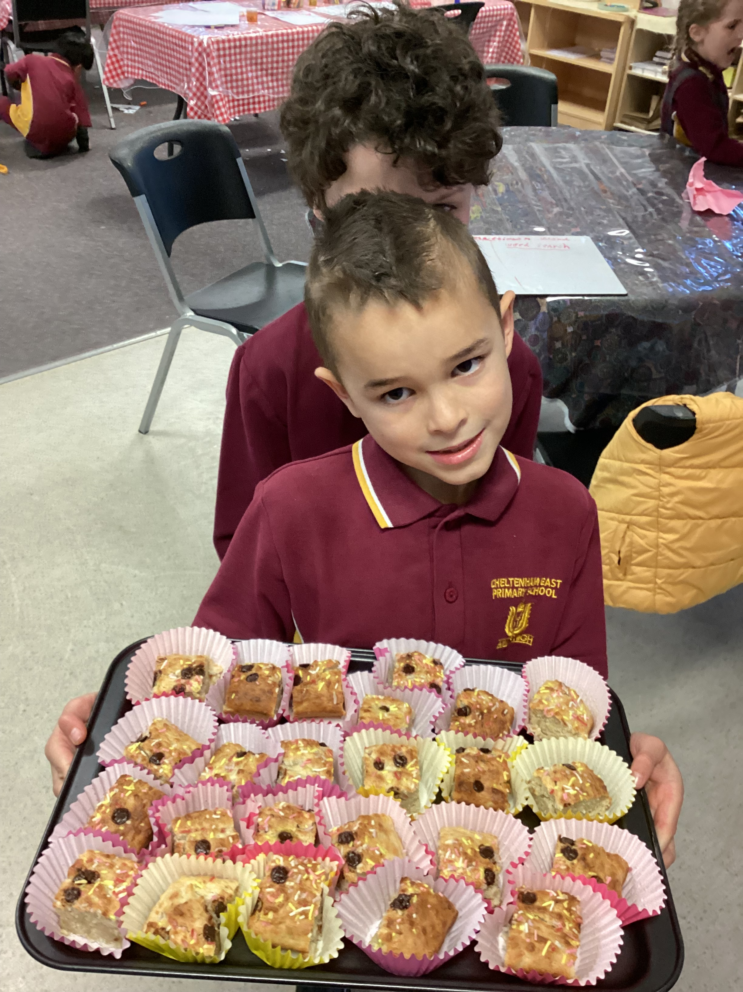
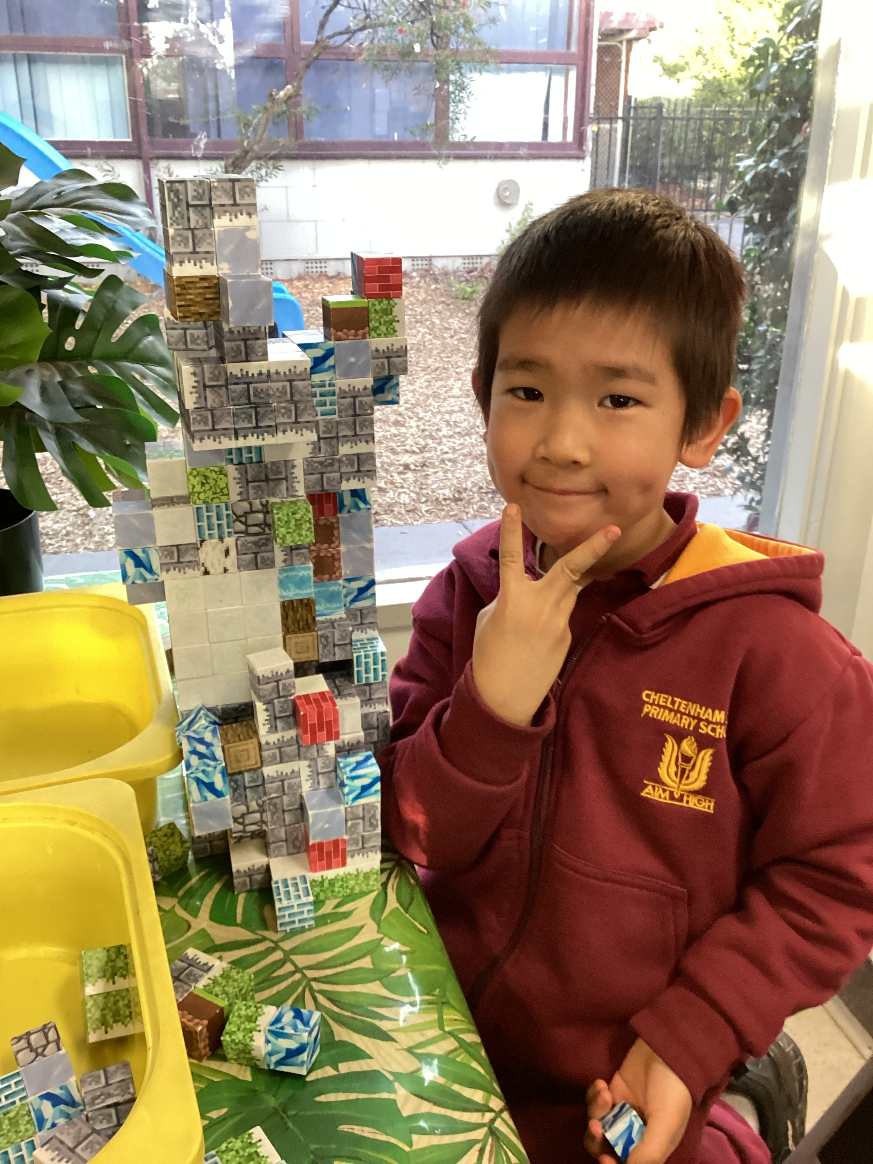



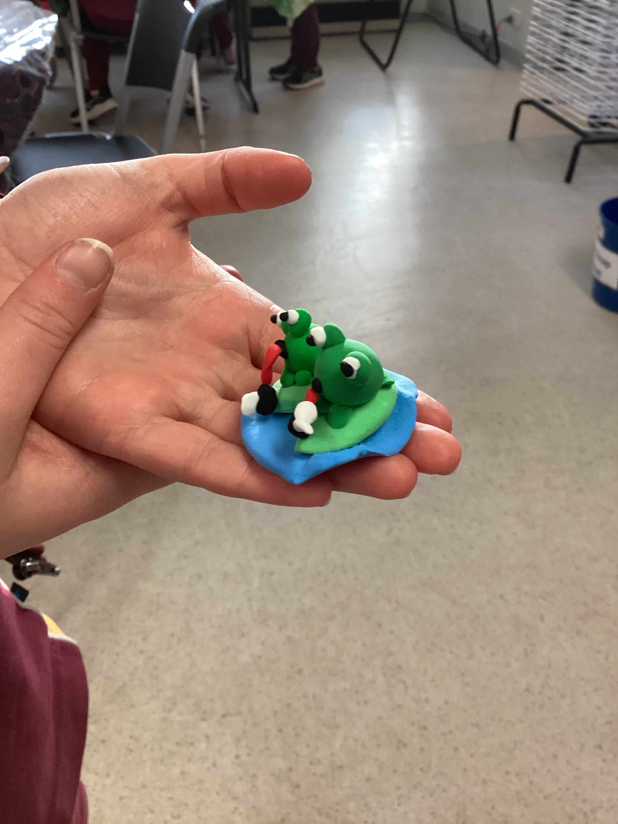
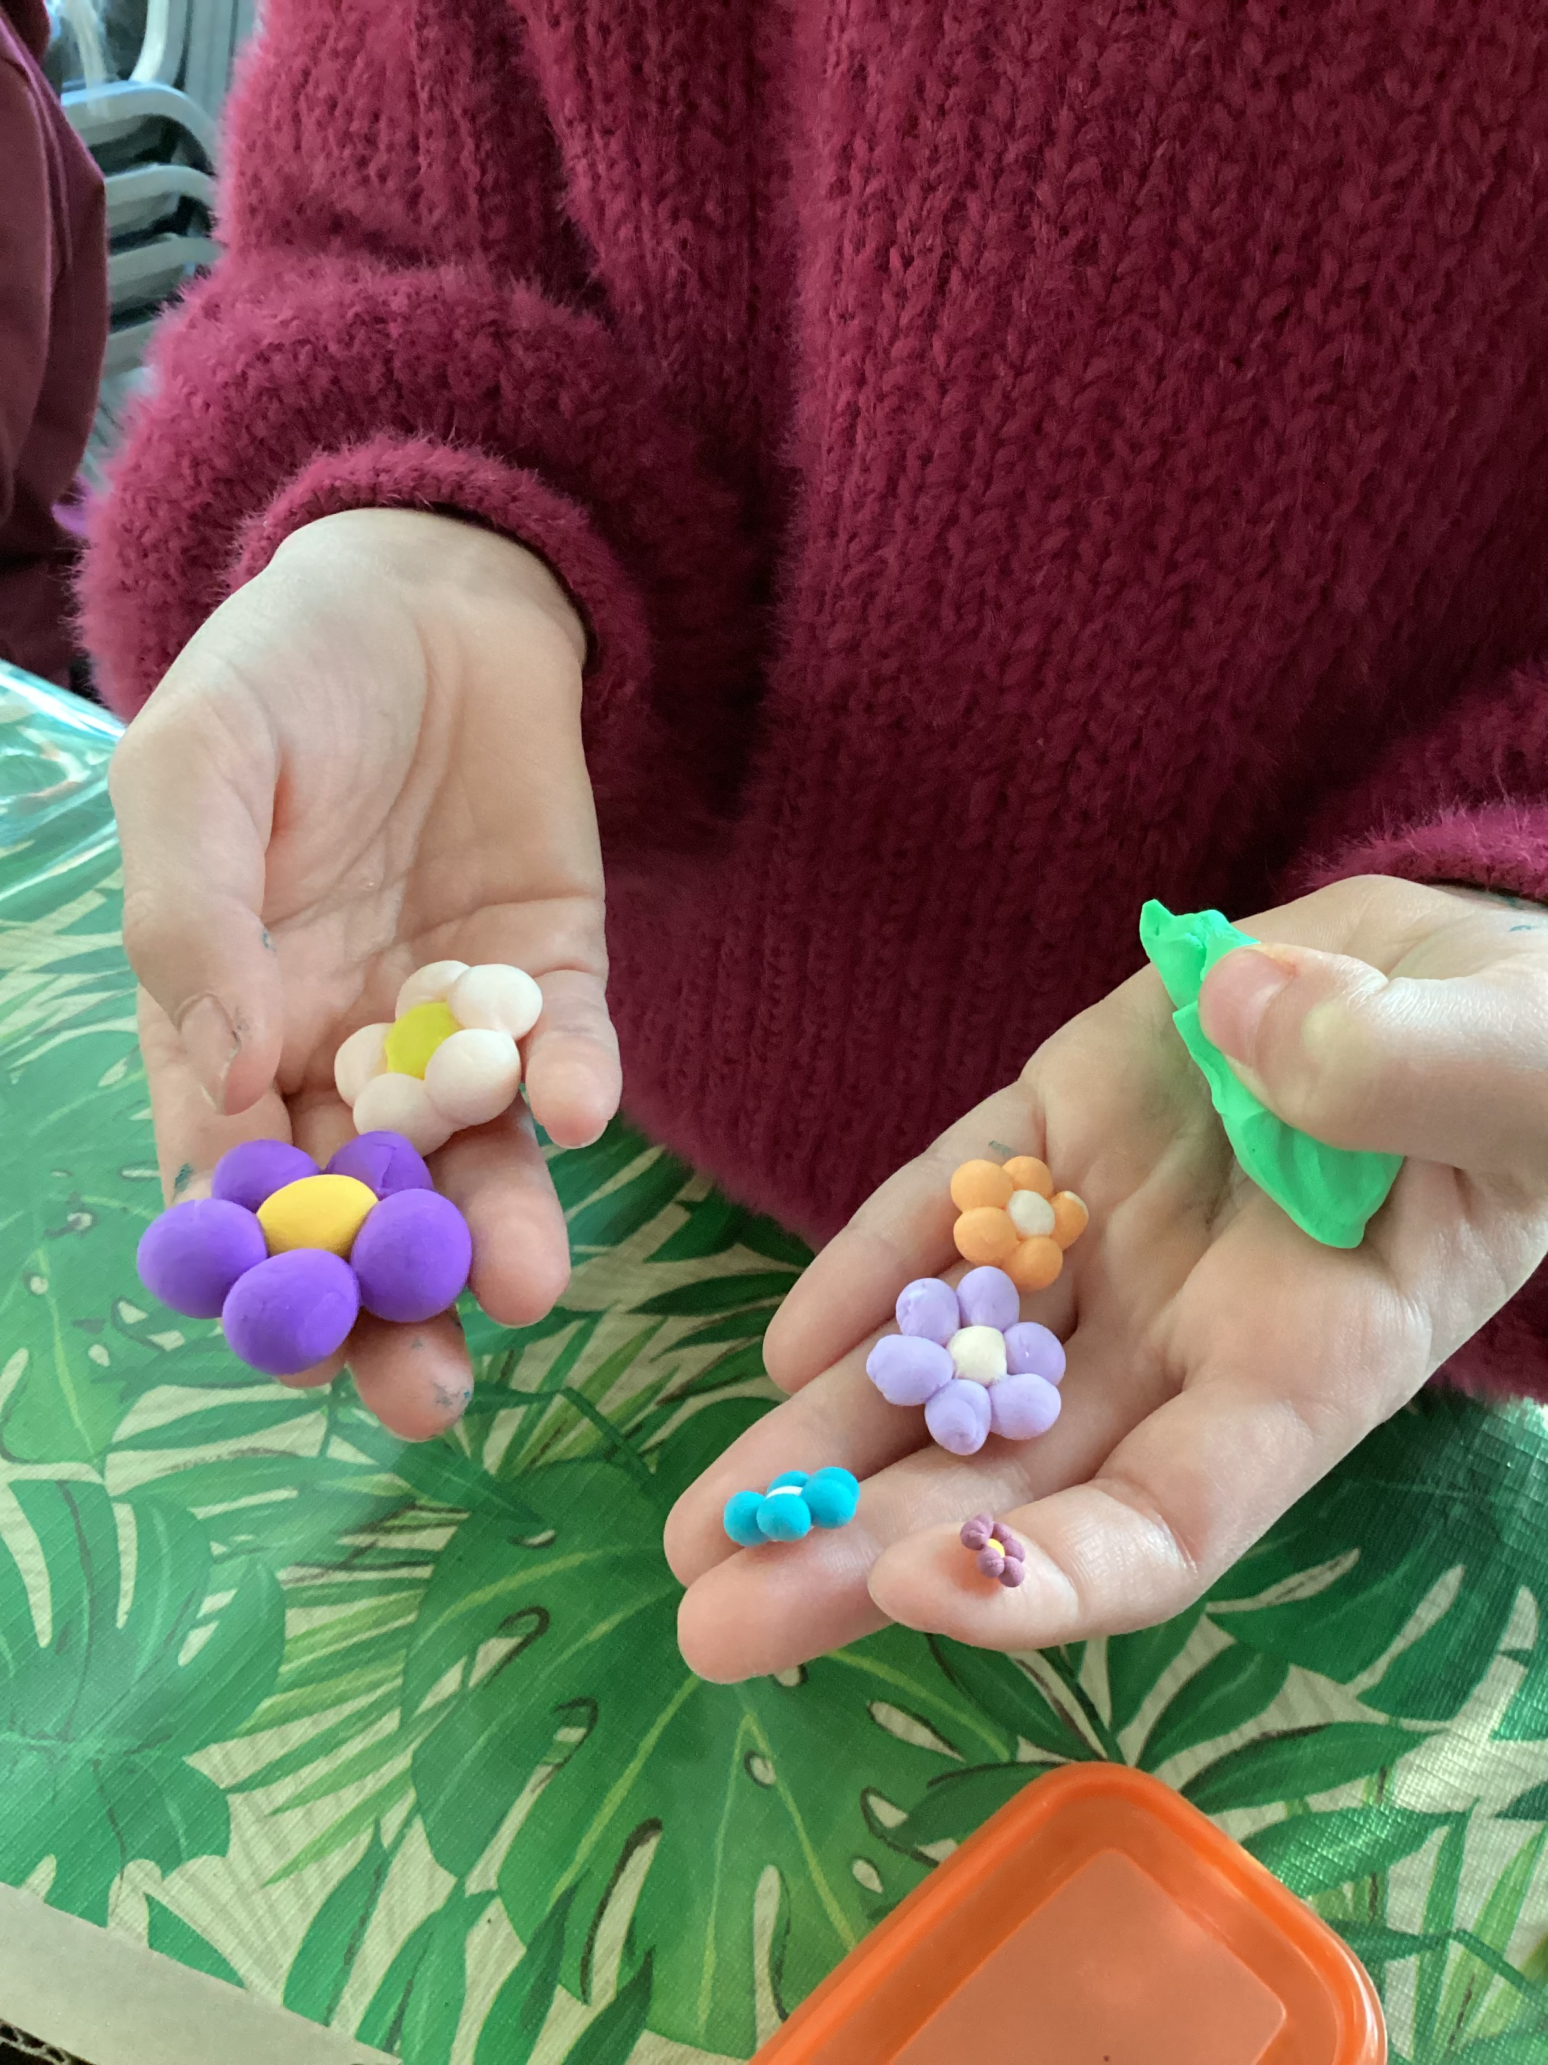

Cheltenham East Team Kids
Dear families,
What a week it’s been! The fun definitely kept rolling, and our little legends amazed us once again with their creativity, kindness, imagination, and fine motor skills. From thoughtful craft projects to imaginative play and team games, the kids brought so much energy and joy to every session. It’s been such a pleasure to watch their ideas come to life!
Can you believe next week is the final week of term? We’ll be wrapping things up with a Last Day of School Celebration on Friday, and we can’t wait to finish the term with a bit of extra fun and excitement. 🎉
As we head into the holidays, don’t forget that our Winter School Holiday Program is just around the corner! We’ve got loads of fun activities planned to keep the kids entertained and engaged during the break. Bookings are now open – head to the Team Kids website to secure your spot.
Thanks again for all your support this term. We’re so lucky to have such a wonderful group of kids and families. Looking forward to a great last week!
Warm regards,
Team Kids, Cheltenham East PS
11
Cooking Club
Art Attack Club
Lego Club
Cooking Club
Lego Club
4th July
Last Day of School Party
7th – 18th July
Winter School Holiday Program
16th June
National Vegemite Day
0432 299 468
CheltenhamEastPS@teamkids.com.au
1300 035 000
info@teamkids.com.au

