Slide 1
Assembly
Term 3 2023

Slide 2


Acknowledgement of Country
Jackson School is a child safe community.
We acknowledge the traditional owners of the land on which our school is situated, the Wurundjeri (Woi Wurrung) peoples of the Kulin Nation, and pay our respects to Elders past, present and emerging.
Wominjeka!
Notes:
Before we begin can I acknowledge the transitional owners on the land we meet today, the Wathaurong peoples of the Kulin nation, and pay my respect to any indigenous peoples past, present and emerging.

Slide 3

We acknowledge the traditional owners of the land on which our school is situated, the Wurundjeri (Woi Wurrung) peoples of the Kulin Nation, and pay our respects to Elders past, present and emerging.
Wominjeka!

Slide 4
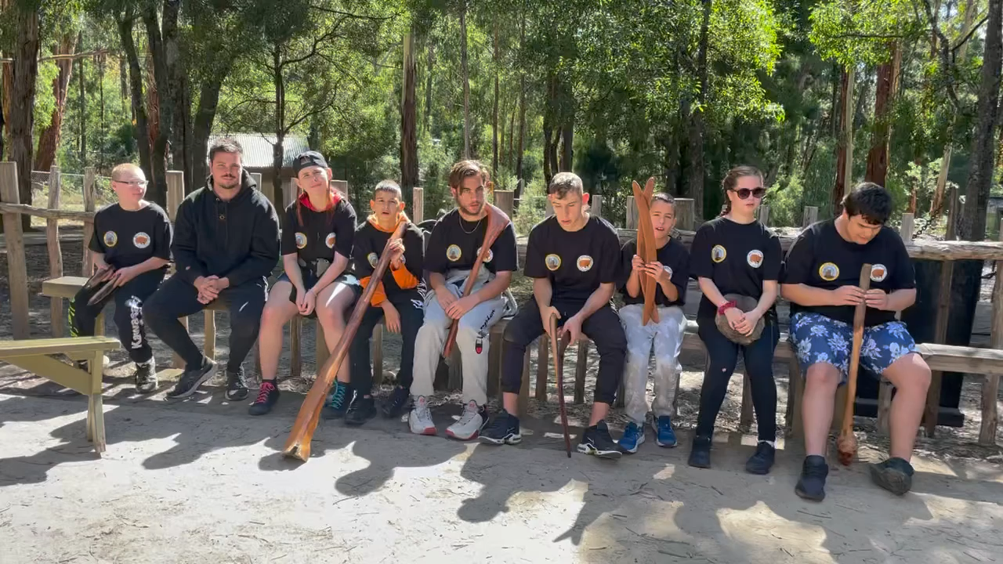
Aboriginal Camp

Slide 5

National Anthem
Notes:
Click to View: https://youtu.be/dLEW0s504tc

Slide 6
Title

Slide 7


Slide 12


Slide 13


