Slide 1
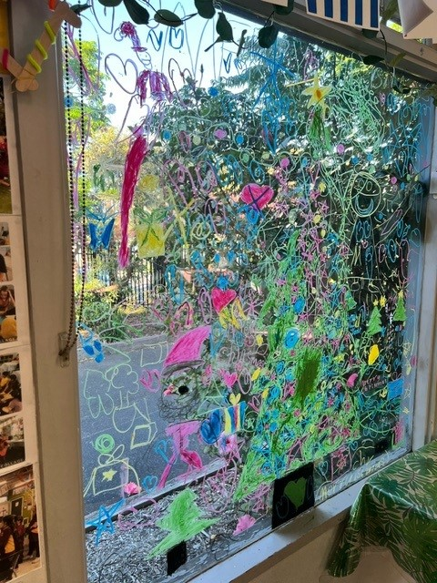
Cheltenham East Team Kids
Dear Families,
We’re feeling festive in Before and After School Care as we prepare for Christmas this week! The children will enjoy a variety of creative and fun activities, including:
•Making paper snowflakes
•Christmas-themed drawings and paintings
•DIY Christmas baubles and ornaments
•Crafting Christmas cards
These activities are a great way for the children to embrace the holiday spirit and showcase their creativity.
Holiday Program Update:
Our School Holiday Program has been published! Please visit the Team Kids website to view the schedule and make your bookings. Spaces fill quickly, so don’t miss out! Thank you for your continued support.
Warm regards,
Eric
Director of Team Kid Before and After School Care
8
Art Attack Club
Cooking Club
Art Attack Club
25th November - 16th December
Party Planning Club
16th - 20th December
Farewell to Our Grade 6’s
20th December
Last School Day Party
0432 299 468
CheltenhamEastPS@teamholiday.com.au
1300 035 000
info@teamkids.com.au

