Slide 1
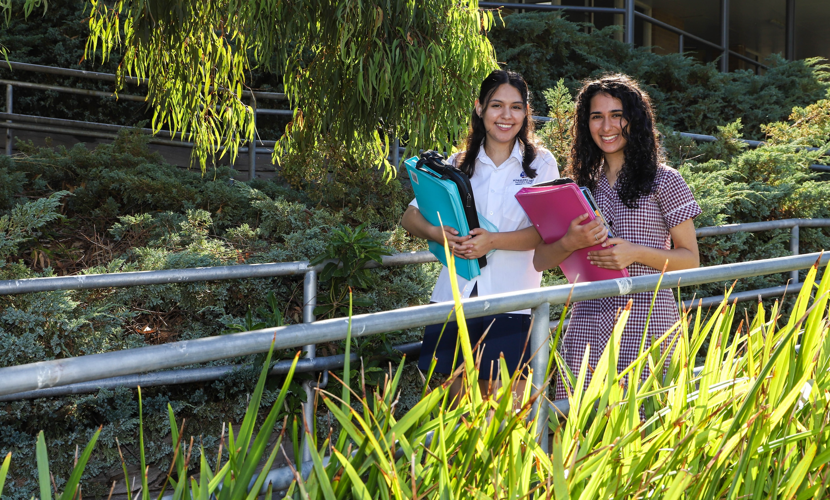


LEGAL STUDIES UNITS 1 & 2

Slide 2
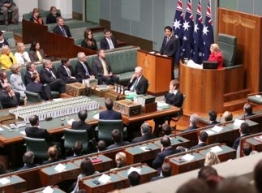

INTRODUCTION
VCE Legal Studies examines the institutions and principles that are essential to the Australian legal system.
Students develop an understanding of the rule of law, law-makers, legal institutions, the relationship between the people and the Australian Constitution, the protection of rights in Australia, and the Victorian justice system.
The study of VCE Legal Studies enables students to become active and informed citizens by providing valuable insight into their relationship with the law and the legal system.

Slide 3
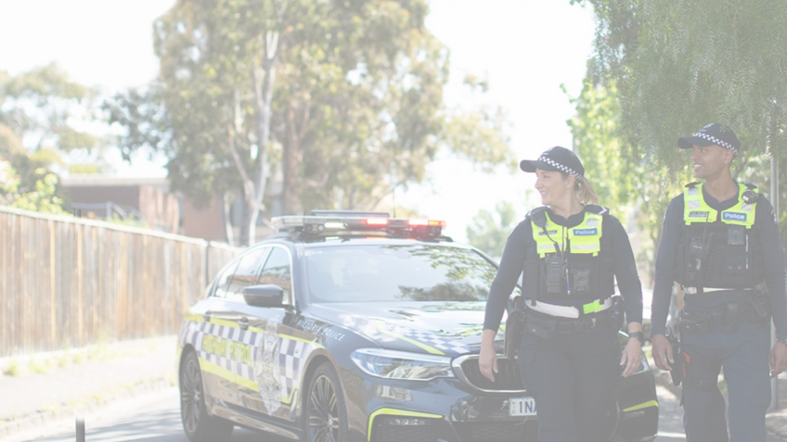
UNIT 1 – The Presumption of Innocence
Three Areas of Study:
Legal Foundations
Proving Guilt
Sanctions
School Office
Gymnasium
Sports grounds

Slide 4
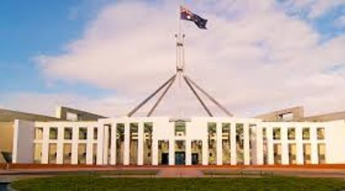
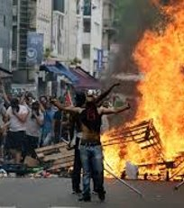
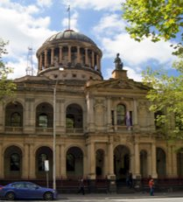
Area of Study 1- Legal Foundations
In this area of study, students:
- explore the role of individuals, laws and the legal system in achieving social cohesion and protecting the rights of individuals
- consider the characteristics of an effective law and sources and types of law
- examine the relationship between parliament and the courts, and the reasons for a court hierarchy in Victoria
Sports grounds outside Gym
Gymnasium

Slide 5
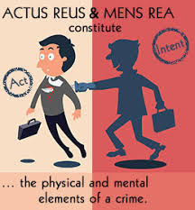
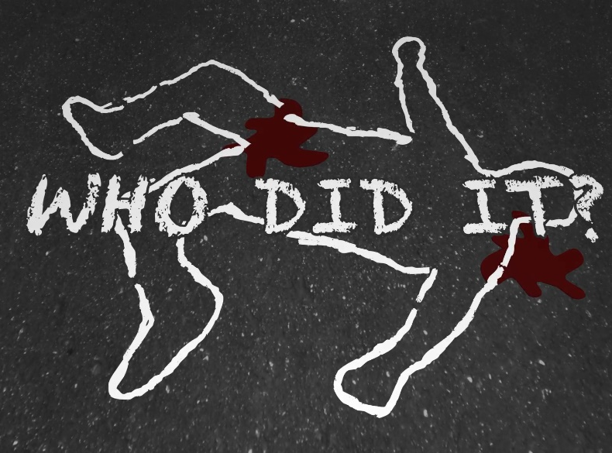
Area of Study 2 – Proving Guilt
In this area of study, the following key concepts in criminal law will be covered:
Elements of crime (actus reus and mens rea)
Strict liability offences
Age of criminal responsibility
Burden of proof and standard of proof
Types of crime
Against the person: Murder, Manslaughter, Assault, Rape
Against property: Theft, Robbery, Armed Robbery
We will investigate two criminal offences:
For each offence, use legal reasoning to determine possible culpability and explain the impact of the offence on individuals and society
School Office
Sports grounds

Slide 6

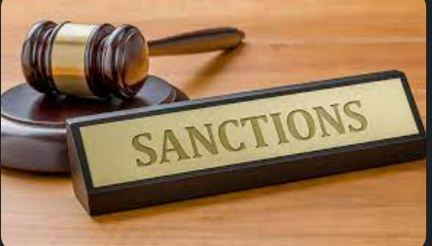

Area of Study 3 - Sanctions
In this area of study, the following key concepts in in the determination of a criminal case will be covered:
The principles of justice and experiences of the Victorian criminal justice system
the principles of justice: fairness, equality and access
institutions that enforce criminal law, such as the police and delegated bodies
the balance between institutional powers and individual rights
an overview of the role and criminal jurisdictions of the Victorian courts
the role of the jury in a criminal trial
the difficulties faced by different groups in the criminal justice system, such as First Nations people, young people, culturally and linguistically diverse people, people with mental health issues, and people with disabilities
Sentencing
the purposes of sanctions: punishment, deterrence, denunciation, protection and rehabilitation
types of sanctions such as fines, community correction orders and imprisonment
factors considered in sentencing
alternative approaches to sentencing, such as the use of the Drug Court, Koori Courts and diversion programs
sentencing practices in one other Australian jurisdiction.
School Office

Slide 7

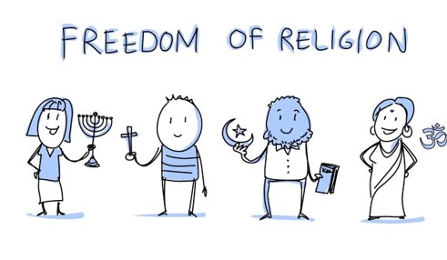
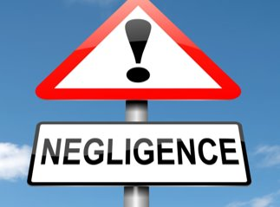
UNIT 2 – Wrongs and Rights
Three Areas of Study:
Civil Liability
Remedies
Human Rights
School Office
Gymnasium

Slide 8
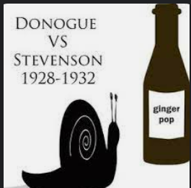
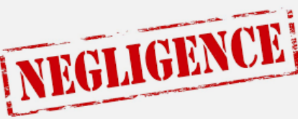

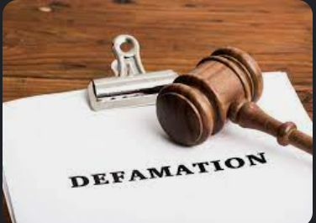
Area of Study 1 – Civil Liability
In this area of study, the following key concepts in civil law ​are studied:
Two areas of civil law are investigated in detail. ​
Possible areas of civil law: negligence, defamation, nuisance, trespass and contracts.
​
For each area of civil law- legal reasoning is applied to determine possible liability for a breach of civil law and explain the impact of a breach of civil law on the parties.
School Office
Gymnasium

Slide 9
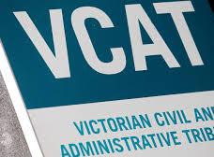
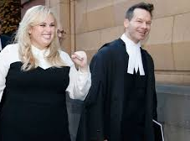
Area of Study 2 - Remedies
In this area of study the following key concepts in the resolution of a civil case are studied:
Methods used to resolve the case
Institutions available to resolve disputes, and the purposes and types of remedies.
Investigation of two civil cases exploring the extent to which the principles of justice were achieved.
School Office
Gymnasium
Sports grounds outside Gym

Slide 10

Area of Study 3 – Human Rights
In this area of study, students:
Examine the ways in which rights are protected in Australia and compare this approach with that of another country.
Possible reforms to the ways rights are protected in Australia.
Investigate an Australian case that had an impact on the protection of rights protection of rights

Slide 11
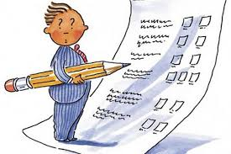
Assessment
Assessment tasks for this unit are selected from the following:
Structured Questions
Tests
Exam
Folio of exercises
Role-play
Debate
Report
A question–and-answer session

Slide 12
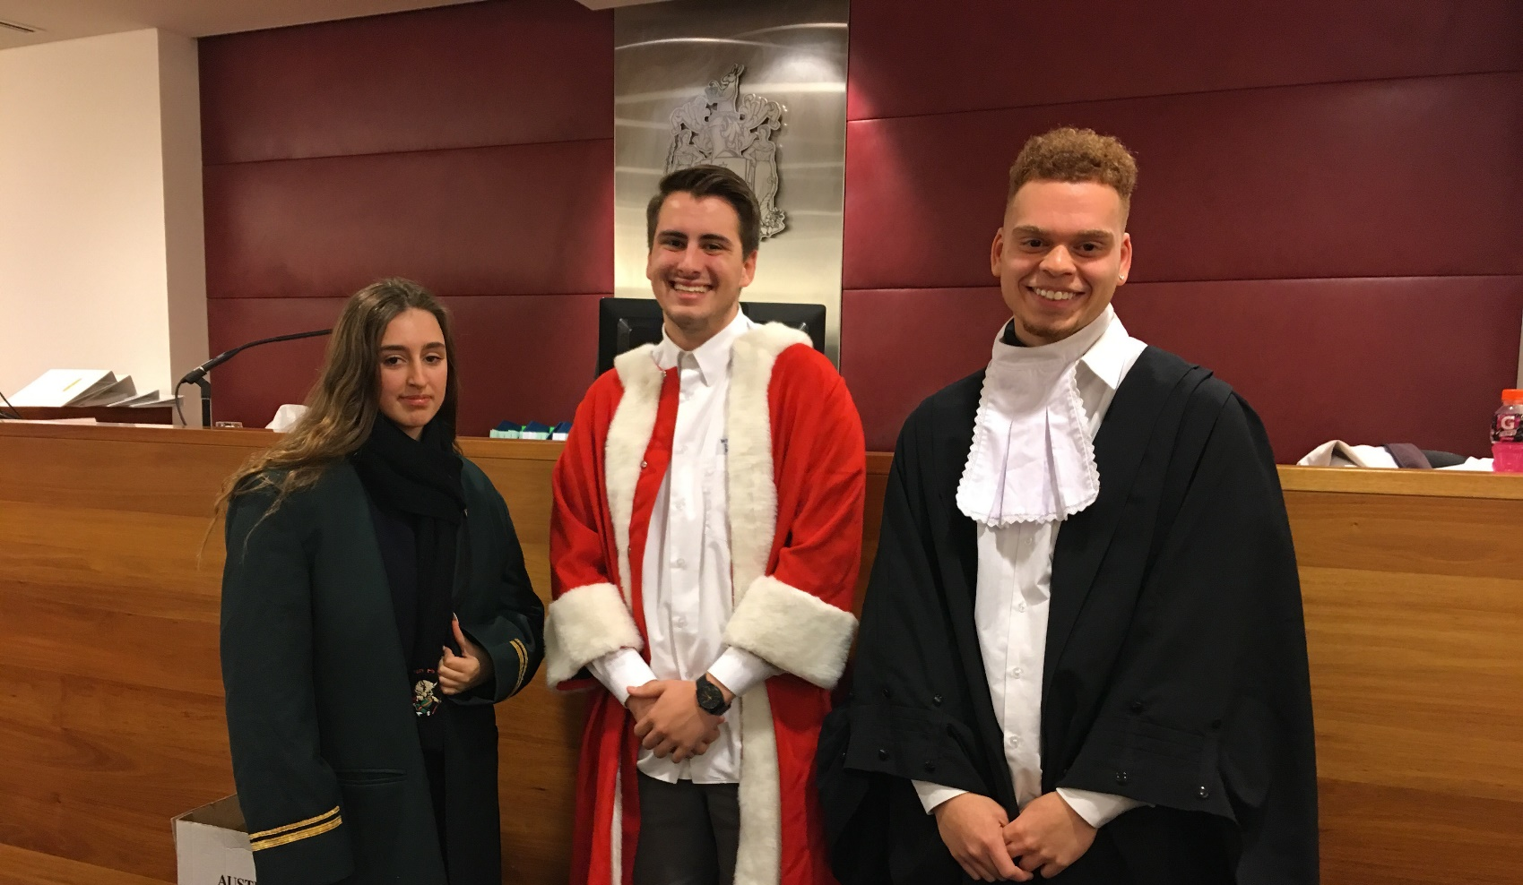
EXCURSIONS
Melbourne Magistrates' Court
Juries Program
Prison

Slide 13
CONTACT……
Wheelers Hill Secondary College
Phone: (03) 9561 5811
Fax: (03) 9561 8227
General Office Enquiries: wheelers.hill.sc@education.vic.gov.au

