Slide 1
SIS Teen Chef 2022
Celebrate your success!

Slide 2
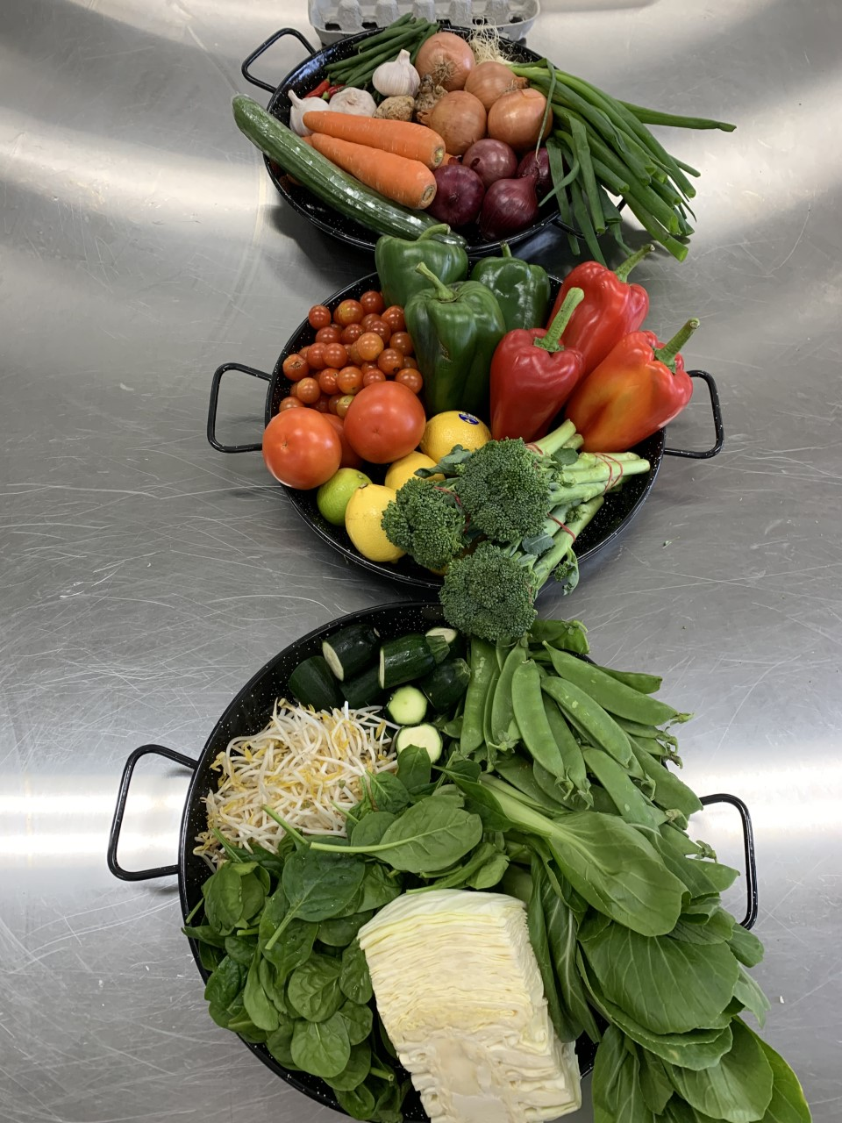
WHAT A YEAR!
14 cook off participants
Let’s see what was made!

Slide 3
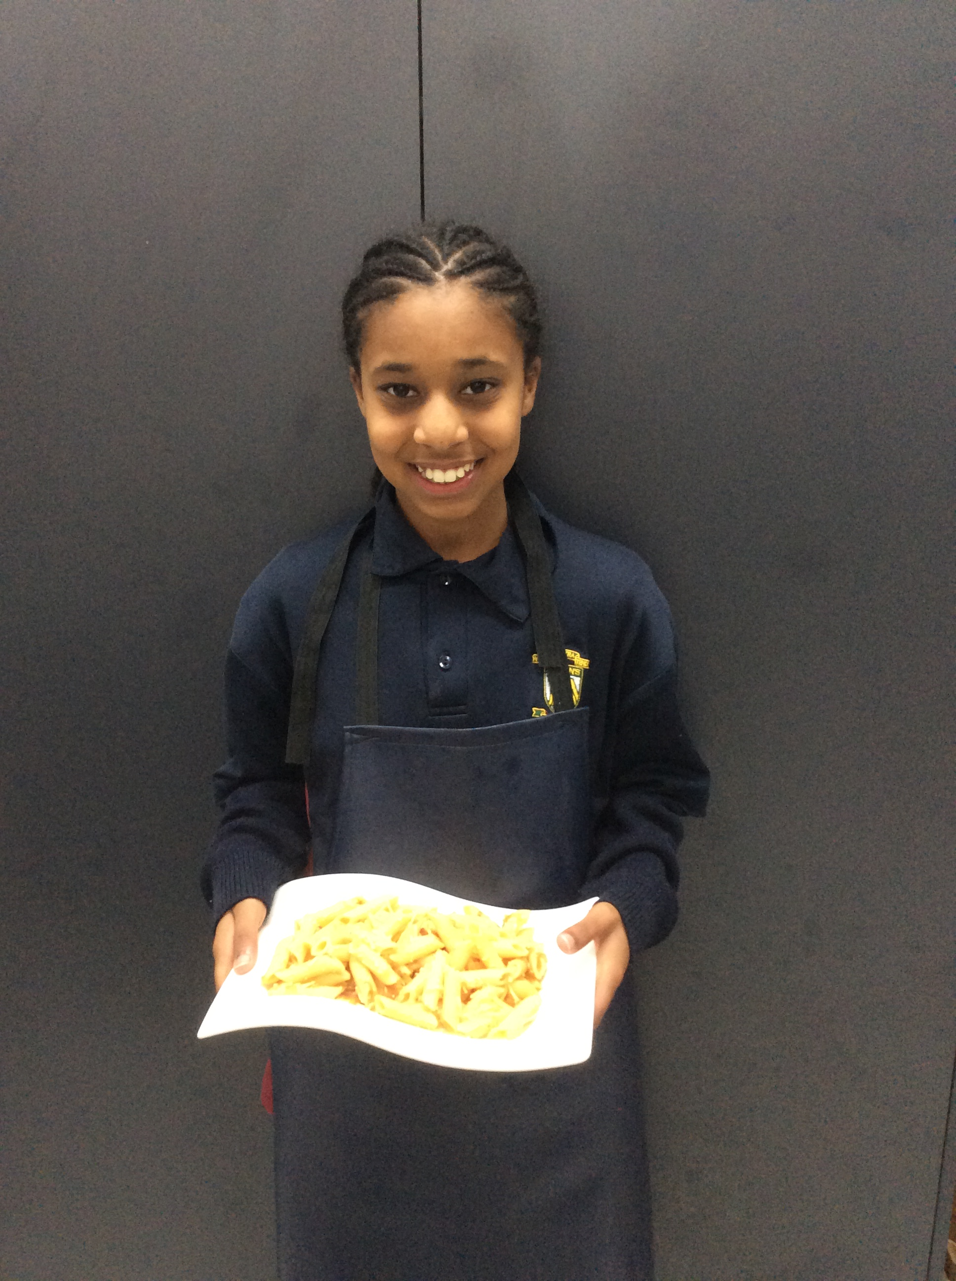
Salem

Slide 4
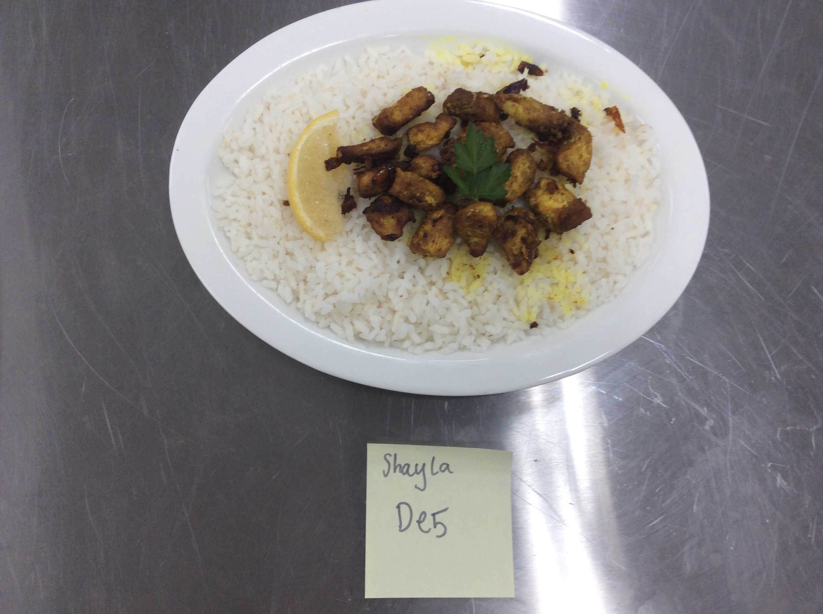
Shayla

Slide 5
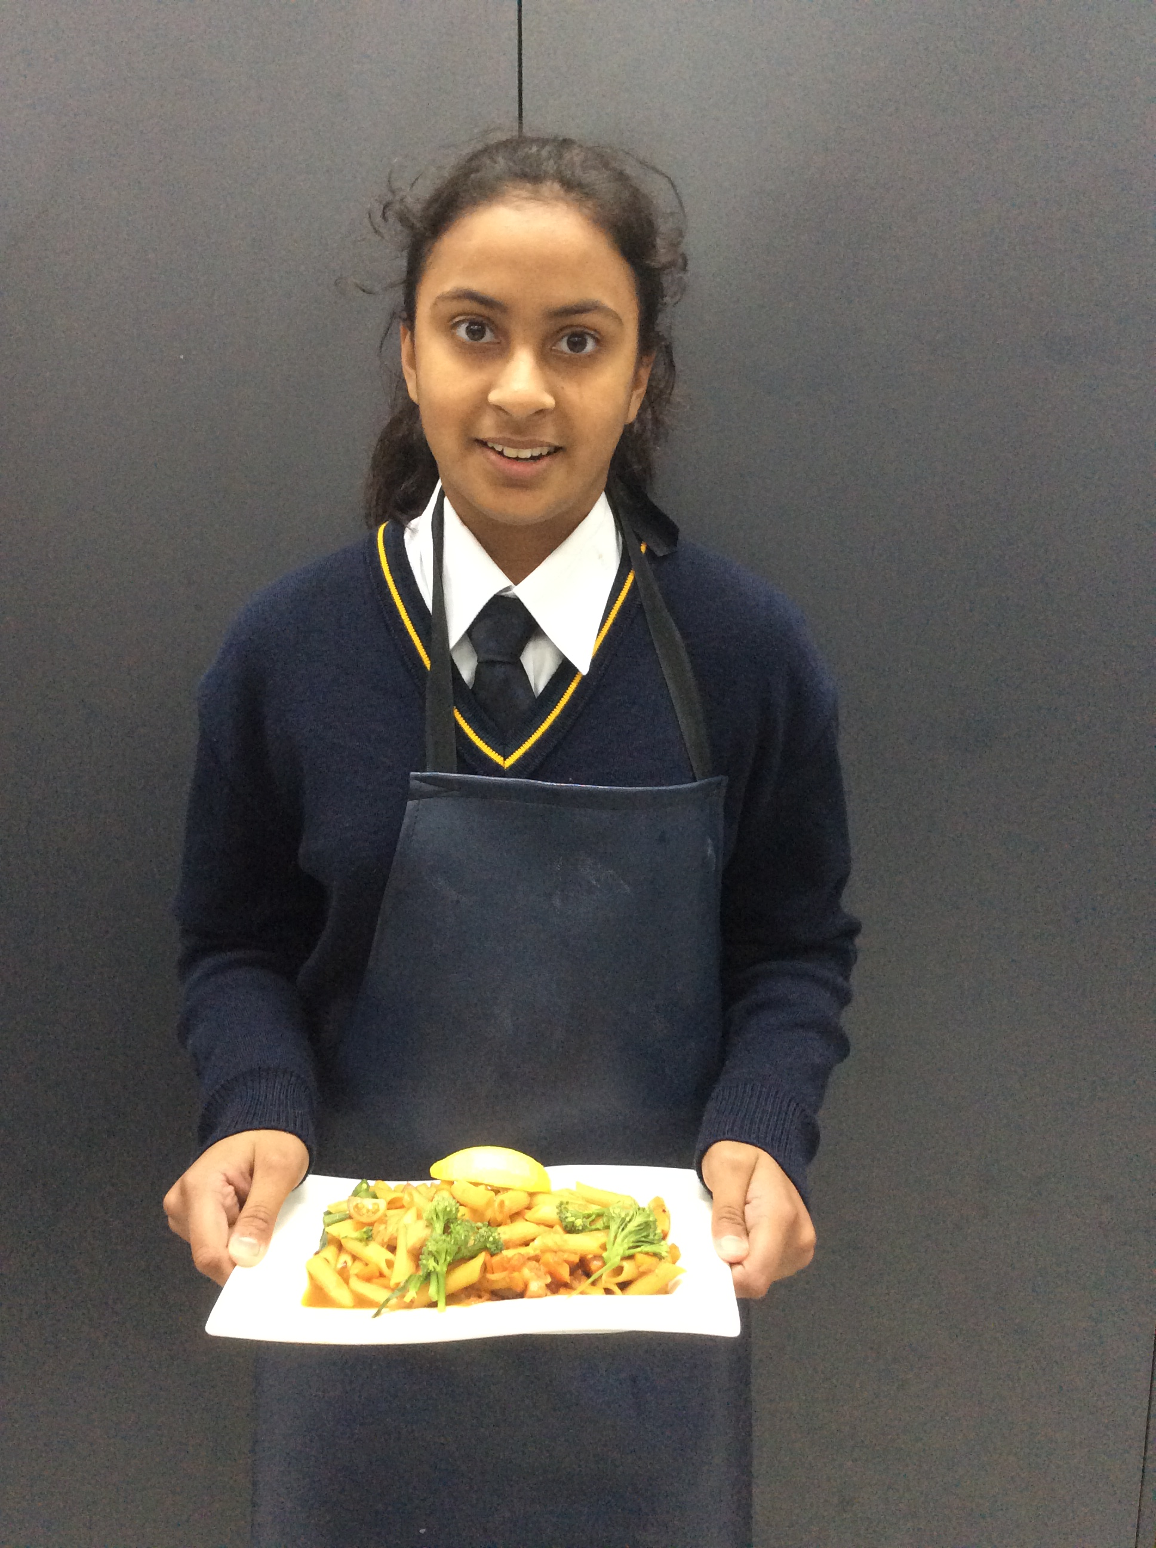
Jasnoor

Slide 6
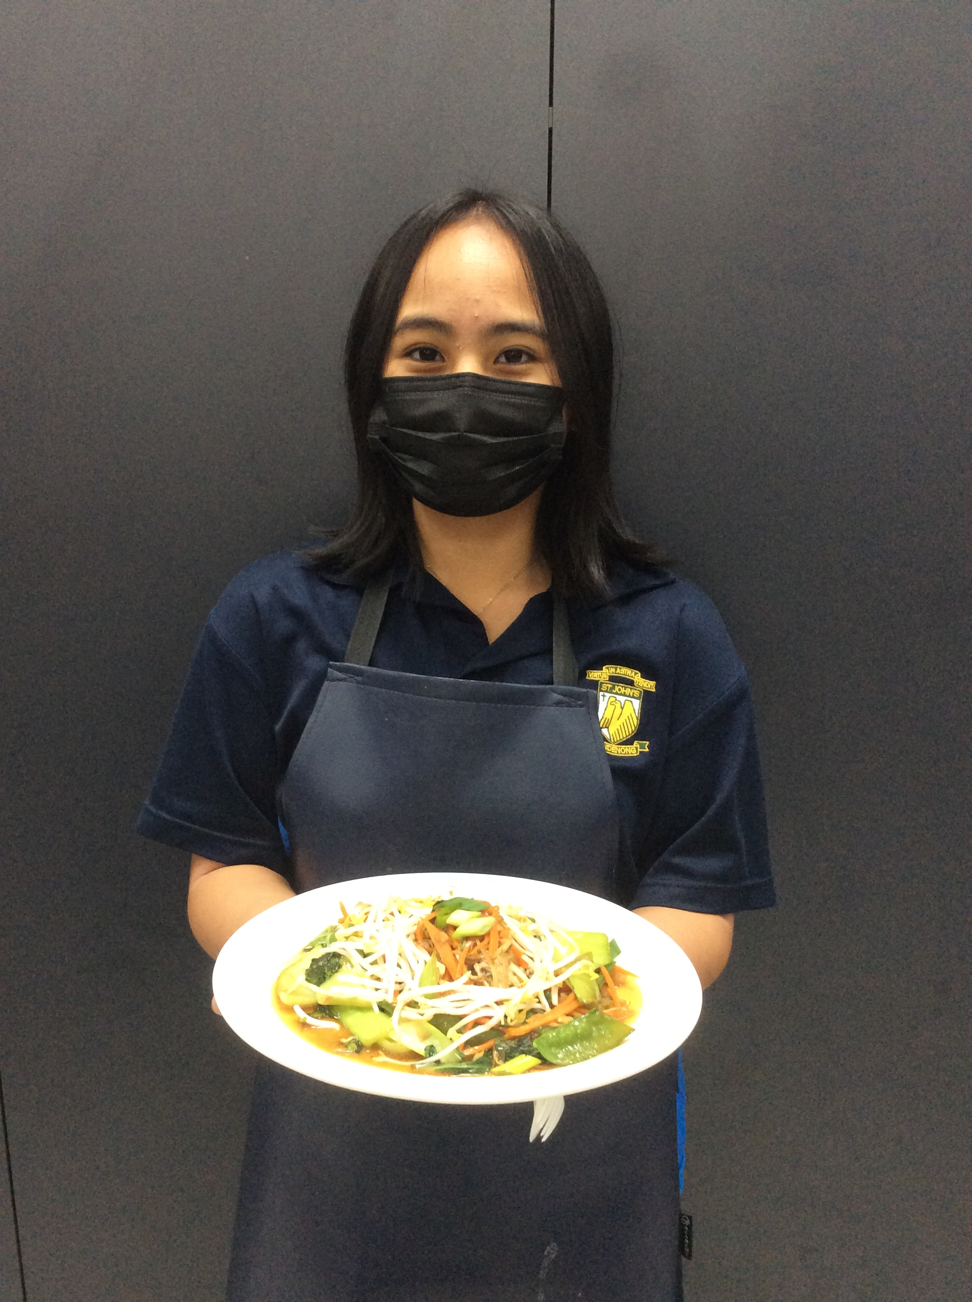
Eliza

Slide 7
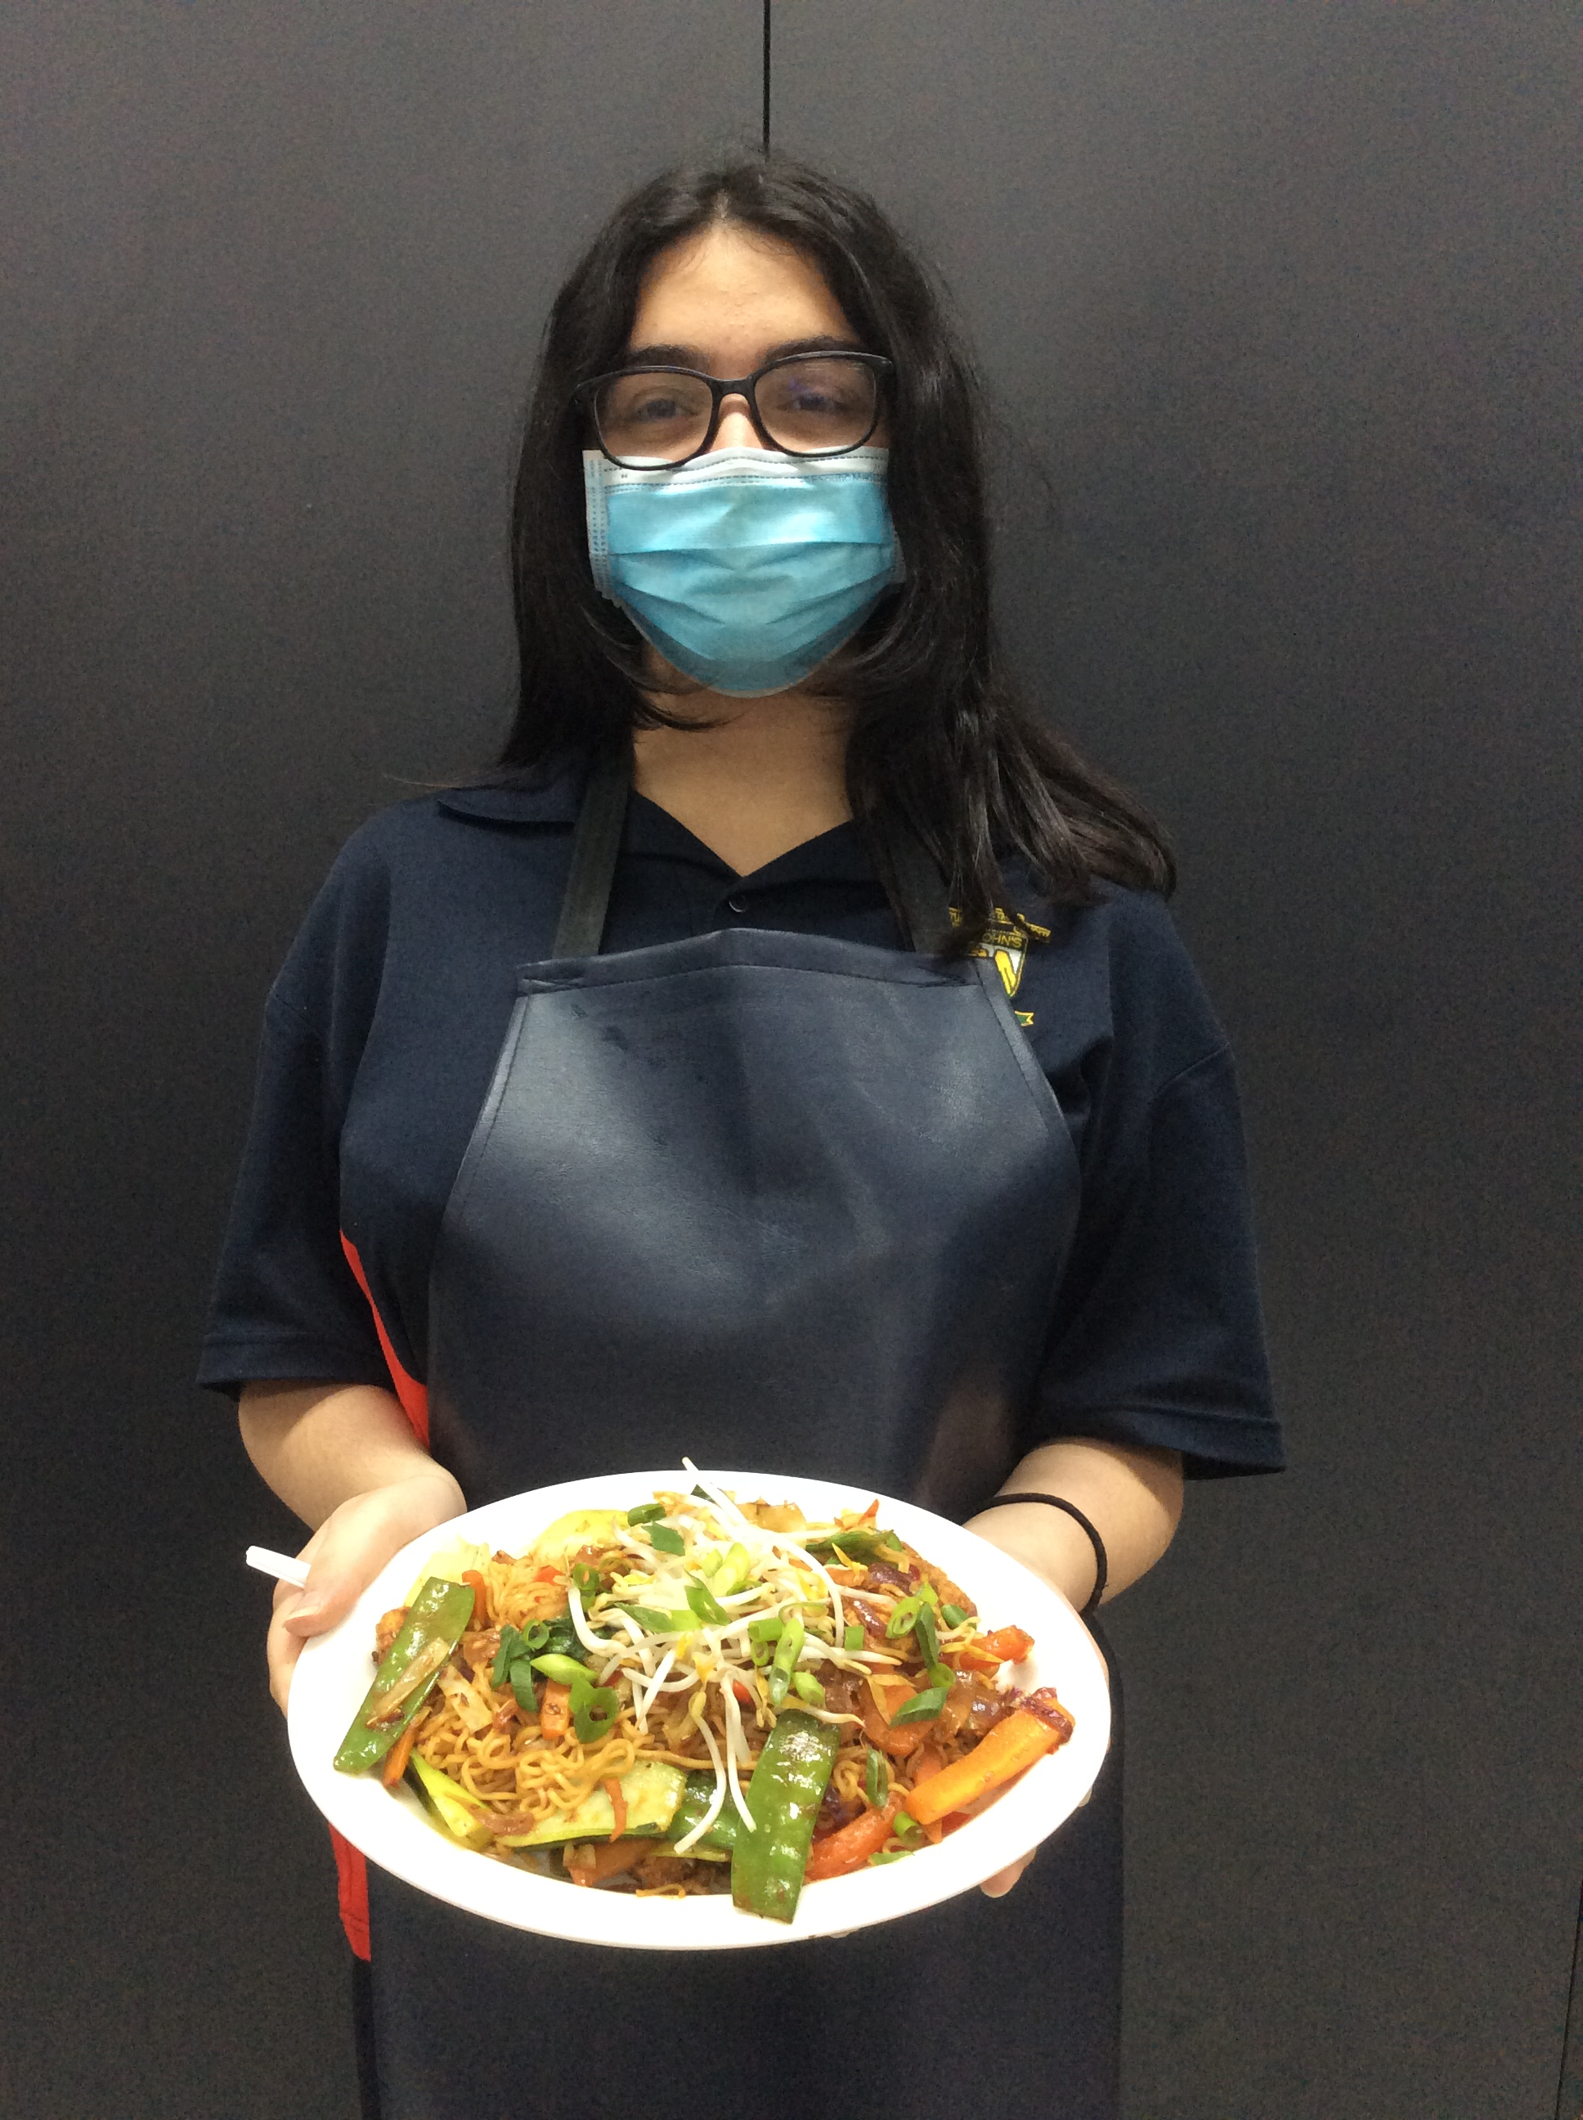
Laura

Slide 8
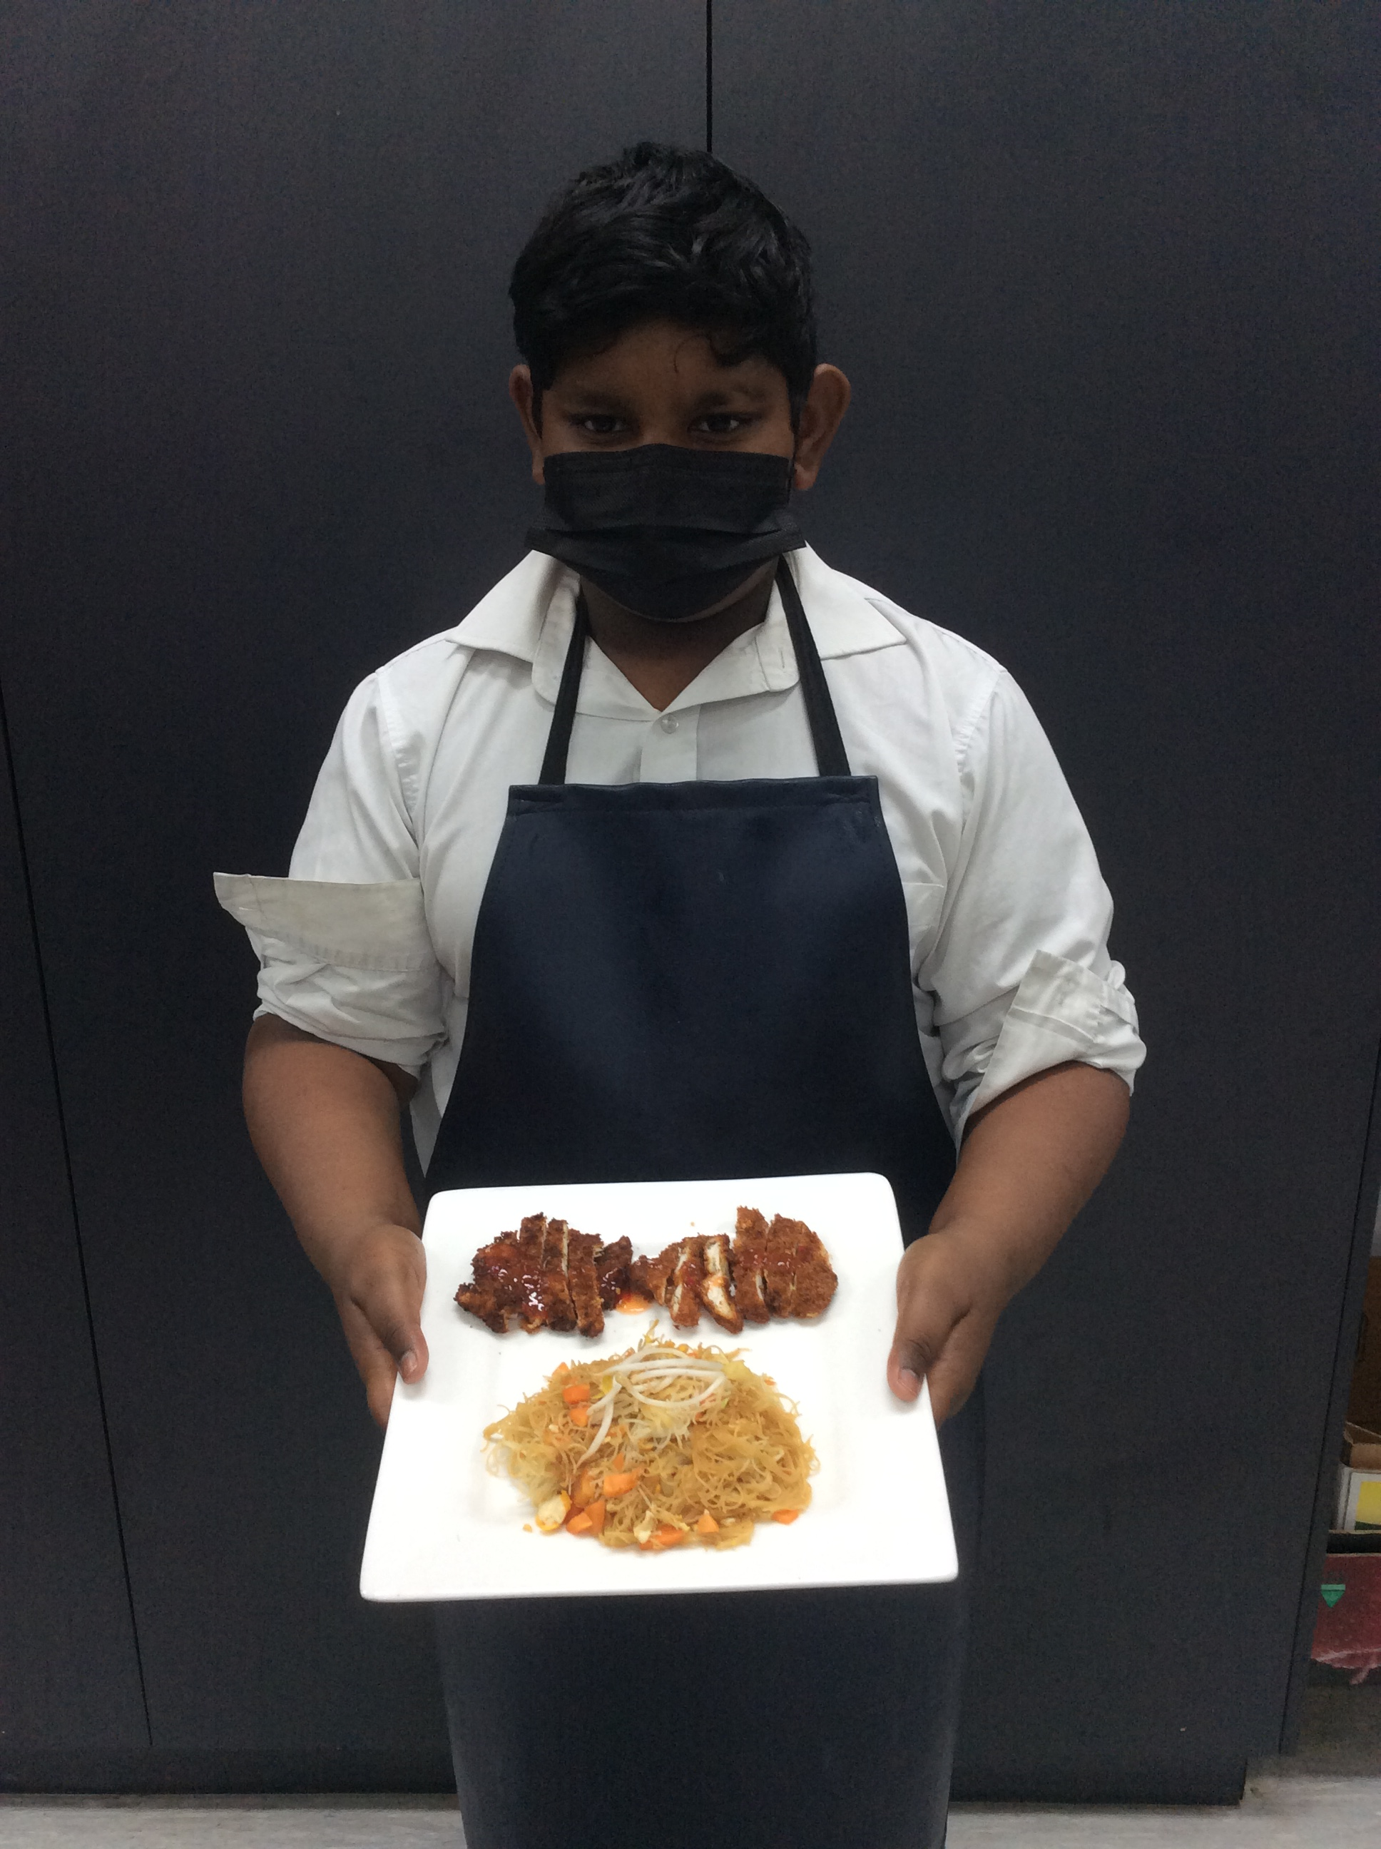
Praharsha

Slide 9
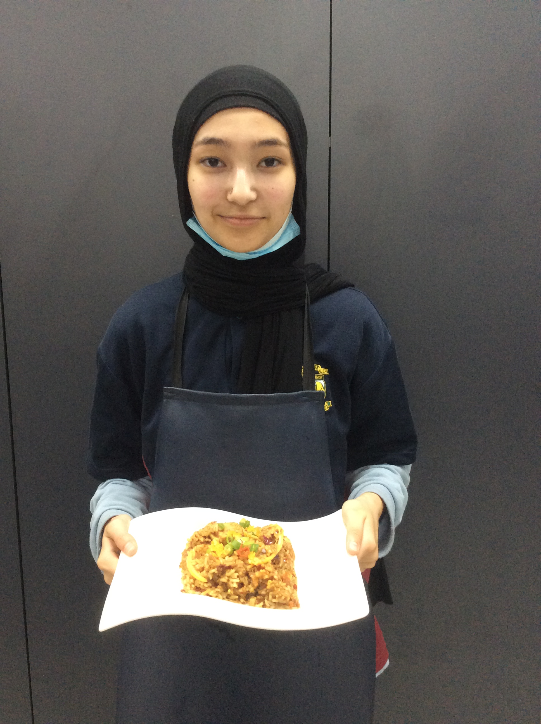
Quratullane

Slide 10
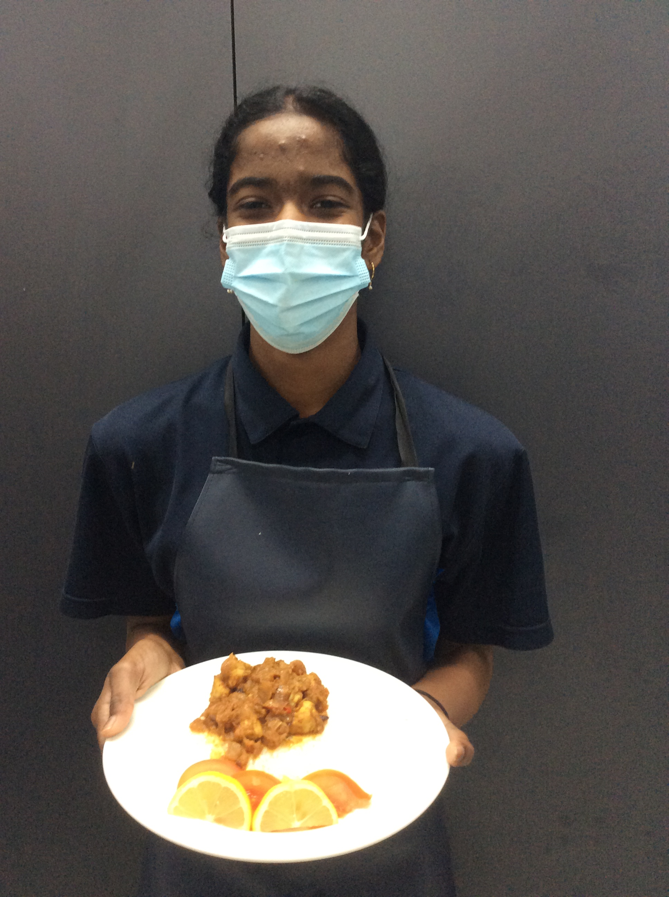
Angel

Slide 11
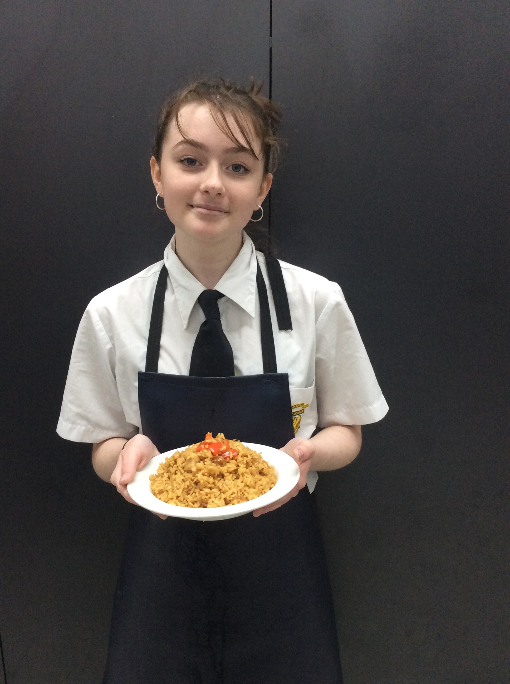
Jessica

Slide 12
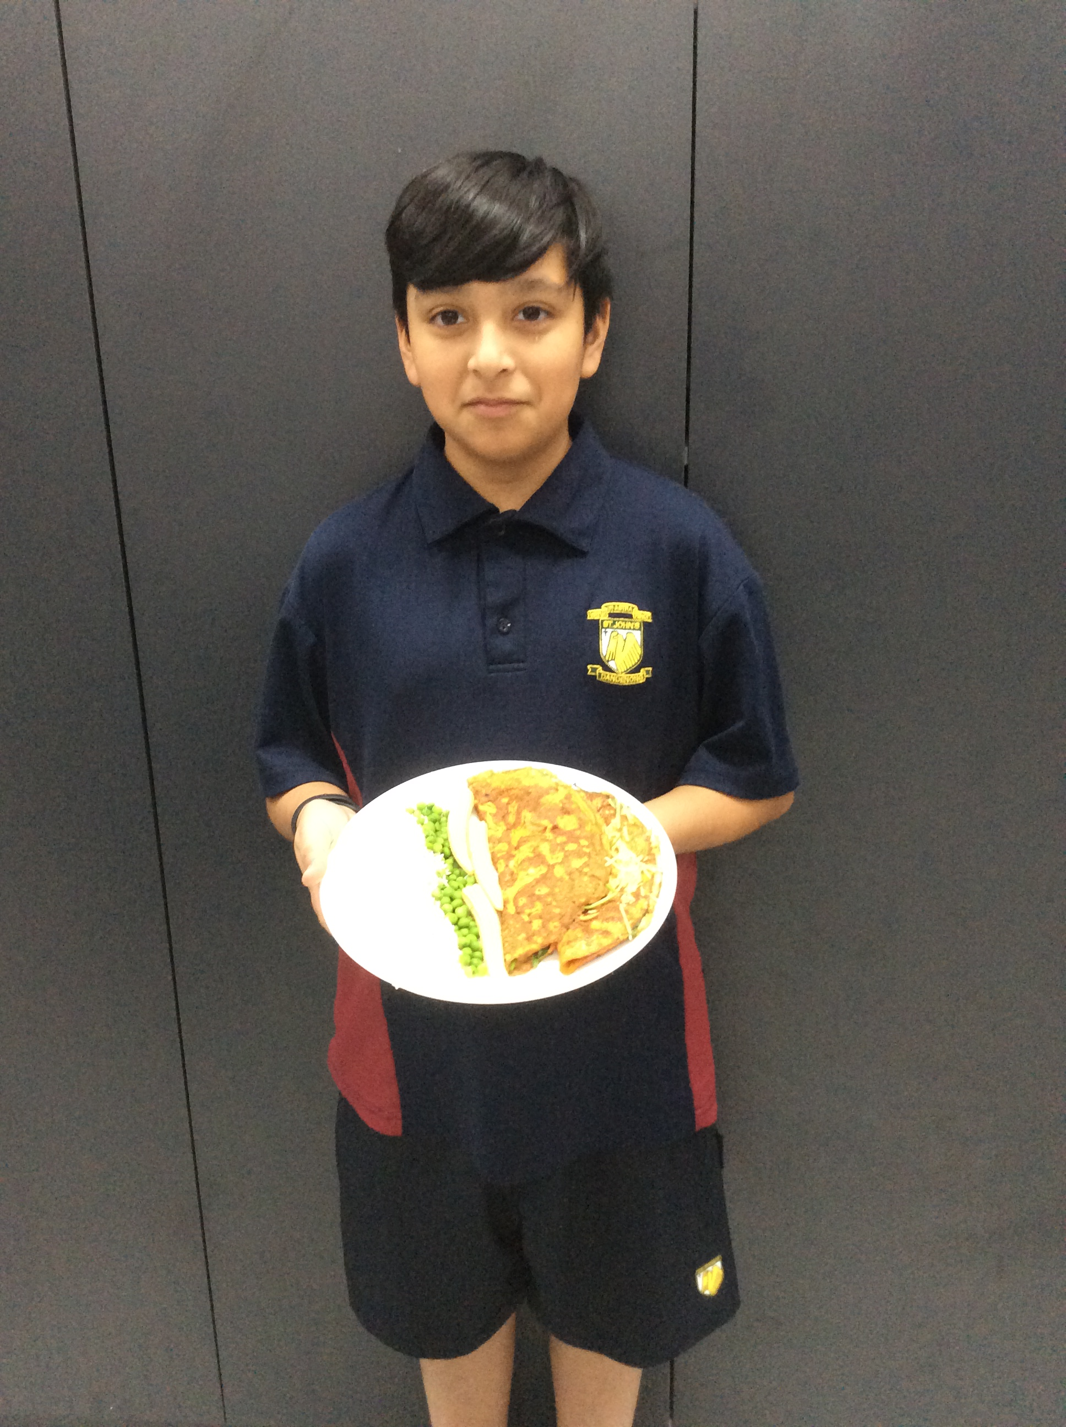
Gabriel

Slide 13
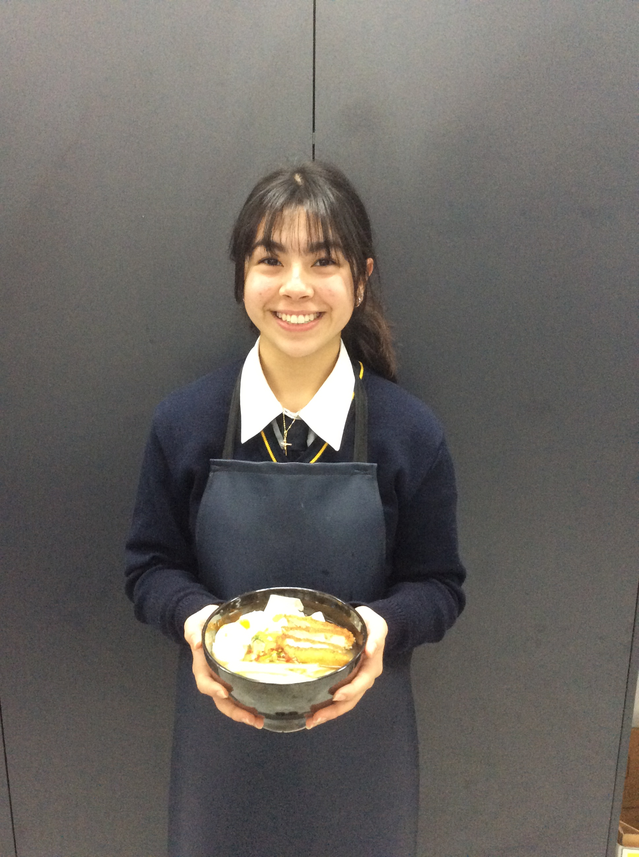
Kiara

Slide 14
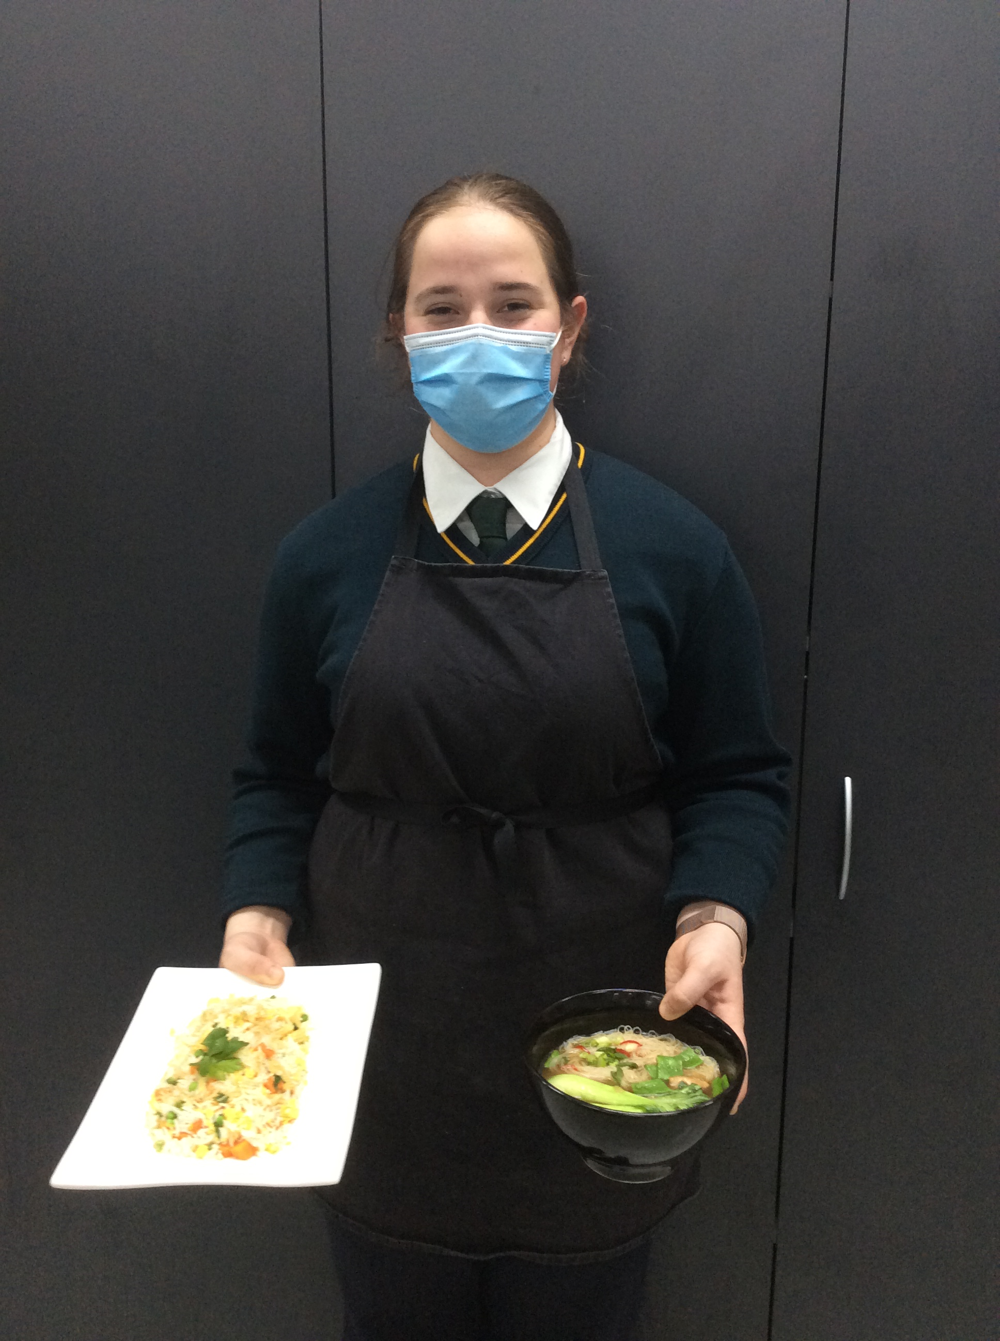
Jayme

Slide 15
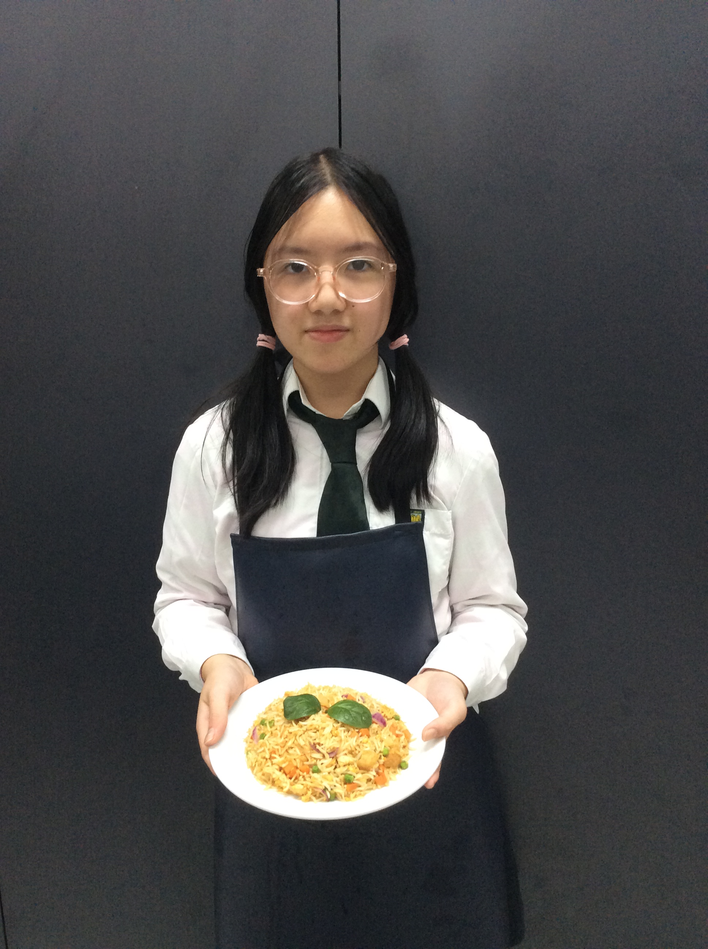
Tien

Slide 16
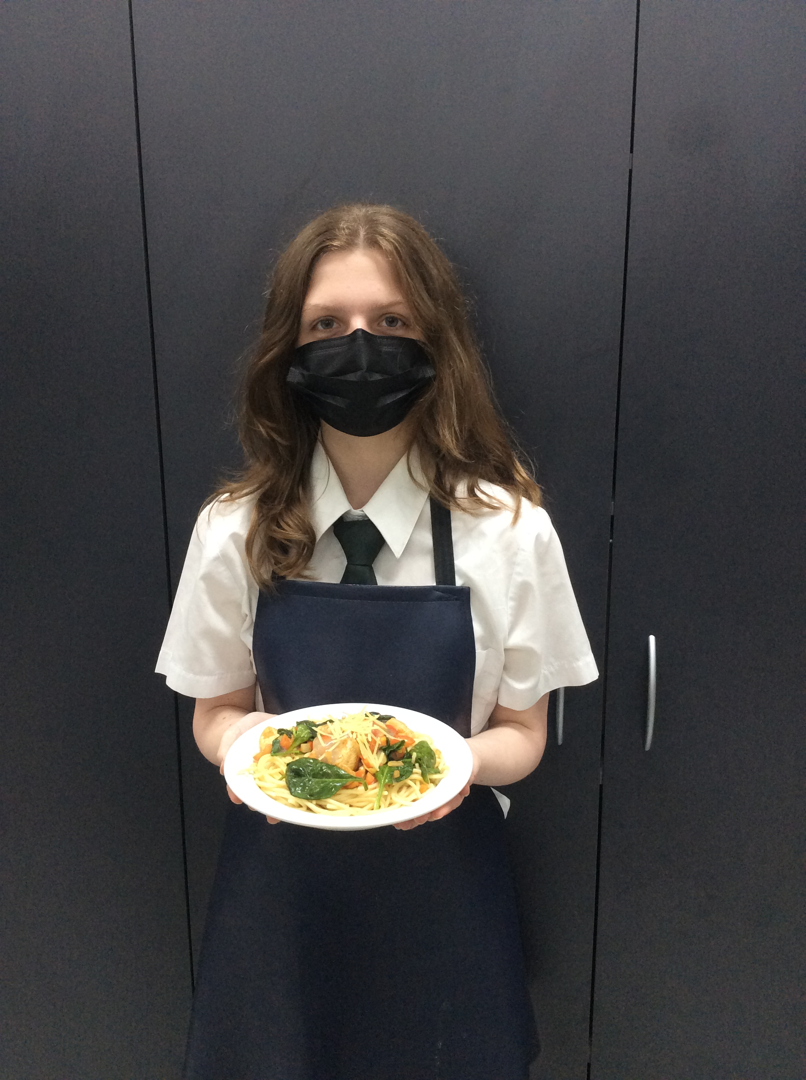
Emilia

Slide 17
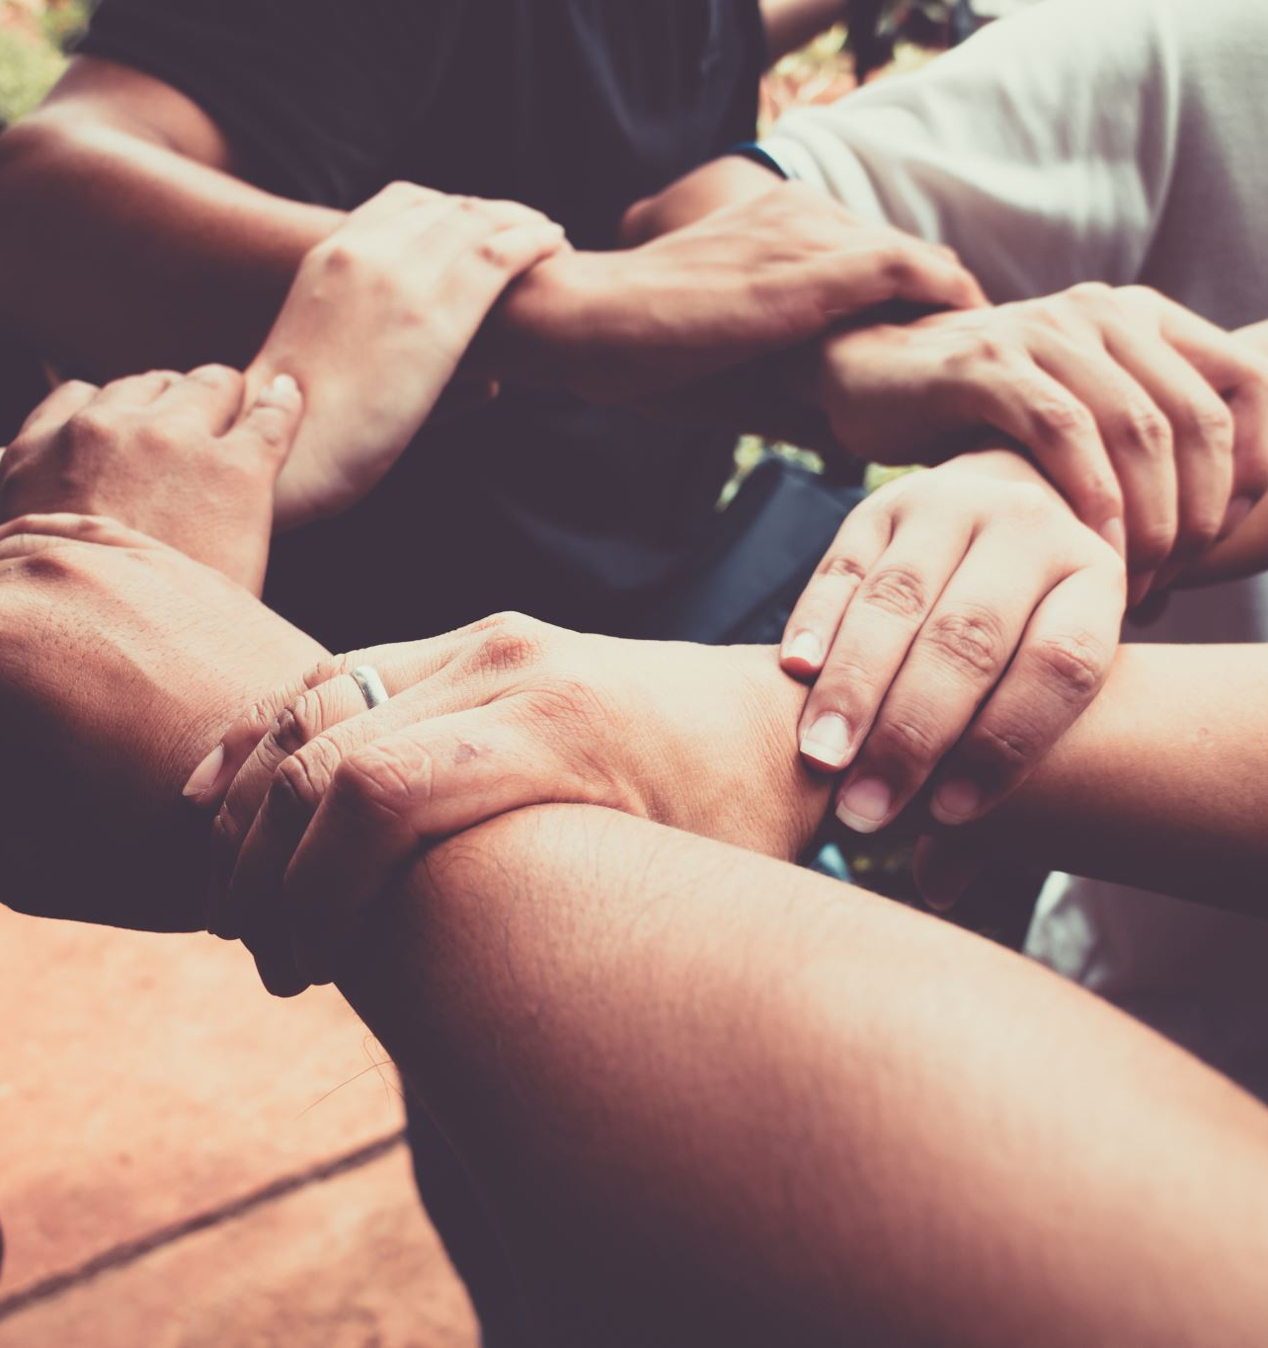
Be proud of your journey!
Thank you to all for your participation.
We saw a great range of skills and ability presented on the nights.
Please be open to try again next year if you have not been successful this year in making our team. Your skills will continue to develop and we appreciate your willingness to give it a go.
It was so lovely to see team work and support of each other on the nights.

Slide 18
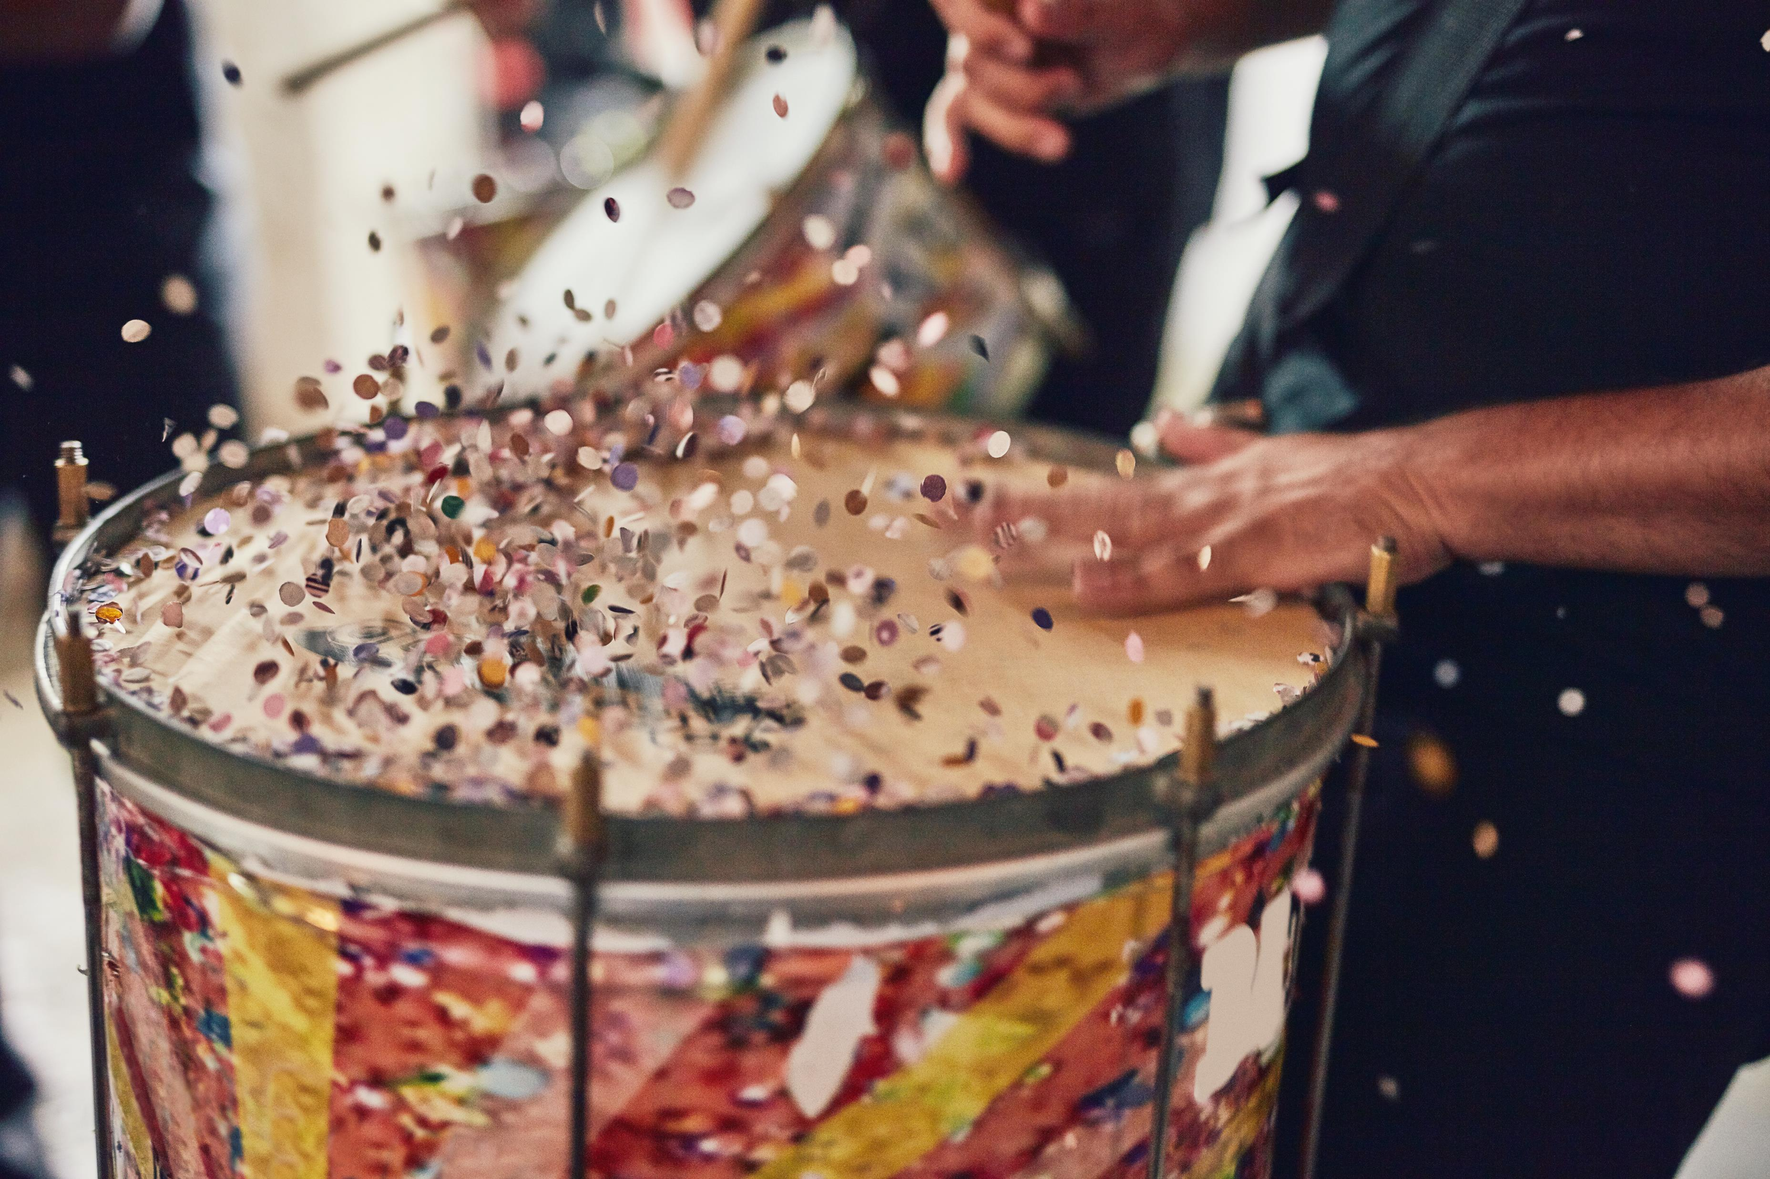
Drum roll please

Slide 19
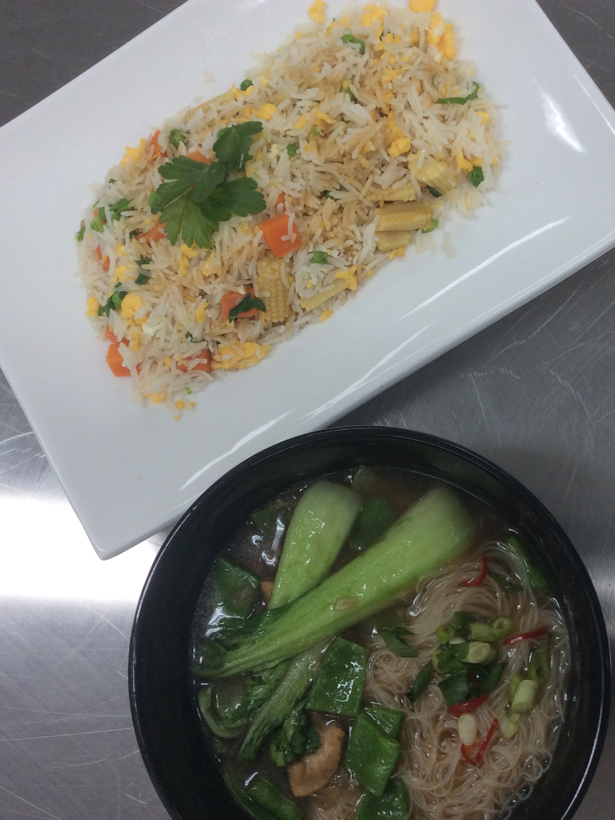
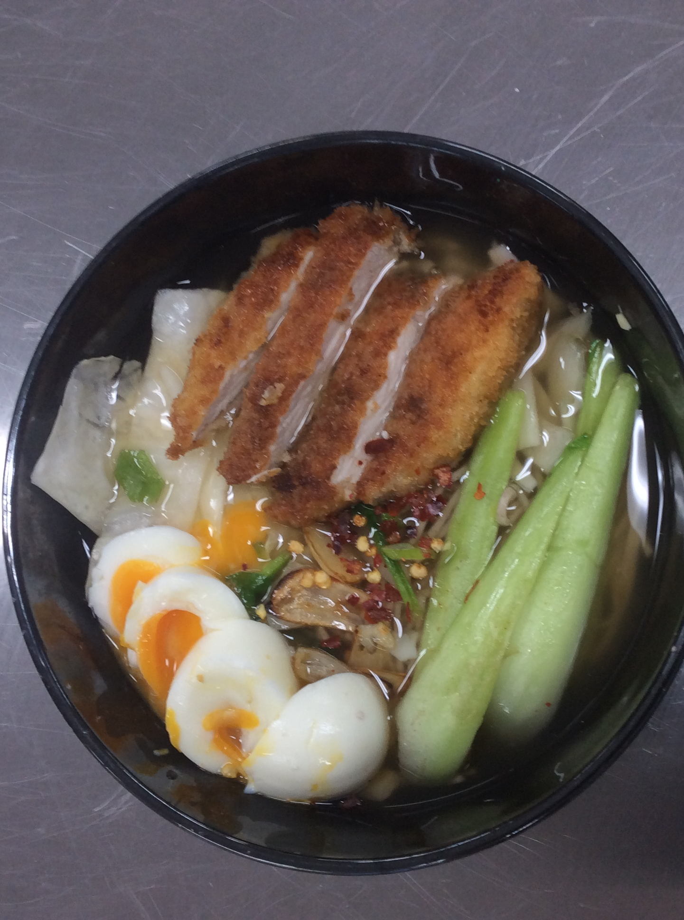
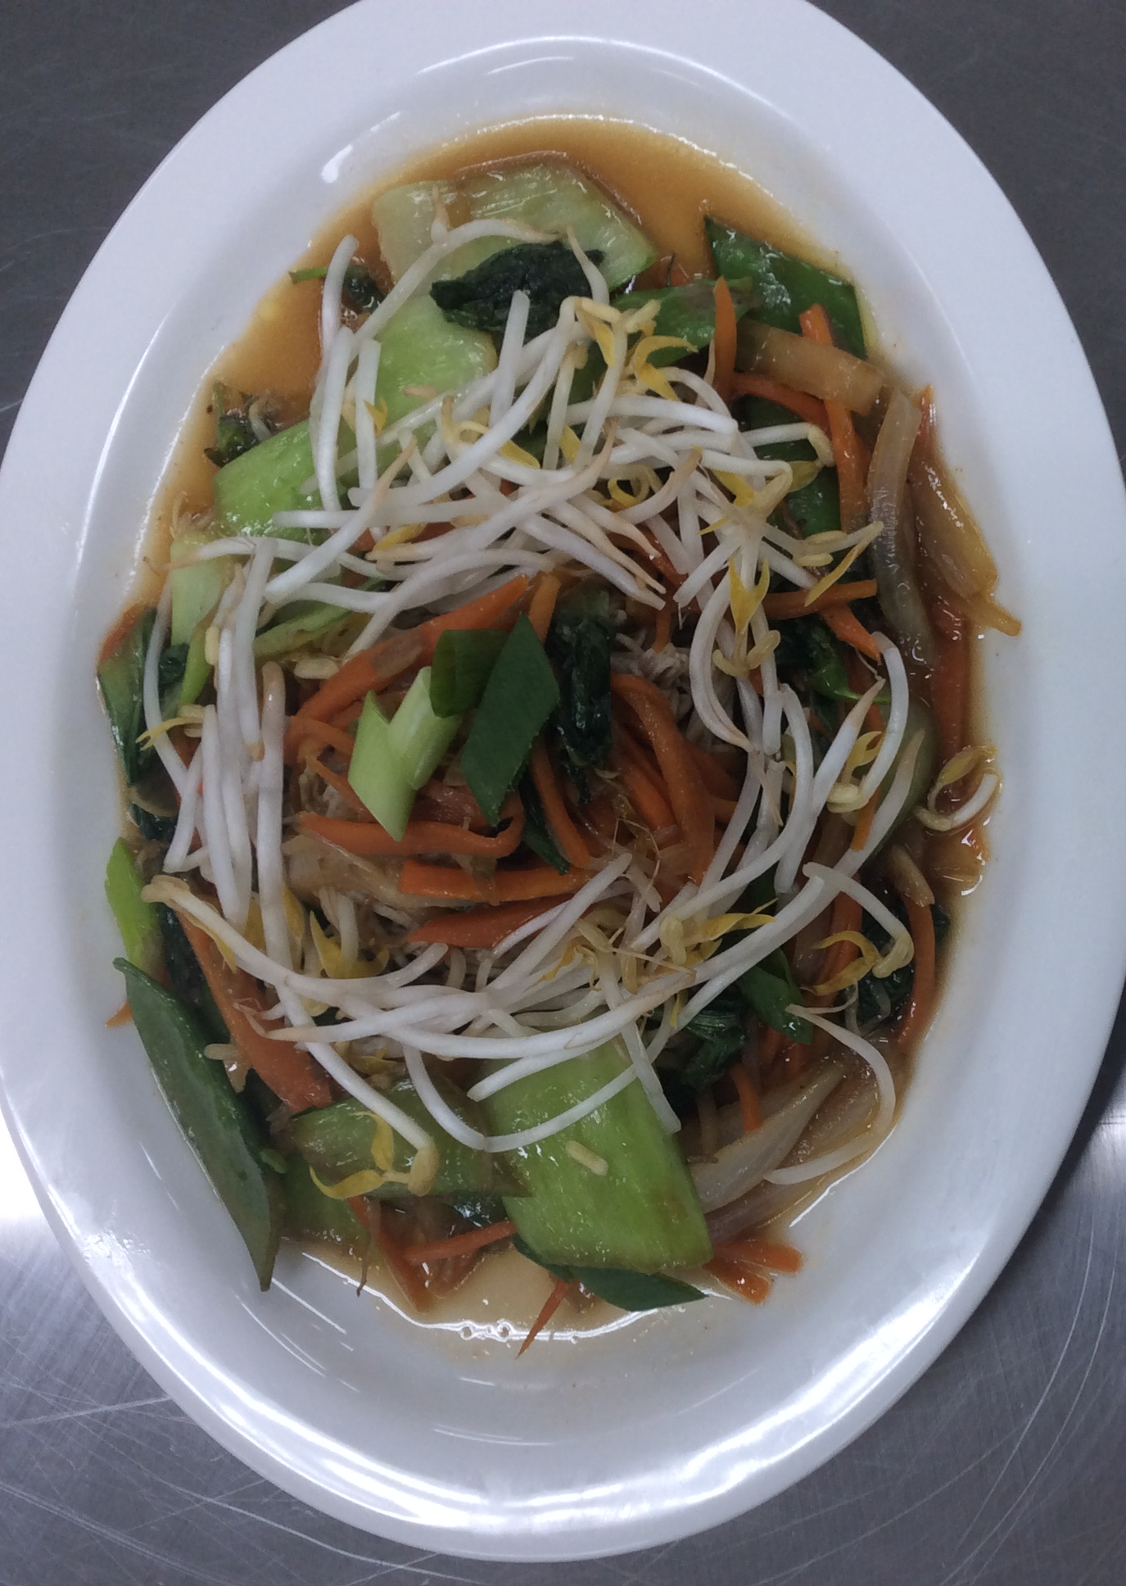
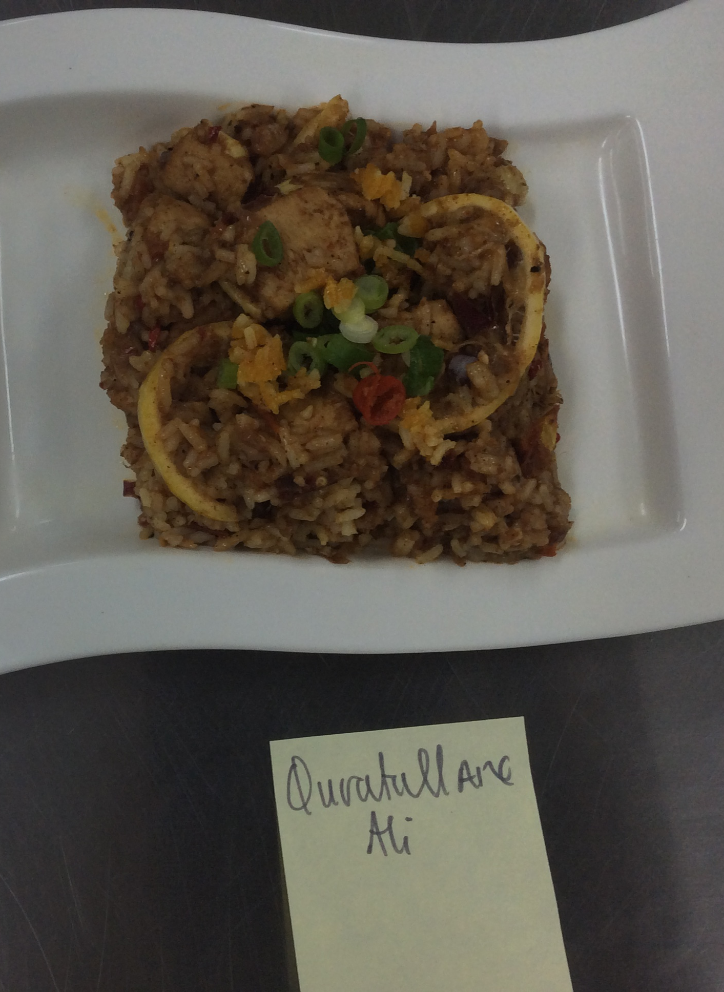
Congratulations to our team for 2022!
Jayme
Kiara
Eliza
Quratullane

Slide 20
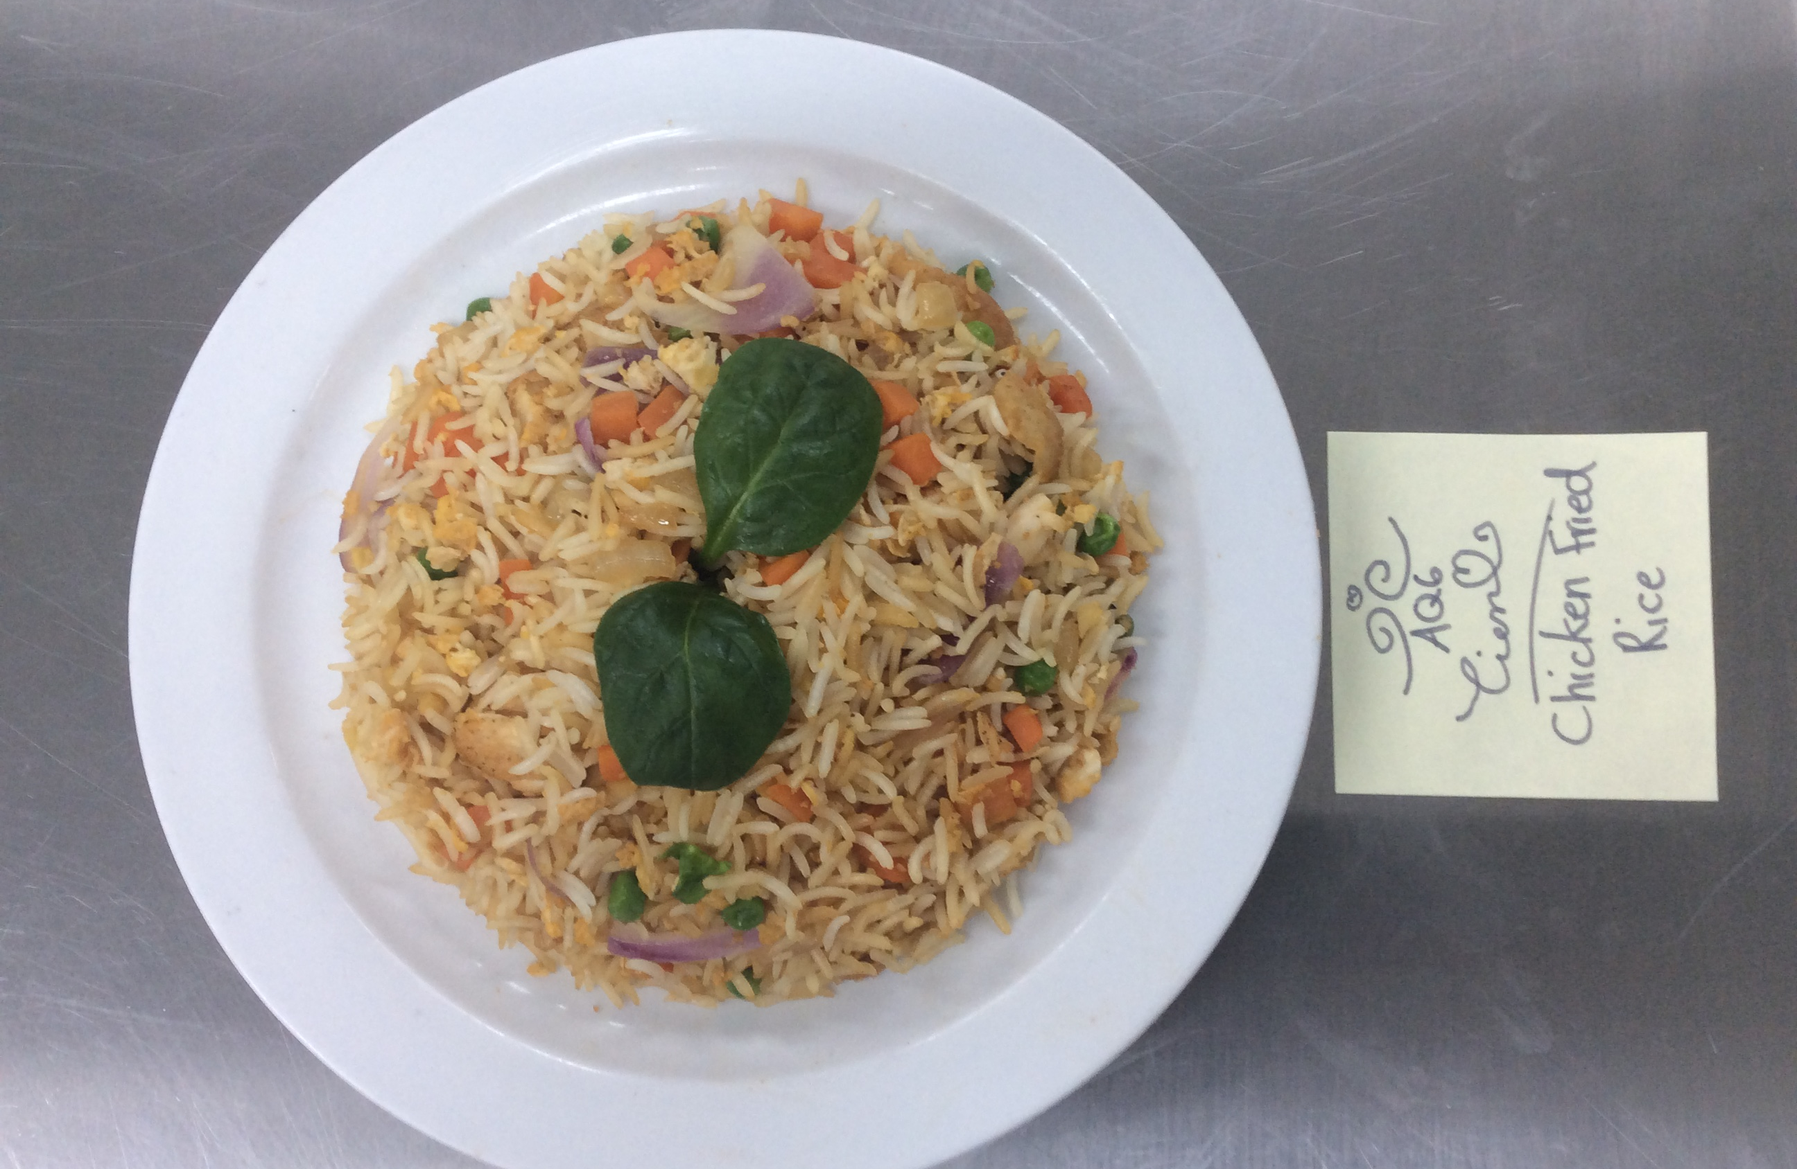
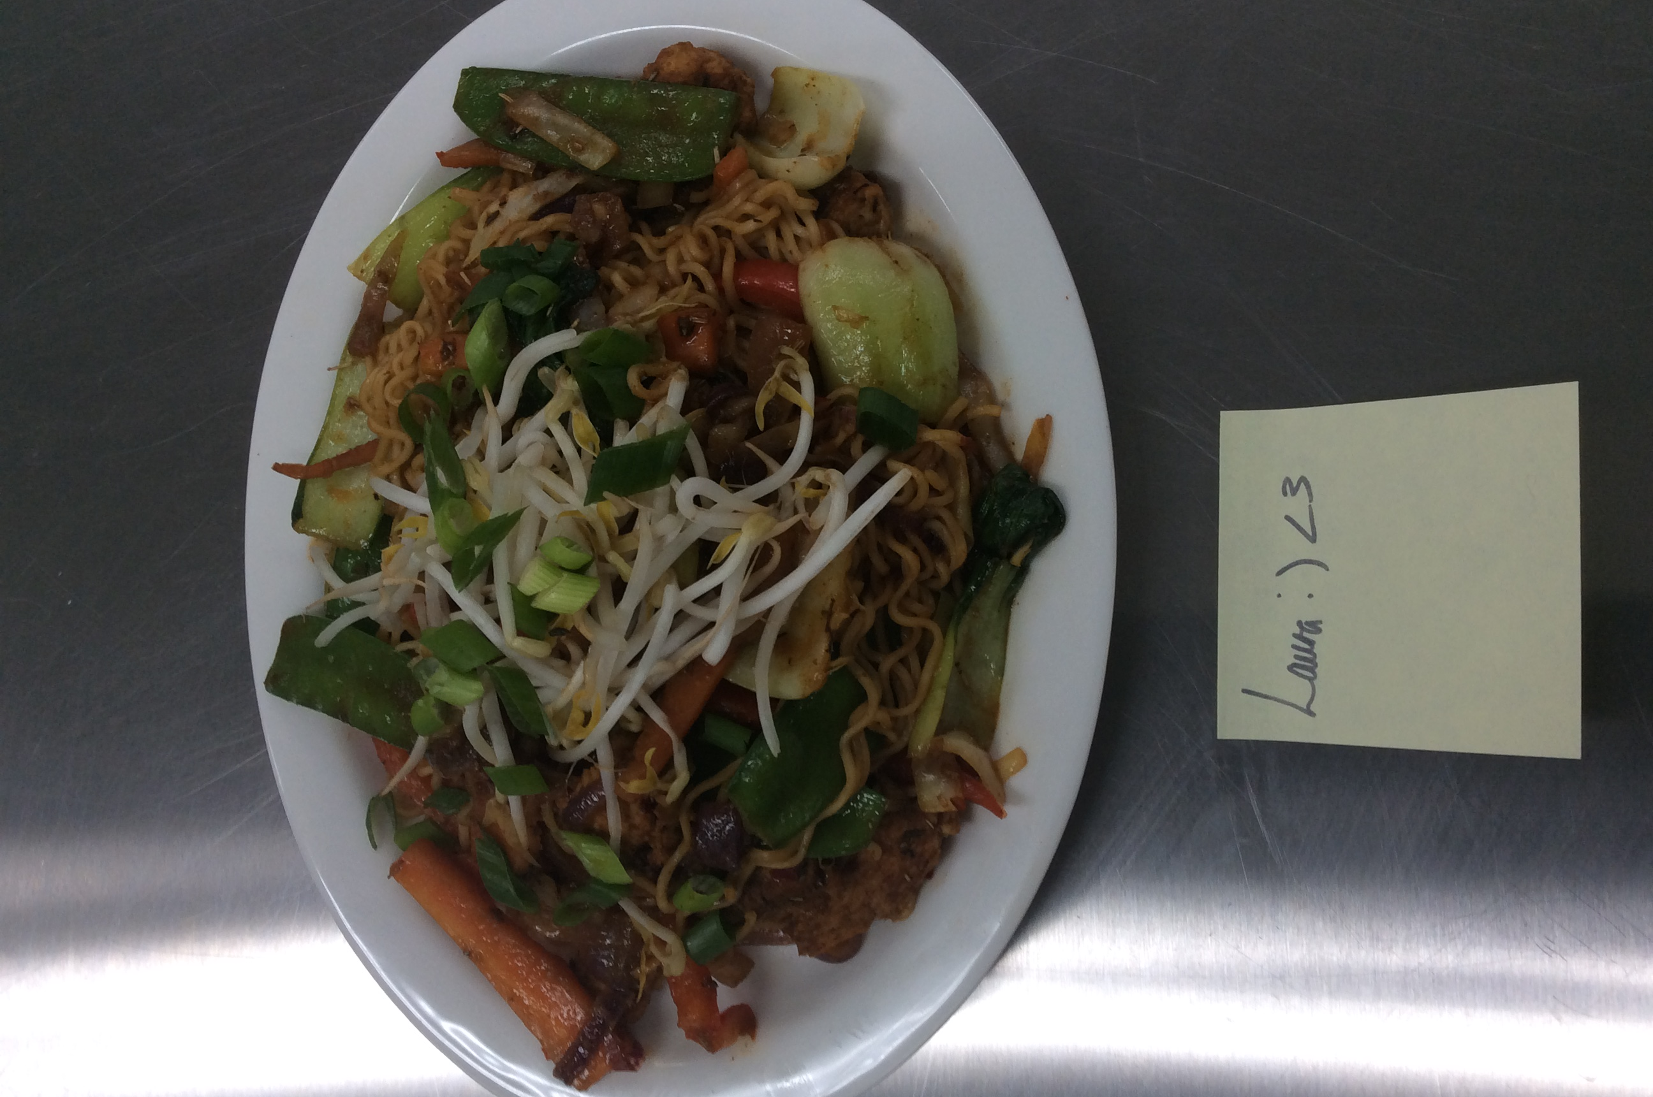
Our 2022 emergencies:
Tien
Laura

Slide 21
Thank you again to everyone!

