Slide 1

Buddy Day!
To celebrate Buddy Day, we met with our Grade 5 Buddies and read a book with them. Then we drew a picture. We love hanging out with our Buddies!
Please have a look at some of our photos and the comments we had to say.

Slide 2
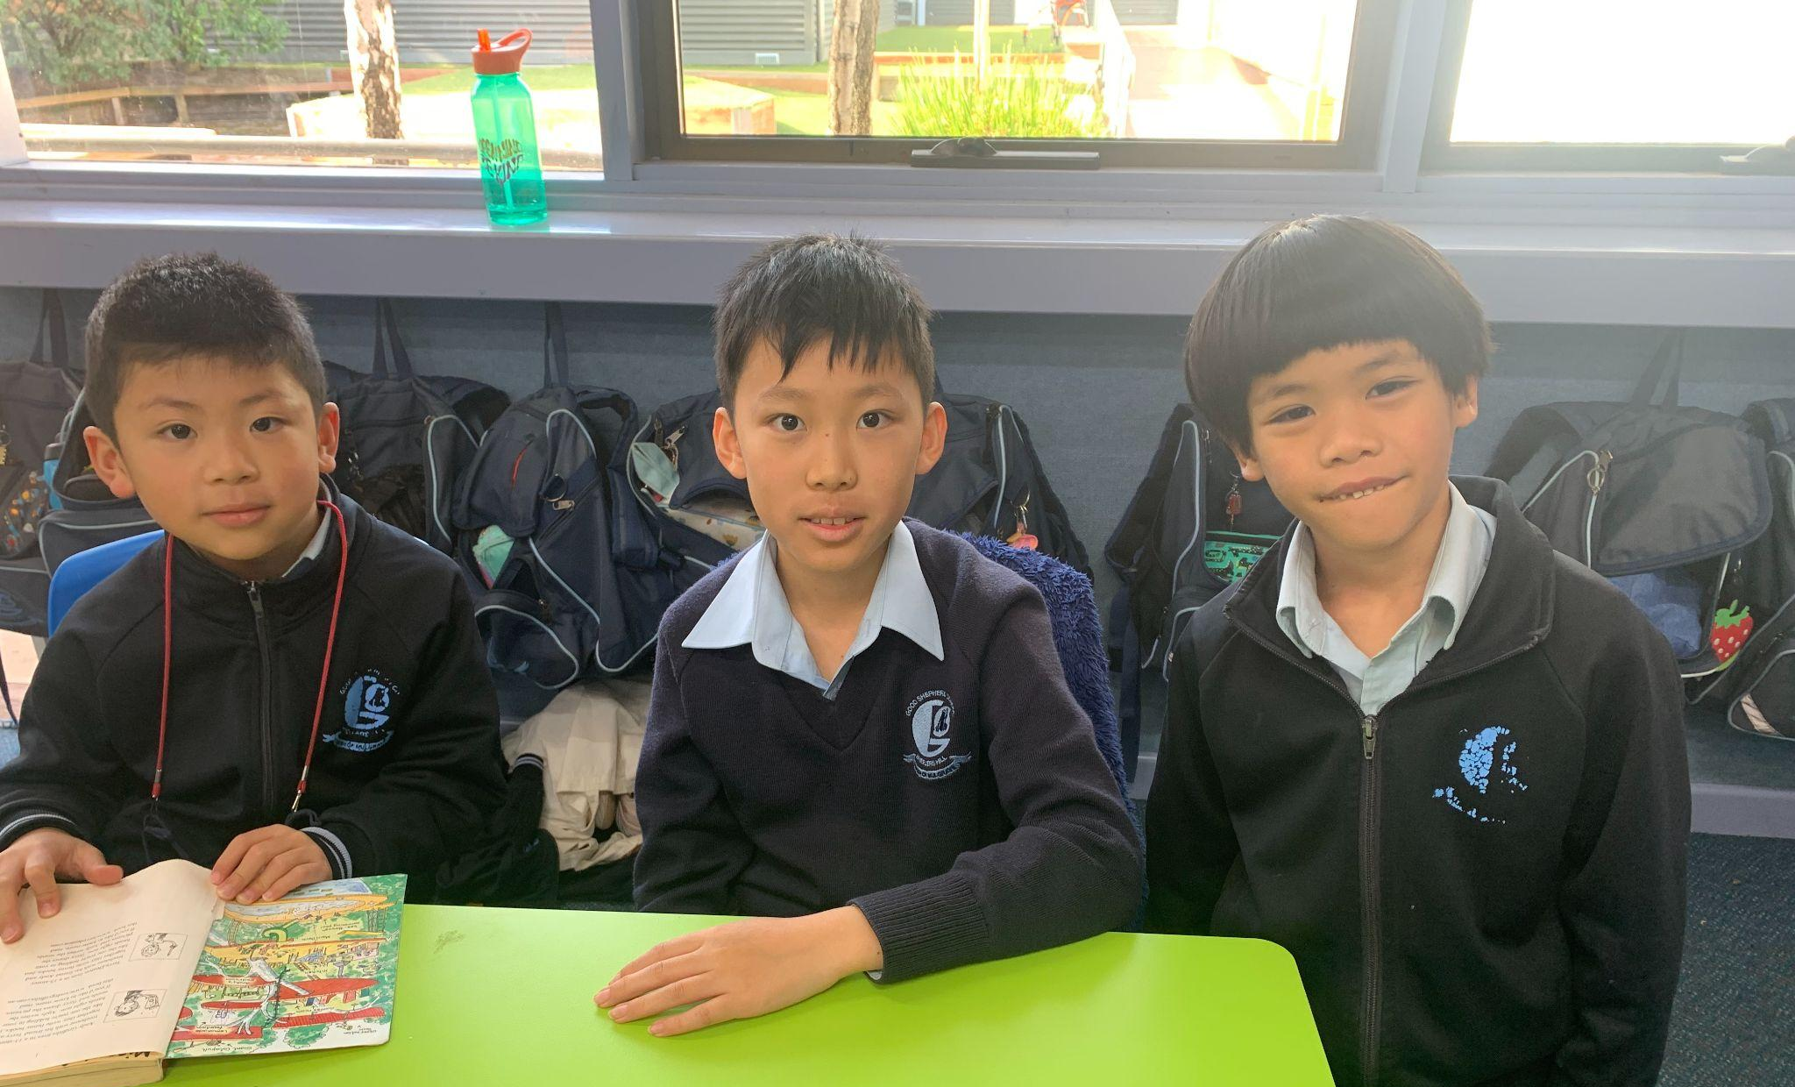
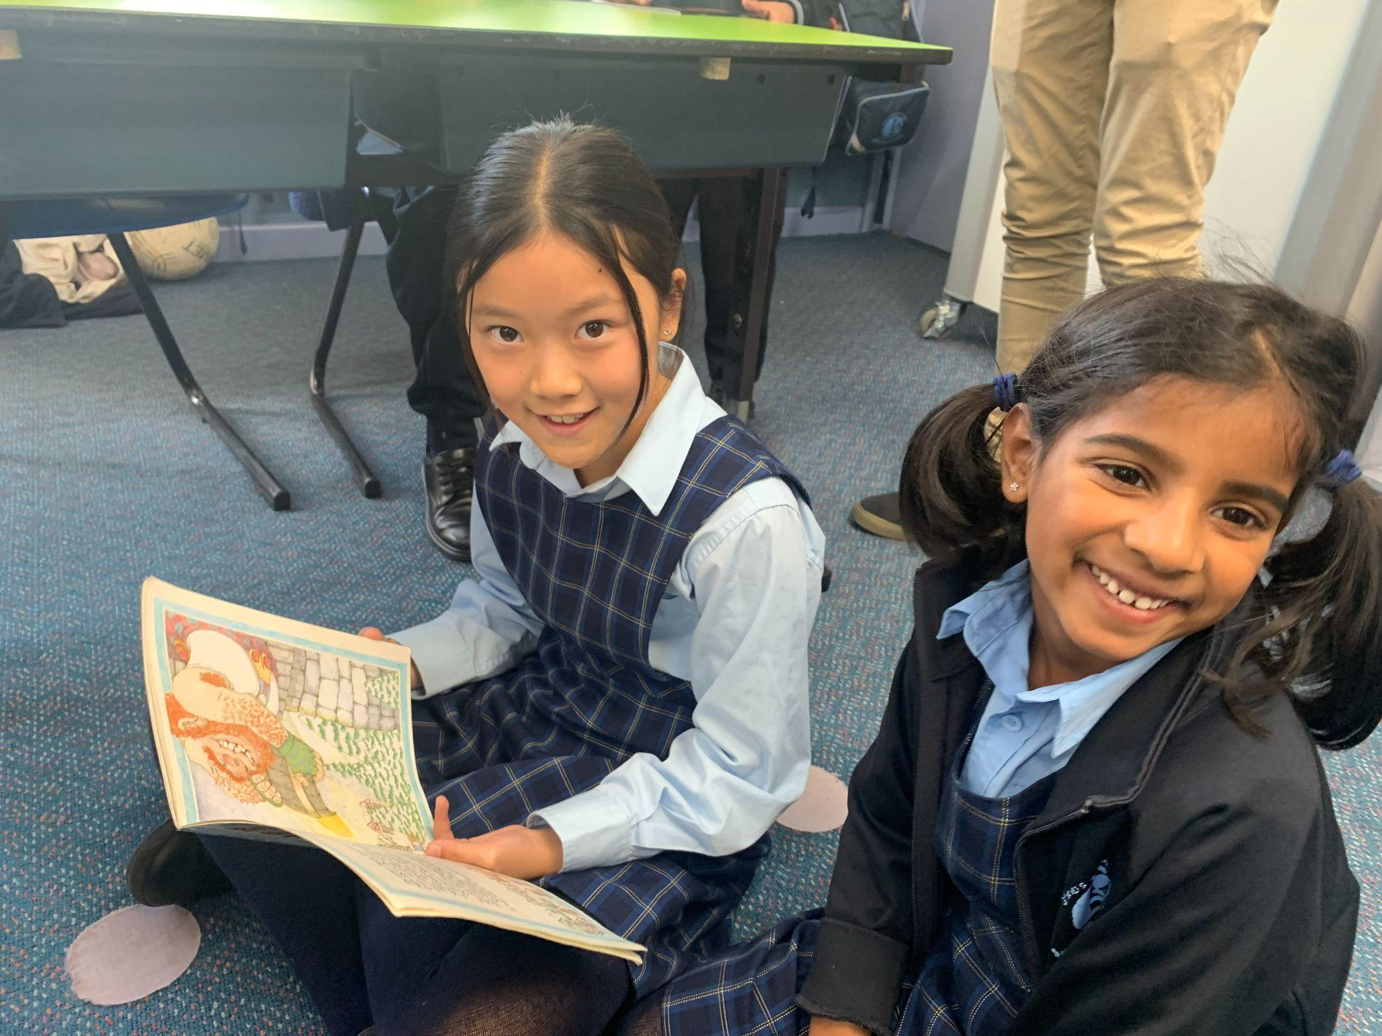
Brendan - “I like my Buddy, Geoff.”
James - “I like to make stuff with Geoff!”
Mikaela - “Jaidyn likes colouring.”

Slide 3
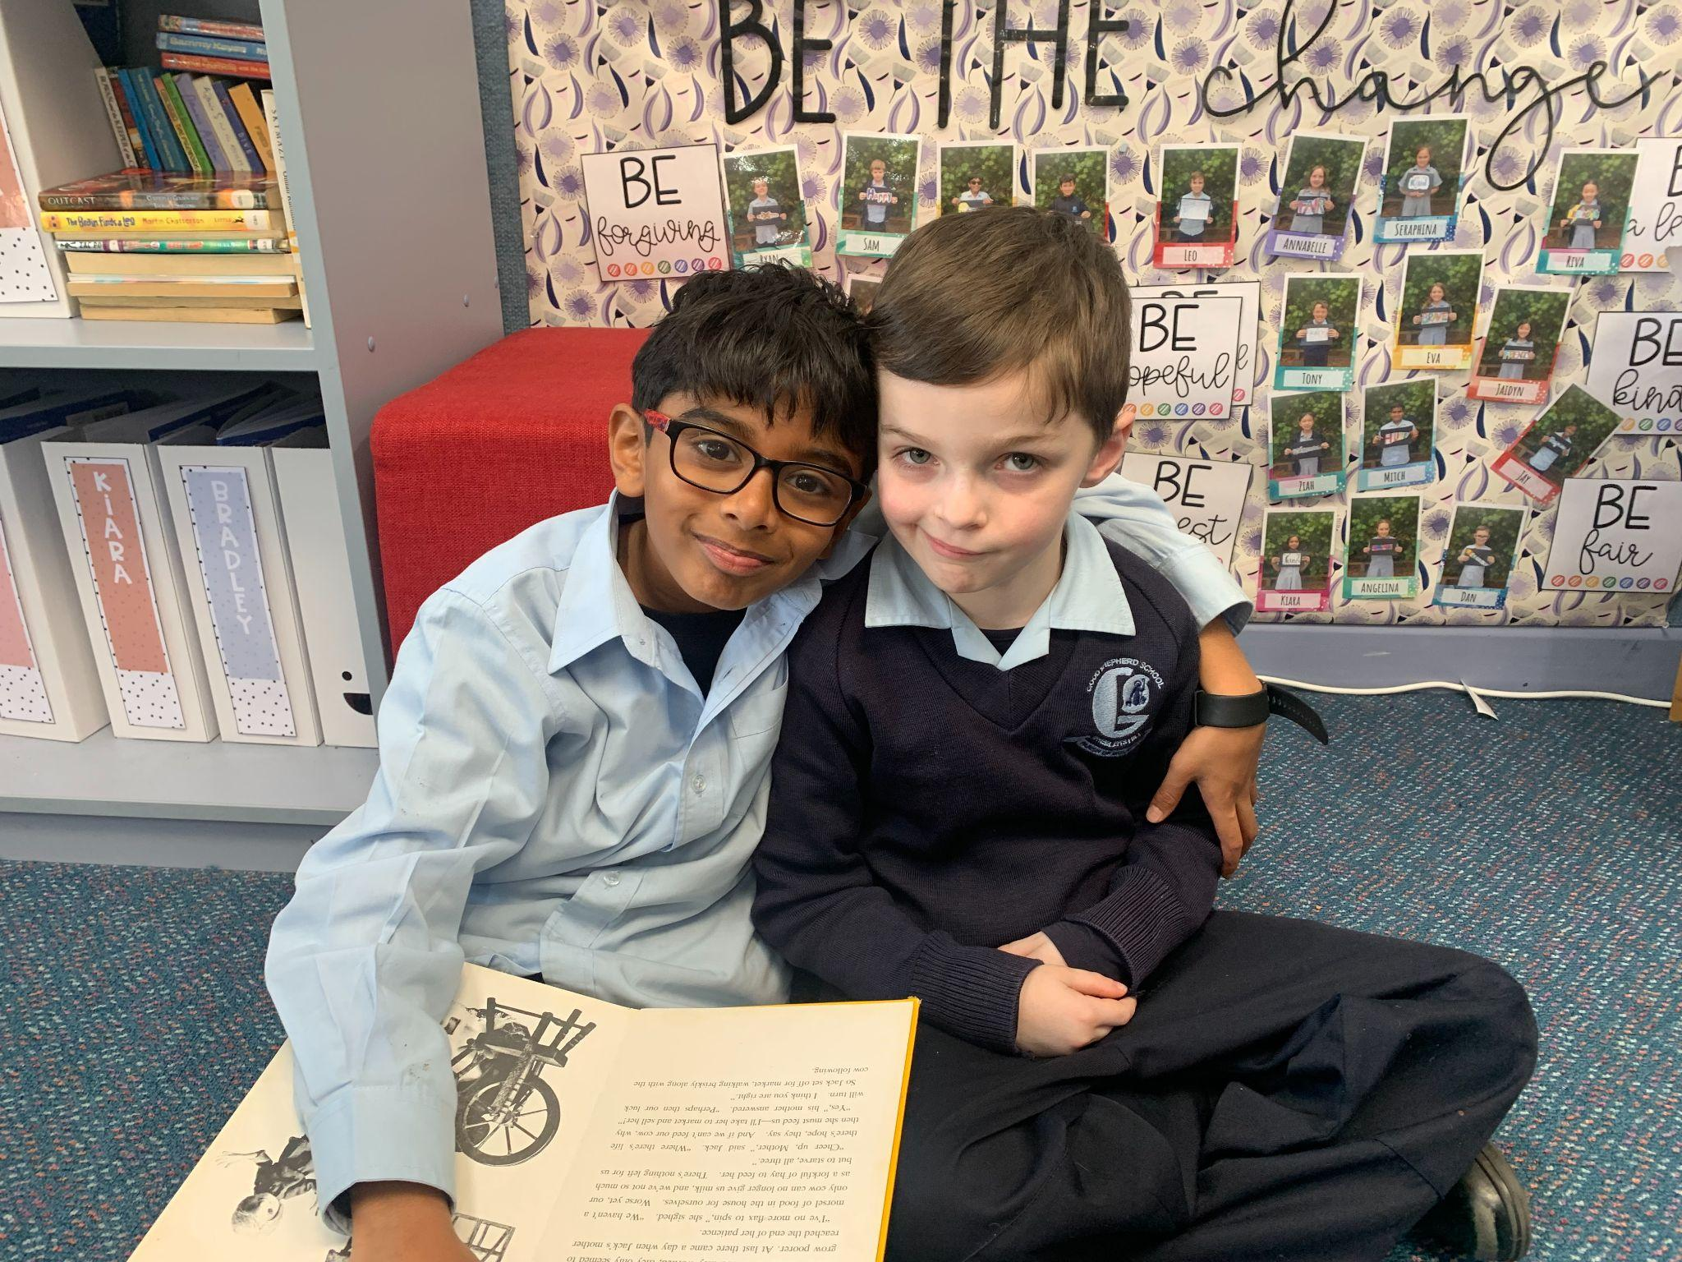
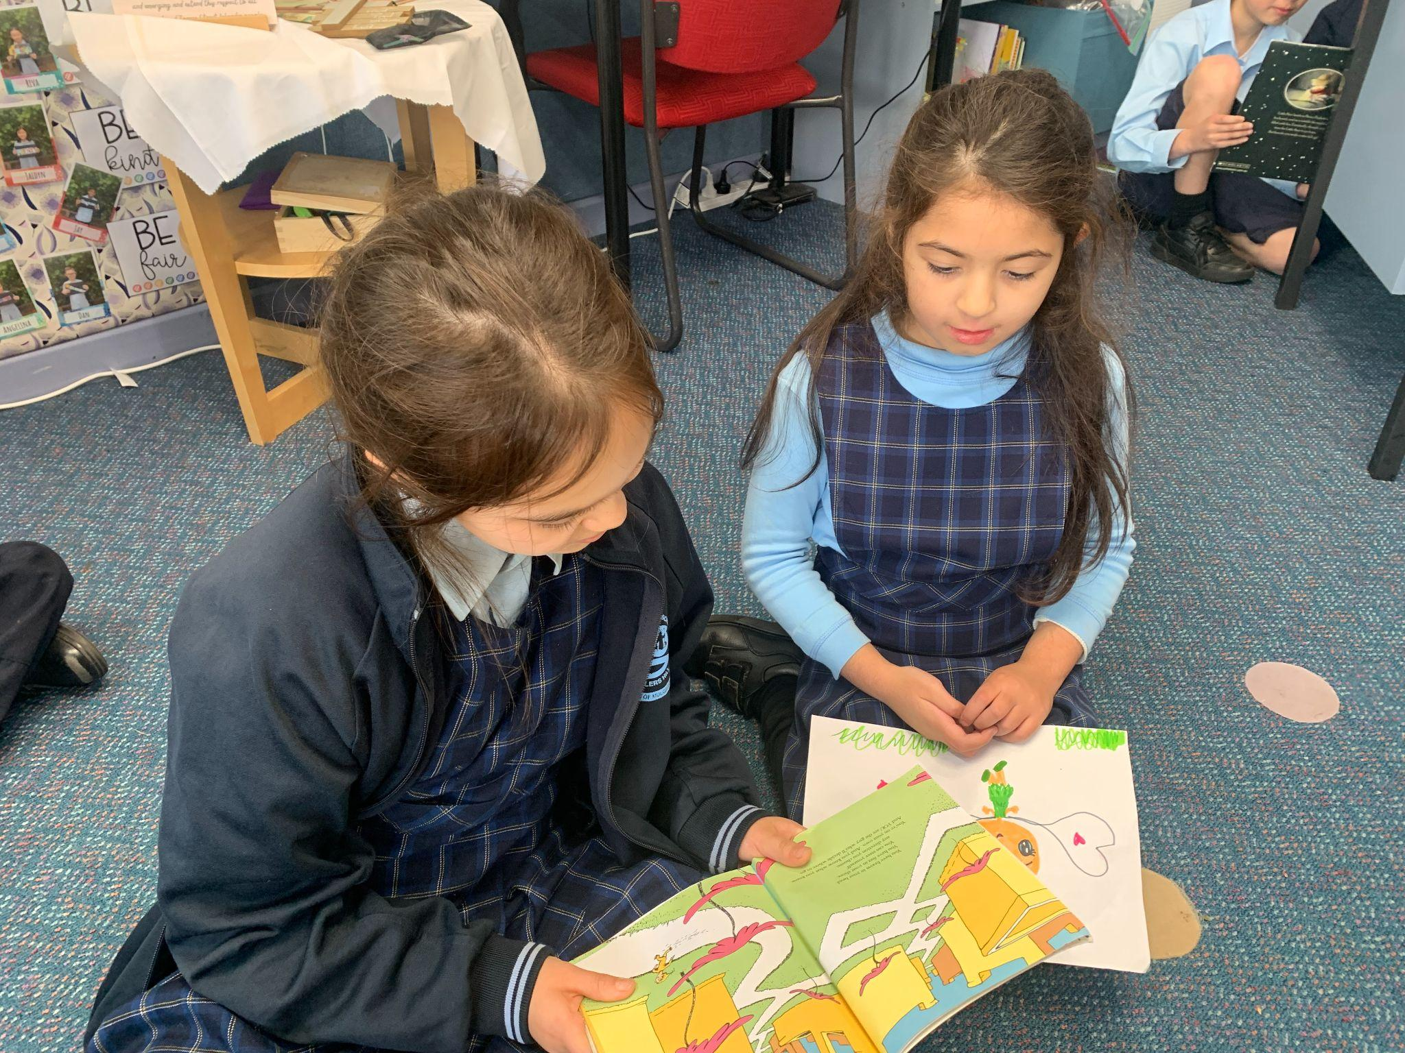
Charlie - “The first time I saw Zenith I went to him and hugged him.”

Slide 4
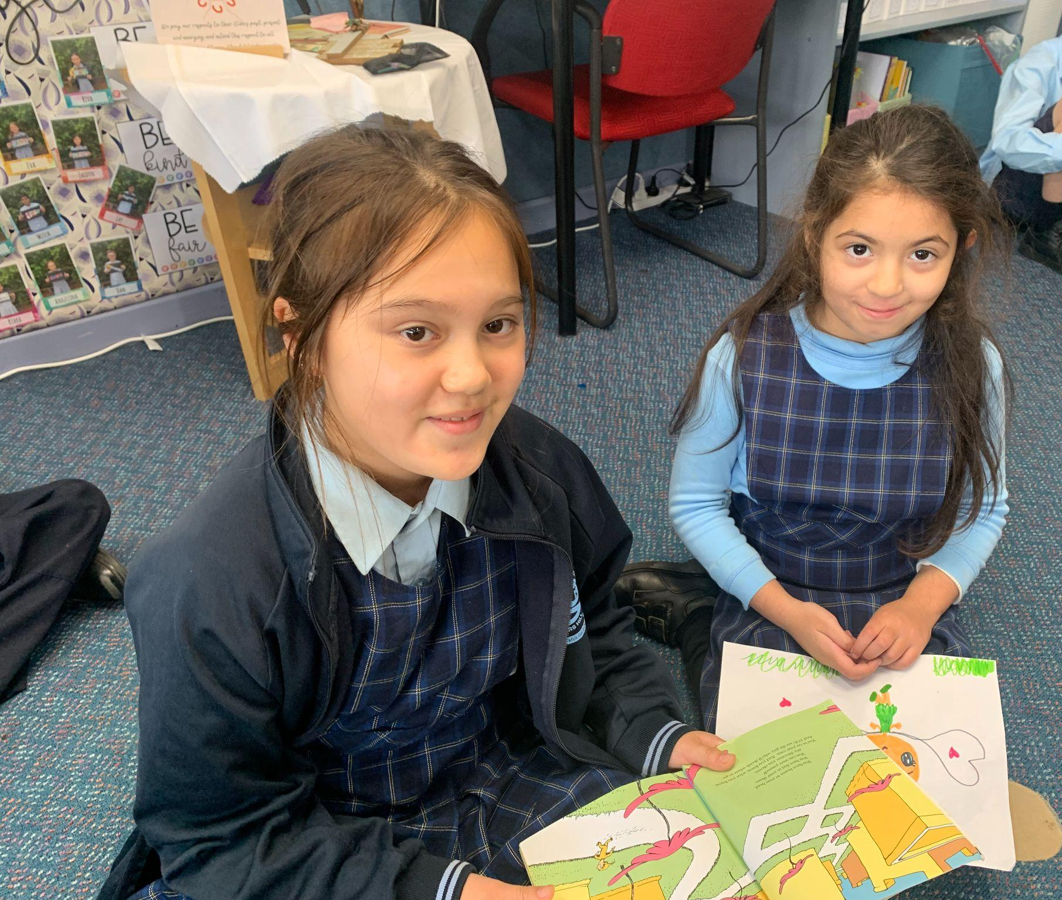
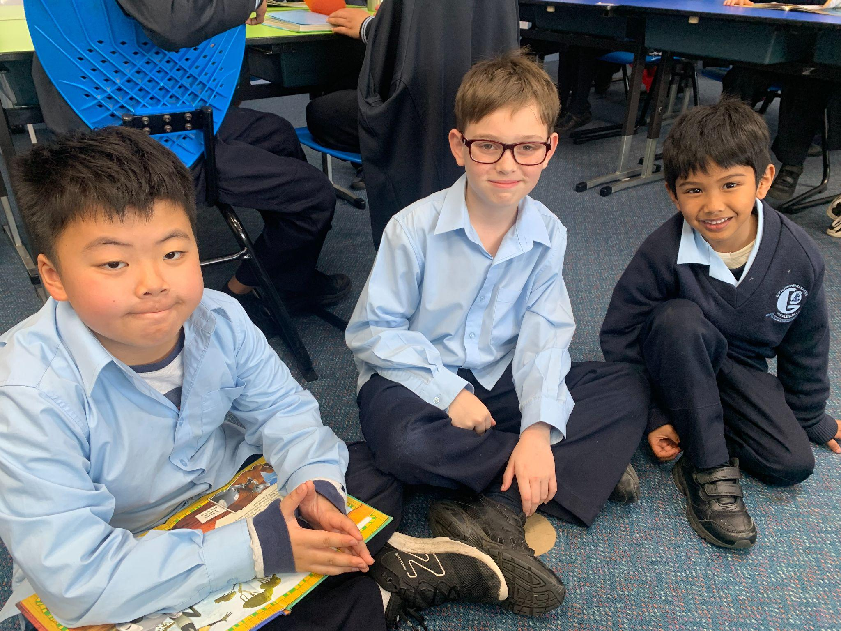
Matthias - “They take care of us.”
Sophie - “Seraphina is fun to read with and draw with. And she is sometimes shy”

Slide 5
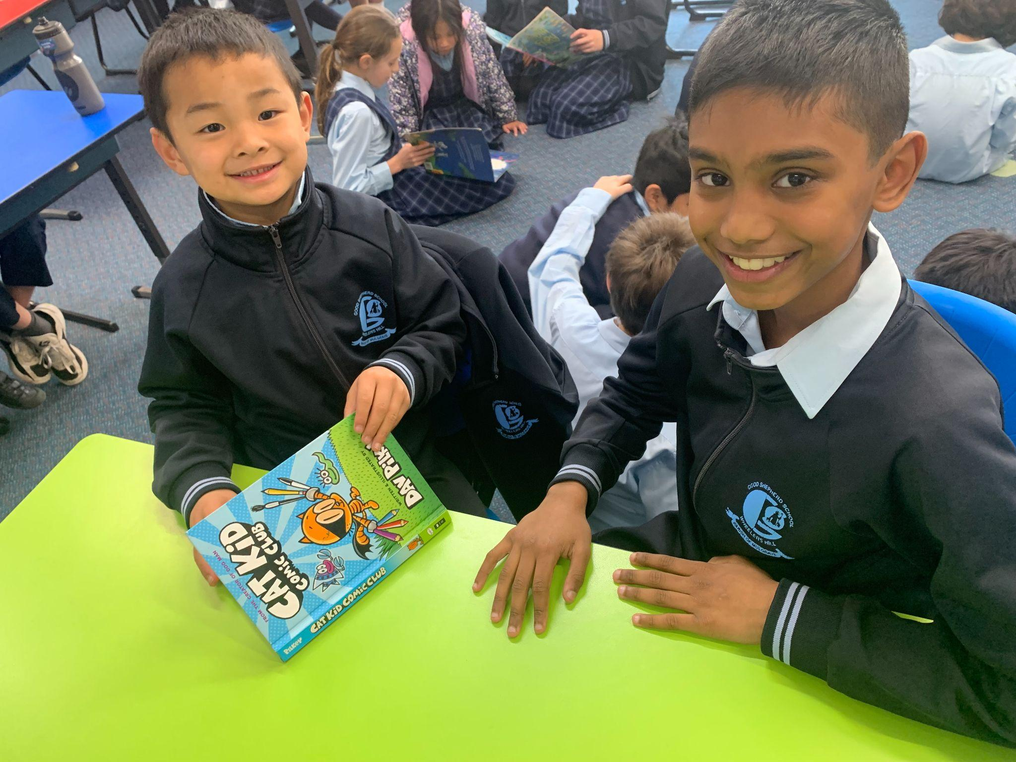
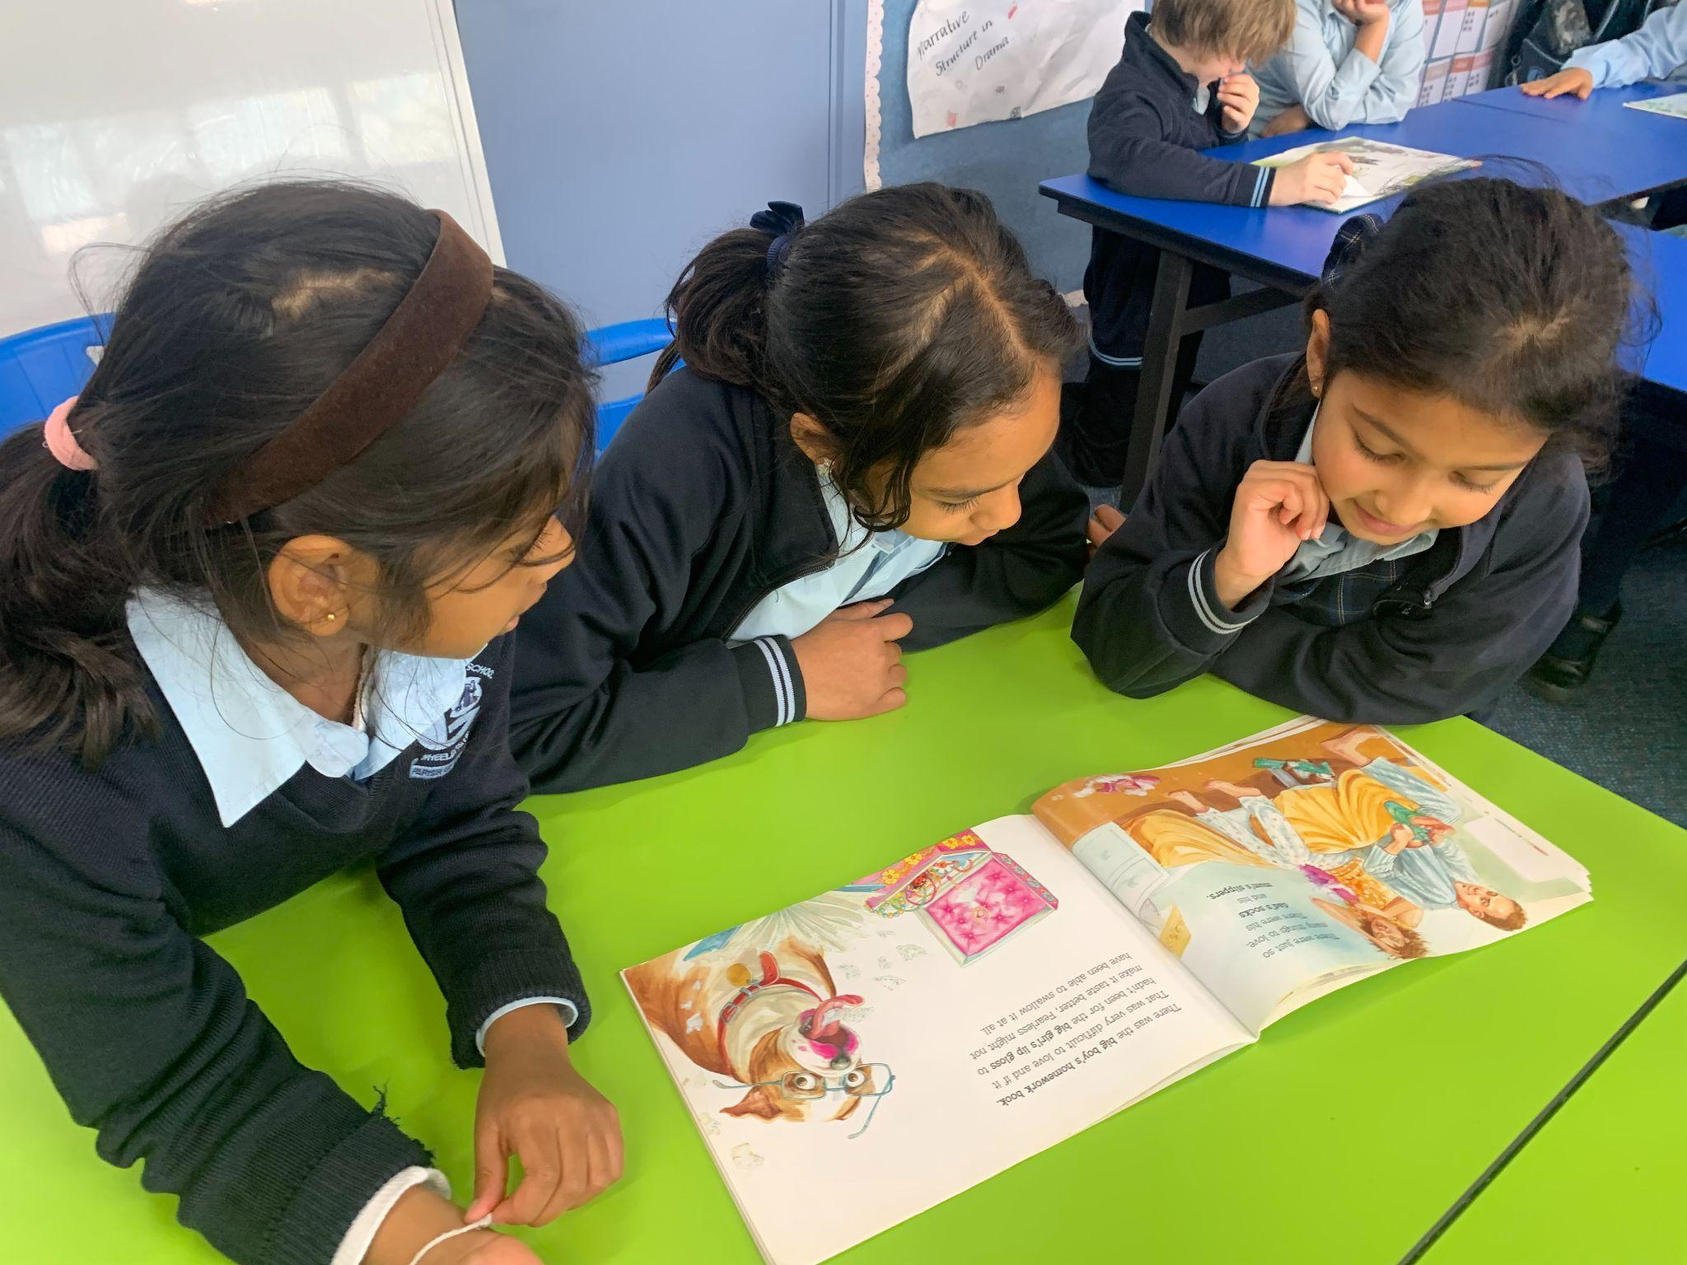
Michael - “We were reading books!”
Mehaiah - “I loved reading with my Buddy and also colouring with her. And I felt happy when Pragathi’s buddy said I could borrow her textas.”

Slide 6
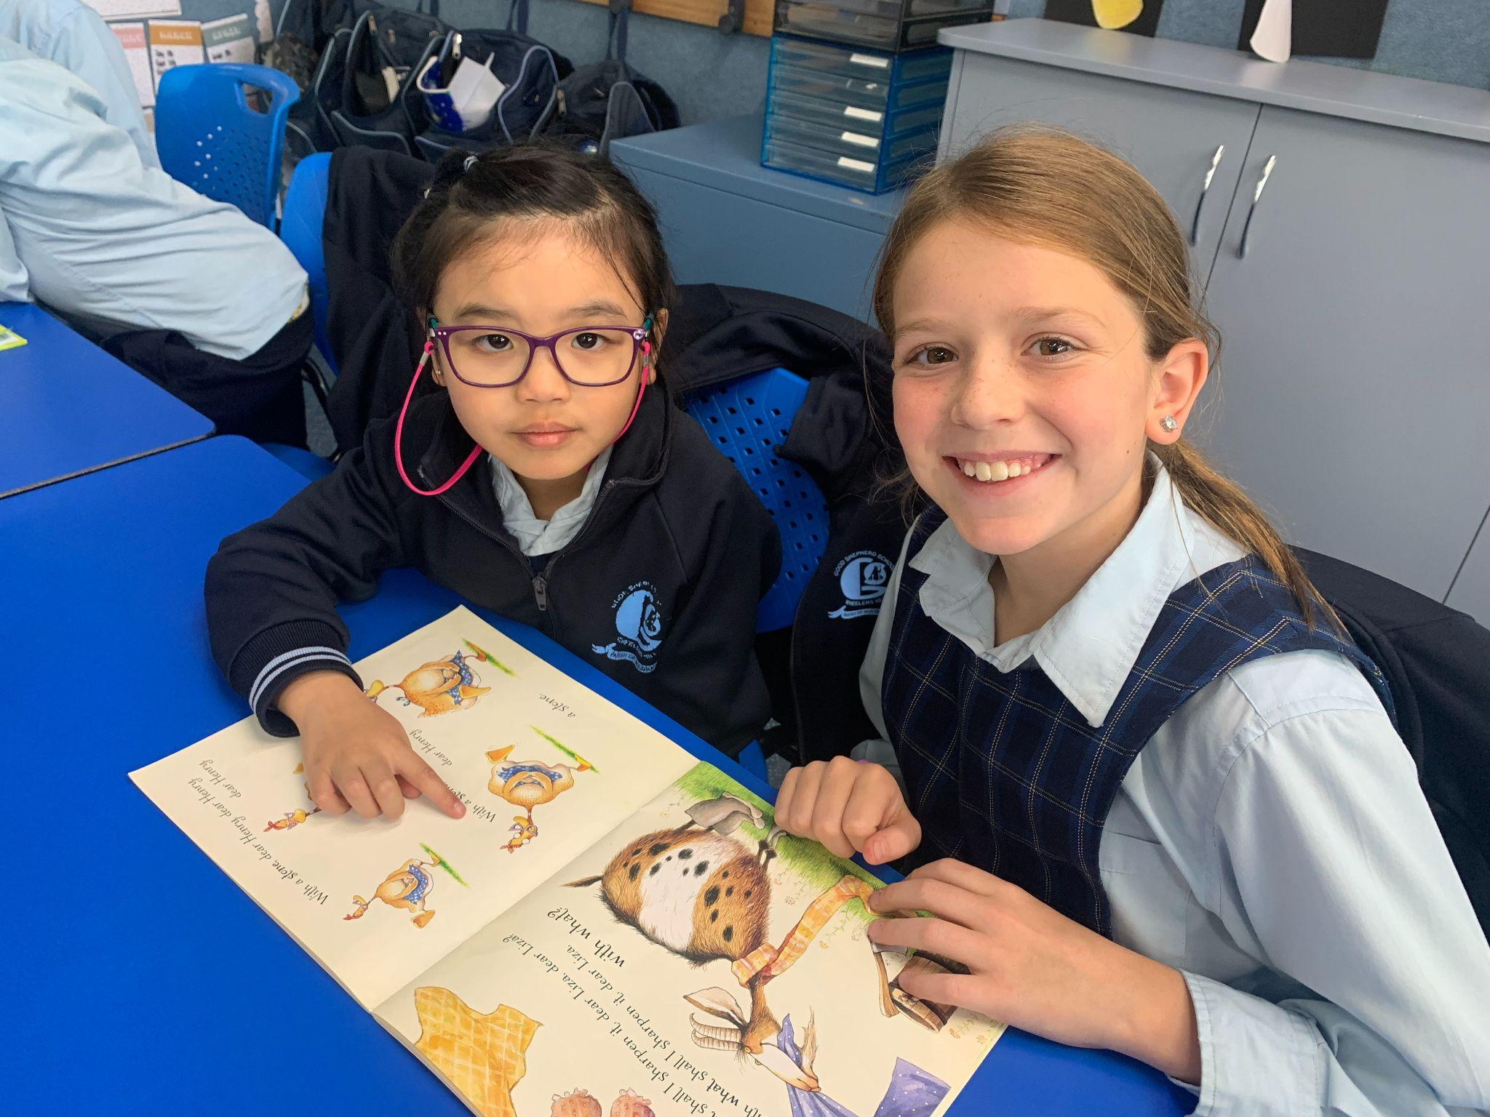
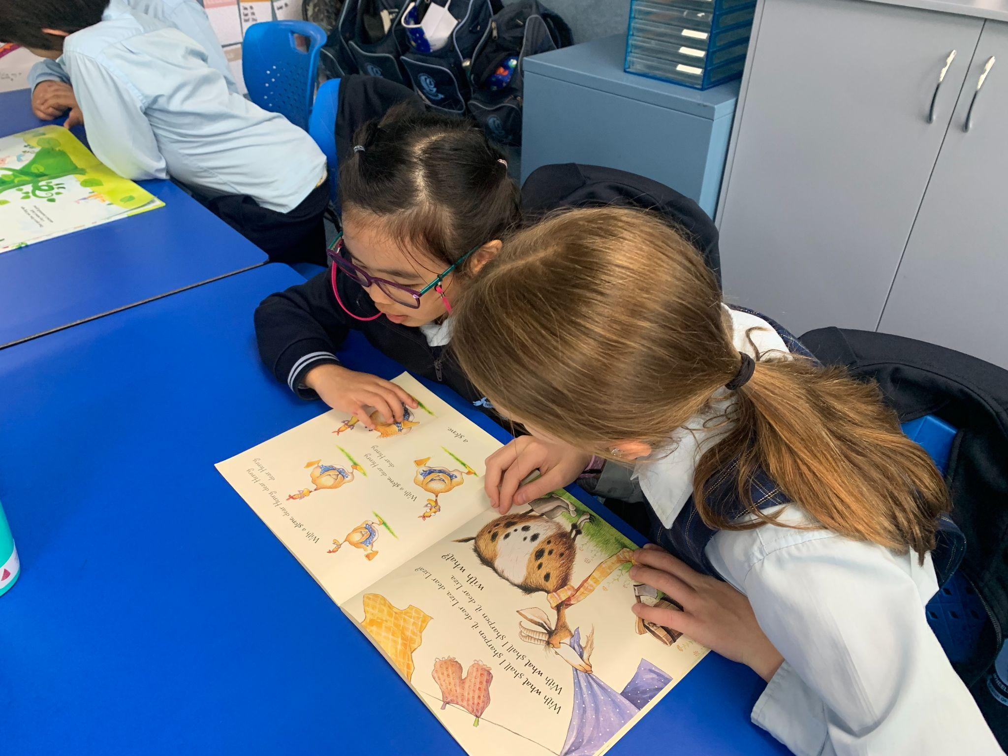
Tina - “I was drawing with Eva.”

Slide 7
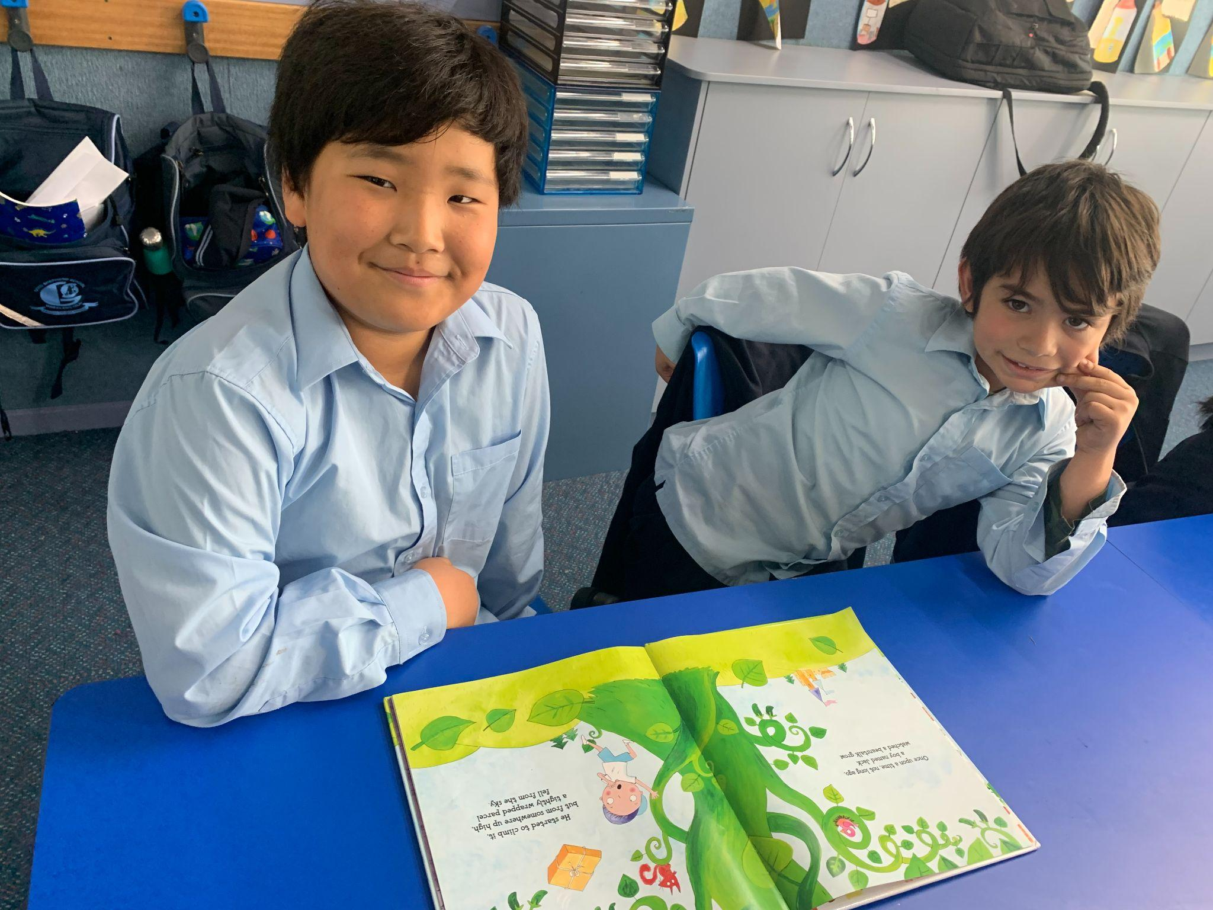
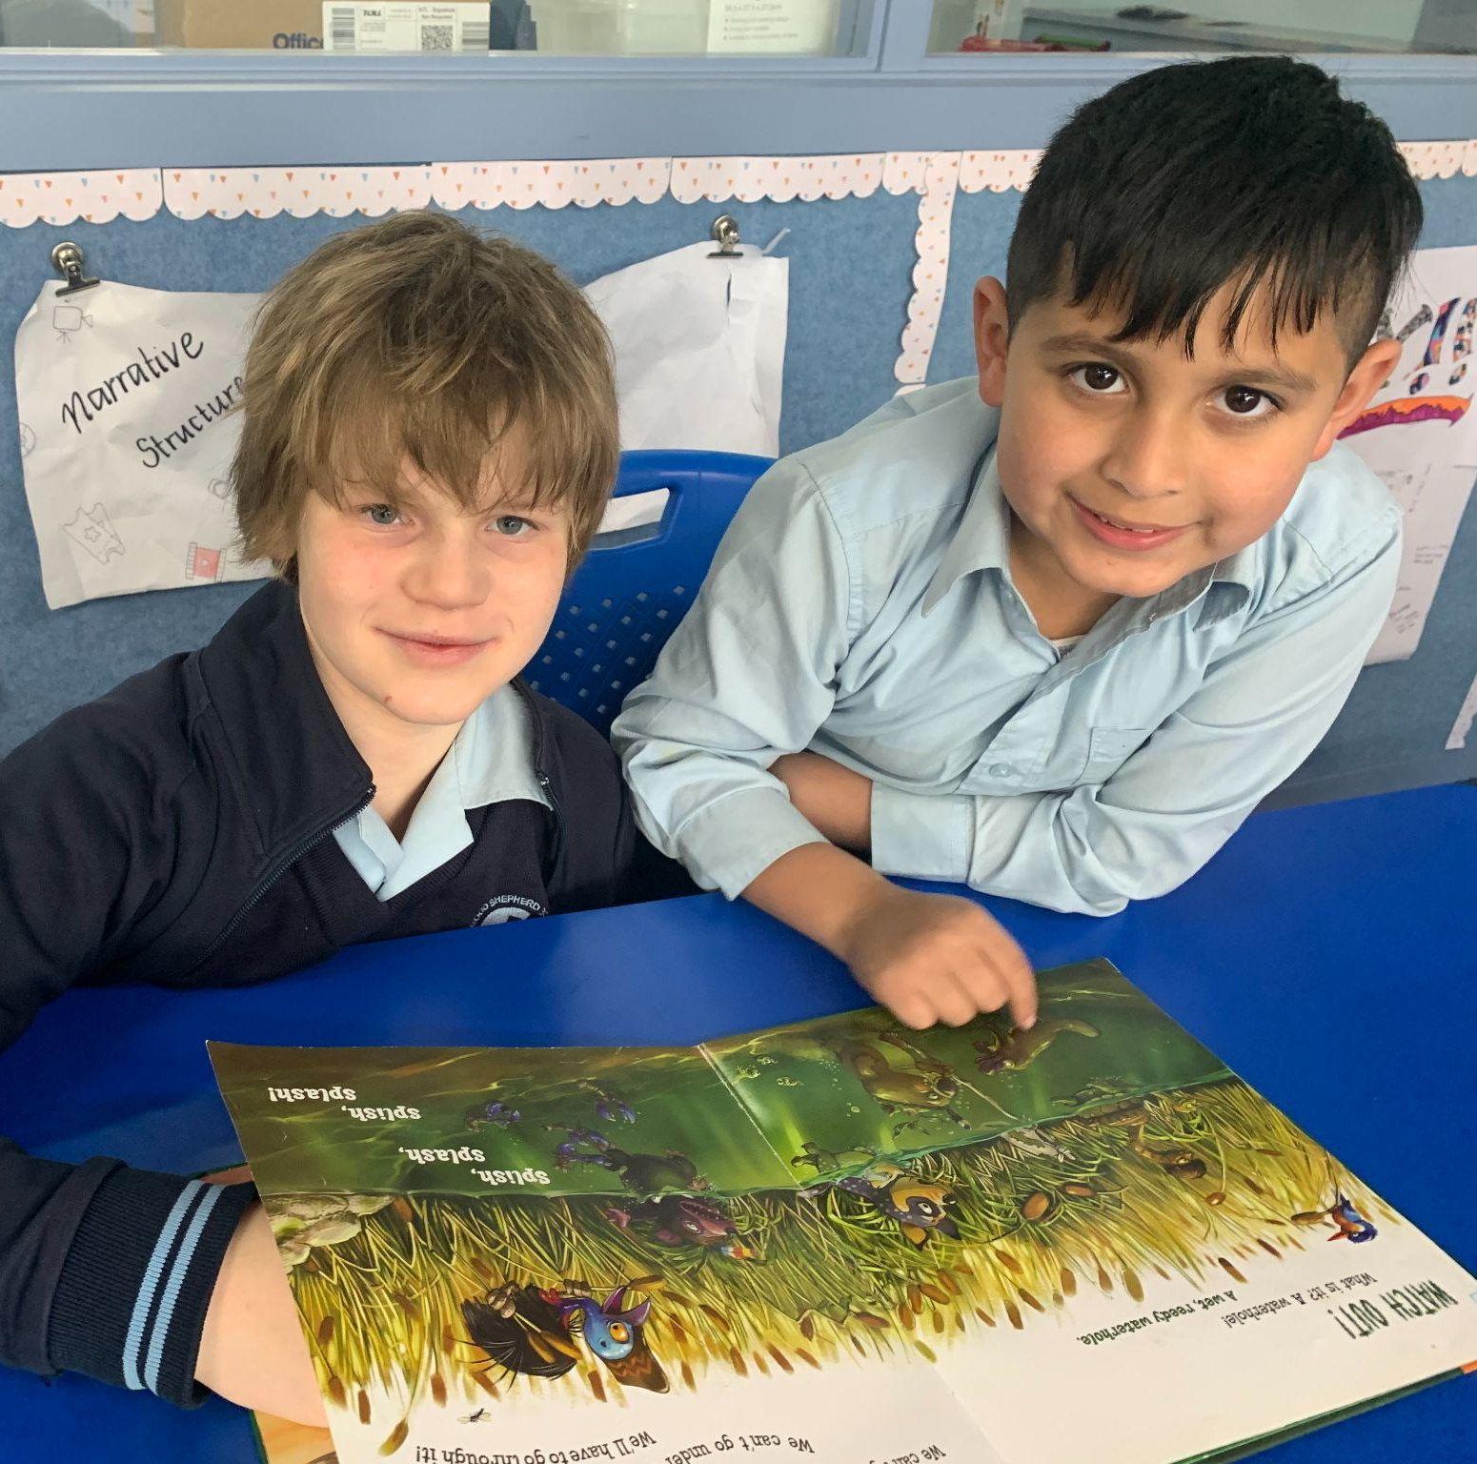
Jordan - “Sam is really nice and funny.”
Ronan - “Buddies are bigger than us and they’re really nice.”

Slide 8
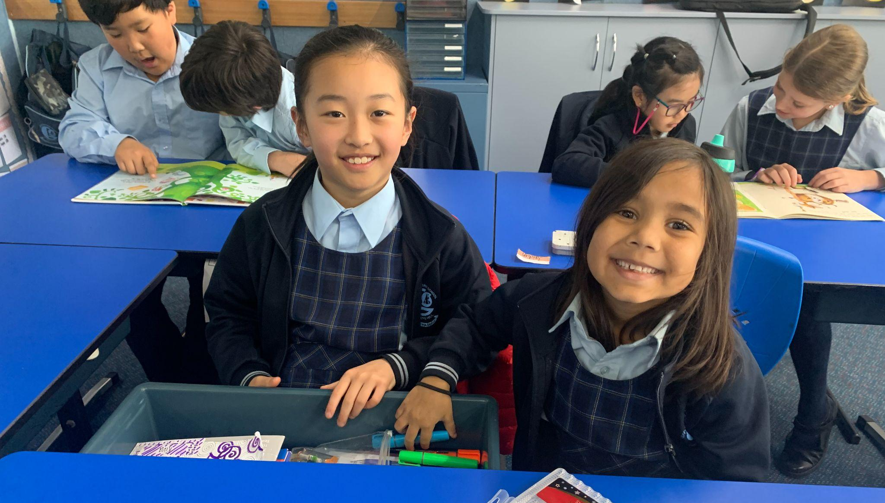
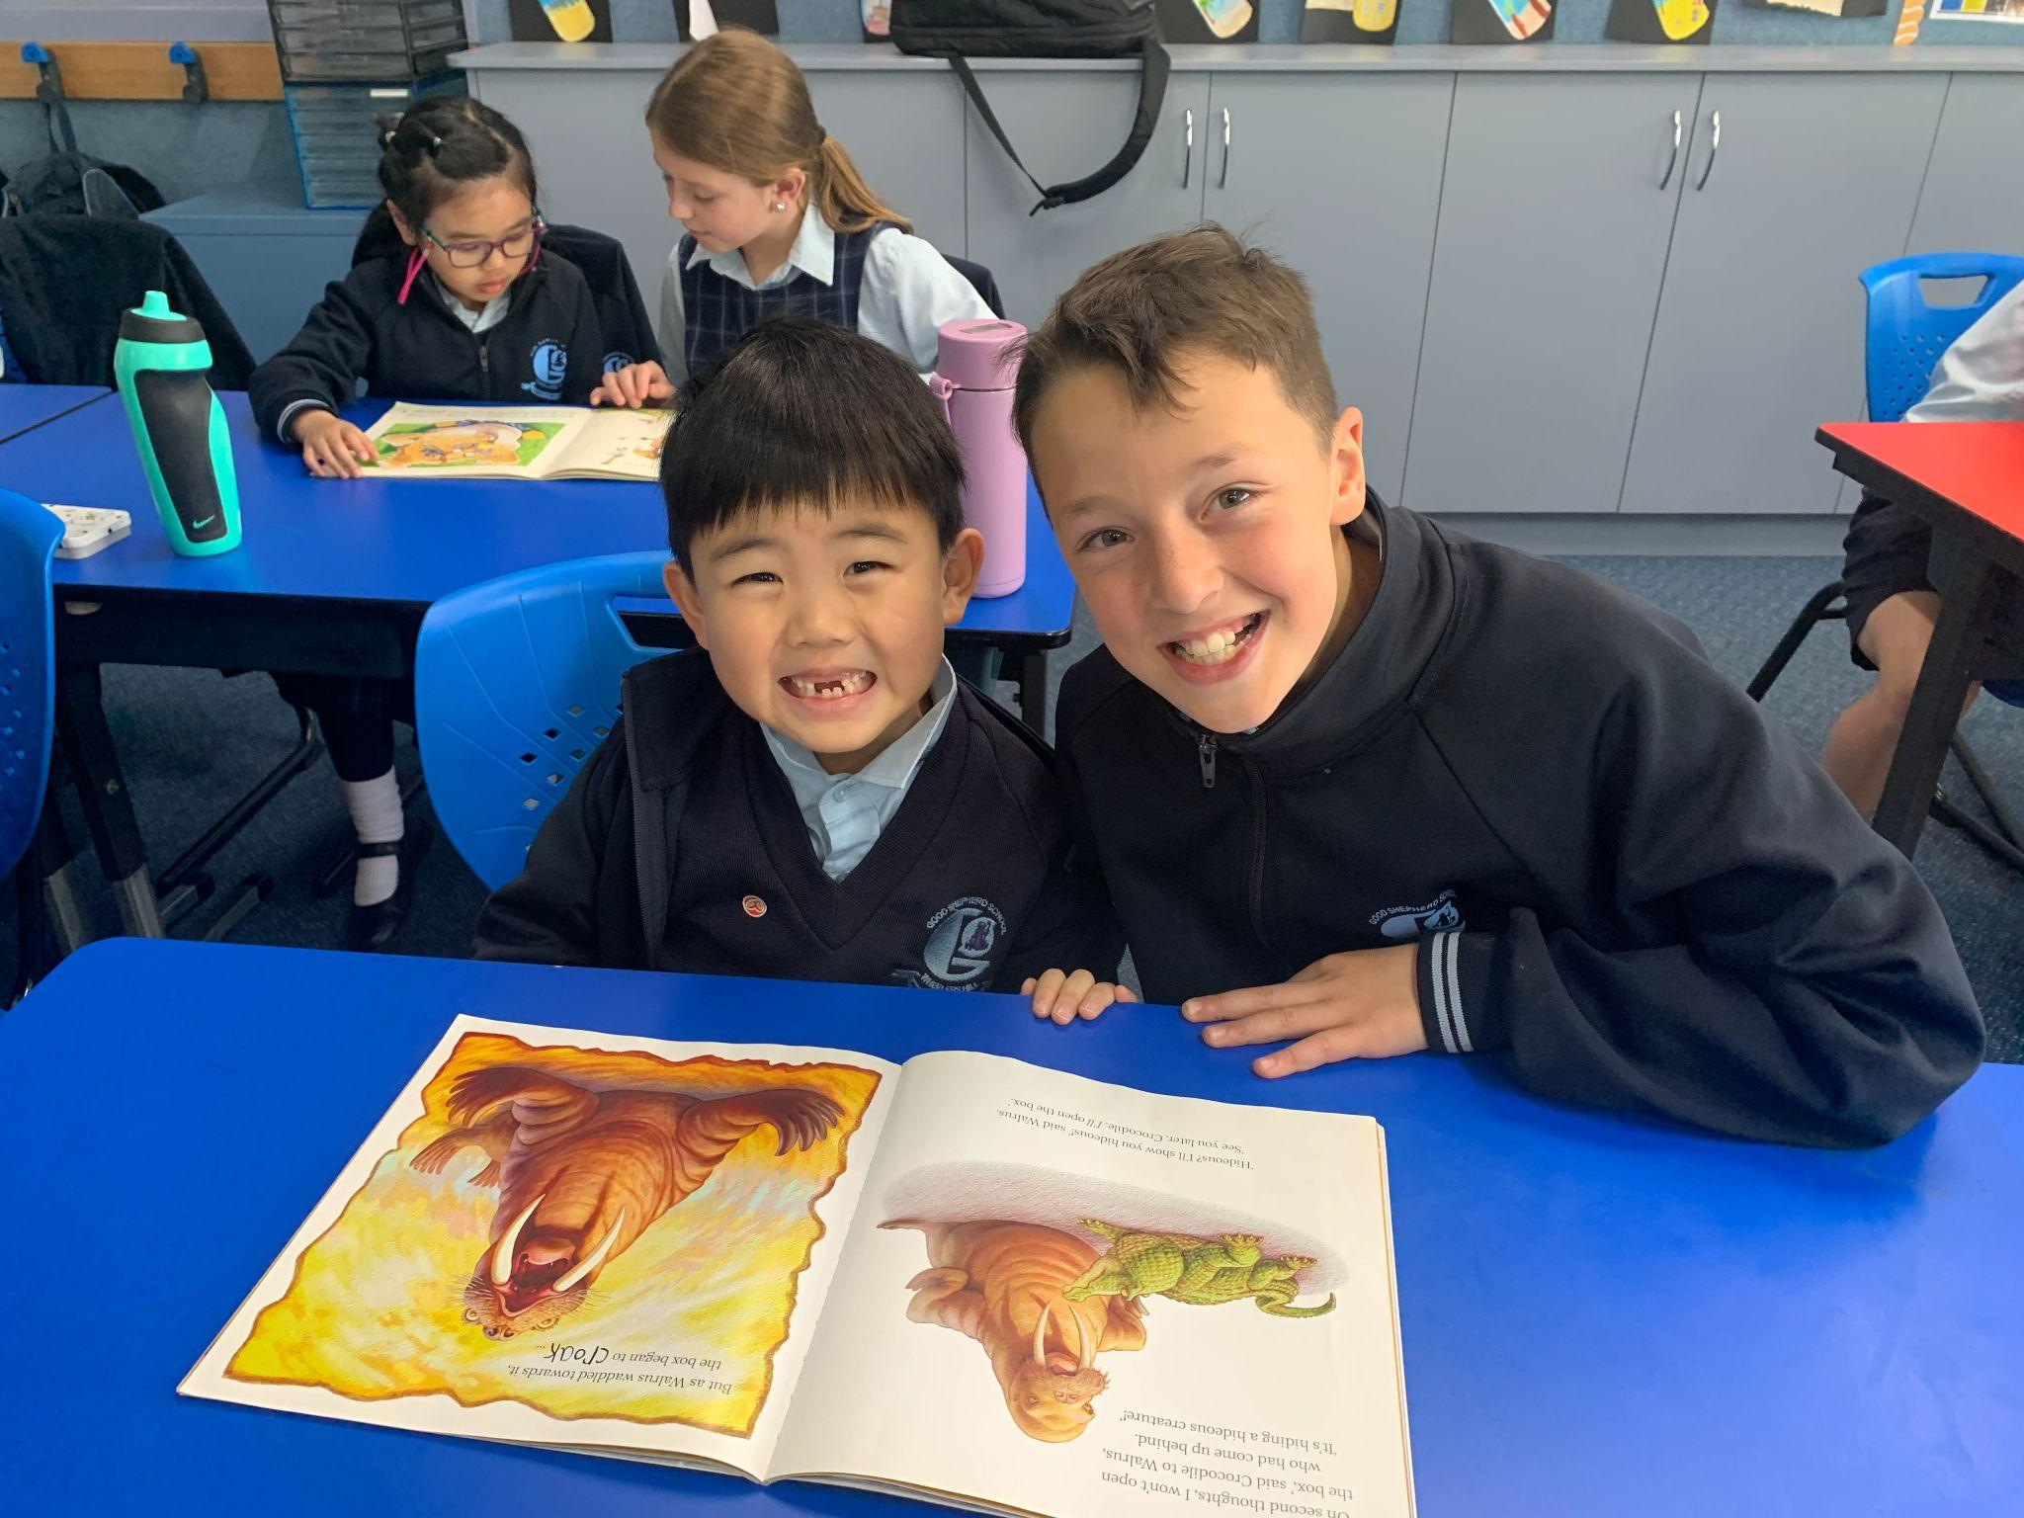
Stacey - “Buddies are really nice and kind and whenever you’re sad they make you happy.”
Eugene - “Anthony is very kind. He is smart.”

Slide 9
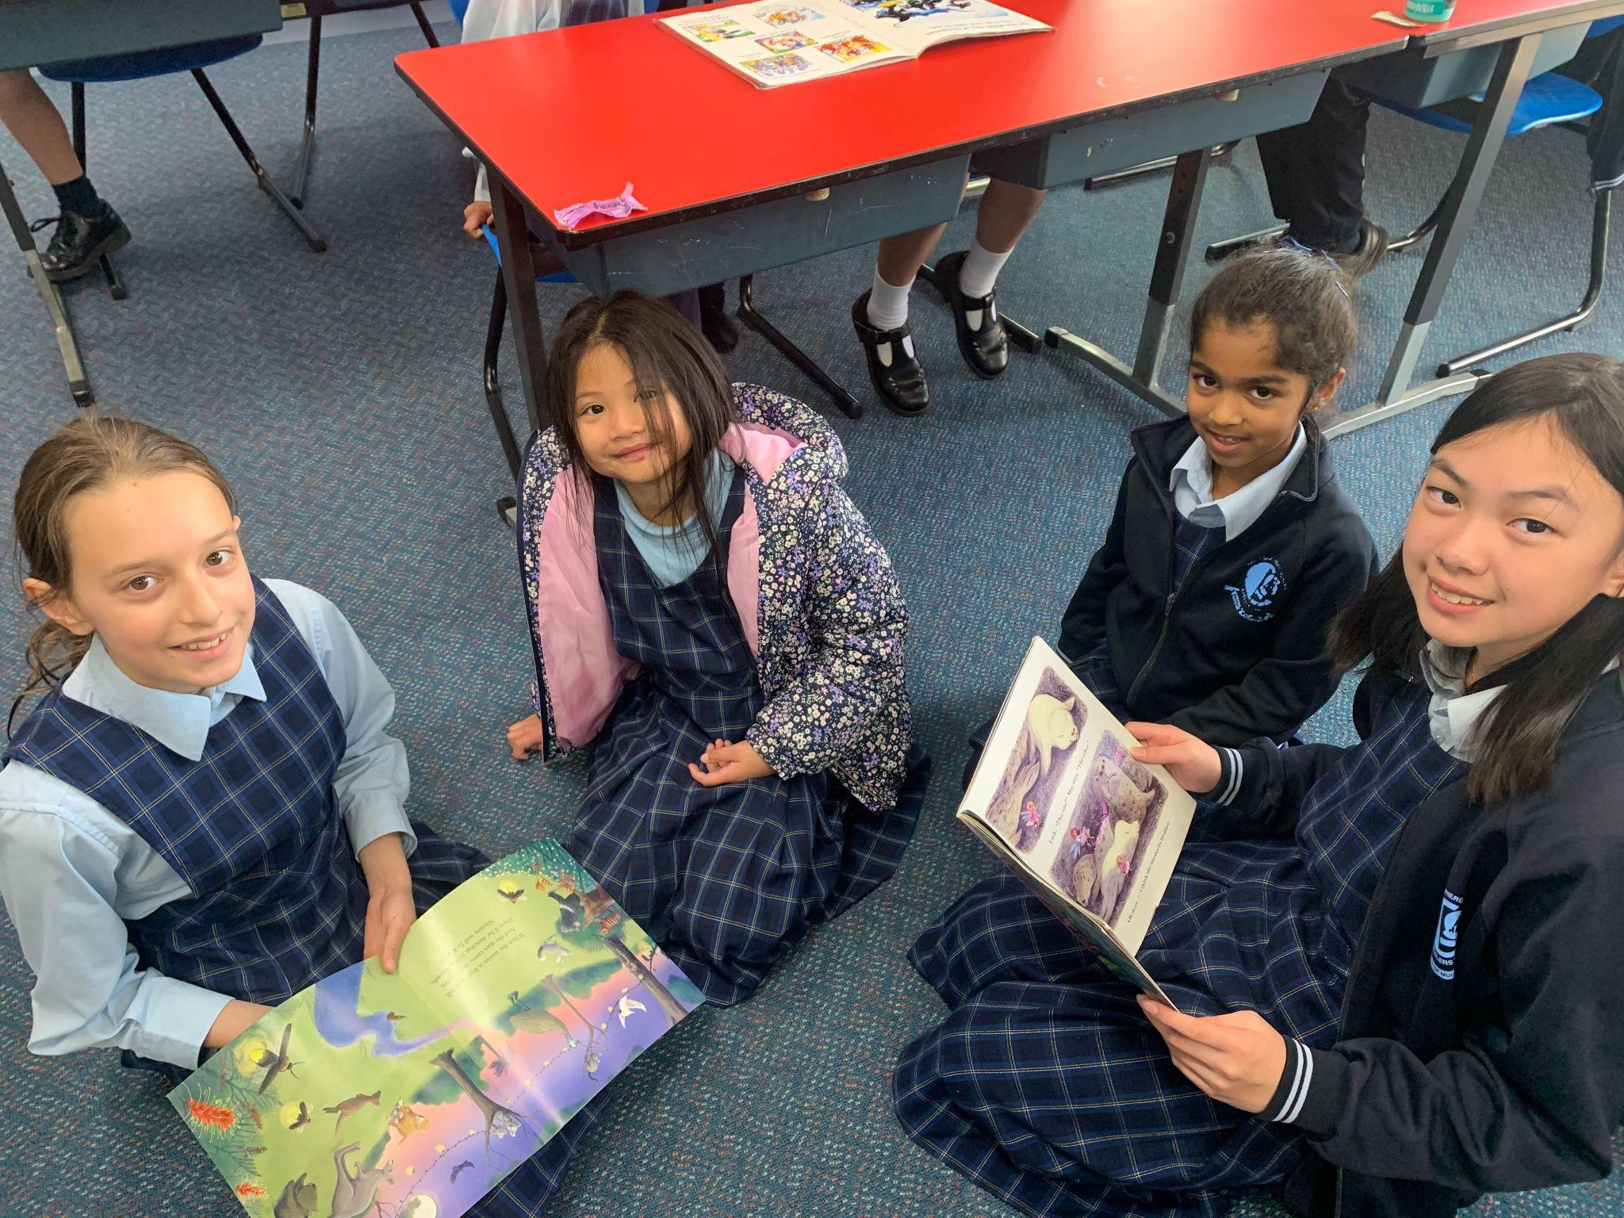
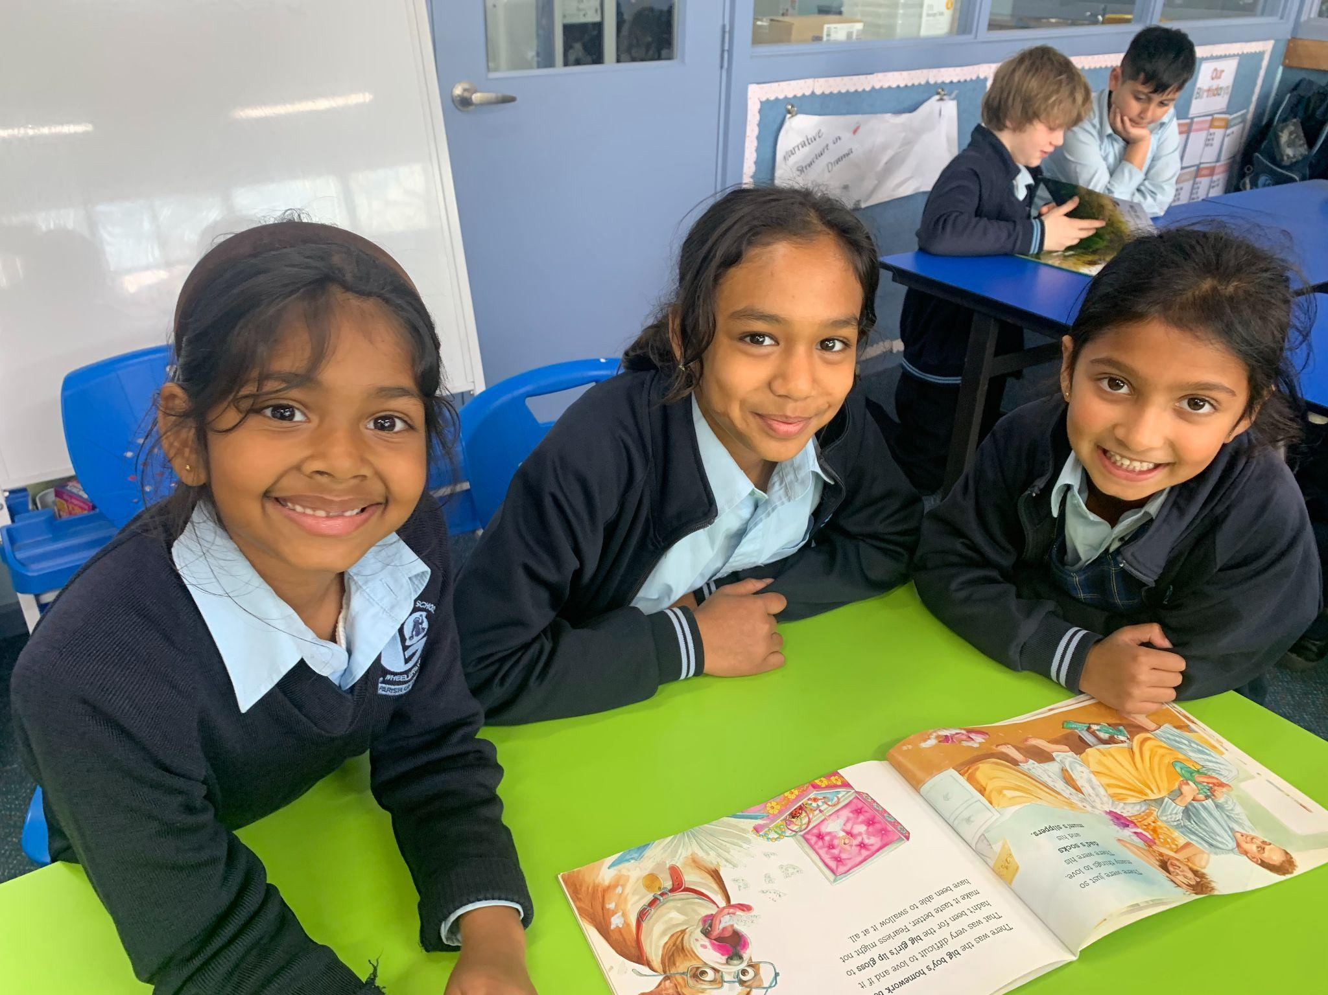
Asha - “I liked colouring with Mehaiah’s Buddy!”
Kiasha - “I like colouring with my Buddy! I also liked reading the book.”
Miya - “Reading is the most awesome part because you can learn how to read!”

Slide 10
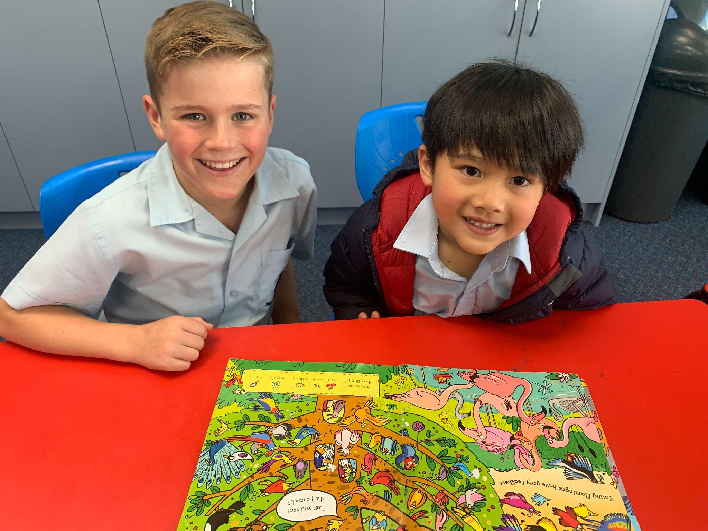
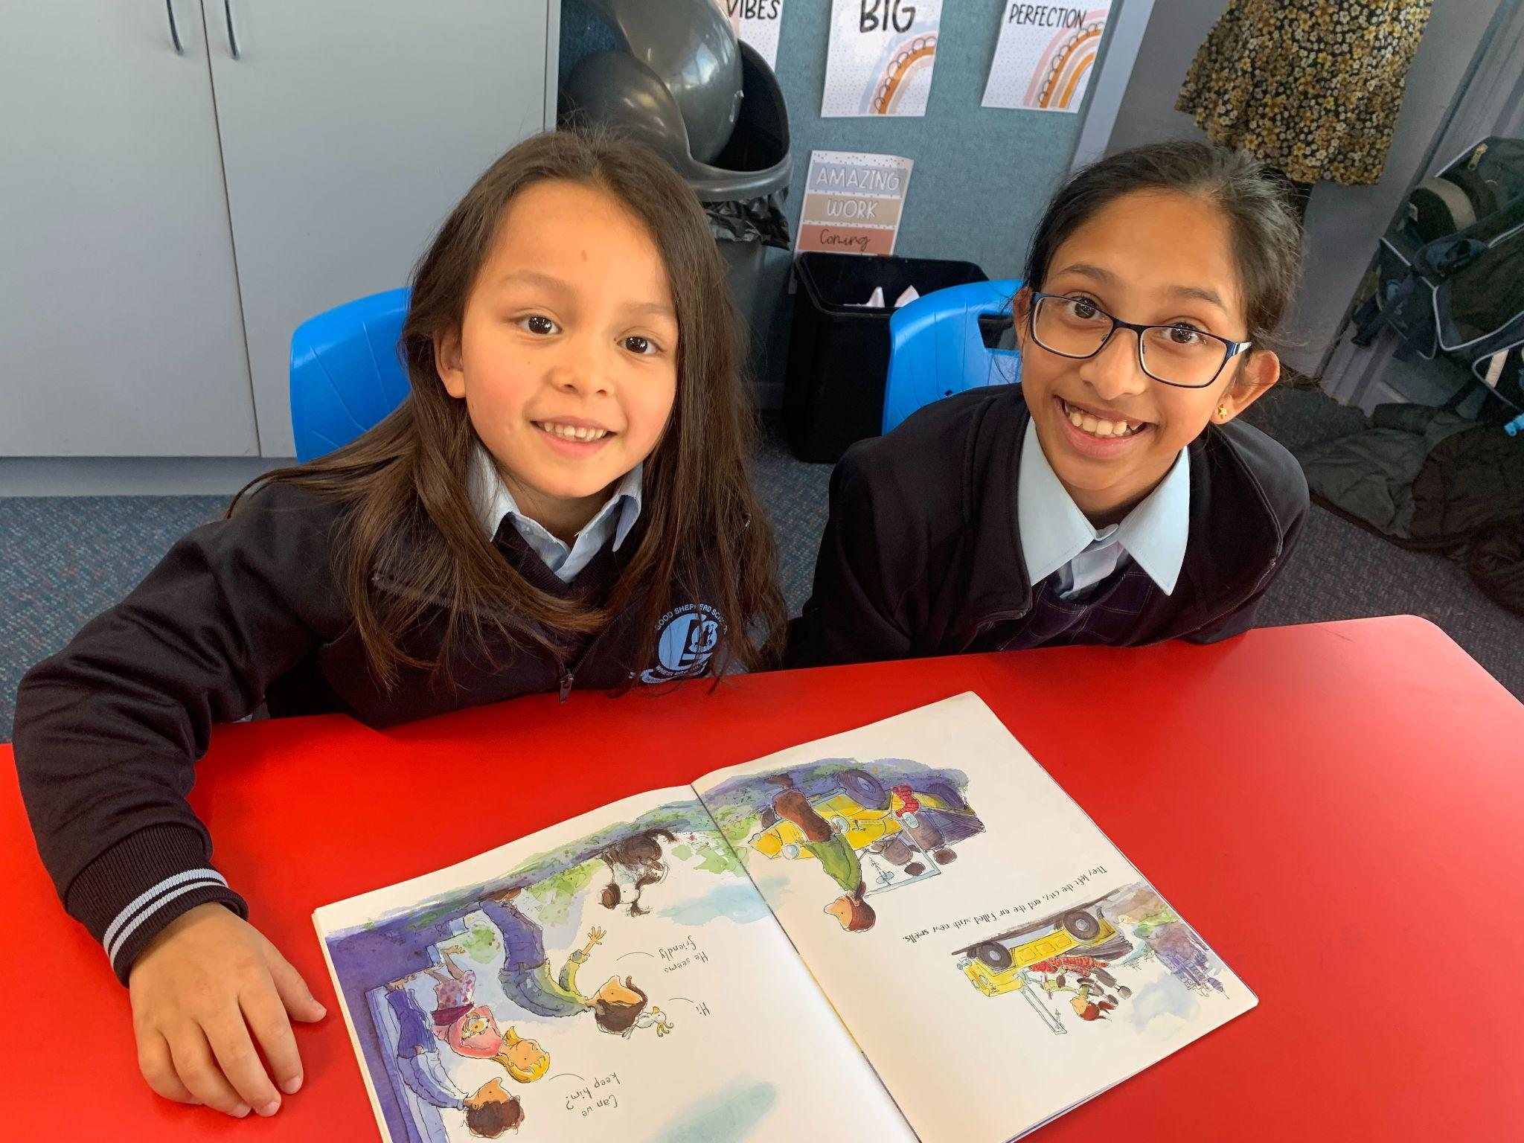
Carter - “Hughie is nice to me.”
Evelyn - “I like to do colouring together.”

Slide 11
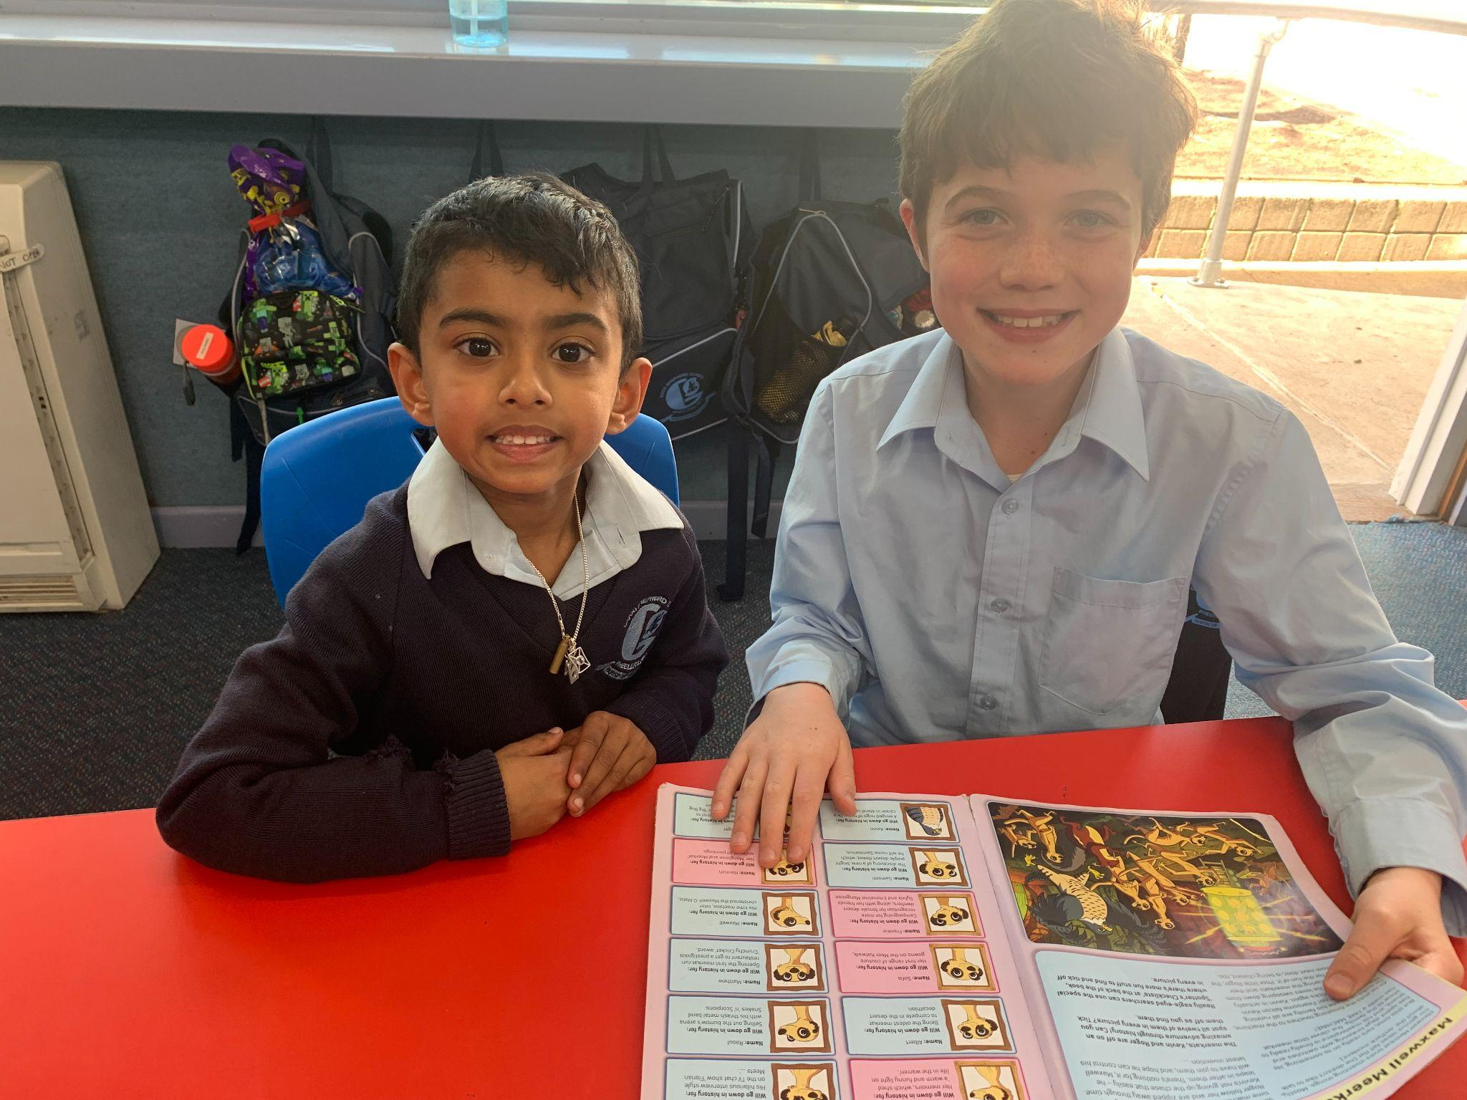
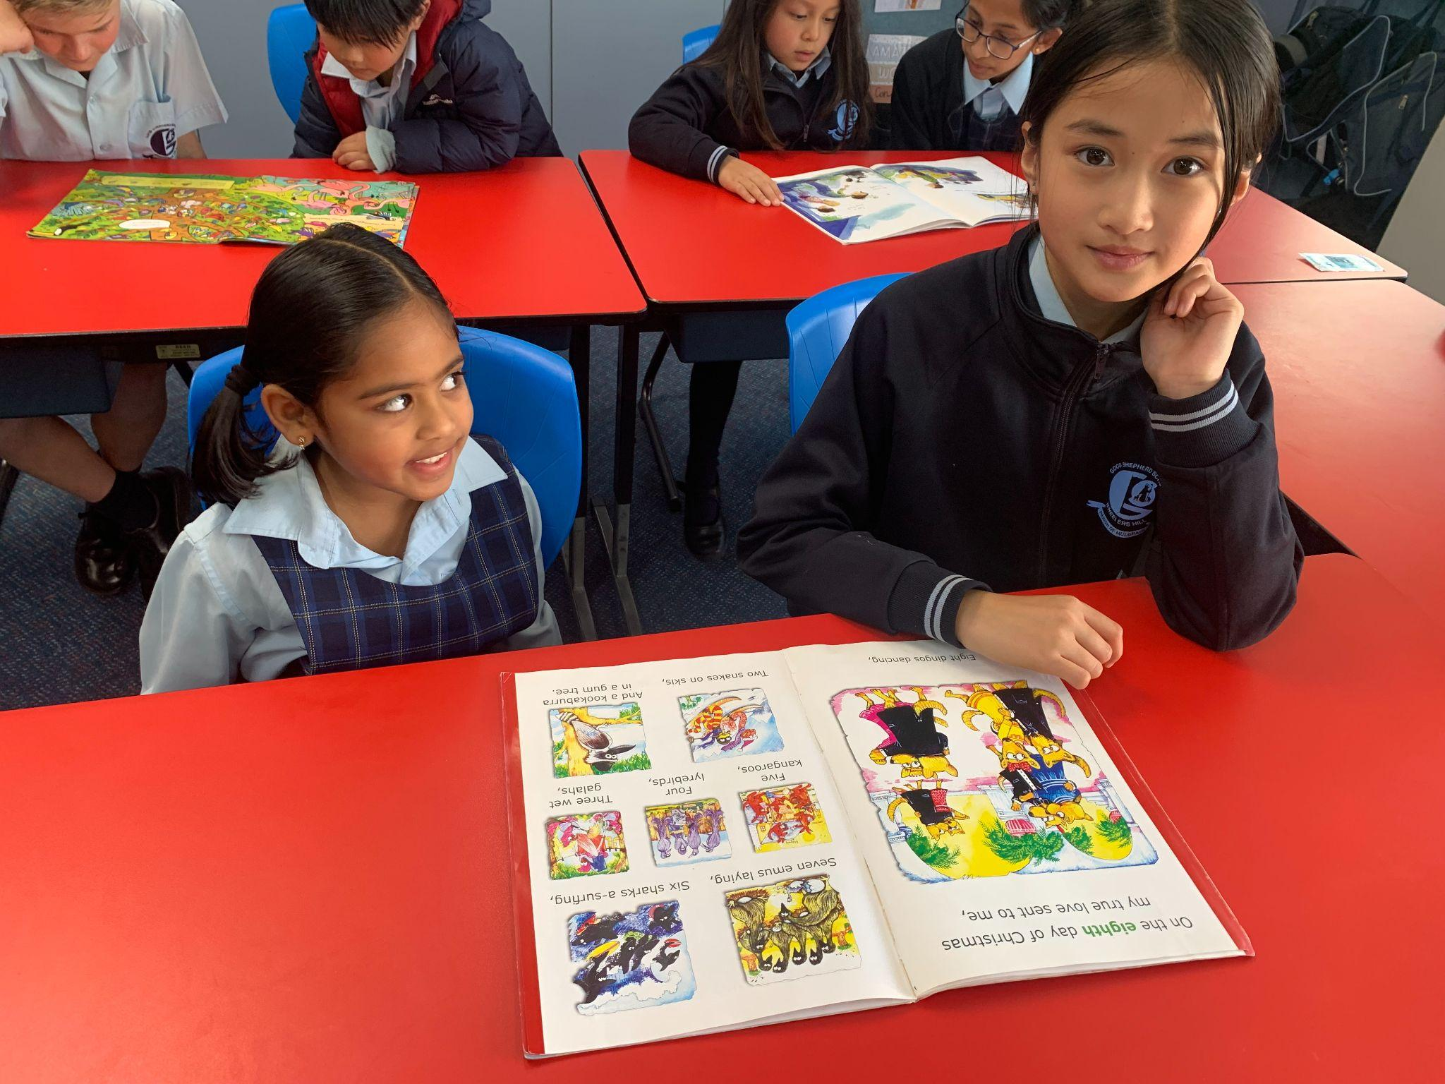
Evin - “Ryan is cool.”
Pragathi - “Tiffany is nice. We got to read books and colour!”

Slide 12
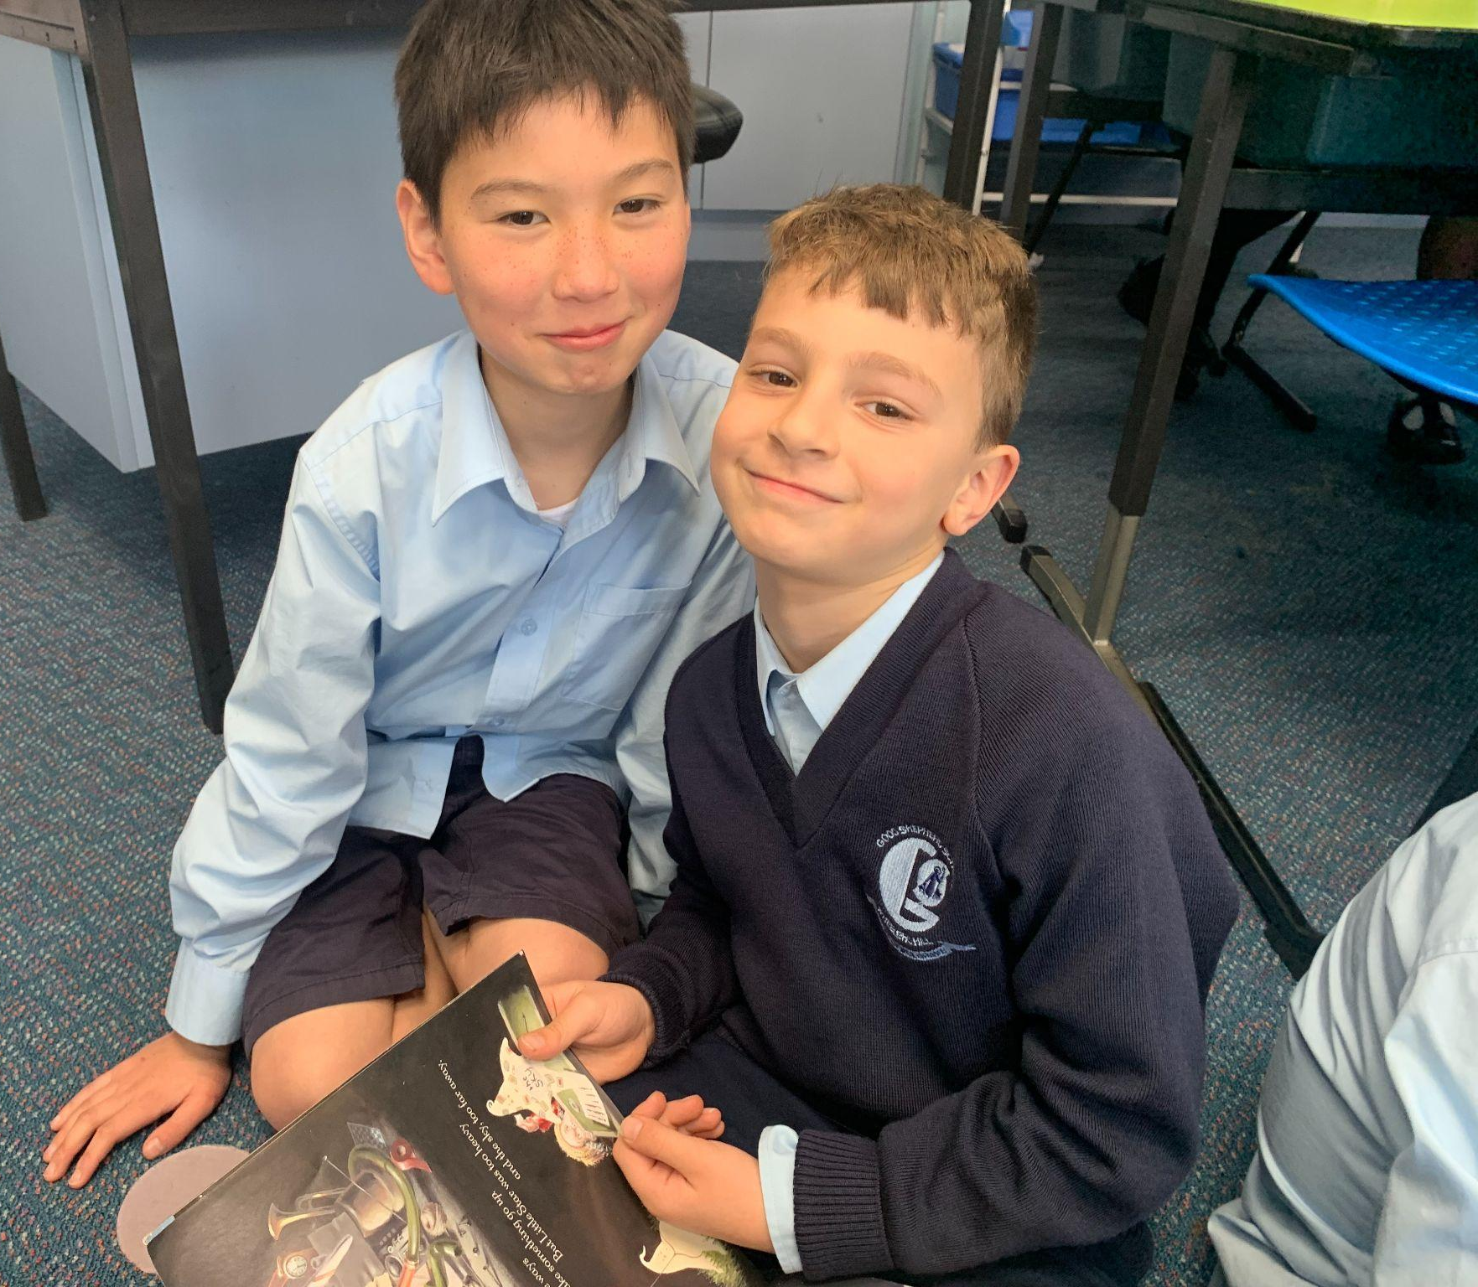
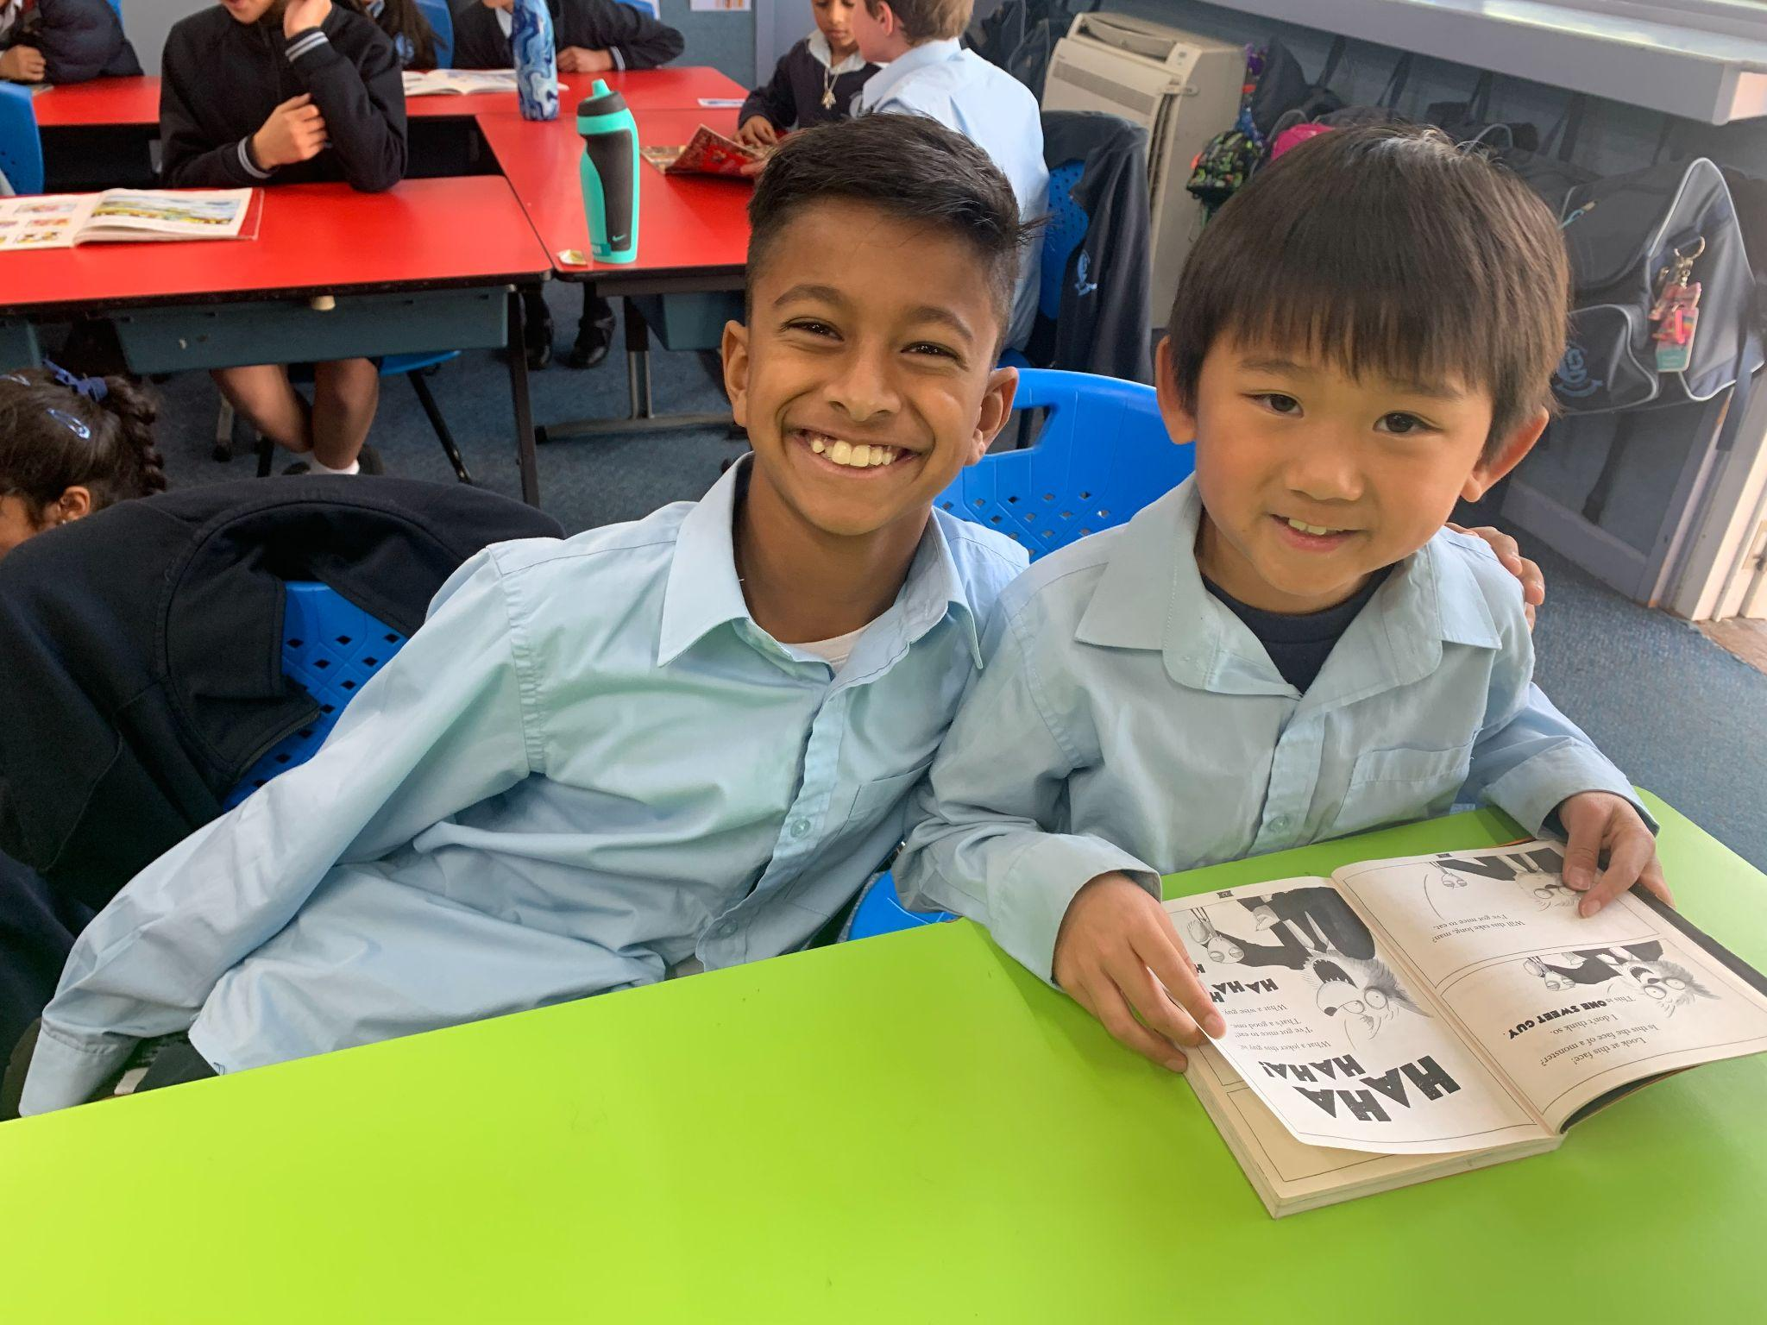
Jack - “My favourite thing that I did with my Buddy is that we read books and drew together. It’s very fun.”

