Slide 3
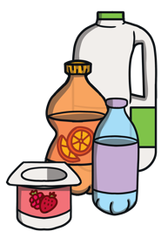
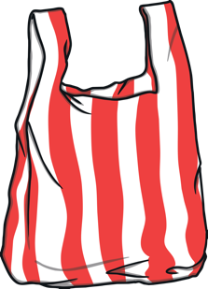
Tackling plastic
Plastic is everywhere!
It is useful material that helps us in our busy lives.
However, we often misuse plastic and this causes a problem.

Slide 4
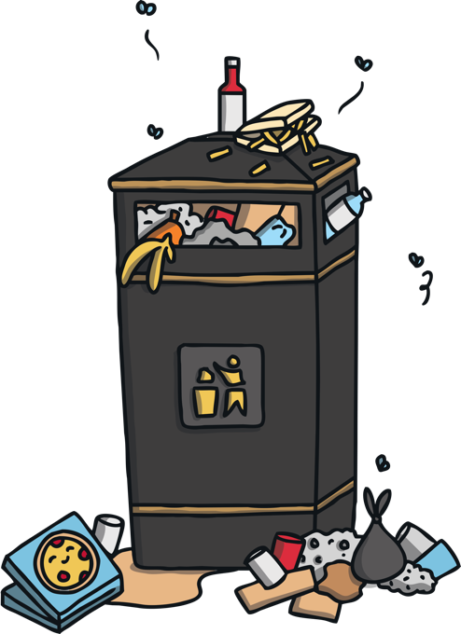
Tackling plastic
We use plastic every day.
Most of it is thrown away within minutes of using it.
Most plastic ends up in landfill or the environment and can take hundreds of years to break down.

Slide 5
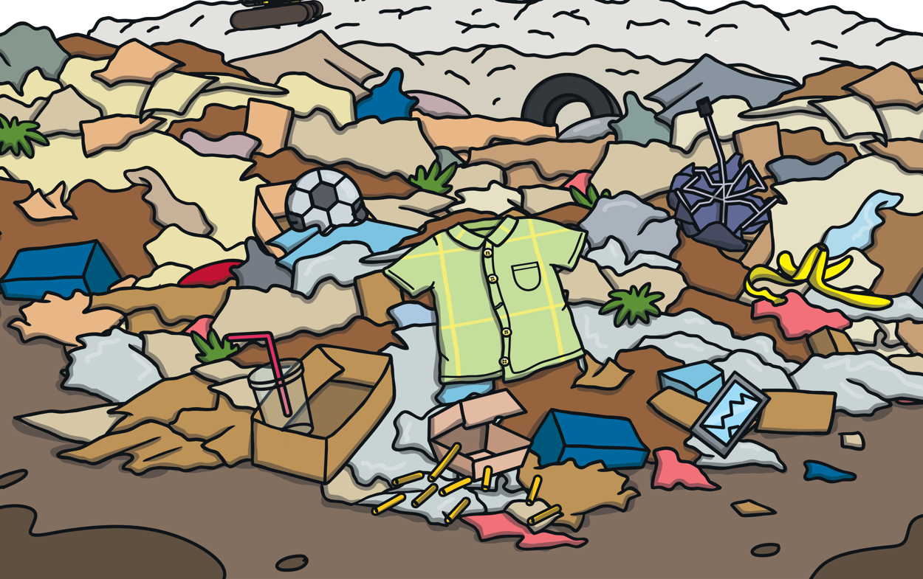
What is a landfill?
Landfill sites are the most common places where household waste is disposed of.

Slide 6
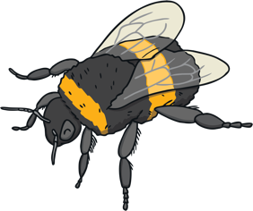
What is the environment?
The environment is anything that surrounds us. It includes living and non-living things, such as water, forests, deserts and animals.

Slide 7
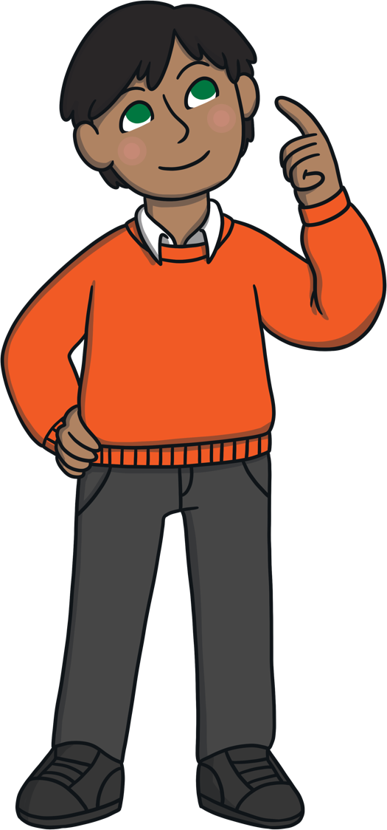
?
Quiz
Some plastics take a long time to break down.
Can you guess how long it takes for some of these plastic items to break down?

Slide 8
?
Plastic bag
20 years
Show Answer

Slide 9
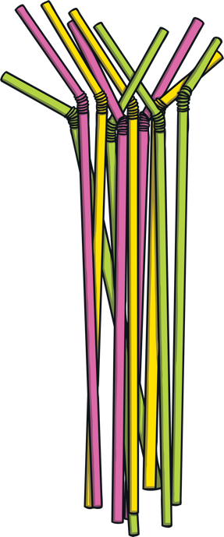
?
Plastic straw
200 years
Show Answer

Slide 10
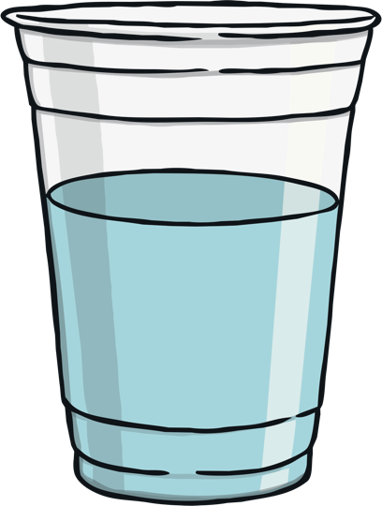
?
Plastic cup
450 years
Show Answer

Slide 11
?
Plastic bottle
450 years
Show Answer

Slide 12
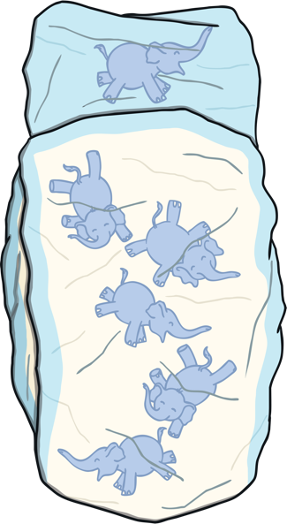
?
Disposable nappy
500 years
Show Answer

Slide 13
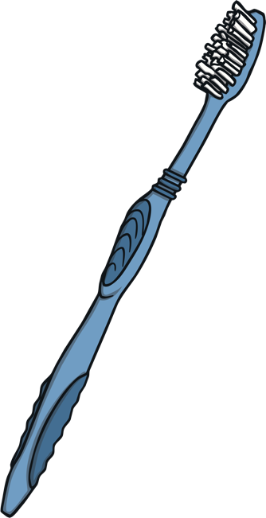
?
Plastic toothbrush
500 years
Show Answer

Slide 14
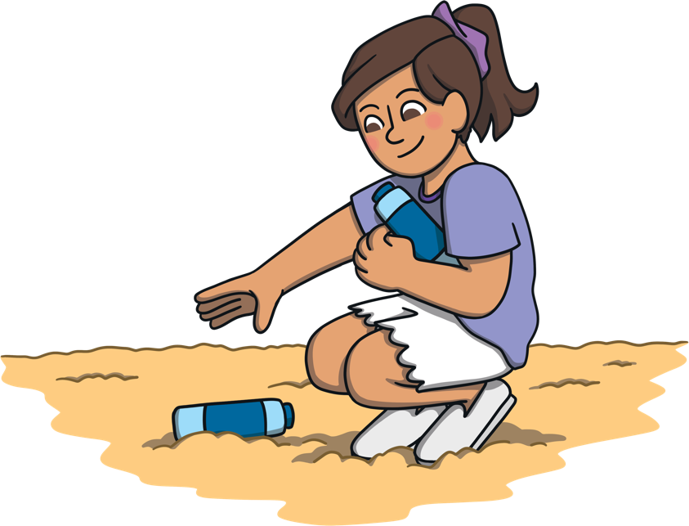
Tackling plastic
In 2019, around 80% of litter found on Northern Ireland beaches was plastic.
It has been predicted that there could be more plastic in our sea than fish by the year 2050 if we don’t start tackling our plastic problem.
Over 7.5 billion tonnes of plastic have never been recycled.

Slide 16
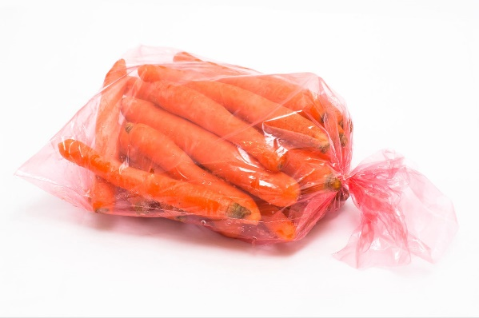
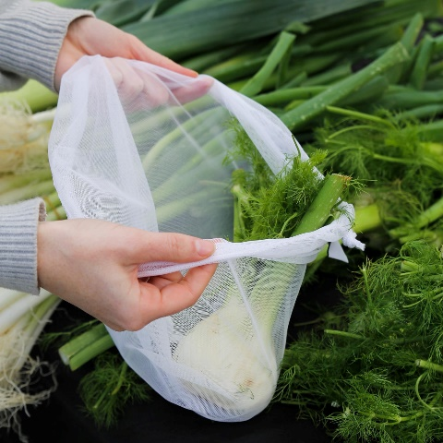
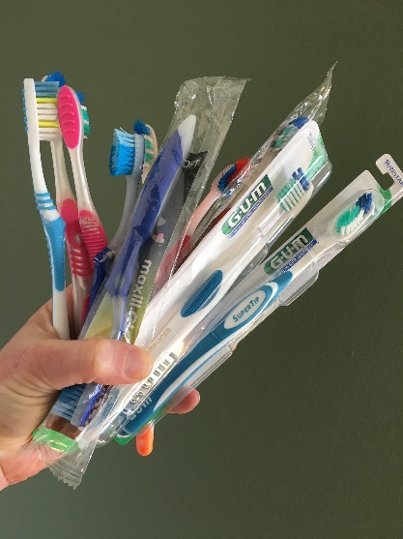
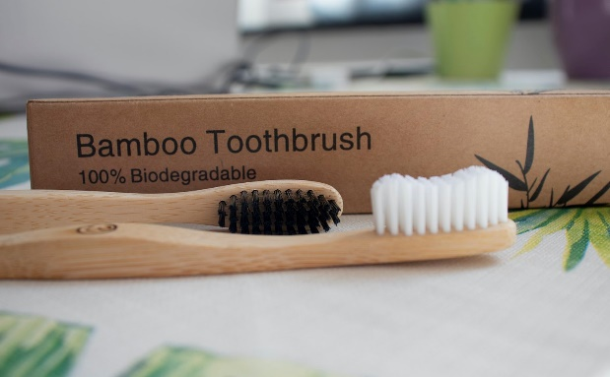
Plastic Free July – What Can You Do?
If everyone can make just one change, that will really help the environment. Here are some ideas!
Buy loose fruit & veggies using reusable bags
Replace a plastic toothbrush with a bamboo one.

Slide 17
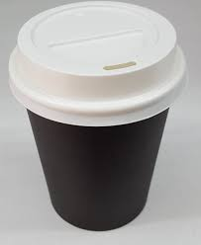
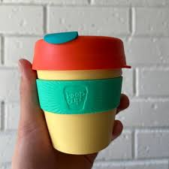
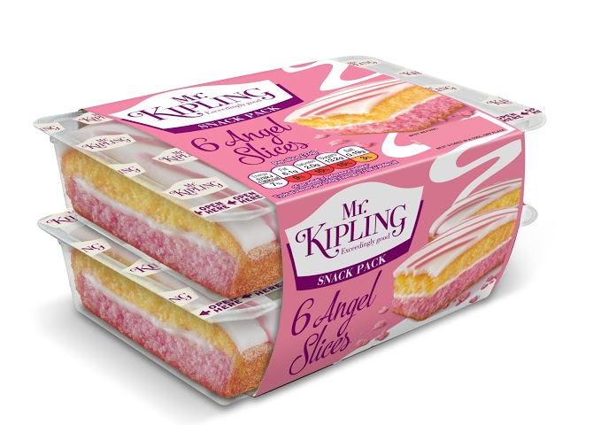
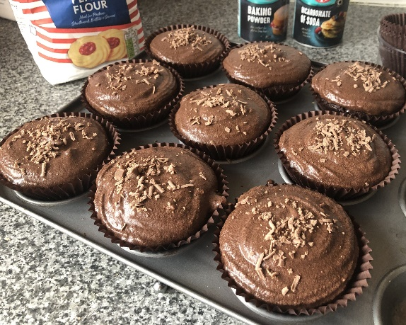
Use a reusable cup instead of takeaway cups.
Make your own snacks and treats instead of buying them – also saves money!

Slide 18
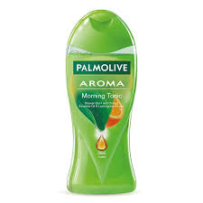
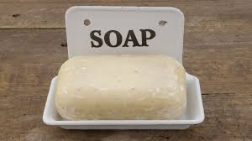
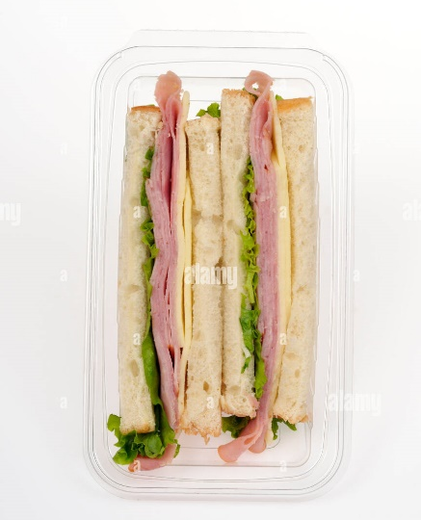
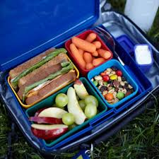
Use soap instead of shower gel.
Try to have more trash free lunches!

